Slide 1


Slide 2

Scholarship Chair Reviewer
Training Objectives
Cal State LA Scholarship System

Slide 3
Training Objectives
Cal State LA Scholarship System Participants will be able to:
Navigation & Logging In
  How to log into the system. Set up password for non Cal State LA personnel
  Navigating the scholarship system
Scholarship Chair
  Creating custom reports to filter and sort the applicants and export lists
  Options for handling large applicant pools
  Determining the recipients and notifying the Financial Aid Office of award winners
Reviewers
  The application process
  Review scholarship applications
  Scoring the reviews
Timeline Review and Contacts
  Scholarship Timeline
  List of Scholarship Liaisons
  Blackbaud Technical Assistance

Slide 4
Logging Into Blackbaud Award Management

Slide 5
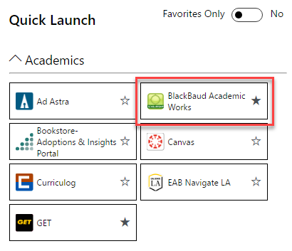
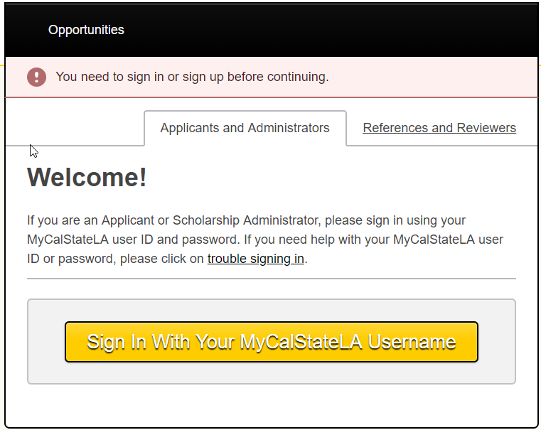
Logging Into Cal State LA Scholarship System
Cal State LA Faculty/Staff: Log into the system with Cal State LA Username/Password
A link to Blackbaud can be found on the MyCalStateLA Quick Launch.
Click on the SIGN IN button located at the top right side of the page.
Click on the APPLICANTS and ADMINISTRATORS Tab.
Click on the SIGN IN WITH YOUR MyCalStateLA USERNAME button.
You will be redirected to the Cal LA State Portal
Enter your Cal State LA User Name, Password and click LOGIN

Slide 6
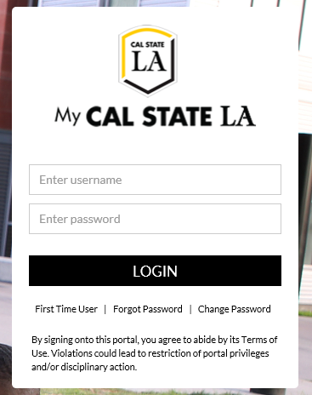
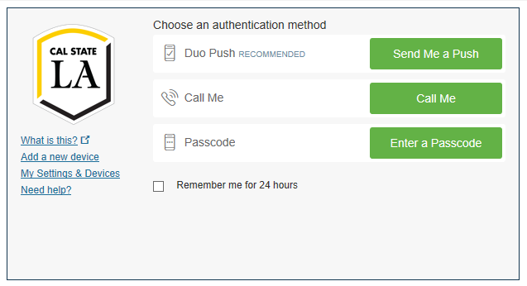
After logging in to the Cal State LA Portal,
you will be redirected to the Duo authentication

Slide 7

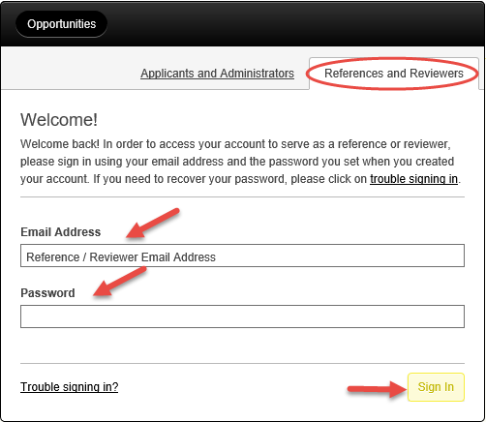
Logging Into the Cal State LA Scholarship System
Reviewers without a Cal State LA Username/Password: Log into the system with your Email Address as your User ID
Enter the BLACKBAUD AWARD MANAGEMENT website: https://calstatela.academicworks.com/
Click on the SIGN IN button located at the top right side of the page:
Click on the REFERENCES and REVIEWERS Tab
Enter your Email Address
Enter your *Password and click SIGN IN.
*NOTE: First time users:
You will receive an email to confirm and to activate your account.
Enter and create a new password

Slide 8
Ensuring that you have the Correct Role to Begin Reviewing

Slide 9
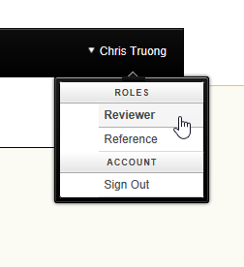
Reviewing the Applications
Which applicants will you see and how to select applications for review
Your name will be visible on the right hand corner of the screen.
Click on your name and select your role which will be REVIEWER:
PLEASE NOTE:

Slide 10
Exporting an Applicant List

Slide 11
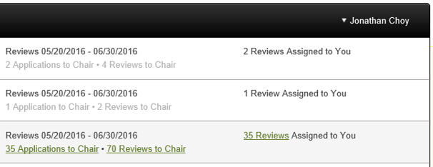
Export an Applicant List in Blackbaud Award Management
After you click REVIEWER, you will see a list of scholarships (opportunities) that are assigned to your reviewer group. Hover your cursor over 35 APPLICATIONS TO CHAIR and click on it. It will highlight in green as a hyperlink. When you click it, it will bring up the applications assigned to your review group.
The 35 applications indicate how many students there are to review for this particular scholarship.

Slide 12
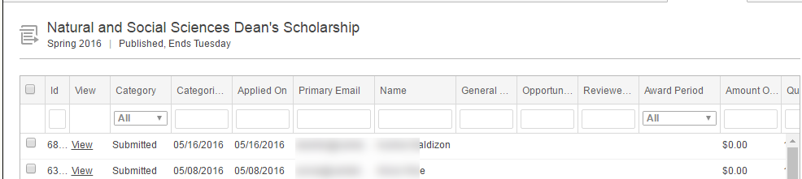
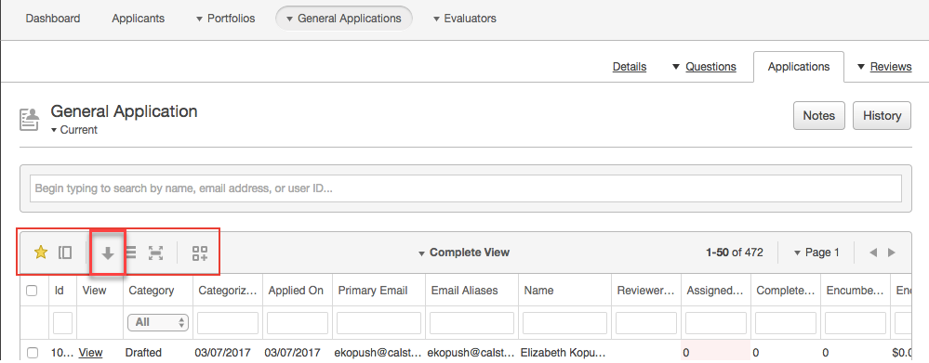
Export an Applicant List in Blackbaud Award Management
How to download/export any grid view.
Users may download/export and open an Excel file (.CSV) reports containing various kinds of information.
Grid views may be exported to a CSV file, which can then be opened with Microsoft Excel.
To request a new report, select a view from the upper left corner of any AcademicWorks grid and click on the DOWNLOAD BUTTON (the downward arrow).
The report will generate the grid data that is selected in the drop-down menu to the left.
Sample Grid View

Slide 13

Export an Applicant List in Blackbaud Award Management (cont.)
How to download/export any grid view.
When a new report is being generated, a process automatically starts in the background to run the report. Depending on the number of records in your grid, the report may take a few moments to generate.
Once completed, a new on-screen flash message will appear to alert you. To open the report, click on the link in the flash message.
You will be prompted to open/save your file and then you can view the results in Excel.

Slide 14
Creating Custom Reports

Slide 15
Reviewer Chairs: Creating Custom Reports
This will allow you to sort and filter candidates as you see fit based on major, GPA, education level (i.e. junior or senior) and export lists.
After you click REVIEWER, you will see a list of scholarships (opportunities) that are assigned to your reviewer group. Hover your cursor over 35 APPLICATIONS TO CHAIR and click on it. It will highlight in green as a hyperlink. When you click it, it will bring up the applications assigned to your review group.
The 35 applications indicate how many students there are to review for this particular scholarship.

Slide 16
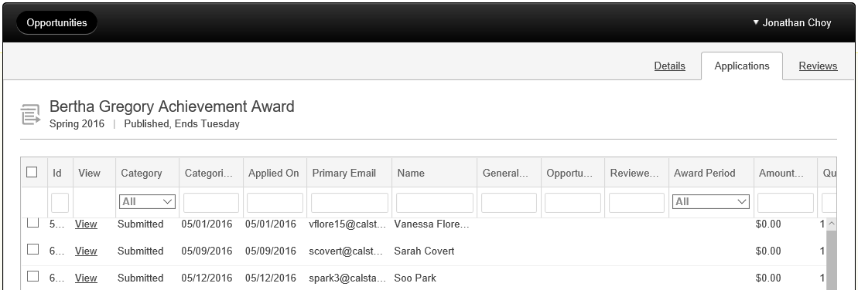
Creating Custom Reports in AcademicWorks
Listing of students in the scholarship opportunity
A list of all students within that scholarship opportunity will be listed as follows under the APPLICATIONS tab:

Slide 17
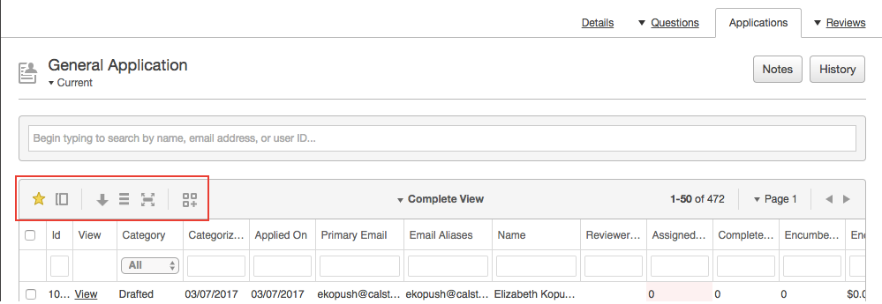
Creating Custom Reports in Blackbaud Award Management
How to filter the report. Make sure you are still under the APPLICATIONS tab
To sort, bring your cursor over any of the EMPTY BOXES.
NOTE: You may expand the columns so that you can see the complete title, hover the cursor over the line (like you would in excel) and stretch the box wider:
To see more category options, select a view from the upper left corner of any Blackbaud grid.

Slide 18
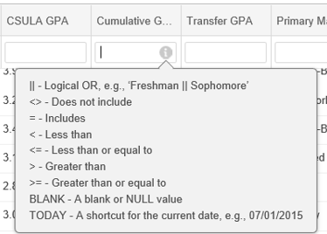


Creating Custom Reports in Blackbaud
How to filter the report by GPA: If you want to find the top students based on a minimum 3.50 GPA to reduce your list
Use the scroll bar and move to the right until you see CUMULATIVE GPA (it’s located about half-way). This is a cumulative GPA that includes both transfer and Cal State LA grades.
Click in the corresponding empty box, and you will see an information icon:
Hover the cursor over the icon and it will give you a list of search options:
To find anyone with a GPA of 3.50 or higher, type >=3.50 in the box then press ENTER on your keyboard.
Example:
Example if column is widened:

Slide 19


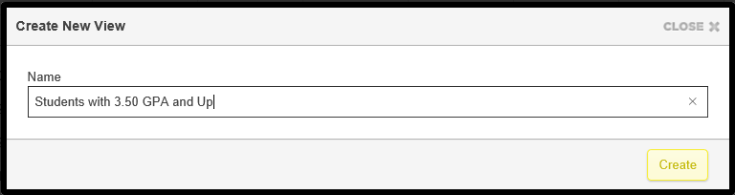
Creating Custom Reports in Blackbaud
How to save the custom report
Once the new list is sorted, you will notice that the number of applications has been reduced
To save the report, click on the DOUBLE PAGE (two box) icon located at the upper left corner of the page:
A pop up box will appear that says CREATE NEW VIEW. Enter a title for the report then click CREATE.

Slide 20
Creating Custom Reports in Blackbaud
How to download the custom report
Once the report is ready, you will see the following message at the top of your webpage. Give it a couple minutes. Then click on the UNDERLINED hyperlink:
A pop up window will inform you that the download is complete and you may now OPEN your report.
The document is now an Excel spreadsheet. You may sort and filter the applicant pool. Be sure to save the document.

Slide 21
Scholarship Chairs:
Options for Handling Large Applicant Pools

Slide 22

Chair Reviewer: Options for Handling Large Applicant Pools
.
Export the applicant list using the previous procedure and ask committee members to each review a subsection of the list. For integrity of process, it is best to have each applicant reviewed by two committee members. You can then review the top rated candidates as a committee to finalize the decision.
The Chair can narrow the applicant pool based on information in Blackbaud and remove applicants from the review process that do not meet the committees’ minimum requirements (e.g. Cumulative GPA, class rank, etc.).

Slide 23
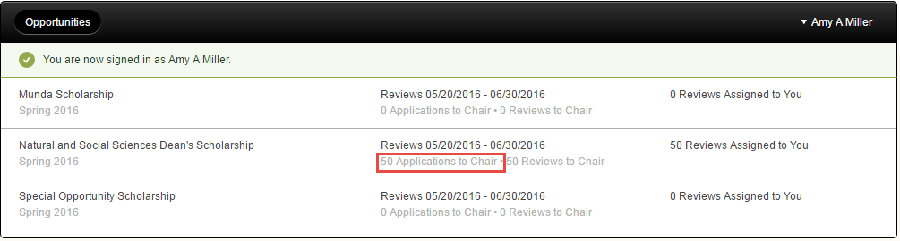
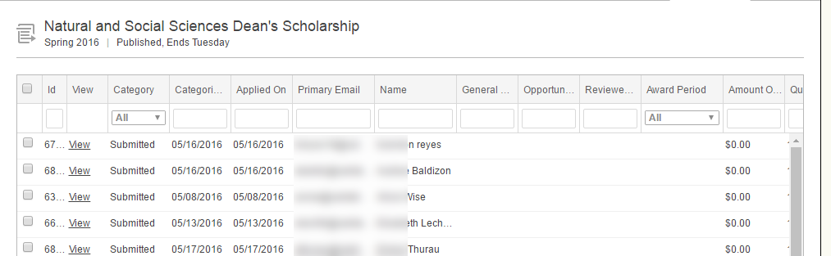
Chair Reviewer: Custom Report/Narrowing Applicants
.
Select the Scholarship/Opportunity to view list of students
Choose the Scholarship/Opportunity
Click on the link (e.g. 50 APPLICATIONS TO CHAIR)
This will bring up the complete list of students in this scholarship opportunity

Slide 24

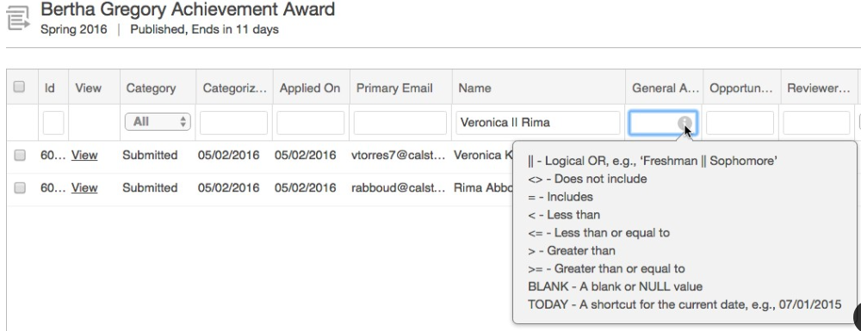
Chair Reviewer: Sorting and Filtering
.
To sort the list, click on any column heading, then click on the up/down arrow.
To filter the list, hover your cursor over any empty field in the column and it will give you the options on how to categorize the report.

Slide 25
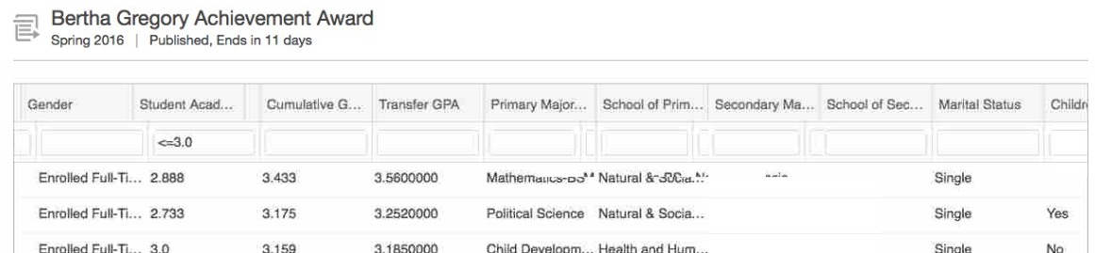
Chair Reviewer: Custom Report/Narrowing Applicants
.
To get custom report to see who you may want to remove from the review process. Make selection qualifications at the top of each column.
To eliminate all students with a less than or equal to a 3.0 GPA—input “<=3.0” at the top of a column. For example:

Slide 26
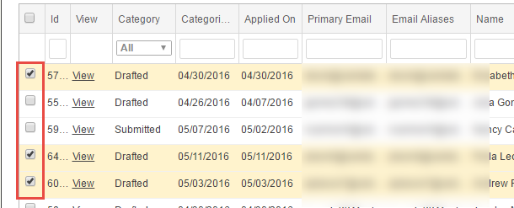
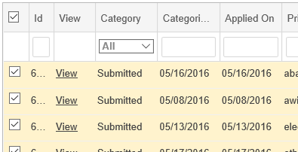
Chair Reviewer: Select Students to Exclude
.
A Chair Reviewer may select who should or should not be selected for review.
Check the boxes next to the students that you wish to exclude from the review process.
Students who remain unchecked will be reviewed.
NOTE: If the page has more than 50 applications, you have to repeat the process for each page.
HELPFUL HINT: If you wish to select ALL the students on the page, check the single box located at the top left of the check box column:

Slide 27

Chair Reviewer: Select Students to Exclude (cont.)
Click on ACT ON SELECTED at bottom of page; then click CATEGORIZE from the drop down menu.
Notes:
This image probably needs to change. VP 3/9/17

Slide 28
Chair Reviewer: Categorize the Review List
The Categorize Selected Screen appears.
IMPORTANT: This process is irreversible, and you will no longer be able to view the selected applicants.
Click on the CHOOSE A CATEGORY drop-down list.

Slide 29
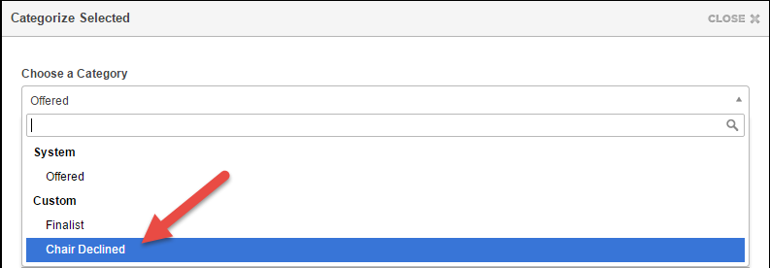
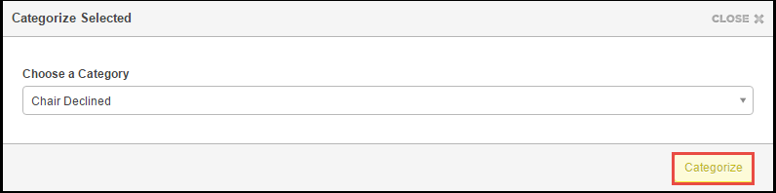
Chair Reviewer: Categorize the Review List
Optional Activity
Select CHAIR DECLINED from the drop-down list.
Click CATEGORIZE button.
IMPORTANT REMINDER: This process is irreversible, and you will no longer be able to view the selected applicants.

Slide 30
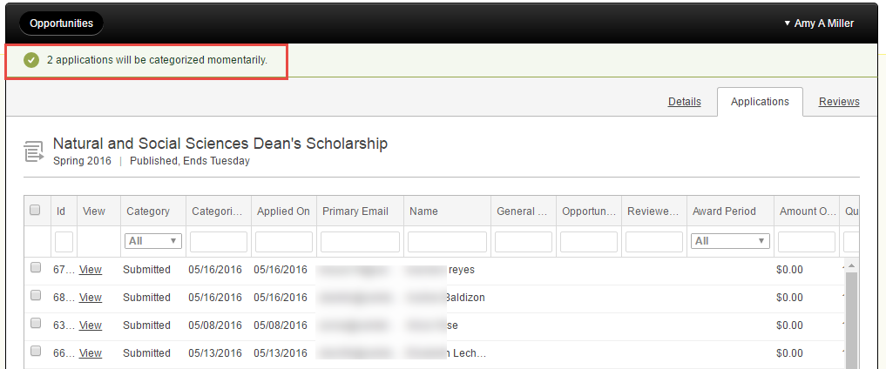
Chair Reviewer: Categorize the Review List (cont.)
The screen will refresh, indicating that the number applications you selected will be categorized.
Note: If the page has more than 50 applications, you have to repeat the process for each page.
Reviewers will now only see the remaining applicants.

Slide 31
Scholarship Reviewer Training

Slide 32
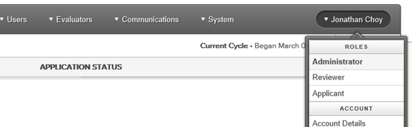
Reviewing the Applications
Which applicants will you see and how to select applications for review
Your name will be visible in on the left right hand corner of the highlighted bar. Click on the drop down menu as you hover over your name and select your role which will be REVIEWER:

Slide 33

Reviewing the Applications Continued…
Click on the image to watch a short training (less than 5 minutes) on how to review scholarship applications.
Please use Google Chrome or Internet Explorer. The video may not open properly if using Microsoft Edge.
https://www.youtube.com/watch?v=eb7ChNMod18&list=PLALjs-CzkPwoFWFcYQ90BkzEJFTZ6msS5&index=4&t=0s

Slide 34
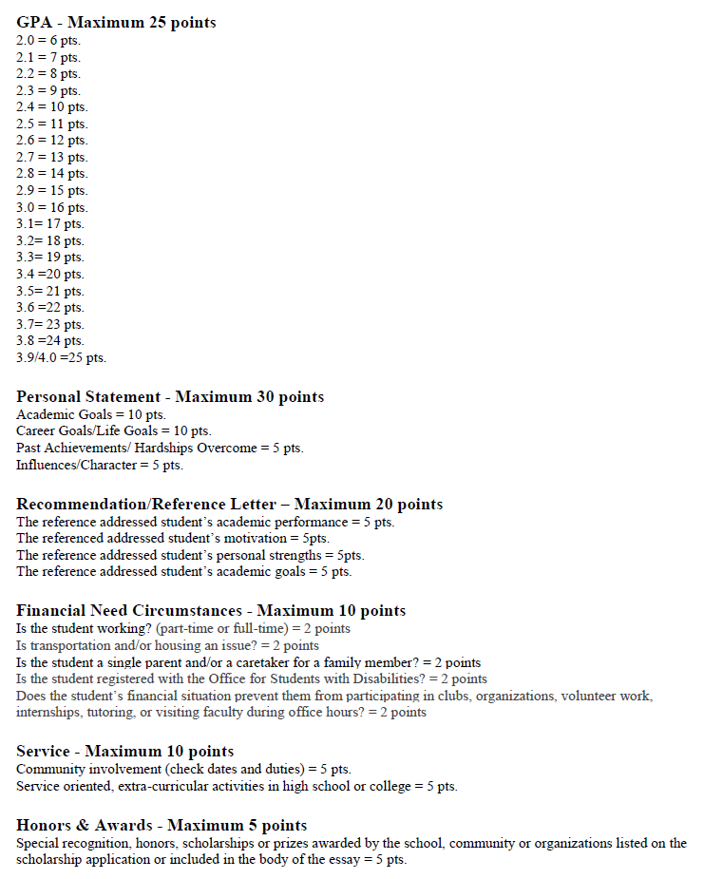
Rubric

Slide 35
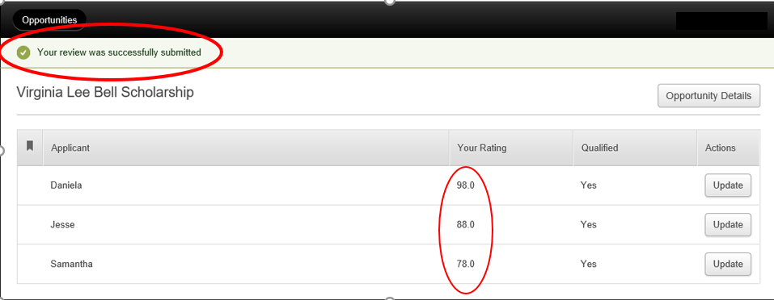
Reviewing the Applications Continued…
Scoring each applicant and selecting the finalist(s)
Once you have completed the review of all the applications assigned to you, you will see your scores for all the applicants:

Slide 36
Determining the Recipients and Notifying the
Scholarship Staff

Slide 37
Reviewing the Applications
Once the reviews have entered their ratings, you will be able to view the scores submitted.
Your name will be visible in on the right hand corner of the highlighted bar. Click on the drop down menu as you hover over your name and select your role, which will be REVIEWER:
After you click REVIEWER, you will see a list of scholarships (opportunities) that are assigned to you. Hover your cursor over “6 REVIEWS TO CHAIR” hyperlink in the middle column. When you click it, it will bring all the applications for the scholarship opportunity.

Slide 38
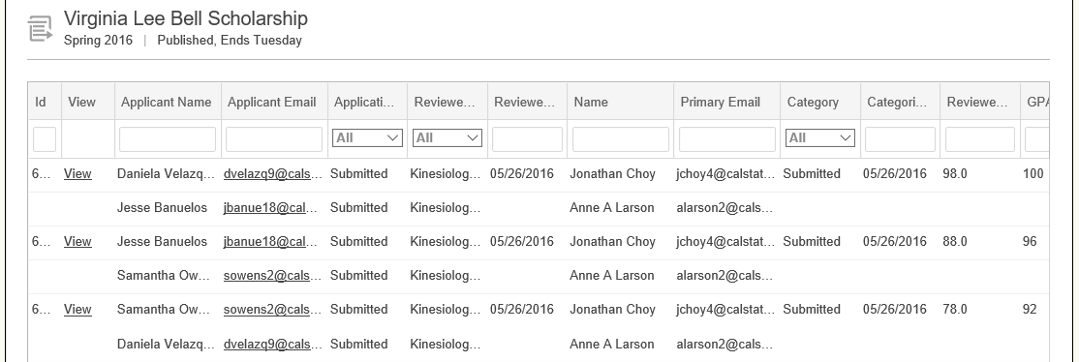
Reviewing the Applications Continued…
Which applicants will you see and how to select applications for review
You will see the scores under the REVIEWER SCORE COLUMN at the far right:
NOTE: You may sort the list by score (see Creating Custom Reports)
You will see the name of the reviewer under the NAME Column. The name on top is the reviewer.
If you only see 5 names on the list but there were “6 Reviews to Chair”, this means that 1 student has yet to be reviewed

Slide 39
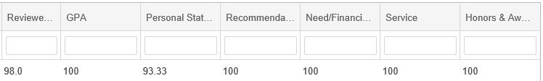
Reviewing the Applications Continued…
Other helpful features
Other helpful features:
You may sort the list by score
You may download the report (see Creating Custom Reports slides)
Scroll to the right to see individual category scores:
Use the scores to determine the finalists for this scholarship
The committee may wish to only use the scores to determine the recipients or may wish to discuss and finalize the top scoring applicants.

Slide 40
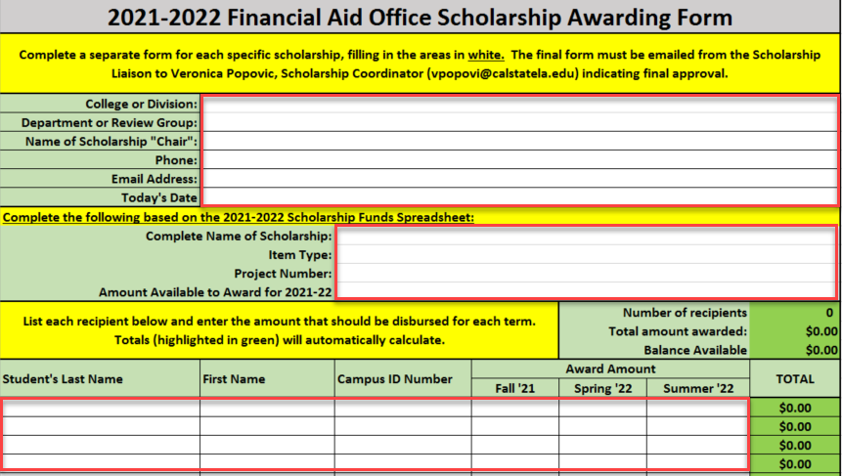
Submitting Names of Scholarship Recipients
Use the Scholarship Awarding Form to provide the following information to your Scholarship Liaison by June 15.
Name(s) of scholarship recipient(s)
Amount of scholarship
Indicate the term that the scholarship should be applied to (i.e. full year, fall only, spring only, etc.)
Fill in all areas in white:

Slide 41
Timeline Review &
Where to go for Assistance

Slide 42
2022-2023 Scholarship Timeline
April 12 by 5pm: General Scholarship Application Deadline
April 12 by 5pm: Deadline for Letter of Reference Submission
April 15-June 15: Scholarship review conducted by Departments and Committees
June 15: Scholarship Selection Deadline
August 12: First Fall ’21 scholarship disbursements processing
September 16-24 Scholarship Liaisons provided with a list of students whose scholarships did not disburse

Slide 43
Scholarship Liaisons
Academic Senate: Dr. Talia Bettcher, Academic Senate Chair
Alumni Relations: Priscilla Parks, Alumni and Student Programs Manager
Arts and Letters: Dr. Katherine Weiss, Associate Dean
Associated Students Inc.: Dena Florez, Office Manager of Administration and Services
Athletics: Daniel Garrett, Assistant Director
Business and Economics: Dr. Angela Young, Associate Dean
Center for Engagement, Service and Public Good: Taffany Lim, Senior Director
Education: Agustin Cervantes, Director of Student Services
Educational Opportunity Program: Danielle Chambers, Director
Emeriti: Alfredo Gonzalez, Committee Chair
Engineering, Computer Science and Technology: Dr. Jane Dong, Associate Dean
Ethnic Studies: Dr. Trinh Pham, Associate Dean
Erika J. Glazer Family Dreamers Resource Center: Luz Borjon, Director
Graduate Studies: Dr. Karin Brown, Associate Vice President and Dean
Health and Human Services: Zully Quezada, Assistant to Associate Dean
Honors College: Dr. Alison McCurdy, Associate Director
Natural and Social Sciences: Amy Miller, Assistant to Associate Dean
Office for Students with Disabilities: Gonzalo Centeno, Director
Pat Brown Institute for Public Affairs: Dr. Raphael Sonenshein, Executive Director
Professional and Global Education: Tom Lau, Financial Aid Advisor
Veterans Resource Center: Cesar Gonzalez, Director

Slide 44
Cal State LA Scholarship System Help/Contact Information
Technical Assistance for Faculty & Staff and Access for Reviewers & Reference Providers
Chris Truong, ITC
ctruong@calstatela.edu
Technical Assistance for Applicants & Reference Providers
Sergio Rosales, Student Personnel Technician
srosal13@calstatela.edu
Scholarship Awarding & Funds Report
Scholarship Coordinator
scholarships@calstatela.edu

