Slide 1


Slide 2

Logging Into Blackbaud Award Management

Slide 3
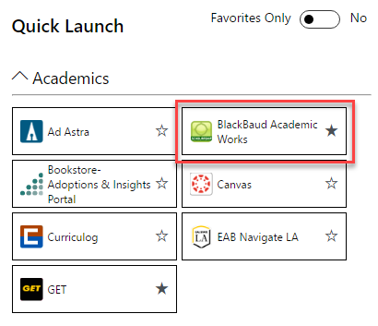
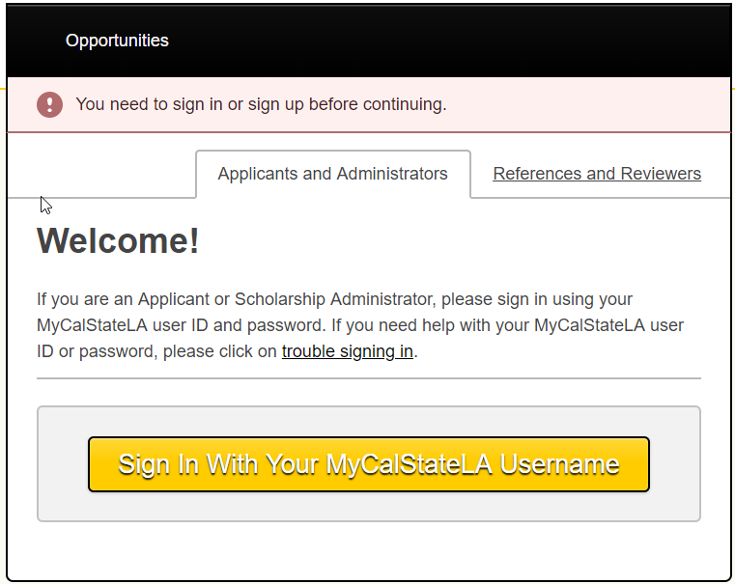
Logging Into Cal State LA Scholarship System
Cal State LA Faculty/Staff: Log into the system with Cal State LA Username/Password
A link to Blackbaud can be found on the MyCalStateLA Quick Launch.
Click on the SIGN IN button located at the top right side of the page.
Click on the APPLICANTS and ADMINISTRATORS Tab.
Click on the SIGN IN WITH YOUR MyCalStateLA USERNAME button.
You will be redirected to the Cal LA State Portal
Enter your Cal State LA User Name, Password and click LOGIN

Slide 4
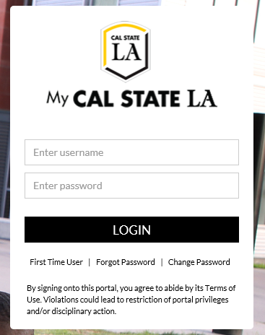
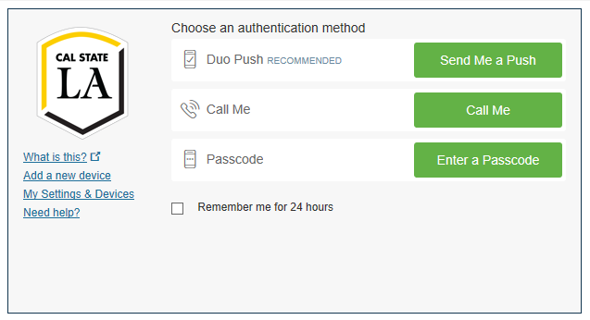
After logging in to the Cal State LA Portal,
you will be redirected to the Duo authentication

Slide 5

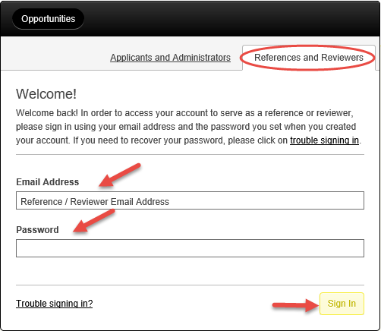
Logging Into the Cal State LA Scholarship System
Reviewers without a Cal State LA Username/Password: Log into the system with your Email Address as your User ID
Enter the BLACKBAUD AWARD MANAGEMENT website: https://calstatela.academicworks.com/
Click on the SIGN IN button located at the top right side of the page:
Click on the REFERENCES and REVIEWERS Tab
Enter your Email Address
Enter your *Password and click SIGN IN.
*NOTE: First time users:
You will receive an email to confirm and to activate your account.
Enter and create a new password

Slide 6
Scholarship Reviewer Training

Slide 7
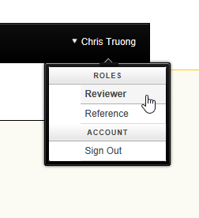
Reviewing the Applications
Which applicants will you see and how to select applications for review
Your name will be visible on the right hand corner of the screen.
Click on your name and select your role which will be REVIEWER:
PLEASE NOTE:

Slide 8

Reviewing the Applications Continued…
Click on the image to watch
a short training (less than 5 minutes)
on how to review scholarship applications.
Please use Google Chrome or Internet Explorer.
https://www.youtube.com/watch?v=eb7ChNMod18&list=PLALjs-CzkPwoFWFcYQ90BkzEJFTZ6msS5&index=4&t=0s

Slide 9
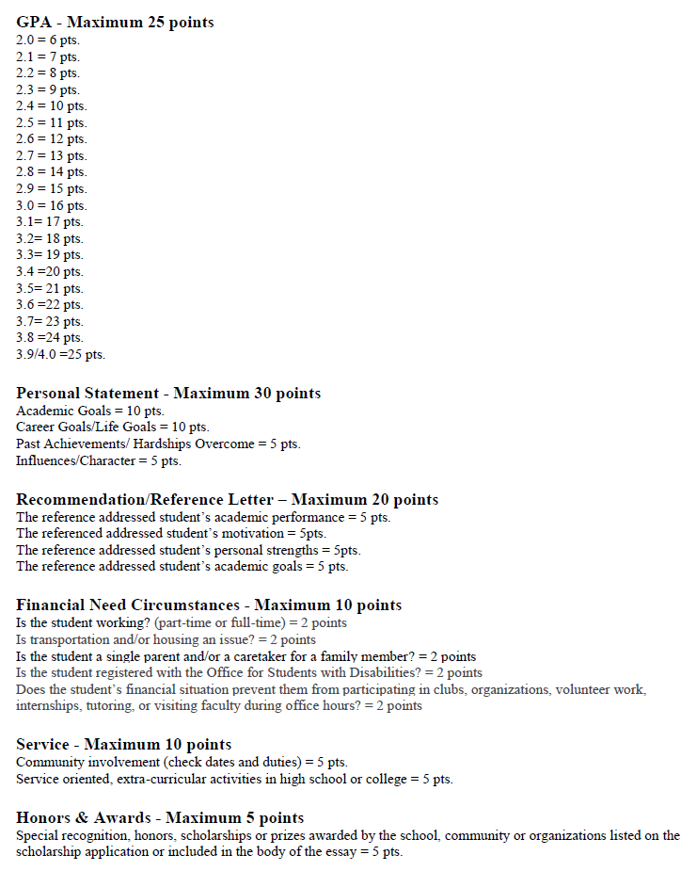
Rubric

Slide 10
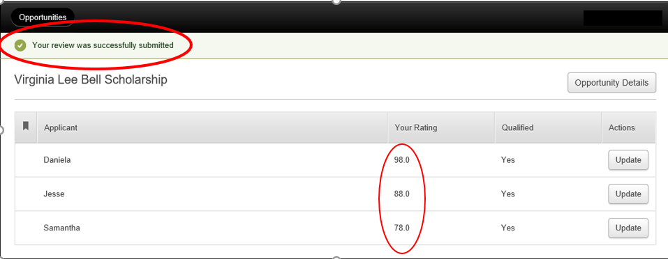
Reviewing the Applications Continued…
Scoring each applicant and selecting the finalist(s)
Once you have completed the review of all the applications assigned to you, you will see your scores for all the applicants:

Slide 11
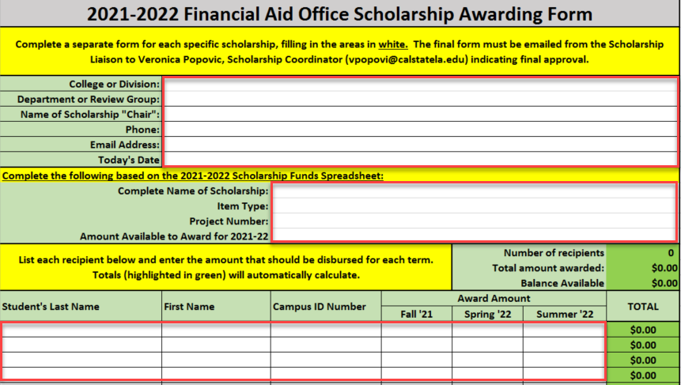
Submitting Names of Scholarship Recipients
Use the Scholarship Awarding Form to provide the following information to your Scholarship Liaison by June 15.
Name(s) of scholarship recipient(s)
Amount of scholarship
Indicate the term that the scholarship should be applied to (i.e. full year, fall only, spring only, etc.)
Fill in all areas in white:

Slide 12
Timeline Review &
Where to go for Assistance

Slide 13
2022-23 Scholarship Timeline
April 12 by 5pm: General Scholarship Application Deadline
April 12 by 5pm: Deadline for Letter of Reference Submission
April 15-June 15: Scholarship review conducted by Departments and Committees
June 15: Scholarship Selection Deadline
August 12: First Fall ’21 scholarship disbursements to students
September 14-24 Scholarship Liaisons provided with a list of students whose scholarships did not disburse

Slide 14
Scholarship Liaisons
Academic Senate: Dr. Talia Bettcher, Academic Senate Chair
Alumni Relations: Priscilla Parks, Alumni and Student Programs Manager
Arts and Letters: Dr. Katherine Weiss, Associate Dean
Associated Students Inc.: Dena Florez, Office Manager of Administration and Services
Athletics: Daniel Garrett, Assistant Director
Business and Economics: Dr. Angela Young, Associate Dean
Center for Engagement, Service and Public Good: Taffany Lim, Senior Director
Education: Agustin Cervantes, Director of Student Services
Educational Opportunity Program: Danielle Chambers, Director
Emeriti: Alfredo Gonzalez, Committee Chair
Engineering, Computer Science and Technology: Dr. Jane Dong, Associate Dean
Ethnic Studies: Dr. Trinh Pham, Associate Dean
Erika J. Glazer Family Dreamers Resource Center: Luz Borjon, Director
Graduate Studies: Dr. Karin Brown, Associate Vice President and Dean
Health and Human Services: Zully Quezada, Assistant to Associate Dean
Honors College: Dr. Alison McCurdy, Associate Director
Natural and Social Sciences: Amy Miller, Assistant to Associate Dean
Office for Students with Disabilities: Gonzalo Centeno, Director
Pat Brown Institute for Public Affairs: Dr. Raphael Sonenshein, Executive Director
Professional and Global Education: Tom Lau, Financial Aid Advisor
Veterans Resource Center: Cesar Gonzalez, Director

Slide 15
Cal State LA Scholarship System Help/Contact Information
Technical Assistance for Faculty & Staff and Access for Reviewers & Reference Providers
Chris Truong, ITC
ctruong@calstatela.edu
Technical Assistance for Applicants & Reference Providers
Sergio Rosales, Student Personnel Technician
srosal13@calstatela.edu
Scholarship Awarding & Funds Report
Scholarship Coordinator
scholarships@calstatela.edu

