Slide 1

On-Campus Student Employment Program:
Employee Transaction Form (ETF)
Completion Handbook

Slide 2
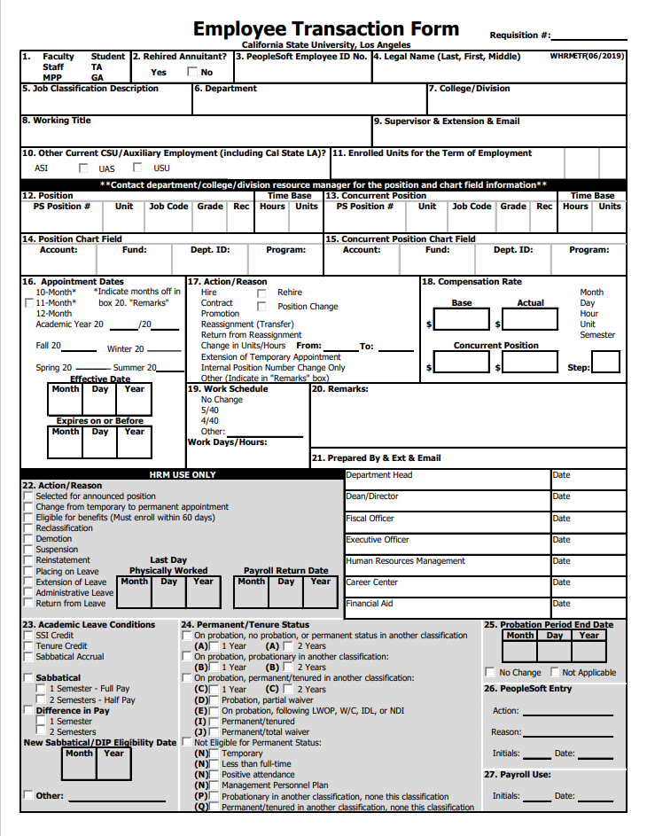

ETF Completion Handbook
Purpose
This handbook is intended to guide departments with the completion of the ETF form when hiring student employees.
NOTE: Questions related to sections of the ETF form not covered in this handbook should be directed to your department's resource manager.

Slide 3

ETF Form
Getting Started
  Where can I access most up to date form?
  Access the form using your Adobe Sign account.
              You can also find the form at the Career Center's Forms & Documents web page.

Slide 4
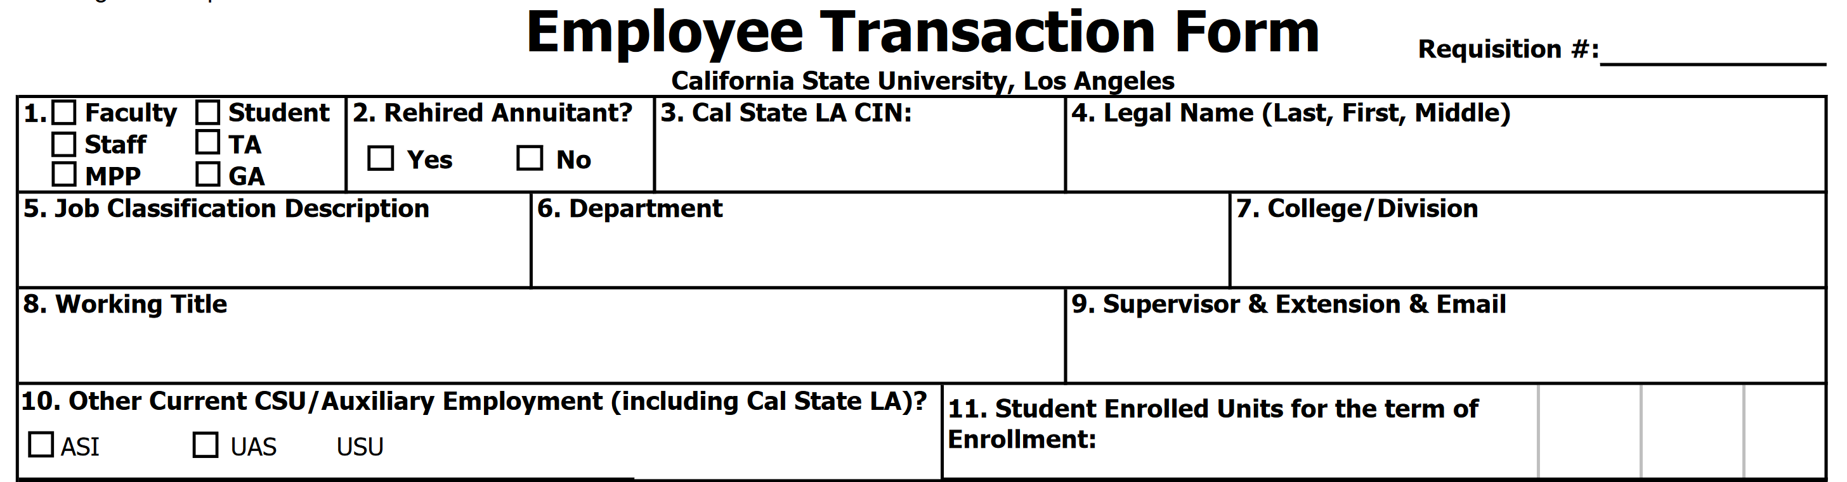
ETF Form
Completion Process
Section 1: Select Student
Section 3: Write the Student's CIN
(NOTE: make sure CIN matches the student's name in PeopleSoft)
Section 4: Write the student's Legal Name
(NOTE: exactly as it appears in PeopleSoft)
Section 5:
Write Student Assistant if using 1870 job code
Write Bridge Student Assistant if using 1874 job code
Write Student Assistant (Nonresident Alien Tax Status) if using 1868 job code
Write Instructional Student Assistant if using 1150 job code
Section 6: Write the name of the department compensating the student employee for work performed
Section 8: Write the Job Title indicated on the approved requisition
Section 9: Write the contact information of the student employee's department supervisor
NOTE: All contact information must be included in this section

Slide 5
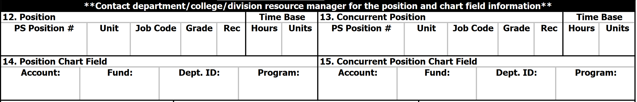

ETF Form
Completion Process
Section 12:
PS Position #: Write the PeopleSoft Position Number that corresponds with the job code.
Unit: Write the Unit number that corresponds with the PeopleSoft Position Number
Job Code: Write the job code that applies to the student you’re hiring. Refer to the Career Center's How to Complete an ETF web page for additional details.
Student Assistant: 1870​
Bridge Student Assistant: 1874​
Student Assistant – Nonresident Alien Tax Status: 1868​
Instructional Student Assistant: 1150

Slide 6

ETF Form
Completion Process
Section 14:
Dept ID: Write the 6-digit number that corresponds to the department (e.g., 400130 for Career Center)
(NOTE: The Department ID on ETF must match the approved requisition)

Slide 7
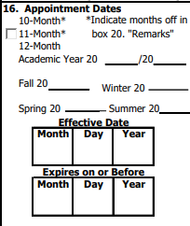

ETF Form
Completion Process
Section 16:
Select: Academic Year 20 __ / 20 __
  Must align with fiscal year indicated on the approved requisition (E.g., Academic Year 20 24 / 20 25)
      Select: The academic term the student employee is being hired for (E.g. Fall 2024)
      Expires on or Before: Enter the end date of the student employment appointment.
        Refer the Dates and Deadline webpage to review the academic term appointment dates.
NOTE: Do not enter an Effective Date. The effective start date is determined when the student employee is authorized to work and the notification is provided by the Career Center.
IMPORTANT: Students cannot begin working until we issue an Authorization to Work notice by email.

Slide 8
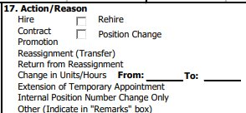

ETF Form
Completion Process
Section 17:
Select the options that best describes the hire request for the student employee.
Defined
Hire: Hiring a new student employee
Rehire: Hiring a former student employee who has not worked for more than a year.
Position Change: Student employee's working title is changing within the same department.
Extension of Temporary Appointment: When extending a student's employment beyond their current expiration date
Refer to the Career Center's Extensions, Rehires & Position Changes web page for additional details.

Slide 9
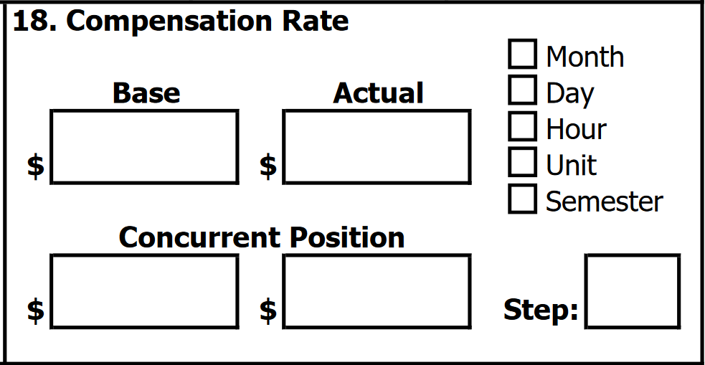

ETF Form
Completion Process
Section 18:
The compensation pay rate must be within the position salary range indicated on the approved requisition.
Base: Minimum salary rate as indicated on the approved requisition.
Actual: The hourly pay rate the student employee will be compensated for work performed.

Slide 10

ETF Form
Completion Process
Section 20:
Remarks section can include the following but not limited to:
Requested effective start date for the student employee
NOTE: Specific start dates can be requested, but it does not guarantee the start date of student employment.

Slide 11
Frequently Asked Questions
When should I submit ETFs to hire student employees?
To ensure a timely start of employment, we encourage you to submit hiring documents as early as possible. Visit our dates and deadlines webpage to plan the hiring process timelines.
2. If I request a specific effective start date for a student employee, are they allowed to start working at the requested date?
No, the effective start date is determined when the authorization to work notification is provided to the student employee by the Career Center. Student employees are not allowed to begin work until they receive an Authorization to Work notice by email.
3. What information on the ETF should align with the approved requisition?
The Working title, Department Name, Department ID, Job classification, and Compensation must align with the approved requisition for the position the student will be hired for.
4. What factors can impact the processing of hire requests related to the submitted ETF form(s)?
The following are examples of possible factors that impact the processing of hire request (note: list provides examples and is not all-inclusive)
  Incorrect information on the ETF
  Submission of ETFs to the incorrect email. All hire requests and corresponding documents must be sent to studemp@calstatela.edu.
  Sending many ETF forms in one PDF. Preferably, ETFs are sent as individual files.

Slide 12

Contact Information
Experiential Learning Office
Email: studemp@calstatela.edu
Phone: 323-343-3293​
Location: Career Center

