Slide 1
HEALTH CAREER READINESS SERIES

Slide 2
Thank you to our partners.
Andres Sandoval & the Career Center
Adele Dobry & the University Library
Dr. Lawson Bush, V & MDPas
Dr. Alaina Bassett (Audiology; Department of Communication Disorders)
Dr. Mengying He (Healthcare Management; Department of Management)
Dr. Maria Hernandez (School of Social Work)
Dr. Talato Kabore (School of Nursing)
Dr. Hyunsook Park (Pre-Health; Department of Biological Sciences)
Dr. Gabriela Simon-Cereijido (Speech-Language Pathology; Department of Communication Disorders)
Sofia Toro: Vice Provost of Enrollment Management, Charles R. Drew University of Medicine and Science
Corey Allen Berry: Admissions Counselor, USC Herman Ostrow School of Dentistry
Terrence Graham: Associate Dean for Graduate Education and Chief International Officer, USC Mann School of Pharmacy and Pharmaceutical Sciences
Dominique Beale: Assistant Director of Recruitment and Outreach, USC Mann School of Pharmacy and Pharmaceutical Sciences
Michael Richards: Assistant Director of Admissions, USC Keck School of Medicine

Slide 3
“We must spare no effort to raise the general level of health in this country. In a nation as rich as ours, it is a shocking fact that tens of millions lack adequate medical care. We are short of doctors, hospitals, nurses. We must remedy these shortages.”
- PRESIDENT HARRY TRUMAN, 1949.
Notes:
Department of Health, Education, and Welfare (HEW) 1953 under Eisenhower

Slide 4
Contemporary Challenges in Healthcare
Stubborn health disparities in underserved communities
Organizational problems
Workforce shortages
Too little patient-provider time
Worker burnout and stress
Prepare future healthcare workers to provide high-quality care and strategic leadership in healthcare settings

Slide 5
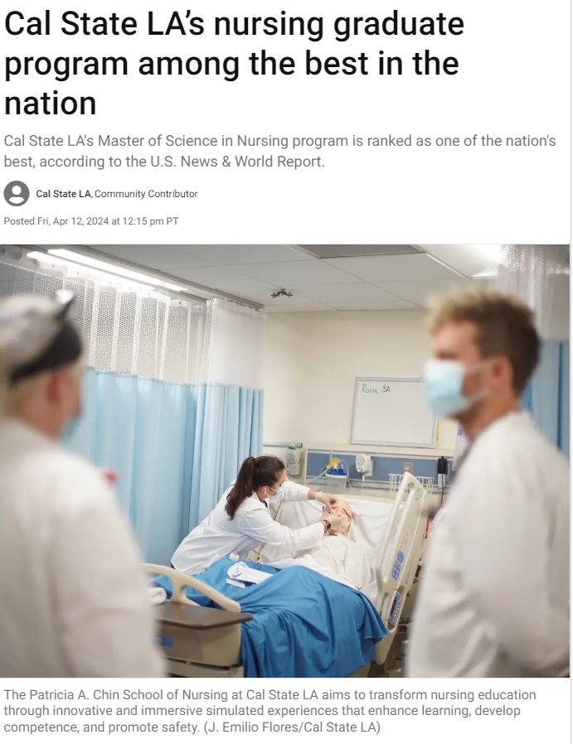
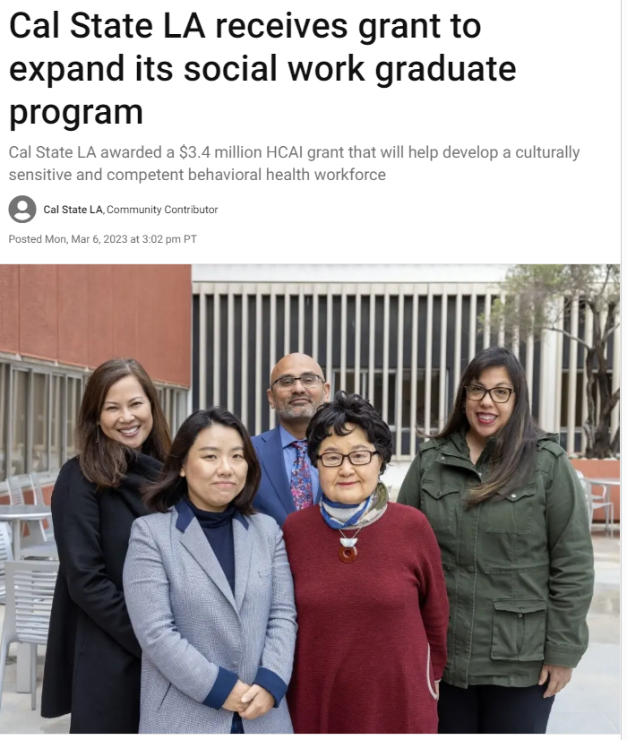
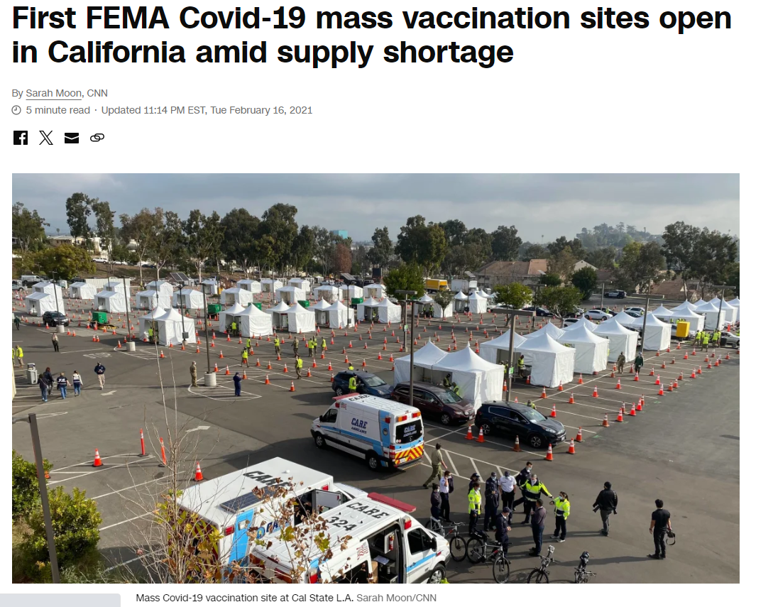
Cal State LA is a great place to get health career-ready!

Slide 6
Career Readiness
“Career readiness is a foundation from which to demonstrate requisite core competencies that broadly prepare the college educated for success in the workplace and lifelong career management.”
“For higher education, career readiness provides a framework for addressing career-related goals and outcomes of curricular and extracurricular activities, regardless of the student’s field of study.”
National Association of Colleges and Employers. (2021, May). What is career readiness? https://www.naceweb.org/career-readiness/competencies/career-readiness-defined/

Slide 7
To be career ready, you need:
An understanding of your strengths, weaknesses, talents, and unique perspectives
Proficiency in the specific tools, technologies, and theoretical or methodological approaches relevant to your field
A clear idea of your career goals and the steps needed to achieve them

Slide 8
Dimensions of Career Readiness
Career and Self-Development
Communication
Equity and Inclusion
Critical Thinking
Leadership
Professionalism
Technology
Teamwork
Notes:
When more

Slide 9
Career Construction Inventory
Crystallizing | Exploring | Deciding | Preparing
Forming a clear picture of my personality. Recognizing my interests and abilities. Determining what values are important to me. Knowing how other people view me. Identifying people that I want to be like. Finding out what my interests are. | Learning about different types of jobs. Reading about occupations. Investigating occupations that might suit me. | Deciding what I really want to do for a living. Finding a line of work that suits me. Selecting an occupation that will satisfy me. Planning how to get into the occupation I choose. Reassuring myself that I made a good occupational choice. | Finding opportunities to get the training and experience I need. Beginning the training needed for my preferred job. Qualifying for the job I like best. Getting a job once I complete my education or training.

Slide 10
A Look Ahead
DAY 1
Academic Pathways to Health Careers
Faculty Panel Discussion
Student and Faculty Mixer
DAY 2
Resources for Health Career Readiness
Career Center Workshop
Library Info Session
DAY 3
The Journey to Medical, Dental, and Pharmacy School
Panel: Charles R. Drew University of Medicine and Science and USC
Health Career Series Readiness Close
Kickoff
MDPas Info Session

Slide 11
What Cal State LA offers
Certificates
Undergraduate Minors
Master’s Degrees
Doctoral Degrees
Bachelor’s Degrees
Minor in Public Health
Minor in Health Communication
Healthcare Management, M.S.
Master of Social Work (M.S.W.)
Communicative Disorders, M.A.
Doctor of Audiology (AuD)
Undergraduate Certificate in Pre-Medicine/MDpas
Post-Baccalaureate Certificate for School Nurse
Nursing, B.S. (BSN)
Nutritional Science, B.S.
Read about the programs in the University Catalog.
Notes:
Certificates: 2
Minors: 12
Bachelor’s: 14
Masters’s: 9
Doctoral Degrees: 1

Slide 12
While you’re a student here…
Learn the prerequisite requirements and work with your adviser to incorporate them into your current student plan
Seek faculty mentorship and work together on research, scholarship, creative activities, or service
Take advantage of learning and professional development resources and opportunities
Explore cultures, life experiences, and worldviews that are different from your own

Slide 13
Questions?

Slide 14
Our Faculty Panelists
Dr. Alaina Bassett (Audiology; Department of Communication Disorders)
Dr. Mengying He (Healthcare Management; Department of Management)
Dr. Maria Hernandez (School of Social Work)
Dr. Talato Kabore (School of Nursing)
Dr. Hyunsook Park (Pre-Health; Department of Biological Sciences)
Dr. Gabriela Simon-Cereijido (Speech-Language Pathology; Department of Communication Disorders)

Slide 15
Introduce yourself and the academic programs you represent.

Slide 16
How did you find your way to a health career?

Slide 17
How does your program prepare students for a health career?

Slide 18
Which personal or professional qualities show a student’s potential for success in a health career?

Slide 19
Final thoughts on the academic pathways to health careers?

Slide 20
Questions?

Slide 21
A Look Ahead
DAY 1
Academic Pathways to Health Careers
Faculty Panel Discussion
Student and Faculty Mixer
DAY 2
Resources for Health Career Readiness
Career Center Workshop
Library Info Session
DAY 3
The Journey to Medical, Dental, and Pharmacy School
Panel: Charles R. Drew University of Medicine and Science and USC
Health Career Series Readiness Close
Kickoff
MDPas Info Session

Slide 22
HEALTH CAREER READINESS SERIES
Resources for health career readiness

Slide 23
A Look Ahead
DAY 1
Academic Pathways to Health Careers
Faculty Panel Discussion
Student and Faculty Mixer
DAY 2
Resources for Health Career Readiness
Career Center Workshop
Library Info Session
DAY 3
The Journey to Medical, Dental, and Pharmacy School
Panel: Charles R. Drew University of Medicine and Science and USC
Health Career Series Readiness Close
Kickoff
MDPas Info Session

Slide 24
PROFESSIONAL BRANDING FOR HEALTH CAREER READINESS
Presented by Andres Sandoval, career advisor

Slide 25
THE CALIFORNIA PRE-DOCTORAL PROGRAM
THE HEALTH PROFESSIONS TRACK

Slide 26
Program Overview
The newly created Health Professions Track aims to increase the number of students in the CSU’s diverse undergraduate and graduate populations who pursue health professional doctoral degrees in the California State University and University of California systems, including PhDs, DrPHs, DNPs, DSWs, and AudDs.
Faculty Mentorship
$5,000 scholarship
Summer research experience
Notes:
Travel Funds for the student to visit U.S. doctoral-granting institutions and/or to attend professional meetings appropriate to the student's development.
Development Funds for other related activities, such as student membership in professional organizations, subscriptions to academic journals, graduate school applications and test fees, GRE preparation, and the cost of minor research materials, for example.
A Summer Research Experience opportunity at a University of California campus or other U.S. major research university, fully funded by the Pre-Doctoral Program, so that the scholar can participate in doctoral-level research prior to applying to a Ph.D. program.
Faculty mentorship to help you implement the budget plan

Slide 27
Program Overview
Faculty Mentorship
$5,000 scholarship
Summer research experience
Fully funded by the California Pre-Doctoral Program, so that the Scholar can participate in doctoral-level research prior to applying to an appropriate doctoral program in the health professions
(Summer 2026)
Implementation of budget and collaborative research plans throughout award year
(August 2025 – May 2026)
Notes:
Travel Funds for the student to visit U.S. doctoral-granting institutions and/or to attend professional meetings appropriate to the student's development.
Development Funds for other related activities, such as student membership in professional organizations, subscriptions to academic journals, graduate school applications and test fees, GRE preparation, and the cost of minor research materials, for example.
A Summer Research Experience opportunity at a University of California campus or other U.S. major research university, fully funded by the Pre-Doctoral Program, so that the scholar can participate in doctoral-level research prior to applying to a Ph.D. program.
Faculty mentorship to help you implement the budget plan

Slide 28
Participant Eligibility
The HPT is designed for students interested in obtaining health professional doctorates with an explicit research component. Students interested in obtaining strictly clinical or practitioner degrees (doctorates in law, medicine, dentistry, pharmacy, for example) are not eligible.
All CSU upper-division undergraduate and master’s students, with the exception of international students, are eligible to apply.
Applicants to the HPT must be matriculated upper-division or master's degree students who are currently seeking a degree at a CSU campus, and will be enrolled at the campus for at least the fall term of the 2025-26 academic year.
Next application cycle: November 2024 – February 2025

Slide 29
LIBRARY RESOURCES

Slide 30
Mometrix eLibrary
Through the University Library you have access to test preparation materials for standardized exams. Access study guides and practice questions for exams including CPA exams, the GRE, GMAT, LSAT, Real Estate, Civil Service, Nurse Practitioner, and CBEST.
Interactive practice tests
Study guides and prep books

Slide 31
Research Support
For BASIC HELP…
For Advanced HELP…
meet with a Student Research Consultant!
Getting started with your research
Brainstorming keywords
Finding books and articles on a particular subject
Formatting citations
meet with a librarian subject specialist!
Writing a literature review
Writing a major paper for an upper-division or graduate course
Researching a topic that is somewhat obscure and not covered well in the Cal State LA collection
Using primary sources or special collections, etc.

Slide 32
MDpas
https://www.calstatela.edu/provost/MDpas

Slide 33
A Look Ahead
DAY 1
Academic Pathways to Health Careers
Faculty Panel Discussion
Student and Faculty Mixer
DAY 2
Resources for Health Career Readiness
Career Center Workshop
Library Info Session
DAY 3
The Journey to Medical, Dental, and Pharmacy School
Panel: Charles R. Drew University of Medicine and Science and USC
Health Career Series Readiness Close
Kickoff
MDPas Info Session

Slide 34
HEALTH CAREER READINESS SERIES
The journey to medical, dental, and pharmacy school

Slide 35
The Series so far…
DAY 1
Academic Pathways to Health Careers
DAY 2
Resources for Health Career Readiness
DAY 3
The Journey to Medical, Dental, and Pharmacy School

Slide 36
Our Community Partners
Sofia Toro Vice Provost of Enrollment Management, Charles R. Drew University of Medicine and Science
Corey Allen Berry Admissions Counselor, USC Herman Ostrow School of Dentistry
Terrence Graham Associate Dean for Graduate Education and Chief International Officer, USC Mann School of Pharmacy and Pharmaceutical Sciences
Dominique Beale Assistant Director of Recruitment and Outreach, USC Mann School of Pharmacy and Pharmaceutical Sciences
Michael Richards Assistant Director of Admissions, USC Keck School of Medicine

Slide 37
Introduce yourself and the academic programs you represent.

Slide 38
What qualities, skills, or experiences do you look for in a successful applicant?

Slide 39
What makes your program unique among other programs that prepare students for medical, dental, or pharmacy careers?

Slide 40
What trends do you see in the medical, dental, and pharmacy fields that aspiring students should be aware of?

Slide 41
How does your program approach diversity and inclusion in the admissions process and in the curriculum?

Slide 42
How do you help students connect with potential career opportunities after graduation?

Slide 43
Final thoughts: What is one piece of advice you wish every applicant would hear before applying?

Slide 44
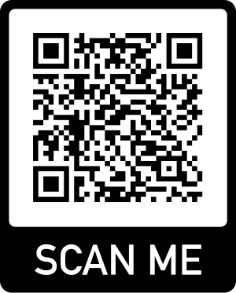
Thank you for joining!
DAY 1
Academic Pathways to Health Careers
Faculty Panel Discussion
Student and Faculty Mixer
DAY 2
Resources for Health Career Readiness
Career Center Workshop
Library Info Session
DAY 3
The Journey to Medical, Dental, and Pharmacy School
Panel: Charles R. Drew University of Medicine and Science and USC
Health Career Series Readiness Close
Kickoff
MDPas Info Session

