Slide 1
On-Campus Student Employment Program:
Requisition Form Completion Handbook

Slide 2
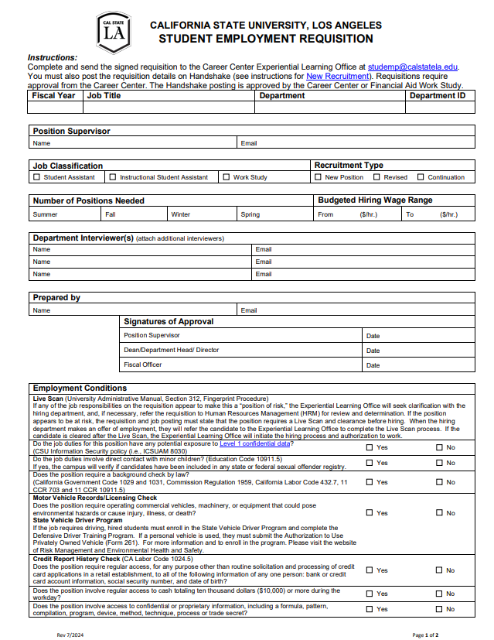
Requisition Completion Handbook
Purpose
This handbook is intended to guide departments with the completion of the Student Employment Program's Requisition form.
NOTE:
Questions related to sections of the Requisition form not covered in this handbook should be directed to studemp@calstatela.edu .
Questions about the requisition related to the work study classification should be directed to fws@calstatela.edu.

Slide 3
Requisition Form
Getting Started
Where can I access the most up to date form?
Access the form using your Adobe Sign account.
You can also find the form on our website under Forms & Documents.
Important:
Requisitions are approved for a fiscal year
The job description on an approved requisition is used on the Handshake job posting
Important: We do not recommend saving the requisition form to reuse in future terms, as it may be updated at any time.

Slide 4
Requisition Form
Process
Fiscal Year: Write the fiscal year when requisition will be active (e.g., 2023 – 2024).
Job Title: Write the job title for the position.
NOTE: The job title on your requisition will be for Handshake job postings and student employment related forms (e.g., ETF).
Department: Write the name of the department hiring the student employees for the position.
Department ID: Write the 6-digit number that corresponds to the department (e.g., 400130 for Career Center)

Slide 5
Requisition Form
Process
Write the budgeted hiring wage range that will be used to determine the student employee's pay rate.
In the From section, write the minimum dollar amount of the position's classification salary range.
The To section shall not be a dollar amount above the position's classification salary rage
Important: All pay rates must be within the position classification’s salary range. To find the salary range for student employee classifications, please visit CSU Salary Schedule.

Slide 6
Requisition Form
Process
Write the number of positions needed for each academic term.
Write zero in the term(s) the department does not need to hire student employees.

Slide 7
Requisition Form
Process
Select the appropriate job classification of the position.
The Student Assistant option is used to employ students in the following classifications:
Student Assistant (1870)
Bridge Student Assistant (1874)
Student Assistant – Nonresident Alien Tax Status (1868)
The Instructional Student Assistant option is used to employ students in the following classification:
Instructional Student Assistant (1150)
The Work Study option is used to employ students in the following classification:
On-Campus Work Study (1871)
Important: A requisition is submitted for ONLY one job classification. If your department plans to hire other job classifications, submit a separate requisition.

Slide 8
Requisition Form
Process
Select the option that best describes the recruitment type of the requisition.
The New Position option is used when the position is new to the department.
The Revised option is used when revising an existing or a previous fiscal year requisition.
The Continuation option is used when submitting a previous requisition for a new fiscal year and no changes are made.

Slide 9
Requisition Form
Process
Write the full name and email of at least one department interviewer who will interview candidates and participate in the candidate selection process for the position.

Slide 10
Requisition Form
Process
Review the Live Scan section before completing the questions in the employment conditions section of the requisition form.
Note: The questions included in the employment conditions section are designed to maintain public trust and protect the students and employees of the University by ensuring a thorough hiring process.

Slide 11
Requisition Form
Process
Review the Guidelines, Standards, and Laws found on the Information Technology Services Department website to guide your response.
NOTE: If any of the job responsibilities on the requisition appear to make this a “position of risk,” the Experiential Learning Office will seek clarification with the hiring department, and, if necessary, refer the requisition to Human Resources Management (HRM) for review and determination.

Slide 12
Requisition Form
Process
Review the key duties and responsibilities to guide your response.
NOTE: Fingerprinting is required employees who perform work involving regular or direct contact with minor children in a recreational program or camp operated by the CSU or on CSU property (HR 2017-17, Background Checks) .

Slide 13
Requisition Form
Process
Positions in which background checks are currently required by law include, but are not limited to the following:
Sworn CSU Police Personnel (California Government Code §1029 and 1031)
Police Officer Cadets (California Government Code §1029 and 1031)
Police Dispatchers (Commission Regulation 1959) ]
Positions with direct contact with minor children at a camp operated by the CSU (Education Code §10911.5)
Positions with access to stored criminal offender record information (11 CCR §703 and 11 CCR §707)
Positions with access to patients, drugs or medication (California Labor Code §432.7)

Slide 14
Requisition Form
Process
Review the key duties and responsibilities of the position and select the appropriate response.

Slide 15
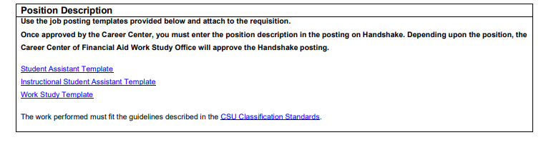
Requisition Form
Position Description
Review the guidelines described in the CSU Classification Standard to learn the general duties performed by positions according to the corresponding job classification.
Click on the appropriate job posting template hyperlink to download the position description template that must be attached to your requisition.
Departments are encouraged to complete a specific position description based on their operational needs.

Slide 16
Frequently Asked Questions
Is it necessary to submit a job requisition for each academic year, even if there is no update to be made?
A new requisition must be submitted each year. Be sure that the active requisition has been approved for the term you are seeking to recruit.
As the interviewer for the role has not been finalized yet, is it permissible for the hiring department to leave the "Department Interviewer(s)" section blank?
For a requisition to be approved, it is necessary to indicate at least one interviewer.
The department seeks to employ a larger number of student assistants than originally outlined in the approved requisition. What steps should be taken to facilitate the hiring of additional student assistants?
If you intend to hire more student assistants than indicated in the current requisition, please submit an updated requisition for review and approval. Any changes made to student employment that differ from the current approved requisition require an update.

Slide 17
Contact Information
Experiential Learning Office
Email: studemp@calstatela.edu
Phone: 323-343-3293​
Location: Career Center

