Slide 1


Slide 2

A Great Place to Work
Presented by Lisa Chavez

Slide 3
Task Force Charge:
Study and assess Cal State LA’s current work environment to support the professional and personal responsibilities of our employees
Conduct a review and inventory of current programs and identify gaps
Make recommendations regarding the continuation, modification, and addition of activities, technology, policies, and programs to enhance the work culture of the University while working within the context of limited resources
Review current charitable efforts and poll University constituents about issues they care about – and solicit passionate and active volunteers to steer
The Goal is to ensure a supportive, balanced, productive work environment which in turn contributes to the University’s continued student success.

Slide 4
Members
Lisa Chavez (Co-chair)
Nancy Wada McKee (Co-chair)
Troy Allen
Ernest Argumaniz
Michael Caldwell
David Connors
Jason Dennison
Cynthia Galvez
Carlos Gutierrez
Margaret Montpas
Cheryl Ney
Pablo Ortega
Tosha Pham
Bidhan Roy
Alma Sahagun
Robert Salerno
Veronica Woo

Slide 5
Who we are:
Faculty
  Tenure Track
  Lecturers
  Department Chairs
Staff
Student Assistants

Slide 6
What do we do Well--Staff
What we do WELL -- STAFF
Benefits (Health/Dental/Vision, Vacation, Recognition)
Mental health workshops
Transportation: great commuter options
Discounted tuition (staff/family)
Summer workshops
Training
Discounted software
Discounted food on campus
Great people
Location
Diversity
Mission driven focus
Health Center (massages, over-the-counter medicine available, flu shots)
Entertainment
Wi-Fi
Teams of greatness all over the campus
Sunshine/weather
Advancement opportunities
Community engagement opportunities
Beautiful campus
Healthy environment
Students
Faculty
Ease of communication, vertical/horizontal

Slide 7
What we can IMPROVE
Market current benefits (discounts, download software)
Intentional spaces for interactions
Training for Students
Staff Training Manual
On Boarding
Signature Reduction Act
Faculty Lecturers: provide sense of belonging; feel needed
Recycling improvements
Personal responsibility
Pride building activities
Retention/Tenure/Promotion (RTP) process
Negativity funneling; place to deliver and handle issues, complaints, suggestions
More mental health resources on campus
Ombudsman
Conduct, Assessment, Response and Evaluation (CARE) Team for employees
Space allocation / locating
Mutual respect
Employee Assistance Program (EAP) on campus

Slide 8
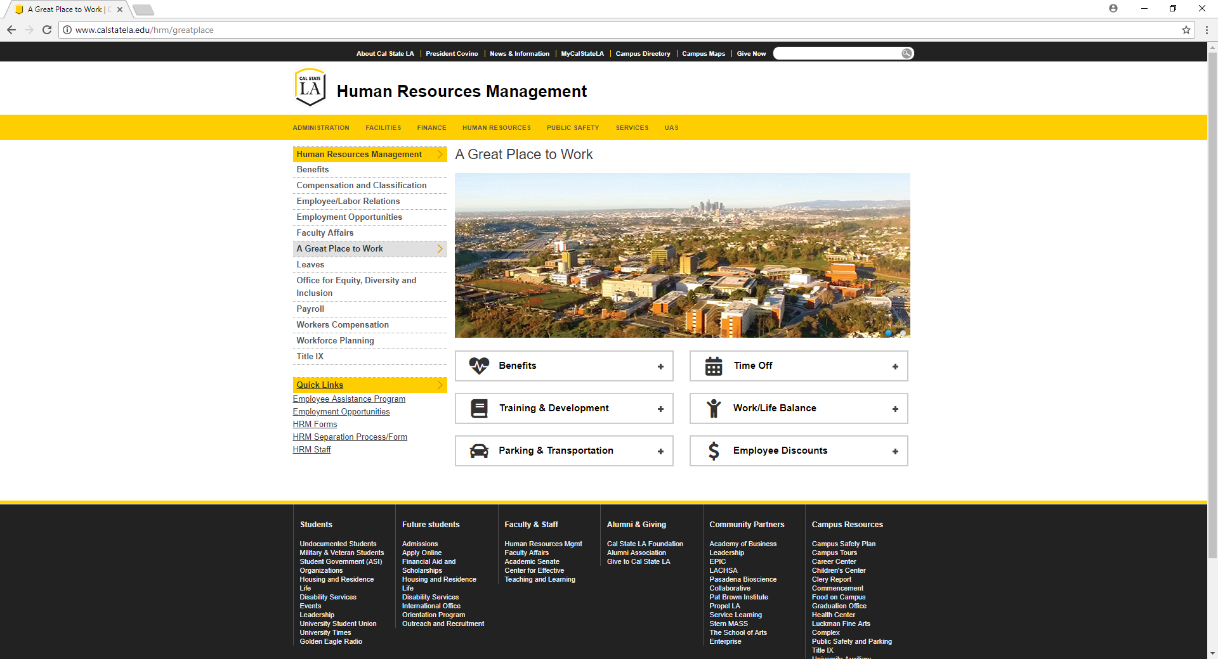

Slide 9
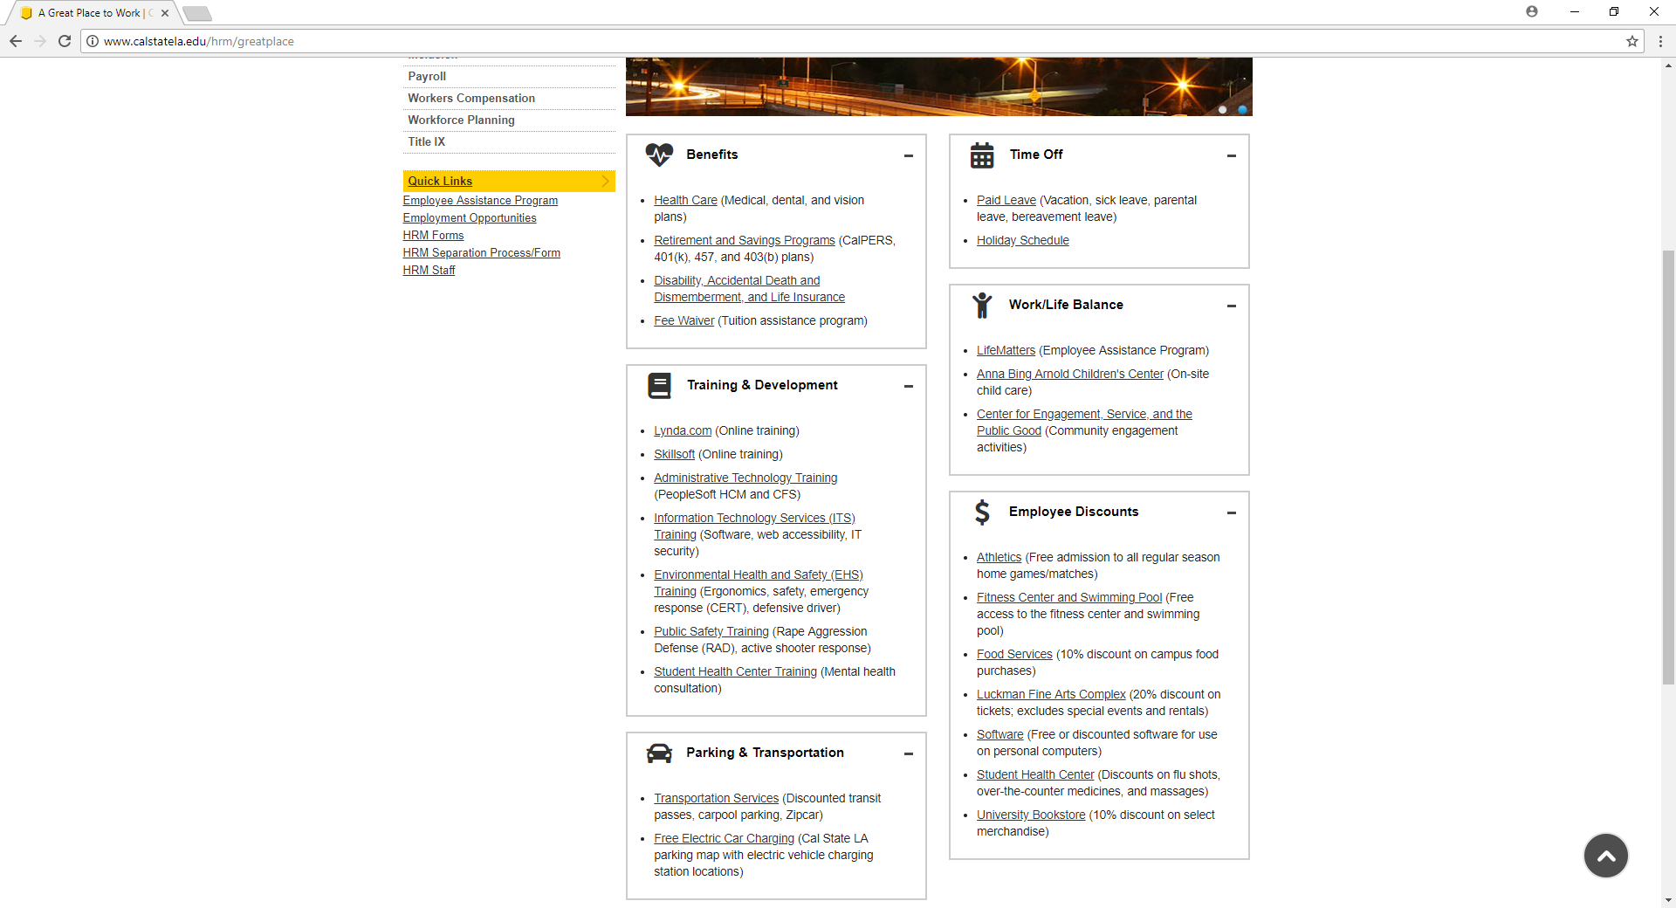

Slide 10
Study and Assess current Environment—
What do our Employees think?

Slide 11
Focus Groups
Faculty Focus Groups-Fall 2017
  Tenure Track Faculty
  Non Tenure Track Faculty
  Department Chairs
Staff Focus Groups-Spring 2018
Student Assistants-To be scheduled

Slide 12
What Faculty think
Campus climate has improved
Exhausted/overwhelmed by the pace of change on campus/workload
Lack of resources to do their jobs effectively, poor classroom conditions
Concern for their students
Lack of office space
Communication on campus is an issue
Hiring and onboarding
Concerns about the quality of teaching on campus/way teaching is evaluated
Concerns about the treatment of staff by faculty
Concerns about processes on campus
Loyal to Cal State LA
Lecturers feel undervalued by the campus (Not seen as “real” faculty)

Slide 13


Slide 14
Cal State LA’s Mission Statement
Cal State LA transforms lives and fosters thriving communities across greater Los Angeles. We cultivate and amplify our students' unique talents, diverse life experiences, and intellect through engaged teaching, learning, scholarship, research, and public service that support their overall success, well-being, and the greater good.

Slide 15
Major Issues:
People
Process
Environment
Time
Money
Will

Slide 16
Now what?
Change Management training end of May
Complete focus group work
Create subcommittees for each of the employee groups that will review focus group topics and propose potential initiatives to begin to address some of the areas of concern or improvements that can be made

Slide 17
Questions

