Slide 1

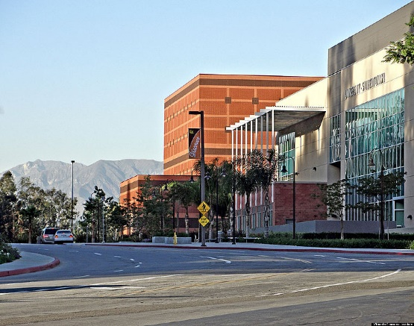
Understanding Article 12 (Unit 3 CBA)
Order of Assignment
Nancy McQueen
Office of Faculty Affairs
October 14, 2020

Slide 2
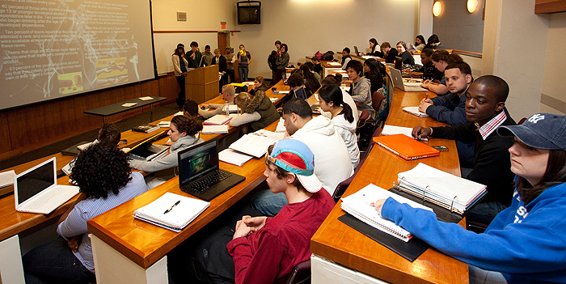
Today’s Topics
  Appointment of Lecturers
  Lecturer Entitlements
  Your Questions

Slide 3

Article 12 Provides the Blueprint
General Principles
  Tenure-track faculty take precedence
  Long-term lecturers (three-year appointments) who have performed satisfactorily have first priority for work among temporary faculty
  Faculty who have worked for you and performed satisfactorily receive careful consideration for reappointment
  Current part-time faculty have opportunities to increase their time base if work is available

Slide 4
The Article 12 Glossary
Careful Consideration
  Lecturers who have been evaluated (12.7)
  Anyone who worked for you in current/prior year (12.29)
  Review of application, evaluations, and Personnel Action File – sign in to PAF and be prepared to justify decisions
Similar Assignment – refers to timebase (12.3)
  Offered to a part-time lecturer with 2 semesters of consecutive employment in the same department and same campus in an academic year
  IF rehired, lecturers get a 1-year conditional appointment to same or higher time base (sufficient work must be available – 12.5)
  Worked turned down by the lecturer counts towards meeting their entitlement as do classes that get canceled due to low enrollment
  If a class is canceled after the third meeting, the lecturer gets paid for the entire class.

Slide 5
The Article 12 Glossary (continued)
Personnel Action File (PAF) (Article 11)
  One official file
  Access is logged
Conditional and Unconditional Appointments
  Part-time may be conditional (12.5) - entitlements apply
    Conditional on enrollment and funding
  Full time must be unconditional (12.6) -
    Must be paid for 15 units even if less than 15 units of work is available
  Entitlement
    Refers to time base

Slide 6
  Preference for Available Temporary Work
  When the need to assign additional temporary work to lecturers after the assignment needs of tenured and probationary faculty have been satisfied (including FERP and PRTB faculty), and after work to be taught by administrators, teaching associates, and other student employees or voluntary faculty, the work shall first be offered to qualified temporary faculty in the department who have performed satisfactorily in the following order: (12.29)

Slide 7
Temporary Faculty:
Order of Assignment
(Article 12.29)
Beginning of the academic year | During the year
1. 3-year full-time appointees | 1. 3-year full-time appointees
2. Continuing multi-year full-time | 2. Continuing multi-year full-time
3. 3-year part-time appointees, up to “entitlement” | 3. 3-year part-time appointees
4. Eligible for 3-year, on “recall” list | 4. Eligible for 3-year, on “recall” list
5. Continuing multi-year part-time | 5. Continuing 1-year full-time
6. Visiting faculty | 6. Continuing 1-year, multi-year part-time
 | 7. Visiting faculty
7. “Careful consideration” (worked prior year) | 8. “Careful consideration”
8.i. 3-year part-time appointees, up to FT (or 1-year PT appointees who are demonstrably better qualified) | 9.i 3-year part-time appointees, up to FT (or 1-year PT appointees who are demonstrably better qualified)
8.ii One-year PT appointees, up to FT | 9.ii One-year PT appointees, up to FT
8.iii All other qualified candidates | 9.iii All other qualified candidates

Slide 8
Temporary Faculty:
Order of Assignment (Article 12.29), 2020-2021 0nly
Beginning of the academic year | During the year
1. 3-year full-time appointees | 1. 3-year full-time appointees
2. Continuing multi-year full-time | 2. Continuing multi-year full-time
3. 3-year part-time appointees, up to “entitlement” | 3. 3-year part-time appointees
4. Eligible for 3-year, on “recall” list | 4. Eligible for 3-year, on “recall” list
5. Continuing multi-year part-time | 5. Continuing 1-year full-time
6. Visiting faculty | 6. Continuing 1-year, multi-year part-time
7. Careful consideration (worked prior year) | 7. Visiting faculty
7a. “Careful consideration” (worked in academic year 2019-2020) | 8. “Careful consideration”
8.i. 3-year part-time appointees, up to FT (or 1-year PT appointees who are demonstrably better qualified) | 9.i 3-year part-time appointees, up to FT (or 1-year PT appointees who are demonstrably better qualified)
8.ii One-year PT appointees, up to FT | 9.ii One-year PT appointees, up to FT
8.iii All other qualified candidates | 9.iii All other qualified candidates

Slide 9
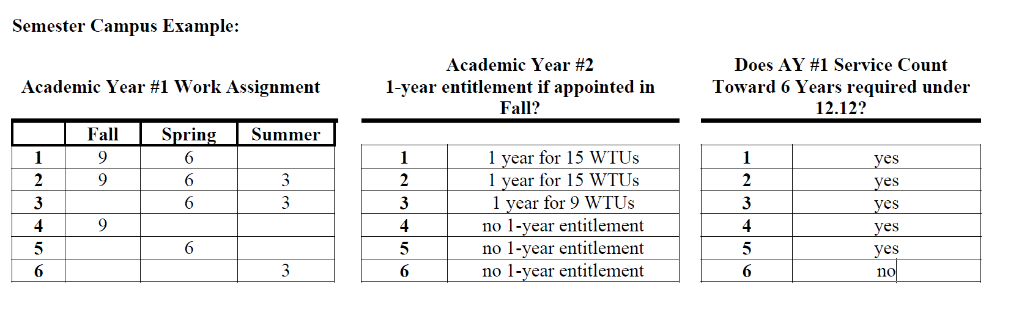
One Year Appointments and Entitlements
Eligibility Criteria for One-Year (Provision 12.3) Appointments
Semester Campus Rule: Must work two consecutive terms in prior academic year and only the first two consecutive terms count in establishing entitlement. Fall is the first term of the year.
Units taught during extension for credit programs do not count towards entitlement

Slide 10

Article 12 Timeline for 3-year Appointments
Years 1-6:
  Original appointment can be for any time base or duration (12.3)
  After that, careful consideration (12.7)
  Only those on a one-year appointment have entitlements (12.3)
Transition to year 7: Requires a cumulative evaluation for 3-year appointment (12.12)
Year 7 and beyond (12.12):
  3-year appointments
  Higher priority for work
  Re-evaluation for subsequent 3-year appointments - Done in year 3 of the appointment – must be deemed satisfactory for reappointment

Slide 11
Article 12 Timelines
3 Year Appointments
  Temporary faculty employed during the previous academic year and possessing six (6) or more years of consecutive service:
    On a single campus, in a single department
    Employment of one (1) semester during the Academic Year is considered one (1) year of service
    “Entitlement” is determined by total paid units during year prior to 3-year contract; 3rd year of subsequent contracts
  Part-time appointments are conditioned on budget and/or enrollment.
  If you are unable to appoint at the previous timebase, you may appoint at a lesser timebase ( 12.13)

Slide 12
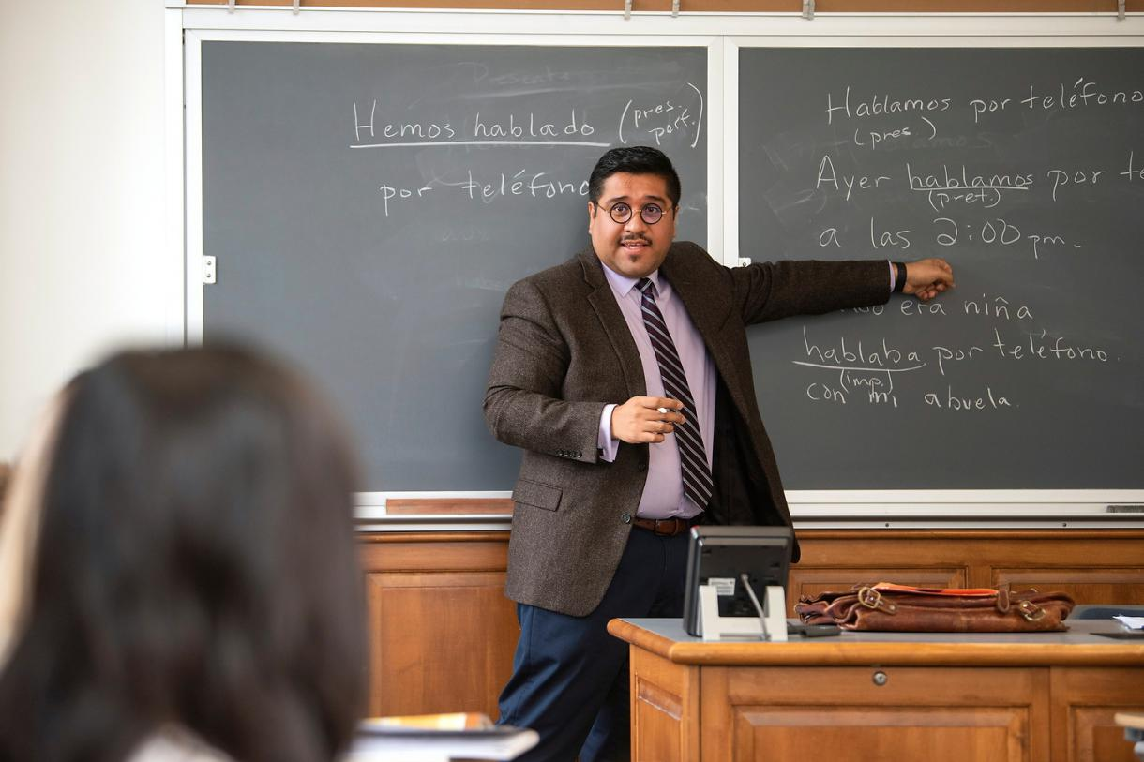
What factors do you consider when we need to appoint work, including hiring new lecturers?
(3-5 Minute Discussion)

Slide 13


Slide 14
Resources
Office of Faculty Affairs
  www.calstatela.edu/academicpersonnel
Faculty Contract
  www.calstate.edu/LaborRel/Contracts_HTML/CFA_CONTRACT/2014-2017/
General
  www.calstate.edu/HR/index.shtml
CFA
  www.calfac.org

