Slide 1
Making Assessment Fun and Interactive using Kahoot!™
Assessment Faire 2017
Dr. Morales-Chicas
Child & Family Studies
Rongxiang Xu College of Health and Human Services

Slide 2



Issues with current assessment tools

Slide 3

Benefits of using Kahoot for assessment
Is it free and fun
It is easy to use
It has multiple formats for assessment

Slide 4
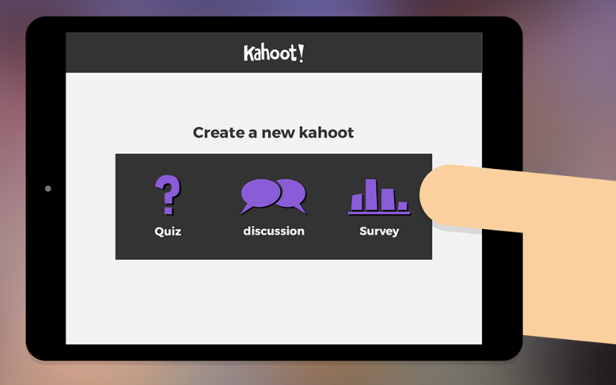
What is Kahoot™?
It only takes a few easy steps to create a quiz, a discussion, or a survey you can use in real time.

Slide 5
Example 1
CHDV 1410: Development Across the Lifespan (Adulthood and Aging)
Students learn about theories and concepts related to various domains of development (e.g., physical development and social development)
I use Kahoot to assess…
  A) whether students understood what they learned
  B) to get feedback about what concepts students are struggle with

Slide 6
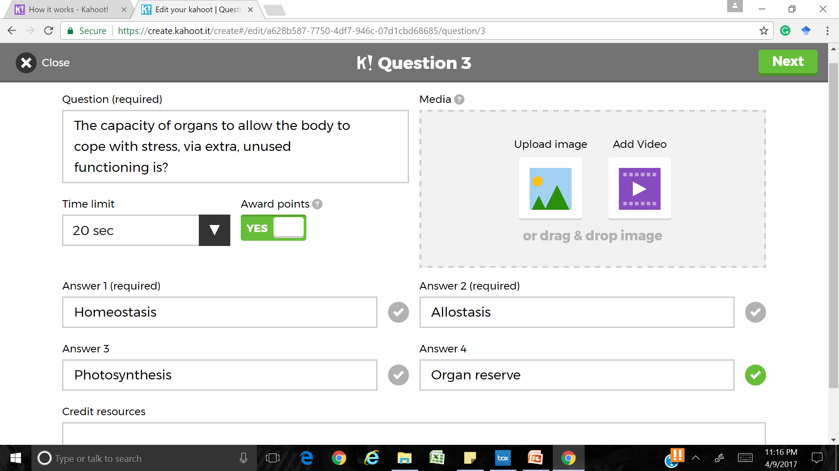
Quiz Creation is Easy!

Slide 7
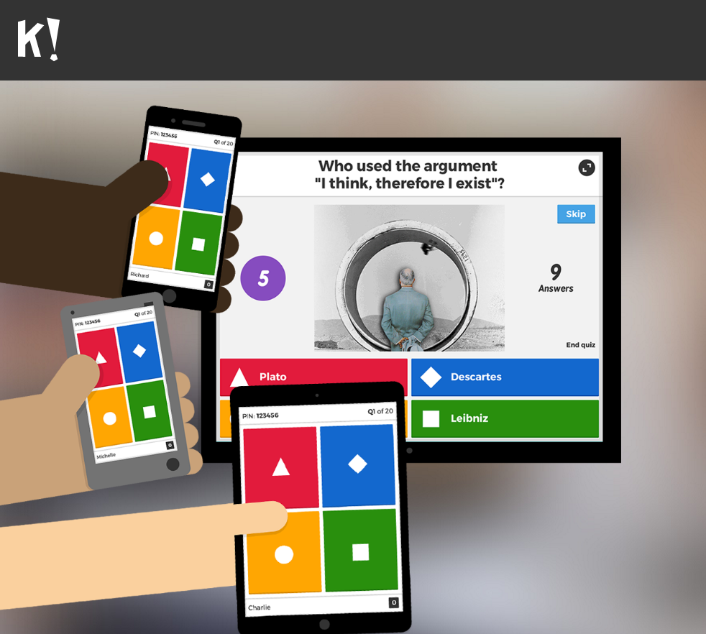
Once your quiz is created simply save and share with your students
Participants log in with a game
pin on any media device
Connected to the internet
Students select their answer as
Shown on the right
Students compete for points after each question
  More accuracy → more points
  Faster response → more points

Slide 8
Other Benefits
Students can use nicknames and remain anonymous
Or
Real names can be used for data tracking purposes

Slide 9
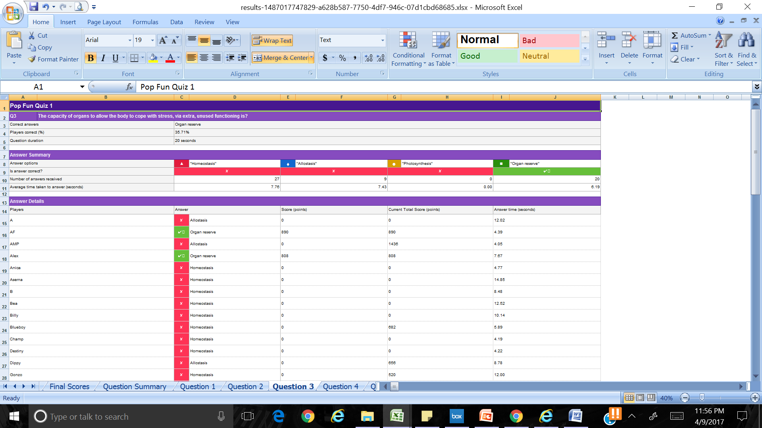
Example of Data Tracking
How did they do in Example 1?
Conclusion:
-No one fell for my trick about “Photosynthesis” (Great!)
-But answers between two responses were split (What do I do now?)

Slide 10
Reflect with students
Go over each answer and assess why students selected the most common wrong answer(s)
Have students explain the correct answer and its meaning
Provide concrete examples to reinforce learning
  E.g., Organ reserve is like a fuel reserve tank for a car;
  The more fuel in your reserve tank, the longer you have before you run out of gas
  The fuller your organ reserve, the more you can handle stress.
    Fullest during emerging adulthood

Slide 11
Limitations to consider
Consider students who may have a disability (e.g., a vision impairment)
  Ask the student how you can best accommodate them
  Talk to the office of disabilities for advice on accommodations
Technology is not perfect
  Check for internet connectivity before you play the game
Not every student will have a phone or media device
  Encourage sharing with a classmate or provide a printed copy as an accommodation

Slide 12
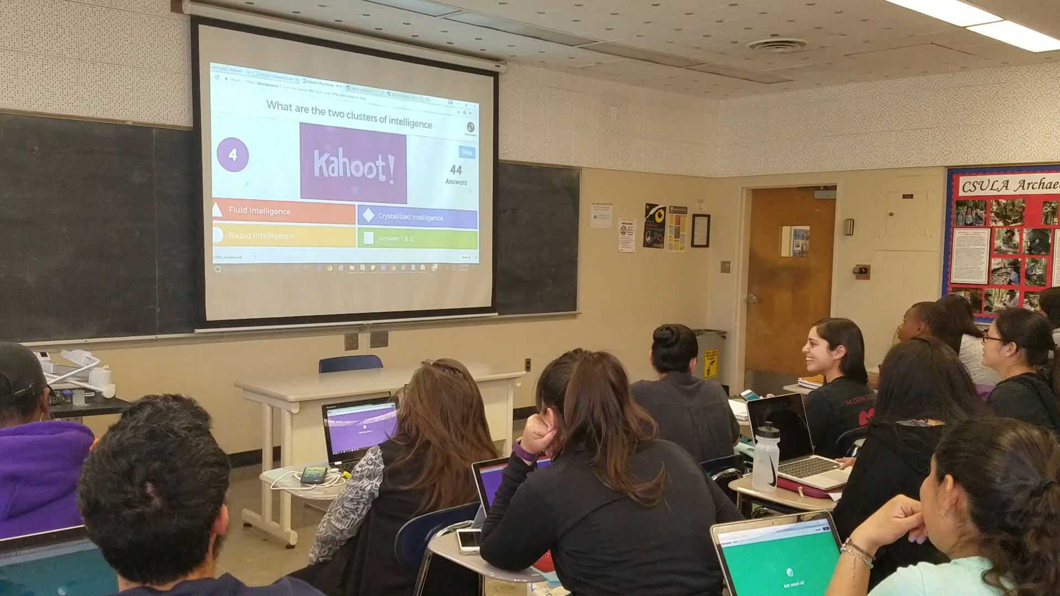
Sample Clip

Slide 13
Let’s try it together!
Step 1: With your phone go to www.kahoot.it
Step 2: Enter the game pin
Step 3: Let’s play!
To create your own Kahoot account go to: https://getkahoot.com/

