Slide 1

Assessment In 5 Easy Steps
November 20, 2017
Dr. Jessica Dennis, Director of Assessment

Slide 2
Workshop Learning Goals
By the end of this workshop participants will be able to:
  Describe the stages of the assessment cycle.
  Differentiate between indirect and direct assessment measures.
  Locate existing sources of data to inform program improvement.
  Formulate a program assessment plan.

Slide 3
Assessment in 5 Easy Steps
1. Pick a PLO (Program Learning Outcome) that is a priority.
2. Examine existing data.
  Data from Institutional Research
  University assessment results (info literacy, oral comm)
3. Formulate a plan to collect more useful data.
  Capitalize on assessments faculty already use
4. Collect and analyze data.
5. Discuss and close the loop.

Slide 4
The Assessment Cycle

Slide 5
Why is assessment important?
Improve student learning and success
  Data-driven culture of evidence instead of anecdotes and opinions
Inform curriculum revision
Communicate the value of our program to our students and the public
Program review and WASC Accreditation

Slide 6
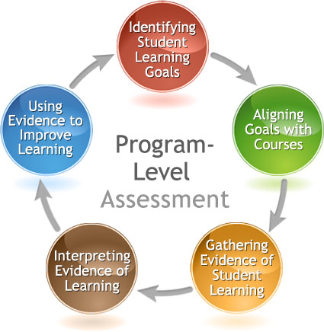
The Assessment Cycle

Slide 7
Step 1:
Choosing a Priority Learning Outcome

Slide 8
What is Meaningful Assessment?
Should be intentional and purposive
Backward design means beginning with the end in mind, anticipating the use of evidence
Articulate questions important for the program:
  Are there disparities in academic performance among various ethnicities in our program?
  Are students able to transfer knowledge between our courses?
  Do students improve their cultural competence skills as a result of our program?

Slide 9
How should we decide what is meaningful?
Consider strategic planning priorities
Collect data to address salient issues faculty have observed
To following best practices- assess each PLO on a 5-year cycle

Slide 10
Institutional Learning Outcomes at Cal State LA
Knowledge: Mastery of content and processes of inquiry
  CSULA graduates have a strong knowledge base in their academic major and can use powerful processes of inquiry in a range of disciplines. They engage contemporary and enduring questions with an understanding of the complexities of human cultures and the physical and natural world and are ready to put their knowledge into action to address contemporary issues.
Proficiency: Intellectual skills
  CSULA graduates are equipped to actively participate in democratic society. They are critical thinkers who make use of quantitative and qualitative reasoning. They have the ability to find, use, evaluate and process information in order to engage in complex decision-making. They read critically, speak and write clearly and thoughtfully and communicate effectively.
Place and Community: Urban and global mission
  CSULA graduates are engaged individuals who have contributed to the multi-lingual and multiethnic communities that constitute Los Angeles and the world of the future. They are aware of how their actions impact society and the environment, and they strive to make socially responsible decisions. They are community builders sensitive to the needs of diverse individuals and groups and committed to renewing the communities in which they live.
Transformation: Integrative learning
  CSULA graduates integrate academic learning with life. They engage in community, professional, creative, research and scholarly projects that lead to changes in their sense of self and understanding of their worlds. Graduates integrate their knowledge, skills and experience to address complex and contemporary issues and act ethically as leaders for the 21st century.

Slide 11
The Big Five Core Competencies as Defined by WASC
Critical thinking
  the ability to think in a way that is clear, reasoned, reflective, informed by evidence, and aimed at deciding what to believe or do. Dispositions supporting critical thinking include open-mindedness and motivation to seek the truth.
Quantitative Reasoning
  the ability to apply mathematical concepts to the interpretation and analysis of quantitative information in order to solve a wide range of problems, from those arising in pure and applied research to everyday issues and questions. It may include such dimensions as ability to apply math skills, judge reasonableness, communicate quantitative information, and recognize the limits of mathematical or statistical methods.

Slide 12
The Big Five Core Competencies as Defined by WASC
Oral Communication
  communication by means of spoken language for informational, persuasive, and expressive purposes. In addition to speech, oral communication may employ visual aids, body language, intonation, and other non-verbal elements to support the conveyance of meaning and connection with the audience. Oral communication may include speeches, presentations, discussions, dialogue, and other forms of interpersonal communication, either delivered face to face or mediated technologically.
Written Communication
  Communication by means of written language for informational, persuasive, and expressive purposes. Written communication may appear in many forms or genres. Successful written communication depends of mastery of conventions, faculty with culturally accepted structures for presentation and argument, awareness of audience and other situation-specific factors.

Slide 13
The Big Five Core Competencies as Defined by WASC
Information Literacy
  according the Association of College and Research Libraries, the ability to “recognize when information is needed and have the ability to locate, evaluate, and use the needed information” for a wide range of purposes. An information-literate individual is able to determine the extent of information needed, access it, evaluate it and its sources, use the information effectively, and do so ethically and legally.

Slide 14
Activity #1: Pick a Priority
Which PLOs are your department’s strengths?
Which are your weaknesses?
What is one question you would most like to answer with regard to your PLOs?

Slide 15
Step 2:
Examine Existing Data Sources

Slide 16
Indirect Methods of Assessment
Graduation or Completion Rates
Placement Rates
Student Survey
Student Interviews or Focus Groups
Alumni Survey
Employer Survey
Faculty Survey
Exit (end of program) Survey or Interviews
Reflection Essays
Diaries or Journals
Data from Institutional Surveys (NSSE)
Curriculum/Syllabus Analysis
Checklists

Slide 17
Existing Data Sources from Institutional Research (IR)
See IR data pull reference sheet
Interactive reports of enrollment trends and graduation rates by gender and ethnicity
Admission and course data, including bottleneck course analysis

Slide 18
Surveys Regularly Administered by IR
Entering Freshman and Entering Transfer Survey
  Collected every year on admissions process, high school experiences, view of self, finances, expectations of time at Cal State LA, degree attainment goals
Senior Survey
  Collected in 2013 and 2015 on time-to-degree, perceptions of faculty, campus community, skill development, time allocation, plans after graduation, different areas of satisfaction
Baccalaureate Alumni Survey
  Conducted in 2015 targeting recent graduates, early career, and mid-career, regarding undergraduate education experience, current activity/employment, career, pursuit of additional education, education-related debt
National Survey of Student Engagement (NSSE)
  Administered in 2014, 2017 with freshmen and graduating seniors focused on student engagement (academic challenge, learning with peers, experiences with faculty, campus environment) and advisement

Slide 19
Recent Data Collected by Assessment Team to Examine Institutional Learning Outcomes
Informed by the Educational Effectiveness and Assessment Council (EEAC)
  Results available from Jessica Dennis
Information Literacy (2017)- Standardized Assessment of Information Literacy Skills (SAILS) test given to sample of freshmen and seniors
  35 Business, 20 Engineering/Computer Science, 17 Science/Math, 32 Social Science/Psychology, 42 Other (Education, Law, Performing Arts, etc.)
Oral Communication (2017)- Seniors presentations in capstone courses were videotaped and scored with a rubric
  A&L (COMM 4300, COMM 4390), B&E (BUS 4150, BUS4970), CCOE (COUN 4940A), HHS (COMD 3190, KIN4250), NSS (ANTH 4970, CHEM4311, PSY 3040).

Slide 20
Activity #2: Existing Data
Make note of any IR or Assessment Team data source that could inform your program and answer key questions you have.
What is the data source?
What question can it answer?

Slide 21
Oral Communication Scores:
Psychology (n = 23)
Proficiency Score | Organization | Language | Delivery | Supporting Material | Central Message
3.75-4.0 | 0 (0%) | 3 (13%) | 1 (4%) | 2 (9%) | 1 (4%)
3.0-3.5 | 15 (65%) | 14 (61%) | 10 (44%) | 15 (65%) | 18 (78%)
2.0-2.75 | 8 (35%) | 6 (26%) | 9 (39%) | 6 (26%) | 4 (17%)
1.0-1.75 | 0 (0%) | 0 (0%) | 3 (13%) | 0 (0%) | 0 (0%)
Note. Scoring was as follows: 1 = Benchmark (Does not Meet Competency), 2 = Milestone (Minimal Competency), 3 = Milestone (Meets Competency), 4 = Capstone (Exceeds Competency).
What trends do you notice?
What questions are left unanswered?
How could we collect more useful data?

Slide 22
Step 3:
Formulate a Plan to Collect More Useful Data

Slide 23
Capitalize on Existing Assessments Used within the Program
Re-examine assessments used in the past.
Find out what course-based assessments are used by faculty.
Are any faculty willing to share results from their course-based assessments?
  Faculty who have participated in CETL course redesigns have results assessing the effectiveness of their practices.
Brainstorm how these can be expanded to inform about the effectiveness of the program as a whole.

Slide 24
Indirect Methods of Assessment
Graduation or Completion Rates
Placement Rates
Student Survey
Student Interviews or Focus Groups
Alumni Survey
Employer Survey
Faculty Survey
Exit (end of program) Survey or Interviews
Reflection Essays
Diaries or Journals
Data from Institutional Surveys (NSSE)
Curriculum/Syllabus Analysis
Checklists

Slide 25
Direct Methods of Assessment
Capstone Products, Theses, Dissertations
Comprehensive Exams
Pass Rates on Certification or Licensure Exams
Published (Standardized) test (e.g., Major Field Test)
Term Papers or Projects
Class Oral or Poster Presentations
Off-campus Presentations (for clients, agencies, etc.)
Case Studies
Portfolios
Artistic Performances, Recitals, & Products
Oral Exams or Competency Interviews
Simulations
Embedded Questions in Course Exams

Slide 26
Example Strategies of Department-Wide or Program-Level Assessment
Administering standardized tests to a sample of students
Embedding a set of items measuring the PLO into final exams of several class sections
Collecting products (such as papers, posters, etc.) from several classes and scoring them with a common rubric
Creating a common assignment for a set of classes and collecting the scores (graded with a common rubric) from instructors
Asking students to self-reflect on their achievement of the learning outcome
Conducting focus groups with students

Slide 27
Why rubrics?
Chance for faculty to explicitly articulate and specify criteria for evaluating student learning
Student work can be scored to examine for which skills are they meeting expectations and which need improvement

Slide 28
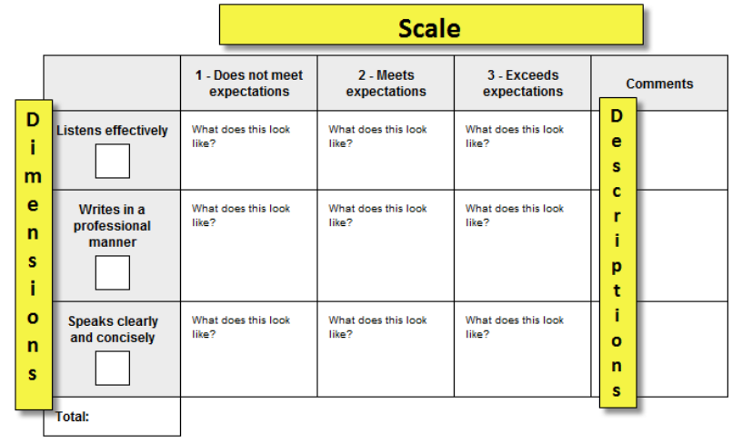
Creating a Rubric

Slide 29
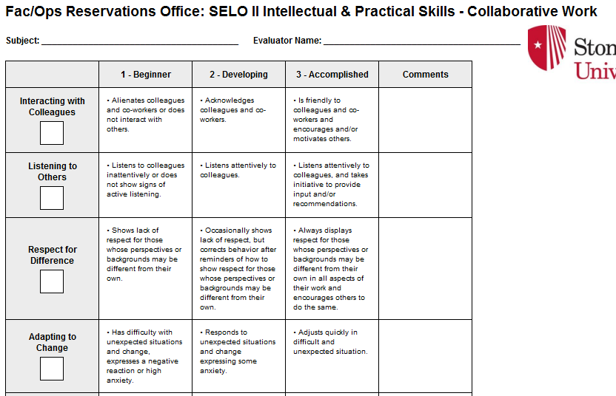

Slide 30
Comm Effectiveness Rubric for a Poster
 |  | Exceeds Competency (3 points) | Meets Competency (2 points) | Does Not Meet Competency (1 pt.)
Content | Introduction | Concisely described background information is logically related to hypotheses | Information is relevant but may be too wordy | Information is confusing or not clearly related to hypotheses
 | Method and Results | Easy to understand method and results | Describes method and results, but clarity could be improved | Difficult to understand methods and/or results
 | Discussion | Connects findings to other research, thoughtful description of implications or future research | Describes conclusions and future research, but may not connect to other research | Description of conclusions is confusing and implications are unclear
Style and Format | APA Format Citations | An occasional error, but demonstrates knowledge of rules | Minor errors in format, but cites appropriately | Major errors and/or missing citations
 | Syntax and Use of Language | An occasional error | Some errors (can be repeated) but not distracting | Errors make it difficult to understand
 | Style | Visually engaging, professional, neat, and organized | Info. is organized, but may be visually boring or crowded with too small font | Components are difficult to follow or hard to read, may look messy
Total Scores
15-18 Exceeds Competency
12-14 Meets Competency
8-11 Approaching Competency
3-7 Does Not Meet

Slide 31
Assessment Resources
Association of American Colleges and Universities (AAC&U) VALUE rubrics
  Intellectual and Practical Skills, including
    Inquiry and analysis
    Critical and creative thinking
    Written and oral communication
    Quantitative literacy
    Information literacy
    Teamwork and problem solving
  Personal and Social Responsibility, including
    Civic knowledge and engagement—local and global
    Intercultural knowledge and competence
    Ethical reasoning and action
    Foundations and skills for lifelong learning
National Institute for Learning Outcomes Assessment (NILOA)
Degree Qualifications Profile (DQP)

Slide 32
Activity #3: Assessment Plan
Pick 1 PLO and brainstorm a plan:
  What assignment or activity will you use?
  How will you score student achievement?
  What classes would you target for sampling and when?
  Which faculty will be responsible for coordinating data collection? Data analysis?
  How will you analyze the results? Will you disaggregate results in some way?
  How will results be shared, discussed, and used to make changes?
  When will the PLO be assessed again?

Slide 33
Step 4:
Collecting and Analyze Data

Slide 34
Dos and Don’ts of Data Collection and Analysis
DO
DON’T
Form a department assessment committee charged with regularly collecting and disseminating data
Ask for faculty volunteers
Give faculty early notice regarding assessment plans
Disaggregate results across time, populations, and outcomes
Protect the confidentiality and anonymity of students and faculty by examining results at the group level
Use results to inform changes
Ask for help at the last minute
Pressure faculty to comply with assessment activities
Use assessment results to call attention to individual faculty or students
Use assessment results to judge or punish faculty
Expect perfection
Collect more data than you can use

Slide 35
Step 5:
Discuss Results and Close the Loop

Slide 36
Closing the Loop: Strategies for Effective Use of Assessment Results
Present results at department meetings or retreats to stimulating faculty discussion on student learning and pedagogy
You might also:
  Present results to student groups or within key classes to engage students in their own learning
  Report results on the website to demonstrate student achievement or raise awareness of learning goals
  Seek input from alumni or employers to improve practices

Slide 37
Using Results to Create A Culture of Evidence
Use results:
  To examine skill development across the curriculum
  To examine curriculum content coverage and areas for program modification
  To improve instruction and introduce new pedagogies
    Contact CETL for resources and support
  To improve and refine your assessment process/methods

Slide 38
The 5-Year Assessment Plan
 | 17-18 | 18-19 | 19-20 | 20-21 | 21-22
PLO1 | Action plan and timeline
PLO2 |  | Action plan and timeline
PLO3 |  |  | Action plan and timeline
PLO4 |  |  |  | Action plan and timeline
PLO5 |  |  |  |  | Action plan and timeline

Slide 39
Comprehensive 5-Year Assessment Plan
I L O | P L O | S L O | Course where each SLO is assessed | Assessment activity/ assignment used to measure each SLO | Assessment tool used to measure outcome success | Assessment schedule – how often SLOs will be assessed | How data/ findings will be quantitatively or qualitatively reported | Designated personnel to collect, analyze, and interpret student learning outcome data | Program data/ findings dissemination schedule
 |  |  |  | Specify the embedded assignment such as oral pres., written exam, essay, etc. |  | Collect for each class & analyze every other year, etc.

Slide 40
Next Steps
What have you learned today that you want to share with others in your department?
Write down 1-3 you can do this semester to keep your assessment momentum going?

