Slide 1


AWS Project
Pasindu Siriwardena
California State University Los Angeles
Commonwealth Casualty Company
Team Members: Pasindu Siriwardena, Nancy Rosa, Saul Rugama, Luis Lucero, Junli Wang, Carlos Mendoza, Rongfeng Tan, Bryan Perez, Jesus Garcia

Slide 2
Pasindu Siriwardena
Advisor:
Dr.Jiang Guo
Graduate Advisor:
Jorge Sanchez
Liaison:
Mahan Hajianpour
Jeffrey Lipeles

Slide 3
Commonwealth
Casualty Company
Carlos Mendoza
Founded in 2010 with a commitment to provide affordable insurance to everyone.
Property & Casualty Insurance for
  Auto
  Homeowners
  Renters
  Roadside
Software internally developed and maintained by a small team of software engineers.

Slide 4
Objectives
Luis Lucero
Develop a document templating solution to enable dynamic document generation for policies. This solution will include:
  A Dynamic templating engine
  A user Interface to modify templates
  Ability to Version control templates
  Document comparison
  Amazon Web Services (AWS)

Slide 5
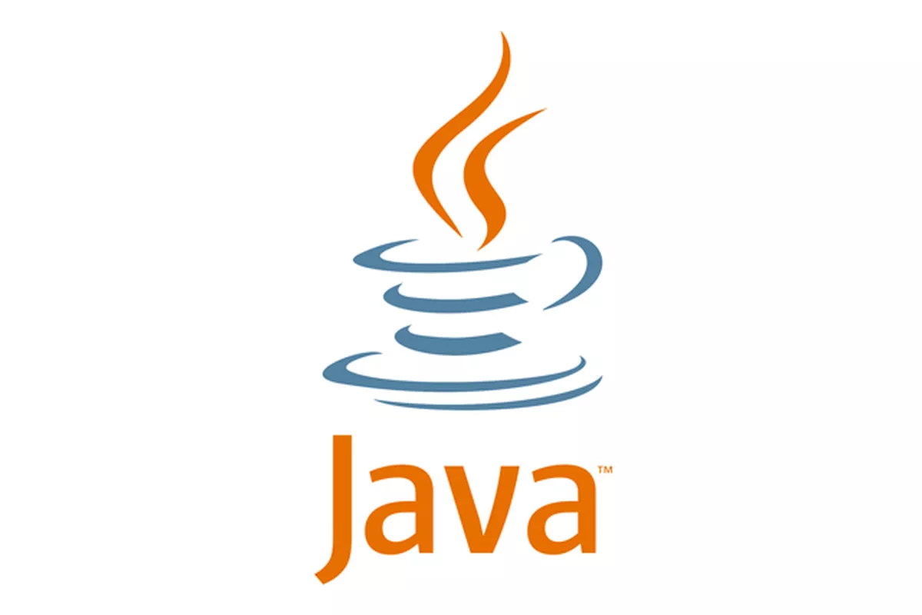


Technologies
Rongfeng Tan
Java
  Fast and powerful language
  The OOP design is very useful
  Easy to use imports
Spring Boot
  Easy to set up
  Dependency injection is very user friendly
  Integration with other frameworks are simplified
Pebble Templates
  Template Inheritance
  Easy-to-read syntax

Slide 6



Technologies
Rongfeng Tan
Discord
  Main form of communication
  Very user friendly
  Informal meetings with group members.
Trello
  Project management system
  Keep track of deadlines and assignments
  Notifications and reminders are very useful
Github
  Version Control
  Integration of Git into Eclipse
  Easy to use UX/UI Design

Slide 7
AWS Technologies
Pasindu Siriwardena
RDS
  A distributed relational database that is a running web service hosted on the cloud
EC2
  A web service that provides to run applications on virtual computers on the cloud
S3
  A simple object storage system that is accessible through a web service interface

Slide 8
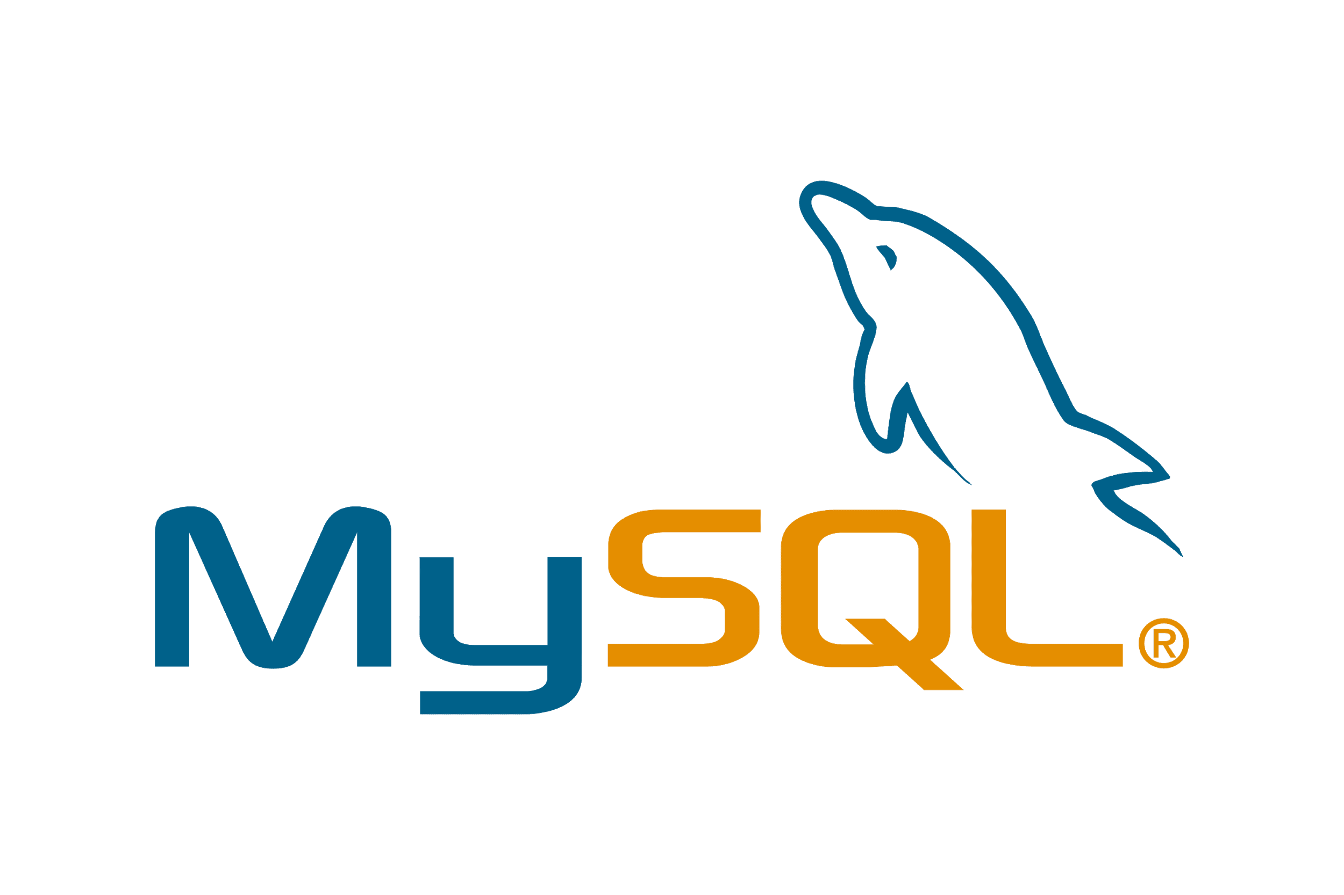


AWS Cloud Database
Jorge Sanchez
Local MySQL Database -> RDS Database
  Edits made to the local database, would be reflected in the cloud database
  RDS is version controlled by AWS
  Secure and efficient data storage

Slide 9
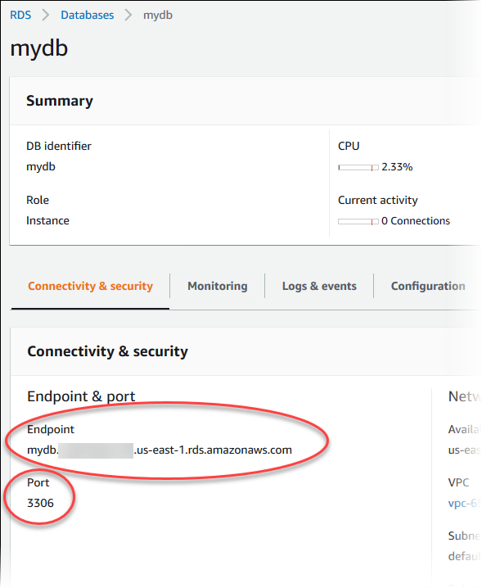
AWS Cloud Database
Jorge Sanchez
Features of RDS
  Auto scaling
  Set threshold
  Service health board

Slide 10
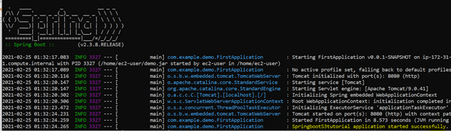
AWS EC2
Jorge Sanchez
EC2 Server for Cloud Computing
  Spring Boot application is currently running on an EC2 server that is deployed on AWS
  Server is scalable and provides an efficient connection to scale web applications
  EC2 allows our project to be accessed with proper credentials
Notes:
-EC2 server can be accessed remotely from anywhere
--Server is access through command prompt
-Need to turn the project into a jar file first and then upload the file to EC2
-the jar file is uploaded using a command scp and the key file to the EC2 server which is more secure
-inbound/outbound rules

Slide 11


AWS S3 Buckets
Carlos Mendoza
Amazon Simple Storage Service / Buckets
Version Controlling
Push or Pull
Date control - Action Control

Slide 12
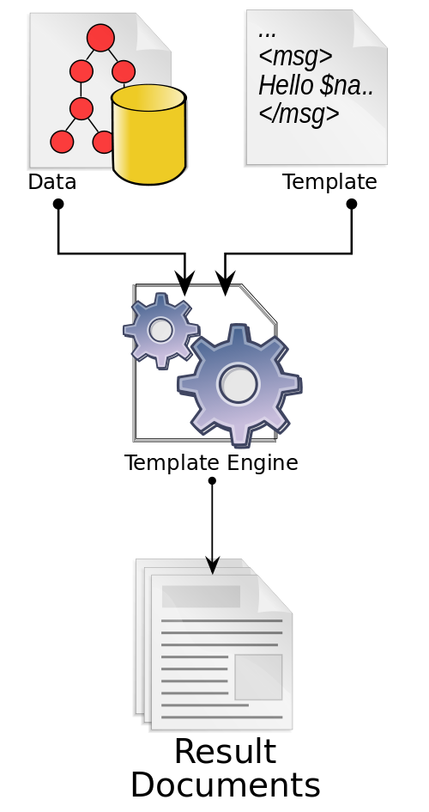

Pebble Templates
Carlos Mendoza
Java Templating engine
Full Featured / Easy to learn
Template Inheritance
Extensible Language

Slide 13
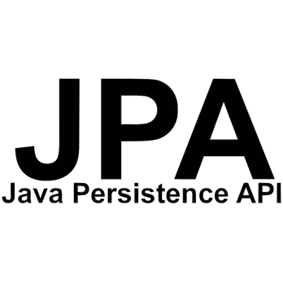
Relational Database and JPA
Nancy Rosa
Relational database stored in AWS cloud database
Java persistence API [JPA] is a collection of classes and methods used to persistently store data in a database
JPA is simpler, cleaner, and less labour intensive to use
JPA framework lets us avoid certain initializations, setups, connections and boiler plate code

Slide 14
Relational Database and JPA
Nancy Rosa
JPA entities are essentially POJOs
JPA entities represent a table stored in the database and every instance of the entity is a row in the table
Some JPA annotations used include:
  @table : defines that an entity should be used as a table
  @id: defines that an attribute should be used as a primary key
  @column : defines that an attribute should be used as a column
  @manytoone,@onetoone,@onetomany :allows for the appropriate relational mapping between entities
Based on the entities JPA will automatically map the info in the entities to a database to create the appropriate tables,keys, attributes and table relations

Slide 15
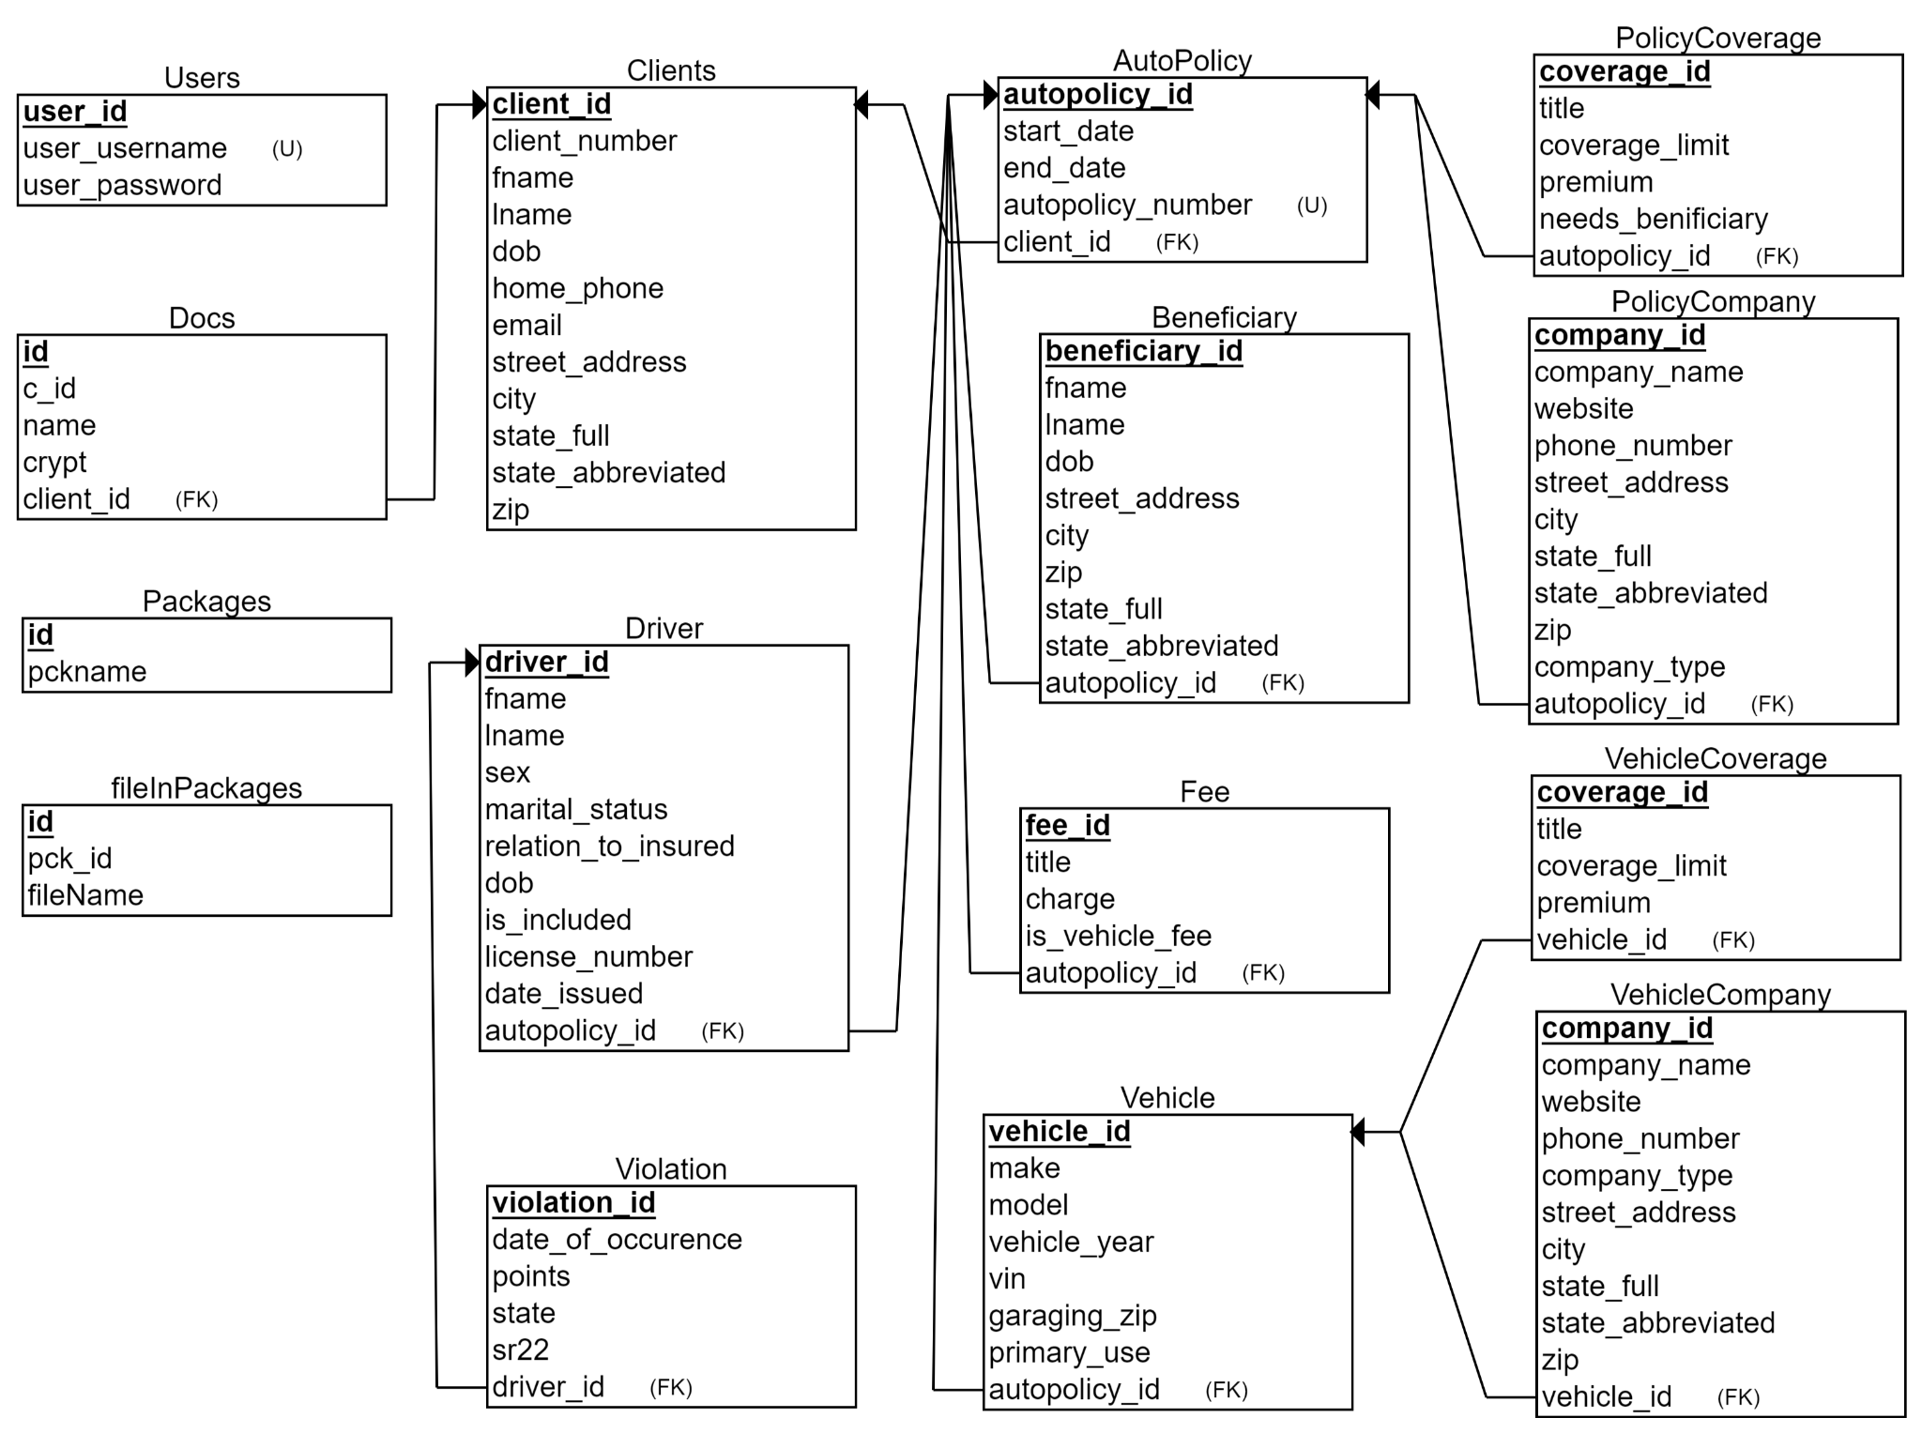
Relational Database and JPA
Nancy Rosa
Database Relational Schema

Slide 16
Spring Dependencies (Libraries)
Jesus Garcia
Spring-boot-starter-web
  Used for building web applications
  Very useful for Spring MVC
Pebble-spring-boot-starter
  Powerful templating engine
  Easy to integrate Spring Boot
Spring-boot-devtools
  Used to make development easier
  LiveReload function

Slide 17
Spring Dependencies (Libraries)
Jesus Garcia
Spring-boot-starter-mail
  Used for Spring Framework’s email sending support.
Spring-boot-starter-data-jpa
  Allows for the creation of data entities
AWS-java-sdk
  Enables use of AWS services in Java

Slide 18
Spring Dependencies (Libraries)
Jesus Garcia
Mysql-connector-java
  Used to connect to mySQL database
Itext7-core & Itextpdf
  Used to sign, merge and split pdfs
  Allows us to write pdfs in java
Html2pdf
  Used for converting html to pdf
  Can also convert css to pdf

Slide 19
System Features
Jesus Garcia
What can our application do
  Create/Edit/Delete templates and clients
  Generate documents based on client information
  Email service
    Send users basic emails
    Send users generated documents
  Convert templates to PDF

Slide 20
> Have Complete
> Data base
User
Junli Wang
User Input
AWS EC2 Server
Home Page
Template List
Update Template List
View/edit/add Template
module
Return Data
Inputs
Request/change Data
AWS RDS DataBase
AWS S3
Client List
Document save to Client
Return Data
Update Client Profile
Request/change Data
Email
Module
Client Profile
Save
Send customers emails
View/add Package
Save
View Template as PDF
Add Document to Client
View Client Document Draft
Select the Document

Slide 21
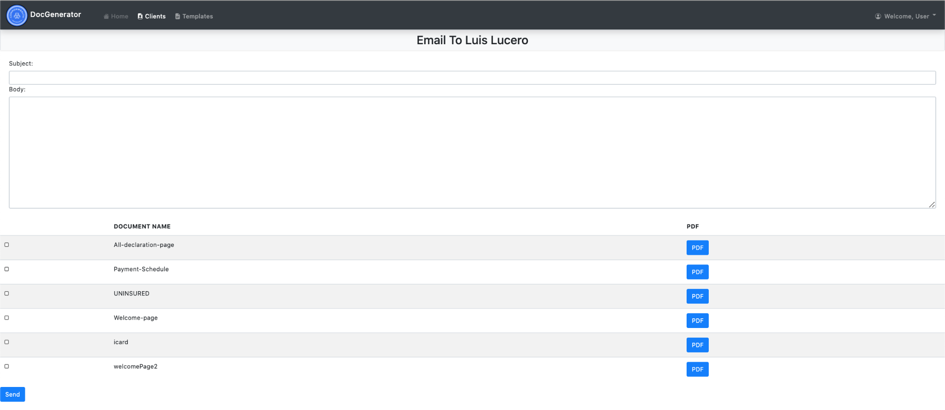
Emailing Feature
Luis Lucero
Aside from this project’s high level goals we have also integrated an emailing module.
This allows a client to be sent an email
  Can send basic emails with just subject and body.
  Uses a template that have been preprocessed which saves time.
  Documents can be attached to the email making it easier to keep clients informed on their new or updated policies.

Slide 22
Template Management Features
Luis Lucero
Comparison
  Allows for the comparison of templates
Template version control
  Uses version controlling based on S3
Template edit
  Allows for the editing of templates which will save the changes to S3
Template deletion
  Allows for the deletion of templates directly from S3
Template insertion
  Addition of new templates or packages of templates

Slide 23
Package Management Feature
Luis Lucero
Package consisting of document templates.
View Package
  View document templates in existing packages.
Edit Package
  Add document templates to existing packages
  Delete document templates in existing packages

Slide 24
Client Management Feature
Pasindu Siriwardena
Client View
  View a list of all client available in the database
Client Edit
  Edit basic client information
Client Delete
  Delete clients from the database
Client Profile View
  View individual client information
View Client Documents
  View individual clients documents as PDFs

Slide 25
What we learned
Pasindu Siriwardena
Technology
  AWS
    Combining the use of S3, EC2, and RDS
  Spring
    Base of our project
  Pebble
    The high level templating engine
Work as a team
  Communication
    Managing 10 members
  Deadlines
    Creating documents for this project on a timely basis
Job ready
  Built a full scale project with both a front-end and back-end

Slide 26
Team Members Contact Info.
Pasindu
  Email: psiriwa@calstatela.edu
Saul Rugama
  Email: rugamasaul@gmail.com
Bryan Perez
  Email:bryan0137@gmail.com
Carlos Mendoza
  Email:carlosmendo04@gmail.com
Luis Lucero
  Email: clucero3696@gmail.com
Nancy Rosa
  Email: nrosa2@calstatela.edu
Junli Wang
  Email: jwang136@calstatela.edu
Rongfeng tan
  Email: trongfe96@gmail.com

