Slide 1
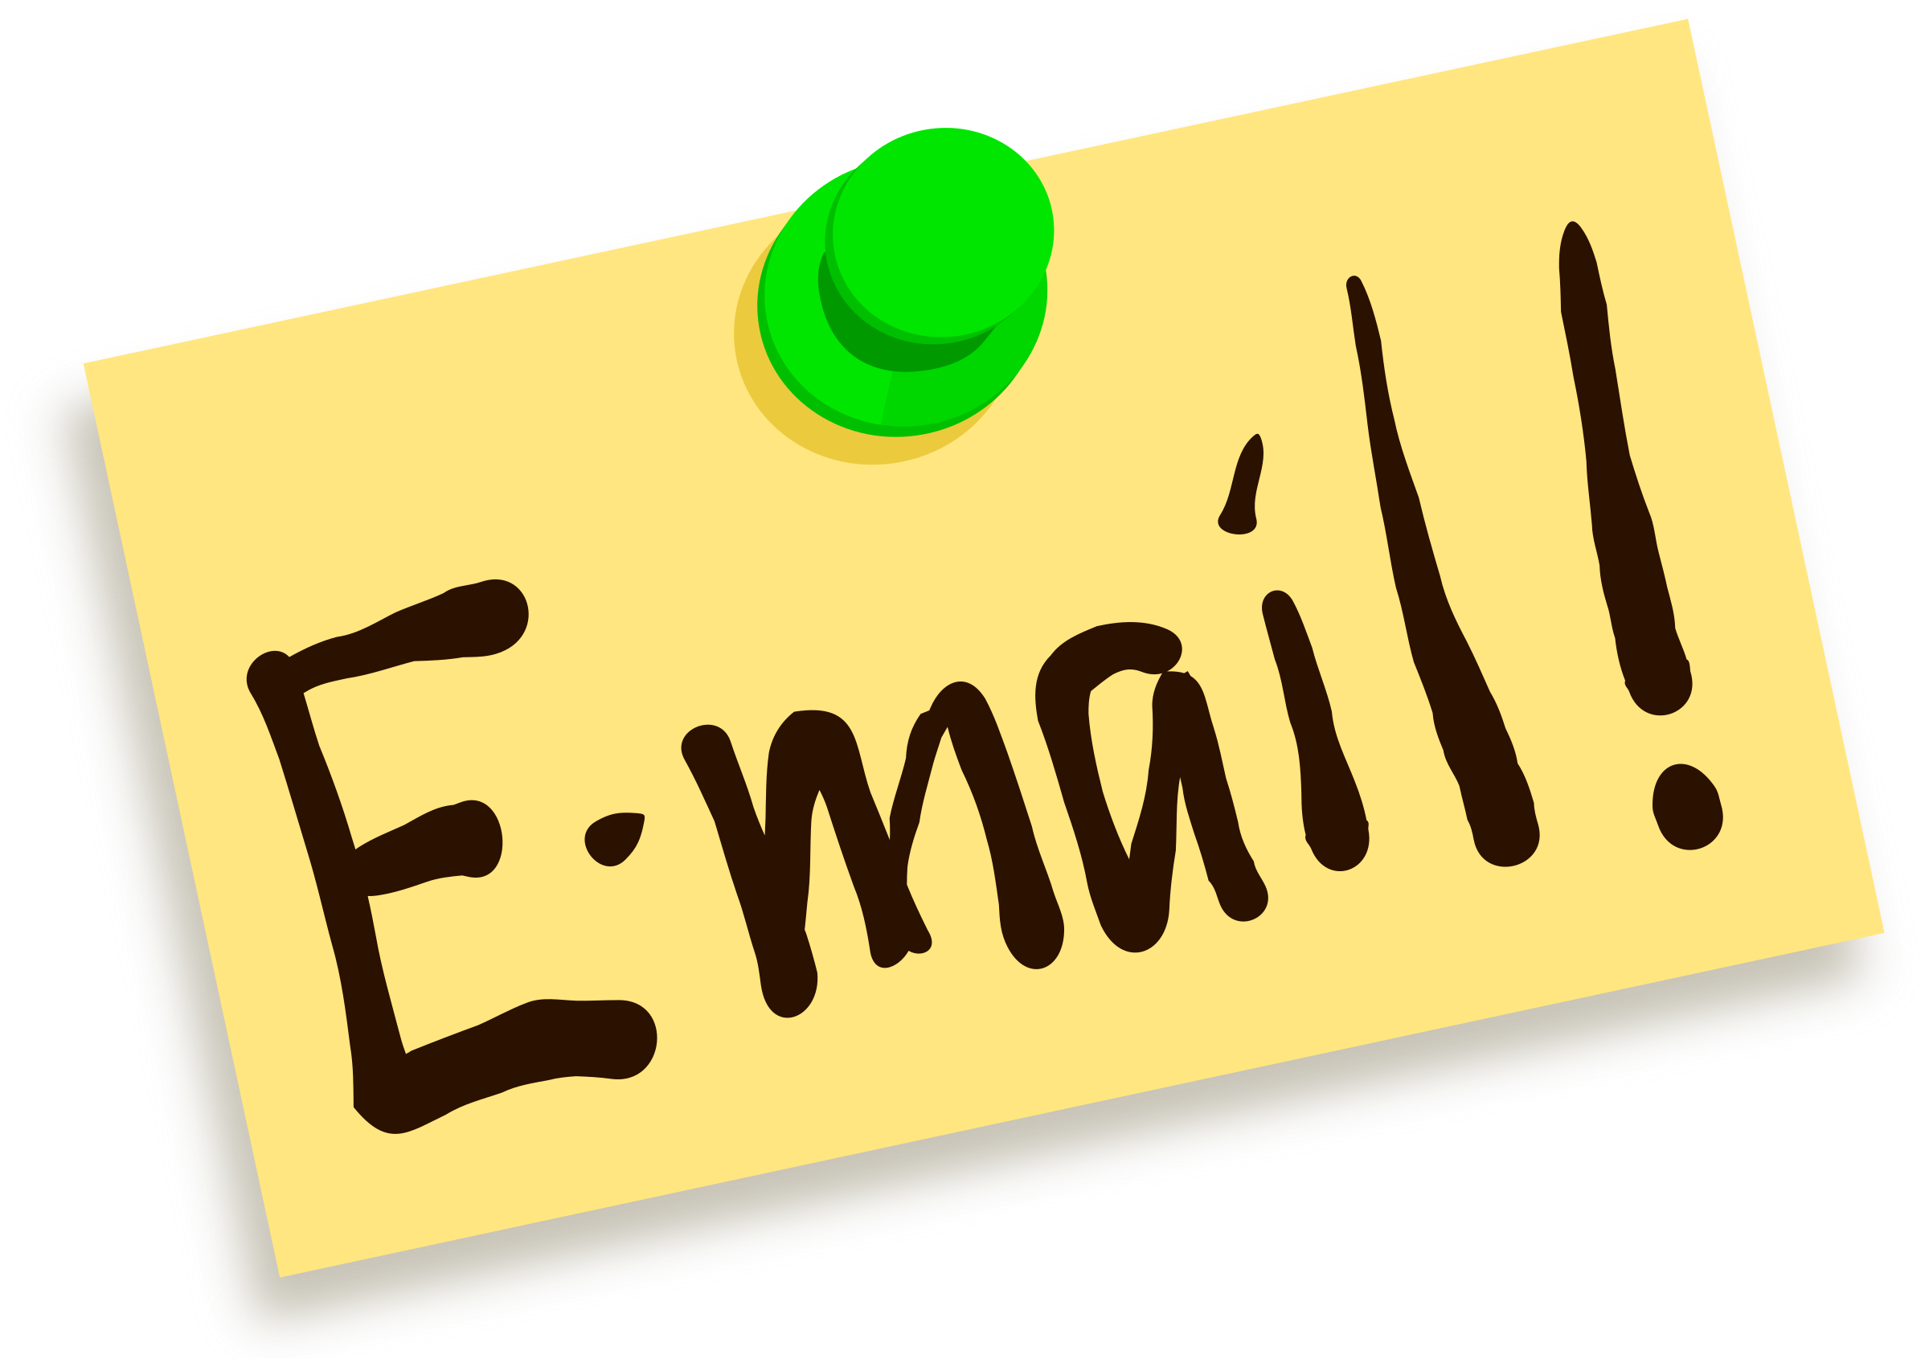


Email Etiquette for Business
Tips to represent yourself and your company well through email.

Slide 2
There is a problem.
There’s likely someone—a colleague, a client, or your boss—who is noticing your writing and, even worse, making a judgment of your professionalism based on it.
-Jenna (Britton) Arak from The Muse
Notes:
Tutor: This quote comes from Jenna Arak’s article in The Muse, “5 Business Writing Mistakes You Don’t Know You’re Making.” https://www.themuse.com/advice/5-business-writing-mistakes-you-dont-know-youre-making
The purpose of this slide is to start the conversation about an employee’s ethos. When emailing, a person represents themselves, their company, and their University degree.

Slide 3
We have a solution.
After this workshop, you will be able to:
Represent your company well when you write emails
Understand how to use the parts of an email
Write effective subject lines
Address someone professionally
Write concise emails
Communicate appropriately with an IT department
Close an email professionally
Avoid commonly misspelled words
Notes:
This is the slide with learning objectives.

Slide 4

Representing your company: Sending email
As an employee, you represent your company.
You are responsible for 1) representing your company and yourself to the best of your ability and 2) protecting the company information you send and receive via email.

Slide 5

Representing your company: Sending email, cont.
Emails sent to and from your work inbox are company files.
It is your responsibility to protect company files/data:
  Do not transfer large files between two offices using your personal cloud storage.
  Do not share work emails on social media.
  Do not forward your work emails to your personal email address.
    Your employer has access to your work email. Mixing work and personal emails blurs the lines between work and personal business.
Notes:
Tutor: “Remember that much or all of the writing you do at work is essentially public and that employers have access to email written by employees. As always, it’s best to use discretion and caution in all on-the-job communication” (Lunsford, 231).

Slide 6
When NOT to use email
Andrea Lunsford, author of The Everyday Writer, asks us to “consider your email messages permanent and always findable, even if you delete them. Many people have been embarrassed (or worse, prosecuted) because of email trails” (p.20).
  Do NOT use email when the information is better handled in person.
    Some ideas are better expressed in person, such as negative feelings about projects or performance reviews.
  Do NOT use email to relay confidential information.
    Email is not private. Do not include anything that you would not want someone else to read.
  Do NOT use email when you’re angry and want to vent.
    It’s better to give the issue some time before writing.

Slide 7

Quiz
No. It is not appropriate for an employee to email work files to their personal email address.
  Talk to your IT department so you can access your email from home using their secure Virtual Private Network (VPN).
Should I email work files to my personal Gmail address, so I can keep working from home?
Notes:
Facilitator should talk about how employees think they’re doing a laudable thing, but in fact they are NOT protecting the company. The last slides told us that work emails belong to the company.

Slide 8
Who are you writing to? Audience and Purpose
As a college student, you brainstormed. Brainstorming is a useful skill to use in the workplace.
Ask yourself these questions about your audience:
    Who am I writing to?
    How much background information do I need to provide on this topic?
    If I am writing to a group, are there people in the group with more experience/expertise than others?
Ask yourself these questions about your purpose:
  Why am I sending this email?
  What action do I want my reader to take? By when do I expect the action to take place? Give someone a deadline or target date.
  What information will my reader need in order to achieve my purpose?
Notes:
Tutor provide this tip:
Write your email on a Microsoft Word document first. That will allow you to brainstorm, draft, and revise before you send the email.
Brainstorming is a skill that continues into the workplace.
Think before you email. Recognize your emotions in writing. Don’t write emails if you frustrated or rushed; save it in the drafts. Leave sensitive issues for face-to-face meetings or a phone call.
Tutor: Foreshadow that you’re going to refer to BCC and CC line; Who am I going to talk to, who else needs to be in the know? Who else needs to know, but others don’t need to know they know.

Slide 9
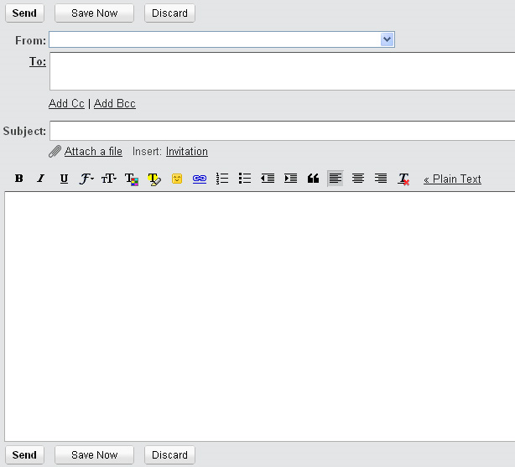
Parts of an email
From:
  Work emails should originate from a work address.
To:
  The address of the person or people you are sending the email to goes in this section.
Cc: (carbon copy)
  Everyone receiving the email sees these addresses.
Bcc: (blind carbon copy)
  Only you see the addresses in the Bcc line.
Subject:
  The subject line is akin to a book title; use it to get your reader’s attention. It should be pertinent to the email’s content and provide enough information that you (or the receiver) can search for your email in the future.
Attachment:
  Accurately name the file so it is easily searchable.
Body of the email:
  The main purpose of the email belongs here.
Notes:
Tutor: “emphasize that email is best used for exchange of information, clarification, and follow-up, rather than as a substitute for face-to-face dialogue. Students should understand that charged or sensitive topics are best addressed in person (or, if necessary, by phone). Further, an email message sent through a work address is usually considered company property and can easily find its way to more recipients than initially intended. I also discuss the volume of email most professionals cope with and the importance of brevity and using this medium sparingly. Finally, I highlight that students should be attuned to their co-workers’ communication styles and preferences, and use email in ways that conform to workplace norms.” and
“Students should understand the significance of including multiple people on a message and that cc’ing a colleague’s manager may escalate a situation unnecessarily. I also encourage students to indicate clearly if a message has multiple recipients (e.g. “Dear Joe, I’d like to introduce you to Jane (cc’d on this message”). This ensures that subsequent replies are suitable for all of the recipients.”
Tutor: If the topic of the Attachment comes up: “Detailed attachment names can also reduce frustration on the recipients’ part – a hiring manager will find it easier to find Jane Doe’s application in a sea of downloaded documents if it is named “JaneDoeInternApplication.pdf” (as opposed to “Final Resume” or “Acme Corporation Resume”).
This comes directly from Professional Communication: Teaching Students to Use Email Effectively by Dori Peleg Mazor: https://associationdatabase.com/aws/NCDA/pt/sd/news_article/94686/_self/CC_layout_details/true

Slide 10
Parts of an email: Subject line
Your subject line should be a clear, precise, and explicit reflection of the email’s content. | Examples:
Clear call to action for your audience. | Absence request for Thursday, March 25, 2021
Precise information provided. | Project development meeting Monday, May 4, 2020 from 10 to 11:30 a.m. in conference room 5
Explicit word choice. | Reporting error message after software update: Network Path Not Found
Notes:
A subject line should be pertinent to the email’s content and provide enough information that you (or the receiver) can search for your email in the future.
A good subject line will get the recipient to open your email.
The subject line should give me a snapshot of what the email is going to be about,
Tip: Consider writing your subject line after you have drafted your email.
Tutor: Please tell students never to email an IT department saying, “there’s something wrong with my computer.” IT departments need precise in formation, a picture of the error message if possible.

Slide 11
Quiz
 | Subject line examples
1 | RE: Hey!
2 | Here you go
3 | From tuesday
4 | Staff meeting notes from Tuesday, May 19, 2020 at 2 PM
5 | FW: Follow-up
Imagine you took meeting notes for your boss.
Which of these subject lines will make it easy for your boss to retrieve the notes at a later date?
Notes:
Tutor: Please give people time to think this question through.

Slide 12
Parts of an email: Body of the email
Most important information at the top
Backup or supplementary information
Extra info
Your first section should answer the following questions regarding purpose: Is an email the appropriate method of communication? Why am I sending this email? What action do I want my reader to take? Do I need to include a deadline?
Your second section should answer the question: What information will my reader need in order to achieve my purpose?
Your third section should include extra information, if pertinent. Keep your email to one or two topics.
Notes:
From Nancy Flynn’s The Business Writing Institute TM, page 35
Tutor: We are paralleling slide 7

Slide 13
Quiz
True!
The first one to two sentences should clearly state the purpose of your email.
True or False:
The first section of the email should tell the reader what you want them to do, what you want to inform them of, or what you want to give them.
Notes:
If your email is too long and hard to read, at best the message is lost and at worst the email won’t be read.

Slide 14
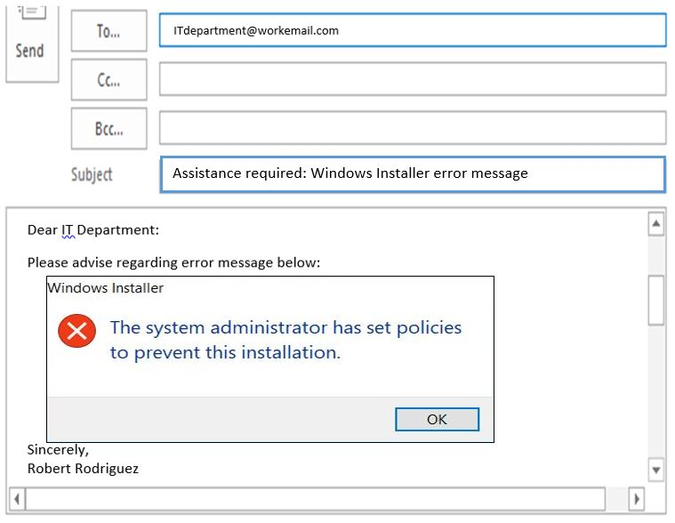
Body of the email: Communicating with your IT department
Always include a picture of the error message when communicating with IT.
Notes:
Tutor: “A key element of professional success is taking the perspective of others and making it as easy as possible for supervisors and co-workers to respond to emails in a timely way. Often this takes the form of doing initial legwork and providing key information up front. For example, an intern requesting supplies should include the prices and item numbers of the items she would like the office manager to purchase; most meeting proposals should include several possible dates/times; questions about specific projects should include key details about the client, timeframe, and the issue at hand; requests for IT support should include screenshots whenever possible. Taking the perspective of the email recipient, and considering his/her time constraints and competing priorities, can help all employees communicate efficiently and effectively. I tell my students repeatedly: make it easy for other people to help you.” From: Professional Communication: Teaching Students to Use Email Effectively By Dori Peleg Mazor: https://associationdatabase.com/aws/NCDA/pt/sd/news_article/94686/_self/CC_layout_details/true

Slide 15
Quiz
Help. My computer is broken.
Please advise regarding error message: Adobe Flash Installation Failure. (Insert picture of error message in the body of the email.)
Imagine you’re having troubles with your workplace computer.
What is the best subject line to use when emailing for IT support?

Slide 16
Body of the email: Greeting
Always use a greeting in your email.
Your greeting should match your audience.
  Use appropriate titles, such as Dr. or Professor.
  Opt for full names instead of Mr./Ms./Mrs./Miss
  Use a colon in formal business greetings.
Examples of formal greetings:
Dear Dr. Jackson:
Dear Ramesh Patel:
Dear John Smith and Carole Lim:
Dear Professor Reyes:
Notes:
Colon use (see LinkedIn article for informal period and/or comma):
The Everyday Writer says colons are used in salutations/greetings in formal letters. Pg. 442 has the example Dear Dr. Chapman:
Grammarly Blog says, “In business emails, the most formal way of ending a salutation is with a colon. So instead of “Dear Mrs. Johnson,” you should write “Dear Mrs. Johnson:” and then continue with the body of the message.” https://www.grammarly.com/blog/comma-rules-for-business-emails/
Business Writing Blog also says use colon in formal business writing: https://www.businesswritingblog.com/business_writing/2006/02/using_commas_wi.html
Don’t use a comma with Dear:
Grammarly Blog says Dear + Name means the salutation is composed of an adjective (Dear) and a name, and there’s no comma between the two.
Supported by: Linkedin article, Chicago Manual of Style 16th edition, Business Writing Blog, Grammar Girl, and The Everyday Writer
Use a comma with Hello:
Grammarly Blog says Hello + Name means the salutation is composed by a direct greeting (Hello) and a person’s name. So if you were to write “Good morning, Mrs. Johnson,” you’d have to place a comma between “Good morning” and “Mrs. Johnson.”
Supported by: Linkedin article, Chicago Manual of Style 16th edition, Business Writing Blog, Grammar Girl, and the Inc. article.

Slide 17
Greeting: First contact
First email contact should be formal in tone.
Dear Beatrice Yim:
……………………..
……………………..
……………………..
Sincerely,
Val Rodriguez
Review how the person signs off via email.
Hello, Val.
………………………..
………………………..
………………………..
Kind regards,
Betty
Now be informal.
Hi, Betty,
……………………….
……………………….
………………………..
Regards,
Val
Notes:
Tutor: “Do not use first names of people you do not know in correspondence (even in text messages) unless invited to do so. Note, however, that an invitation to use a first name could come indirectly; if someone signs a message to you with his or her first name, you are implicitly invited to use the first name as a term of address” (Lunsford, 280).
Tutor: “Unless the person has introduced him- or herself using a nickname or uses one in an email signature, stick to the full name.” From Inc. https://www.inc.com/business-insider/best-and-worst-email-greetings.html
Tutor: Also, look at the colon use from formal to less formal. Notice the shift from Beatrice to Betty—they are giving you permission to be informal.
Tutor: Reference no “Mr.” or “Mrs.” in the greeting. Gender neutral.

Slide 18
Quiz
Formal | Dear Dr. Jackson:
Familiar | Hello, Dr. Jackson. Hi, Andrea, Hi, everyone, Greetings, Hello, Andrea,
Inappropriate | Hiiieee Hi there Hey!
Formality is important when making a first impression. Arrange the following greetings from formal to familiar.
Hello,
Dear Dr. Jackson:
Hi, Andrea,
Andrea,
Greetings,
Hello, Dr. Jackson.
Hi, everyone,
Notes:
https://www.inc.com/business-insider/best-and-worst-email-greetings.html
See article for importance of knowing who you are addressing and why some greetings don’t work (e.g., good morning, hey, hi there, Mr. Xu, hi all, Ms. (first name))
Tutor: The formal doesn’t allow for personality. The familiar starts to allow one’s personality to come through, but there’s a limit as we’re still at work.
The “Inappropriate” column is never appropriate—especially when interacting with someone for the first time.
https://www.linkedin.com/pulse/email-salutations-formal-informal-comma-colon-kathleen-a-Watson
Kathleen Watson, known as The Ruthless Editor, says the following in her LinkedIn Learning article:
*If your email has a formal tone, use Dear and a colon at the end your email salutation. Dear Ms. Watson:
*If your email has an informal tone, insert a comma between the greeting and the name, and use either a comma or a period at the end of the greeting. Hello, Kathy, (followed by your message) or Hi, Kathy. (followed by your message)

Slide 19
Body of the Email: Closing
The closing of your email should be as formal as the opening of your email.
  Since your business email might be accessible to employers, it’s recommended that you do not include personal tag lines.
  Follow your company’s PR or email etiquette guidelines to create an official signature.
  Always include your name.
Professional closings:
Sincerely,
Best regards, / Kind regards,
Warm regards, (business thank you; familiar)
Thank you,
Best, / Regards, / Warmly,
Thanks, / Many thanks,
Hope this helps,
Looking forward to hearing from you,
Initials (frequent correspondence)
Notes:
Organized from Formal to Less Formal.
Tutor: Our company has an official signature template: http://www.calstatela.edu/brand/templates
Tutor: see this article for meanings and usage of closing: https://www.forbes.com/sites/susanadams/2013/09/27/57-ways-to-sign-off-on-an-email/#47abeb1c25d0

Slide 20
Checklist
Use email appropriately
    Should I email or call?
Check your tone
    Did I used a professional tone to address the recipient?
Review your subject line
    Is it precise and informative?
  Revise the body paragraphs in the email
    Is the purpose of the email clearly stated in the first couple of lines?
  Spell check
    Did I check for commonly misspelled words?

Slide 21
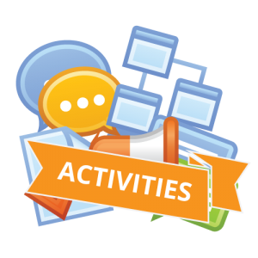
Review this email

Slide 22
Sample email
Dear all,
Sorry to send you this second reminder, but please, please, please just come to the planning meeting next week. As you all know we here at the YMCA have been working diligently to come up with great activities for our incoming cohort of students for this summer. This year I am pleased to inform you that we have approximately 120 new K-12 students joining the existing 400 YMCA members for this year!!! ☺
In preparing these new students for a worthwhile summer, we should be planning for a successful program. Attached you will find specific details regarding logistics, deadlines and FAQs for this year’s program.
Thank you for your continued support. I look forward to seeing you all in many—if not all—of the new 2019 summer program activities!
Oh, yeah…I hope this email finds you doing great and well rested from our three-day weekend!
Thank you,
Tracy
Notes:
TUTOR: Ask the students questions regarding the inverted pyramid. For example: Is the most important part of the email in the first paragraph? What the heck is this email about? Did Tracy give the audience all the information they need? Where’s the meeting? Where? What does Tracy sound like when they begins this email with “sorry”? What are people supposed to do with the attachments? What does Tracy sound like with a salutation to his team at the end.

Slide 23
Sample email
Dear all,
Sorry to send you this second reminder, but please, please, please just come to the planning meeting next week. As you all know we here at the YMCA have been working diligently to come up with great activities for our incoming cohort of students for this summer. This year I am pleased to inform you that we have approximately 120 new K-12 students joining the existing 400 YMCA members for this year!!! ☺
In preparing these new students for a worthwhile summer, we should be planning for a successful program. Attached you will find specific details regarding logistics, deadlines and FAQs for this year’s program.
Thank you for your continued support. I look forward to seeing you all in many—if not all—of the new 2019 summer program activities!
Oh, yeah…I hope this email finds you doing great and well rested after our three-day weekend!
Thank you,
Tracy
Notes:
What’s wrong with Tracy’s email? In this slide point out all the issues.
Dear all IS NOT WRONG, but there are better ways of addressing a group—especially if it’s a specific group.
Don’t beg. While some people say, never apologize, this instance makes it seem like you’re begging people to come to the meeting. You may want to mention to people that this is the second reminder but you may opt just to ask them to do something like “mark their calendars.” It will depend on who you are (aka your authority) in the group.
Avoid repetition and the word just.
TUTOR to emphasize that “next week” is too vague, have the students “book” this event in their phones or planners. Their inability to “book” this time should convince them that they need to write down days and times for efficient communication.
We should…again are you asking or telling? What’s the purpose of the email?
Attachments are great, but what is the person supposed to do with them? Specifically tell them if they need to be reviewed or read and returned.
Thank you in this position in the email is premature.
Check your syntax (and spelling)
Instance of “oh yeah” when creating a rough draft are hints that this section may need to be reorganized.
Check your signature. Is this the right time in the email thread when a casual signature should be used?

Slide 24
Sample email
Dear Summer Activities Team Members:
I hope this email finds you well rested after our three-day weekend. Please mark your calendars for our next planning meeting on Wednesday, March 3, 2019 from 10 to 11 a.m. in the conference room.
Attached you will find specific details regarding logistics, deadlines, and FAQs for this year’s program. Please read these items in preparation for the meeting.
I am excited to inform you that we have approximately 120 new K-12 students enrolling this year, for a total of 520 students attending our summer program.
I look forward to seeing all of you during the new 2019 summer program activities meeting.
Sincerely,
Tracy Robertson
Summer Program Coordinator, YMCA
Notes:
TUTOR: Please compare and contrast this new draft. HOW does the inverted pyramid parallel the information in this email? Focus on the greeting, the body, and the closing. Note: The word “oh,yeah” has been deleted.
Tutor: If you have time, talk about how to name the files. Example: “Summer 2020 program logistics.doc” (Note: Word documents tend to be more accessible than PDFs.)
Tutor: Please refer to “from 10 to 11 a.m.” Use the “to” when using “from.” OR use a comma and a hyphen, for example: Wednesday, March 3, 2019, 10-11 a.m.

Slide 25
Grammar rules
Notes:
Tutor: “Business writing tends to use conventional formats and to follow the conventions of standard written English. When you write to employers or prospective employers, stick to more formal communication unless you have a very good reason to do otherwise” (Lunsford, 231).

Slide 26
Compound structures (when a pronoun and noun are grouped together)
Incorrect | Fix-it tip | Correct
When him and Brian worked on the project, they were junior engineers. | When him and Brian worked on the project, they were junior engineers. | When he and Brian worked on the project, they were junior engineers.
The boss invited she and her family to dinner. | The boss invited she and her family to dinner. | The boss invited her and her family to dinner.
Bob and me are going on vacation. | Bob and me are going on vacation. | Bob and I are going on vacation.
Notes:
From Writing Effective Email page 79
Tutor: “When a pronoun is part of a compound subject, complement, object, or appositive, put it in the same case you would use if the pronouns were alone.” See page 385 in Lunsford.
LinkedIn Learning has many writing videos. Participants interested in life-long learning should access those videos.

Slide 27
Capitalization
Incorrect | Correct | Rationale
The City of Pasadena hosted 200 Doctors of Internal Medicine. | The City of Pasadena hosted 200 doctors of internal medicine. | The “City of Pasadena” is a proper noun, but “doctors of internal medicine” describes a job.
The Engineers are waiting for the latest report to be sent to them by the Regional Manager of Sales David Roy. | The engineers are waiting for the latest report to be sent to them by the Regional Manager of Sales David Roy. | The word “engineers” is a job category that is used in place of a name or group, but “Regional Manager of Sales” is the person’s actual job title.
Notes:
The Purdue OWL, Writing Effective Email by Nancy Flynn, and The Everyday Writer say Titles preceding names should be capitalized, but not titles that follow names
Capitals before the name
Purdue OWL: She worked as the assistant to Mayor Hanolovi.
Writing Effective Email: The upcoming conference will be the responsibility of Human Resources Director Mary Smith.
The Everyday Writer: Chief Justice Roberts
No caps after the name
Purdue OWL: I was able to interview Miriam Moss, mayor of Littonville.
Writing Effective Email: The upcoming conference will be the responsibility of Mary Smith, human resources director.
The Everyday Writer: John Roberts, the chief justice

Slide 28
Commonly misspelled words
Its, It's | Than, Then | Their, There, They're
its = possessive adjective (possessive form of the pronoun it): The presentation was impressive in its scope. | Than=used in comparison statements: She took more notes than I. Than=used to suggest quantities beyond a specified amount: Sleep more than four hours a night. | Their = possessive pronoun: Companies want their employees to have good writing skills.
it's = contraction for it is or it has (in a verb phrase): It's important to know that I should use a short and explicit subject line when emailing; it’s been an eye-opening presentation. | Then=a time other than now: Back then, I didn’t know these handy tips. Then=next in time, space, or order: I’m going to write first; then I’m going to revise. Then=suggesting a logical conclusion: If I think about the main purpose of the email, then I’ll be able to write more effectively. | There = that place: Taking quizzes here and there during the presentation kept me engaged.
 |  | They're = contraction for they are: They're going to be impressed by my writing skills.
Notes:
The definitions come directly from Purdue OWL from the Grammar section titled, Spelling: Common Words that Sound Alike. https://owl.purdue.edu/owl/general_writing/grammar/spelling_common_words_that_sound_alike.html

Slide 29
Word choice
Opt for formal word choices | Rationale
Spell out all words: spell “you” instead of typing “u” | Your audience may think you are sloppy.
Avoid slang | Your audience may think you are unprofessional.
Use appropriate titles for your supervisors and colleagues | Your audience will appreciate your professionalism.
Avoid gendered language when referring to a person, such as “businessman,” or when greeting groups of people, such as “Hi, Guys.” | Your company may encourage the term “businessperson.” When greeting a group, consider: “Hi, Everyone.” “Hi, Team,” “Hi, Staff.” “Hi, All,” “Hi.”
Use preferred pronouns. | Your respect of another person’s preferred pronouns is expected.
Notes:
Tutor: “Choose a level of formality for your audience and purpose” (Lunsford, 290).

Slide 30


Continue to explore this topic with more resources
Notes:
Tutor: Tell students that both Grammarly and LinkedIn Learning are available for free through Cal State LA.
Tutors who present this PPT will be required to take a LinkedIn Learning course on business etiquette.

Slide 31
Resources used
Books
The Everyday Writer, Cal State LA edition, by Andrea Lunsford, pages 19-20, 231, 280-290,267.
Writing Effective E-Mail by Nancy Flynn
University Resources Online
Purdue OWL (Online Writing Lab)
Humboldt State University: “Email Etiquette for Technical Communication”
Online Resources
Business Writing Blog: Using Commas with Names and Greetings
Grammar Girl: Dear Comma
Grammarly Blog: Comma Rules for Business Emails
Forbes: 57 Ways to Sign Off on an Email.
Inc: The Single Best Way to Start an Email—and 18 Greetings that Will Immediately Turn People Off.
LinkedIn: Email Salutations: Formal or Informal? Comma or Colon?
National Career Development Association: Professional Communication: Teaching Students to Use Email Effectively
The Muse: “5 Business Writing Mistakes You Don't Know You're Making”

Slide 32
Thank you
for your participation

