Slide 1
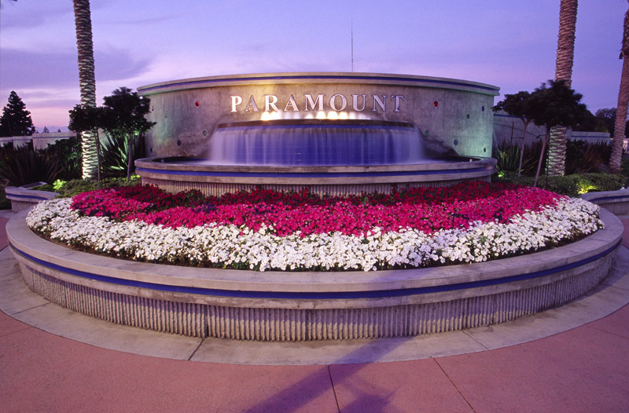
Homeowners associations in paramount
Erika Estrada
Dr. Lynch
November 30, 2017
Notes:
NOTE:
To change the image on this slide, select the picture and delete it. Then click the Pictures icon in the placeholder to insert your own image.

Slide 2

Background
City
HOAs
Los Angeles County, CA
Compton, Lynwood, South Gate, Downey, Bellflower, and Long Beach
General Law City → Council/Manager form of government
Five council members elected at larger
Population → 54,100
  Predominately Spanish Speakers
City has lost communication
Too many citizen calls regarding concerns and complaints
Objective:
    Identify HOAs within city limits
    Identify which HOAs are defunct
    Create a pamphlet

Slide 3
Proposed Changed Conditions
Educate Citizens
Translate information

Slide 4
Examination and Determination
Difficulty finding Information

Slide 5
Course of Action
Option 1
Index on City website
Easier public access
Less City involvement
Option 2
Informative pamphlet
Understand rules and regulations
Access through City website
Option 3
Series of HOA awards
Promote productivity
Option 4
Newsletters
Up-to-date information
Free advertisement
Current events
Civic participation
HOA information
Printed Copies
Civic Participation

Slide 6
Fiscal Impacts
Option 1
Index on City website
Option 2
Informative pamphlet
Series of HOA awards
Promote productivity
Option 4
Newsletters
Primary source: online access, reduces cost
Collaborate with non-profits and local businesses
IT employee
Intern (Computer Science)
Reusable awards
Partner with local colleges (El Camino College Compton Center, Cerritos College, Cal State Dominguez Hills)

Slide 7
Team Dynamics

Slide 8
Successes
Different strategies
Team Work
Real Estate Agent
Responsive HOAs
Research
Work independently

Slide 9
Breakdowns
Team
Case Study
Extremely demanding
Communication
Time
Human Resouces

Slide 10
Lessons Learned
Personality
Immediately connected
Respect
Rising above any conflict
Communication
Provided solutions
Suggestion
Closer radius

Slide 11
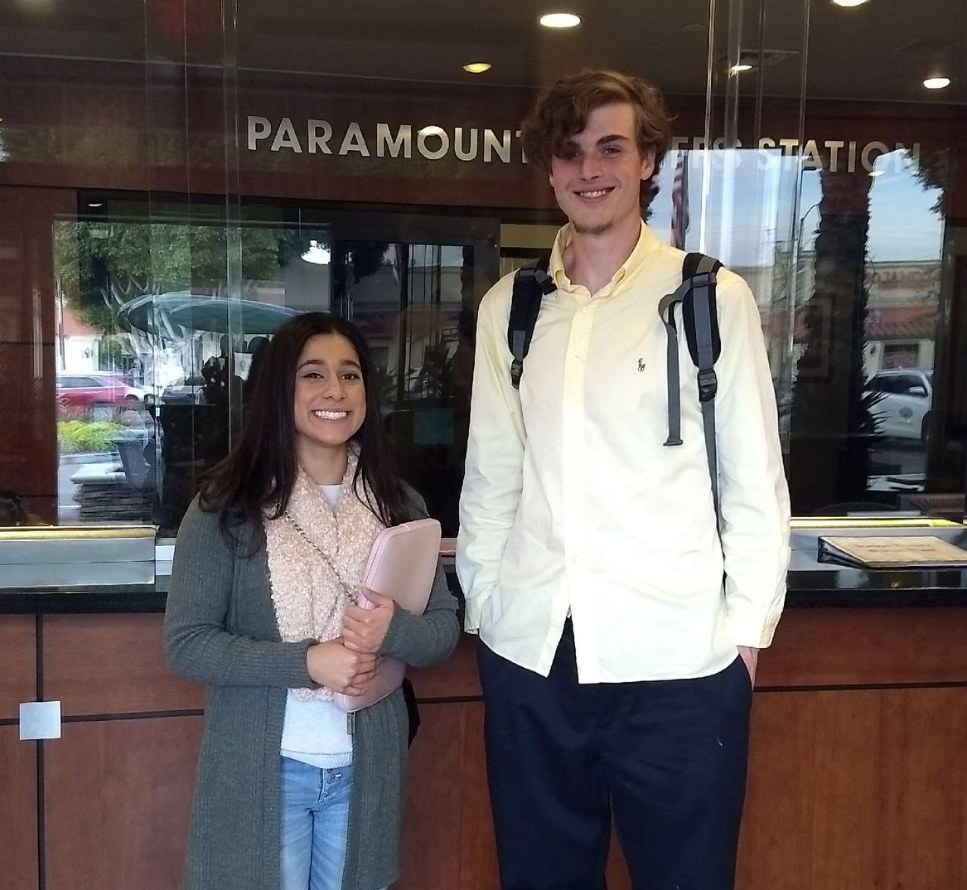
Questions?

