Slide 1
Welcome to ABACC 2015 Staff Development
Run down of todays plans
Introductions of new and returning staff
Recent changes (Mulberry Room)
DRDP Training
Classroom prep or meetings

Slide 2
Ice Breaker Human Bingo
B | I | N | G | O
1 Play a musical instrument | 2 Never had a car accident | 3 Knows how to ballroom dance | 4 Knows how to knit or crochet | 5 Have competed in 10K
6 Have taken a mud bath | 7 Has worked at ABACC more than 3 years | 8 Native California | 9 Born a military brat | 10 Has never had a speeding ticket
11 Traveled over seas | 12 Has worked infant and preschool at ABACC | 13 FREE | 14 Have had a broken limb | 15 Has a tattoo
16 Can juggle | 17 Is ambidextrous? | 18 Has eaten snails | 19 Has green eyes | 20 Has a pet

Slide 3
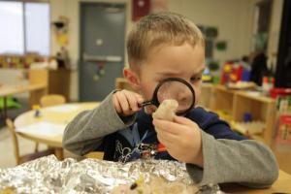
Training Agenda
Overview of the DRDP
DRDP (2015): What’s the same/What’s new?
Professional Development and Resources Available
Notes:
Go over the agenda.

Slide 4
Outcomes
Learn about the DRDP (2015) including identify similarities and differences between the DRDP (2010) and DRDP (2015).
Learn about DRDPtech and how the results can be used for planning purposes.
Identify online resources to support implementing DRDP (2015).

Slide 5
DRDP (2015) What’s It All About?
Notes:
Welcome to the DRDP (2015) session.
You will be introduced to the new DRDP (2015).
Have everyone get handouts as they enter.

Slide 6
Overview of DRDP (2015)
Notes:
This presentation will be posted on the Desired Results Web site as a resource for administrators to train their staff on the DRDP (2015) at the end of April 2015
Ask your staff:
What do they already know about DRDP 2015?
What do they want to know?
You can chart these responses

Slide 7
What is the DRDP?
Individual child assessment
Observation-based assessment tool
Based in developmental research and theory
Includes developmental sequences of behavior
Based on ongoing activities and routines in the early care and education setting with familiar adults
Notes:
Observation is the foundation of the DRDP (2015) assessment instrument.
It is NOT a test.
Not a checklist
Not a right or wrong list
Authentic assessment is a recommended practice and includes the ongoing documentation of what children are able to accomplish. California has consistently pulled researchers together to write what typical development looks like based on the research, then complete research studies to ensure the instrument reflects development and get feedback from teachers.This is a very stringent process that California has followed to ensure a quality instrument that is valid and reliable.

Slide 8
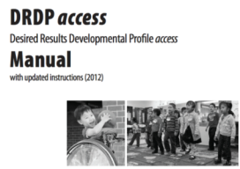
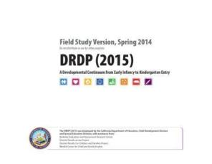
DRDP (2015) Implementation in 2015
Notes:
Currently there are three assessments used for children before kindergarten entry.
The DRDP-IT and the DRDP-PS are aligned to the Early Learning and Development System. Children with IEPs receive two assessments the ACCESS and the age appropriate instrument.
The DRDP 2015 replaces these three instruments.
.
Effective fall of 2015, the DRDP 2015 is required of all EESD programs and Special Education Programs and it is required for all children with an IFSPs and IEPS. (new contract year 2015-16).

Slide 9
Notes:
The DRDP aligns with the:
Infant and Toddler Early Learning and Development Foundations
Preschool Learning Foundations, Volumes 1-3
Common Core Standards
Head Start Child Development and Early Learning Framework
Now let’s look at the instrument in more detail…

Slide 10
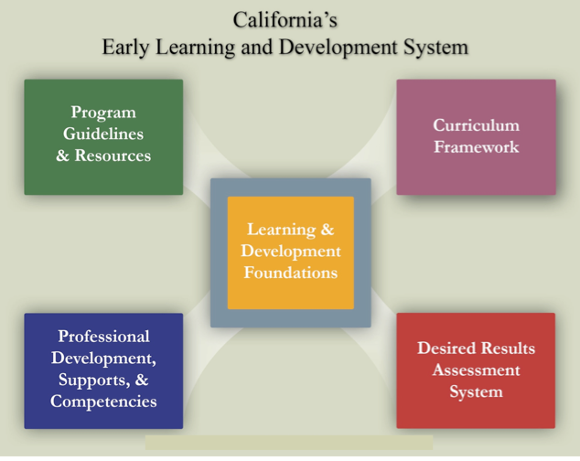
2010 © California Department of Education
Desired Results T & TA Project
10
Notes:
10
HO: CAELDS AND IMPLEMENTATION GUIDE
This is the CAELDS. We are familiar with how all the components fit together and support what we know is appropriate for early childhood.
As an administrator, are you able to find all the resources needed within each component?
Let us start with the DR assessment system. There is an implementation guide in your folder (it can also be found on the Web site) to help administrators and their staff embed the DR system in to their programs.
On the DR Web site, there are resources for administrators to use with their staff. Under the regional training link http://www.desiredresults.us/trainings_regional.htm, there are activities to conduct with your staff as you train them on observation an the DR process.
We will talk more about resources as we go throughout the day

Slide 11
What’s new in the DRDP (2015) ?
Domains
Developmental levels
Measure names
Number of measures completed for each age group
Notes:
The DRDP (2015) includes new domains not previously assessed.
Given the continuum from birth through age five, new developmental levels have been added.
New measures have been developed both in the new domains and the existing domains.
The number of measures will differ from the existing DRDP instruments due to the new domains and the developmental continuum.
There are more changes for special education assessor, e.g., the page orientation is now horizontal, and the developmental levels are named and not numbered.
Trainer note: Participants are familiar with these terms, but there are additions to each category. The number of measures completed depends on the age of the child being assessed.

Slide 12
The DRDP (2015) Instrument
Create a single DRDP instrument for all children infancy to kindergarten entry — typically developing and special needs
Add domains for all of the Early Learning Foundations (I/T & Preschool Vol. 1 – 3 )
Comply with federal reporting requirements for the Special Education Division
Align to Head Start Early Learning Framework
Notes:
Purpose behind DRDP (2015):
The DRDP (2015) represents a full continuum instrument to assess all children from early infancy to kindergarten entry including children with Individual Family Service Plans (IFSP) and Individualized Education Programs (IEP).
The DRDP (2015) provides one single instrument in place of the three. It is aligned to infant toddler foundations, preschool foundations, Common Core and Head Start Early Learning Framework.

Slide 13
DRDP (2015) Domains
Approaches to Learning—Self-Regulation*
Social and Emotional Development*
Language and Literacy Development*
English Language Development
Cognition, Including Math and Science*
Physical Development—Health*
History—Social Science
Visual and Performing Arts
Notes:
These are the domains of the DRDP (2015). There are some new domains, such as Approaches to Learning--Self-regulation.
Some of the domain names have changed slightly, and some have been combined. The DRDP (2015) for use with infants and toddlers includes only the domains listed with an asterisk.
Preschool teachers will notice that there are two additional domains from Volume 3 of the California Preschool Learning Foundations --Visual and Performing Arts and History-Social Science.
The measures in the Visual and Performing Arts, History-Social Science, and the English Language Development domains pertain to preschool aged children.

Slide 14
Developmental Levels
The full-range of developmental levels on the DRDP (2015) includes the following:
Responding (Earlier, Later): Generally, knowledge, skills, or behaviors observed during early infancy
Exploring (Earlier, Middle, Later): Generally, knowledge, skills, or behaviors observed in later infancy, toddlerhood, and early preschool
Exploring Later/Building Earlier: Generally, knowledge, skills, or behaviors observed in later toddlerhood and early preschool
Building (Earlier, Middle, Later): Generally, knowledge, skills, or behaviors observed in preschool
Integrating Earlier: Generally, knowledge, skills, or behaviors observed in late preschool and early kindergarten
Notes:
All infants will not be at Responding Earlier, but this chart gives a gauge of each developmental level and the age range it may cover. This can also be found inside your DRDP on page iv.

Slide 15
DRDP (2015) Continuum of Developmental Levels
Continuum from earlier to later levels of development
Notes:
The full range of developmental levels on the DRDP (2015) goes from responding to integrating. Throughout the instrument, the number of levels for each measure can vary depending on the competencies that are appropriate for that measure.

Slide 16
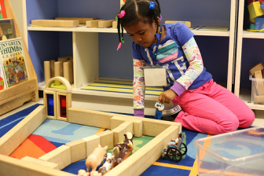
DRDP (2015): A Full Continuum Instrument
The DRDP (2015) represents a full continuum instrument to assess all children from early infancy to kindergarten entry including children with Individual Family Service Plans and Individualized Education Programs.
Notes:
The instrument consists of a full continuum representing development from early infancy to early kindergarten. There is also the DRDP-K for children in transitional kindergarten or kindergarten.

Slide 17
Accommodating the Range of Abilities
Accommodate the development of almost all children in the age range:
Each measure was created to prevent ceiling or floor effects.
Preventing a floor effect: The earliest level of development on the continuum begins a little earlier than what would be expected for most children assessed by the instrument.
Preventing a ceiling effect: In the developmental continuum, the latest level is beyond the development of what would be expect of most children assessed by the instrument.
Notes:
The DRDP has been created to prevent both the floor and the ceiling effect. In other words, all infants are not expected to be at Responding Earlier and all preschoolers are not expected to be at Integrating Earlier. It depends on each individual child and the teacher must review and reflect on their documentation before rating a measure.

Slide 18
Three Types of Measures
Full Continuum Measures consist of 7-9 levels that describe development from early infancy to early kindergarten.
Earlier Development Measures consist of 5-6 levels that describe development that typically occurs in the infant/toddler and early preschool years.
Later Development Measures consist of 6 levels that describe development that typically occurs in the preschool years and early kindergarten.
Notes:
There are three types of measures. This is a new part of the DRDP 2015.
Full continuum measures are in both views of the assessment.
Earlier Development measures are in both views of the assessment.
Later Development measures are only in the preschool view of the assessment.
Let’s look at the different types.

Slide 19
Full Continuum Measures
Notes:
Have participants turn to PD HLTH 1.
This is a full continuum measure. Full continuum measures provide behaviors and skills on a continuum from early infancy to kindergarten entry and it is inclusive of children with special needs.
In the preschool view all of the developmental levels are an option for rating.

Slide 20
Full Continuum Measures Continued…
Notes:
This is the full continuum measure in the infant/toddler view. The last few developmental levels are not a rating option in the infant/toddler view. The last few developmental levels are late preschool to early kinder skills so they do not apply to infant and toddlers.

Slide 21
Earlier Development Measures
Notes:
Participants turn to ATL REG 1
The earlier development measures consist of 5-6 levels that describe development that typically occurs in the infant/toddler and early preschool years. There are no later levels for this measure because the developmental continuum does not extend further. If a preschool-aged child is beyond the latest developmental level on this measure, there is an opportunity to mark that when rating. These measures are aligned to the Infant toddler foundations. However preschool teachers may very well have a preschool aged child that is still working in the skills in these measures.
There are 4 earlier development measures:
Attention Maintenance
Self-comforting
Spatial relationships
Imitation

Slide 22
Later Development Measures
Notes:
Participants turn to ATL REG 5
The later development measures consist of six levels that describe development that typically occurs in preschool years and early kindergarten. The reason there are no earlier levels for this measure is because the developmental continuum does not begin any earlier. However preschool teachers who have children who are not at the earliest developmental level on this measure will have the option to mark child is not at the earliest developmental level on this measure.
Later development measures are only in the preschool view of the assessment. There are no later development measures in the infant toddler view.

Slide 23
DRDP (2015) Navigation Map
23
Notes:
This navigation map of one measure covers the full developmental continuum of early infancy through five years of age.
Domain: The domain is listed at the top left and bottom right. A domain represents an essential area of learning and development for young children.
Measure: A measure describes a specific competency along a continuum of developmental levels. Each domain consists of a set of measures. ( in DRDP 2015 the measures are numbered within the domain)
Definition: The definition of a measure specifies the aspects of development being observed.
Developmental Level: Each developmental level specifies a point along the continuum that ranges from earlier to later levels of development. (the number of developmental level depend on that specific measure)
Descriptor: Each descriptor identifies knowledge, skills, or behaviors that are observed at a specific developmental level along the continuum.
Example: Examples illustrate the descriptors. An example is one of many possible ways a child might demonstrate knowledge, skills, or behaviors.

Slide 24
DRDP (2015) Navigation Map
Domain
24
Developmental Level
Definition
Measure
Descriptor
Example
Notes:
This navigation map of one measure covers the full developmental continuum of early infancy through five years of age.
Domain: The domain is listed at the top left and bottom right. A domain represents an essential area of learning and development for young children.
Measure: A measure describes a specific competency along a continuum of developmental levels. Each domain consists of a set of measures. ( in DRDP 2015 the measures are numbered within the domain)
Definition: The definition of a measure specifies the aspects of development being observed.
Developmental Level: Each developmental level specifies a point along the continuum that ranges from earlier to later levels of development. (the number of developmental level depend on that specific measure)
Descriptor: Each descriptor identifies knowledge, skills, or behaviors that are observed at a specific developmental level along the continuum.
Example: Examples illustrate the descriptors. An example is one of many possible ways a child might demonstrate knowledge, skills, or behaviors.

Slide 25
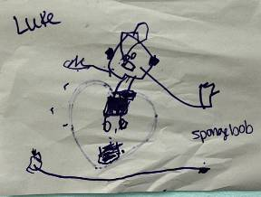
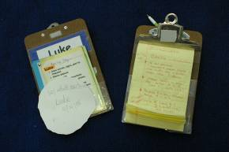
Collected documentation includes:
Anecdotal notes
Photos
Work samples
Other evidence of knowledge and behaviors
Notes:
Teachers collect a substantial number of anecdotal notes, photos, work samples, and other pieces of documentation that demonstrate the children’s mastered developmental levels. The organization of collected documentation can be achieved through “portfolios.”
Clarify that the intent is not to “test” children.

Slide 26
Still Photo Observation
Adapted by permission, The Art of Awareness © 2000 Deb Curtis and Margie Carter, Redleaf Press. St. Paul, Minnesota, www.redleafpress.org.
Notes:
Trainer note: Keep this slide up during the activity.

Slide 27
Definitions: Descriptive and Interpretive
Descriptive
Interpretive
What are the specific details?
What you actually…
Observed
Read
Heard
Example: He is holding shirt with one hand and pen in other hand.
What were your initial reactions?
How you felt about what you…
Observed
Read
Heard
Example: He looks worried
Notes:
This is a reminder of what quality notes have.

Slide 28
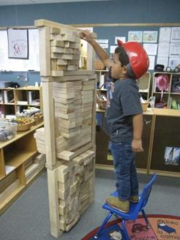
Build A Structure
Use the items on your table.
As a group, build a structure.
You have 5 minutes.
Report back to the group
Notes:
Refer to DR-2015 Activity Sheet #3 – Build a Tower
Have participants build a tower using (cups, blocks, paper) any accessible material.

Slide 29
Observers & Group Report
What was your first step?
How did you know to start there?
What does this have to do with children’s learning and documentation?
Notes:
This is the debrief slide.
The purpose of the activity is to make a connection between having a foundation in order to support a structure. For us that structure is children’s learning. Our foundation is our California Preschool and Infant toddler Learning and development Foundations. These are important first steps in understanding child development and understanding the skills that children are capable of.

Slide 30
How do children demonstrate a developmental level is mastered?
A developmental level is mastered when the child typically demonstrates the behavior(s):
Easily and confidently,
Consistently over time,
In different settings.
Notes:
Trainer note: Read slide. Give pause to let participants think about the criteria for “mastered.” Suggest participants make poster to put around center to help staff learn this as a mantra.

Slide 31
Developmental Level Activity
Where are you in your development…
as a cook?
Notes:
Trainer note: Explain that now the training will move to learning more about developmental levels in the DRDP.
Read slide… “Where are you in your development…as a cook?”
This practice model is a playful creation to assist staff consider how circumstances may change behaviors - not just developmental progress.

Slide 32
Notes:
Trainer note: Ask participants to raise hands or stand up to show pride for the level of “mastery” attained.
It does not matter where the participants are on the continuum, each one is making continuous progress towards the desired result!

Slide 33
A Deeper Look at the Descriptors
Look at Cog 3 in DRDP 2015- PS (see handout)
Circle all the “ ; “ “and” and “or” in the descriptor section
Notes:
Lets take a deeper look at the descriptors in Measure 32 and Measure 33.
Please place Measures 32 and 33 side by side.
It’s important to understand what the descriptors are asking you to observe. As you read the descriptor think about what skills you are looking for. Are they asking you to observe a specific skill? Are they asking you to observe the child displaying more than one skill? Read through each descriptor for each measure and circle the word or and highlight the word and.

Slide 34
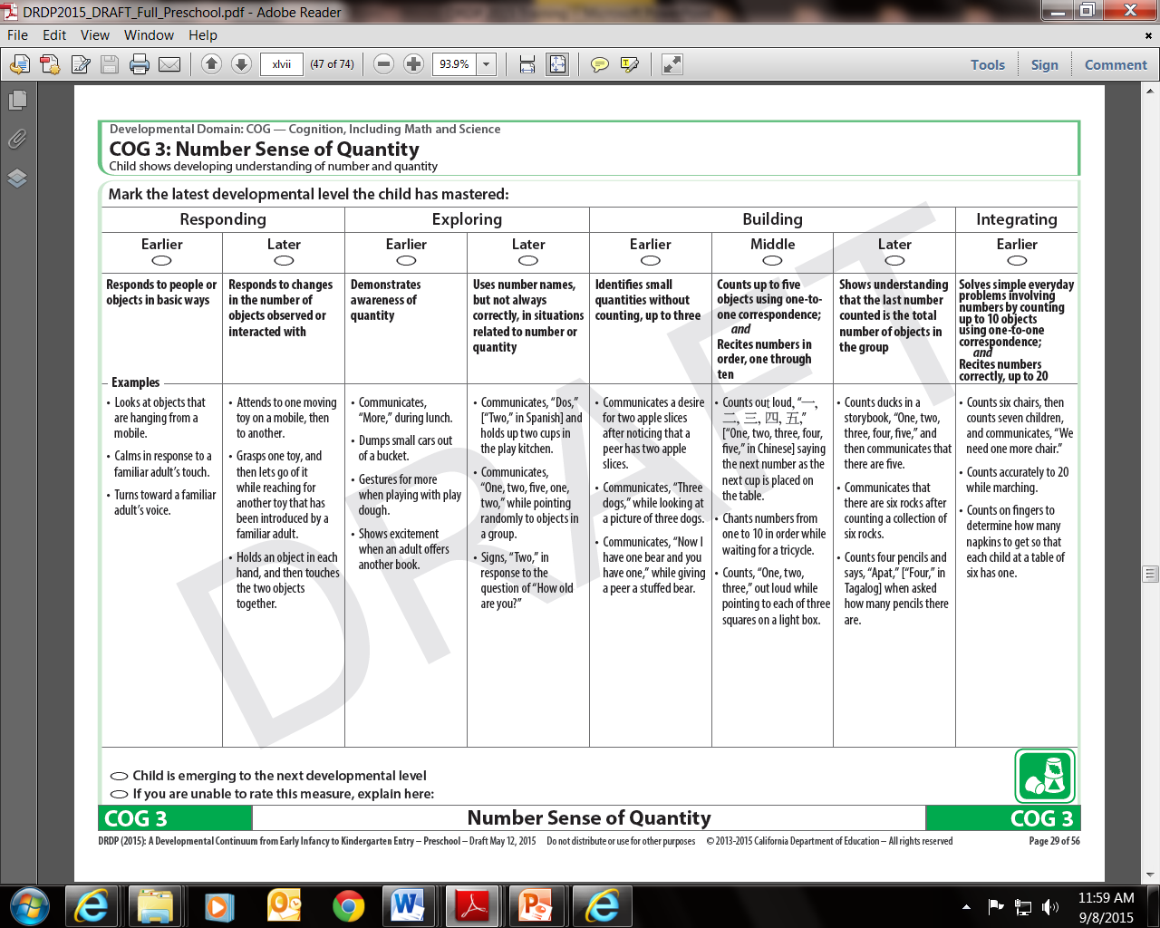
If the descriptor has “; “ followed by “and” , the child MUST do all of the behaviors but not necessarily in the same observation
If the descriptor has “AND” only then the child must be able to do all of the behaviors and they need to be observed together
BUT…

Slide 35
“OR”
If the descriptor says “OR” a child needs to demonstrate the behavior in ONE of the listed ways
Example : Responds to people or objects in basic ways
Looks at objects that are hanging from a mobile.
Calms in response to a familiar adult’s touch.
Turns toward a familiar adult’s voice.

Slide 36
Notes:
Effective February 2015, there are two more measures in the infant/toddler view of the DRDP (2015). These are COG 10 and COG 12. Please check the Web site for the most up to date version of the instrument.

Slide 37
Notes:
This is the Measures at-a-Glance page from the instrument. Teachers are able to see which measures carried over from the DRDP (2010) and which new measures for which they may need to be more intentional about collecting documentation.
COG 10 and COG 12 have been expanded to full continuum measures. Please make sure to check the Web site for the most recent version of the assessment.

Slide 38
Resources
Notes:
The Desired Results Web site has a wealth of observation resources and training opportunities. There is more detailed information about DRDP (2015) on the Web site.
This is the end of the 1st ppt

Slide 39
DRDP (2015) Module
http://www.desiredresults.us/training_drdp2015.html
Notes:
There is a DRDP (2015) module available with more detailed information under the DRDP (2015) link. http://www.desiredresults.us/training_drdp2015.html
Administrators are encouraged to visit this module with their staff and go through it together.
Activities for the module include
Have DRDP handy and circle and highlight in the descriptors
Chart Responses for Math video
Partner read the Assessing Dual Language Handout

Slide 40
Completing the Assessment
Gather evidence
Other teachers, parents or caregivers
Review and reflect
Determine mastery
Select developmental level
Notes:
The steps for completing the assessment remain the same in the DRDP (2015) version.
You still:
Gather evidence.. Pictures, notes, work samples
Review and reflect all of the evidence you have on a child
Determine mastery as overtime and in different settings
Select the highest developmental level mastered for the skill.

Slide 41
DRDPtech
Notes:
DRDPtech is an online data entry system. It is free to EESD contractors, LEAs, Tribal CCDF, CA Head Start programs. For more information on DRDPtech, sign up for the free Webinars.

Slide 42
According to Our Data
Notes:
DRDP (2015) Scale level reports will be ready in the FALL of 2015.

Slide 43
DRDPtech Resources
DRDPtech Webinars are provided twice a month for free.
http://www.desiredresults.us/trainings_opp_teacher.html
Notes:
This is the end of the 2nd ppt

Slide 44
Putting It All Together
Notes:
This is the beginning of the 3rd PPT.

Slide 45
Use Frameworks as a Resource
All frameworks including school-age are available on CDE Web site
Notes:
Note to trainer:
The curriculum framework chapters provide information to support children's learning in the areas described in the California Infant/Toddler Curriculum Framework, California Preschool Learning Foundations, Volumes 1- 3 and school age frameworks are available on the CDE web site.

Slide 46
Curriculum Framework in CECO
http://www.caearlychildhoodonline.org/
Notes:
For more information about the framework, visit California Early Childhood Online. There are modules for each of the domains. The actual curriculum framework can be downloaded for free from the CDE Web site.

Slide 47
Resources

Slide 48
California Early Childhood Online (CECO)
Notes:
The courses provided on the California Early Childhood Online (CECO) Web site enable teachers to increase content knowledge and ability to provide developmentally appropriate experiences for children in their care.
Meeting the developmental needs of young children and their families requires a comprehensive approach.
CECO provides access to comprehensive resources and courses in one centralized location to meet the ever-changing needs of the early childhood field.
Use CECO ERS module
Use this resource now, it is free until the end of 2015. Big thanks to CA First 5.
www.caearlychildhoodonline.org

Slide 49
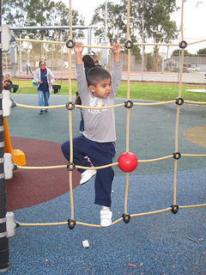
Training Opportunities
CECO Online Modules
Interactive Modules
Face to Face Training
Live Web Conferences
Certified Trainers Institutes (for EESD programs)
Train-the Trainer Institutes (for SED programs)

Slide 50
Questions??

Slide 51
Thank you!!

