Slide 1

Taking it to the Next Level:
Measuring Graduate Learning Outcomes
Jessica Dennis, Interim Director of Assessment
April 9, 2018

Slide 2
Workshop Learning Goals
By the end of this workshop participants will be able to:
  Differentiate between undergraduate and graduate Program Learning Outcomes.
  Select a variety of indirect and direct assessment measures to assess graduate outcomes.
  Formulate a graduate program assessment plan.

Slide 3
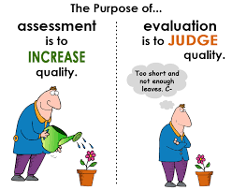
Why is assessment important?
Improve student learning and success
  Provide faculty and students with useful information about student learning and progress
Data-driven culture of evidence instead of anecdotes and opinions to inform curriculum revision
Communicate the value of the program to our students and the public
Program review and WASC Accreditation

Slide 4
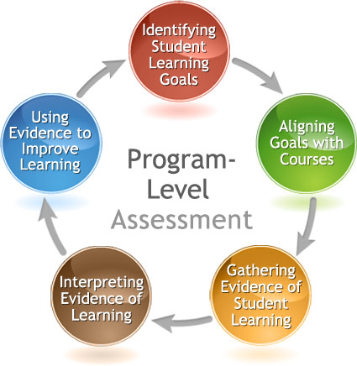
The Assessment Cycle

Slide 5
Articulating Graduate Learning Outcomes

Slide 6

Differentiating Undergraduate and Graduate Expectations
See Chancellor’s Office Definitions of Graduate Instruction in the CSU.
The graduate course deals with more complex ideas, materials, techniques or problems than the undergraduate course, and demands searching and exhaustive analysis.
The graduate course requires:
  The identification and investigation of theory or principle.
  The application of theory to new ideas, problems, and materials.
  Extensive use of bibliographic and other resource materials with emphasis on primary sources of data.
  Demonstration of competence in the scholarly presentation of the results of independent study.
Satisfactory completion of a graduate course requires more creative thinking than an upper division course.

Slide 7
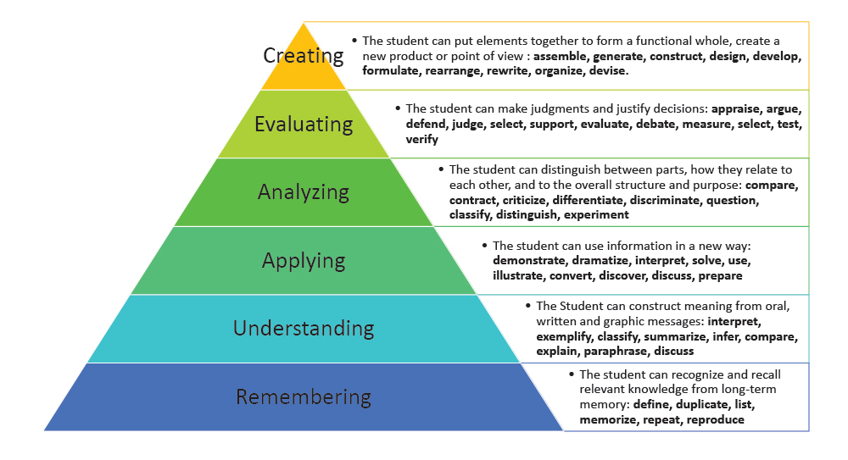
Bloom’s Taxonomy

Slide 8
Graduate Learning Outcomes Proposed by Cal State LA Graduate Subcommittee (tentative, not approved by Senate)
Specialized Knowledge
  Articulates the major theories, research methods, and approaches to inquiry and schools of practice in the field of study; evaluates their sources and illustrates their applications through projects, papers, exhibits, or performances.
Broad, Integrative Knowledge
  Investigates how the field of study has developed in relation to other major domains of inquiry and practice; and assesses the implications of the resulting advantages, challenges, and trends in a social or global context.
Intellectual Skills:
  Critiques and synthesizes the assumptions, conventions, and diverse perspectives appropriate to the field of study. (Analytical Inquiry)
  Frames and examines a controversy or problem via research, project, paper, or performance in the field of study. (Analytical Inquiry)
  Applies, articulates, and challenges traditions, assumptions, or prevailing practices in the field of study using ethical reasoning in the discipline. (Ethical Reasoning)
  Critically examines the power and limitations of quantitative evidence in the evaluation, construction, and communication of arguments, in their field of study. (Quantitative Fluency)
  Demonstrates communicative fluency and information literacy appropriate to their field of study through skillful translation across multiple expressive modes, such as oral, written, or digital forms of communication. (Quantitative Fluency)
Civic and Global Learning
  Articulates or demonstrates how advancing knowledge in their field of study contributes to the public good.

Slide 9
Degree Specification using the DQP
The Degree Qualifications Profile (DQP) outlines a set of reference points for what students should know and be able to do upon completion of associate, bachelor’s and master’s degrees – in any field of study.
  There are five broad categories of proficiencies which provide a profile of what degrees mean in terms of specific learning outcomes.
  Through focusing on broad areas of learning and the application of that learning, the DQP illustrates progressively challenging performance expectations for all students.

Slide 10
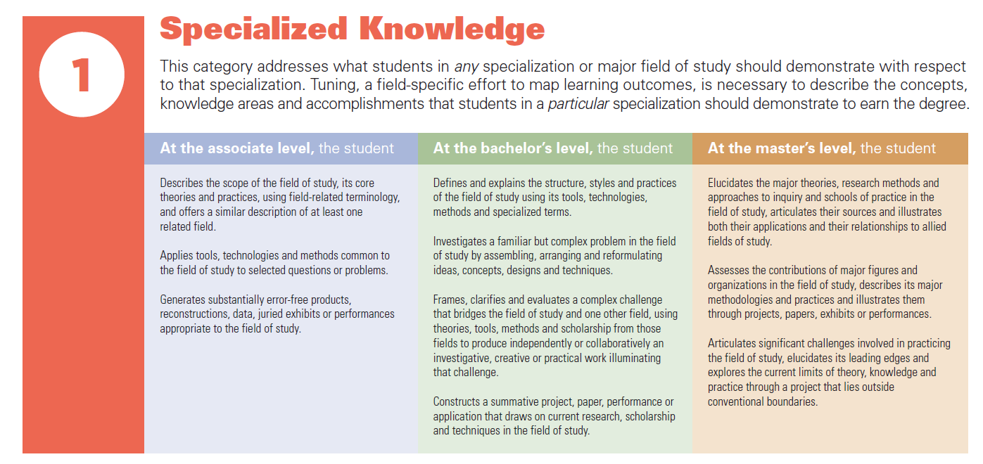
Degree Qualifications Profile (DQP)

Slide 11
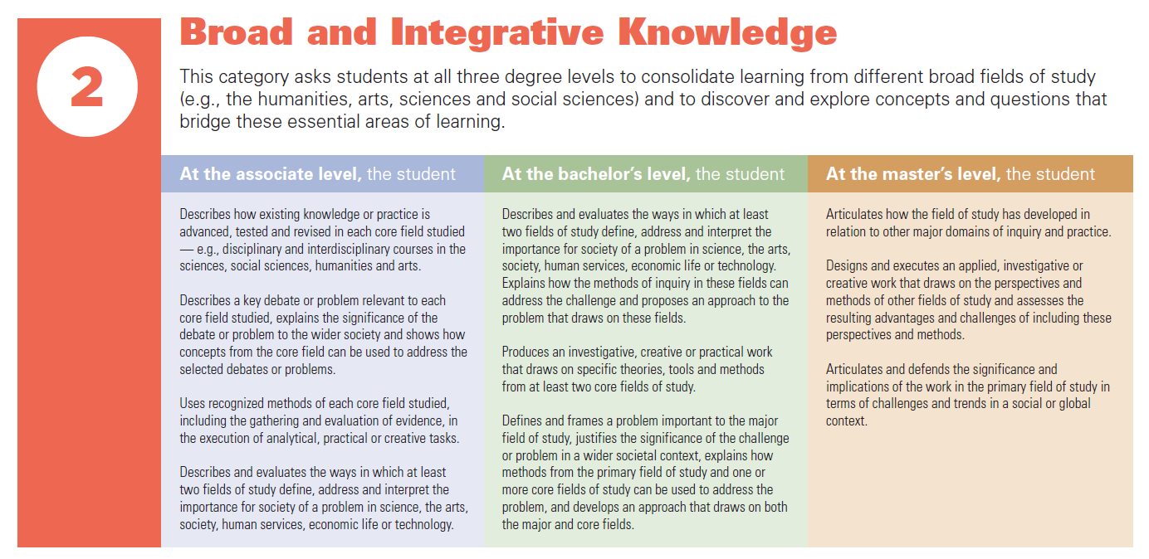
DQP cont.

Slide 12
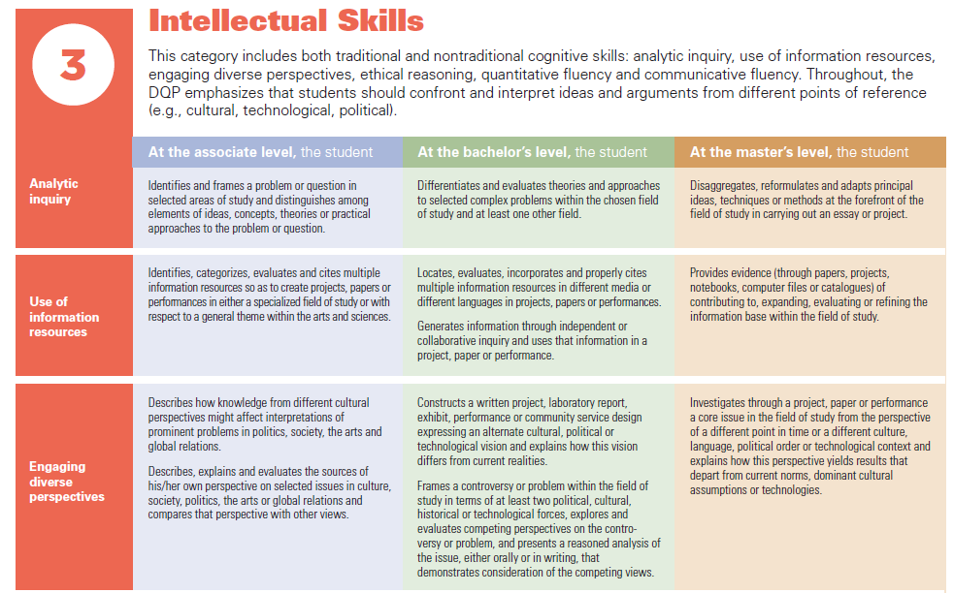
DQP cont.

Slide 13
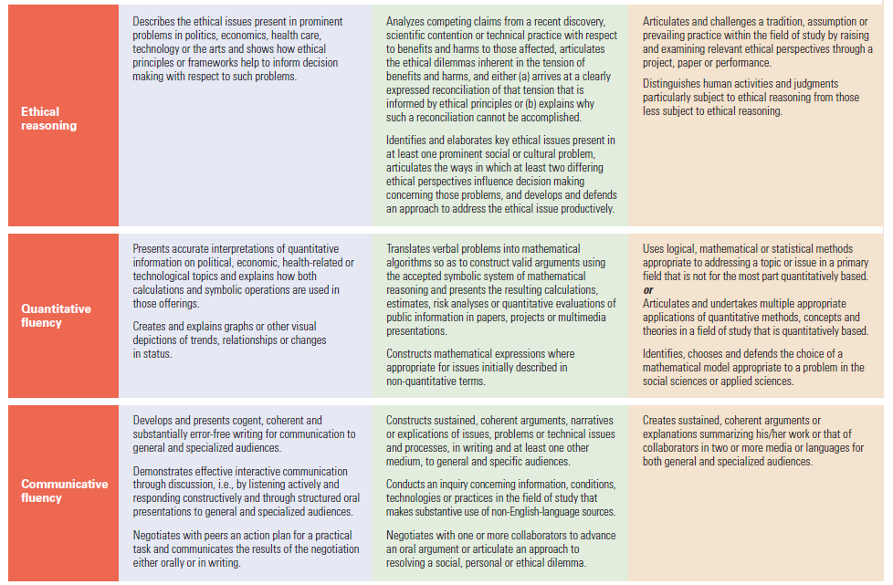
DQP cont.

Slide 14
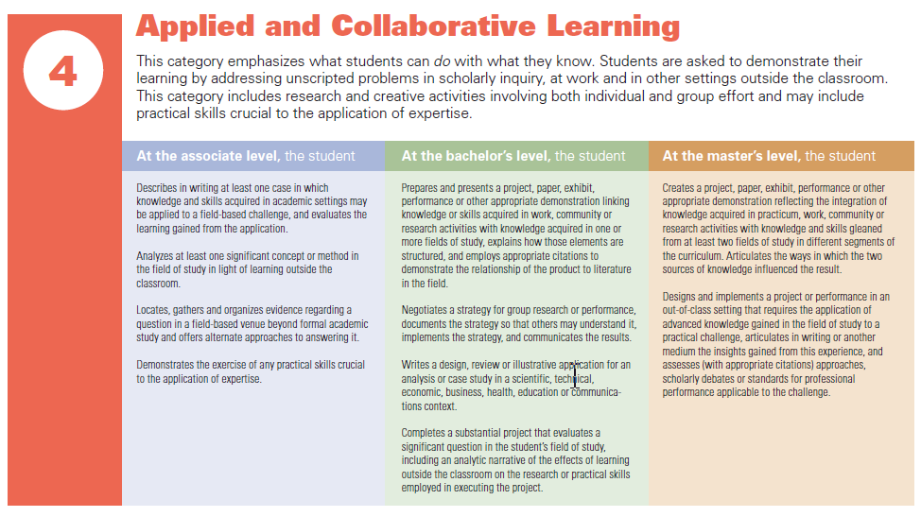
DQP cont.

Slide 15
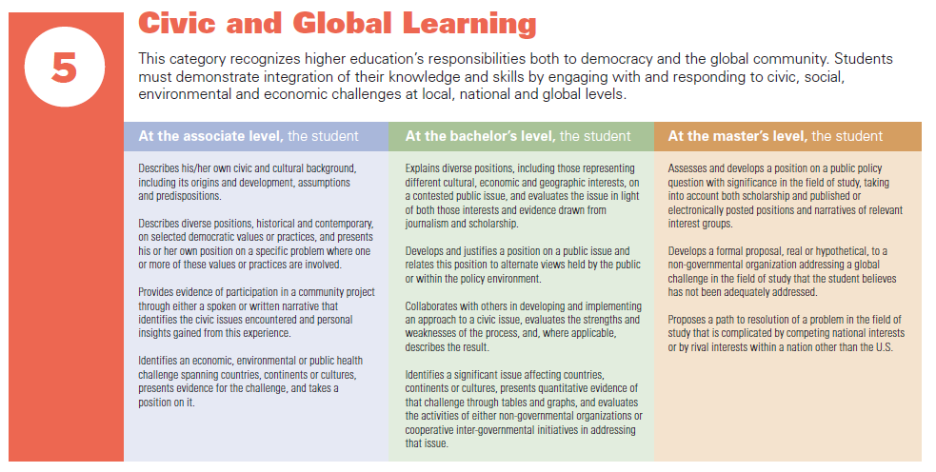
DQP cont.

Slide 16
Using the DQP for Tuning
Tuning is the collaborative process of coming together to define core competencies expected of students studying a particular discipline
Activity #1: Look at the degree specification rubrics and worksheet.
  How can you use these help you to differentiate expectations for the Bachelor’s and Master’s degrees?
  How could you involve the other faculty in the tuning process?

Slide 17
Assessment Methods

Slide 18
Indirect Methods of Assessment
Graduation or completion rates
Placement rates
Student, employer, alumni, and faculty surveys
Student focus groups
Exit (end of program) survey or interviews
Reflection essays
Self-ratings
Diaries or journals
Data from institutional surveys (NSSE)
Curriculum/syllabus analysis
Checklists

Slide 19
Direct Methods of Assessment
Capstone products, theses, dissertations
Comprehensive exams
Pass rates on certification or licensure exams
Oral exams or competency interviews
Portfolios
Off-campus professional presentations (for clients, agencies, etc.)
Case studies
Artistic performances, recitals, & products
Field evaluations (supervisor or instructor)
Published (standardized) test (e.g., Major Field Test)

Slide 20
Direct Methods of Assessment: Class-based
Term papers or projects
Oral or poster presentations
Simulations
Embedded questions in course exams

Slide 21
Assessing the Culminating Experience

Slide 22
Using Rubrics for Direct Assessment of Learning Outcomes
Why use rubrics?
  Chance for faculty to explicitly articulate and specify criteria for evaluating student learning
  Student work can be scored to examine for which skills are they meeting expectations and which need improvement

Slide 23
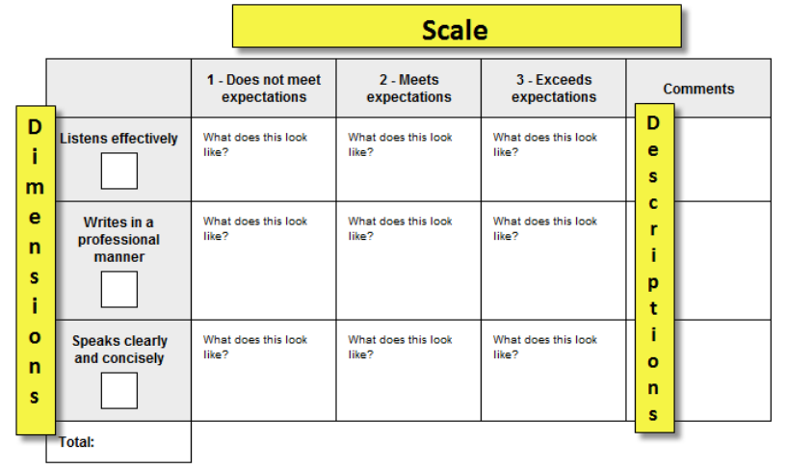
Creating a Rubric

Slide 24
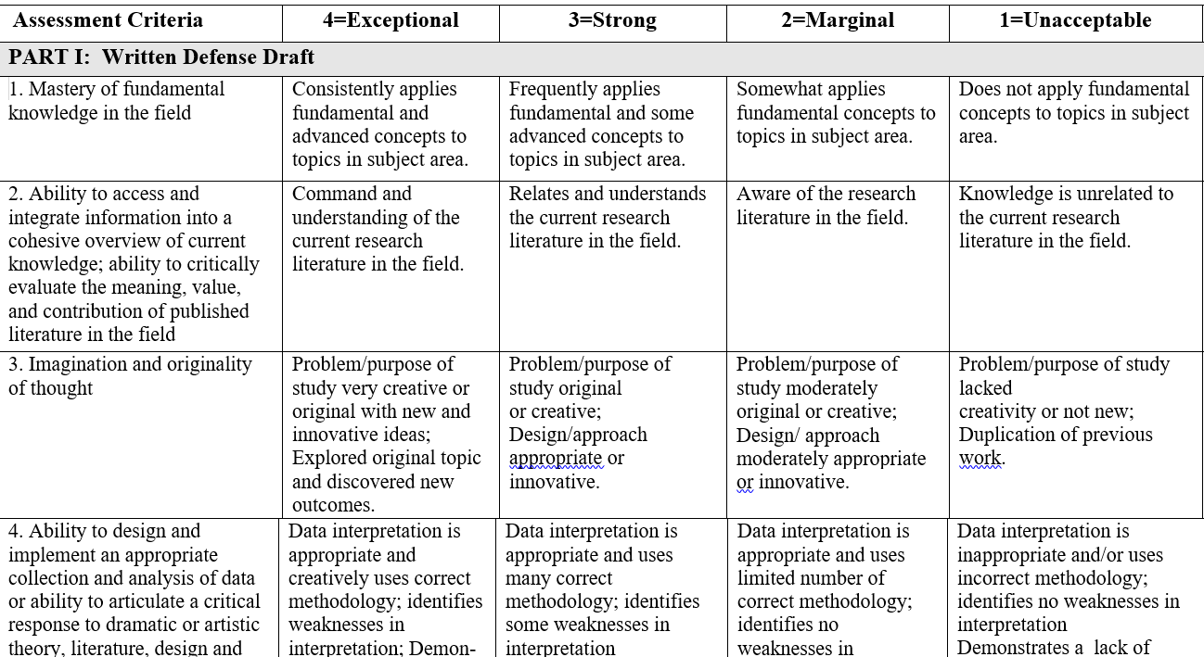
Thesis Rubric Example 1

Slide 25
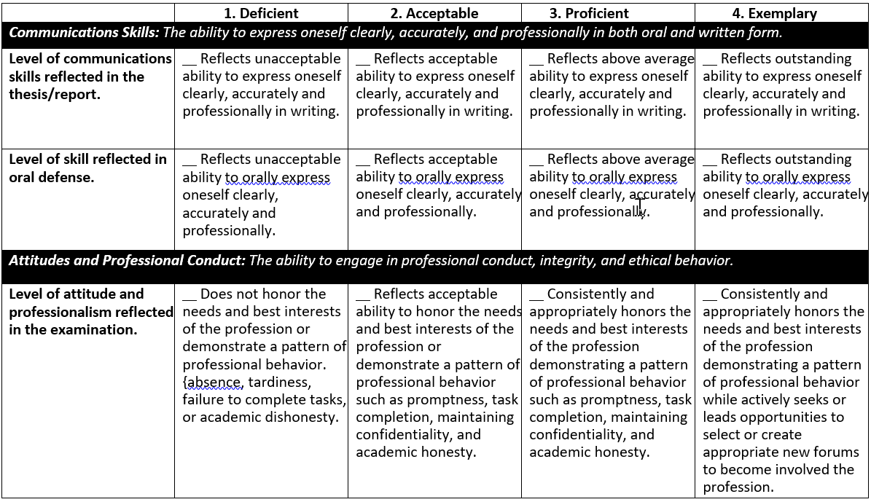
Thesis Rubric Example 2

Slide 26
Exercise #2: Assessing Graduate Outcomes in the Culminating Experience
For culminating experience options:
  What are the learning outcomes measured?
  On what basis is it decided if performance is satisfactory?
  Do faculty (outside of the committee) regularly discuss student performance?
  How could you use a rubric to aid in the assessment of student performance?
    If you already use a rubric, how could the rubric or procedure be improved upon?

Slide 27
Assessment at Key Transition Points

Slide 28
Formative vs. Summative Assessment
Formative assessment:
  takes place during the learning process
  gauges student progress
  allows for modification of teaching and learning activities
  e.g., quizzes, field ratings, student reflections
Summative assessment:
  evaluate student learning at the end of an instructional unit
  compares student performance against some standard or benchmark
  tend to be high stakes
  e.g., papers, exams, projects

Slide 29
Combining Formative and Summative Assessment in Graduate Programs
Assessing outcomes only at the culminating experience doesn’t allow students and faculty to monitor progress
Are there transition points within the program (e.g., admission, completion, completion of a field experience) that lend themselves to assessing student learning?
  Faculty, students, field supervisors, etc. can all play a role in providing useful assessment and feedback

Slide 30
Example- Assessment of Dispositions in CCOE’s Los Angeles Urban Teaching Residency Program (LAUTR)
RT360 Formative Framework
  Integrates 360 degrees of dispositional data from online surveys into systematic reflection between residents and support providers about strengths, needs, areas for improvement, and action plan generation
  Culminates in two-levels of facilitated debrief meetings (Residents and LAUTR Faculty and Staff)
  Generates “actionable goals” for resident growth
  Actionable plans for growth implemented collaboratively by residents and mentors in the field

Slide 31
Dispositions Assessed with RT360
Professionalism
1) Communication
Interpersonal Skills
1) Interaction
Values & Advocacy
1) For Learning
Reflecting
1) On Teaching & Learning
2) For Diversity & Social Justice
3) For Community Role
2) Collaboration & Collegiality
3) Feedback: Receiving & Soliciting
2) Organization,
Planning, and
Punctuality
3) Tact & Judgment
4) Reliability, Persistence
5) Self-Initiative,
Independence,
Responsibility
Basics for Success
TPE 6*
Notes:
Equity is the core of each of these domains—Ruth will work on puzzle diagram

Slide 32
Sampling of RT360 Items
Diversity and Social Justice
  14-1 - Demonstrated unbiased treatment of students
  14-2 - Honored and acknowledged diversity among students
  14-3 - Effectively built upon students' backgrounds
  14-4 - Views diversity as an asset which enhances student knowledge

Slide 33
Sample Open-Ended Responses
Resident
  It took me some time to get to know the students, their backgrounds and interests. I have some good ideas as to how can incorporate social justice themes into my teaching though I didn't always feel comfortable doing so. There were some aspects of the content material that I struggled with connecting to social justice themes (e.g. photosynthesis and cellular respiration).
Mentor
  The Resident has participated in several Restorative Justice Circles. S/he greets students on a daily basis. S/he will ask students how they are doing.
Supervisor
  S/He has articulated that he desires to have more opportunities to engage in social justice work within the classroom and is finding the right opportunities to express this desire with his mentor.

Slide 34
Curriculum Mapping
PLO | 4950 | 4910 | 5040 | 5150 or 5910 | Elective 1 | Elective 2 | Elective 3 | Elective 4
1 Knowl | I |  | I |  | P/D | P/D | M | M
2 Skills |  | I | P/D | M
3 Comm | I | I | P/D | M | P/D | P/D | M | M
4 Prof | I |  | M | P/D
Identify which PLOs will be Introduced (I), Practiced/Developed (P/D), and Mastered (M) across the curriculum

Slide 35
Assessment across the Curriculum
PLO | 4950 | 4910 | 5040 | 5150 or 5910 | Elective 1 | Elective 2 | Elective 3 | Elective 4
1 Knowl | I |  |  |  |  |  |  | M
2 Skills |  | I | P/D | M
3 Comm | I |  | P/D |  |  |  |  | M
4 Prof | I |  | M
Identify where you will collect assessment evidence for analysis at the program-level

Slide 36
Gathering Evidence in Multiple Courses
Student Assignments
Student Assignments
Student Assignments
Student Assignments
Student Assignments
Student Assignments
Student Assignments
Student Assignments
Student Assignments
Student Assignments
Student Assignments
Student Assignments
Student Assignments
Student Assignments
Student Assignments
Grade to students
Grade to students
Grade to students
Course #1 Instructor
Course #2 Instructor
Course #3 Instructor
Team of Faculty Score Assignments
Course Instructor(s)
Score Assignments
or
Assessment Coordinator or Committee Compile Results
Program Faculty Reflect on Results

Slide 37
Assessment Resources
National Institute for Learning Outcomes Assessment (NILOA)
Degree Qualifications Profile (DQP)
Association of American Colleges and Universities (AAC&U) VALUE rubrics
  Intellectual and Practical Skills, including
    Inquiry and analysis
    Critical thinking, creative thinking
    Written communication, oral communication
    Quantitative literacy, information literacy
    Teamwork, problem solving
  Personal and Social Responsibility, including
    Civic knowledge and engagement—local and global
    Intercultural knowledge and competence
    Ethical reasoning and action
    Foundations and skills for lifelong learning

Slide 38
Exercise #3: Assessing at Transition Points
Are there transition points within the program (e.g. admission, completion, completion of a field experience) that lend themselves to assessing student learning?
Does your program have a practical field experience component? If so, what is the purpose of that component? How can assessment take place in those experiences?

Slide 39
Comprehensive Assessment Plan
PLO | Course(s) where PLO is assessed | Assessment activity/ assignment used to measure PLO | Assessment tool used to measure outcome success | Criteria/benchmark | Assessment schedule – how often SLOs will be assessed | Designated personnel to collect, analyze, and interpret student learning outcome data | Program data/ findings dissemination plan | Possible actions based on results
 |  | Oral pres., written exam, essay, etc. | Rubric or other scoring system | Specify benchmark performance for students in program | Collect in classes & analyze every other year, etc. | Committee, instructors, etc. | How will the results be shared/discussed? | What actions could results inform?

Slide 40
Example: Engineering
PLO | Course | Activity | Assessment Tool | Benchmark | Schedule | Personnel | Program dissemination plan | Possible actions
B1. Ability to effectively collect and present data | ME 5150 (Thermal Lab) | Lab report | Rubrics in lab report | 90% meet or exceed standard | Spring 1st year | Instructor | Committee compiles results and presents at fall faculty meeting | Changes in courses, increased opportunities for practice, feedback to students, etc.
B2. Ability to clearly analyze and interpret results | ME 5060 (Heat Transfer) | Lab report | Rubrics in lab report |  | Spring 1st year | Instructor
B3. Ability to develop a proper testing and/or data collection process as appropriate to the project. | ME 5972 (Design II) | Final Project Report | Rubrics in project report |  | Spring 2nd year | Instructor and faculty advisor
B4. Ability to design and conduct experiments and/or data analysis to verify design analysis. | ME 5972 (Design II) | Project presentation | Rubrics in design presentation survey |  | Spring 2nd year | Instructor and faculty advisor

Slide 41
Closing the Loop: Strategies for Effective Use of Assessment Results
Present results at department meetings or retreats to stimulating faculty discussion on student learning and pedagogy
You might also:
  Present results to student groups or within key classes to engage students in their own learning
  Report results on the website to demonstrate student achievement or raise awareness of learning goals
  Seek input from alumni or employers to improve practices

Slide 42
Next Steps
What have you learned today that you want to share with others in your department?
Write down 1-3 you can do this semester to keep your assessment momentum going?

