Slide 1

Advisor : Dr. David Krum
Liaison : Prof. Sylke Rene Meyer
Sponsor: Institute for Interactive arts, research, and technology (INART)
Notes:
shoot for 20-25 min

Slide 2
Team Roles
Team Lead: Kevin Diaz-Lopez
Documentation: Taha Kamran, Steve Galvan
Communication: Daniel Ramirez
Project Planners: Kiet Hoang, Noah Castro
Architecture: Jessy Francisco
Software Engineers: David Hermosillo, Zudong Li
Steve Galvan

Slide 3
Agenda
Project Overview
Functions & Uses
Functional Requirements
Nonfunctional Requirements
Future Plans
Summary
Steve Galvan

Slide 4

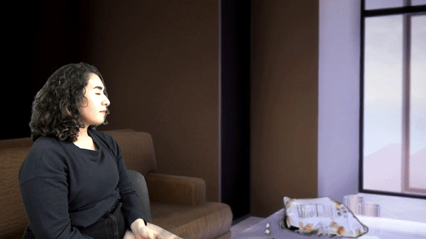
What is our project about…
Create a virtual 3D photo-realistic setting to be used by film students as their production set.
Provide tools to simplify virtual film production
  Automate camera movements
  Adjustable environment lighting
Steve Galvan
Notes:
have an outline of the project (current focus, goals, future plans, and other things talked about in this presentation)
Illustrative image for the description

Slide 5
Client Goals
Virtual Filming Set
Lighting
Camera
Photo-Realism
Daniel Ramirez
Notes:
add footage or illustrative image

Slide 6
Client Challenges
Mood of the Hotel
Camera angles
Lighting
Daniel Ramirez
Notes:
Illustration images

Slide 7

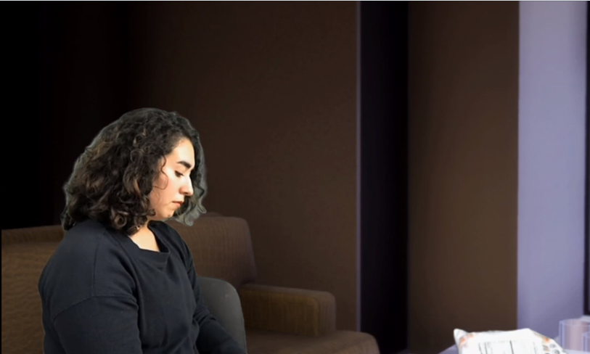



How does it work?
Steve Galvan
Notes:
-create a diagram
-the connections between unreal engine and the recording of the actors in zoom/OBS

Slide 8
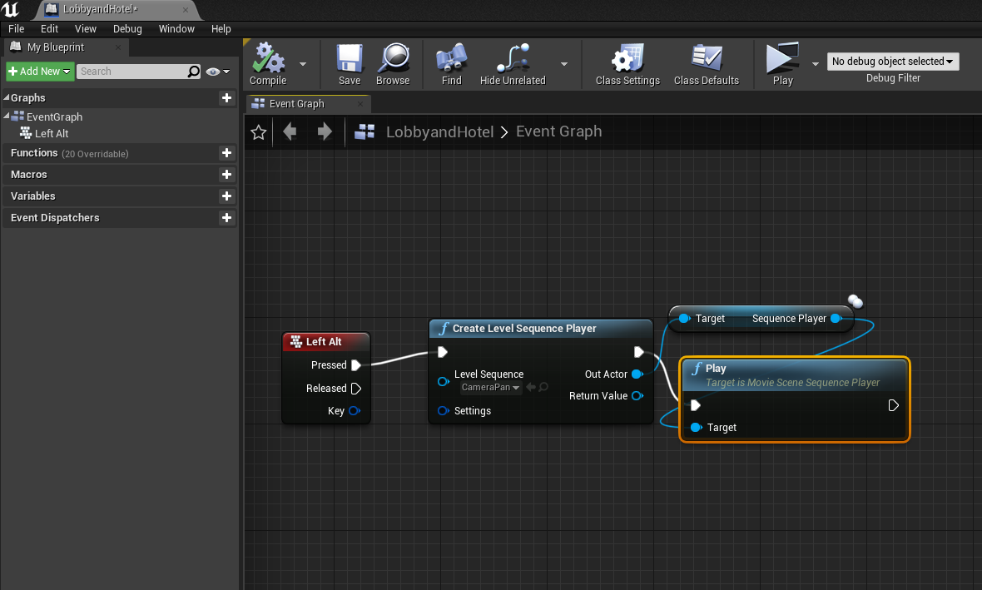
The Problems and Challenges
Traversing through the unknown, such as learning how to use Unreal and its controls
Accommodating the lighting needs of our liaison and their team.
Learning how the actors would be imported into the world created by our team.
Jessy Francisco
Notes:
change the image to interface in unreal or
setting
-crop off right side of image to make it bigger zoom in on details
-

Slide 9
Where Our Project Stands
Our job in the process of the movie making is to provide the backgrounds and transition scenes
Our recorded shots and pans will go to the virtual cinematographer
The editor will then take the compiled footage to assemble all the shots in order
Taha Kamran
Notes:
talk about director, actor, artifacts they are handling(cameras green screens, props) given our situation
use diagram talk about where we are
-director
-editor
-virtual cinematographer
-actors
-
backgrounds and transition scenes not scenes

Slide 10
Goals
Main goal to create a virtual world for our client to use to record scenes.
Transitioned to adding in environment lighting and implementing objects.
Further along we would like to implement functions in creating virtual scenes in Unreal Engine
Taha Kamran
Notes:
third bullet point needs to be cecked for grammatical error

Slide 11
Functions & Uses
Creating a virtual world where multiple scenes can be filmed
Allow for imports of recordings into the environments
Create a camera to be set on a course for common pans/shots
Customizable environment to allow production team to change based upon their own needs
David Hermosillo
Notes:
first bulletin point needs to be checked cause its unambiguous(you are shooting multiple scenes in the world)

Slide 12
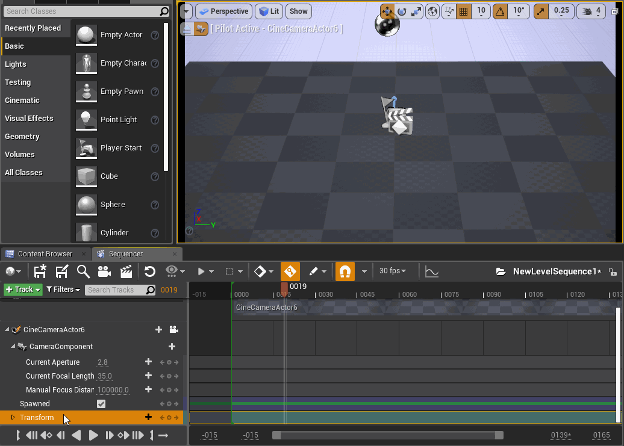
Sequencers in Unreal Engine
David Hermosillo
Notes:
when you introduce the topic make sure to say how it fits in into the production, like pans and establishing shots

Slide 13
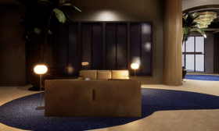
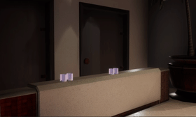
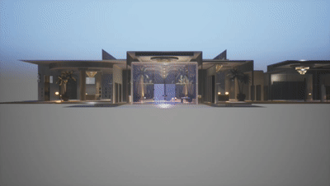
Examples
David Hermosillo

Slide 14
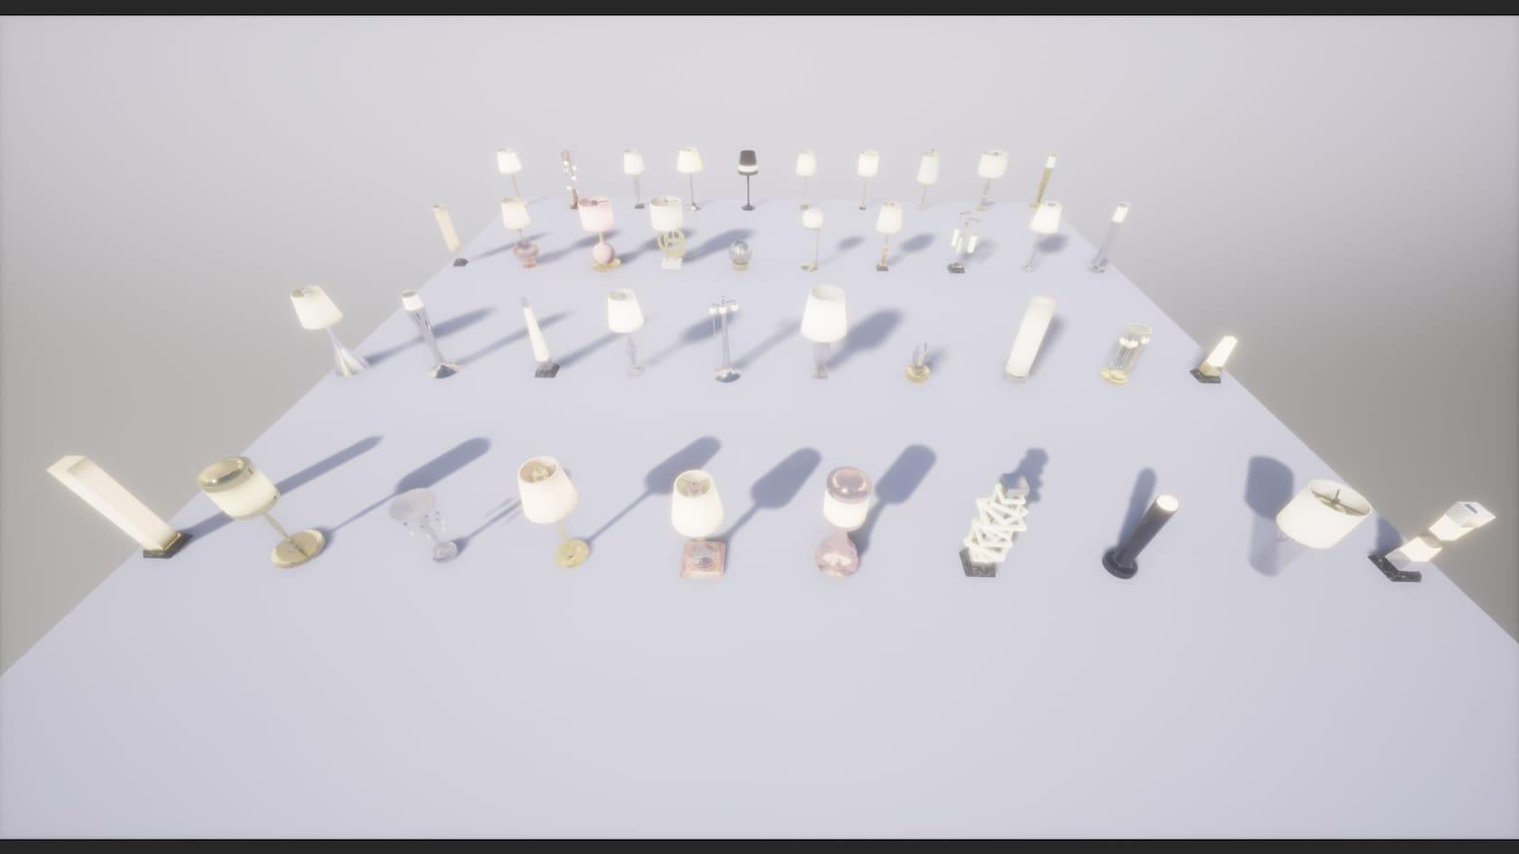
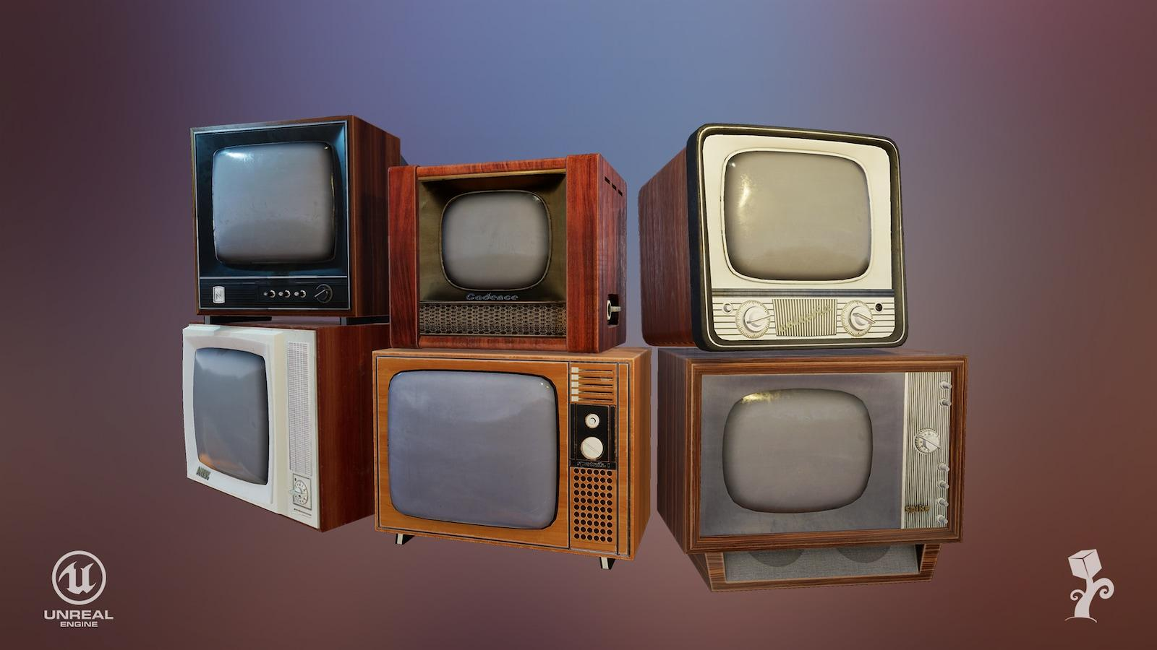
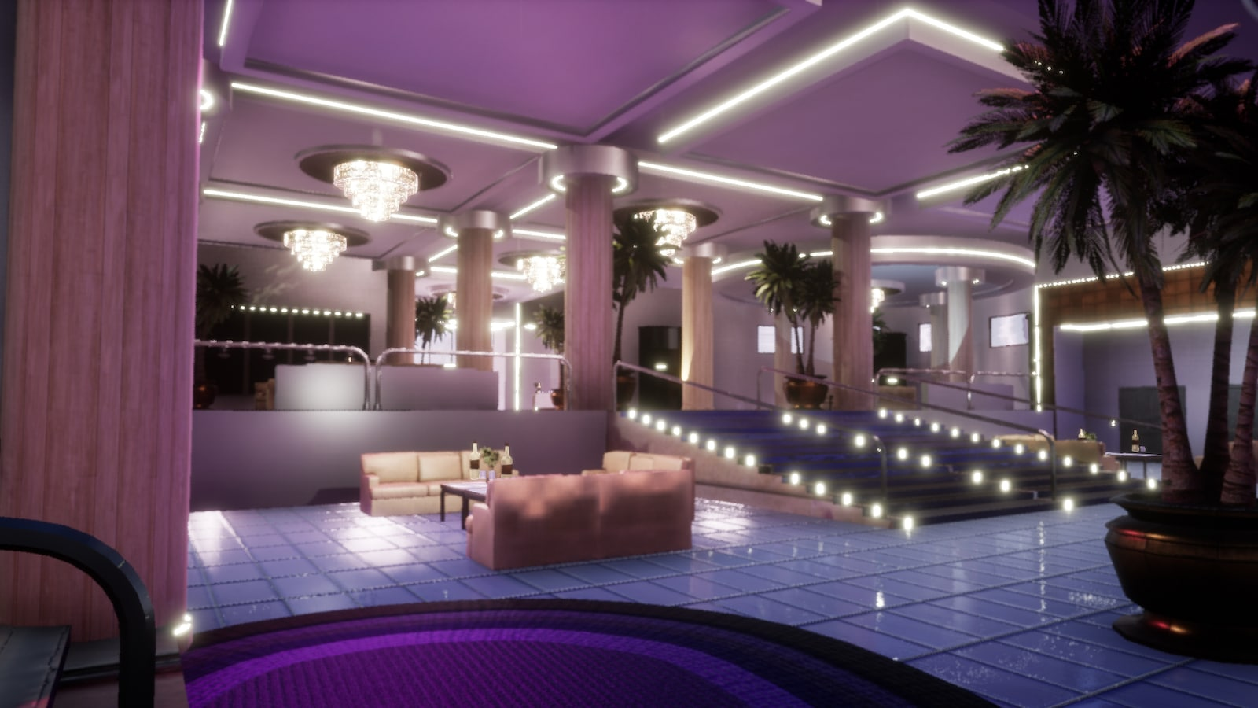
Using Unreal Engine Asset Store
Hotel Lobby and Bar
Vintage TV
Lamps
David Hermosillo

Slide 15


Communication
Contact Liaison
Work with Filming Team
Make changes of model
Send samples
Make decision
Get involved
Make control
Zudong Li

Slide 16
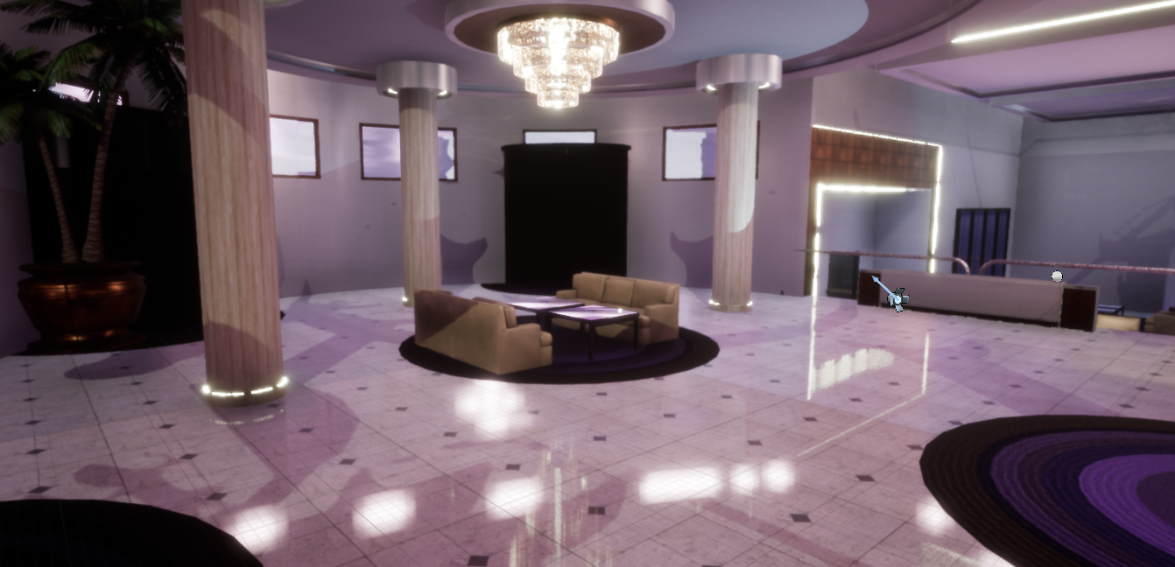
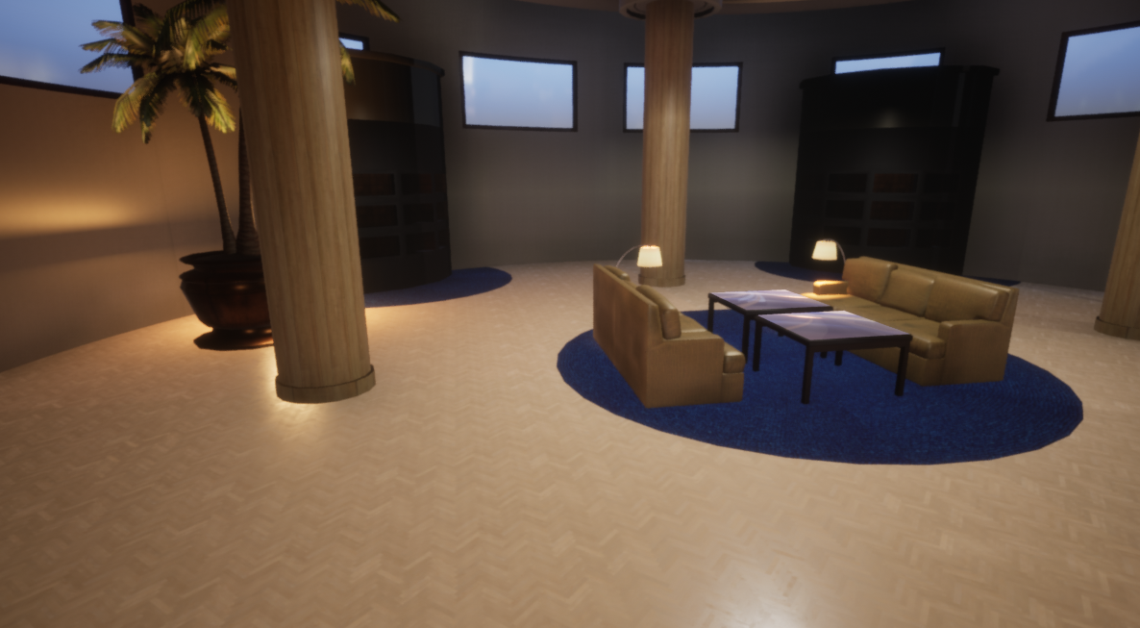
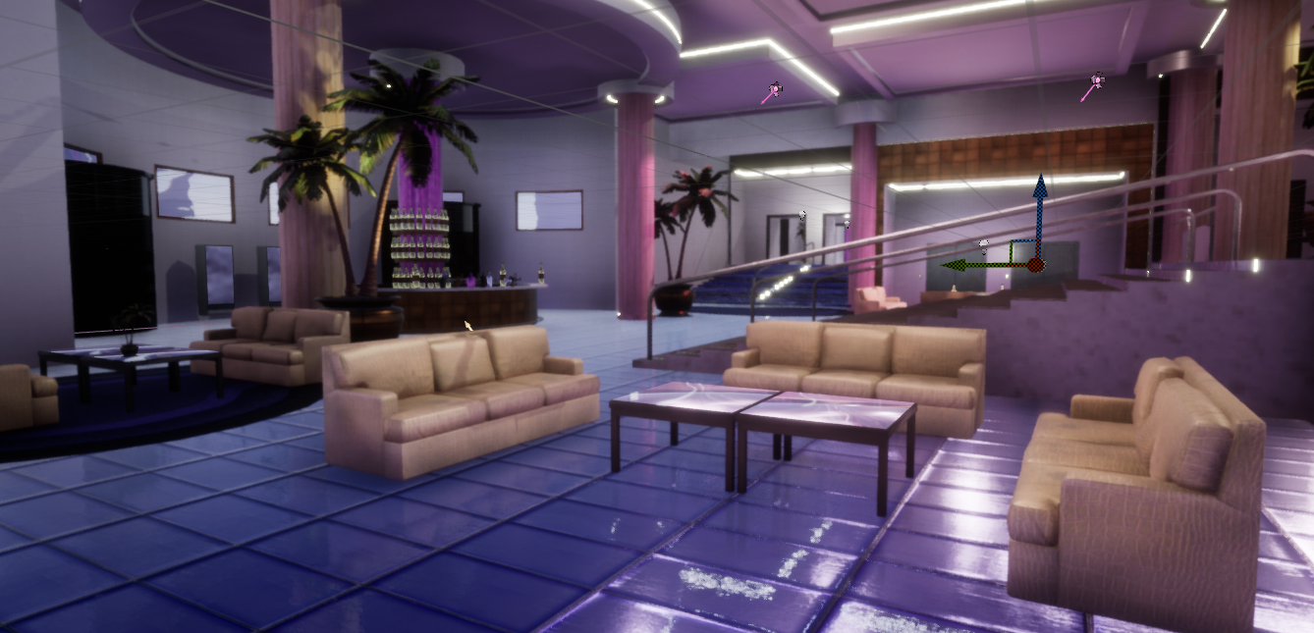
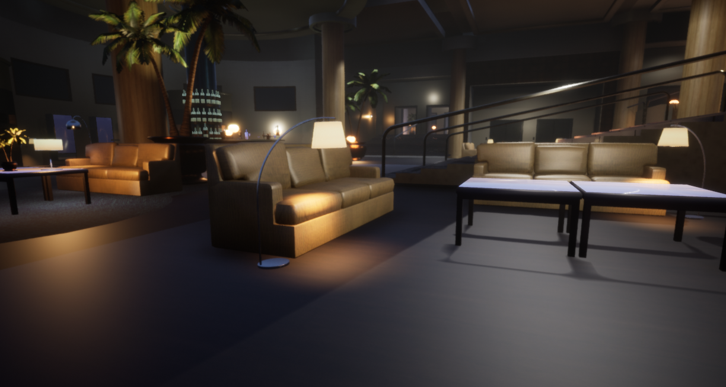
Before
Changes We Made
Universal lighting
Mood lighting
Added lamps/lights
Created sequencers
Changed color of certain objects
After
Before
After
Zudong Li
Notes:
add a before and after in the picture so the person can tell

Slide 17
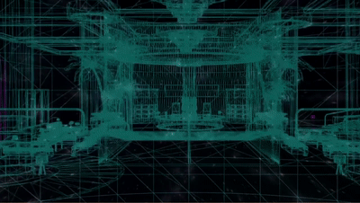
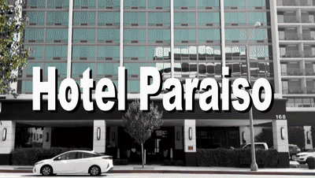
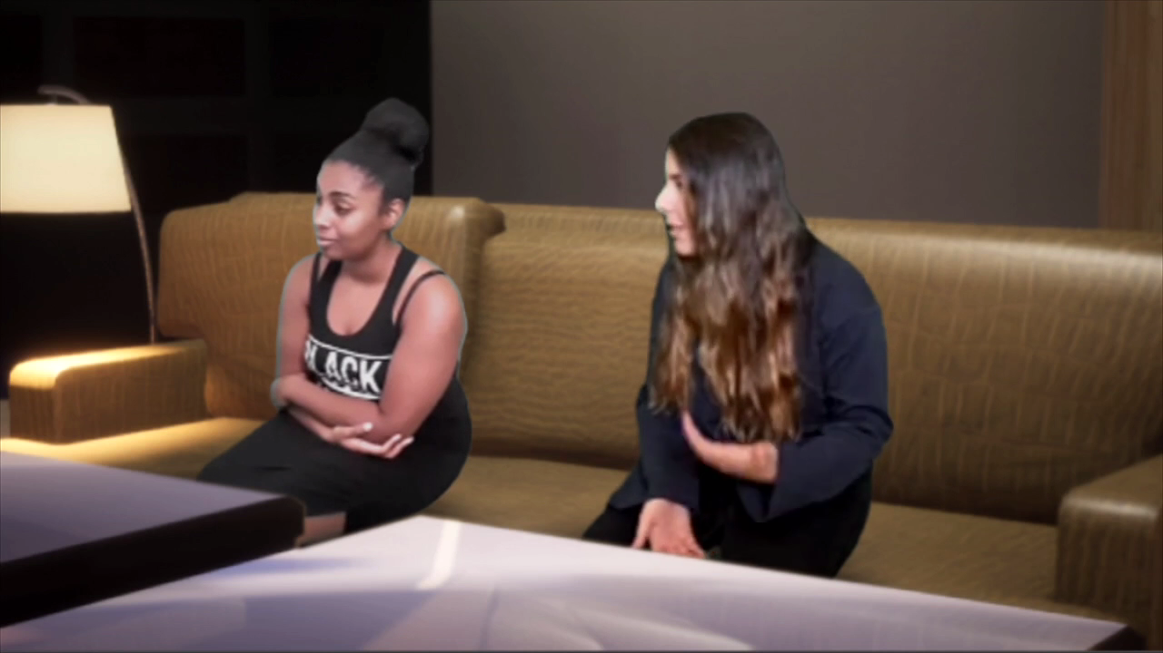
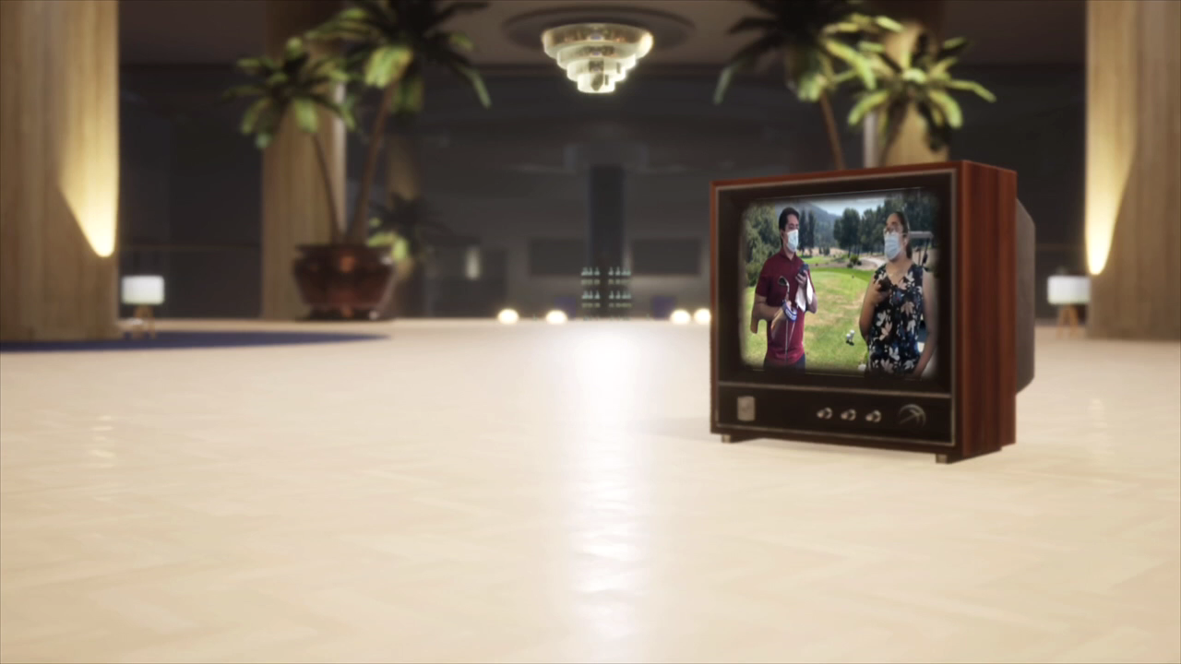
Uses of Our Work
Zudong Li
Notes:
intro class going on,work with class with their needs in the project

Slide 18
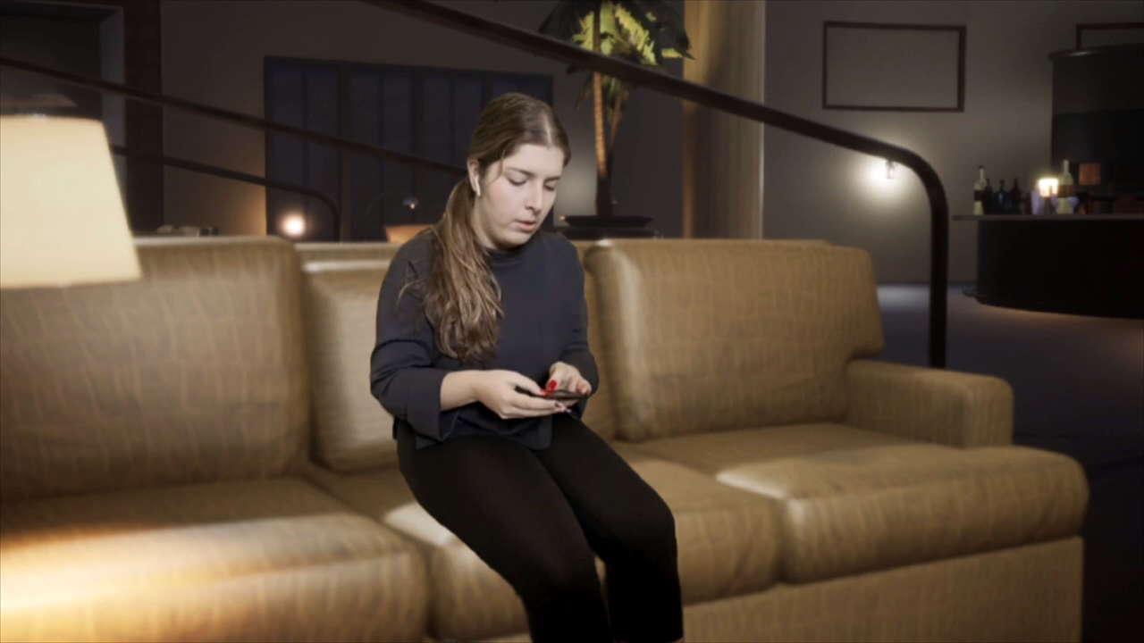
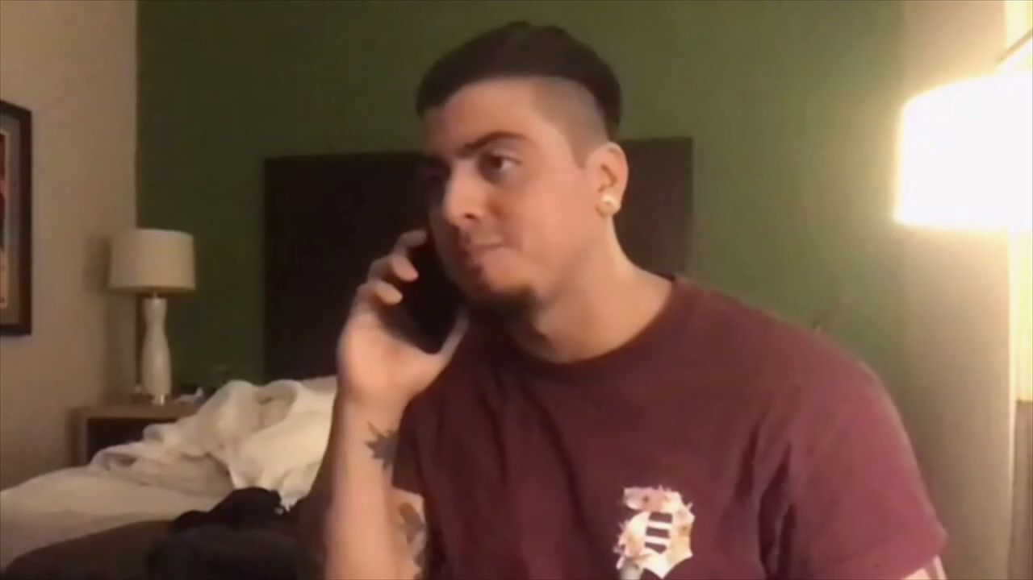
Comparing
Zudong Li

Slide 19
Functional Requirements
Environment
  Create objects that the actors can interact with.
  Users must be able to make changes to any objects
  Importing levels.
Lighting
  Add or remove light sources.
  Adjust the atmospheric lighting and other light sources.
  Should have the option to transfer the virtual environment lighting over to actor, vice versa
  Adjust reflections on material surfaces.
Kevin Diaz-Lopez
Notes:
fix the fonts size

Slide 20
Functional Requirements
Camera Controls
  Basic traversal of X, Y and Z axis (movement or coordinates)
  Camera rotations.
  Ability to bookmark camera positions.
  Adjustment of camera speed along with an automated camera movement.
  Tracking of a virtual object with the camera.
Kevin Diaz-Lopez
Notes:
-Mention other aspects of the camera such as focal length and other videographer terms
-change camera movement to camera controls

Slide 21
Functional Requirements
Camera Settings
  Adjustment of camera’s focus method (manual or tracking) and focal distance.
  Changes for lens (manually or preset focal lengths) and film back.
  Adjustment and automation of camera zooms.
  Aperture adjustments.
Kiet Hoang
Notes:
-Mention other aspects of the camera such as focal length and other videographer terms
-change camera movement to camera controls

Slide 22
Functional Requirements
Stand-In (Virtual Character)
  Act as a placeholder in the virtual set.
  Must be able to adjust it’s position and body parts individually.
  Must have the ability to animate the stand-in.
Recording
  Basic features of screen recording, import live video, pre-rendered video and audio.
  Multiple cameras.
  Chroma key videos within the set.
Kiet Hoang
Notes:
-Reorganize requirements so as the environment is first,lighting, camera movement, mannequin, & recording
-Talk about how some of our team attended the production class to find what they wanted/needed
-How we learned their process of production/recording
-This ties in with the requirements
-Goes before the requirements or after “What is our project about”

Slide 23
Non-Functional Requirements
UE is a licensed product for all developers and users
  No need for safety requirements
UE requires an account with Epic Games and only applicable to devs and users wanting to edit the virtual world
  By policy, any data collected from users will be used to improve UE code
Per UE policy, any revenue made from the use of this software includes a 5% royalty to Epic Games
Jessy Francisco
Notes:
Non-functional requirements such as safety req, security req, software quality attrs, and business rules
Ethical and legal considerations - different licensing agreements for different assets. Revenue royalty.
Place after funcitonal requirements

Slide 24
Performance Requirements
User Friendly
  The program must be simple so that the director could use it without any assistance
Realistic
  The environment must be photorealistic
Daniel Ramirez
Notes:
-identify what should be user friendly
-such as camera options
-make sure to talk about
may not need to be anyone it should be people who are trying to create a production like actors, amauter

Slide 25
Interface and Constraints
Interface
Requires that input be the live stream video files provided by the user. Outputs another video file with the virtual objects and sets included.
Design Constraints
- Implementation is limited to C++ in order to work with UE4
- Limited hardware capabilities could impact ability to run UE4 and load assets effectively
- Sponsors budget could dictate quality of assets
Noah Castro
Notes:
think about having the virtual assets as a constraint

Slide 26
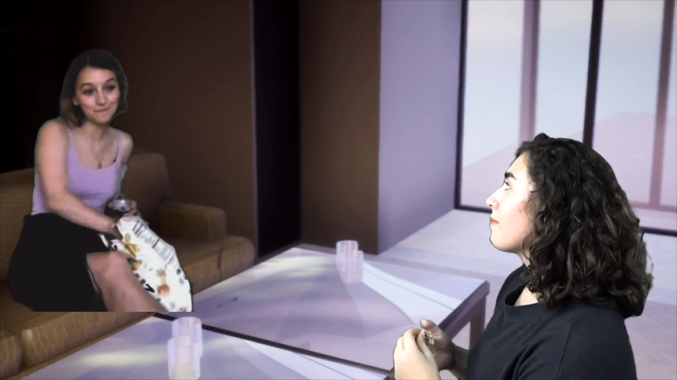
What we need to improve…
Creating a feature that can help match an actor’s recording to the current lighting of the set or vice versa
Ensure that frames are seamless between green screen recordings and the actual environment
Noah Castro
Notes:
-change the second statement so as to explain the green screen cutoff and recording issue.

Slide 27
Recap
What is the project about
Creating a photo-realistic 3D virtual setting for film students.
Problems and Challenges
Traversing through UE and its controls, Importing actors
Functions and Uses
Allow for imports of recording into the 3D environment
Create camera to be set on course for different pans and shots
Noah Castro
Notes:
talk about the 3 takeaways points about our project(pick something about project overview. future plans)

Slide 28





Questions?
Notes:
shoot for 20 minutes - 25 minutes

