Slide 1
QTC-CSULA: Web PDF Viewer
SENIOR PROJECT 2020-2021

Slide 2
Team Introduction
CSULA Students Roles
Cristian Corrales Team Leader / Public Relations Specialist
Roman Arias Public Relations Specialist
Ares Ton-That Documentation Author
David Sanchez Documentation Author / Project Planning Committee
Chandel Buelna Project Planning Committee/Lead Software Engineer
Phoebe Castanedo Project Design Committee
Sean Ybarra Project Design Committee
Brandon Gonzalez Quality Assurance
Joaquin Robles Quality Assurance

Slide 3
Liason Introduction
CSULA Advisor
Keenan Knaur
QTC Liaisons
Francisco Guzman
Ashwariya Chopra
Matthew Truxaw
Julian Gutierrez

Slide 4
Agenda
Background
  QTC’s Needs
  QTC’s Current Solution
Project Requirements
Technologies Used
Project Overview
  Frontend
  Backend + APIs
Challenges
Achievements
Demo
‹#›

Slide 5

QTC Overview
Quality. Timeliness. Customer Service
A subsidiary of Leidos ($10B+ technology solution provider)
Processes over 4 million pages of medical records daily
Conducts over 750 examinations annually
The largest provider of government-outsourced occupational health and disability examination services in the nation
Notes:
focus on delivering high quality exam solutions for clients.
systematic operational workflow to administer evaluations.
QTC works in the medical field and they have to examine large amount of medical records that are pdfs.

Slide 6

QTC’s Business Needs
QTC’s business operations require personnel to view and search through thousands of medical documents.
These medical documents contain very large files with huge amounts of information, much of which is necessary for providing quality care to their clients.
A service provider of this caliber must also require the adequate infrastructure to allow for the timeliness of their service, as well as quality software to make this system function properly.

Slide 7

QTC’s Current Solution
QTC’s current solution requests for and retrieves a list of PDFs from a database and combines all of those PDFs into one enormous PDF.
A size constraint issue arises since the enormous PDF can be several gigabytes large.
The size issue also leads to the issue of individual file distinction, where it can take a lot of time to find specific information or a particular document within the large file.

Slide 8

Project Requirements
Keeping Timeliness in mind, a new, more resource-efficient document viewer was proposed as our project
Requirements for this new software are as follows:
  Displaying PDFs without exceeding a 500 MB storage limit.
  Viewing PDF documents continuously.
  Retrieving a list of PDFs from a declared category. (e.g. for a specific medical specialty)
  Providing a search and filter function for PDFs.
  Highlighting all instances of a keyword or phrase being searched within the current document.
  Implementing QTC’s design standards.

Slide 9







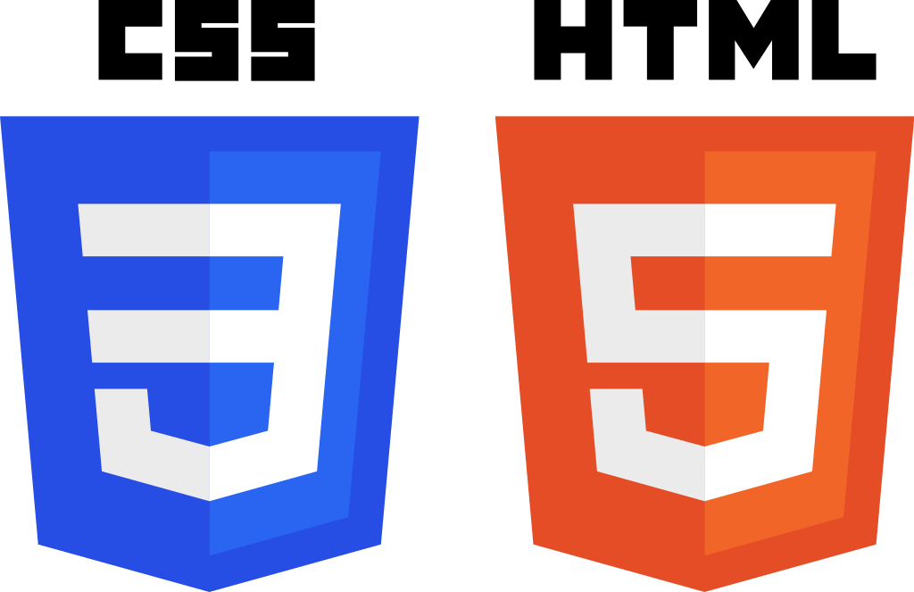
Technologies Used
C#
ASP.NET Core MVC
Atalasoft SDK
Microsoft Visual Studio
Bootstrap
Microsoft SQL Server
JavaScript
CSS
HTML

Slide 10
The Project
Client Side / Javascript
Server Side / C#
Controls the viewer directly according to user interaction
Detects when there’s a page change and changes PDF files if required
Changes PDF files according to button press
Handles Search functionality and updates the viewer accordingly
Detects a request for filter
Retrieves file paths from the database
Serves up the file paths to the index using MVC model
UI / UX
User UI
Displays the PDF viewer and buttons
Directs button functionality accordingly
user

Slide 11




Front End
QTC wanted the UI to be compact and to comply with their design standards.
The UI integrates a custom package provided to us by QTC’s UX/UI developer.
  Design guide and standards.
  Overrides default Bootstrap with to a custom QTC version.

Slide 12
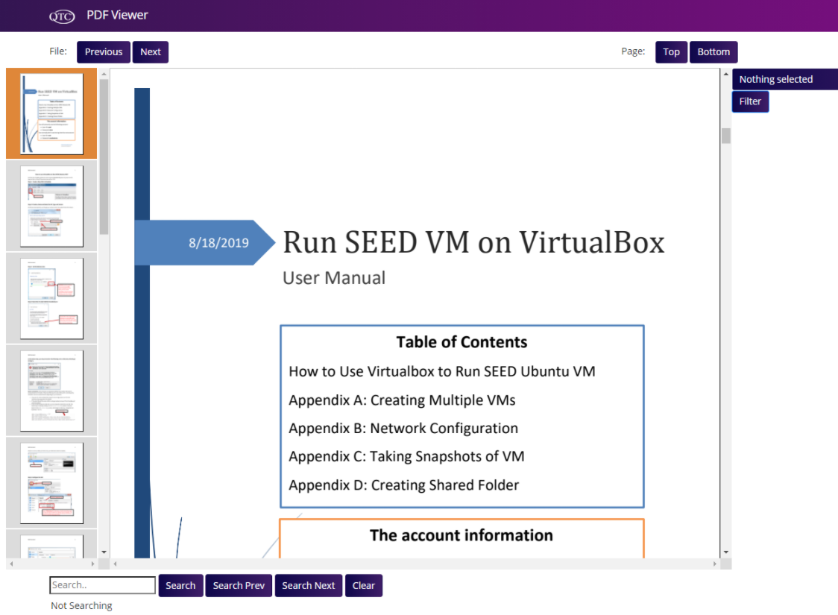
Front End
An optional feature we included is the thumbnailer.
Works with the viewer for an additional ease of navigation.
How does it all work?

Slide 13

Back End
The back end of the project consists of our data model, view model, and controller.
The data model reflects the tables and stored procedures contained within our database.
Stored procedures provide most of the functions needed for the project, such as sorting and retrieving the list of documents.

Slide 14
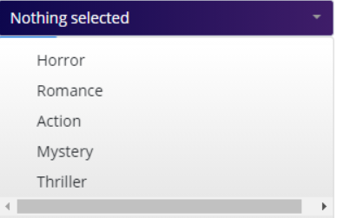
Back End
The view model sets the properties and functions used in the view
Consists of three methods
  Retrieving list of categories
  Retrieving list of document file paths
  Sorting by category
* Note that we used ‘book types’ in our solution as a substitute for the QTC Medical Specialty Categories

Slide 15
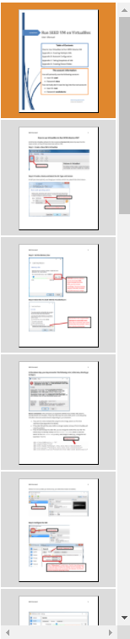
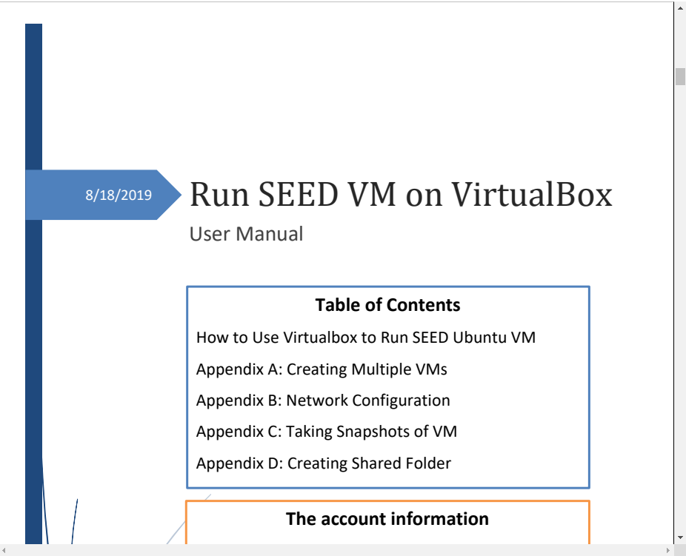
Atalasoft API
The Atalasoft API provides our application with the PDF viewer module.
Atalasoft’s DotImage SDK allows the viewer to display PDFs
The SDK also provides the application with several event triggers, allowing our application to detect changes within the viewer.

Slide 16
Atalasoft API
Atalasoft API enables us to create the desired viewer we had in mind
  OpenUrl
  PageChange
  DocumentChange
Lazy loading
  Open files fast
  Loaded few pages at a time

Slide 17
Changing Documents
OpenUrl is used to open documents
Can only load one document at a time
Documents are stored in a list
A counter is used to keep track of the documents.
["/Document1.pdf","/Document2.pdf","/Document3.pdf"]
OpenURL(path)

Slide 18
Switching documents
Page Change Function
Idea
  Check when the user is at the beginning or end of the document then switch documents
Issue
  Can’t compare the beginning or end of the document to initiate a document change.
  Results in an endless loop.
  Logic issues
Solution
  Added extra padding pages to the start and end

Slide 19
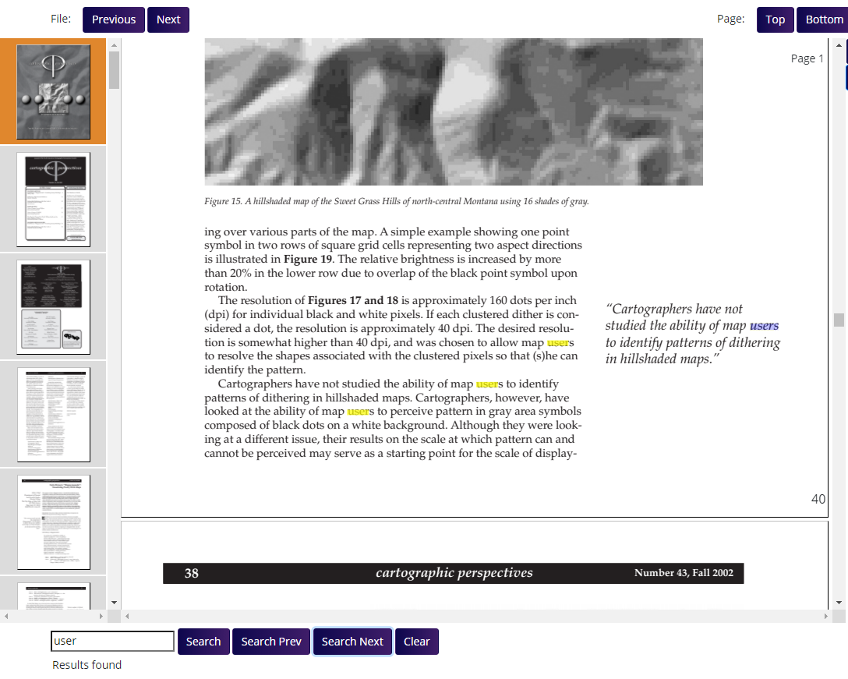
Atalasoft Search API
Easy-to-use Search API
Provides basic functionality

Slide 20
Atalasoft Search API
Initial search traverses through all files within the list
Creates a sub-list of files to be used for the Find Next/Find Previous functionality

Slide 21
Atalasoft Search API
Search API also provides the Find Next/Find Previous functionality
Full list
Search list
Instance list
Doc 1
Doc 2
Doc 3
.
.
.
Doc 9
Doc 10
Instance 1
Instance 2
.
.
.
Instance 45
Doc 3
Doc 4
Doc 7
Doc 9

Slide 22
Atalasoft Search API
Search API also provides the Find Next/Find Previous functionality
Full list
Search list
Instance list
Doc 1
Doc 2
Doc 3
.
.
.
Doc 9
Doc 10
Instance 1
Instance 2
.
.
.
Instance 45
Doc 3
Doc 4
Doc 7
Doc 9

Slide 23
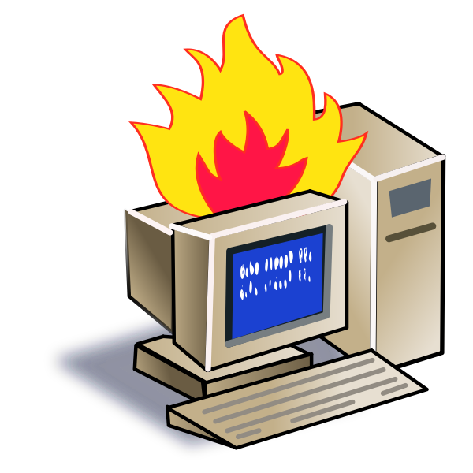

Challenges
Social Challenges
Coordinating time schedules in the team.
Understanding of software requirements.
Levels of communication.
Meeting critical deadlines.
Collaborating with many groups.
Technical Challenges
Learning new technologies.
Figuring out where to get answers to questions.
Debugging and Logic.
Being realistic with solutions.
Software requirement priorities.

Slide 24
Retrospective on this Project
What went well?
  100% Project completion.
  Team collaboration was very effective and productive.
What didn’t go well?
  The original proposed project was not feasible; QTC had to introduced a new project.
What can we improve next time?
  Effectiveness in all areas.
  Apply experience gained

Slide 25
Achievements
Completed a fully functional web application viewer
The web viewer allows users to view PDFs in a continuous manner.
Users will be able to filter through multiple types of PDFs by selecting one or more categories.
Users can also search for keywords contained within any of the PDFs in the viewer.
All of the initial requirements have been implemented and delivered to QTC’s satisfaction.

Slide 26
Demonstration

Slide 27
Thank You!

