Slide 1


Slide 2
Welcome to University Advancement
Engagement, Service, and the Public Good

Slide 3
Where are Cal State LA Alumni?

Slide 4

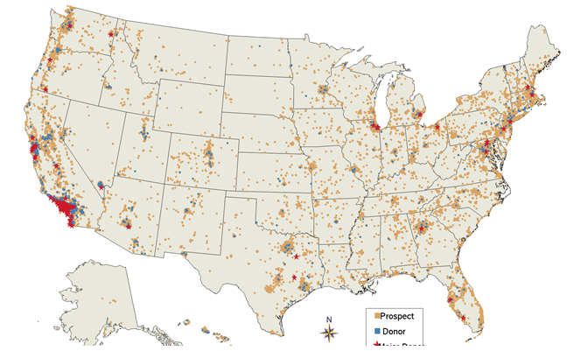
12 Month Snapshot of Our Database - Nationwide

Slide 5
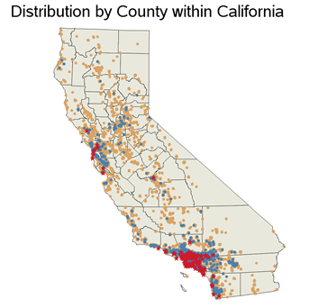
12 Month Snapshot of Our Database - California

Slide 6

ALUMNI
ASSOCIATION

Slide 7
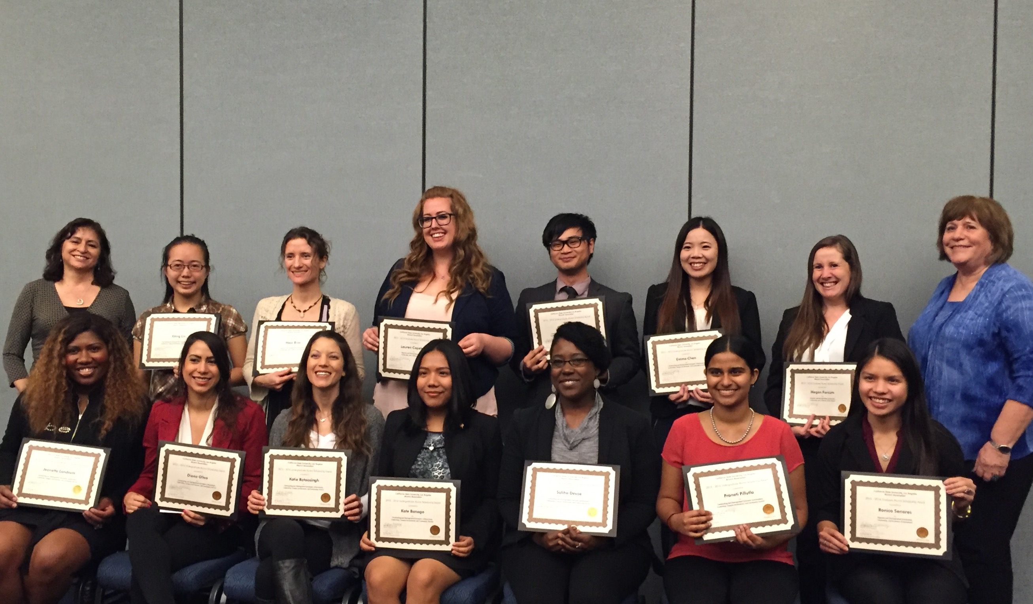
Cal State LA Alumni Association
Alumni Engagement
Alumni Scholarship Program
Alumni Mentoring Program
New Student and Parent Program (Parent Academy)
Associated Students, Inc. (ASI)
Job Shadowing/Internships
Grad Fair

Slide 8
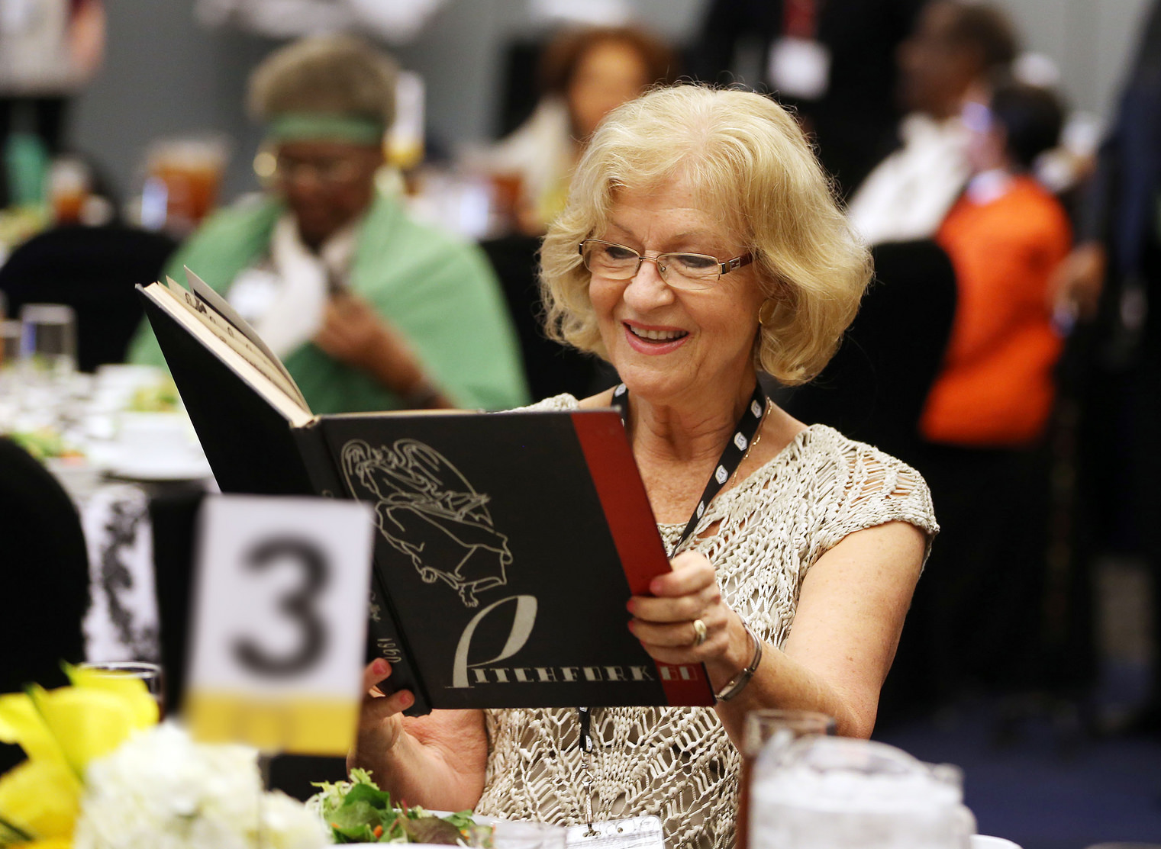
Cal State LA Alumni Association
Alumni Engagement (cont.)
Alumni Association Board of Directors and Alumni Committees
Life Membership/Life Member Appreciation
Mentoring, Career Panels, and Workshops
Alumni Awards Gala
Class Reunions
City Hall Alumni Reception
Dodger Day
Online networking groups (LinkedIn, Facebook, and Instagram)
Update alumni data and input contact reports into Raiser's Edge

Slide 9
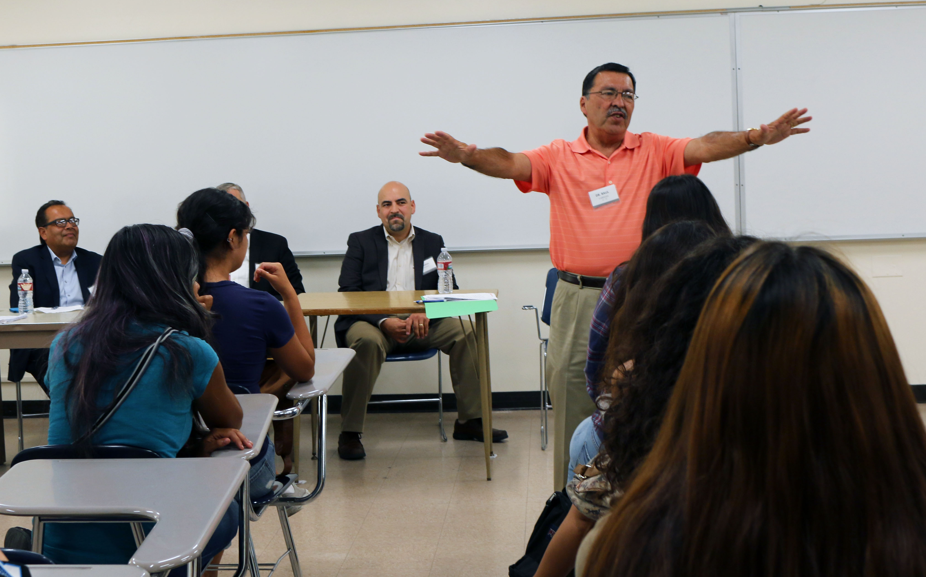
Cal State LA Alumni Association
New Programs/Opportunities
Student Alumni Ambassador Program
Revamp Alumni Affinity Networks
Center for Engagement, Service, and the Public Good
Intercollegiate Athletics/Golden Eagle Pride
Regional Alumni Networking Receptions

Slide 10
ANNUAL GIVING
Call Center, Direct Mail, E-Solicitations, President’s Associates

Slide 11
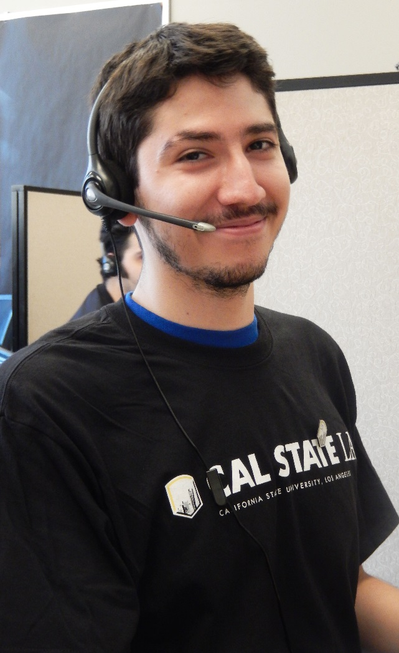
Call Center
25 Student Callers/ 11 Workstations
  Training and Script Strategies
80,000 alumni with active phone numbers
Monday – Thursday 6:00 PM – 9:00 PM
Calling Strategy
Collaboration Calls (ex. Emeriti, Reunion)

Slide 12
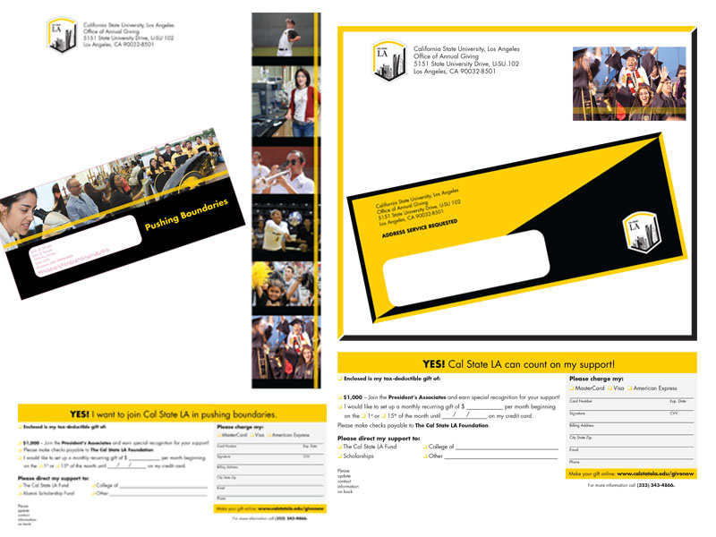
Direct Mail
Two mailings annually
  Fall & Spring
Fall General Appeal
  Focused on unrestricted giving
Spring Appeal
  Focused on 2nd asks and College based appeals

Slide 13
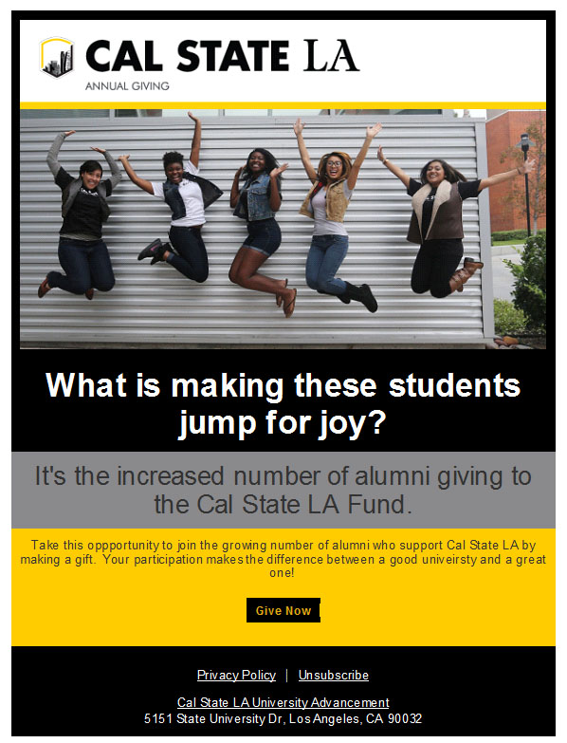
Email Solicitations
General solicitations
Geared toward driving donors to the website
Sent 6 – 8 weeks apart
  With the exception of Thanksgiving to the end of the year (about every two weeks)

Slide 14
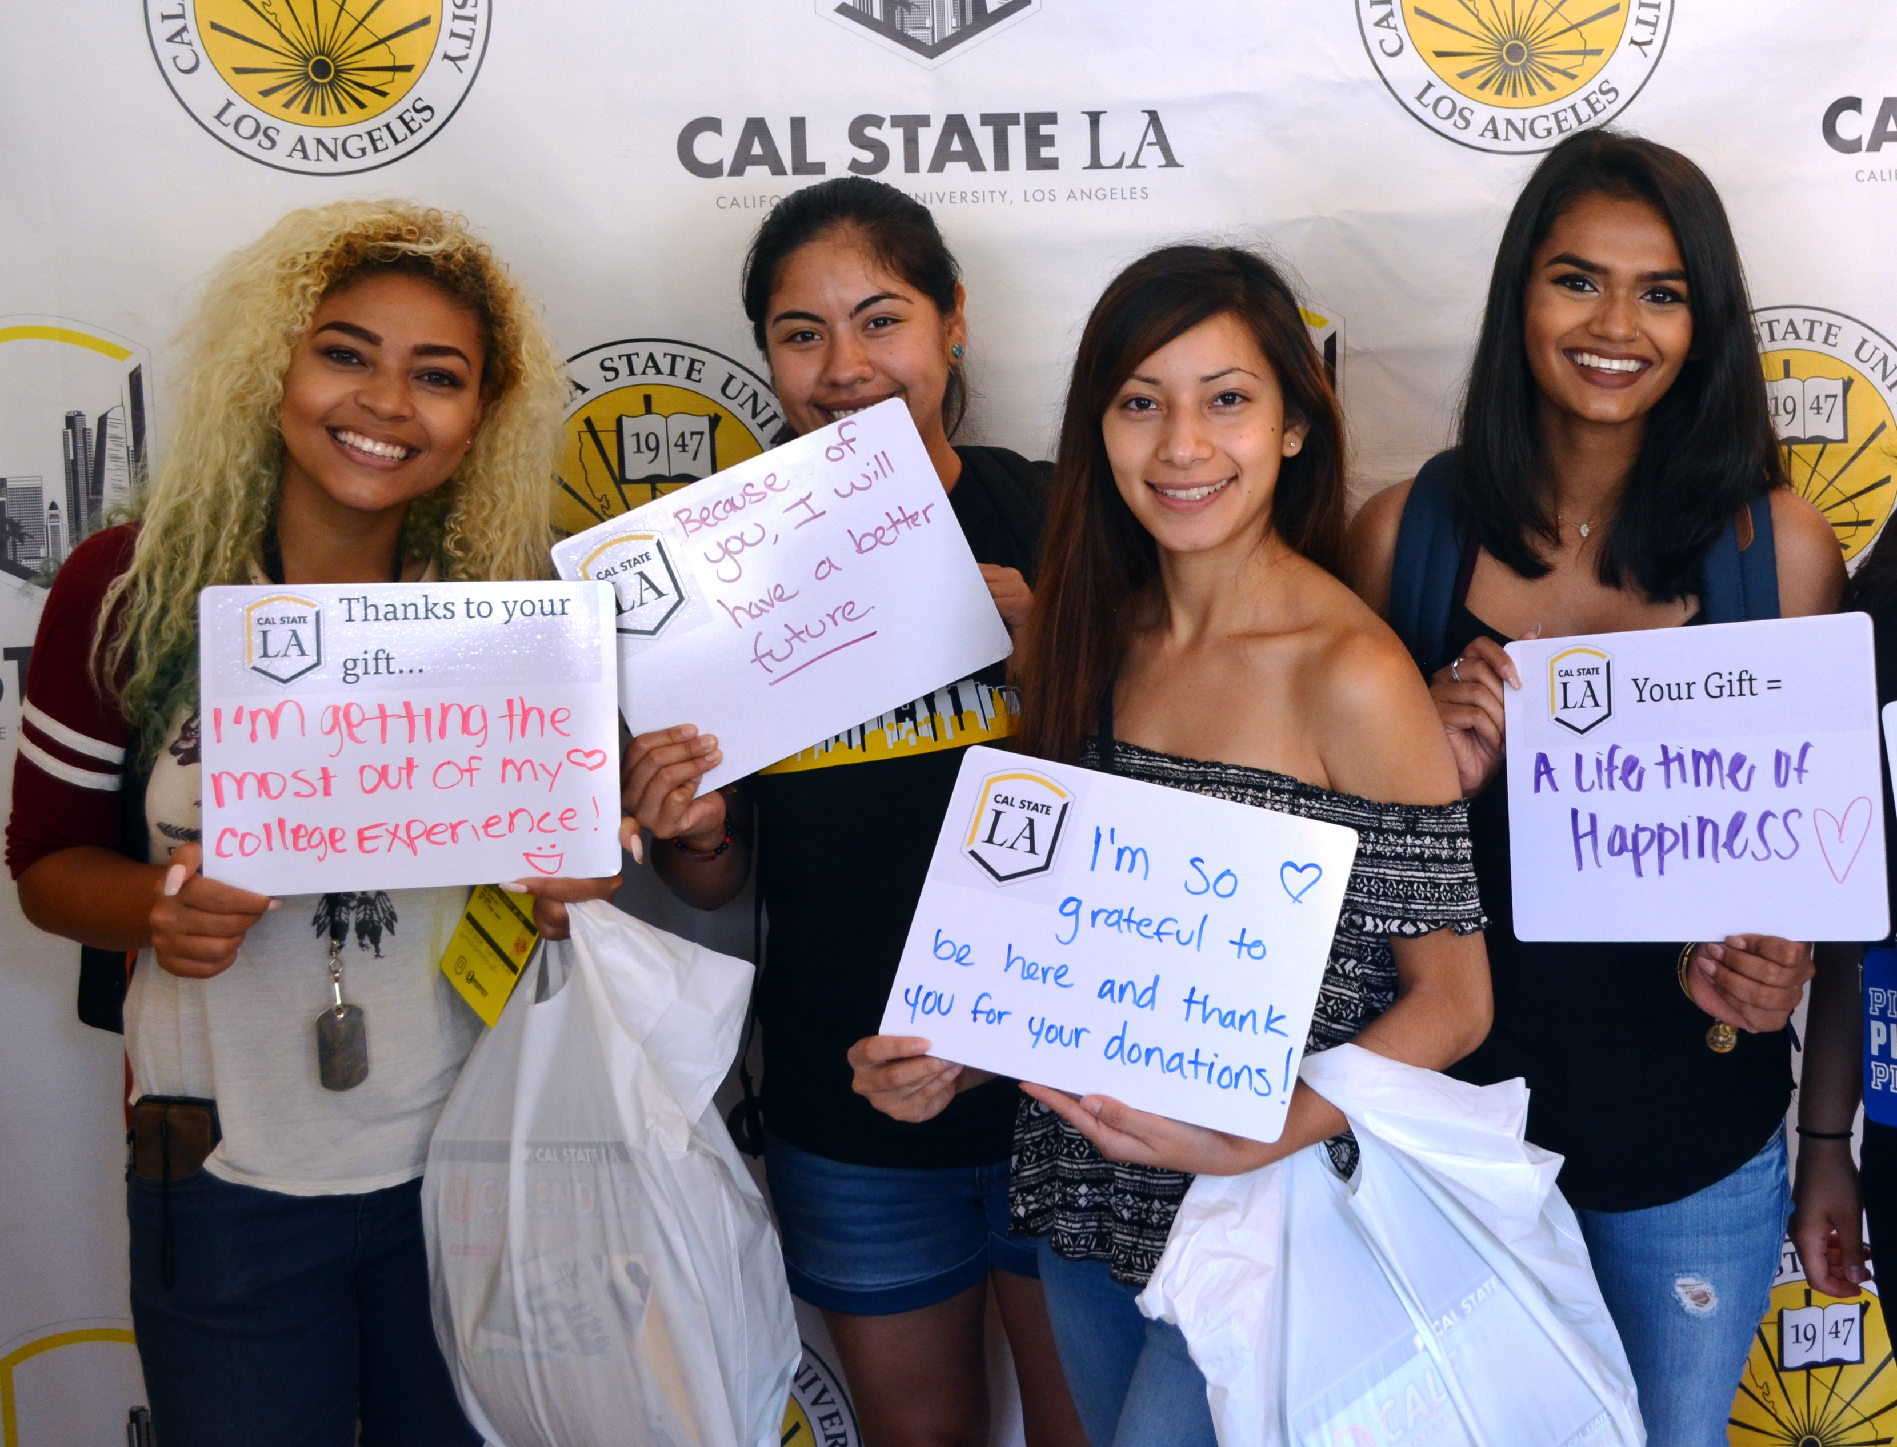
The President’s Leadership Circle
President’s Leadership Circle Giving Levels
President’s Associate $1,000 - $2,499
President’s Partner $2,500 - $4,999
President’s Benefactor $5,000 - $9,999
President’s Visionary $10,000 or more
Young Alumni President’s Leadership Circle
Giving Levels
Golden Eagle Associate (Graduates of the last decade) $500 - $999
1st Year Golden Eagle Associate (New grads one year) $250 - $499

Slide 15
MAJOR GIFTS

Slide 16
Donor Contact and Industry Benchmarks
Gift Officer Donor Contact Expectations | # Average Monthly Contacts*
Personal visits | 1-15
Contact at Events | 1-5
Telephone Conversations | 6-20 or more
Personal Letters | 1-20 or more
Email Contacts | 6-20 or more

Slide 17
Donor Contact and Industry Benchmarks
Gift Officer Performance Measurement | Ranked by Priority*
Number of in-person donor/prospect visits | 1
Number of donor contacts (including phone, e-mail, mail) | 2
Dollars raised in current gifts and/or in planned gifts with documented commitments | 3
Number of donors added to Heritage Society | 4
Number of planned gift commitments without documented dollar amount | 5

Slide 18
FACULTY AND STAFF
ENGAGEMENT

Slide 19
Engagement, Service and the Public Good
  Comprehensive List
  Cal State LA in the Community
  Programs, Workshops, Activities
  Your Work, Students’ Work

Slide 20
How You Can Participate
Contact Us: Janet Dial janet.dial@calstatela.edu
Jane Rhee jrhee7@calstatela.edu
(323) 343-3073
Thank You!

Slide 21
SAVE THE DATE
MONDAY, APRIL 16, 2018
5-8 PM

