Slide 1
Program Review
Self Study Process for Continuous Program Improvement
Karin Elliott Brown
October 7, 2022
Notes:
PR surveys, focus groups with groups that have recently undergone PR, conversation with Deans and faculty, a new PR handbook is in the works.

Slide 2
Program Review Orientation
Agenda
Learn about Program Review process
Review the Self Study template
Understand how the Self Study will be evaluated.
Learn about assessment, and IE resources
Review strategies for inclusive participation of Self Study and five-year plan.
Understand the post review process and its utility.

Slide 3
Definition and Purpose of Program Review
A program review is a cyclical process for evaluating and continuously enhancing the quality and currency of programs.
The evaluation is conducted through a combination of self-evaluation, followed by peer-evaluation by external reviewers to the department and the University (external review by outside disciplinary experts).
The results of the evaluation process are then used to inform follow-up planning and budgeting processes at various levels of the institution-program, department, college, university.

Slide 4
Why program review?
Your program’s regular check up…
  Gather numbers and qualitative data
    Who are your students?: Enrollments, majors and graduation numbers
    What will they know and be able to do upon graduation?: Assess quality of program and graduates through alumni surveys, student surveys and focus groups, employer data
  How to improve the program?
    Need evidence to demonstrate educational effectiveness
    Need evidence to support resource requests (faculty, space, staff, educational technology equipment…)
    Discussion of notable achievements and areas for improvement
    Assessment data can sometimes upset the conventional wisdom
    Examine the impact of changes in faculty and curriculum
    PR recommendations can make a difference

Slide 5
WSCUC’s Requirements for Program Review
The Program Review Process includes, but is not limited to:
Analysis of student achievement of the program’s learning outcomes (PLOs)
Retention and graduation rates
Results of licensing exams and placement
Evidence from external constituencies such as employers and professional organizations.

Slide 6
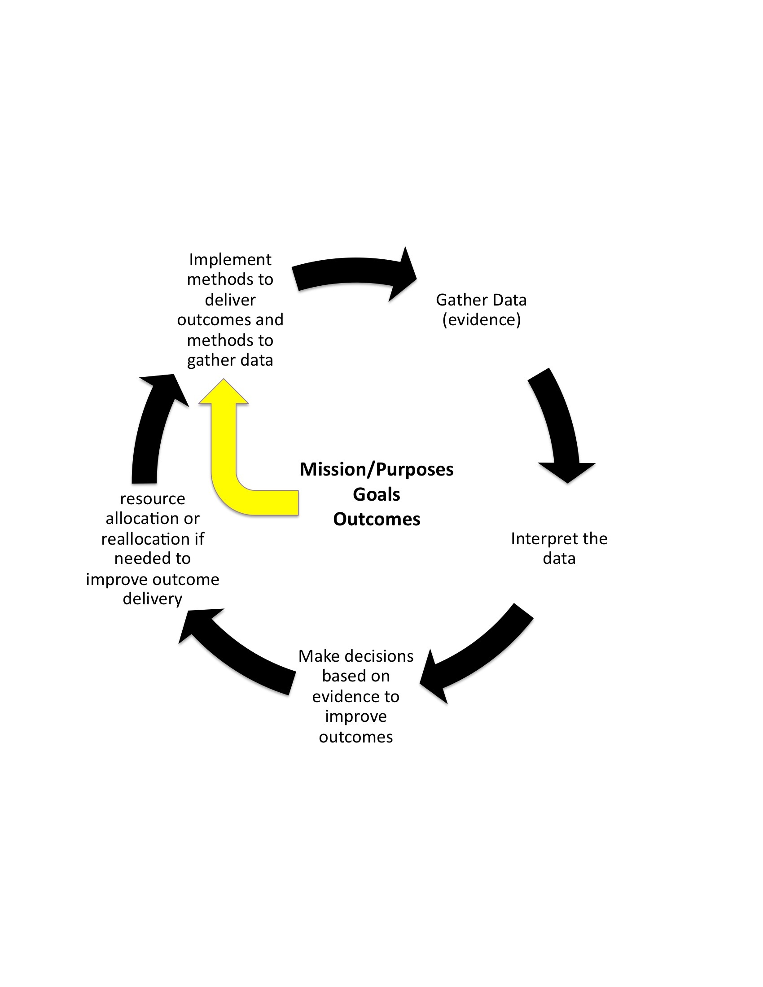
Program review-the circle

Slide 7
Steps in Program Review
Year 1: The Preparation Year (this year)
Year 2: The Review Year
Year 3: Action Plan is approved by the Provost through a MOU. Annual report due.
Post Review
Years 4-5: Action Plan
implementation continues along with
annual reports.

Slide 8
This year: The Preparation Year
Gathering data and conducting a self study
Writing the self study report
Developing a Five Year Plan
Finding candidates to recommend as external reviewers
This impacts and should involve ALL faculty members

Slide 9
Self Study: Contents
1.0 History, Mission, Goals, and Objectives
2.0 Program Data
3.0 Curriculum and Instruction
4.0 Assessment of Program Level Outcomes
5.0 Department Faculty
6.0 Student Engagement, Outreach and Recruitment
7.0 Program Self Recommendations
The Five Year Plan

Slide 10
Self Study preparation
Establish working groups that will address different sections of the Self Study.
Utilize existing standing committees (e.g., the curriculum committee addresses the curriculum section, the appropriate Assessment committee addresses the PLO section, etc.).
Develop a timeline for drafts to be finished.

Slide 11
Self Study preparation
Establishing coordination and communication mechanisms.
Complete a draft of the Self Study by/before early Spring Semester.
  The faculty can discuss it and reflect on the data with a view toward developing the core goals of the Five-Year Plan for the program(s).
Self Study report Due May 1, 2022
  College Dean’s must sign approval before submission

Slide 12
Resources for Program Review
Program Review Website
  http://www.calstatela.edu/apra/program-review-resources
Institutional Effectiveness
  http://www.calstatela.edu/InstitutionalEffectiveness

Slide 13
The 5-Year Plan Rubric
Progress | Stage Element | DEVELOPED (3)
Internal Recommendations | Recommendations and concerns identified in the PR self-study are partially addressed.
Curricular Changes | Specific curricular changes are discussed as they are affected by emerging developments using recent supporting data.
Student Factors (including SLOs) | Some student factors based on trends are described. Preliminary planning in the areas of curriculum, outreach, scheduling and student retention are documented.
Resources | Preliminary analysis of adequacy of resources for 5-yr period. Needs are identified based on program priorities or data.
Action Plan and Timeline | Preliminary action plan included. May include revised curriculum, timeline for task, person/committee. responsible, and cost.

Slide 14
Accredited programs (with external reviewers)
These program may opt to use a modified Self Study report (MSSR).
Most accreditation agencies require elements in their Self Study that are similar to those in the CSULA Self Study (and usually many that are beyond the scope of the CSULA requirements).
In most cases, these programs can use the MSSR matrix (a selected portion is shown on the next slide).

Slide 15
The Review Year
External Review in Fall Semester
  Internal Review (Meetings, meetings, meetings, with you, the College Dean, and the PRS committee meets most of all)
  PRS review of self study and external reviewers report
  Questions
  Drafts of recommendations
  Draft of the final summary report

Slide 16
The Review Year
External reviewers selected by PRS prepare a review document that contains recommendations and commendations after visiting the Program, meeting with the Program faculty and students as well as College and University administrators.
PRS examines both the self-study and the external reviewers' report. PRS meets with the program representative(s) and the College Dean(s) to forge the final summary report that contains commendations and recommendations (addressed to the program, College and University as appropriate).

Slide 17
Year Three: Action Plan and MOU
The Program Chair will meet with the College Dean to discuss the report and collaboratively develop an Action Plan to implement the recommendations in the report.
The action plan has roots in the Five-Year Plan and reflects the recommendations of PRS and accreditation bodies (if any).
The Action Plan will specify the goals and objectives for implementation before the next review and the steps to be taken by all participants to accomplish them. Reflected in a MOU with the Provost.

Slide 18
Annual reports
Will be due in Fall Semester.
The annual report is important for several reasons.
  It will be a piece of your next Self Study, both as an appendix and summarized in your assessment section.
  It is an odometer reading on your progress in accomplishing the goals the program set in its action plan (are we there yet?).
  It facilitates annual meetings with your College Dean to support continuous program improvement.

Slide 19
Questions?

