Slide 1
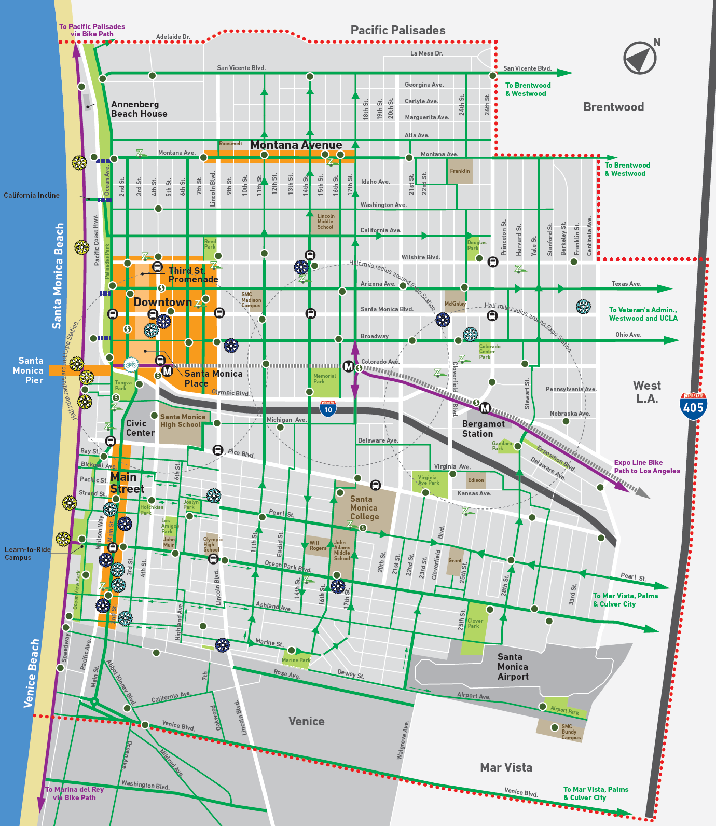
Impacts on
Santa Monica's
BIG BLUE BUS
By
Ivett Zazueta
Jose Chavez
POLS 5840
Dr. Lynch

Slide 2
OVERVIEW
Project Direction
Background
Data Analysis
Findings
Recommendations
Group Dynamic
Community Services
Concerns

Slide 3
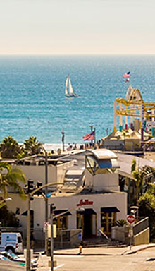
BACKGROUND
City of Santa Monica
  2016 Population 92,000
    Median Household Income (2015) $76k
    Income Per Capita (2105) $59k
  Big Blue Bus
    Since 1928
    Approx. 15 million riders per year
    200 vehicles
    51 Sq. mile service area

Slide 4
Initial Project
Data review on how homelessness and the mental health population affect the safety, security, and property damage
Literary review on best practices to address transient population
Project’s Direction Shift
Data review on safety, security, and property damage
Literary review on best practices to address transient population

Slide 5
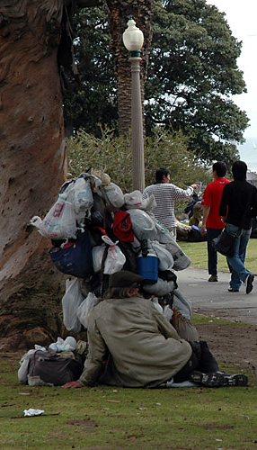
ISSUES
Santa Monica
  26% increase in homeless population since last year
Big Blue Bus
  Ridership has decreased about 12% as of March 2017
  The decline is believed to be caused by the homeless/mental health population

Slide 6
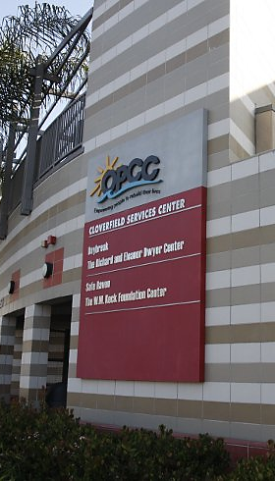
COMMUNITY SERVICES
Local organizations
  Various services specific groups
211 24hr Hotline
  Connects people to basic needs
Santa Monica Homeless Count
  Largest proactive measure

Slide 7
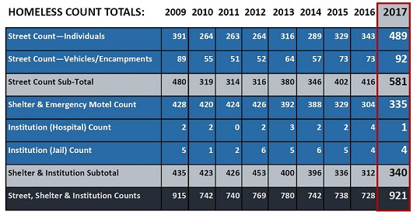
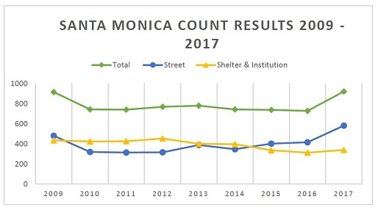
results

Slide 8
ANALYSIS
Raw Data
Datasets
Data Analyses
Data Validity

Slide 9
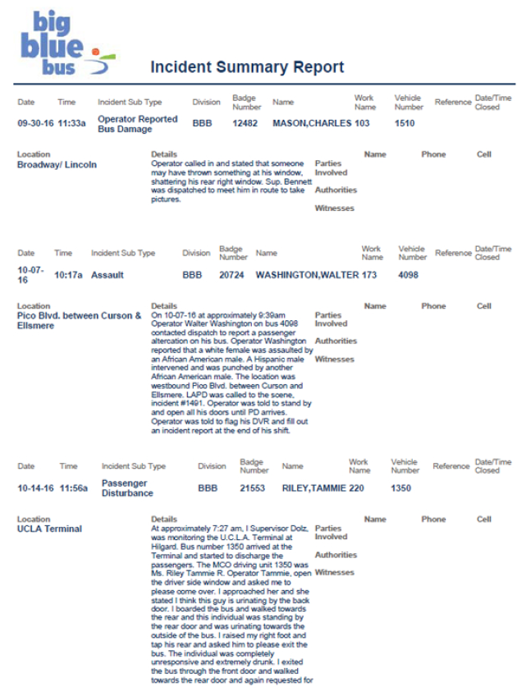
RAW Data sample

Slide 10
Dataset sample
Categorical Incident Index Table Chart
CATEGORIES | INCIDENTS | PERCENT
Assault | 21 | 12.65%
Bus Damage/Property Damage | 28 | 16.86%
Fare Dispute w/o Passenger Disturbance | 4 | 2.40%
Miscellaneous | 48 | 28.91%
Operator/Passenger Altercation | 1 | 0.60%
Passenger Disturbance | 63 | 37.95%
Theft | 1 | 0.60%
TOTAL | 166 | 100%

Slide 11
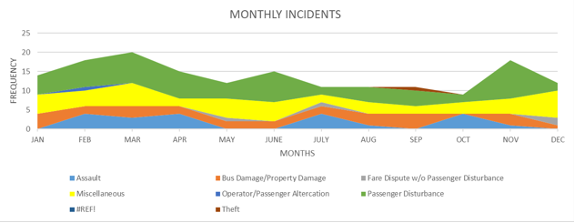
Data analyses Continued:
Incident area chart
Most incidents do not occur
80% hike

Slide 12
Data analyses continued
DAILY INCIDENT APPROXIMATE
44%
75%
-2%

Slide 13
Data analyses
CONTINUED
from 1:00 to 5:00 pm
Cluster column chart

Slide 14
Data
analyses
continued
AM
PM

Slide 15
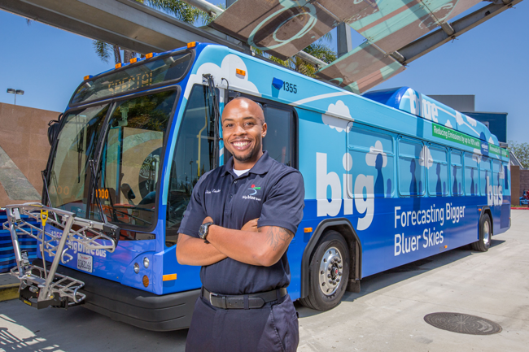
INTERVIEWS
Motor Coach Operator
  40% of riders do not pay their fare
Potential external factors
  Metro extension of Expo Line
  Increased Uber/Lyft ridership
  File incident report if necessary

Slide 16
FINDINGS
The transient population may not be the problem
  Homeless/Mental illness individuals are not easily identified
External Factors
Several competitions in ridership market
  Uber/Lyft
  Expo line
  Bicycles

Slide 17
CONCERNS
Proposition HHH
    City initiative increased of sales tax
    $1.2 billion for permanent supportive housing
Measure H
    County initiative increased of property tax
    $355 million dedicated to supportive services

Slide 18
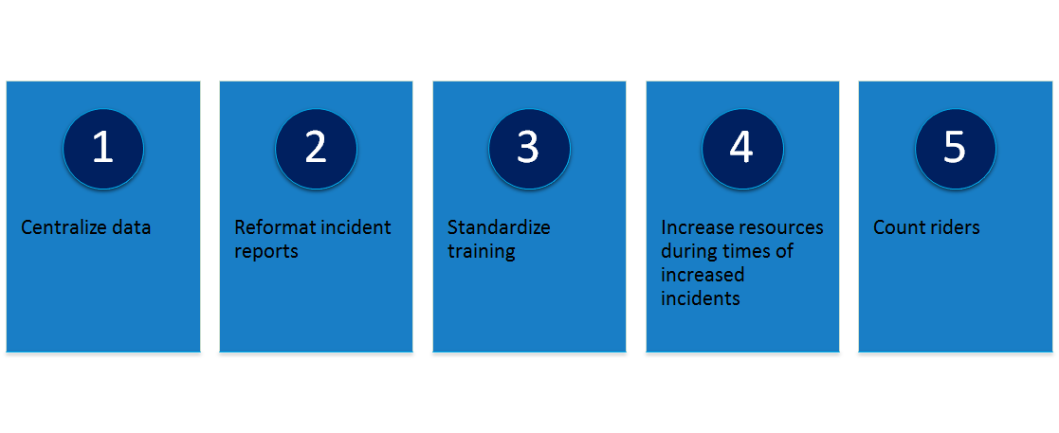
RECOMMENDATIONS

Slide 19
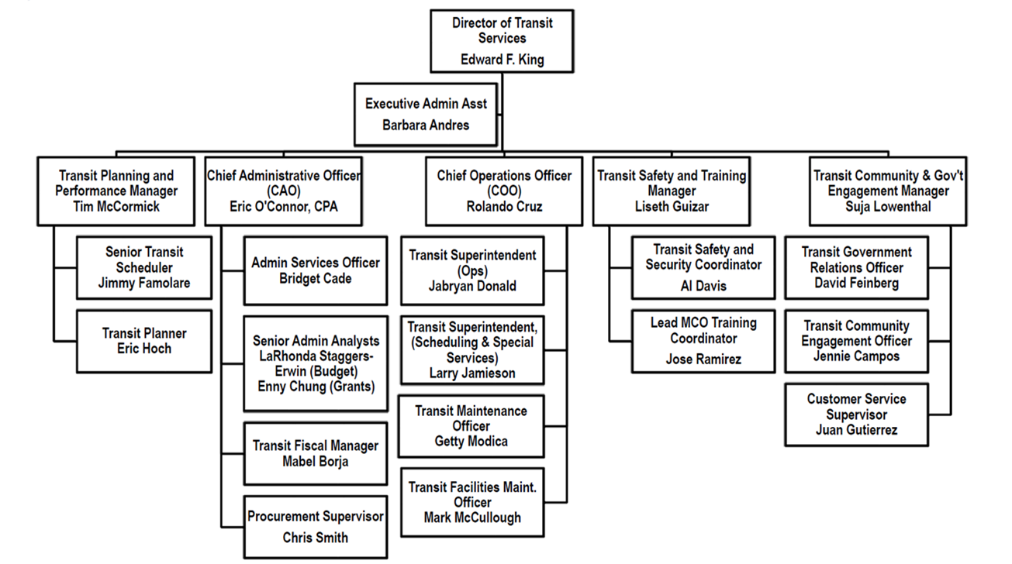
CITY CONTACTS

Slide 20
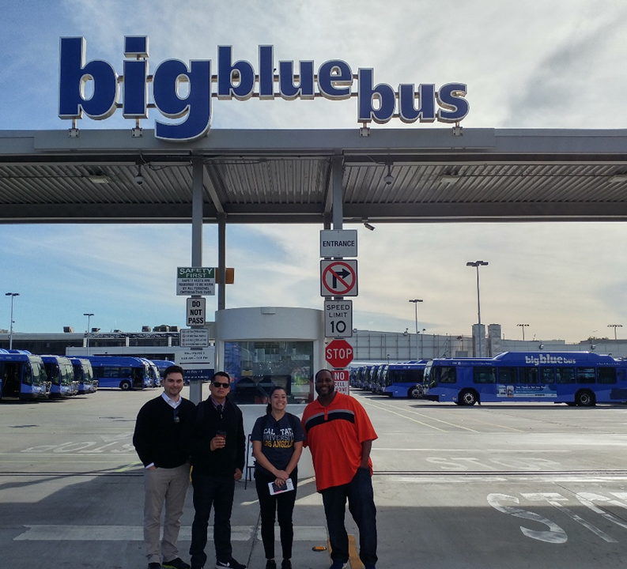
GROUP DYNAMIC
Frequent communication through various forms
Open floor
1st meeting, introduces, divided tasks, appointed Cameron as primary contact person
Adaptive to new shifts and necessary changes
Collaborative and supportive

Slide 21
References
Elijah Chiland, “Homeless population in Santa Monica is up 26 percent,” Curbed Los Angeles, May 9, 2017, https://la.curbed.com/2017/5/9/15601342/santa-monica-homeless-population-increase.
Community and Cultural Services. Information Item: Local Homeless Efforts in a Regional Context. Santa Monica, CA: Karen Ginsberg, Director of Community and Cultural Services, 2017.
Anonymous interviews with the homeless community
Amelia Taylor-Hochberg, “How Metro is responding to LA’s homelessness crisis,” Curbed Los Angeles, September 20, 2017, https://la.curbed.com/2017/9/20/16327770/la-metro-homeless- services.
Katie Cagle, “Big Blue Bus ridership down 12% despite mass transit push,” Santa Monica Daily Press, March 3, 2017, http://smdp.com/big-blue-bus-ridership-down-12-despite-mass-transit- push/159976.

