Slide 1
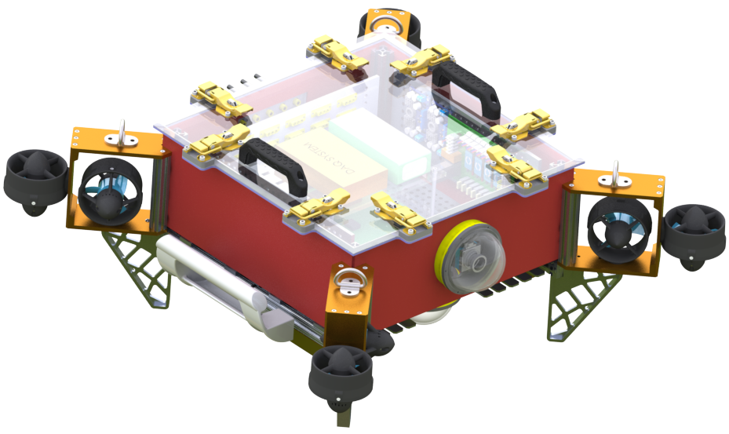
Senior Design Capstone Project: RoboSub
By: Albert Chew, Gabriela Cortes-Mejia, Heriberto Gonzalez, Ricardo Medina, Horacio Mondragon, Brandon Pham, Sana Shaikh, Wilson Weng, Kevin Williams
Advisor: Richard Cross Liaison: Mark Tufenkjian

Slide 2





What is Robosub
Purpose - To foster ties between young engineers and the organizations developing AUV technologies.
Competition Goal - Design an Autonomous Underwater Vehicle (AUV) demonstrate its autonomy by completing a series of tasks.
Competition Sponsors:

Slide 3
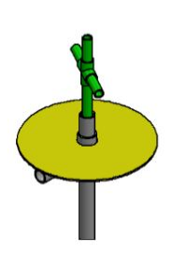
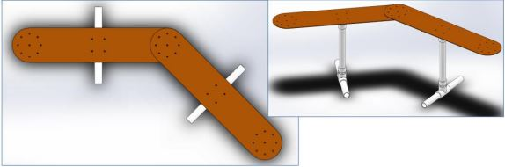
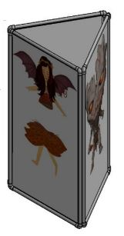
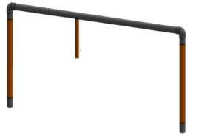
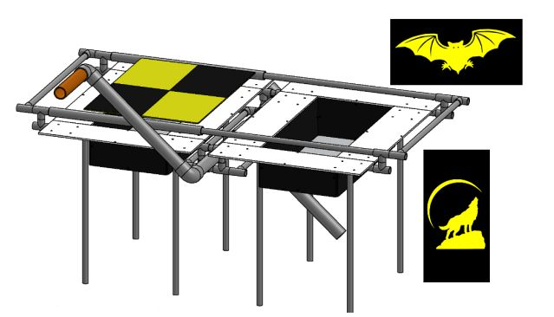
Tasks
Pick Up
Paths
Buoy
Gate Task
Bins Task

Slide 4
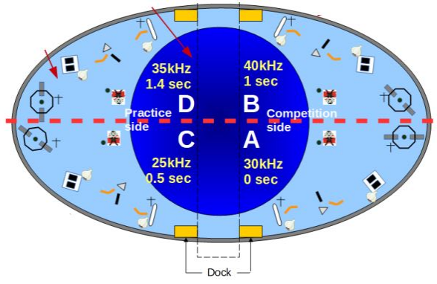
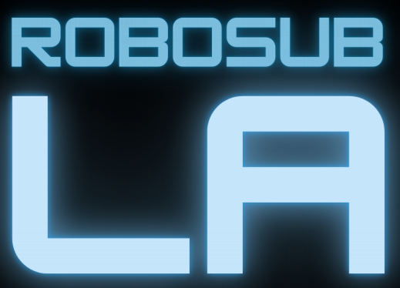
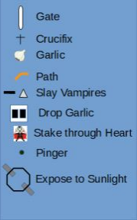
Competition Map

Slide 5
Competition Required Technologies
Heriberto Gonzalez
Artificial Intelligence
Object Recognition
Autonomous Movement and Navigation
Peripheral Controls
Sensor Data Acquisition and processing

Slide 6
Competition Format
Heriberto Gonzalez
Judged on 3 Submissions
Design Document
  Technical document explaining the project
Team Video
  Video describing a specific subsystem of the project
Website
  Timeline of project
  Project Description
  Fostering community

Slide 7
Project Breakdown
Heriberto Gonzalez
Computer Science Senior Design Team:
9 Computer Scientists
Objective
  Design and implementation of AUV software
Mechanical Engineering Senior Design Team:
Team of 10 Mechanical & Electrical Engineers
Objective:
  Design and construct an AUV
Robosub Club Team:
Team of lower division students from ME/EE/CS fields
Objective
  Build Secondary AUV for the competition
  Learn skills needed for future design teams

Slide 8
Software Team Breakdown
Controls
Mission Planning
Navigation
Computer Vision

Slide 9
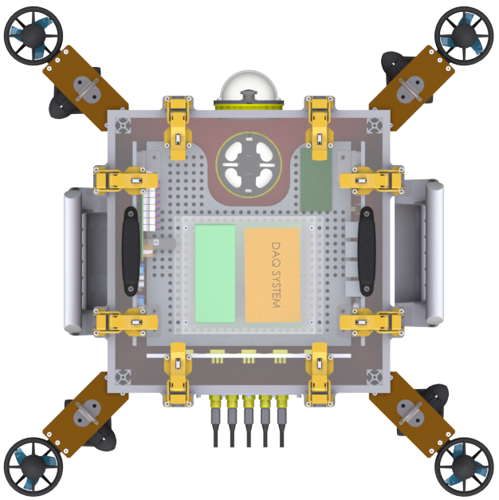
Controls
Controls Objective:
Research and implement code for the 8 thrusters on the sub using PID controllers
Tasks:
Analysis of the requirements
Developed code for each thruster
Created a prototype to test code
Created Graphical User Interface

Slide 10
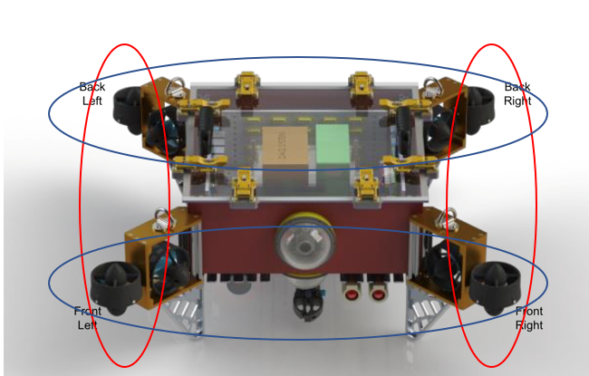
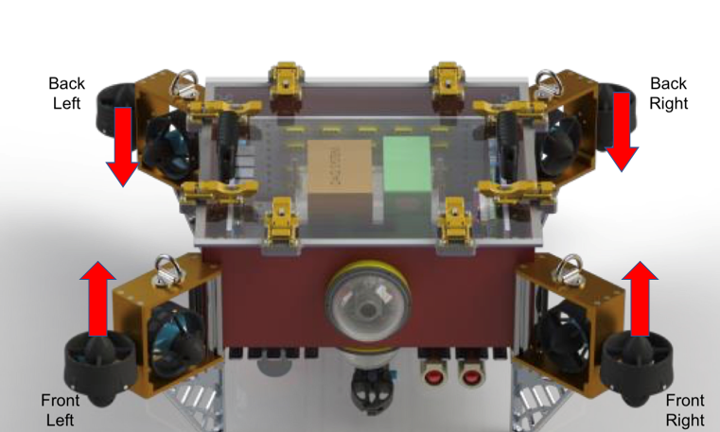
Thruster Movement
Thruster Movement:
The red circles represent Roll, while the blue circles represent Pitch. The front and back thrusters are grouped together​
The PID controllers will help balance the sub if it tips up or down. The arrows represent the direction the sub will move while balancing

Slide 11
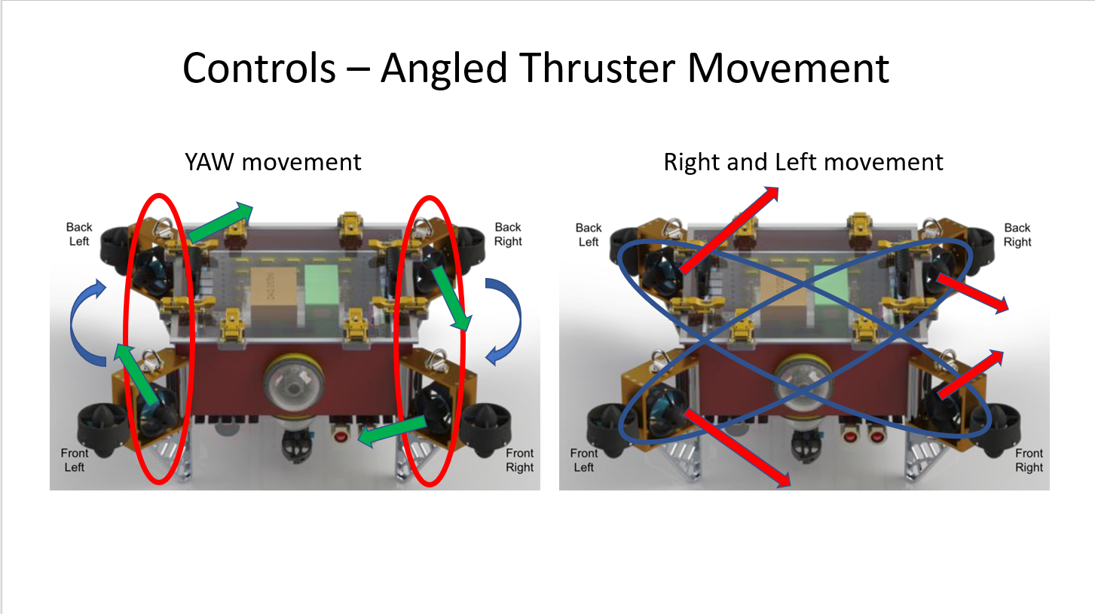
Angled Thruster Movement

Slide 12
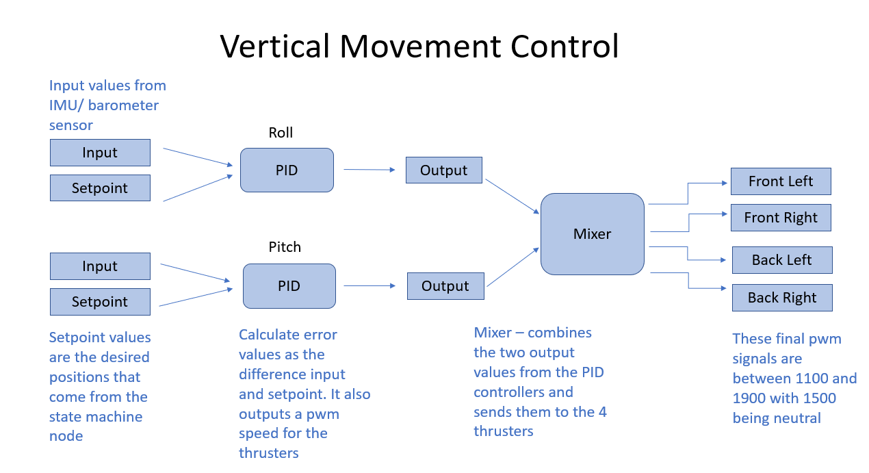

Slide 13
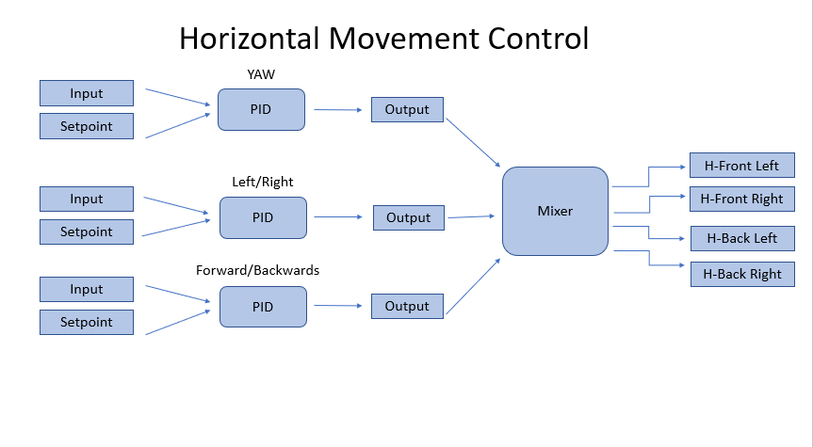

Slide 14
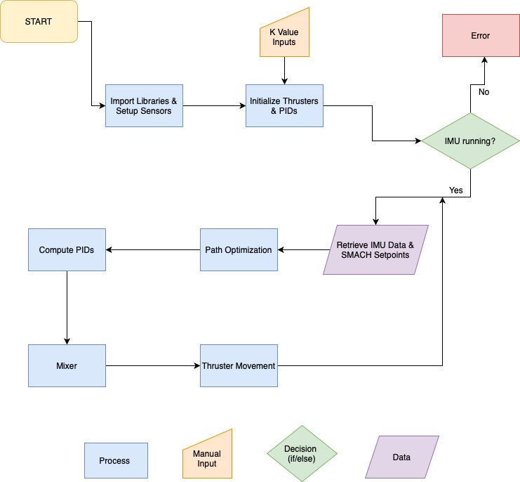
Code Flowchart

Slide 15
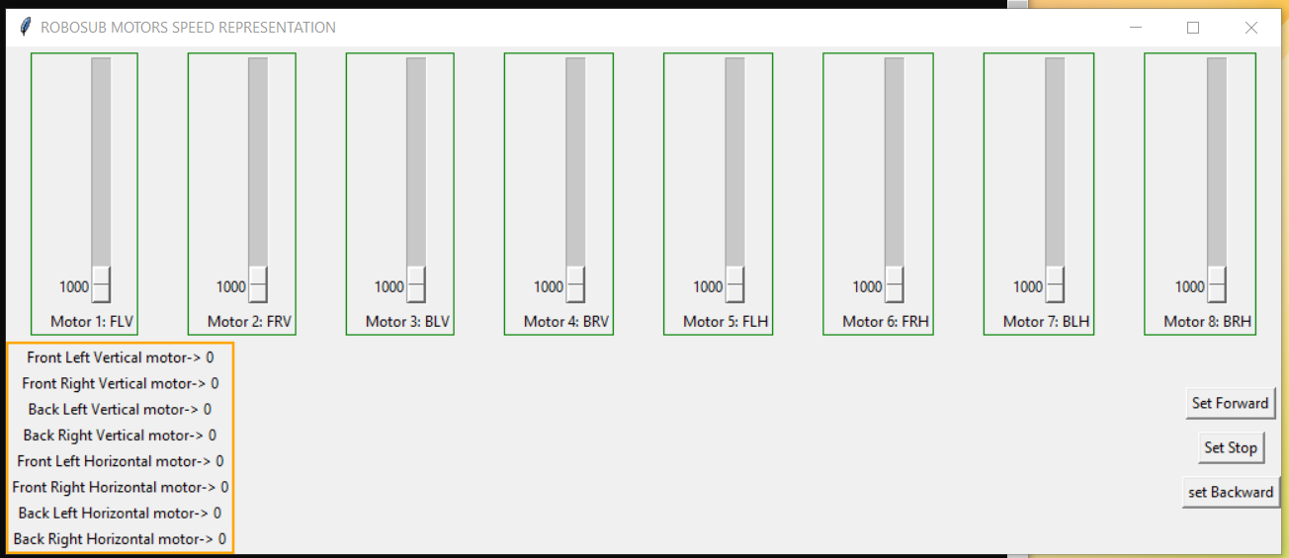
Graphical User Interface
GUI:
Representation of RoboSub thrusters with a user interface coded in python
Simulation motors output.

Slide 16
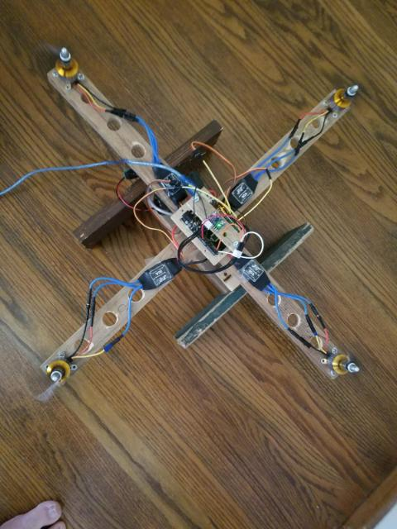
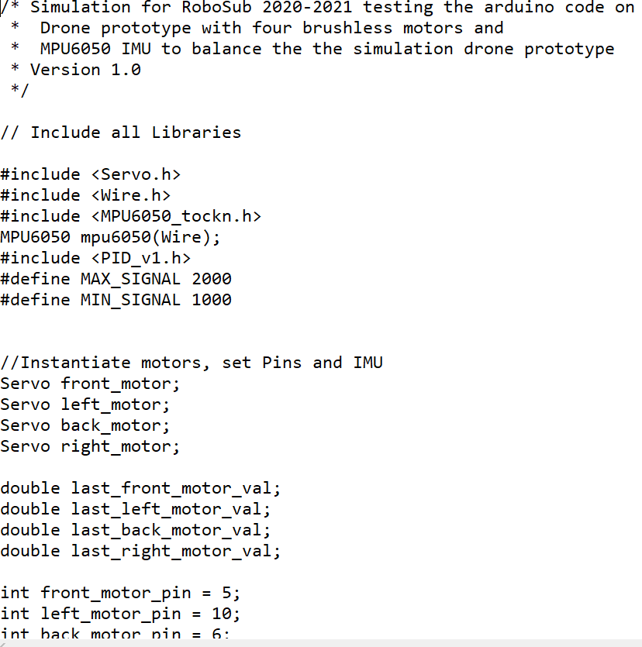
Prototype
Prototype:
Built a drone prototype to test PID algorithms and balancing code
A small segment of Arduino Balance code to balance the drone.

Slide 17
Mission Planning
Mission Planning Objective:
Implement AI to control the functions of the AUV to clear tasks
Allow the subsystems and hardware to interact and transfer required data so the AUV can complete its current objective
Tasks:
Establish data that each subsystem requires from others.
Implement the specific actions required for each task
Connect the subsystems through AI with the usage of ROS.

Slide 18
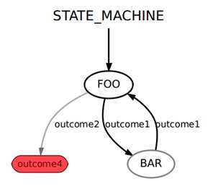
ROS and Smach
Robot Operating System:
Libraries and tools to help with the development of robot applications
Publishers & Subscribers
  Publishers continually broadcasts a message
  Subscribers listen in to receive messages
Smach:
ROS package used for complex plans
Example given is a state machine flow chart showing different states with transitions
Written in python

Slide 19
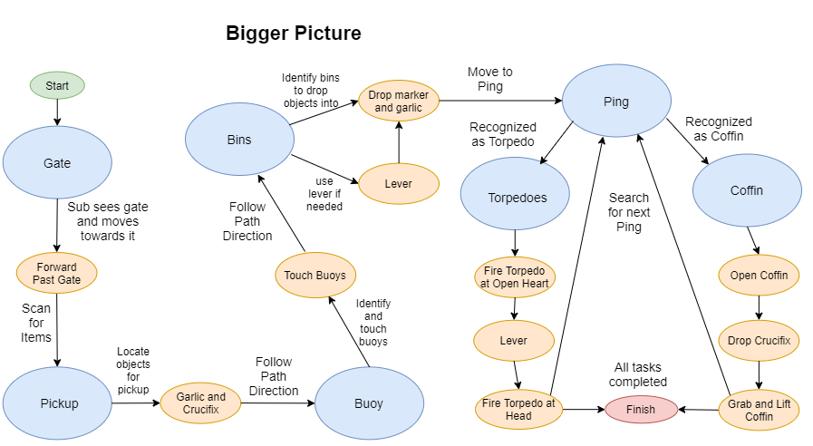
General Flowchart
Wilson Weng

Slide 20
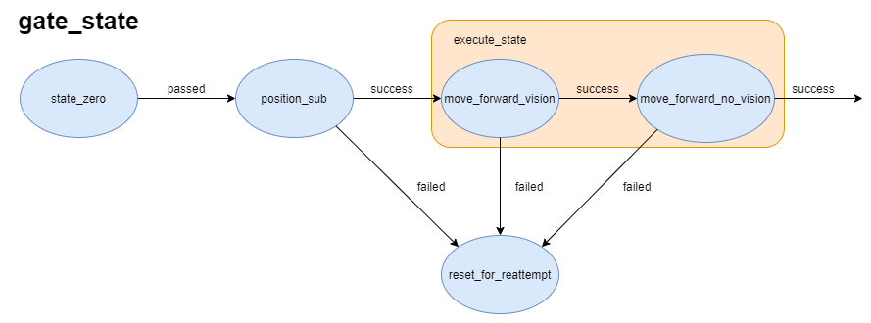
State Charts
Info:
Charts are placed alongside code in Github
Position_sub is a file that takes data from Computer Vision and transitions into Execute_state
Execute_state is the substates in one file
The arrows are names of transitions between states
Wilson Weng

Slide 21
Navigation
Tasks:
Connect Sensor to Arduino board/ understand errors
Install and run ROS
Incorporate ROS on Arduino
Combine sensor code with ROS for creation of ROS nodes which sends data from sensors to Mission Planning
Sonar Objective:
Detect objects underwater and deliver objects distance in a ROS node to controls
Output distance in mm, inches, and confidence score
IMU Objective:
Determine position and angles that the platform is facing

Slide 22
Computer Vision
Heriberto Gonzalez
Cv Objective:
Object Detection:
  Be able to detect when an object of interest is present in view of our AUV
Object Recognition:
  Classify and Recognize the various objects throughout the course
Output:
  Outputting what we see and where in relation to the cameras it is.
Tasks:
DataSet:
  Gather and develop a large enough dataset to train our CNN on.
Training Convolutional Neural Network:
  Using Darknet to train our YOLO V4 CNN algorithm
Testing:
  Testing the performance and accuracy of our Network on live video.

Slide 23
Convolutional Neural Networks (C.N.N)
Heriberto Gonzalez
Convolutional Neural Networks:
Deep Learning algorithm which can take in an image, assign importance to various aspects/ objects in the image and be able to differentiate one from the other
Darknet:
Open-Source Neural Network framework written in C and CUDA
Allows us to train our CNN using our GPU ( Graphics Processing Unit )
YOLO v4:
Convolutional Neural Network algorithm for real-time object detection.

Slide 24
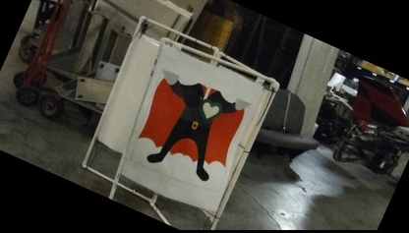
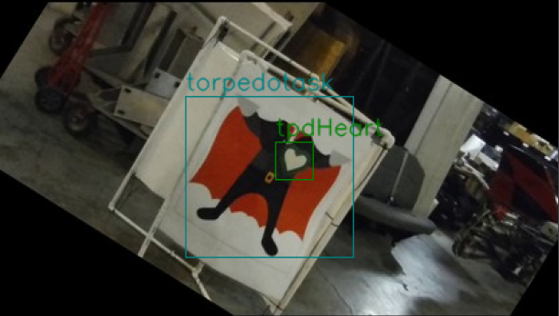
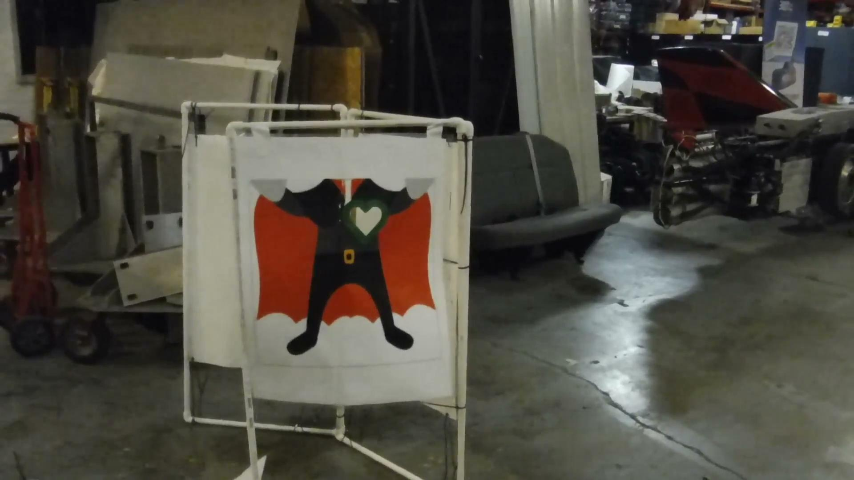
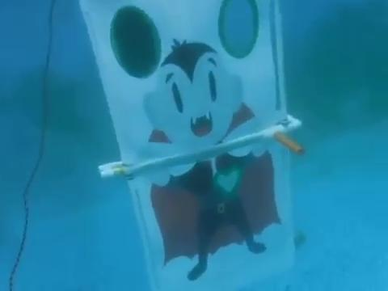

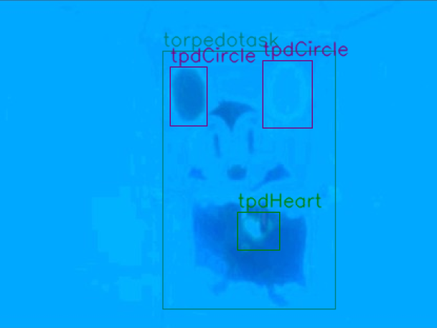
Image DataSet
Horacio Mondragon
Image DataSet:
Was developed from videos provided to us by the Ohio State University RoboSub team.
12 Objects were selected to train our Convolutional Neural Network
DataSet consists of 4,000+ images
Frame Extract
Labeling Images
Frame Extract
Labeling Images

Slide 25
Website: RobosubLA.com
Details:
Programmed using Javascript using the frontend library React.js
  React- Open Source, front end, Javascript library for building user interfaces or UI components.
  Components created with focus on reusability and site expansion.
  Hosted on AWS Server in connection to the Github Repository
Central Resource for incoming students and senior design members
Host links to all relative materials related to the RoboSub Project and Club
Website: robosubla.com

