Slide 1
The Gaussian Primes
Tony Shaheen
CSU Los Angeles
This talk can be found on my website:
www.calstatela.edu/faculty/ashahee/

Slide 2
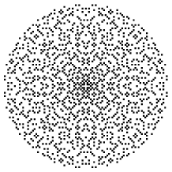
These are the Gaussian primes.
The picture is from http://mathworld.wolfram.com/GaussianPrime.html

Slide 3
Do you think you can start near the middle and jump along the dots with jumps of
bounded size (like size 3) and make it out to infinity?
That is, are there arbitrarily large gaps in the Gaussian primes?

Slide 4
No one knows the answer to this question. We do know the answer for the ordinary
integers though. The answer there is no.
This talk is about these two problems.

Slide 5
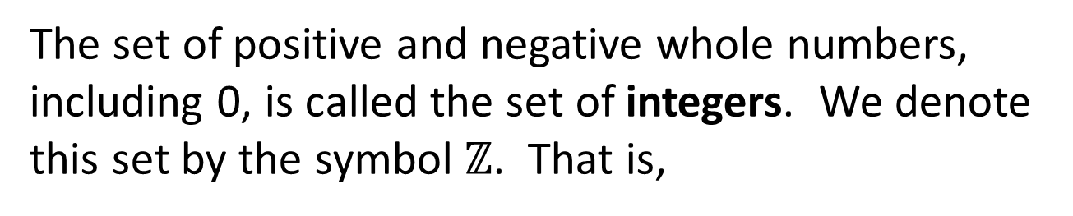
The set of positive and negative whole numbers,
including 0, is called the set of integers. We denote
this set by the symbol $ℤ$. That is,
$$ℤ=\{ 0, 1, −1, 2, −2, 3, −3, 4, −4, 5, −5, …\}$$

Slide 6

We can visualize the integers as an infinite set of points
on the number line extending in both directions.
-7
-6
-5
-4
-3
-2
-1
0
1
2
3
4
5
6
7
$$ℤ$$

Slide 7
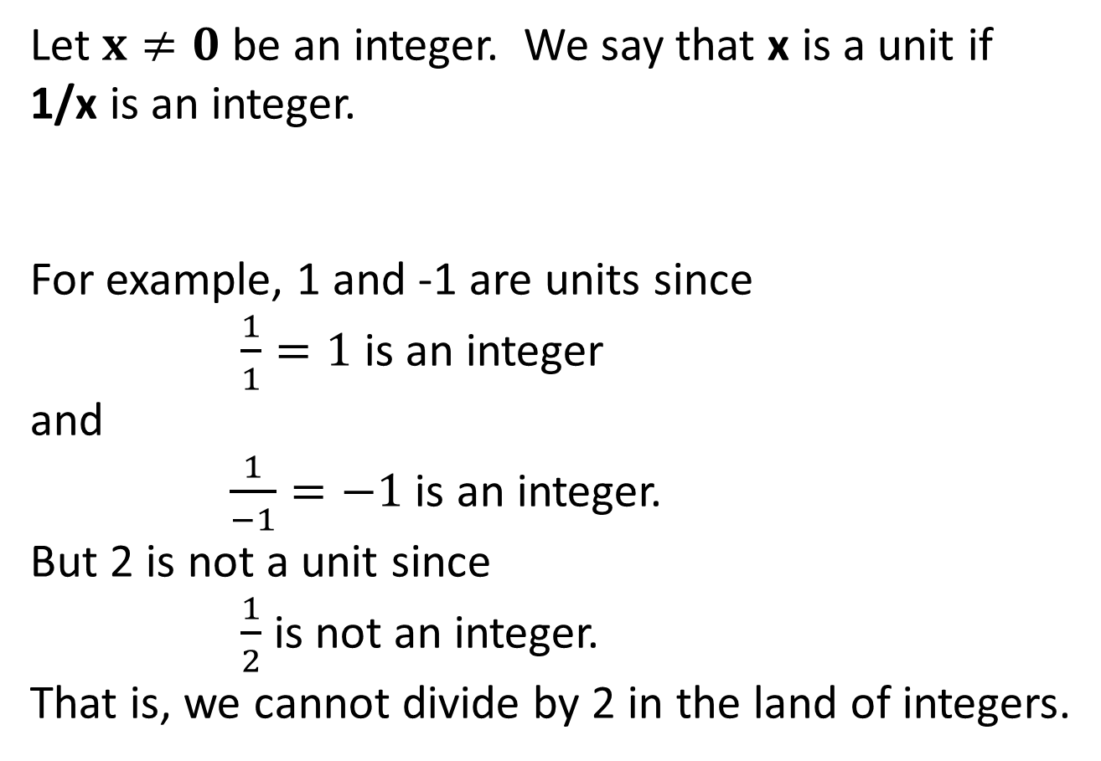
Let $x≠0$ be an integer. We say that x is a unit if
1/x is an integer.
For example, 1 and -1 are units since
$\frac{1}{1}=1$ is an integer
and
$\frac{1}{−1}=−1$ is an integer.
But 2 is not a unit since
$\frac{1}{2}$ is not an integer.
That is, we cannot divide by 2 in the land of integers.

Slide 8

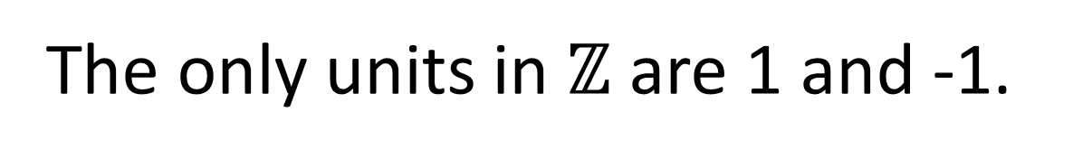
The only units in $ℤ$ are 1 and -1.
-7
-6
-5
-4
-3
-2
-1
0
1
2
3
4
5
6
7
$$ℤ$$

Slide 9
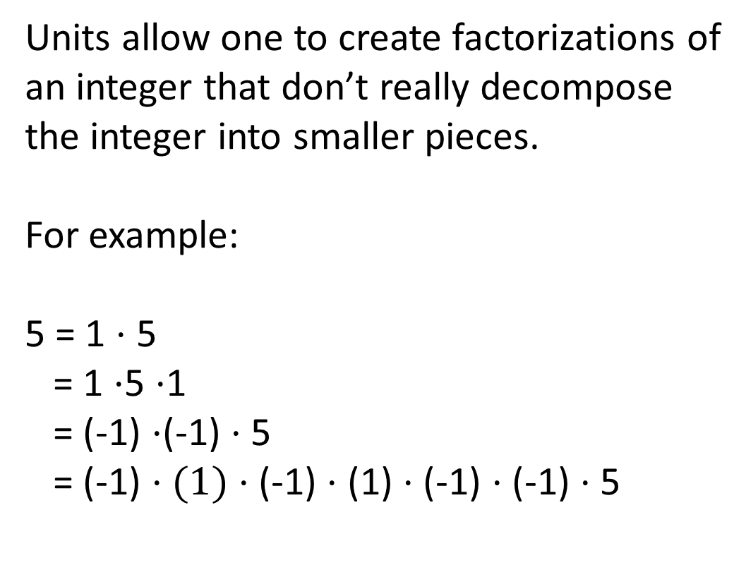
Units allow one to create factorizations of
an integer that don’t really decompose
the integer into smaller pieces.
For example:
5 = 1 $⋅$ 5
= 1 $⋅$5 $⋅$1
= (-1) $⋅$(-1) $⋅$ 5
= (-1) $⋅(1)⋅$ (-1) $⋅$ (1) $⋅$ (-1) $⋅$ (-1) $⋅$ 5

Slide 10
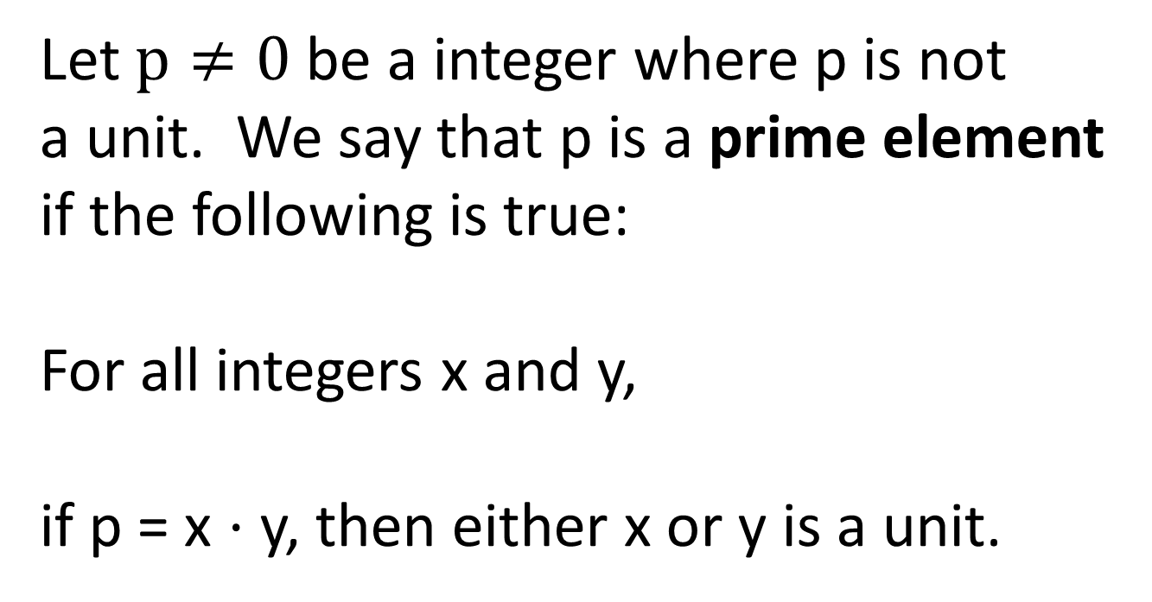
Let $p≠0$ be a integer where p is not
a unit. We say that p is a prime element
if the following is true:
For all integers x and y,
if p = x $⋅$ y, then either x or y is a unit.

Slide 11
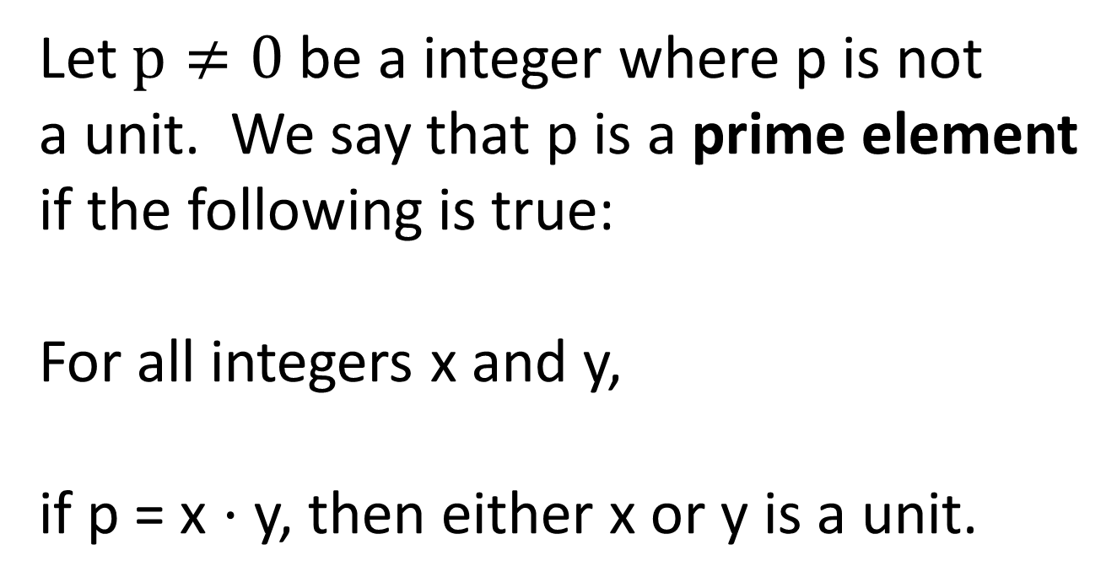
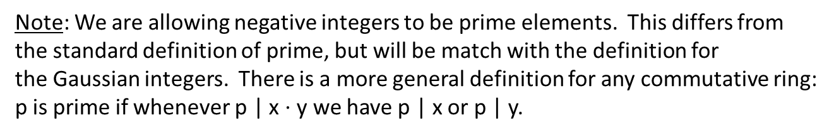
Let $p≠0$ be a integer where p is not
a unit. We say that p is a prime element
if the following is true:
For all integers x and y,
if p = x $⋅$ y, then either x or y is a unit.
Note: We are allowing negative integers to be prime elements. This differs from
the standard definition of prime, but will be match with the definition for
the Gaussian integers. There is a more general definition for any commutative ring:
p is prime if whenever p | x $⋅$y we have p | x or p | y.

Slide 12
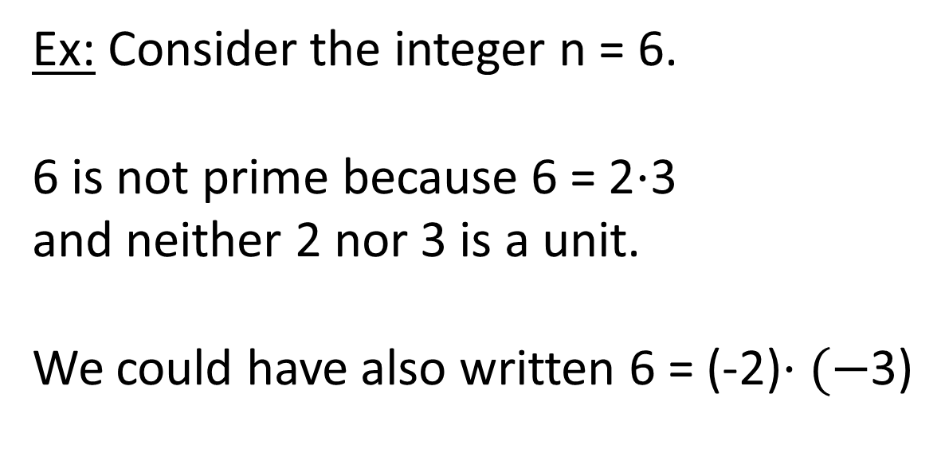
Ex: Consider the integer n = 6.
6 is not prime because 6 = 2$⋅$3
and neither 2 nor 3 is a unit.
We could have also written 6 = (-2)$⋅(−$3)

Slide 13
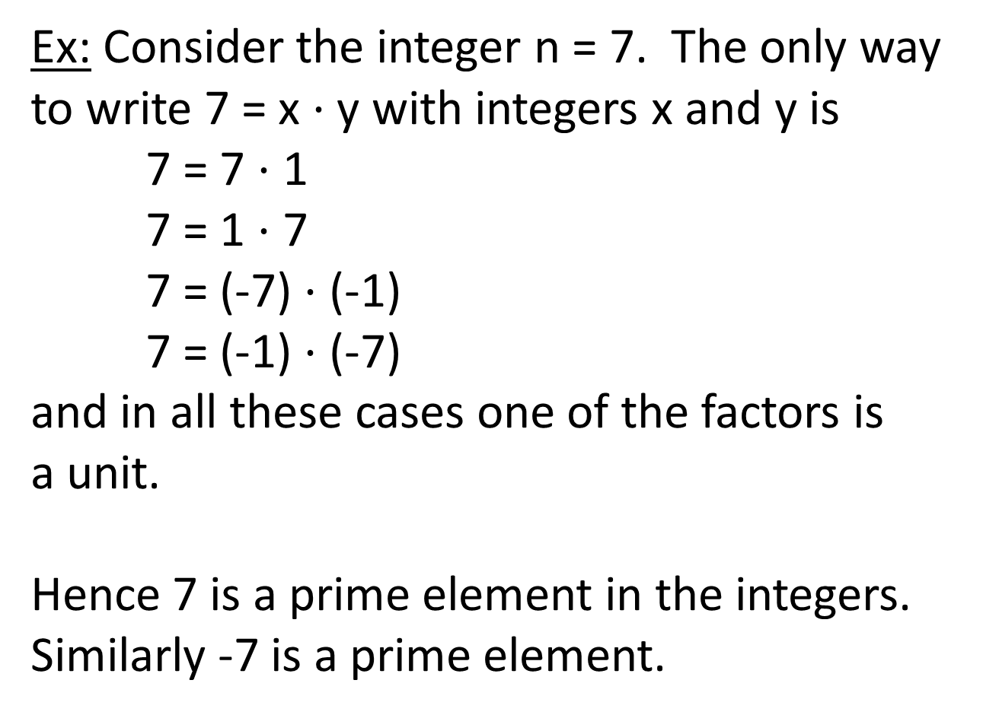
Ex: Consider the integer n = 7. The only way
to write 7 = x $⋅$y with integers x and y is
7 = 7 $⋅$ 1
7 = 1 $⋅$ 7
7 = (-7) $⋅$ (-1)
7 = (-1) $⋅$ (-7)
and in all these cases one of the factors is
a unit.
Hence 7 is a prime element in the integers.
Similarly -7 is a prime element.

Slide 14
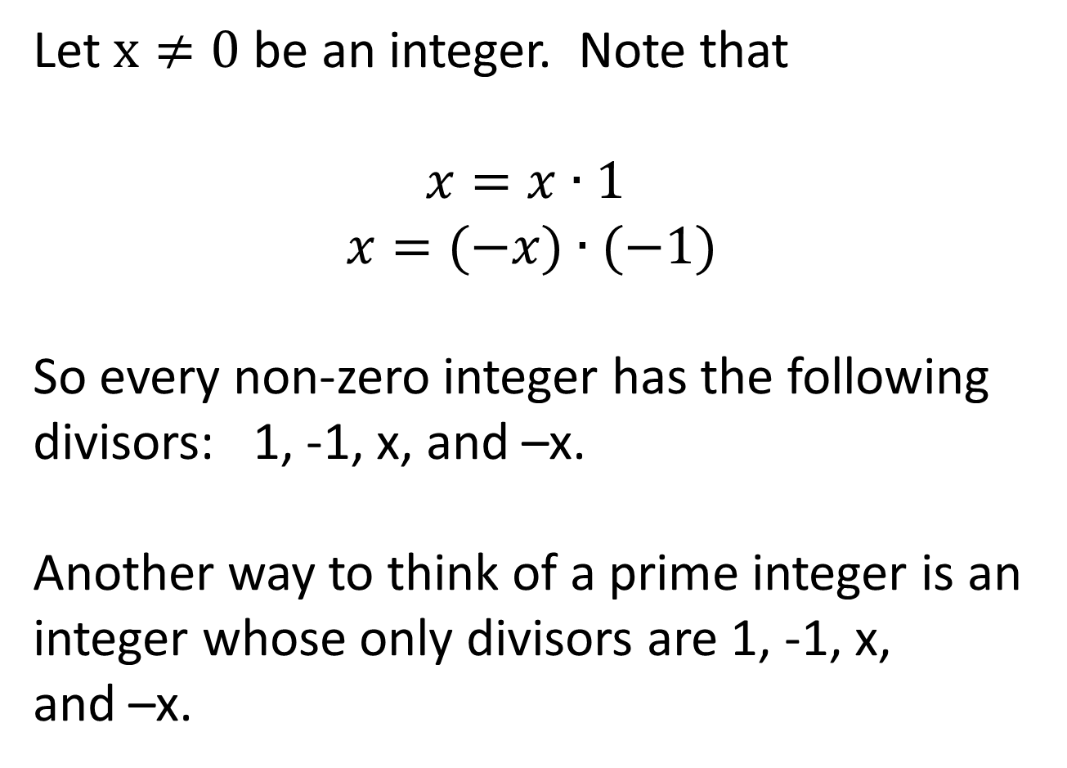
Let $x≠0$ be an integer. Note that
$$x=x∙1$$
$$x=(−x)∙(−1)$$
So every non-zero integer has the following
divisors: 1, -1, x, and –x.
Another way to think of a prime integer is an integer whose only divisors are 1, -1, x,
and –x.

Slide 15
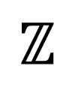
Here are some of the prime elements in the integers.
Note the symmetry about the integer 0.
-7
-6
-5
-4
-3
-2
-1
0
1
2
3
4
5
6
7
$$ℤ$$

Slide 16
Question: Can one start at the prime 2
and then jump along the primes to infinity
where the jumps are of bounded length?
2, 3, 4, 5, 6, 7, 8, 9, 10, 11, 12, 13, 14, 15, 16, 17, 18, 19, 20, 21,
22, 23, 24, 25, 26, 27, 28, 29, 30, 31, 32, 33, 34, 35, 36, 37, 38, 39,
40, 41, 42, 43, 44, 45, 46, 47, 48, 49, 50, 51, 52, 53, 54, 55, 56, 57,
58, 59, 60, 61, 62, 63, 64, 65, 66, 67, 68, 69, 70, 71, 72, 73, 74, 75,
76, 77, 78, 79, 80, 81, 82, 83, 84, 85, 86, 87, 88, 89, 90, 91, 92, 93,
94, 95, 96, 97, 98, 99, 100, 101, 102, 103, 104, 105, 106, 107, …

Slide 17
For example, suppose we start at 2 and can only make jumps
of size at most 7. Then we get stopped at the prime 89.
2, 3, 4, 5, 6, 7, 8, 9, 10, 11, 12, 13, 14, 15, 16, 17, 18, 19, 20, 21,
22, 23, 24, 25, 26, 27, 28, 29, 30, 31, 32, 33, 34, 35, 36, 37, 38, 39,
40, 41, 42, 43, 44, 45, 46, 47, 48, 49, 50, 51, 52, 53, 54, 55, 56, 57,
58, 59, 60, 61, 62, 63, 64, 65, 66, 67, 68, 69, 70, 71, 72, 73, 74, 75,
76, 77, 78, 79, 80, 81, 82, 83, 84, 85, 86, 87, 88, 89, 90, 91, 92, 93,
94, 95, 96, 97, 98, 99, 100, 101, 102, 103, 104, 105, 106, 107, …

Slide 18
What about steps of size at most 100,000?
What about steps of size at most 1,000,000?
Are there arbitrarily large gaps in the primes?

Slide 19
What about steps of size at most 100,000?
What about steps of size at most 1,000,000?
Are there arbitrarily large gaps in the primes?
For the integers we can answer this question.

Slide 20
Let N be a positive integer. Here N represents the
jump size. Consider the following list of consecutive integers:
(N+1)! + 2, (N+1)! + 3, (N+1)! + 4, …, (N+1)! + (N+1)

Slide 21
Let N be a positive integer. Here N represents the
jump size. Consider the following list of consecutive integers:
(N+1)! + 2, (N+1)! + 3, (N+1)! + 4, …, (N+1)! + (N+1)
For example, if N = 4, then we have the sequence:
5! + 2, 5! + 3, 5! + 4, 5! + 5

Slide 22
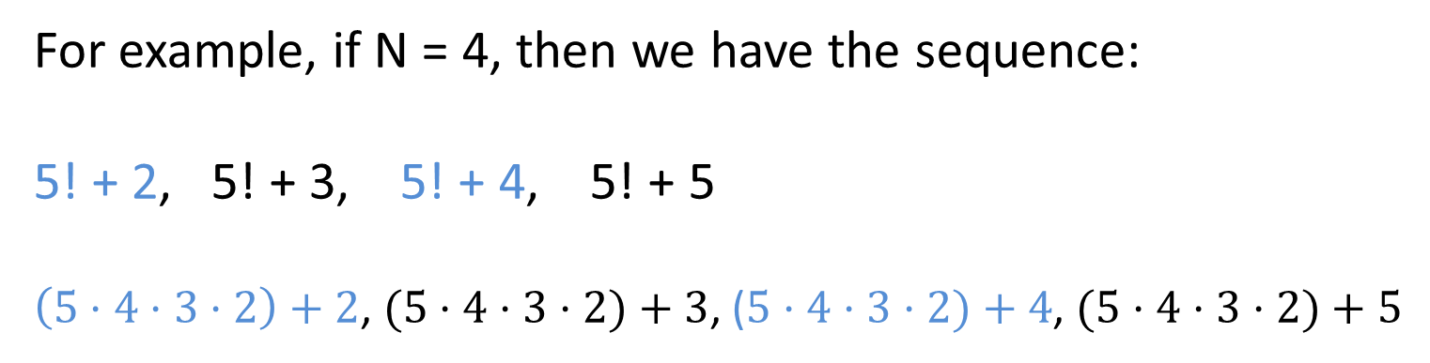
Let N be a positive integer. Here N represents the
jump size. Consider the following list of consecutive integers:
(N+1)! + 2, (N+1)! + 3, (N+1)! + 4, …, (N+1)! + (N+1)
For example, if N = 4, then we have the sequence:
5! + 2, 5! + 3, 5! + 4, 5! + 5
$\left(5⋅4⋅3⋅2\right)+2$, $(5⋅4⋅3⋅2)+3$, ($5⋅4⋅3⋅2)+4$, $(5⋅4⋅3⋅2)+5$

Slide 23
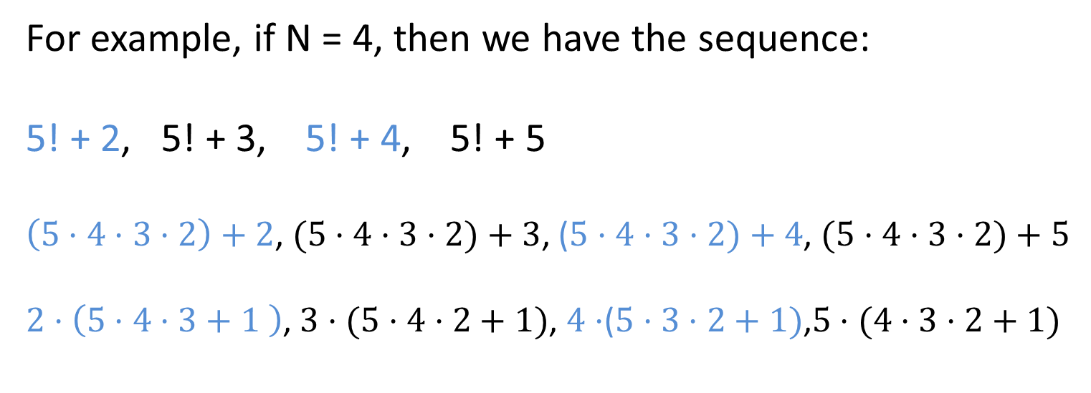
Let N be a positive integer. Here N represents the
jump size. Consider the following list of consecutive integers:
(N+1)! + 2, (N+1)! + 3, (N+1)! + 4, …, (N+1)! + (N+1)
For example, if N = 4, then we have the sequence:
5! + 2, 5! + 3, 5! + 4, 5! + 5
$\left(5⋅4⋅3⋅2\right)+2$, $(5⋅4⋅3⋅2)+3$, ($5⋅4⋅3⋅2)+4$, $(5⋅4⋅3⋅2)+5$
$2⋅\left(5⋅4⋅3+1 \right)$,$3⋅(5⋅4⋅2+1)$, $4⋅$($5⋅3⋅2+1)$,$5⋅(4⋅3⋅2+1)$

Slide 24
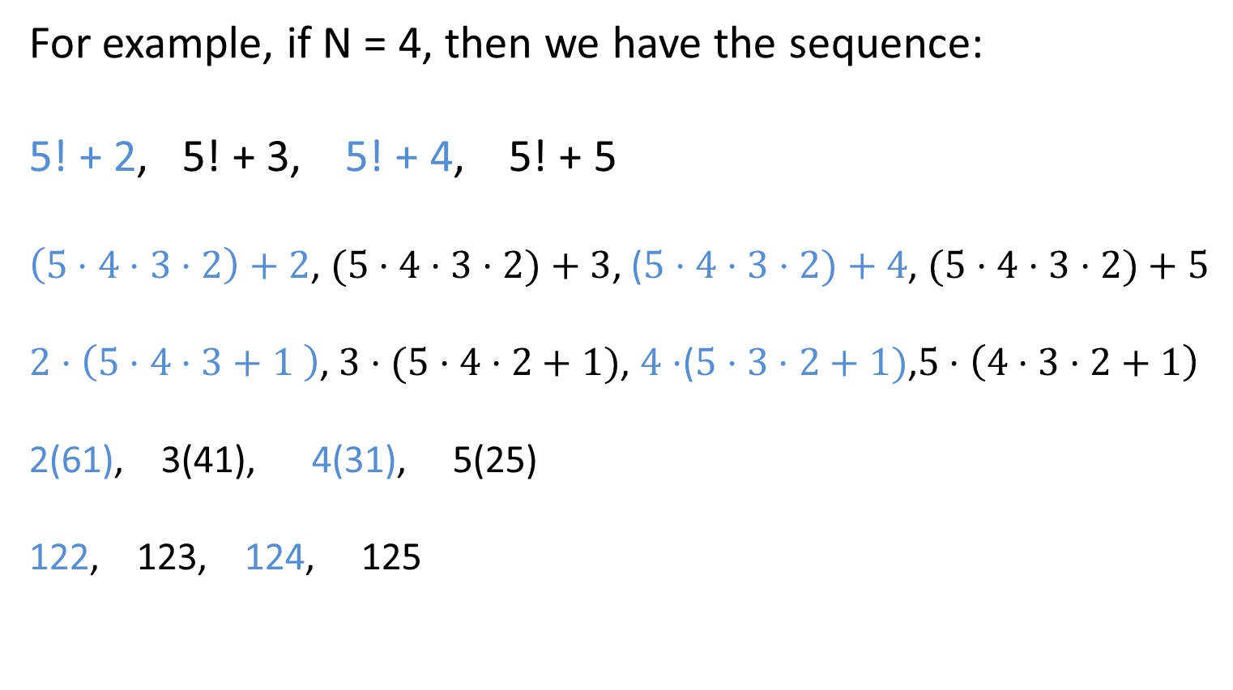
Let N be a positive integer. Here N represents the
jump size. Consider the following list of consecutive integers:
(N+1)! + 2, (N+1)! + 3, (N+1)! + 4, …, (N+1)! + (N+1)
For example, if N = 4, then we have the sequence:
5! + 2, 5! + 3, 5! + 4, 5! + 5
$\left(5⋅4⋅3⋅2\right)+2$, $(5⋅4⋅3⋅2)+3$, ($5⋅4⋅3⋅2)+4$, $(5⋅4⋅3⋅2)+5$
$2⋅\left(5⋅4⋅3+1 \right)$,$3⋅(5⋅4⋅2+1)$, $4⋅$($5⋅3⋅2+1)$,$5⋅\left(4⋅3⋅2+1\right)$
2(61), 3(41), 4(31), 5(25)
122, 123, 124, 125

Slide 25
(N+1)! + 2, (N+1)! + 3, (N+1)! + 4, …, (N+1)! + (N+1)

Slide 26
(N+1)! + 2, (N+1)! + 3, (N+1)! + 4, …, (N+1)! + (N+1)
In general, (N+1)! + k is composite since (N+1)! + k is
divisible by k.

Slide 27
(N+1)! + 2, (N+1)! + 3, (N+1)! + 4, …, (N+1)! + (N+1)
In general, (N+1)! + k is composite since (N+1)! + k is
divisible by k.
Hence, for any positive integer N we can make a list
of N consecutive integers where none of them
are prime.

Slide 28
So we cannot start at 2 and jump along the primes
to infinity with jumps of size at most
N = 10

Slide 29
So we cannot start at 2 and jump along the primes
to infinity with jumps of size at most
N = 10
or
N = 10,000

Slide 30
So we cannot start at 2 and jump along the primes
to infinity with jumps of size at most
N = 10
or
N = 10,000
or
N = 10,000,000,000,000,000,000,000,000,000,000

Slide 31
So we cannot start at 2 and jump along the primes
to infinity with jumps of size at most
N = 10
or
N = 10,000
or
N = 10,000,000,000,000,000,000,000,000,000,000
or any N.

Slide 32
Hence the primes contain
arbitrarily large gaps.

Slide 33
What about the Gaussian primes?

Slide 34
What about the Gaussian primes?
Before we introduce the Gaussian primes
we need to know something about the integer
primes.

Slide 35



The positive primes break into 3 groups.
$$\{2\}$$
$$S_{1}= \left\{p \right| p ≡1 \left(mod 4\right)\}$$
$$=\{5, 13, 17, 29,37,41,53,61,73,89,97, … \}$$
$$S_{3}= \left\{p \right| p ≡3 \left(mod 4\right)\}$$
$$=\{3, 7, 11, 19,23,31,43,47,59,67,71, 79, 83,… \}$$

Slide 36
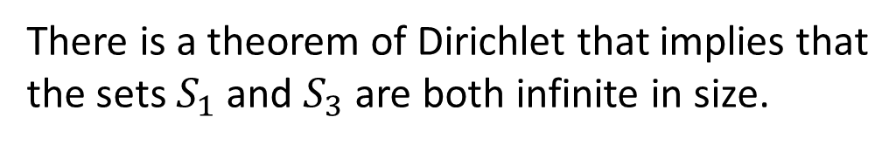
The positive primes break into 3 groups.
$$\{2\}$$
$$S_{1}= \left\{p \right| p ≡1 \left(mod 4\right)\}$$
$$=\{5, 13, 17, 29,37,41,53,61,73,89,97, … \}$$
$$S_{3}= \left\{p \right| p ≡3 \left(mod 4\right)\}$$
$$=\{3, 7, 11, 19,23,31,43,47,59,67,71, 79, 83,… \}$$
There is a theorem of Dirichlet that implies that
the sets $S_{1}$ and $S_{3}$ are both infinite in size.
http://en.wikipedia.org/wiki/Dirichlet's_theorem_on_arithmetic_progressions

Slide 37
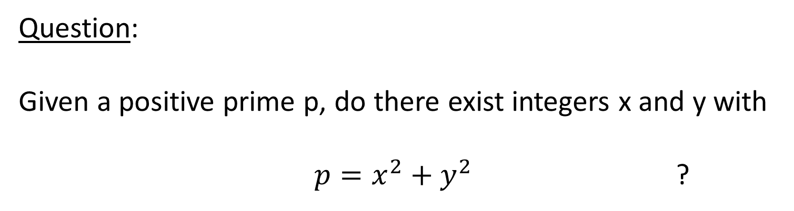
Question:
Given a positive prime p, do there exist integers x and y with
$p=x^{2}+y^{2}$ ?
We say that p expressible as a sum of squares if
p is of the above form.

Slide 38















$$1^{2}+1^{2}=2$$
$$1^{2}+2^{2}=5$$
$$2^{2}+2^{2}=8$$
$$1^{2}+3^{2}=10$$
$$2^{2}+3^{2}=13$$
$$3^{2}+3^{2}=18$$
$$1^{2}+4^{2}=17$$
$$2^{2}+4^{2}=20$$
$$3^{2}+4^{2}=25$$
$$4^{2}+4^{2}=32$$
$$1^{2}+5^{2}=26$$
$$2^{2}+5^{2}=29$$
$$3^{2}+5^{2}=36$$
$$4^{2}+5^{2}=41$$
$$5^{2}+5^{2}=50$$

Slide 39
$$1^{2}+1^{2}=2$$
2 is prime and is a sum of squares.
$$1^{2}+2^{2}=5$$
$$2^{2}+2^{2}=8$$
$$1^{2}+3^{2}=10$$
$$2^{2}+3^{2}=13$$
$$3^{2}+3^{2}=18$$
$$1^{2}+4^{2}=17$$
$$2^{2}+4^{2}=20$$
$$3^{2}+4^{2}=25$$
$$4^{2}+4^{2}=32$$
$$1^{2}+5^{2}=26$$
$$2^{2}+5^{2}=29$$
$$3^{2}+5^{2}=36$$
$$4^{2}+5^{2}=41$$
$$5^{2}+5^{2}=50$$

Slide 40
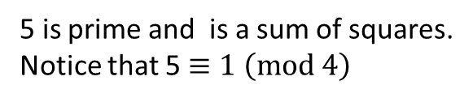
$$1^{2}+1^{2}=2$$
2 is prime and is a sum of squares.
$$1^{2}+2^{2}=5$$
5 is prime and is a sum of squares.
Notice that 5 $≡1 \left(mod 4\right)$
$$2^{2}+2^{2}=8$$
$$1^{2}+3^{2}=10$$
$$2^{2}+3^{2}=13$$
$$3^{2}+3^{2}=18$$
$$1^{2}+4^{2}=17$$
$$2^{2}+4^{2}=20$$
$$3^{2}+4^{2}=25$$
$$4^{2}+4^{2}=32$$
$$1^{2}+5^{2}=26$$
$$2^{2}+5^{2}=29$$
$$3^{2}+5^{2}=36$$
$$4^{2}+5^{2}=41$$
$$5^{2}+5^{2}=50$$

Slide 41
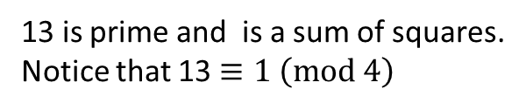
$$1^{2}+1^{2}=2$$
2 is prime and is a sum of squares.
$$1^{2}+2^{2}=5$$
5 is prime and is a sum of squares.
Notice that 5 $≡1 \left(mod 4\right)$
$$2^{2}+2^{2}=8$$
$$1^{2}+3^{2}=10$$
$$2^{2}+3^{2}=13$$
13 is prime and is a sum of squares.
Notice that 13 $≡1 \left(mod 4\right)$
$$3^{2}+3^{2}=18$$
$$1^{2}+4^{2}=17$$
$$2^{2}+4^{2}=20$$
$$3^{2}+4^{2}=25$$
$$4^{2}+4^{2}=32$$
$$1^{2}+5^{2}=26$$
$$2^{2}+5^{2}=29$$
$$3^{2}+5^{2}=36$$
$$4^{2}+5^{2}=41$$
$$5^{2}+5^{2}=50$$

Slide 42
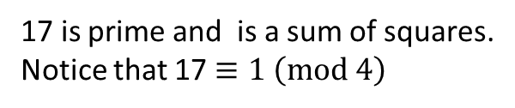
$$1^{2}+1^{2}=2$$
2 is prime and is a sum of squares.
$$1^{2}+2^{2}=5$$
5 is prime and is a sum of squares.
Notice that 5 $≡1 \left(mod 4\right)$
$$2^{2}+2^{2}=8$$
$$1^{2}+3^{2}=10$$
$$2^{2}+3^{2}=13$$
13 is prime and is a sum of squares.
Notice that 13 $≡1 \left(mod 4\right)$
$$3^{2}+3^{2}=18$$
$$1^{2}+4^{2}=17$$
17 is prime and is a sum of squares.
Notice that 17 $≡1 \left(mod 4\right)$
$$2^{2}+4^{2}=20$$
$$3^{2}+4^{2}=25$$
$$4^{2}+4^{2}=32$$
$$1^{2}+5^{2}=26$$
$$2^{2}+5^{2}=29$$
$$3^{2}+5^{2}=36$$
$$4^{2}+5^{2}=41$$
$$5^{2}+5^{2}=50$$

Slide 43
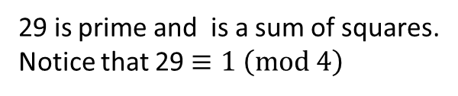
$$1^{2}+1^{2}=2$$
2 is prime and is a sum of squares.
$$1^{2}+2^{2}=5$$
5 is prime and is a sum of squares.
Notice that 5 $≡1 \left(mod 4\right)$
$$2^{2}+2^{2}=8$$
$$1^{2}+3^{2}=10$$
$$2^{2}+3^{2}=13$$
13 is prime and is a sum of squares.
Notice that 13 $≡1 \left(mod 4\right)$
$$3^{2}+3^{2}=18$$
$$1^{2}+4^{2}=17$$
17 is prime and is a sum of squares.
Notice that 17 $≡1 \left(mod 4\right)$
$$2^{2}+4^{2}=20$$
$$3^{2}+4^{2}=25$$
$$4^{2}+4^{2}=32$$
$$1^{2}+5^{2}=26$$
$$2^{2}+5^{2}=29$$
29 is prime and is a sum of squares.
Notice that 29 $≡1 \left(mod 4\right)$
$$3^{2}+5^{2}=36$$
$$4^{2}+5^{2}=41$$
$$5^{2}+5^{2}=50$$

Slide 44
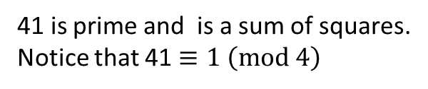
$$1^{2}+1^{2}=2$$
2 is prime and is a sum of squares.
$$1^{2}+2^{2}=5$$
5 is prime and is a sum of squares.
Notice that 5 $≡1 \left(mod 4\right)$
$$2^{2}+2^{2}=8$$
$$1^{2}+3^{2}=10$$
$$2^{2}+3^{2}=13$$
13 is prime and is a sum of squares.
Notice that 13 $≡1 \left(mod 4\right)$
$$3^{2}+3^{2}=18$$
$$1^{2}+4^{2}=17$$
17 is prime and is a sum of squares.
Notice that 17 $≡1 \left(mod 4\right)$
$$2^{2}+4^{2}=20$$
$$3^{2}+4^{2}=25$$
$$4^{2}+4^{2}=32$$
$$1^{2}+5^{2}=26$$
$$2^{2}+5^{2}=29$$
29 is prime and is a sum of squares.
Notice that 29 $≡1 \left(mod 4\right)$
$$3^{2}+5^{2}=36$$
$$4^{2}+5^{2}=41$$
41 is prime and is a sum of squares.
Notice that 41 $≡1 \left(mod 4\right)$
$$5^{2}+5^{2}=50$$

Slide 45
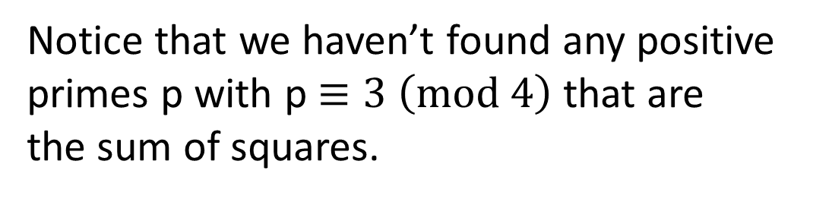
Notice that we haven’t found any positive
primes p with p $≡3 \left(mod 4\right)$ that are
the sum of squares.

Slide 46
Notice that we haven’t found any positive
primes p with p $≡3 \left(mod 4\right)$ that are
the sum of squares.
That’s because there aren’t any.

Slide 47
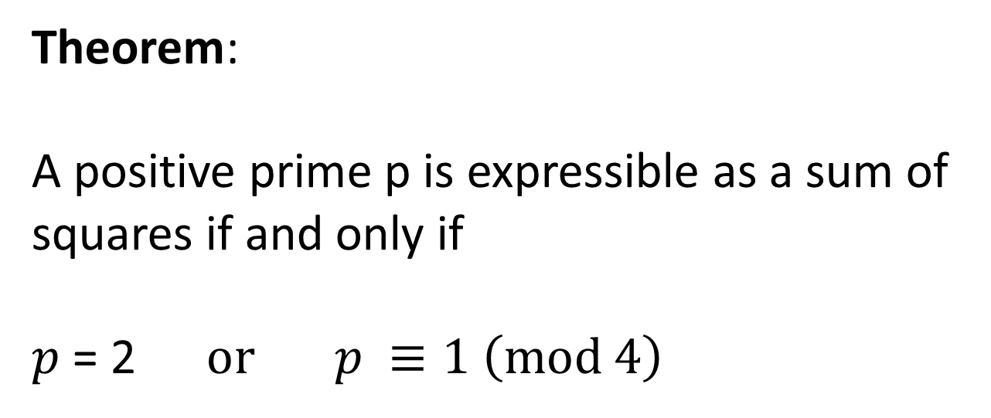
Theorem:
A positive prime p is expressible as a sum of
squares if and only if
$p$ = 2 $or p ≡1 \left(mod 4\right)$

Slide 48
Theorem:
A positive prime p is expressible as a sum of
squares if and only if
$p$ = 2 $or p ≡1 \left(mod 4\right)$
According to wikipedia:
Albert Girard (1632) was the first to make this observation.
Fermat claimed to have a proof of it in a letter to Mersenne (1640).
Euler was the first person to provide a proof in 1749.
There have been many different proofs of the above theorem.
http://en.wikipedia.org/wiki/Fermat's_theorem_on_sums_of_two_squares

Slide 49
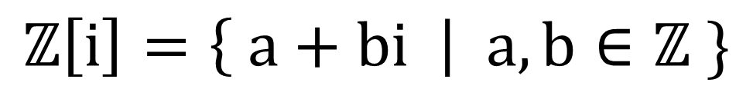
The following set is called the set of Gaussian integers.
$$ℤ\left[i\right]=\left\{ a+bi \right| a,b∈ℤ \}$$
-3+ 2i
i
1+ i
2+ i
3+ i
-5
-4
-3
-2
-1
0
1
2
3
4
5
-2i
4 - 2i
-2- 3i

Slide 50
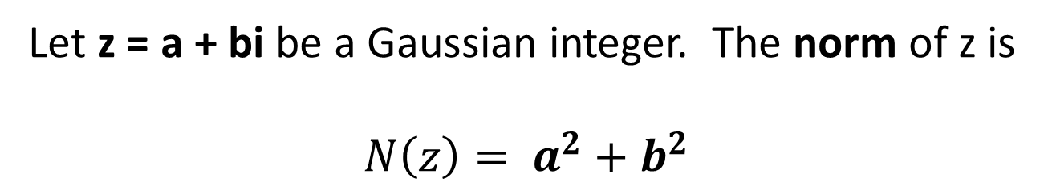
Let z = a + bi be a Gaussian integer. The norm of z is
$$N\left(z\right)= a^{2}+b^{2}$$

Slide 51
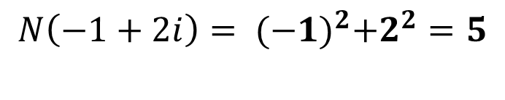

Let z = a + bi be a Gaussian integer. The norm of z is
$$N\left(z\right)= a^{2}+b^{2}$$
Ex:
z = -1 + 2i
$$N\left(−1+2i\right)= {(−1)}^{2}+2^{2}=5$$
$$\sqrt{5}$$
0

Slide 52

Useful fact:
$N\left(z⋅w\right)=N\left(z\right)N(w)$

Slide 53
Let z = a + bi be a Gaussian integer. We say that
z is a unit if 1/z is a Gaussian integer.

Slide 54
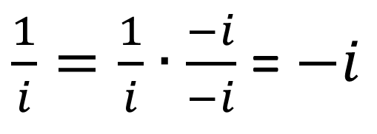
Let z = a + bi be a Gaussian integer. We say that
z is a unit if 1/z is a Gaussian integer.
Ex:
$\frac{1}{i}=\frac{1}{i}∙\frac{−i}{−i}$ = $−i$

Slide 55
Let z = a + bi be a Gaussian integer. We say that
z is a unit if 1/z is a Gaussian integer.
Ex:
$\frac{1}{i}=\frac{1}{i}∙\frac{−i}{−i}$ = $−i$
Thus, i is a unit.

Slide 56
The units in the Gaussian integers are
z = 1, -1, i, and -i

Slide 57
Useful fact: z is a unit iff N(z) = 1.
i
-1
1
-i

Slide 58
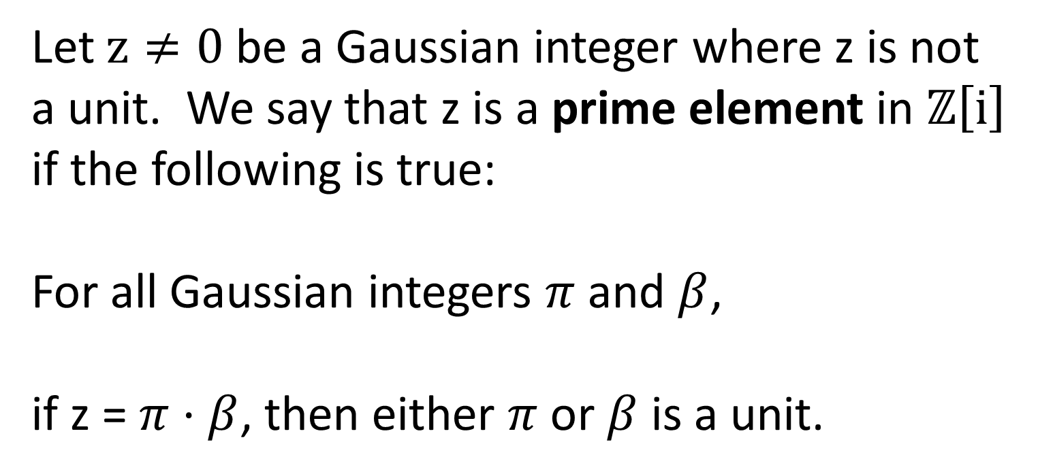
Let $z≠0$ be a Gaussian integer where z is not
a unit. We say that z is a prime element in $ℤ\left[i\right]$
if the following is true:
For all Gaussian integers $π$ and $β$,
if z = $π$ $⋅$ $β$, then either $π$ or $β$ is a unit.

Slide 59
Ex: 2 is not a prime in the land of
Gaussian integers because
2 = (1+i)(1-i)
And neither 1+i nor 1-i are units.

Slide 60
Ex: 2 is not a prime in the land of
Gaussian integers because
2 = (1+i)(1-i)
And neither 1+i nor 1-i are units.
We could have also factored 2 this way:
2 = (-1+i)(-1-i)
And neither -1+i nor -1-i are units.

Slide 61
Ex: 3 is a prime in the land of Gaussian
integers.

Slide 62
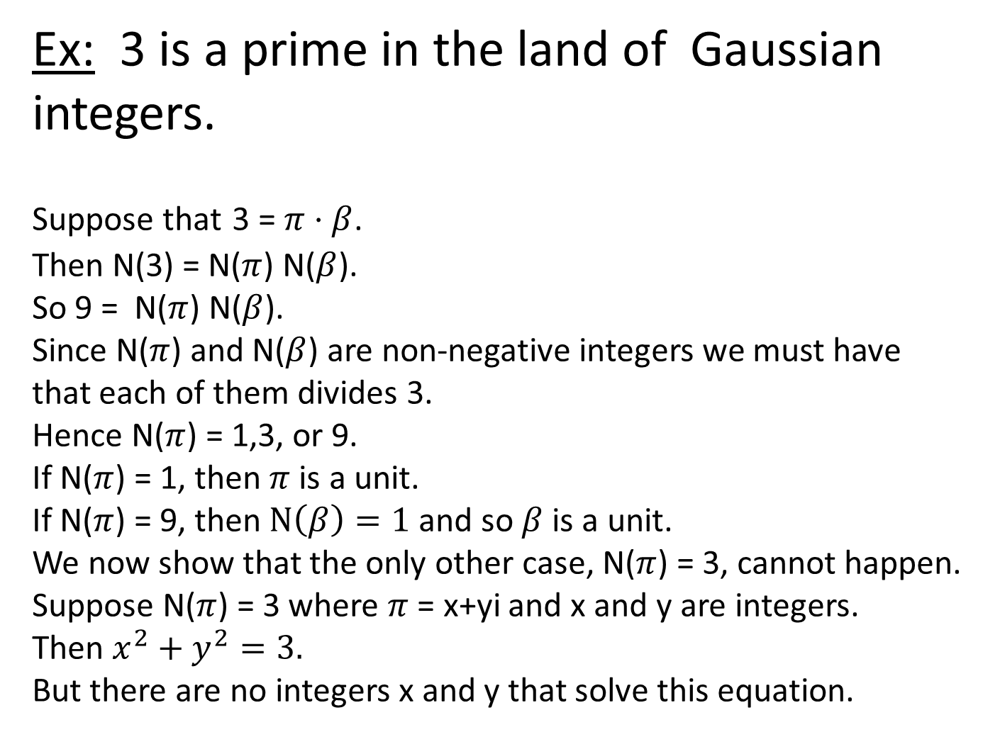
Ex: 3 is a prime in the land of Gaussian
integers.
Suppose that 3 = $π$ $⋅$ $β$.
Then N(3) = N($π$) N($β$).
So 9 = N($π$) N($β$).
Since N($π$) and N($β$) are non-negative integers we must have
that each of them divides 3.
Hence N($π$) = 1,3, or 9.
If N($π$) = 1, then $π$is a unit.
If N($π$) = 9, then$N\left(β\right)=1$ and so $β$is a unit.
We now show that the only other case, N($π$) = 3, cannot happen.
Suppose N($π$) = 3 where $π$ = x+yi and x and y are integers.
Then $x^{2}+y^{2}=3.$
But there are no integers x and y that solve this equation.

Slide 63
Can we determine which Gaussian integers
are Gaussian primes?

Slide 64
Can we determine which Gaussian integers
are Gaussian primes?
Yes. Let p be an integer prime. Then either
p is a Gaussian prime, or
p factors into several Gaussian primes

Slide 65
Can we determine which Gaussian integers
are Gaussian primes?
Yes. Let p be an integer prime. Then either
p is a Gaussian prime, or
p factors into several Gaussian primes
All of the Gaussian primes come about this
way. That is, each one “comes from” the
factorization of some integer prime p.

Slide 66
I will now give you 3 cases that illustrate
the three different scenarios that can
happen.

Slide 67



I will now give you 3 cases that illustrate
the three different scenarios that can
happen.
These cases from the way we described
the primes earlier in this talk:
$$\{2\}$$
$$S_{1}= \left\{p \right| p ≡1 \left(mod 4\right)\}$$
$$=\{5, 13, 17, 29,37,41,53,61,73,89,97, … \}$$
$$S_{3}= \left\{p \right| p ≡3 \left(mod 4\right)\}$$
$$=\{3, 7, 11, 19,23,31,43,47,59,67,71, 79, 83,… \}$$

Slide 68
The first integer prime to consider is
the even one, that is p = 2.

Slide 69
Recall that
2 = (1 - i)(1 + i) = (-1 - i)(-1 + i)
Each of the elements above, except
for 2, is a Gaussian prime. You can
check it with a norm argument.
So 2 splits and gives us 4
different primes.

Slide 70
The Gaussian primes 1 + i, 1 - i, -1 - i, or -1 + i
are the solutions to the equation N(z) = 2.
-1+i
1 + i
-1 - i
1 - i

Slide 71
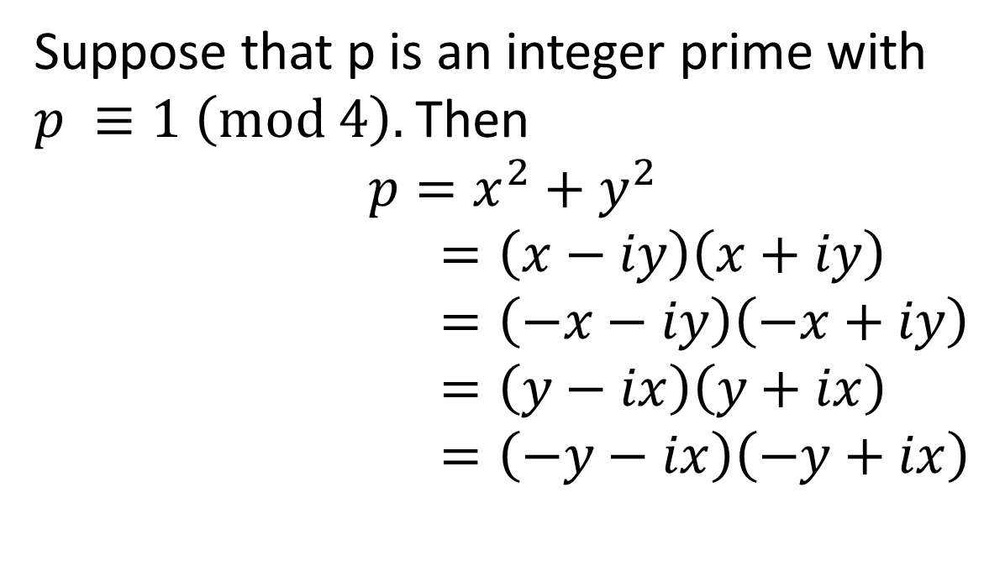
Suppose that p is an integer prime with
$p ≡1 \left(mod 4\right).$Then
$$p=x^{2}+y^{2}$$
$=\left(x−iy\right)\left(x+iy\right)$
$=\left(−x−iy\right)\left(−x+iy\right)$
$=\left(y−ix\right)\left(y+ix\right)$
$=\left(−y−ix\right)\left(−y+ix\right)$

Slide 72
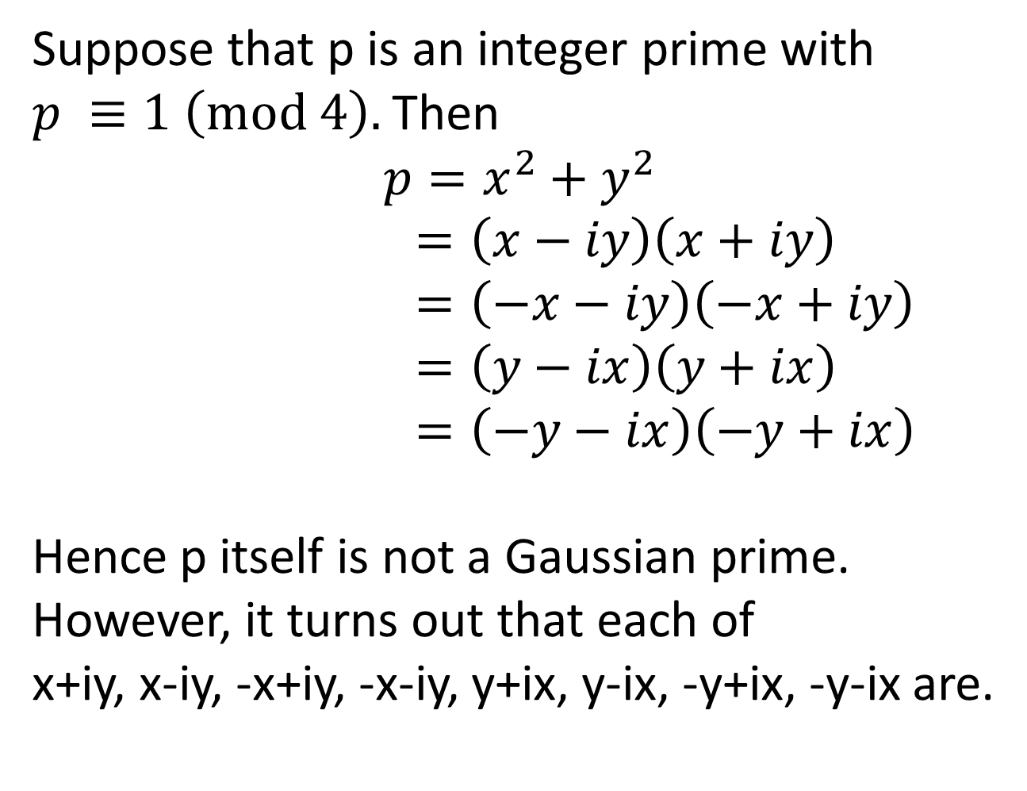
Suppose that p is an integer prime with
$p ≡1 \left(mod 4\right).$Then
$$p=x^{2}+y^{2}$$
$=\left(x−iy\right)\left(x+iy\right)$
$=\left(−x−iy\right)\left(−x+iy\right)$
$=\left(y−ix\right)\left(y+ix\right)$
$=\left(−y−ix\right)\left(−y+ix\right)$
Hence p itself is not a Gaussian prime.
However, it turns out that each of
x+iy, x-iy, -x+iy, -x-iy, y+ix, y-ix, -y+ix, -y-ix are.

Slide 73
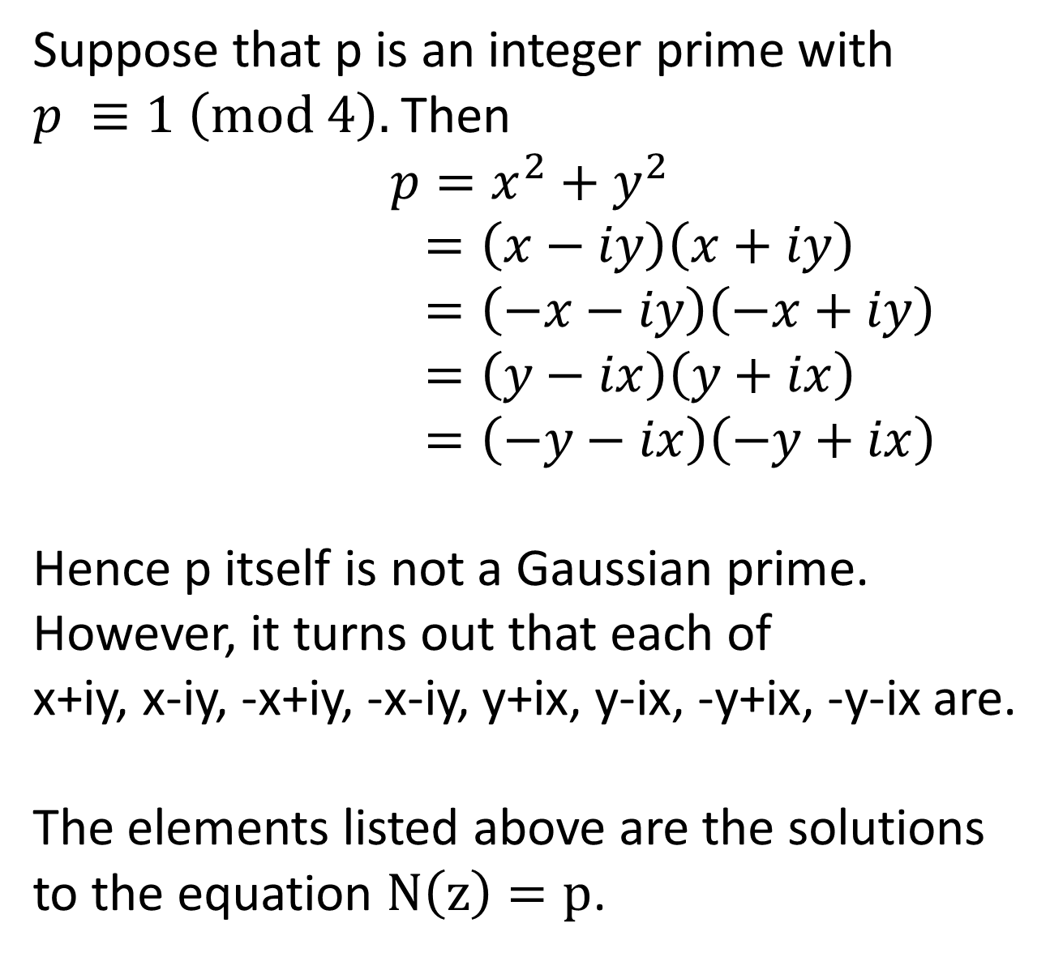
Suppose that p is an integer prime with
$p ≡1 \left(mod 4\right).$Then
$$p=x^{2}+y^{2}$$
$=\left(x−iy\right)\left(x+iy\right)$
$=\left(−x−iy\right)\left(−x+iy\right)$
$=\left(y−ix\right)\left(y+ix\right)$
$=\left(−y−ix\right)\left(−y+ix\right)$
Hence p itself is not a Gaussian prime.
However, it turns out that each of
x+iy, x-iy, -x+iy, -x-iy, y+ix, y-ix, -y+ix, -y-ix are.
The elements listed above are the solutions
to the equation $N\left(z\right)=p$.

Slide 74
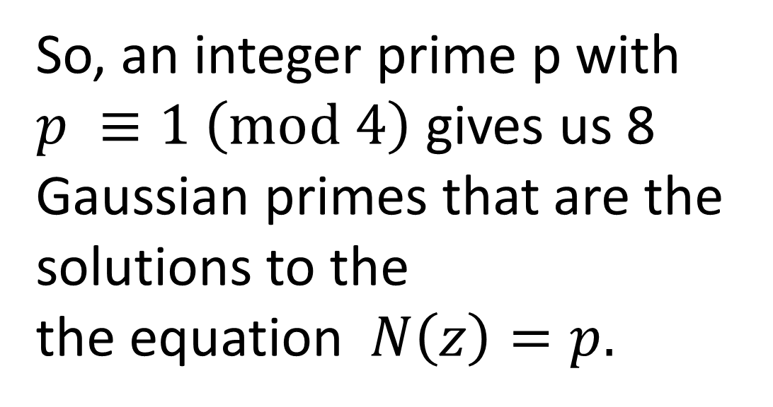
So, an integer prime p with
$p ≡1 \left(mod 4\right)$ gives us 8
Gaussian primes that are the
solutions to the
the equation$N\left(z\right)=p.$

Slide 75
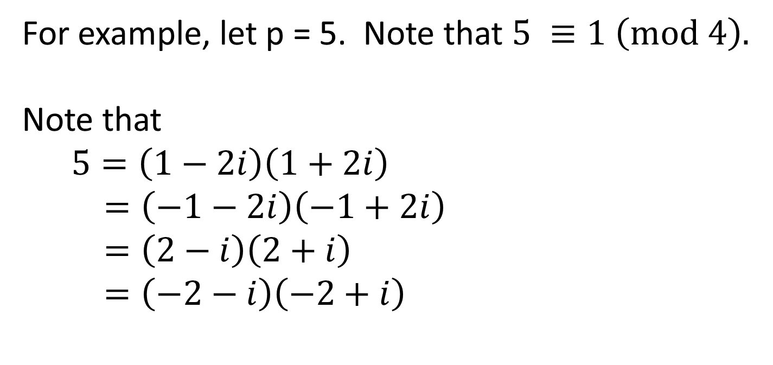
For example, let p = 5. Note that $5 ≡1 \left(mod 4\right).$
Note that
$5=\left(1−2i\right)\left(1+2i\right)$
$=\left(−1−2i\right)\left(−1+2i\right)$
$=\left(2−i\right)\left(2+i\right)$
$=\left(−2−i\right)\left(−2+i\right)$

Slide 76
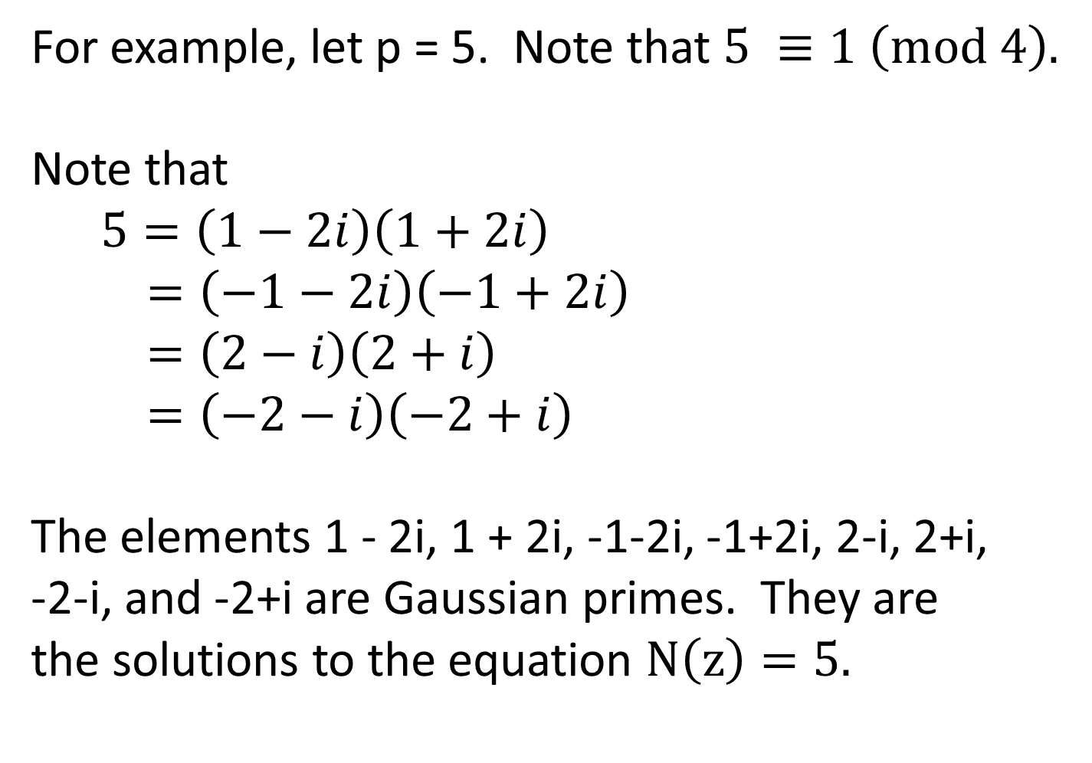
For example, let p = 5. Note that $5 ≡1 \left(mod 4\right).$
Note that
$5=\left(1−2i\right)\left(1+2i\right)$
$=\left(−1−2i\right)\left(−1+2i\right)$
$=\left(2−i\right)\left(2+i\right)$
$=\left(−2−i\right)\left(−2+i\right)$
The elements 1 - 2i, 1 + 2i, -1-2i, -1+2i, 2-i, 2+i,
-2-i, and -2+i are Gaussian primes. They are
the solutions to the equation $N\left(z\right)=5.$

Slide 77
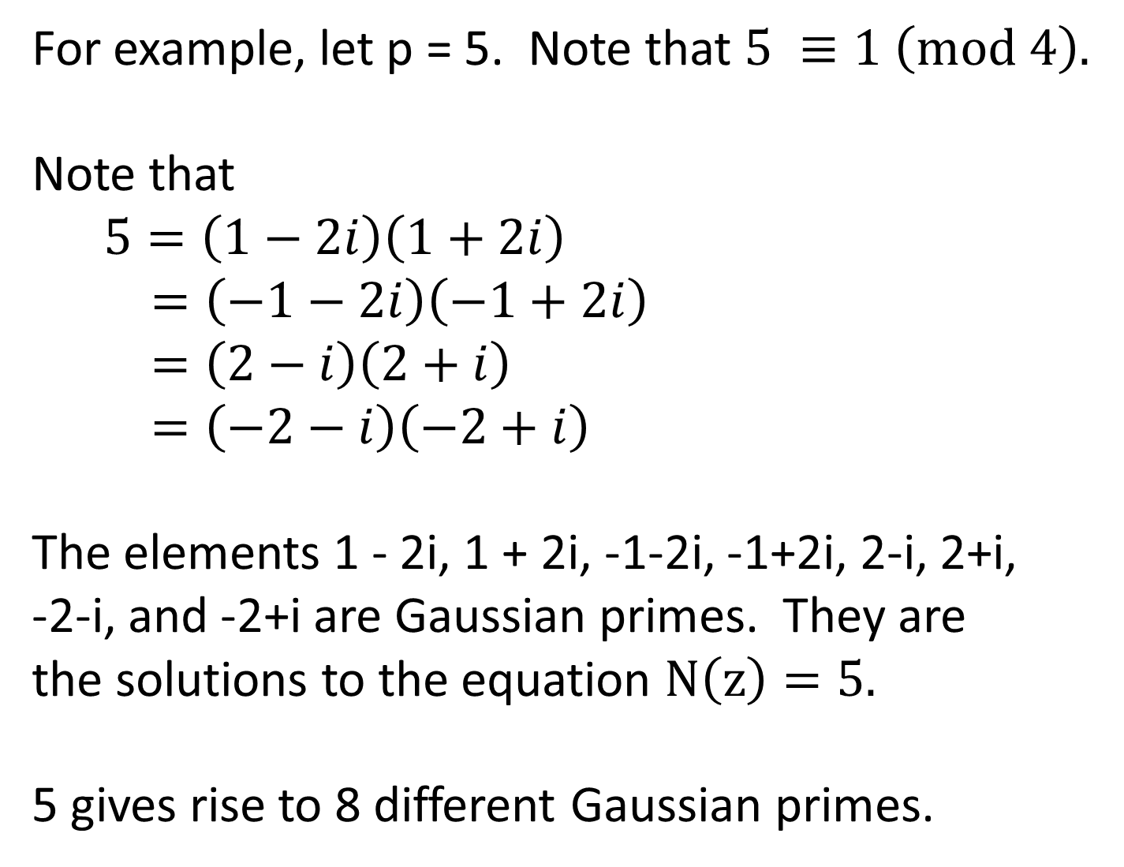
For example, let p = 5. Note that $5 ≡1 \left(mod 4\right).$
Note that
$5=\left(1−2i\right)\left(1+2i\right)$
$=\left(−1−2i\right)\left(−1+2i\right)$
$=\left(2−i\right)\left(2+i\right)$
$=\left(−2−i\right)\left(−2+i\right)$
The elements 1 - 2i, 1 + 2i, -1-2i, -1+2i, 2-i, 2+i,
-2-i, and -2+i are Gaussian primes. They are
the solutions to the equation $N\left(z\right)=5.$
5 gives rise to 8 different Gaussian primes.

Slide 78
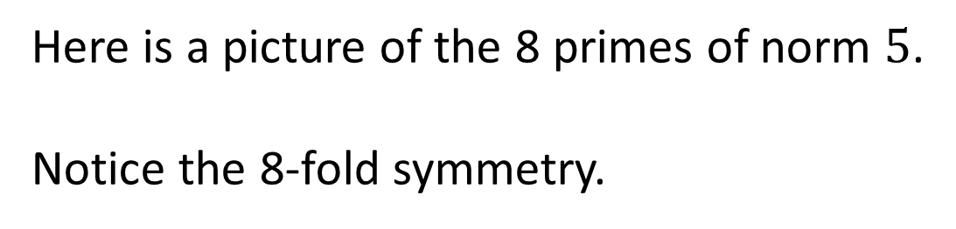
Here is a picture of the 8 primes of norm $5$.
Notice the 8-fold symmetry.
-1+2i
1+2i
-2+i
2+i
-2-i
2-i
-1-2i
1-2i

Slide 79
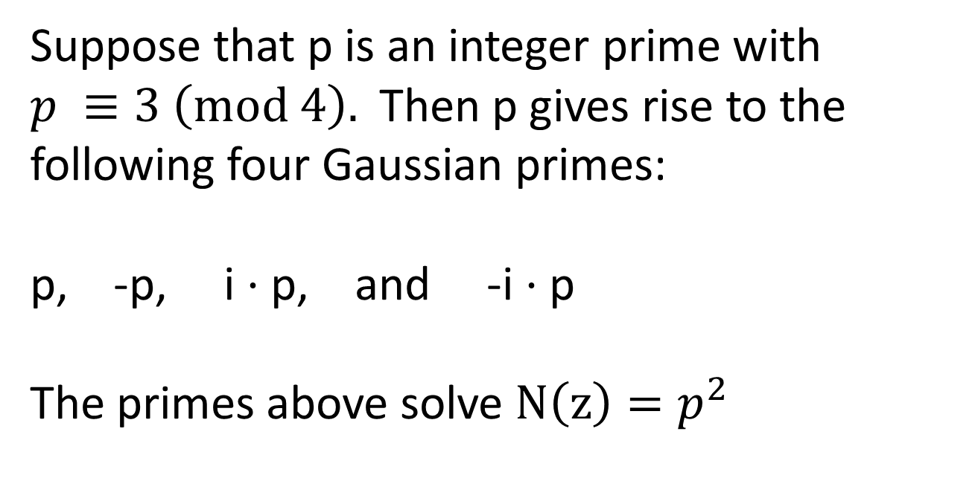
Suppose that p is an integer prime with $p ≡3 \left(mod 4\right).$ Then p gives rise to the
following four Gaussian primes:
p, -p, i $⋅$p, and -i $⋅$p
The primes above solve $N\left(z\right)=p^{2}$

Slide 80
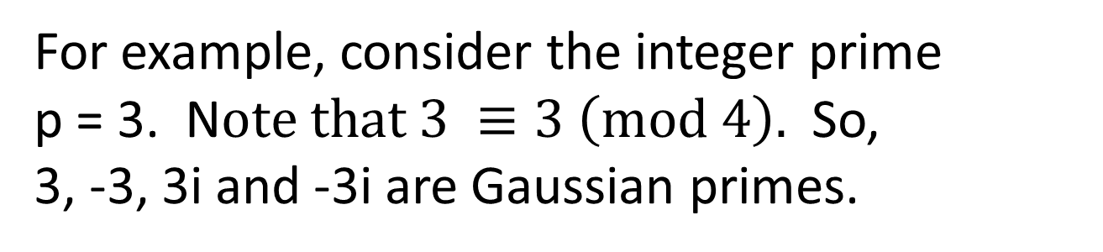
For example, consider the integer prime
p = 3. N$ote that 3 ≡3 \left(mod 4\right).$ So,
3, -3, 3i and -3i are Gaussian primes.
3i
-3
3
-3i

Slide 81
We now give a theorem that
characterizes the Gaussian
primes.

Slide 82
Let z be a Gaussian integer. Then z is a
Gaussian prime if and only if one of
the following conditions hold:

Slide 83
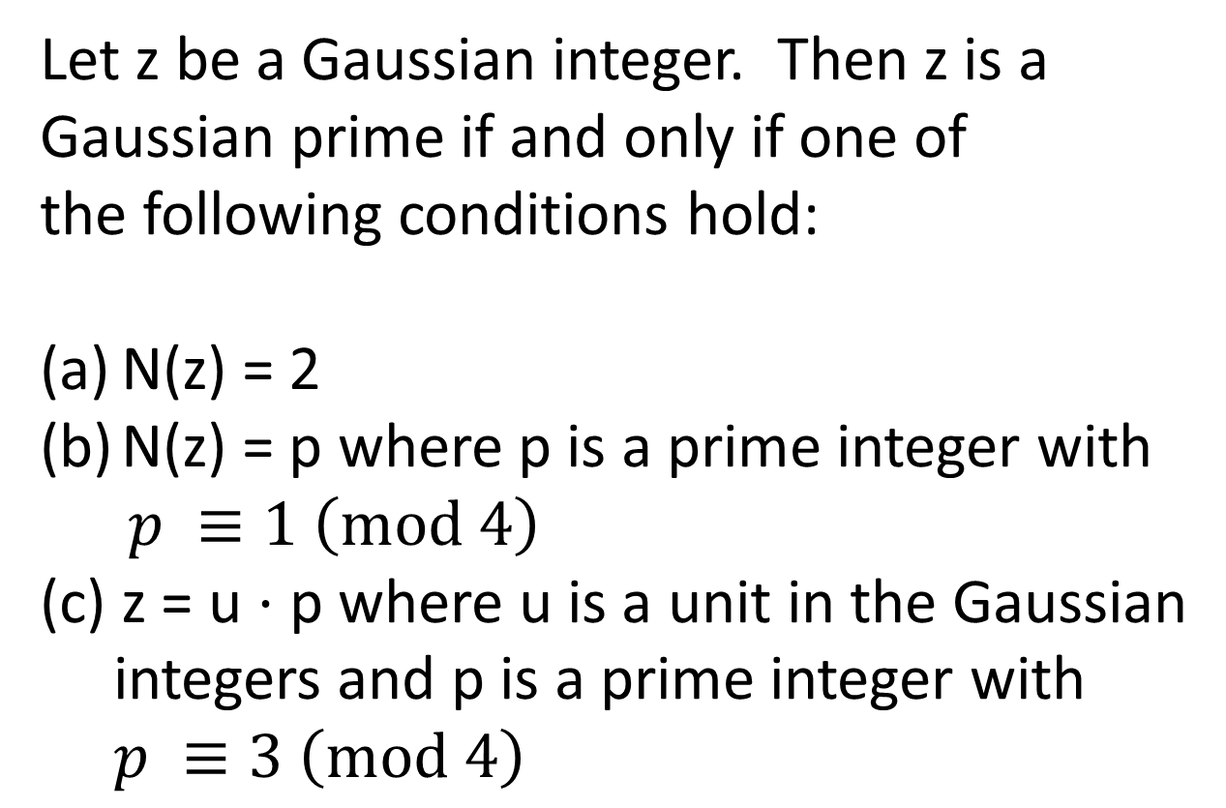
Let z be a Gaussian integer. Then z is a
Gaussian prime if and only if one of
the following conditions hold:
N(z) = 2
N(z) = p where p is a prime integer with
$p ≡1 \left(mod 4\right)$
(c) z = u $⋅$ p where u is a unit in the Gaussian
integers and p is a prime integer with
$p ≡3 \left(mod 4\right)$

Slide 84
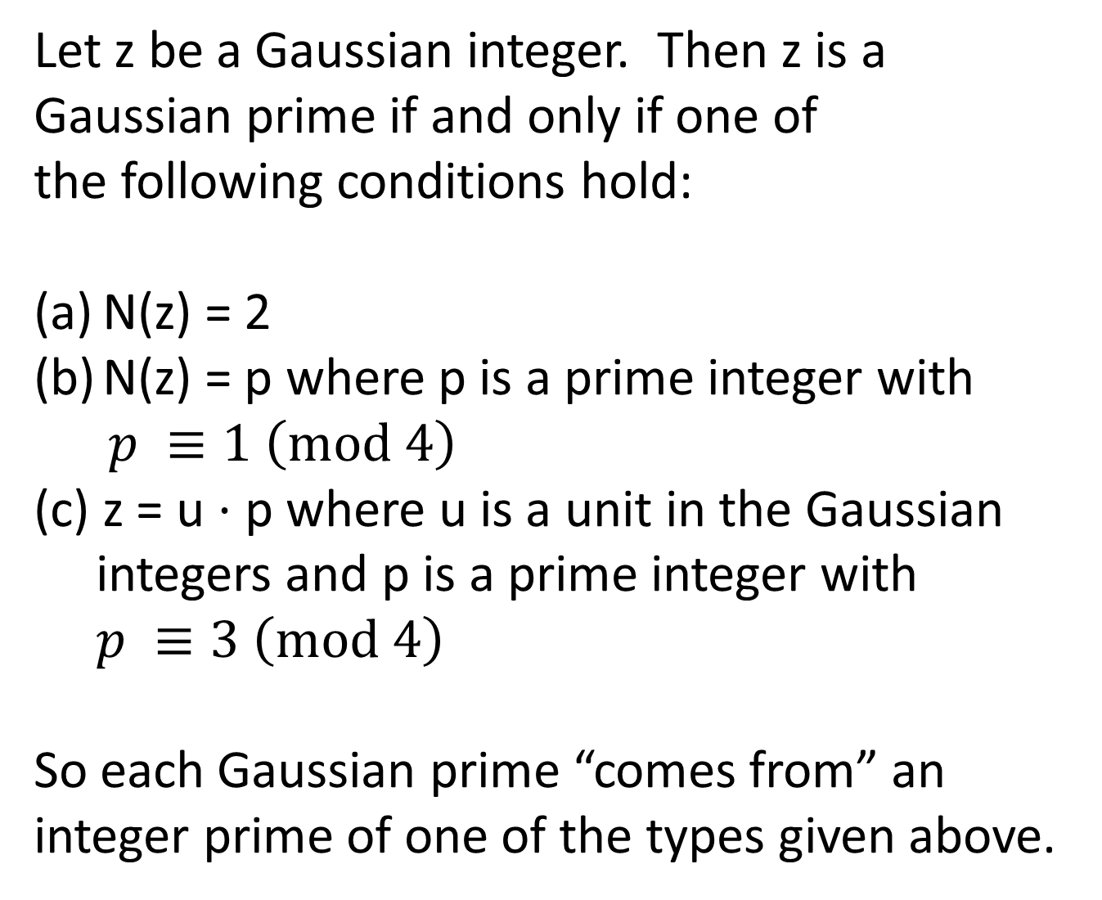
Let z be a Gaussian integer. Then z is a
Gaussian prime if and only if one of
the following conditions hold:
N(z) = 2
N(z) = p where p is a prime integer with
$p ≡1 \left(mod 4\right)$
(c) z = u $⋅$ p where u is a unit in the Gaussian
integers and p is a prime integer with
$p ≡3 \left(mod 4\right)$
So each Gaussian prime “comes from” an
integer prime of one of the types given above.

Slide 85
Let’s look at some pictures of the
Gaussian primes.

Slide 86
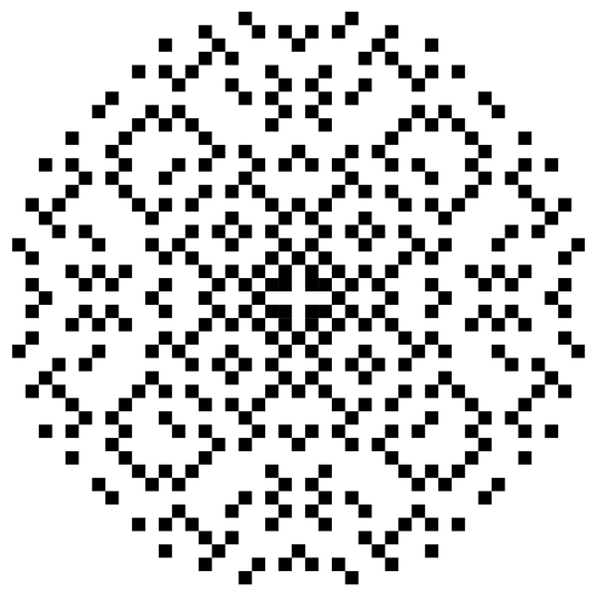
The following picture is from: http://commons.wikimedia.org/wiki/File:Gaussian_primes.png
(The Mathematica code that made the picture is on the above website.)
(Wikipedia on Gaussian integers: http://en.wikipedia.org/wiki/Gaussian_integer)

Slide 87
This picture is from Wolfram’s Gaussian primes page:
http://mathworld.wolfram.com/GaussianPrime.html

Slide 88
The next picture can be found at
http://www.maa.org/editorial/mathgames/mathgames_01_25_04.html
It’s from an article “Prime MegaGap,” Ed Pegg Jr., January 26, 2003

Slide 89
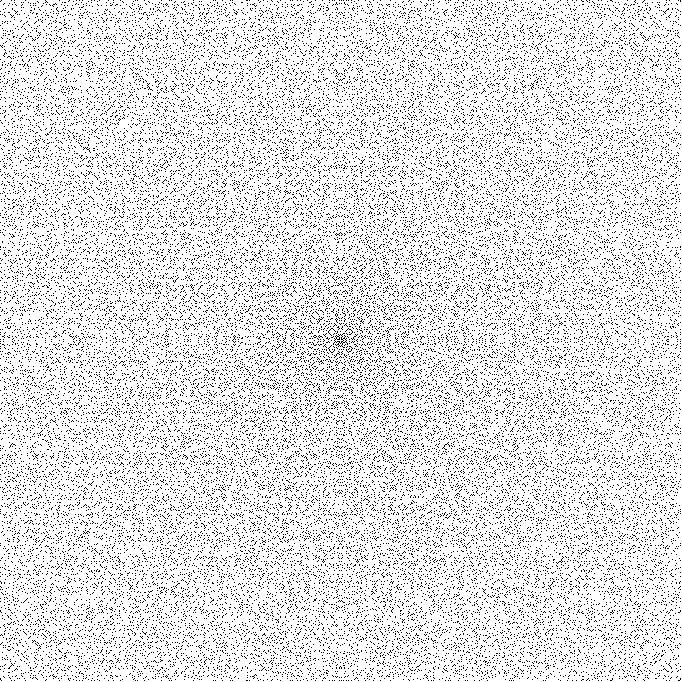

Slide 90
Question: Can one start at the prime 1+i and
jump to infinity where the jump size if bounded?

Slide 91
Question: Can one start at the prime 1+i and
jump to infinity where the jump size if bounded?
No one knows the answer to this question.
Let’s go over some of the facts that people do know.

Slide 92
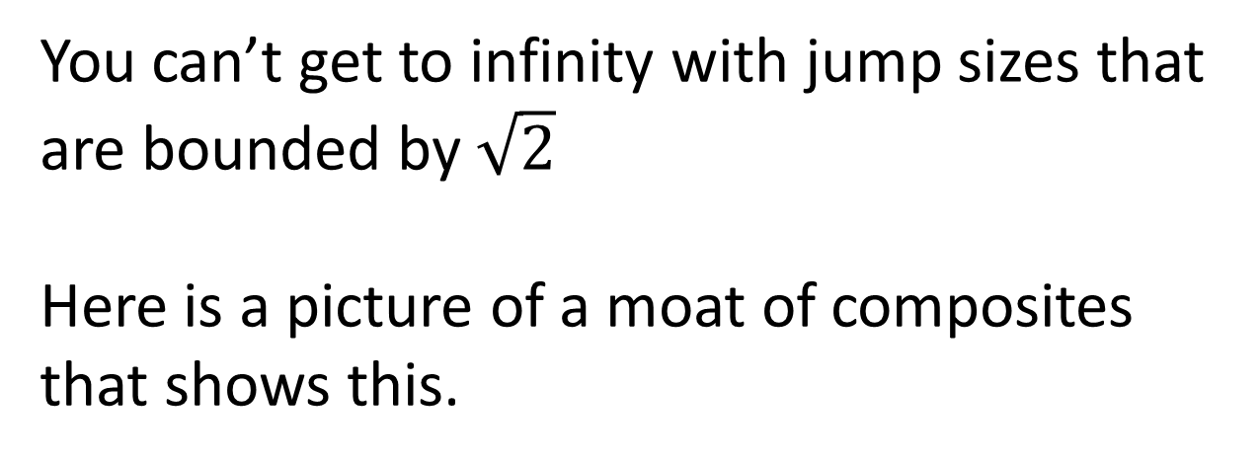
You can’t get to infinity with jump sizes that
are bounded by $\sqrt{2}$
Here is a picture of a moat of composites
that shows this.

Slide 93
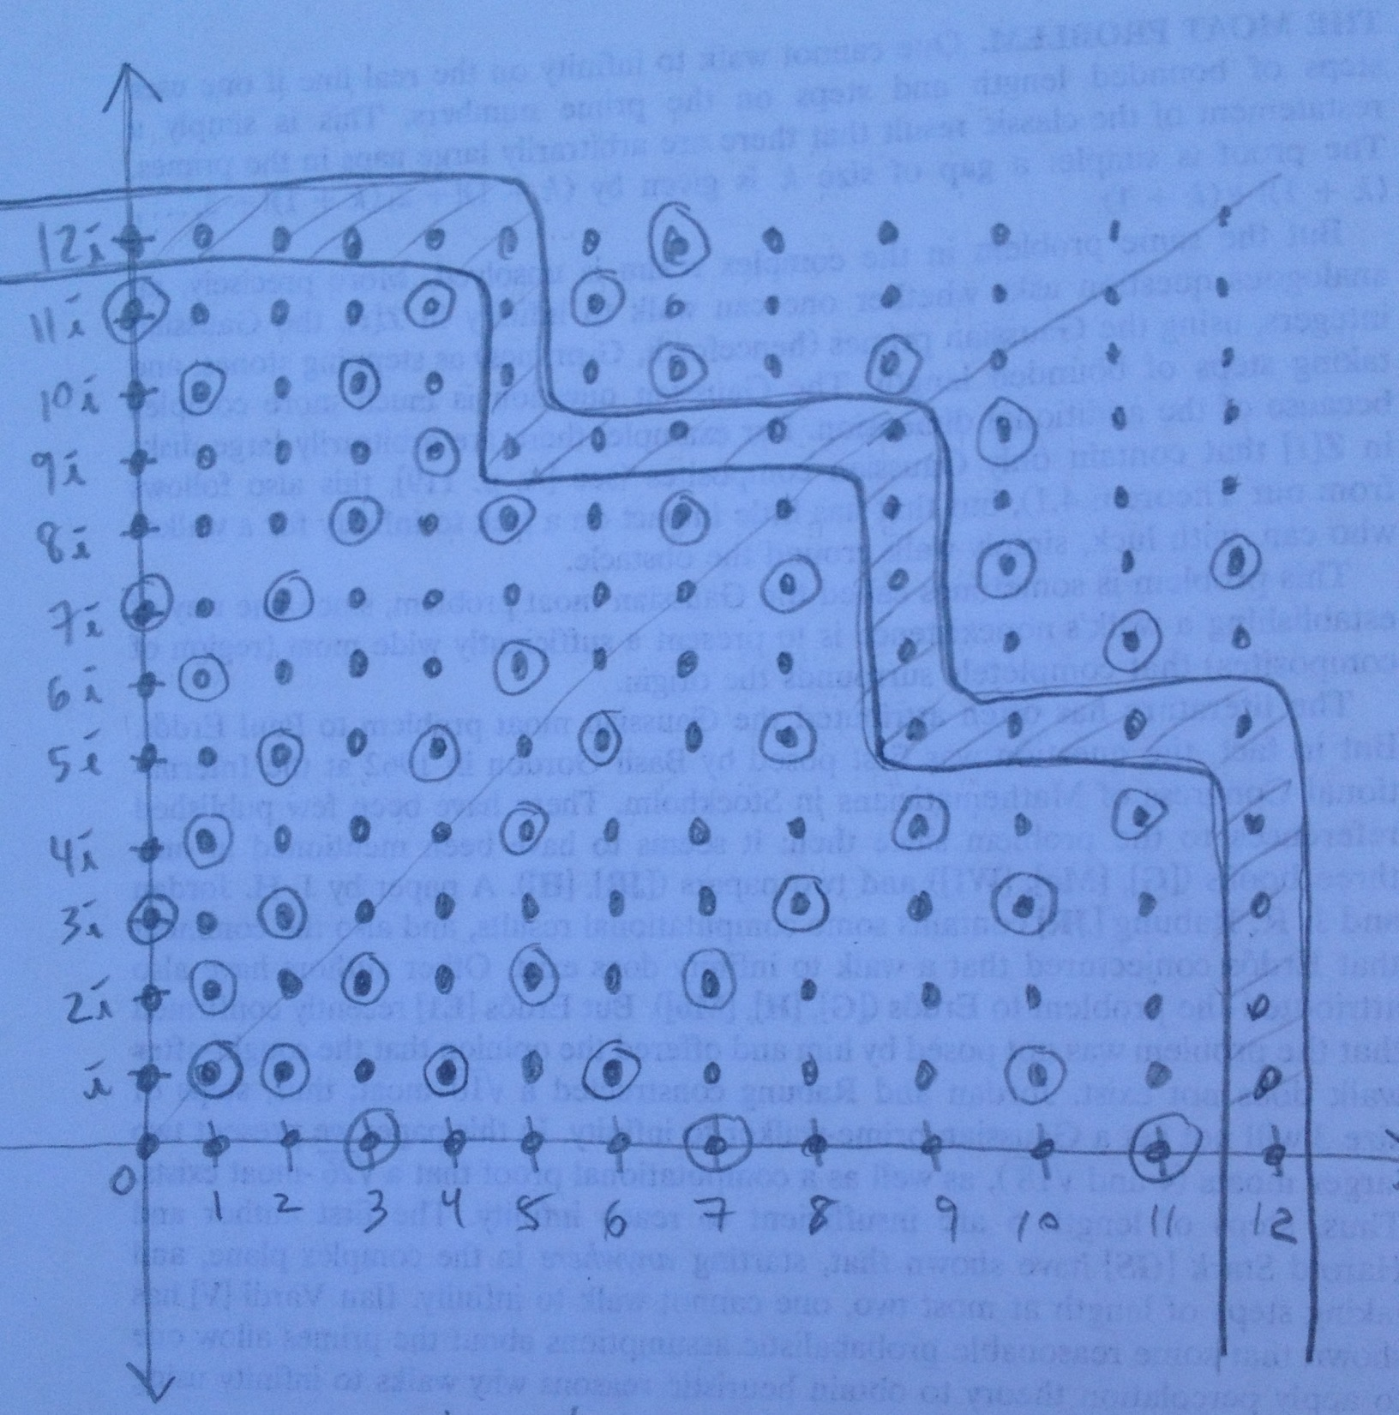

Slide 94
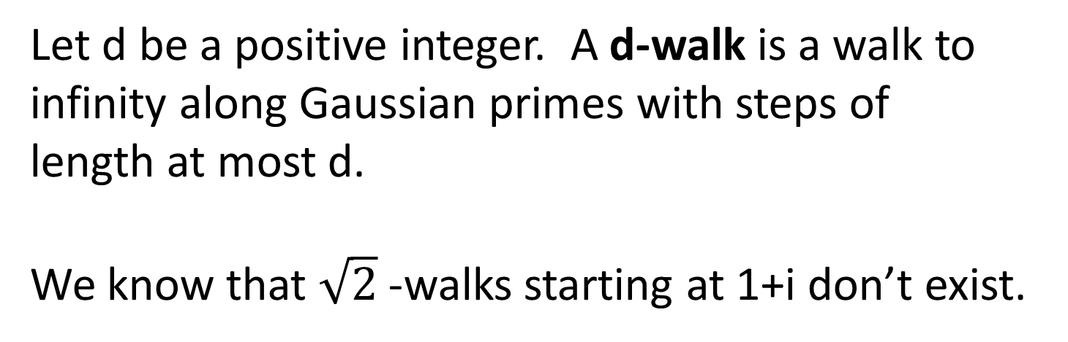
Let d be a positive integer. A d-walk is a walk to
infinity along Gaussian primes with steps of
length at most d.
We know that $\sqrt{2}$-walks starting at 1+i don’t exist.

Slide 95
4-walks starting at 1+i don’t exist.
“A conjecture of Paul Erdos concerning Gaussian Primes,” Jordan and Rabung, J. Number
Theory, 8:1, (1976), 43—51. (It’s on JSTOR.)

Slide 96
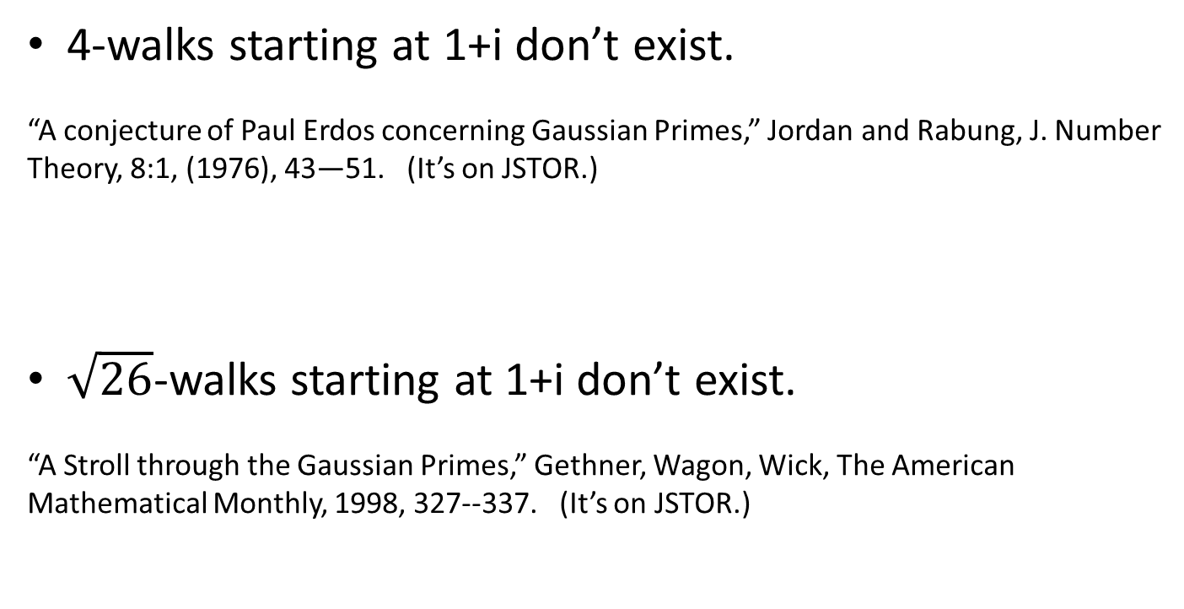
4-walks starting at 1+i don’t exist.
“A conjecture of Paul Erdos concerning Gaussian Primes,” Jordan and Rabung, J. Number
Theory, 8:1, (1976), 43—51. (It’s on JSTOR.)
$\sqrt{26}$-walks starting at 1+i don’t exist.
“A Stroll through the Gaussian Primes,” Gethner, Wagon, Wick, The American
Mathematical Monthly, 1998, 327--337. (It’s on JSTOR.)

Slide 97
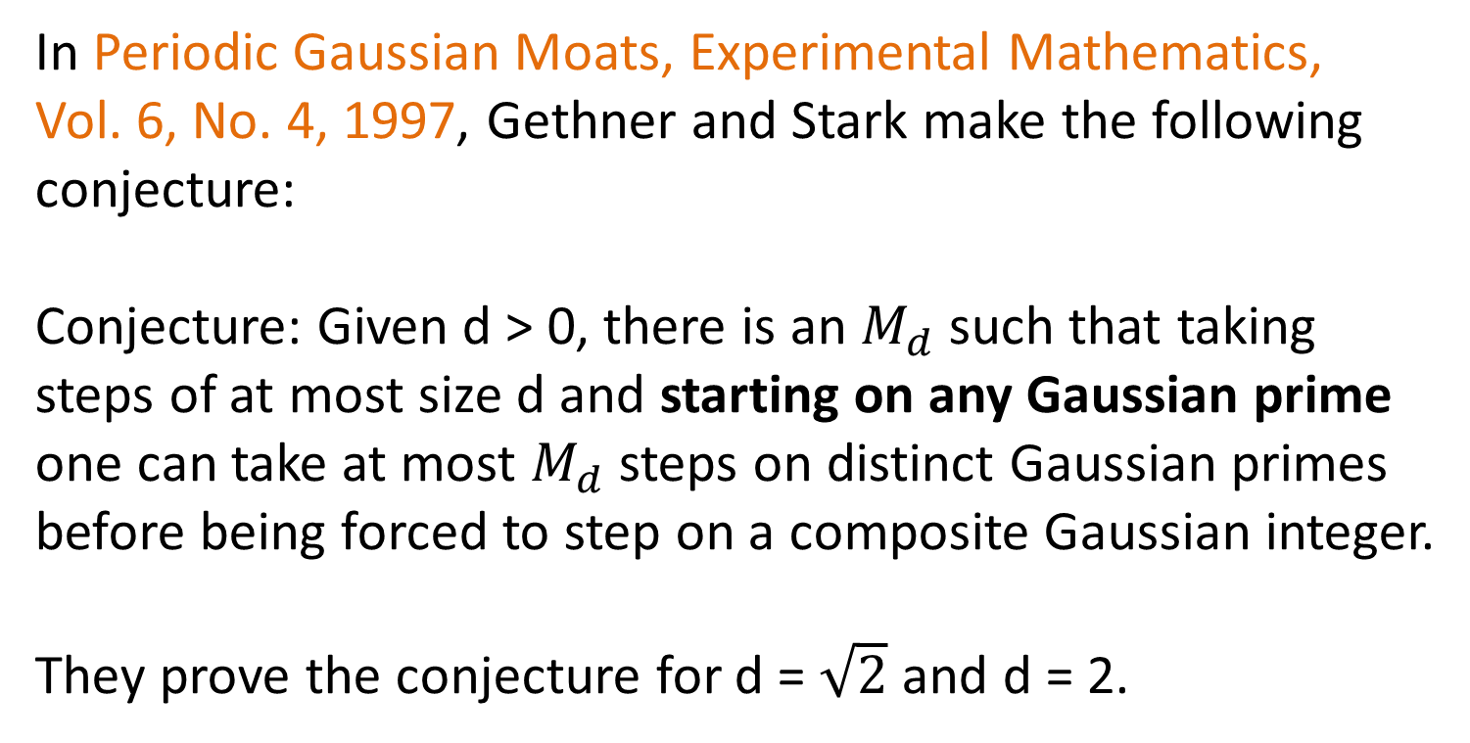
In Periodic Gaussian Moats, Experimental Mathematics,
Vol. 6, No. 4, 1997, Gethner and Stark make the following
conjecture:
Conjecture: Given d > 0, there is an $M_{d}$ such that taking
steps of at most size d and starting on any Gaussian prime
one can take at most $M_{d}$ steps on distinct Gaussian primes
before being forced to step on a composite Gaussian integer.
They prove the conjecture for d = $\sqrt{2}$ and d = 2.

Slide 98
Theorem: d-walks don’t exist
when the walk is confined to a line.
“A Stroll through the Gaussian Primes,” Gethner, Wagon, Wick, The American
Mathematical Monthly, 1998, 327--337. (It’s on JSTOR.)

Slide 99
More precisely:

Slide 100
Theorem: Let L be a line in the Gaussian plane that
contains at least two distinct Gaussian integers and let
d be a positive integer. There is a Gaussian integer
w on L such that all Gaussian integers within a
distance d of w are composite.
w
d
L

Slide 101


Theorem: Let d be a positive integer. Let z be a Gaussian integer.
There exists an angle $θ$ such that no d-walk starting at z
exists within any angular sector of measure $θ$centered at z.
Stepping to Infinity along Gaussian Primes, Loh, American Mathematical Monthly,
2007, 142—151.
z
$$θ$$

Slide 102

Theorem: Let d be a positive integer. Let z be a Gaussian integer.
There exists an angle $θ$ such that no d-walk starting at z
exists within any angular sector of measure $θ$centered at z.
Stepping to Infinity along Gaussian Primes, Loh, American Mathematical Monthly,
2007, 142—151.
One possible choice for $θ$ is given by
$$θ=2\arcsin{\frac{c{(d+1)}^{2}}{{|P(d,z)|}^{2}}} >2c\frac{d^{2}}{{|P(d,z)|}^{2}}$$
where c is a constant and P(d,z) is the least common multiple of all
the nonzero Gaussian integers within distance 2d+2 of z.
In fact, c = 3 $\sqrt{2}$ /8 suffices.

Slide 103


Theorem: Let z be a Gaussian integer. Let C denote the collection of
unions S of nonoverlapping angular sectors centered at z with common
measure. Then for any step size d there exists S in C composed of n
angular sectors of measure $∅$ such that no d-walk exists on S and
$n∙∅$ can be made arbitrarily close to 2π.
Stepping to Infinity along Gaussian Primes, Loh, American
Mathematical Monthly, 2007, 142—151.

Slide 104
Some references:
Gethner, Wagon, and Wick, A Stroll Through the Gaussian Primes, American
Mathematical Monthly, 1998, 327--337.
Loh, Stepping to Infinity Along Gaussian Primes, American
Mathematical Monthly, 2007, 142--151.
Gethner and Stark, Periodic Gaussian Moats, Experimental Mathematics,
Vol. 6, No. 4, 1997, 298—292.
Jordan and Rabung, A Conjecture of Paul Erdös Concerning Gaussian Primes, J. Number
Theory, 8:1, (1976), 43—51.
Vardi, Prime Percolation, Experimental Mathematics, Vol. 7, No. 3, 1998, 275—289.
Renze, Wagon, and Wick, The Gaussian Zoo, Experimental Mathematics, Vol. 10, No. 2,
2001, 161—173.
Wagon, The Magic of Imaginary Factoring, Mathematica in Education and Research,
Vol. 5, No. 1, 1996, 43—47.

