Slide 1
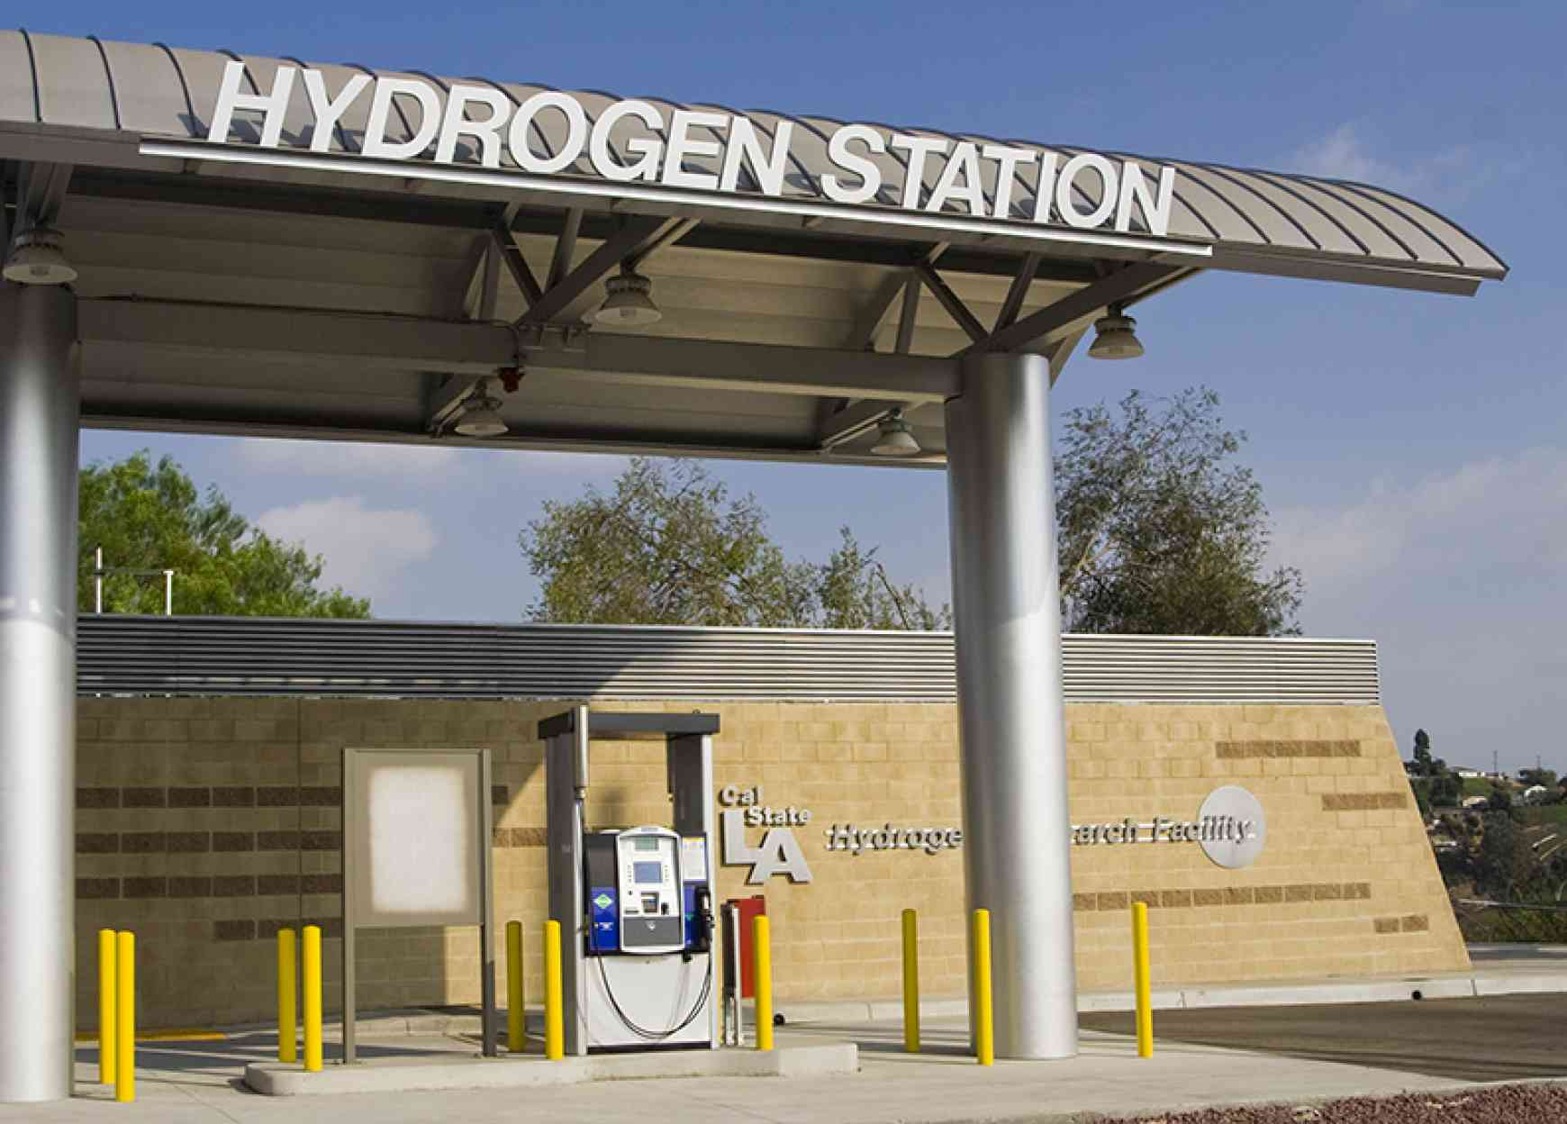



OPTIMIZATION OF HYDROGEN PRODUCTION SCHEDULE & STRATEGY OF POWER TRADING
Project 16.2 | EXPO Presentation| Spring 2021
Southern California Gas Company
Client
Arezoo Khodayari, PhD
Advisor
Michael Thorburn​
Director of Capstone Senior Design
Mayra Izquierdo Montoya | Abdullah Thabet | Yobany Cabrera | Joel Cook | Maria G Turrubiartes
Team Members

Slide 2
AGENDA
Introduction
Approach
Applications
Summary
Introduction
Applications
Approach
Summary

Slide 3




1. Introduction
Background
Impact
Objective
Requirements
Introduction
Applications
Approach
Summary

Slide 4


BACKGROUND
Cal State LA Hydrogen Station
  The Cal State LA Hydrogen Research and Fueling Facility was formally opened on May 7, 2014
  On November 12, 2014, the Cal State LA Hydrogen Research and Fueling Facility became the first in the world to sell hydrogen fuel by the kilogram directly to retail customers
Hydrogen Fuel production
  Electrolysis – dependent on LADWP Power Grid
  Maximum storage capacity - 60kg Hydrogen Fuel
Hydrogen Fuel Benefits
  Consumer – Healthier living environment.
  Environment – zero emission utilization alternative

Slide 5

PROJECT SIGNIFICANCE
Minimize cost of producing hydrogen fuel
  Allow for additional profits to be used elsewhere on campus
Alternative applications of hydrogen fuel within campus
  Increase demand for hydrogen → decrease production costs
  Motivate others to consider going green with hydrogen
  Reduce tailpipe emissions
A step closer to Carbon Neutrality
  Lead CSULA towards achieving carbon neutrality as indicated in the Climate Action Plan
    Operational carbon neutrality by 2040
    Full carbon neutrality by 2045

Slide 6
OBJECTIVES
Collect and analyze
Collect and analyze data regarding hydrogen production and sales
Identify and Incorporate
Identify & Incorporate potential hydrogen fuel applications within Cal State LA campus to maximize its environmental benefits and increase hydrogen fuel utilization
Create
Create an algorithm that will optimize the hydrogen production schedule to minimize production costs

Slide 7

PERFORMANCE REQUIREMENTS
By how much can the hydrogen fuel production cost be reduced?
How many more kilograms of hydrogen per day can be utilized for potential applications?
By how much do new applications of hydrogen fuel on campus affect the production costs?

Slide 8
2. Approach
Data Collection
Data Analysis
Algorithm
Introduction
Applications
Approach
Summary

Slide 9


DATA COLLECTION
Obtained Hydrogen Data
  Raw sales data log of every occurrence hydrogen was filled (April 2019 – March 2020)
Electricity Rate Plan - LADWP
  High Season (June – Sept)
  Low Season (Oct – May)
Challenges
  No production data
  No electrical metering data
Assumptions
  Electrolyzer starts producing at the time of each fueling event until full capacity is reached
  Electrolyzer functions 24/7
LADWP Electricity Rates Commercial Area A2-B
 | LOW PEAK 10 am – 1 pm 5 pm – 8 pm | HIGH PEAK 1 pm – 5 pm | BASE PAY 8 pm – 10 am weekends
HIGH SEASON June – September | $0.05595/kWh | $0.06322/kWh | $0.03522/kWh
LOW SEASON October – May | $0.05688/kWh | $0.05688/kWh | $0.03895/kWh

Slide 10

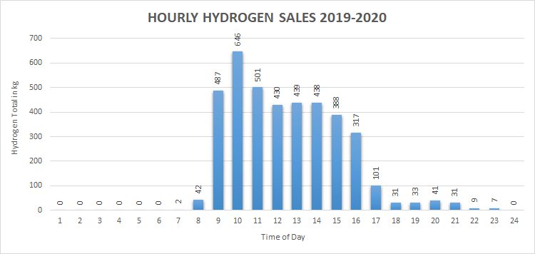
DATA ANALYSIS
Major Findings
Most Hydrogen fuel is sold between 9am-4pm
  Production is occurring during most expensive electricity rate
Currently, the station produces to maintain full storage capacity, but this is not necessary
Hydrogen fuel sold on the weekends is very little to none
Electrolyzer Average values
  62.5 kWh/kg
  2.4 kg/hr
  58 kg max daily production
With the data gathered we developed an algorithm that would optimize the production of this hydrogen

Slide 11


Algorithm Model
Optimization Parameter
Cost per Unit ($/kg)
Constants
Electrolyzer Energy per Unit (kWh/kg)
Electrolyzer Production Rate (kg/hr)
Electricity Cost ($/kWh)
Kilograms of Hydrogen Sold (kg/day)
Optimization Hierarchy
Tier 1: Lowest cost
Tier 2: Second lowest cost
Tier 3: Highest cost
Business-As-Usual
Output
Monthly Total Sales (kg)
Business-as-Usual Cost ($)
Optimized Schedule Cost ($)
Total Savings ($)
Business-as-Usual Cost per Unit ($/kg)
Optimized Schedule Cost per Unit ($/kg)
Savings per Unit ($/kg)

Slide 12

Algorithm Development
Importing Excel Data
  Date &Time and Kg Filled
Assume
  Electrolyzer turns on after each sale of day & remains on until maximum storage capacity of 60kg of hydrogen is reached
Separate sales data between weekdays and weekends
Production Scenarios
1. Business-as-Usual
2. Optimized Production Tiers
Calculations
  Monthly Total Kg of Hydrogen
  Total Costs & Savings
  Cost & Savings per unit ($/kg)
Weekdays
 | Low Season | High Season
12am
1am
2am
3am
4am
5am
6qm
7am
8am
9am
10am
11am
12pm
1pm
2pm
3pm
4pm
5pm
6pm
7pm
8pm
9pm
10pm
11pm
 | Always
 | Sometimes
 | Avoid

Slide 13
Low Season
Weekdays
 | Low Season | Kg of H2
12am |  | 24 kg | Tier 1
1am
2am
3am
4am
5am
6am
7am
8am
9am
10am
11am
12pm
1pm
2pm
3pm
4pm
5pm
6pm
7pm
8pm |  | 9kg | Tier 1
9pm
10pm
11pm
January – May & October – December
Tier 1 – Lowest cost
  Base Pay Electricity Cost
 | < 33kg
 | Avoid

Slide 14
High Season
Weekdays
 | High Season | Kg of H2 | Hierarchy
12am |  | 24 kg | Tier 1
1am
2am
3am
4am
5am
6am
7am
8am
9am
10am |  | 7.5 kg | Tier 3
11am
12pm
1pm
2pm
3pm
4pm
5pm |  | 7.5 kg | Tier 2
6pm
7pm
8pm |  | 9 kg | Tier 1
9pm
10pm
11pm
July – September
Tier 1, 2, 3
 | < 33kg
 | 33kg < x < 48 kg
 | Avoid

Slide 15

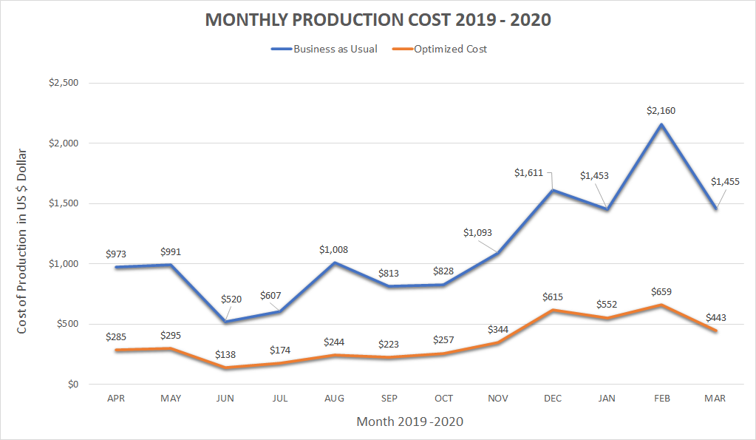

Slide 16

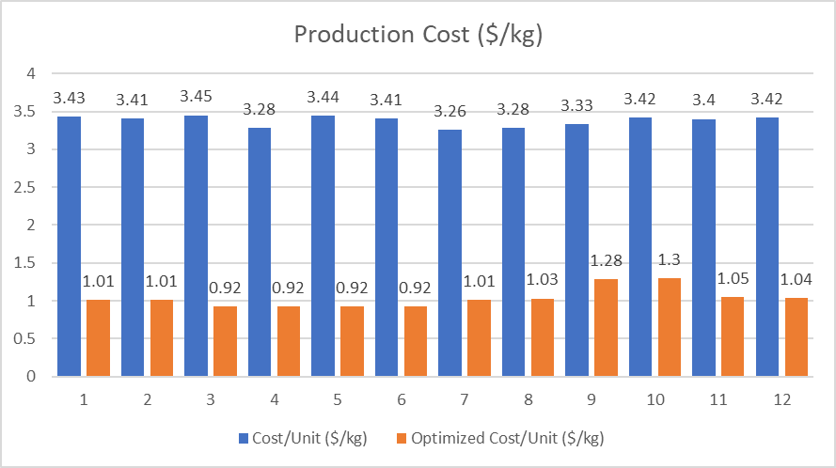
Optimized Results
Average production cost from normal operations: $3.38/kg
Average production cost from optimized schedule: $1.03/kg
Average % savings: 69%

Slide 17
3. Applications
Gasoline to Hydrogen
Waive Car
Analysis
Introduction
Approach
Summary
Applications

Slide 18


Gas to Hydrogen Vehicle
Cal State LA – Strategic Energy Plan
Alternative fuel program for on-campus fleet vehicles in 2016
Promised to make all fleet vehicles alternative energy
184 Vehicles
  Hydrogen Fuel-Cell 4
  Electric Vehicles 87
  Hybrids 93
  Gasoline 6
PROPOSAL:
Replace 6 gasoline vehicles with hydrogen fuel-cell vehicles

Slide 19
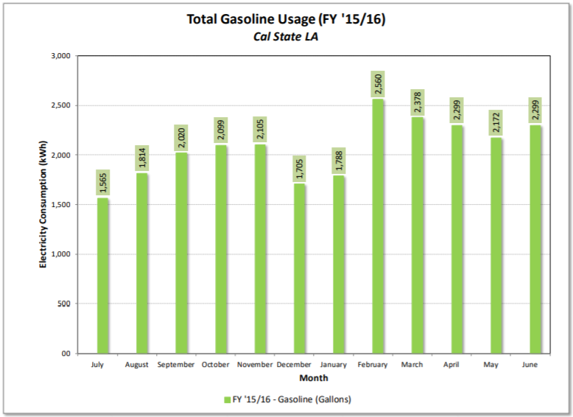


Assumptions:
Gallons used and miles driven are same every year
Gas-powered vehicle - 6 vehicles
  Honda Accord 24MPG (4.2gal/100miles)
Hybrid vehicles – 93 vehicles
  Toyota Camry 33MPG (2.9gal/100miles)
Hydrogen vehicle
  Toyota Mirai 82 MPKg (1.22 $kg_{H_{2}}$/100 miles)

Slide 20
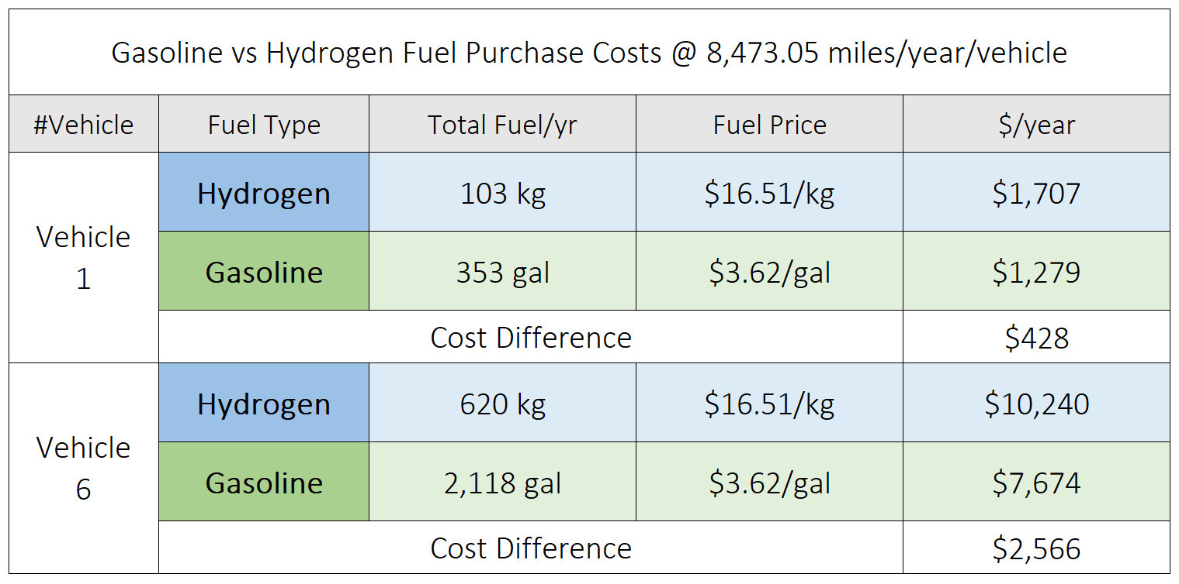
Gasoline vs. Hydrogen Cost
We also receive a $15,000 fuel credit

Slide 21


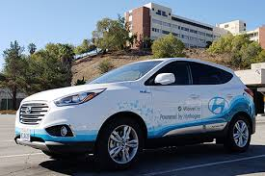
WaiveCar
Purpose:
Increase utilization of Cal State LA Hydrogen station
Decrease emissions
4 Hyundai Tucson Hydrogen EV
  Tank size = 5.63 kg
  Range = 265 miles
Hours of operation
  Monday – Friday: 8am-5pm
Program:
For students and staff to rent
First hour is free + $5.99/hour afterwards
4 vehicles - 30 miles maximum per roundtrip

Slide 22
Estimation of Hydrogen Fuel Consumption
Hydrogen Fuel Consumption
 | Min kg | Max kg
Day | 7.64 | 12.61
Week | 38.24 | 63.05
Month | 153.13 | 252.22
4 WaiveCar Vehicles
Price of Hydrogen Fuel = $16.51/kg
Each roundtrip can be estimated to be 2-3 hours
Maximum 3 - 5 trips per day = 90-150 miles/day
  34-56% of hydrogen tank usage
Monthly Utilization
  153.13-252.22 kg of Hydrogen
Monthly Cost
  $2,522-$4,163.82 to refuel the vehicles
Hydrogen vehicle Fuel cost
 | Min Cost | Max Cost
Day | $ 126.13 | $ 208.19
Week | $ 630.68 | $ 1,040.95
Month | $ 2,522.73 | $ 4,163.82

Slide 23

Low Carbon Fuel Standard (LCFS) Credit System
For every 250 kg of Hydrogen fuel sold, 1 unit of credit is received
March 2021: $167-$213 per credit
Waive car program will yield 12 credit per year
6 Hydrogen fleet vehicles will yield 2 credits per year

Slide 24

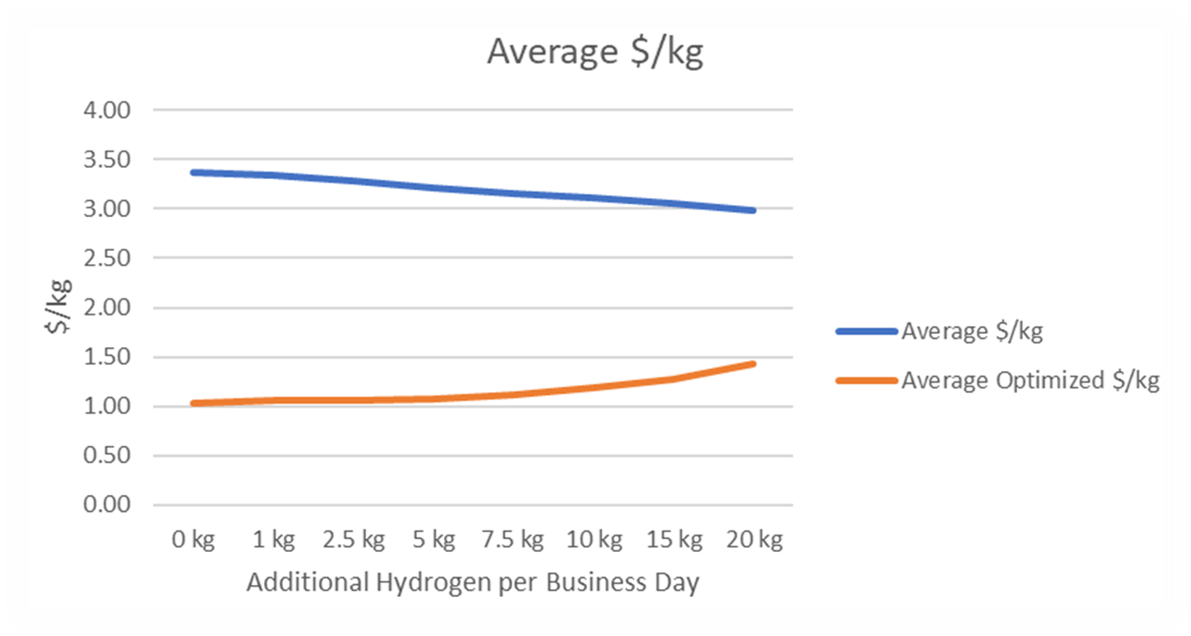

Effect of Additional Hydrogen Sales
Average Additional Cost is $0.008
24

Slide 25
Additional Hydrogen Available

Slide 26
4. Summary
Objectives:
  Collect and Analyze Data
  Create an Algorithm
  Identify and Incorporate Applications
Optimized schedule reduced cost by 69% for April 2019 to March 2020.
Approximately 41.6 additional kilograms available each business day
Every additional kg of hydrogen sold → average + $0.008/kg
Introduction
Applications
Approach
Summary

Slide 27




Acknowledgements
California State University
  Arezoo Khodayari, Ph. D.
David Blekhman, Ph. D.
Brad Haydel
Hydrogen Station Staff
Los Angeles Department of Water and Power
Southern California Gas Company

Slide 28
Joel Cook
Mayra Izquierdo Montoya
Yobany Cabrera
Maria G. Turrubiartes
Abdullah Thabet
THANK YOU

