Slide 1

Senior Design EXPO
Team 22 – Inflation of a Membrane
California State University, Los Angeles
College of Engineering, Computer Science and Technology
Advisor - Dr. Mathias Brieu
Team - Cesar Cerda Solorio, Kulvir Beinig, Danny Sanchez, Justin Thai

Slide 2






Client & Team Members
Dr. Mathias Brieu
Cesar Cerda Solorio | Justin Thai | Danny Sanchez | Kulvir Beinig

Slide 3




Agenda
Objective
Significance
Experimental setup
Constraints
Deliverables
Requirements
Approach
  Gripping
  Sealing
  Pressure application
  Strain evaluation
Conclusion

Slide 4
Objective
Design a device to evaluate the response of various synthetic materials to cyclic biaxial loads

Slide 5
Significance soft tissue are subjected to biaxial loads....
Most soft issues experience biaxial loading
Vaginal prolapse – 30% women in U.S./60% women over 60
Two treatments:
  Hysterectomy
  Mesh hysteropexy
3-year outcome:
  failure rate mesh hysteropexy – 26%
  failure rate hysterectomy – 38%
Inefficacy of implants:
  Failure rates is reach 40%
​
Notes:
Most soft tissues - Pelvic tissue – experience biaxial loadings that’s why we use a biaxial method

Slide 6
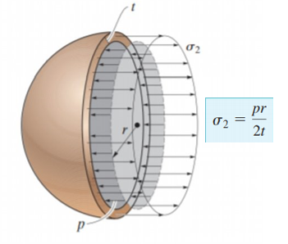

How to complete biaxial loads on sample?
System Requirements
Pressure Application
Identification of fluid to be used.
Spherical shaped vessels concept.
Research of other BIT devises.
Pressure Range.
Pressure range: 0 to 270 KPa

Slide 7
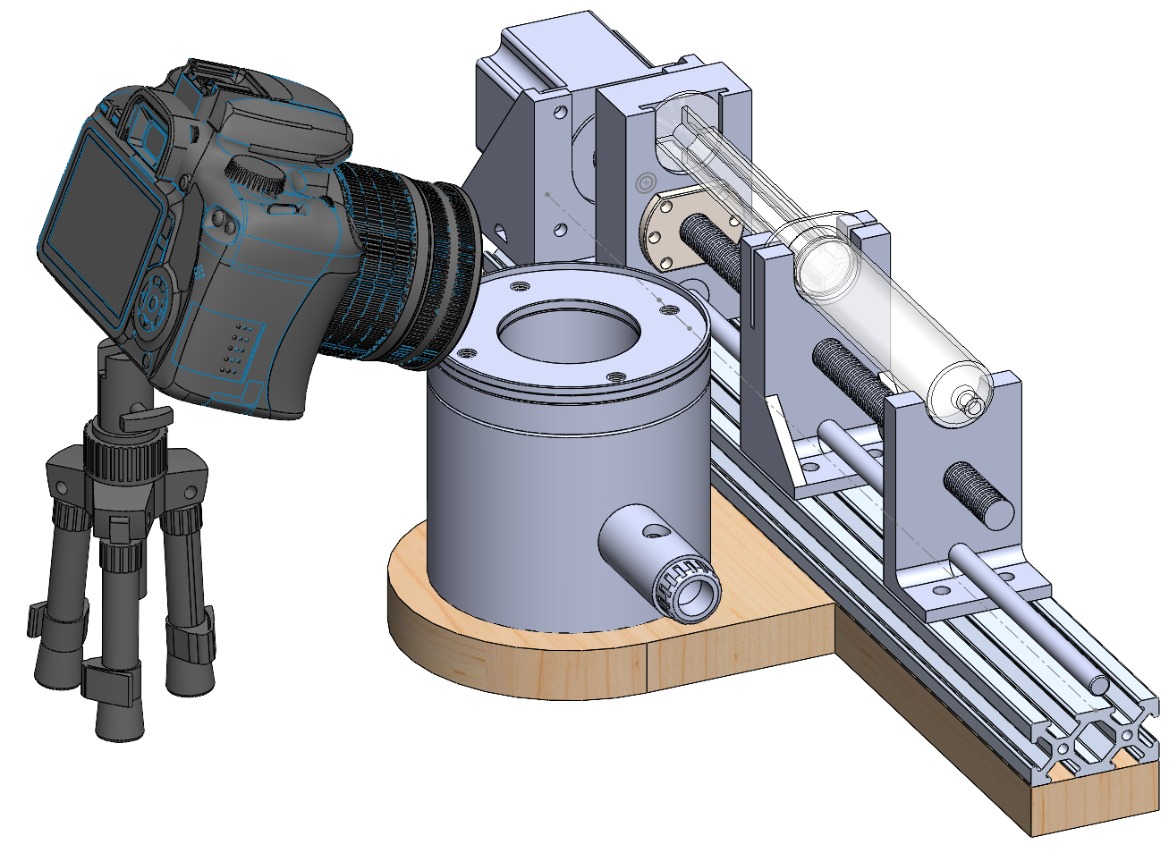
Approach
Notes:
Justin
Here we have a render of the experimental setup
It consists of a syringe based pressure application system,
This is just a visual representation to show the components of the setup and not representative of the exact final set-up
The camera and the pressure transducer will be connected to a computer for data logging

Slide 8
Deliverables
Item | Description | Date of Delivery
1 | Hermetically-sealed pressure chamber with adjustable gripping solution for membrane inflation testing | May 2021
2 | Hardware and software solution for performing and evaluating optical strain measurement | May 2021
3 | Software-controlled fluid pressure application system capable of applying cyclic loads and measuring pressure | May 2021
Notes:
Justin

Slide 9
Requirements
No. | Team | Subject | Requirement | Source | Method of Verification
1 | Sealing | Seal | Hermetic, low-cost | Customer | Design/Testing
2 | Gripping | Gripping pressure | Properly grip tissue | Derived | Analysis
3 | Pressure | Pressure application | 0-270KPa | Derived | Analysis
4 | Pressure | Cyclic loading capability | <100 cycles per sample | Customer | Design
5 | Pressure | Cyclic loading speed | Variable | Customer | Design
6 | Strain | Strain measurement method | Optical | Customer | Design
7 | Strain | Imaging resolution | 1080p | Customer | Design
8 | Strain | Lens focal distance | 16mm, fixed | Derived | Design
9 | Strain | Camera sensor triggering | Remote, ~100 ms latency | Customer | Design/Testing
Notes:
Justin
Organize the requirements by deliverable derived from
For pressure, we have requirements that deal with the application of the pressure and the cyclic loading capability of the device
For strain, the requirements deal with the actual strain measurement and the image capturing software and hardware

Slide 10
Hermetical Chamber
Gripping
Sealing
Pressure system

Slide 11
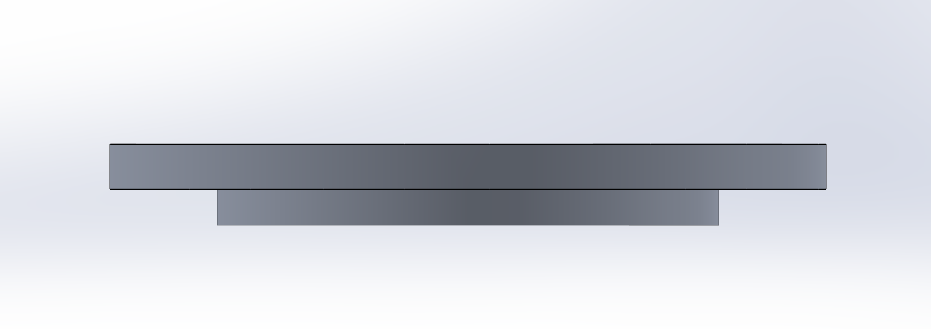
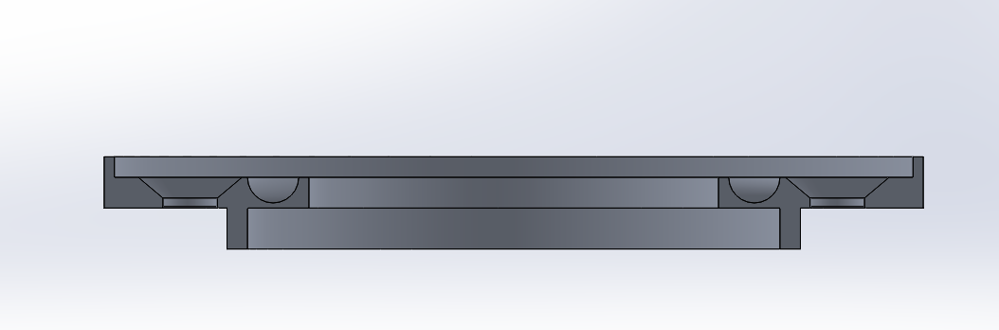
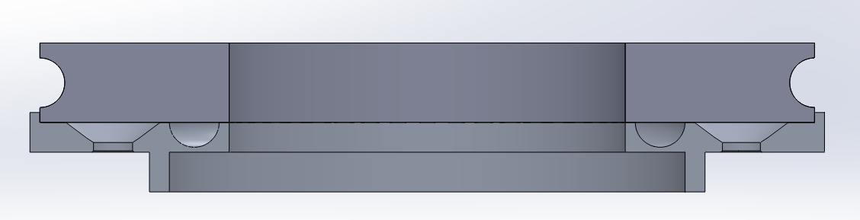
Gripping
Must be able to secure the replaceable membrane under fluid pressure.
Must be able to apply even pressure when securing the testing sample.

Slide 12
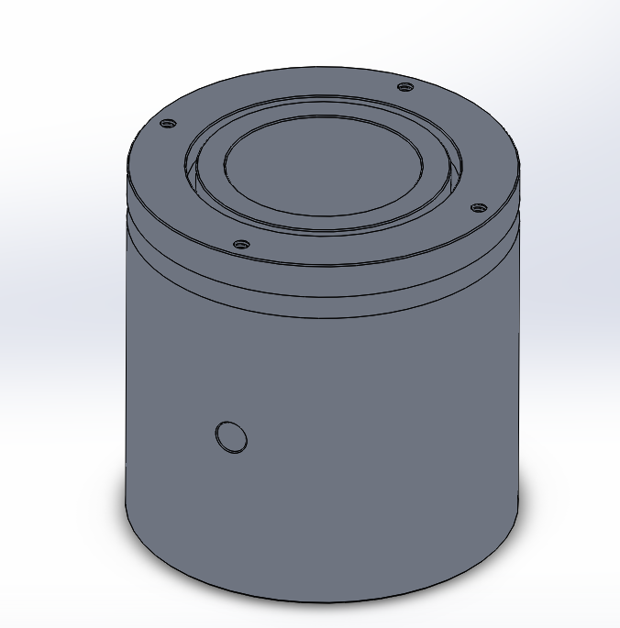
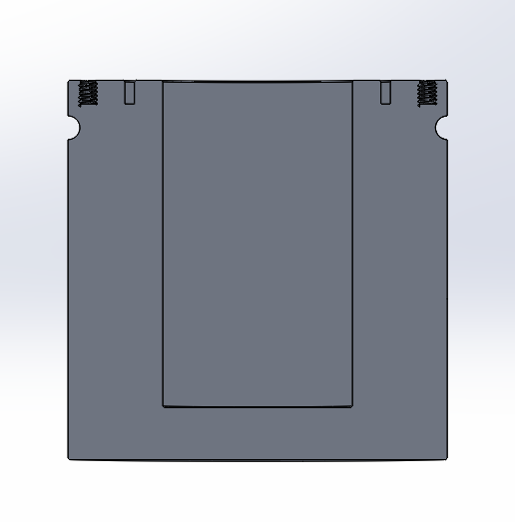
Sealing
Must be air-tight to prevent leaking from pressure application.
Must be able to secure the membrane and adapt to pressure applications

Slide 13
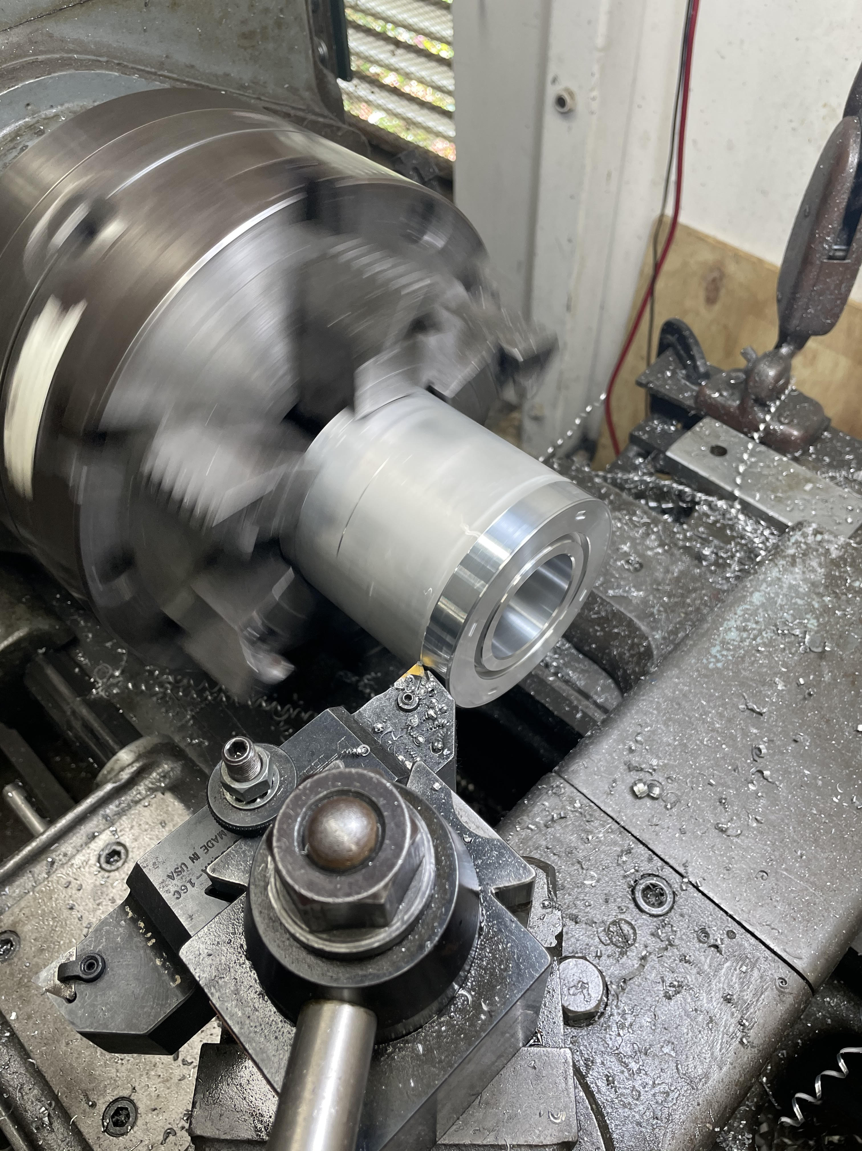
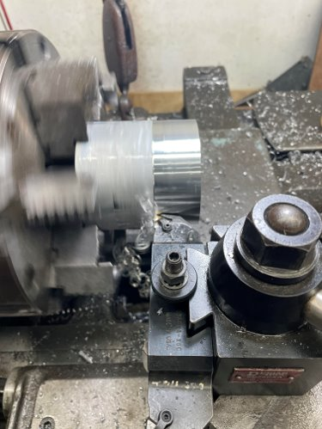
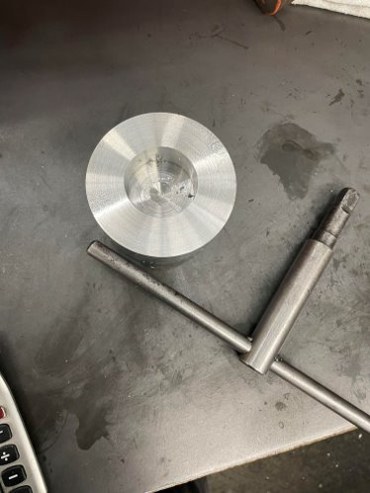
Gripping and Sealing
Machining

Slide 14
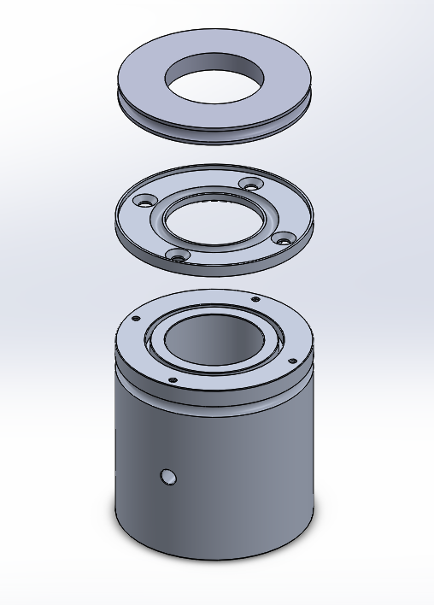
Gripping and Sealing
Assembly

Slide 15
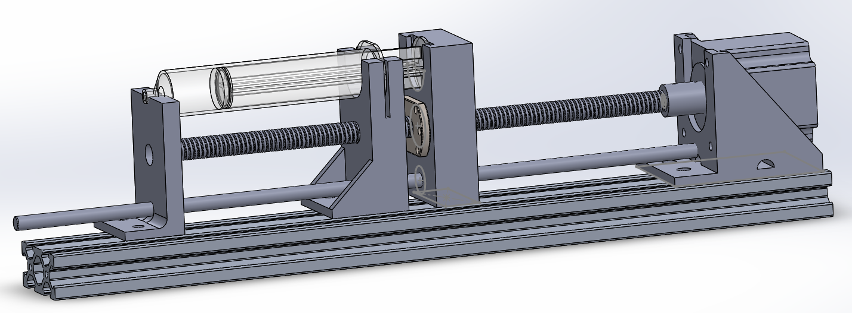
Pressure Application
System Overview

Slide 16
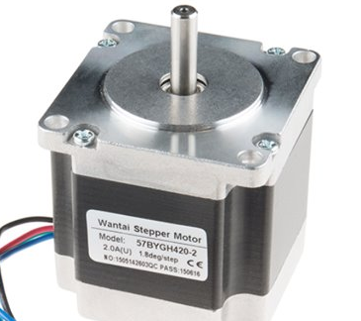
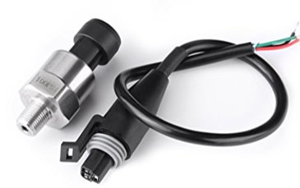

Hardware control of the chamber
Pressure control
Electronic acquisition

Slide 17
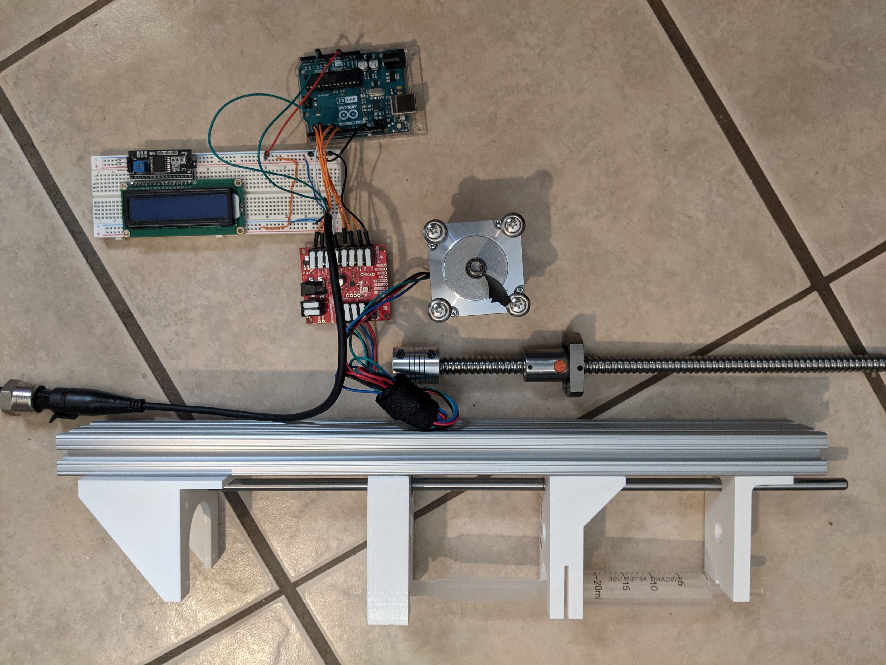
Pressure Application
Methods
Open-source initial design
Improvement on design
Reduction of friction
Stepper motor requirements

Slide 18
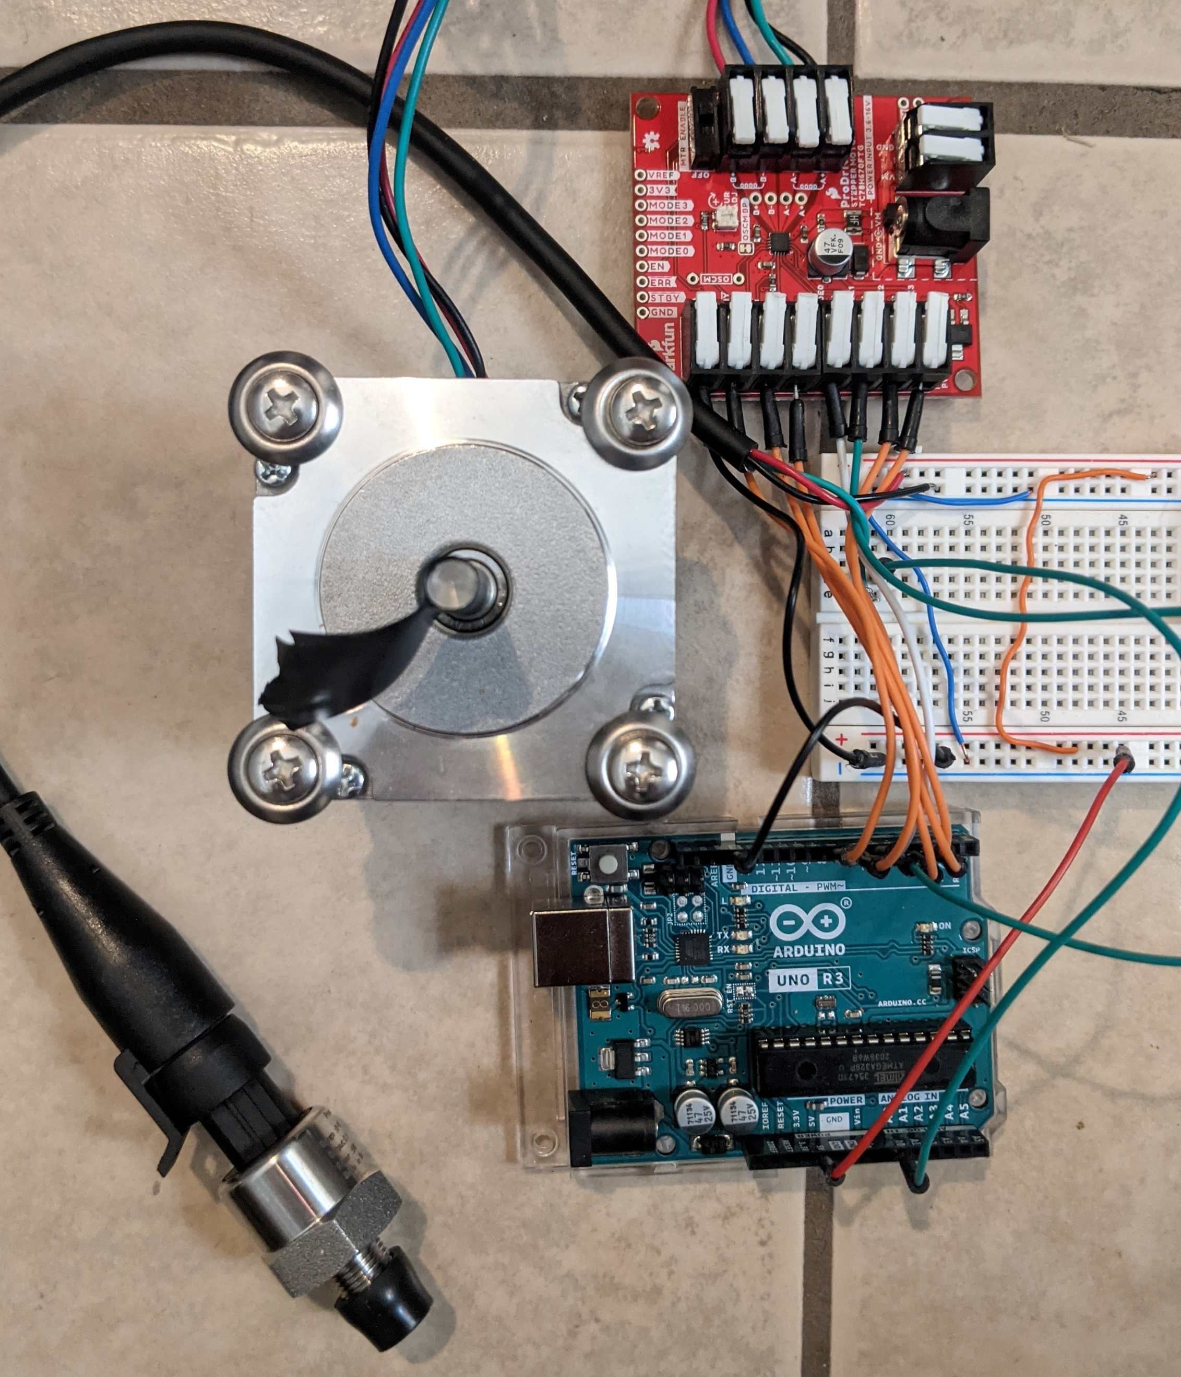
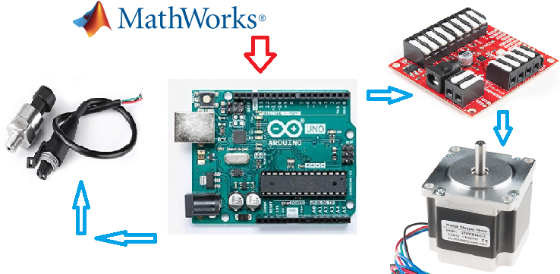
Pressure Application
Controls
Motor Driver
Pressure Sensor
Arduino Uno
Stepper Motor

Slide 19
Strain measurement
Principle of contactless strain measurements
Image acquisition
Preliminary results

Slide 20
Strain Evaluation
Constraints
1. The method of strain measurement must not involve physically contacting the membrane
2. The method of strain measurement, like the other components of the membrane inflation testing device, must take data over time

Slide 21
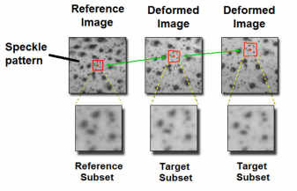
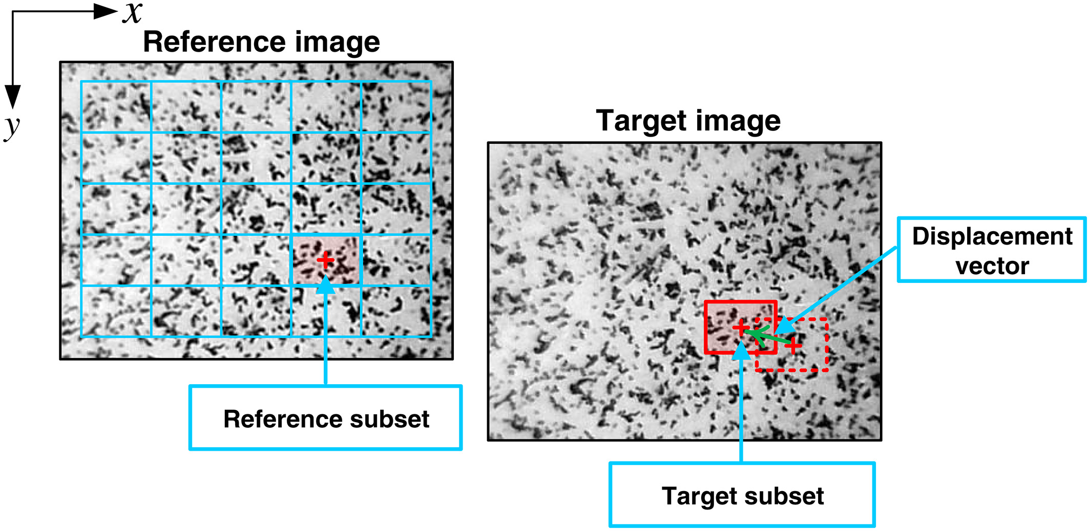
Strain Evaluation
Digital Image Correlation
Involves applying a stochastic pattern to the sample
Uses that pattern to subdivide the sample into subsets
Calculates the strain by tracking the deformation of each subset
Notes:
Using DICe digital image correlation engine an open source DIC tool and paraview the open source visualization software to generate strain animations

Slide 22
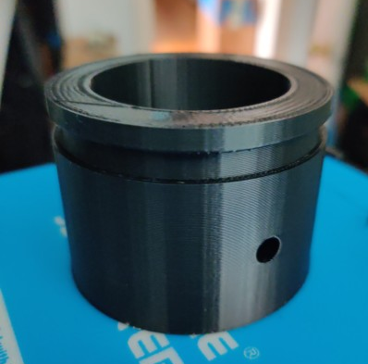
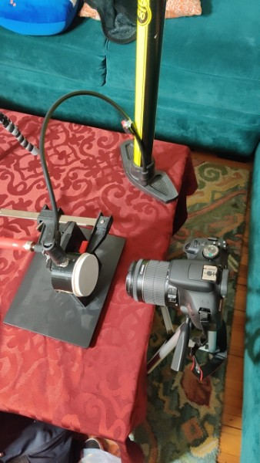
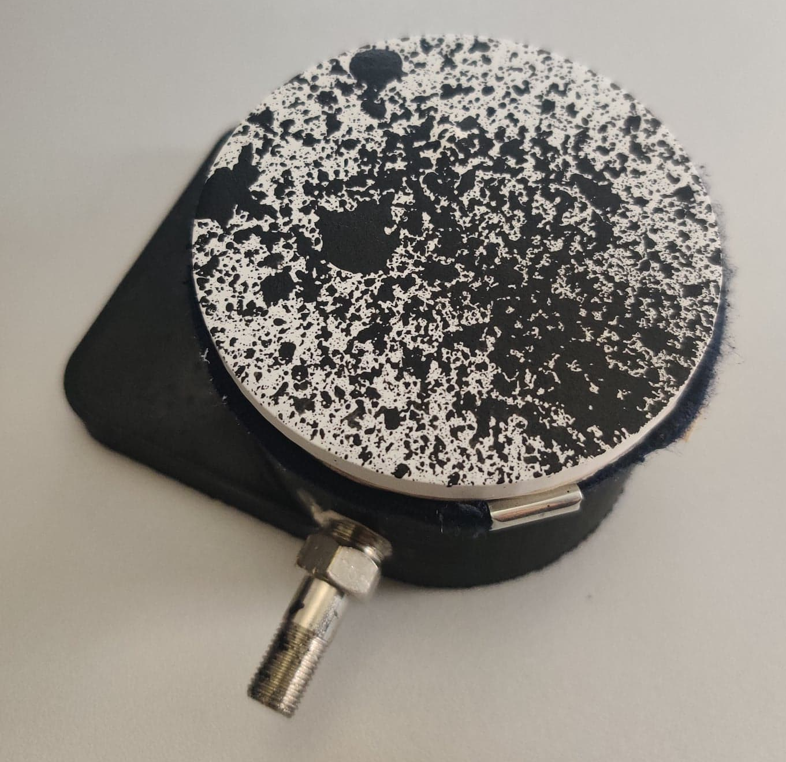
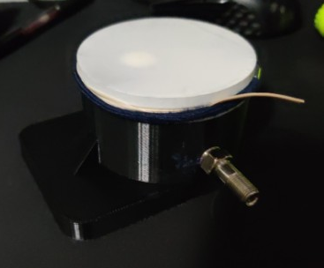
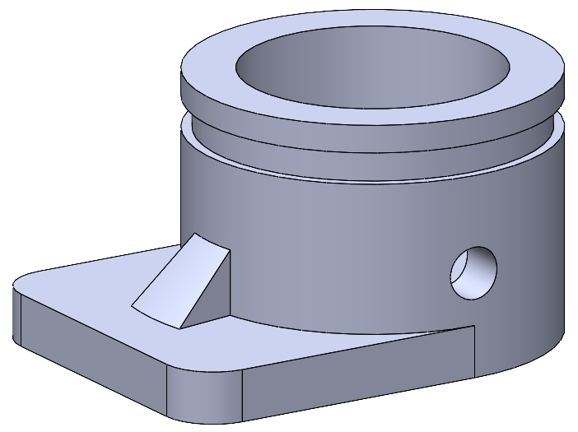
Strain Evaluation
Initial Testing - COVID Edition
Notes:
3D printed chambers with a groove for membrane attaching and hole for valve
Leaks
Valve has restrictive flow

Slide 23
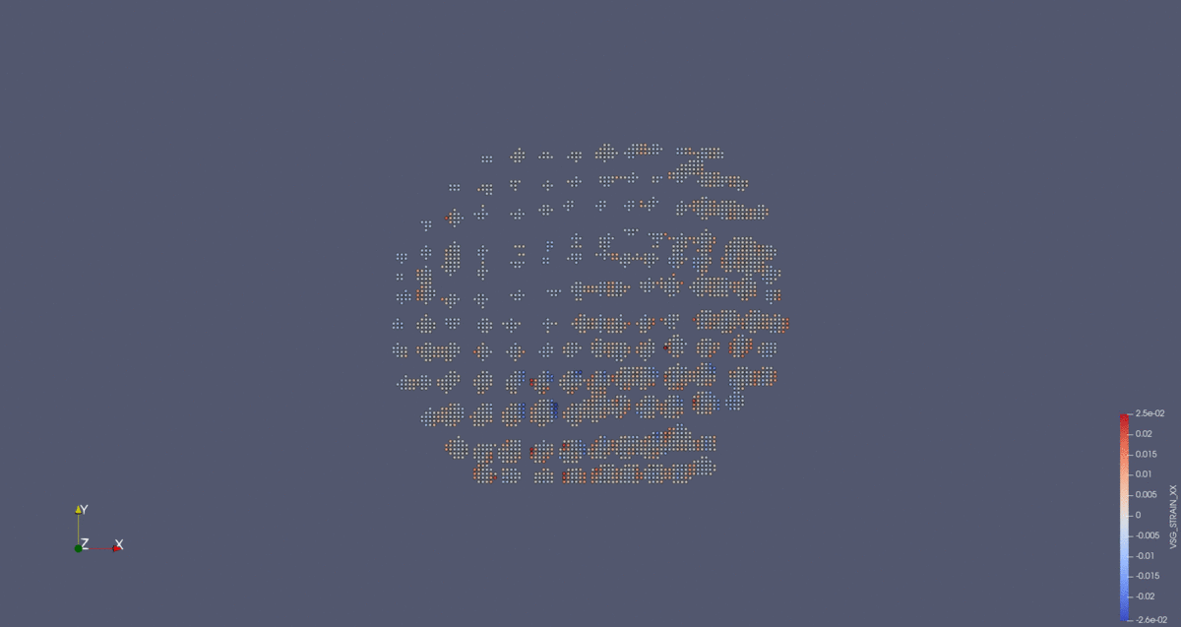
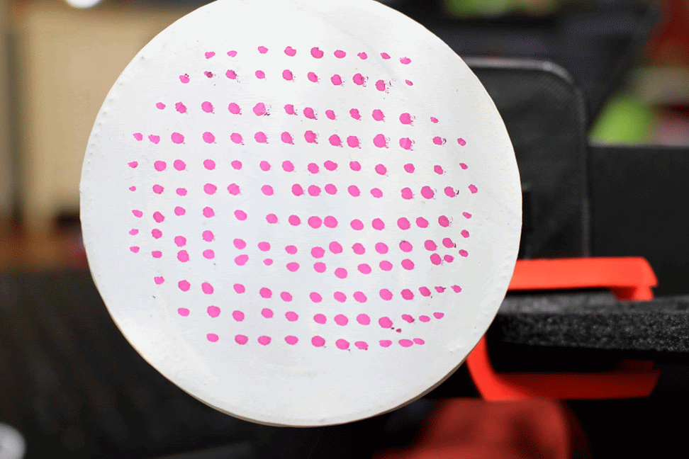
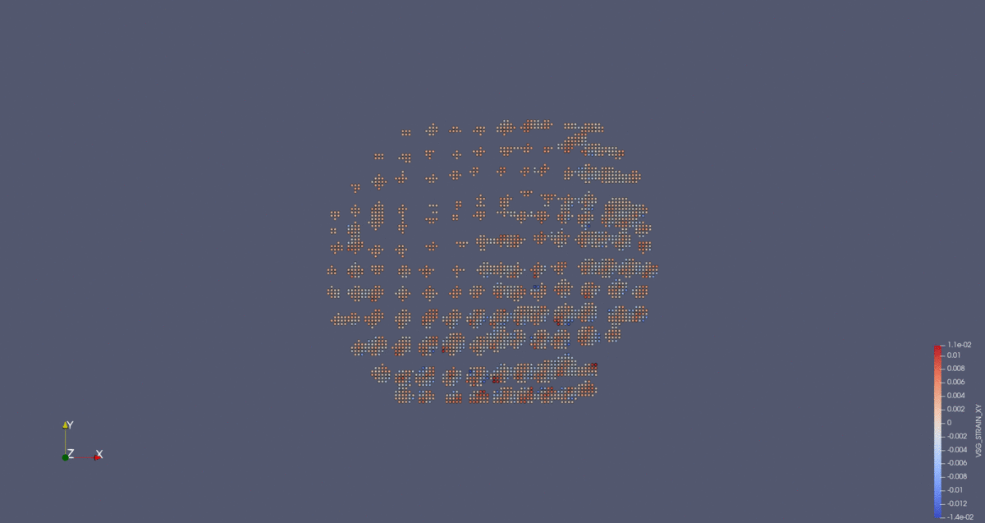
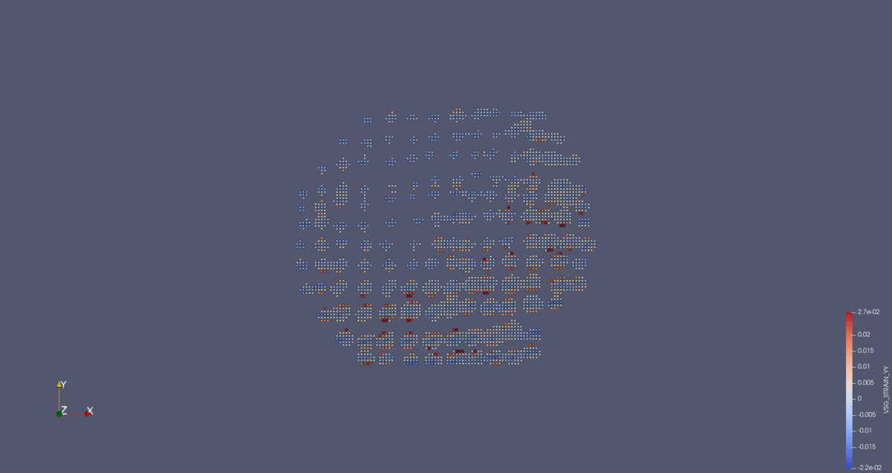
Strain Evaluation
Captured Images and Initial Results
Ɛ_{XX}
γ_{XY}
Ɛ_{YY}
Notes:
So here we have some initial results
The image set being analyzed can be seen animated on the top left and the normal strains and shear strain can be seen on the right side
The animation for the shear strain evaluation can be seen in a zoomed in view on the bottom left
Minimal shear strain in the center indicates consistency with expectation
It implies a somewhat uniformity between axial strains
An issue that came up was that Since the deformation in the center of the membrane is occurring in the direction of the lens, at such a small initial focal length, focusing changes the focal length enough to cause a general relative translation that can be seen in the raw image data and the paraview animations

Slide 24
Conclusion
Work Completed
  Completed design of system and subsystems
  Completed hardware and software incorporation of pressure system
  Completed successful strain measurements using DICe using provided sample image sets
Work to be completed
  Need to complete manufacturing of pressure chamber
  Need to complete final assembly of the Inflation system
  Need to validate mechanical characterization of a membrane
  Strain evaluation methods can be further tested
  Need to find a way to fashion the mason jar clamping mechanism on the chamber
Notes:
Justin
Divide the conclusion into work done and work to be completed
These topics are currently in progress and an update on the state of completion of the project will be given at the ECST expo

Slide 25
References
Chung, Timothy Kwang-Joon. "Study of multi-axial failure properties of planar biological soft tissue." PhD Thesis. 2017. Document.
Dr. D-Flo. Syringe Pump "Automatic dispensing of liquids". 20 February 2017. Website. 15 October 2020.
Hibbler, R. C. Mechanics of Materials. Pearson Prentice Hall, 2011.
M. Brieu, Senior Design project: 3D printed implants: Inflation Testing Device, Los Angeles: California State University Los Angeles, 2020
“Mesh implants have similar outcomes to hysterectomy for vaginal prolapse repair,” National Institutes of Health, 17-Sep-2019. [Online]. Available: https://www.nih.gov/news-events/news-releases/mesh-implants-have-similar-outcomes-hysterectomy-vaginal-prolapse-repair. [Accessed: 07-Apr-2021].

