Slide 1

Development of a Manufacturing System for Bulk Metallic Glass Wires
Team Members:
Bardo Amaya​
Wilkin Chan​
Edwin Lopez​
Christopher Penilla​
Fabiola Sanchez​
Peter Daniel Tabangin​
​
Advisor: Mohsen Eshraghi
Advisor’s Intern: David Reyes-Ramirez​
Sponsor: ​Advanced Material and Manufacturing Laboratory
Department of Mechanical Engineering
Academic year 2020-2021

Slide 2
Organization
Peter Daniel (Team Leader)
Dr. Mohsen Eshraghi
(Advisor)
Simulation Team
Electrical Team
Design Team
Fabiola Sanchez
Bardo Amaya
Edwin Lopez
Wilkin Chan
Christopher Penilla
2

Slide 3
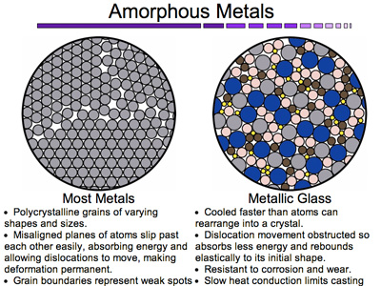
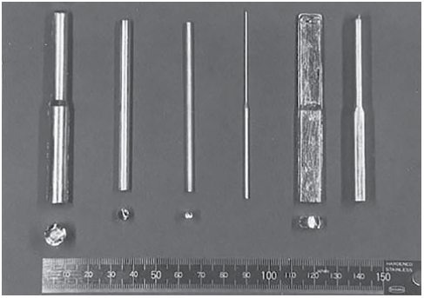
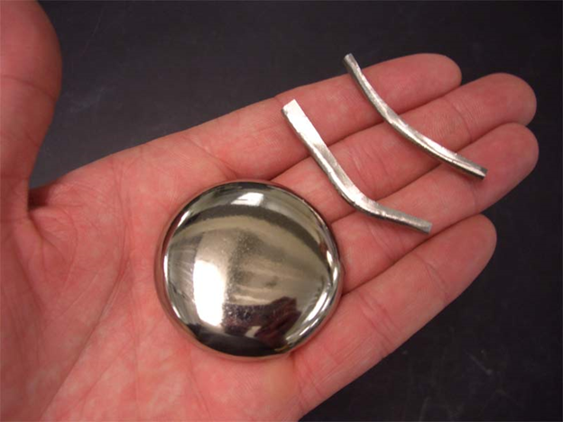
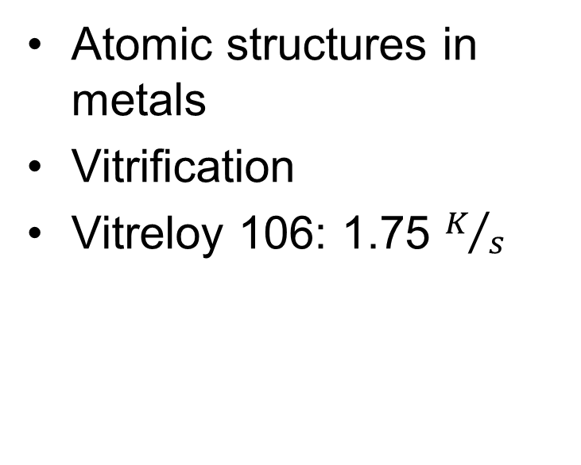
What is Bulk Metallic Glass?
Atomic structures in metals
Vitrification
Vitreloy 106: 1.75 $K/s$
"https://www.scienceabc.com/innovation/metallic-glass-will-revolutionize-future.html," [Online].
Notes:
Brief history

Slide 4
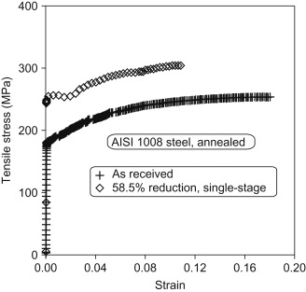
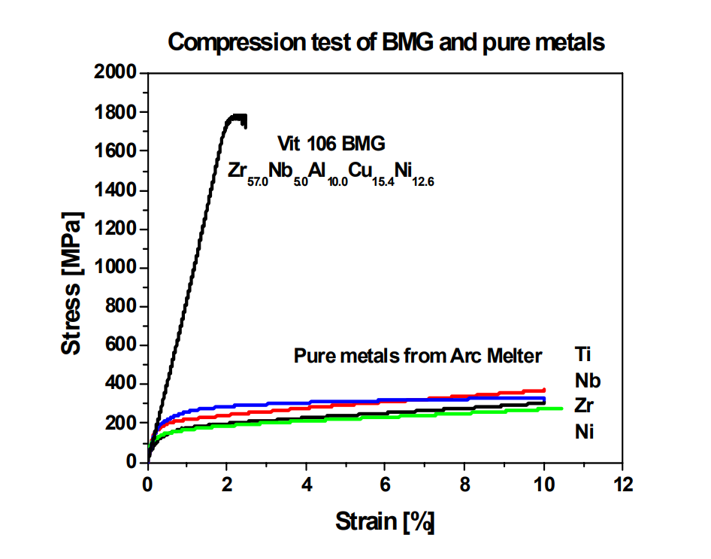
Why is Bulk Metallic Glass special?
Higher yield strength
Higher elastic limit
Low Young's Modulus
Yub Lee, S., 2005. Deformation Mechanisms Of Bulk Metallic Glass Matrix Composites.
Lenard, J. 2014. Ch. 8 Material Attributes. Primer on Flat Rolling

Slide 5
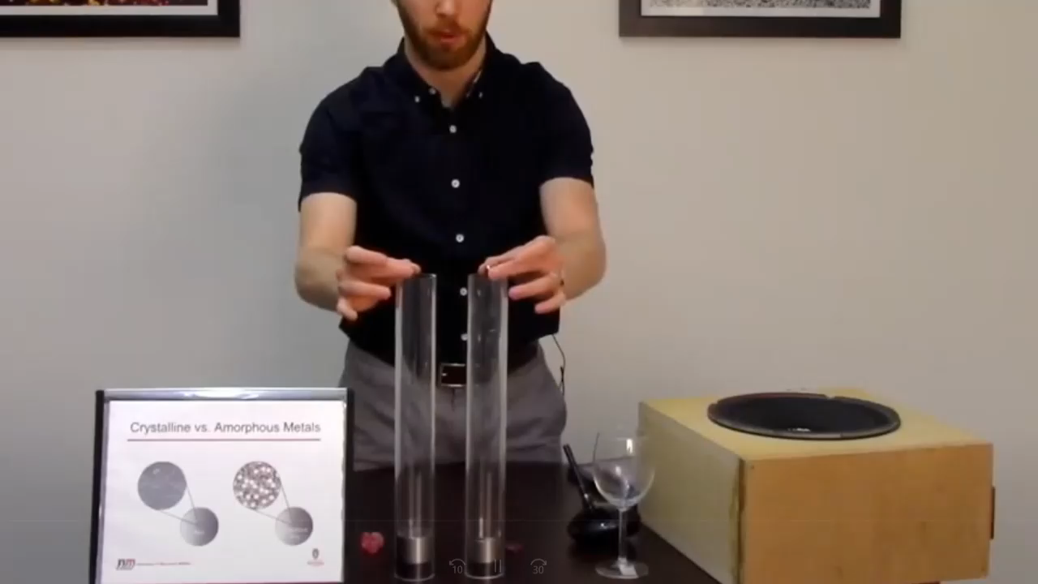
Why is Bulk Metallic
Glass special?
Resistance to plastic deformation
High corrosion resistance
Not ductile
No solidification shrinkage
Wisconsin Mrsec. 2018. Metallic Glasses. YouTube
Notes:
The lack of dislocations in metallic glass allows the ball bearing to retain most of its energy allowing, therefore it continues bouncing as oppose to the regular metal ball bearing that has these defects
Maybe talk briefly about dislocations and defects and why it makes bulk metallic unique

Slide 6
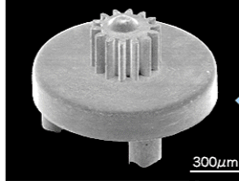
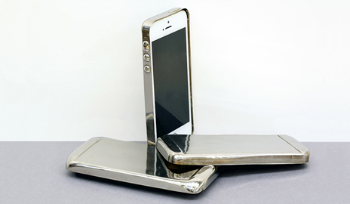
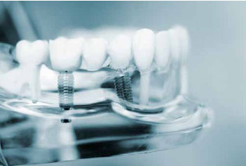
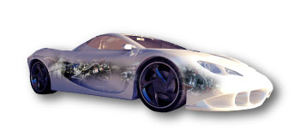
Applications
Micro Gear
Scratch resistance Cell Phone Case
Pressure sensors
Biomaterial
Parts, P. and Glass, M., 2021. Metallic Glass｜Adamant Namiki Precision Jewel Co., Ltd.. [online] Ad-na.com.

Slide 7
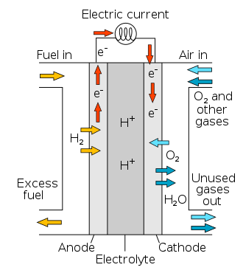
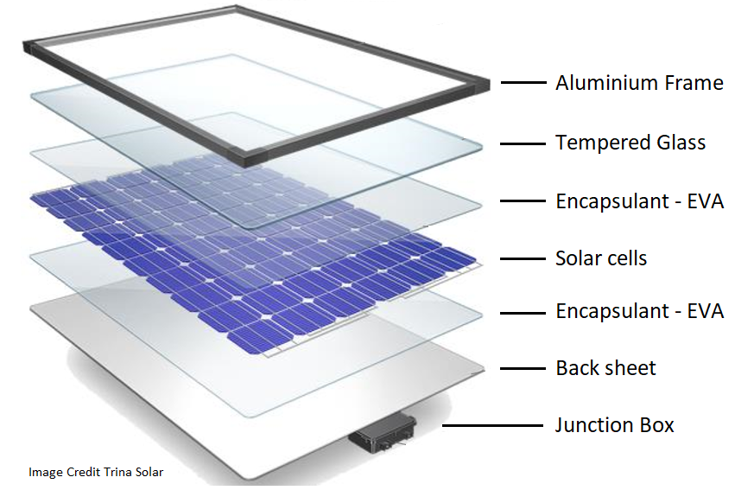
Wire Application
Solar cells
Sensors
Batteries
Fuel cells

Slide 8
Objective
The objective of this project is to develop a manufacturing system for wires and/or springs out of Bulk Metallic Glass (BMG).

Slide 9
Requirements
Enclosed System
Rapid Cooling Rate
Induction Furnace
Slow Flow Rate
Low RPM on Copper Mold

Slide 10
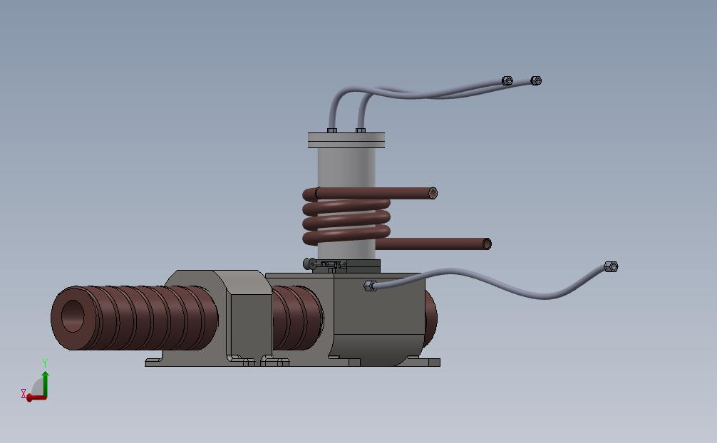
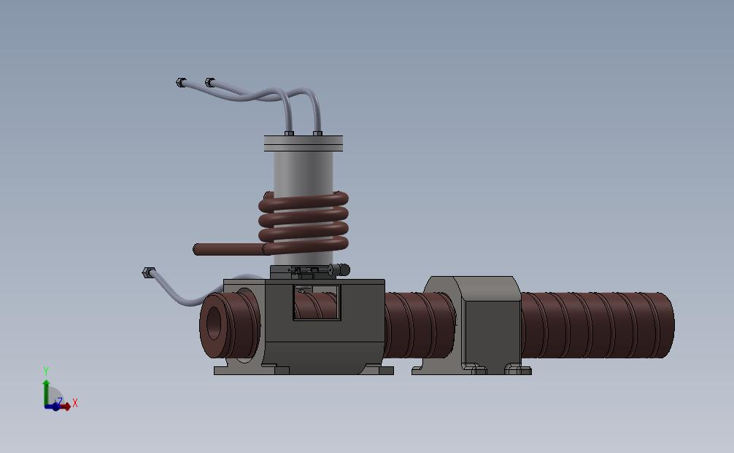
Design Concept
Induction Furnace
Grooved Copper Mold
Crucible
Enclosure
Crucible
Induction Heater
Copper Mold
Notes:
Credits to Dr. Eshragi for the design

Slide 11
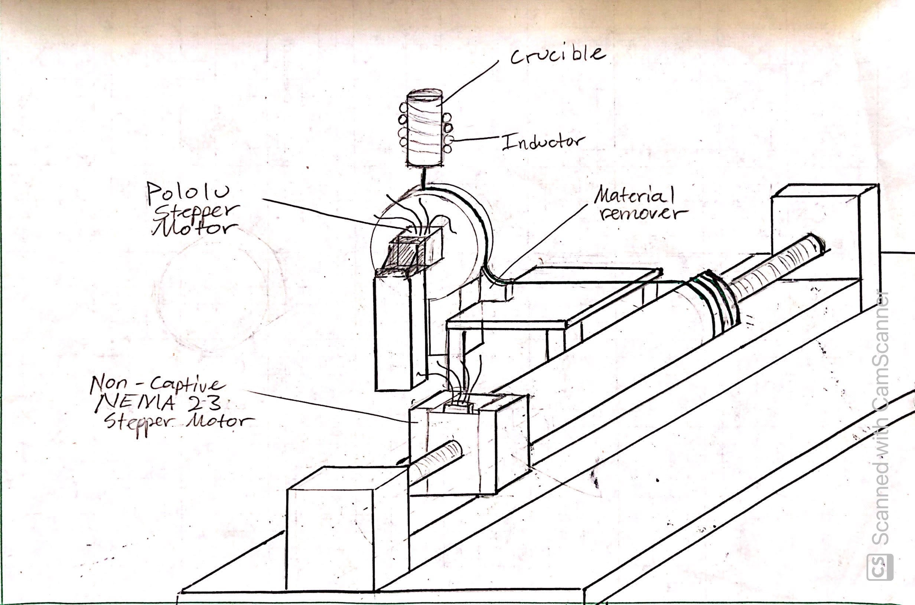
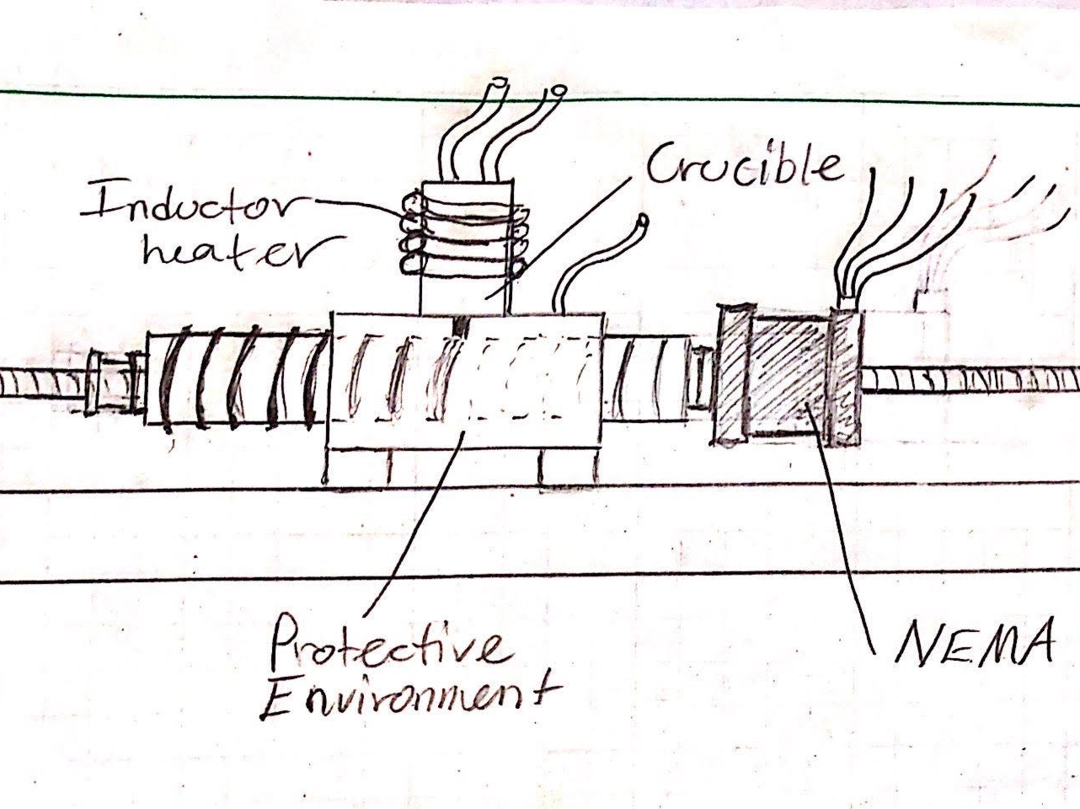
Preliminary Design for a Bulk Metallic Glass Wire System and Spring System

Slide 12
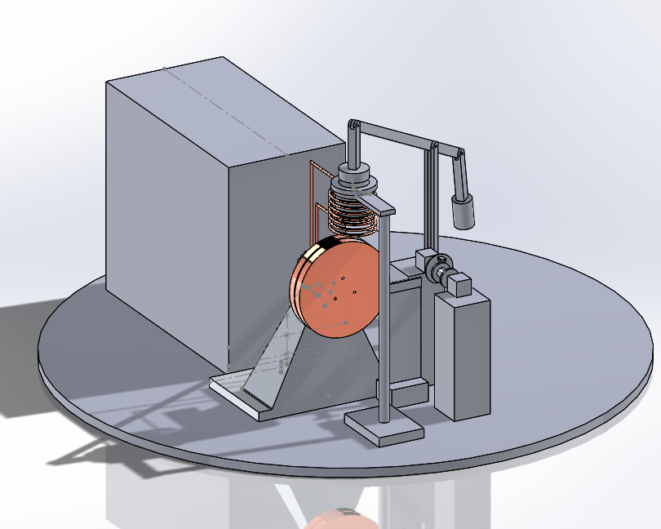
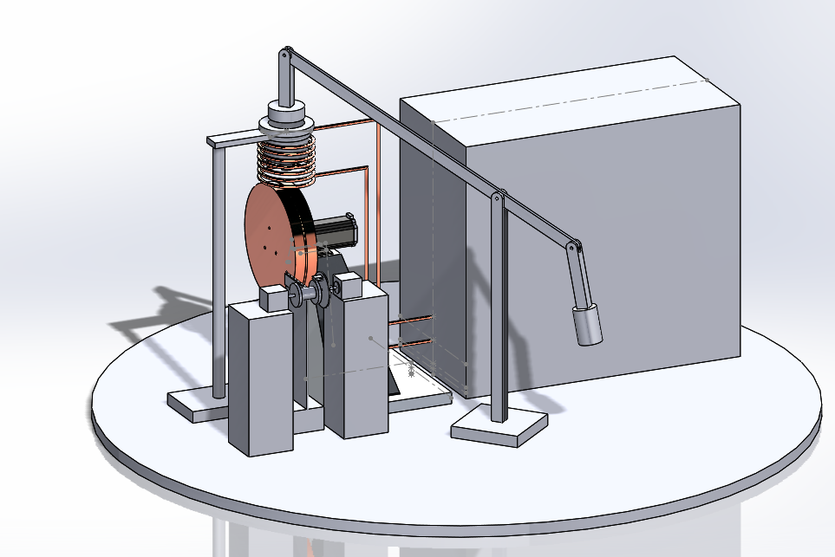
Final Design
Copper mold will cool liquid BMG
Nema 32 and 14 motors rotate copper mold and wire collector system
Lever arm mechanism controls flow rate
Temperature sensor
Inductor furnace
Crucible
Inductor
Copper Mold
Motor
Wire Collector
Lever Arm

Slide 13
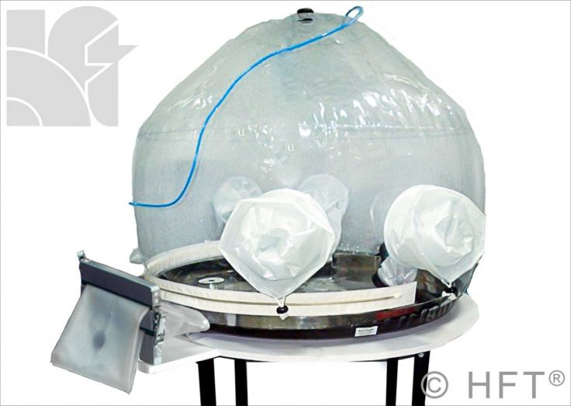
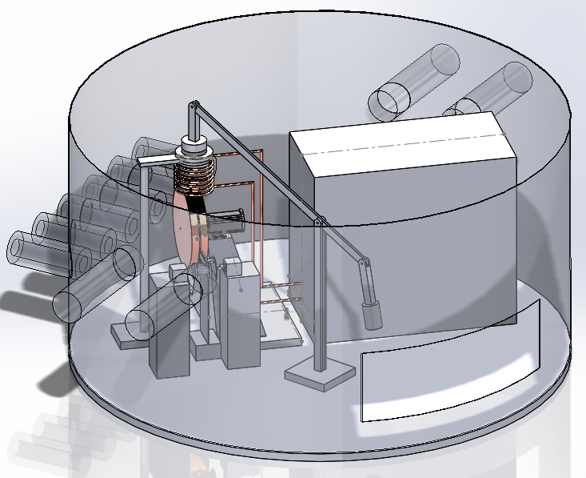
Control Environment
Flexible Welding Enclosure
  Low Cost
  Customizable
  Allows access from outside
  Strong ability to remove air
Notes:
Remove air to 10 ppm
36 in enclosure - $3831
48" --> 4344
60" --> 4761
72" --> 5265

Slide 14
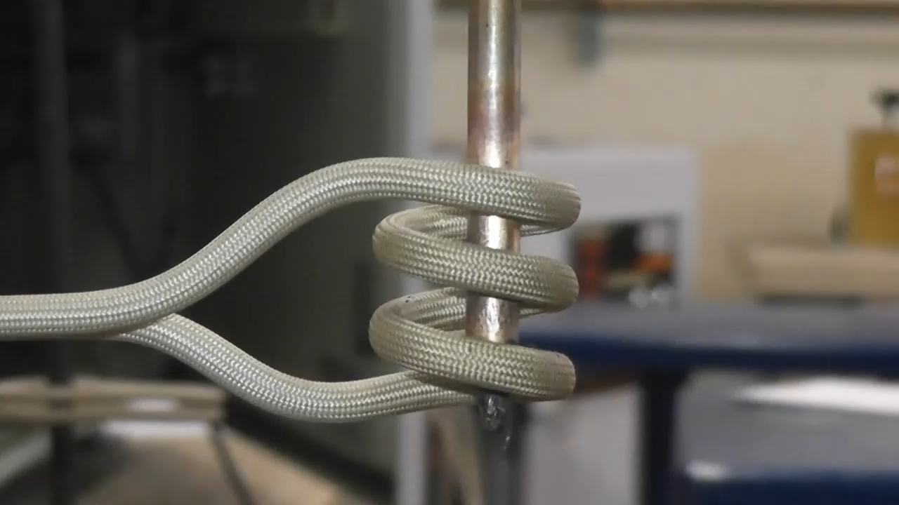
Induction Furnace
Varying magnetic field
Eddy Currents
Skin Effect
Joule Heating
Induced Voltage (workpiece)
Coil of wire
$Q \sim {P=I}^{2}∗R$
𝑄 ~ 〖𝑃=𝐼〗^2∗𝑅
AC at fixed frequency
Rdoinduiction. 2020. Induction Melt Copper tubing as it is being fed through an Induction Coil. YouTube.
Notes:
Non-contact heating, the bigger the workpiece the higher the frequency must be
Skin effect, in electricity, the tendency of alternating high-frequency currents to crowd toward the surface of a conducting material
Time 20s and just how it melts

Slide 15
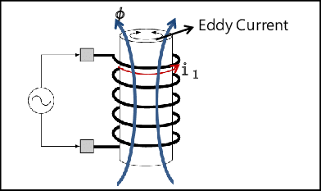

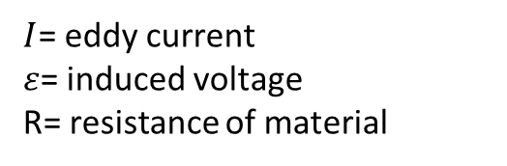

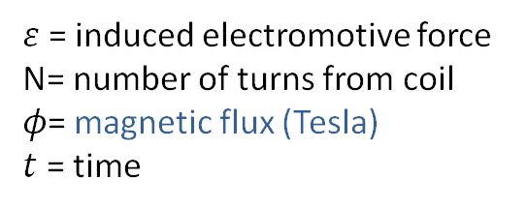

Electromagnetic Induction
Faraday’s Law of Induction:
$ε$ = induced electromotive force
N= number of turns from coil
$φ$= magnetic flux (Tesla)
$t$ = time
R
$$ε=−N⋅\frac{ⅆφ}{ⅆt}$$
$$V_{s}$$
Ohms Law:
$I$= eddy current
$ε$= induced voltage
R= resistance of material
$$I=\frac{ε}{R}$$
Image source: ResearchGate
Notes:
Bulk metallic glass highly reactive in a molten state and can corrode when exposed to oxygen
Why not arc melting? And other conventional heating methods
Explain eddy currents are a form of energy loss in an electronic system, however in this case we want this power loss because it take in the form of heat.

Slide 16
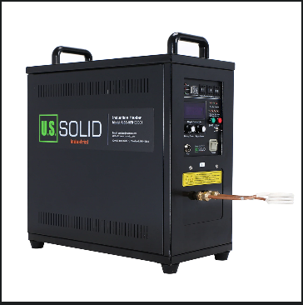
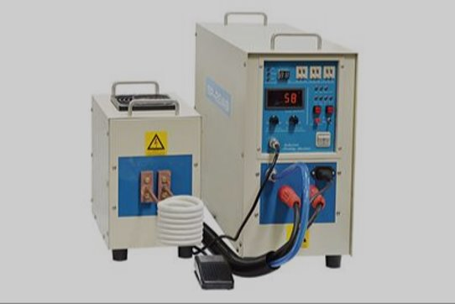
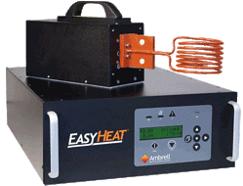
Induction Furnace
U.S Solid
MTI Corp
EASYHEAT
$944
Non-UL Complaint
$7,896
UL Complaint
$20,000
ISO Certified
Notes:
In a nutshell, UL is a safety organization that sets industry-wide standards on new products. They continually check these products to ensure they’re up to these standards. UL testing makes sure that wire sizes are correct or devices can handle the amount of current they claim to be able to. They also ensure that products are constructed correctly for the highest safety.
Talk about the issues as well?

Slide 17
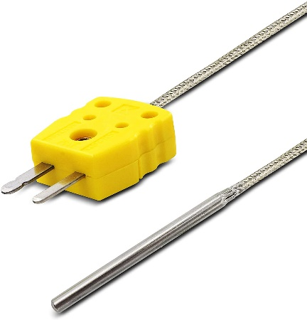


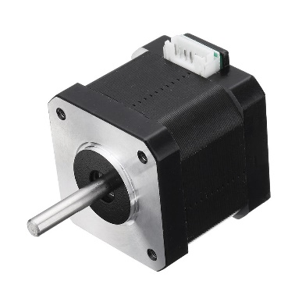


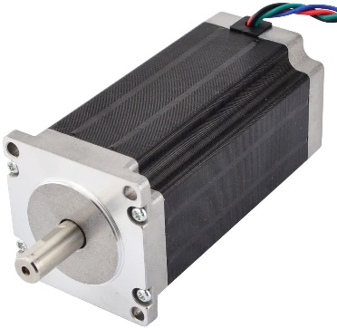
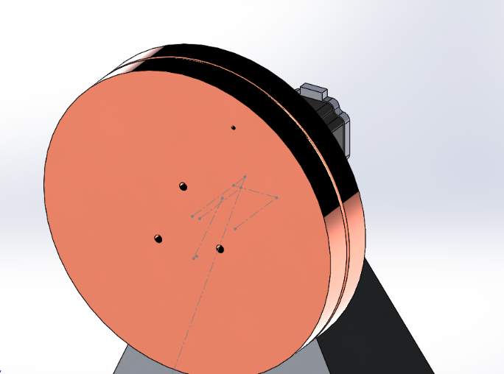
Sensors and Motors
Stepper Drivers
Nema 17
AD8495 module
Thermocouple
Arduino Uno
Nema 23
17
Notes:
Last comment. Mention other temperature sesnors. We want to make sure the mold is cool enough to provide the rapid cooling rate for vitrification of BMG. We also did some simulation to see how molten BMG will behave [pass it on]

Slide 18
ANSYS Flow Chart
To assist the manufacturing efforts
Transient thermal system to calculate cooling rate
ANSYS Fluent to analyze fluid mechanics behavior
18
Notes:
ANSYS simulations were created to assist in the manufacturing of springs and wires to understand its behavior and be efficient with material
The transient simulation of the mold and solid BMG wire to calculate the cooling rate needed to undergo the vitrification process to reach the amorphous crystal structure.
Then, we will use ANSYS Fluent to analyze the fluid mechanics behavior of the molten metallic glass to understand the material and to see if it will splash, which is an undesirable factor, as it is not cost efficient to waste the material. the heat transfer will also be analyzed
Previously from pdr:
The simulation is to assist in the manufacturing efforts
Before we go to the lab and manufacture the springs and wires, the simulation will give us an understanding on the thermal and fluid mechanic properties of the metallic glass
The steps we need to take are as follows: pour to study the fluid properties of vitreloy 106, then cast on the following geometries
The simulation will give us numerical data to understand before we physically study and manufacture, which is vital due to our current virtual environment, it is cost effective, and will assess what is possible. We will also have a cooling rate for the plate and disk, and see if the copper mold is suffienient to cool the metallic glass or if an exrernal cooling sourse is required

Slide 19
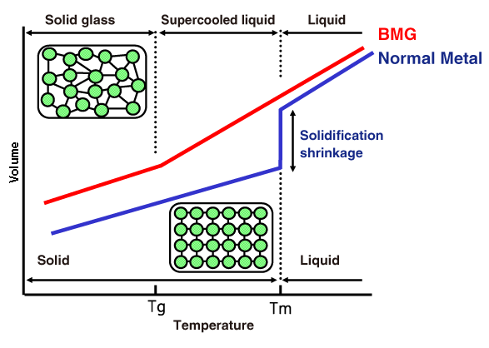
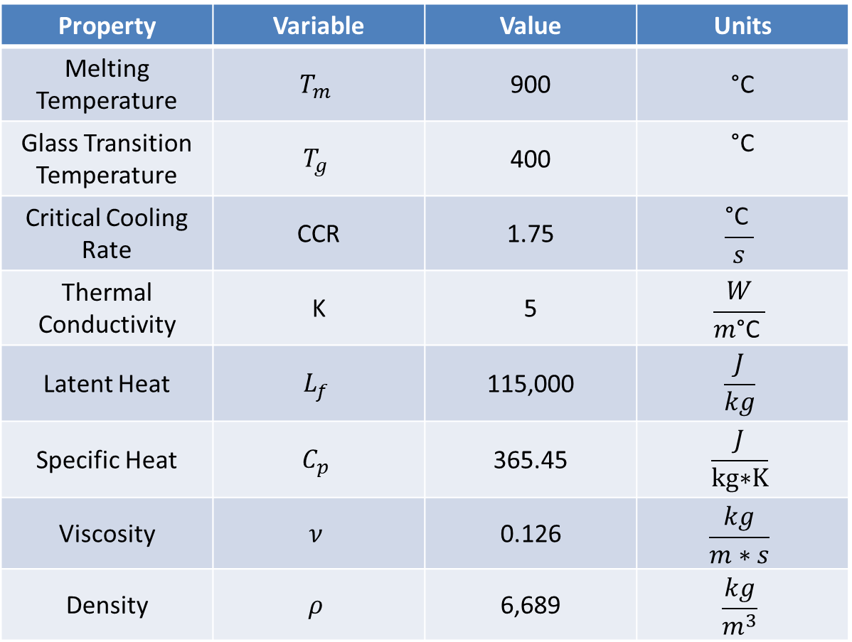
Properties of Vitreloy 106 used in ANSYS
Casting: BMG vs Crystalline Metals
Properties of vitreloy 106:
Adamant Namiki. 2021. Metallic Glass. ad-na.com
“Liquidmetal Material Properties,” Liquidmetal Technologies, 11-Jun-2020.
Materion, “Bulk Metallic Glass- The Next Metal,”
Yub Lee, S., 2005. Deformation Mechanisms Of Bulk Metallic Glass Matrix Composites.
Notes:
The graph on the left -> the red line pertains to metallic glass, and the blue for regular, crystalline metals
As the normal metal cools, it shrinks and forms crystalline structures, reducing their volume
BMGs do not undergo the solidification shrinkage as they cool, so they do not lose any volume as they solidify, they instead form glassy and amorphous structures
The table on the right has the properties of the bulk metallic glass vitreloy 106
Melting temperature is 900 C
Glass transition temperature is 400 C and is the solidification temperature so that it does not form crystalline structures (form glassy structures)
Thermal conductivity is the measure on how well a material conducts and transfers heat
Latent heat is the amount of energy required to undergo a phase change, latent heat of fusion is that energy required to go from a solid to a liquid
critical cooling rate is dictated per material, 1.75 C/s, which is the required rate for the amorphous structure to form

Slide 20
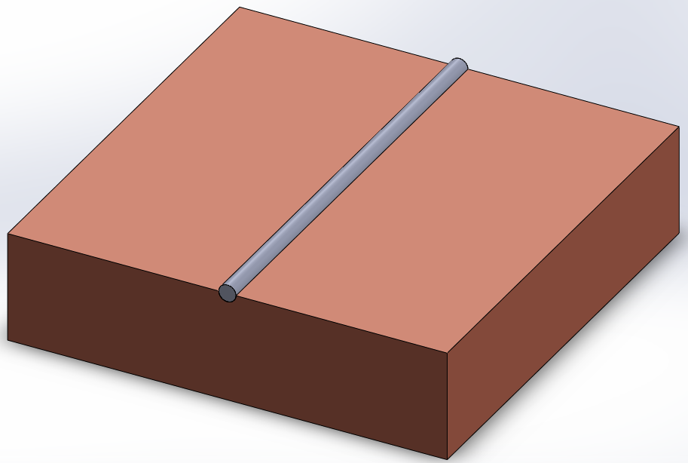
ANSYS Plate Set Up
Vit. 106 Wire:
Temp = 900 °C
Diameter = 2 mm
General:
Transient Conduction heat transfer
No phase change
Ambient temp = 25 °C
The goal is to calculate the cooling rate.
Copper Mold:
Temp = 25 °C
Length: 50.8 mm
Width: 50.8 mm
Thickness: 12.7 mm
Notes:
Transient Conduction heat transfer – to analyze thermal change in respect to time
Ambient temp = 25 °C
No phase change
The goal is to calculate the critical cooling rate.
Temp of bmg wire is at 900 C (melt temp)
D = 2mm
Copper mold 25 C (ambient temp)

Slide 21
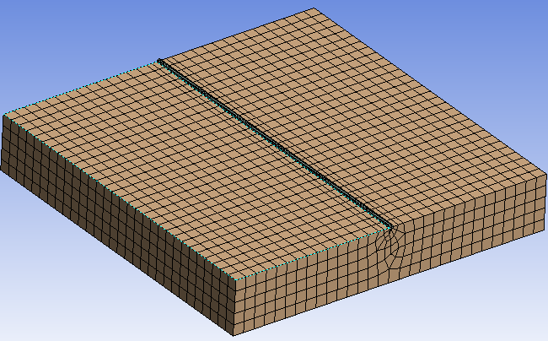
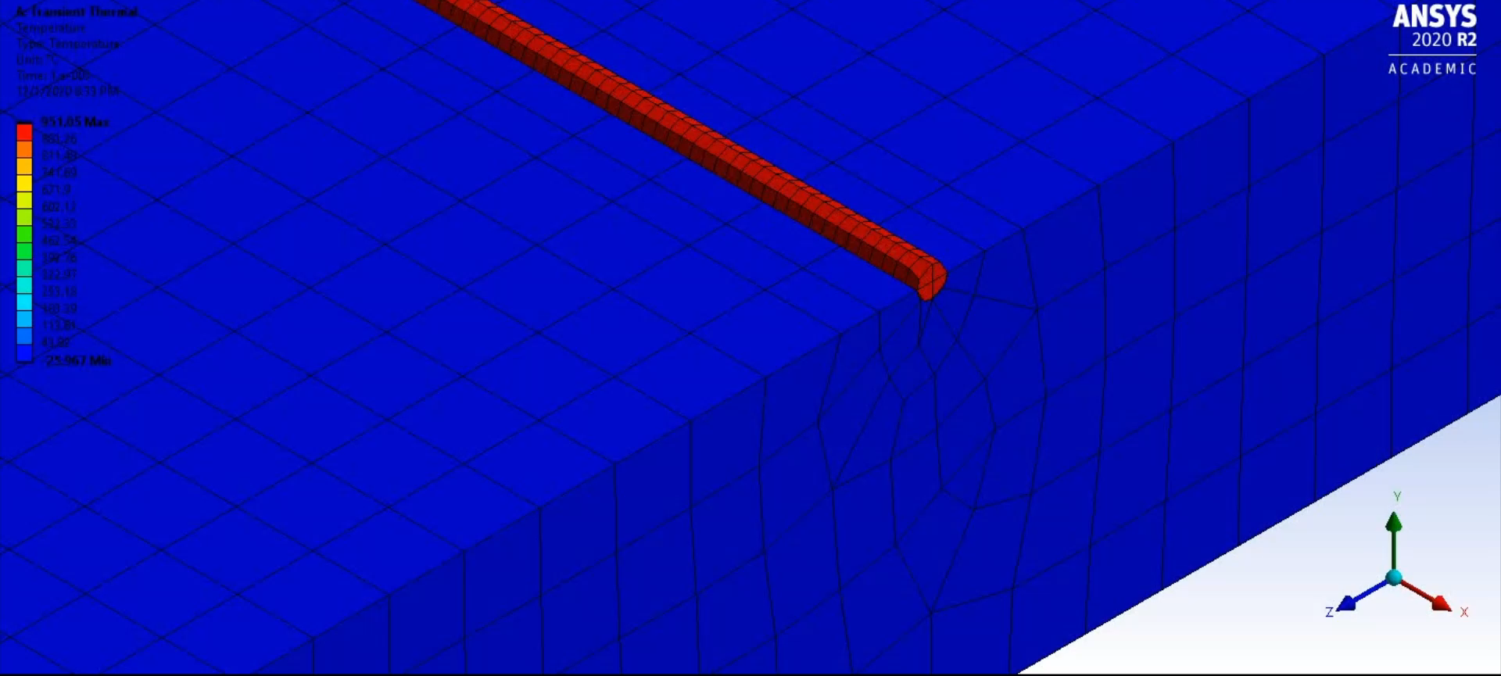
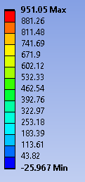
Notes:
To learn ANSYS and to determine an external cooling sources is needed, a simple simulation was made. For simulation’s purposes only, the block was assumed to be pure copper and the wire was made from BMG with the properties stated previously.
Video is slowed to 0.25 speed

Slide 22
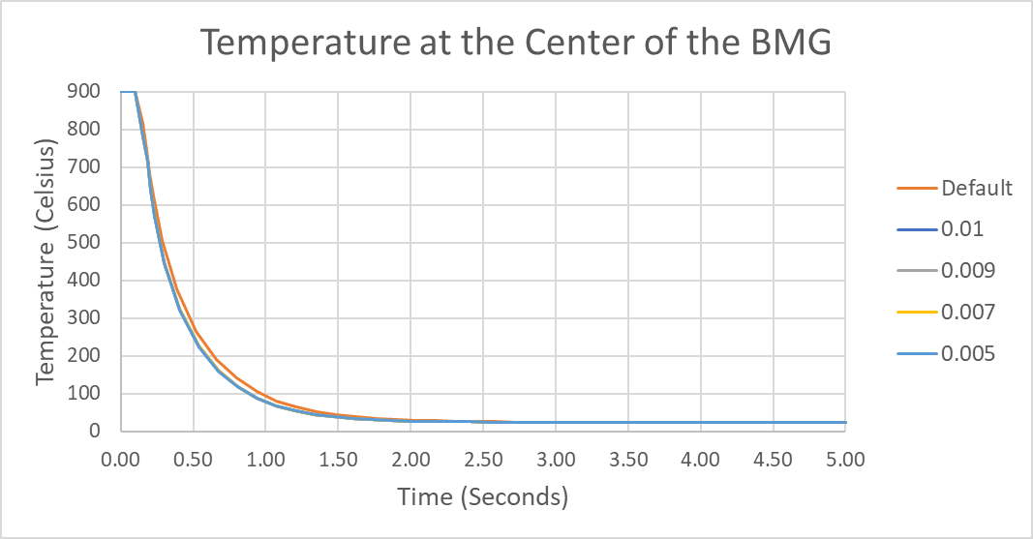
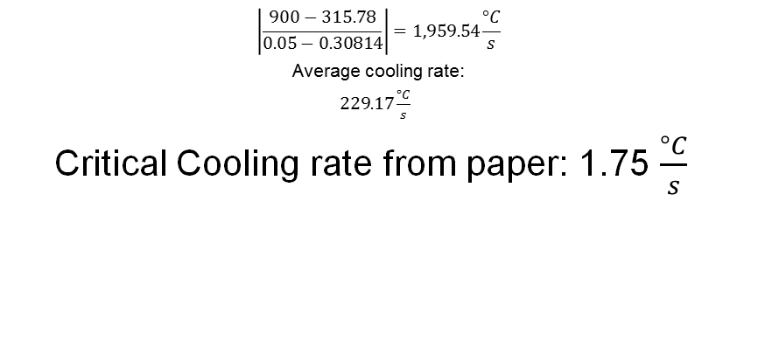
Mesh Analysis and Cooling Rate
$$\left|\frac{900−315.78}{0.05−0.30814}\right|=1,959.54\frac{°C}{s}$$
Average cooling rate:
$229.17\frac{°C}{s}$
Critical Cooling rate from paper: 1.75 $\frac{°C}{s}$
Mesh Size (m) | Cooling Rate (C/s)
Default | -1909
0.01 | -1920
0.009 | -1920.5
0.007 | -1921
0.005 | -1917
Mesh size
Notes:
Glass transition temperature: 400C or 673K
Calculate the critical cooling rate from 900C to 400C
Cooling rate was calculated by solving for the slope from 900C (melting temp) to just below 400C (Glass transition temp)
The cooling rate was calculated to be roughly in the 1900 C/s range, which is more than enough to meet the 1.75 C/s critical cooling rate

Slide 23
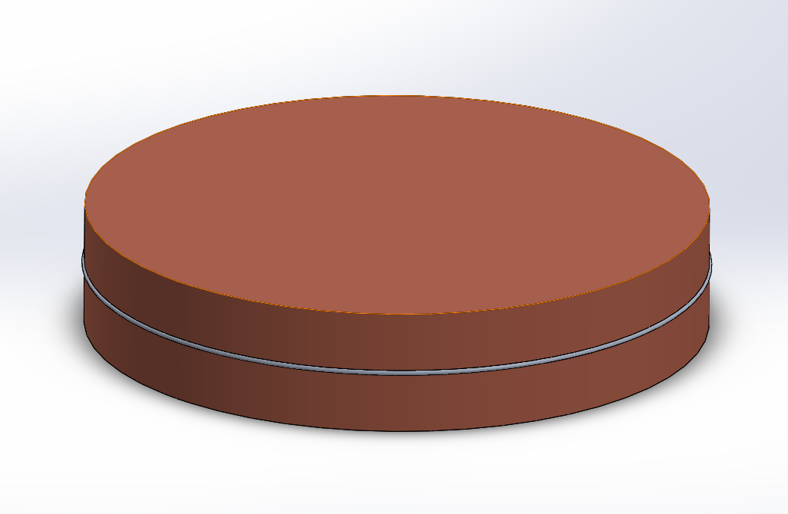
ANSYS Disk Set Up
General:
Transient Conduction heat transfer
No phase change
Ambient temp = 25 °C
The goal is to calculate the cooling rate.
Vit. 106 Ring:
Temp = 900 °C
Diameter = 2 mm
Copper Mold:
Temp = 25 °C
Diameter = 254 mm
Thickness = 50.8 mm
Notes:
Similarly to the previous set up, this has two solid bodies thermally in contact the solid copper mold and the solid bmg ring
The goal is to calculate the cooling rate to see if it will vitrify and form the amorphous structures
Bmg is at melting temp and D = 2mm
Copper mold is at ambient temp and D = 254 mm, thickness = 50.8mm
Adjusted the design to have a similar design for the solidworks assembly

Slide 24
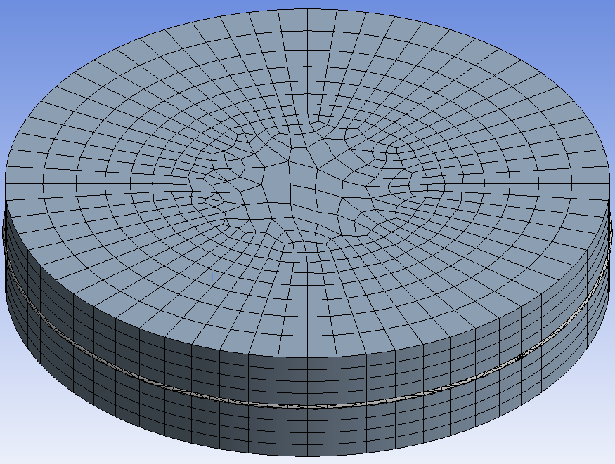
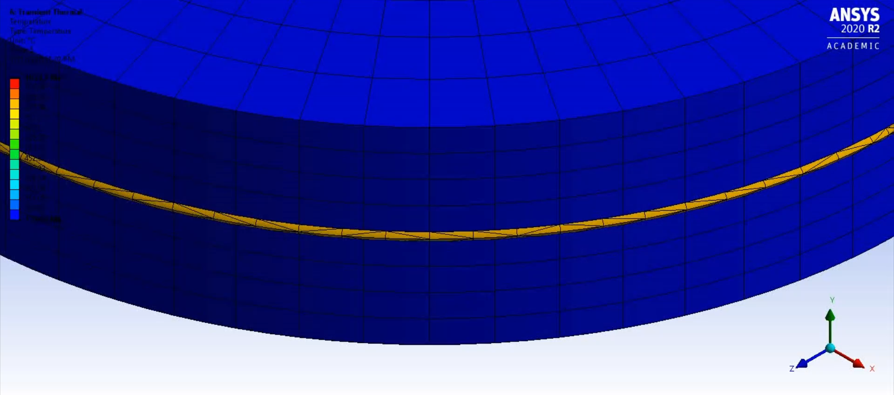
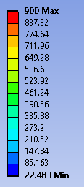
Notes:
On the left is the mesh setting applied
On the right is the ANSYS simulation
Video is slowed down by to 0.25 speed

Slide 25
Mesh Analysis and Cooling Rate
Mesh Size (m) | Cooling Rate (C/s)
Default | -3469
0.017 | -3499
0.019 | -3249
0.021 | -3264
Mesh size
Notes:
Glass transition temperature: 400C or 673K
Calculate the critical cooling rate from 900C to 400C
Cooling rate was calculated by solving for the slope from 900C (melting temp) to just below 400C (Glass transition temp)
The cooling rate was calculated to be roughly in the 3400-3200 C/s range, which is more than enough to meet the 1.75 C/s critical cooling rate
Similarly, the cooling rate was calculated by solving for the slope between melting temp and TG
Read out range high – low or average

Slide 26
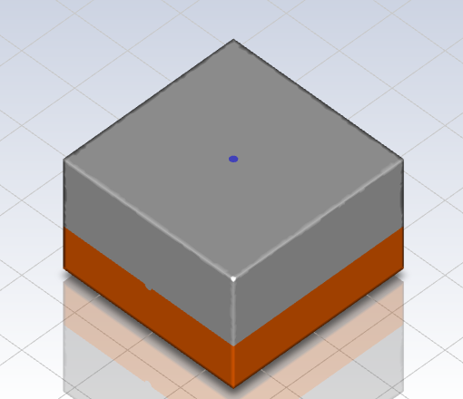

ANSYS Fluent Set Up
Vit. 106 domain:
Covers the top of the plate
Overall temperature will vary with time within
General:
Transient to analyze temperature as time changes
The goal is to analyze the fluid mechanics behavior
Laminar $Re<2000$
Copper Mold:
Temp = 25 °C
Length = 254 mm
Thickness = 12.7 mm
Groove:
Diameter = 2 mm
Notes:
What's the significance of the simulation
Does it splash?
What is the difference from the previous simulation
Latent heat – amount of energy used during phase change
Viscosity – flow of the material
Enthalpy -
Entropy -

Slide 27
ANSYS Fluent Set Up
General:
Two phases:
  Argon
  Molten vit. 106
Boundary conditions defined at inlet
Material flows in for 3 second
Cools for the rest of the simulation
Inlet:
Velocity = 0.066 m/s
Molten vit. 106 flows in
Temp = 900 °C
Notes:
Boundary conditions specified at inlet
Molten vit. 106 flows to the two outlets
Face shape for simulation accuracy to account for overflow
* subject to be taken out if outlet is removed
Need to: add face snippets to display domains if inlet and outlet (if it is kept)
If we keep outlet – material will pour out and perhaps not cool properly
No outlet – might not cool properly still

Slide 28
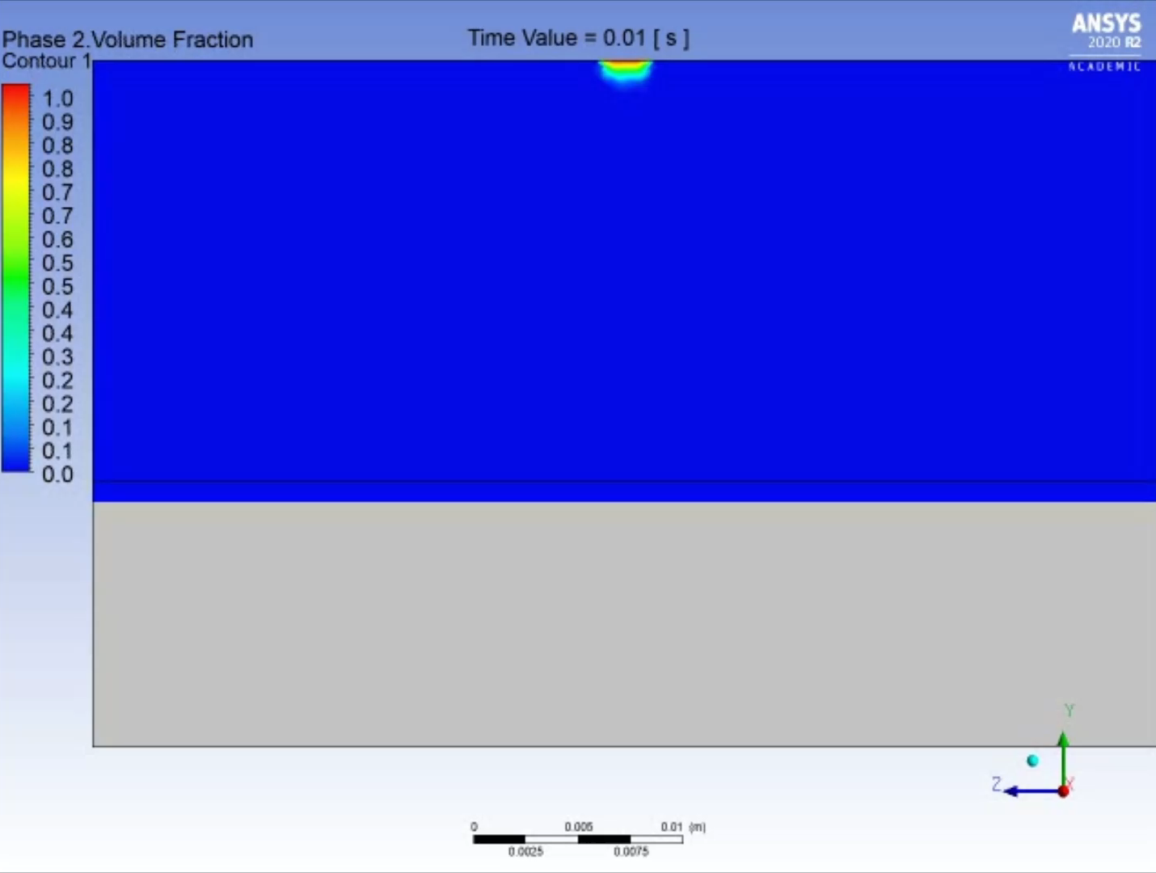
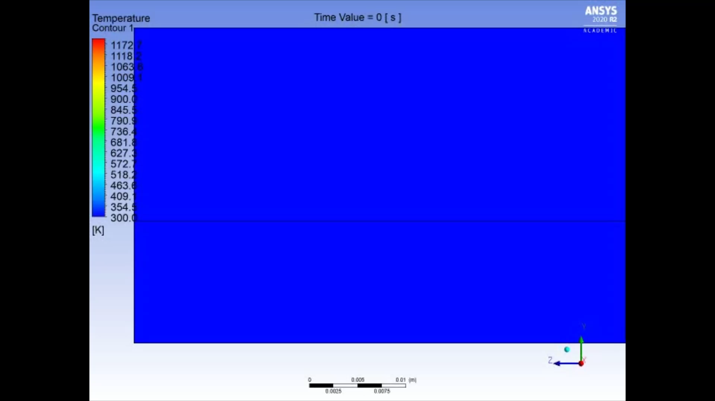
RESULTS

Slide 29
Limitations of the Simulation
Difficult to create complex simulations
Vitreloy 106 is a relatively new material
Notes:
1 simulate a moving part and fluid flow
rotation, translation, and fluid dynamics are computationally taxing. Causes our laptops to overheat
2 Since we cant simulate the moving part, the material will overlap itself and keep it hot which makes it difficult to determine the cooling rate of the material
3 needed to be in a lab environment to do testing of properties
Various unknown properties

Slide 30
Conclusion
Designed two manufacturing systems but one was developed
Searched for induction furnaces, thermal sensors, and motors
Copper can cool down the BMG per transient model
The fluent model showed some splashing and confirmed that copper can cool down the BMG
Notes:
Talk about the design and how springs were mentioned at the start of the presentation
Mention the electrical decision and the final decisions
What we did and what we found out during the project
Design

Slide 31
Questions or comments?

