Slide 1
Turbo Trike Expo
Team 35-1/ TEAM 35-2
Advisor: Dr. Samuel Landsberger
SPONSOR: John Wieland, Inc. & Grid Alternatives, Inc.
Members: Loren Barton
Jihane Ait Bella
Hernan Reyes
Martin Morales
David Bonilla
Jairo Martinez
Wesley Aquino
Ivan Petean
Dillon Howard

Slide 2
Project Organization
Turbo Tike Team
Advisor Prof. Samuel Landsbeger
Team 1 Lead/ Suspension
Loren Barton
Auto Braking
Martin Morales
Regenerative Braking/Safety
Dillon Howard
Team Sponsor John Wieland Inc & Grid Alternatives Inc
Team 2 Lead/ Steering
Jihane Ait Bella
Steering/Frame
Hernan Reyes
Solar Charging
David Bonilla
Suspension/Scale Modeling
Jairo Martinez
Roll Cage
Wesley Aquino
Roll Cage/Street Legal Design
Ivan Petean

Slide 3
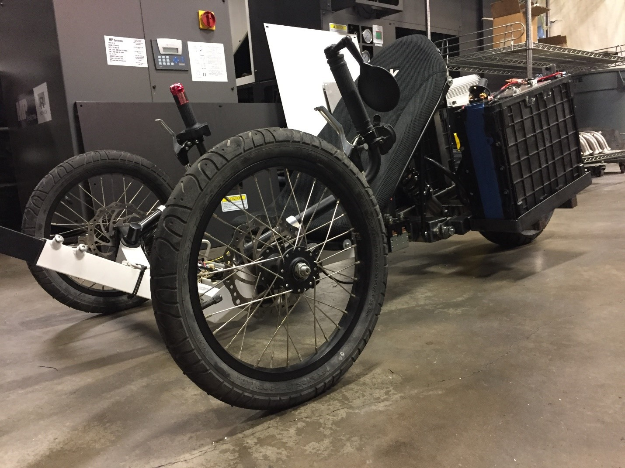
Agenda
Introduction
  Objectives and Constraints
  Global Impact
  Original Turbo Trike
Trike A and B
  Modifications
  Suspension
  Steering
  Roll Cage
Autobraking
Regenerative Braking
Solar Assist
Road Legal
Lateral Acceleration
Rollover Prevention
Scale Models
Jihane
David
Jihane
Dillon/ Loren
Wesley
Loren/ Jairo
Loren/ Jairo
Jihane/ Hernan
Wesley/ Ivan
Martin
Dillon
David
Ivan
Dillon
Dillon
Jairo/Loren/Hernan

Slide 4
Project Schedule

Slide 5
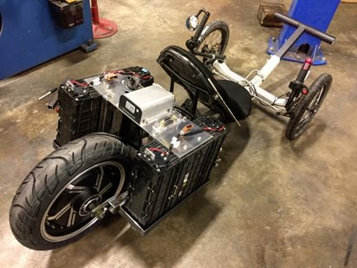
Objectives and constraints
Conceive, design and improve an electric three-wheeled vehicle for daily application.
Safe at speeds of 45 mph.
Improve power efficiency by implementing regenerative braking
Add solar panels to increase ideal range by 30 miles
Assuring safety of rider.
Accessibility for individuals up to 195cm

Slide 6
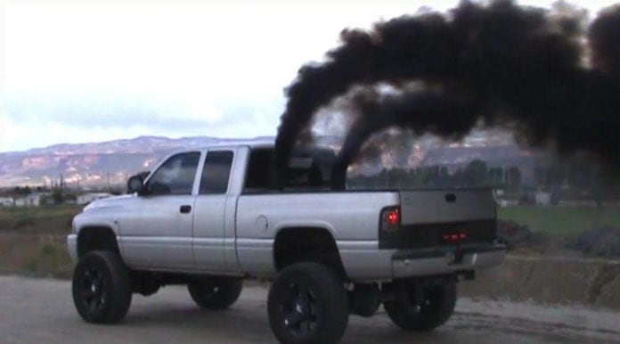
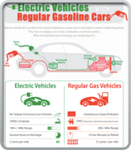
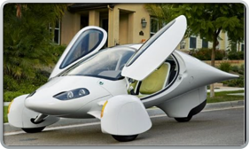
Impact on the Planet
Majority of vehicles today use an internal Combustion Engine.
Contributes to air pollution and releasing CO2 into the atmosphere.
Benefit nature and fight against global warming.
Inefficient car
Aptera EV

Slide 7
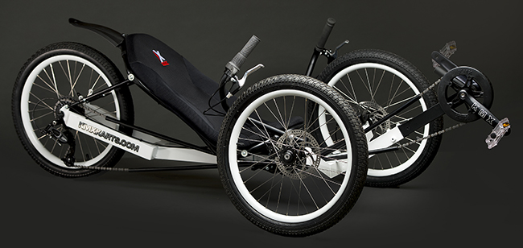
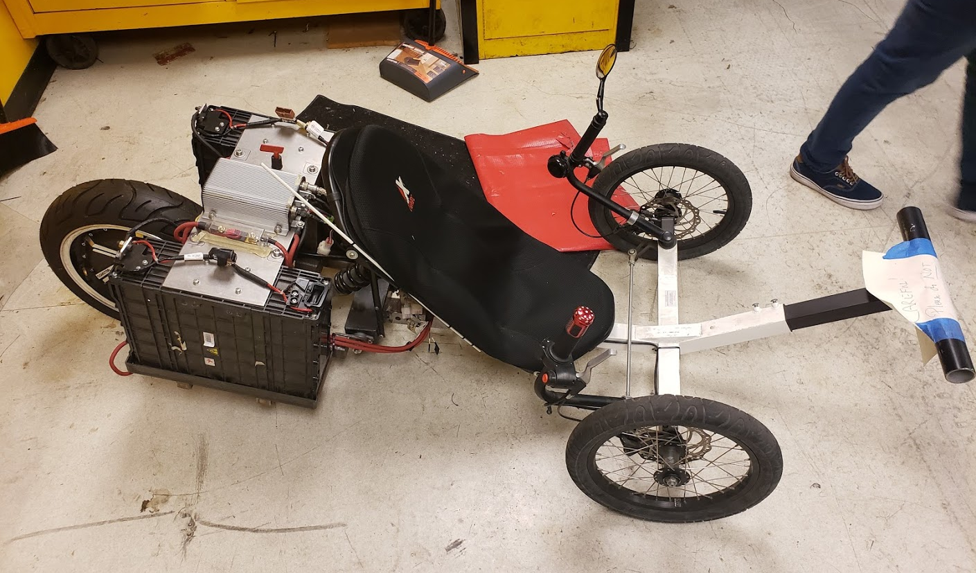
Original Turbo Trike
The Turbo Trike was constructed from a KMX Kolt Recumbent tricycle.
Kelly Controls KBL Series motor controller and 48V 3KW hub motor
2 lithium iron phosphate (LiFePo4) Batteries
Numerous ergonomic issues
Has shown to have stability issues and understeer when cornering.

Slide 8
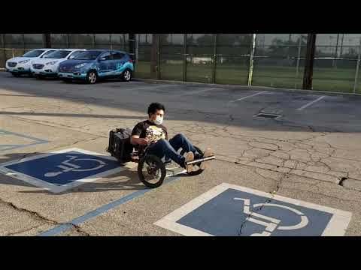
Original Turbo Trike

Slide 9
Road Map
Simplicity
Leaf Suspension
Go-Kart Steering
Long Roll Cage
Model A
Driver Controls (Quick)
Roll Cage A
Comfort
Turbo Trike Design Requirements
Spring/Damper Suspension
Rack & Pinion Steering
Short Length Roll Cage
Scale Models
Final Decision
Model B
Driver Controls (Precise)
Roll Cage A
Solar Panels
Solar Power
Outrigger Wheels
Lidar
Kelly Controller
Driver Pedals
Common Ground
Auto Braking
Street Legal
Safe at 45 mph

Slide 10

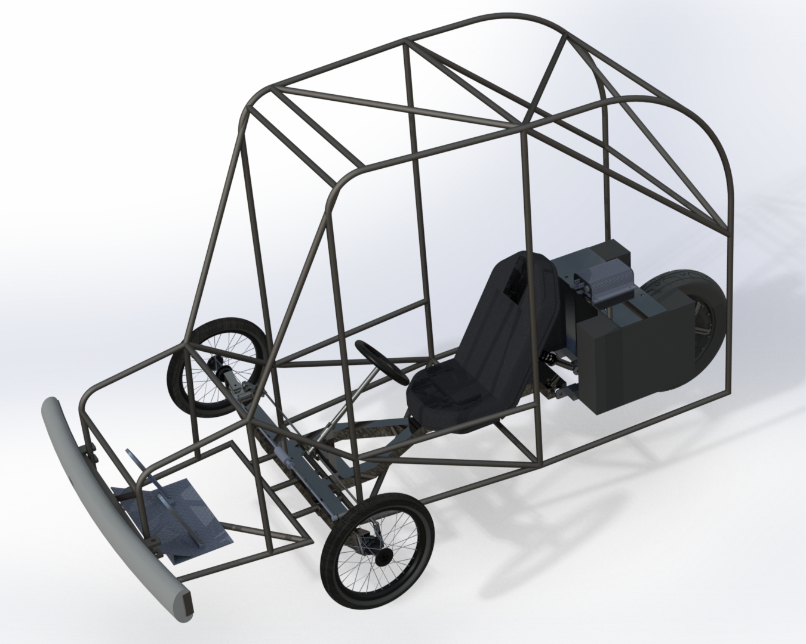

Model A

Slide 11
Design Approach
Maximize Simplicity
Minimal Modification to existing model
Minimize overall cost
Improved Driver Controls
Steering Wheel
Foot pedals
Driver Protection
Visually appealing
Energy absorption zones on all sides
Safe for travel at 45 mph

Slide 12
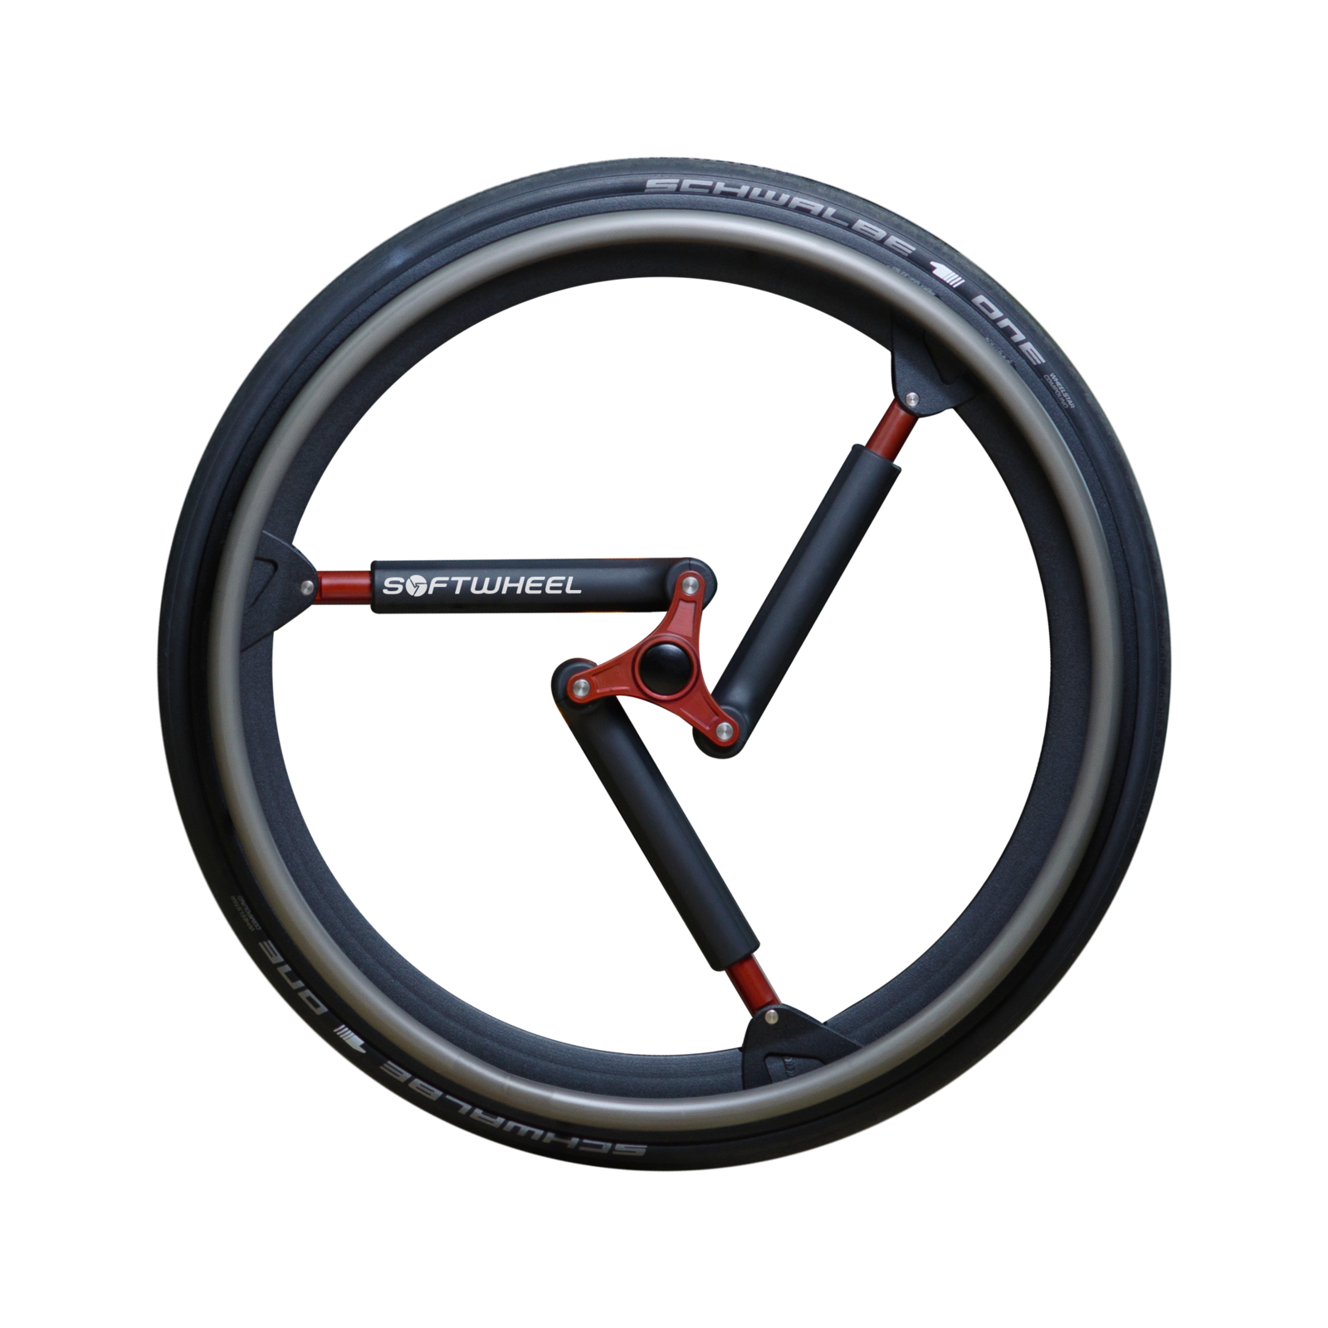
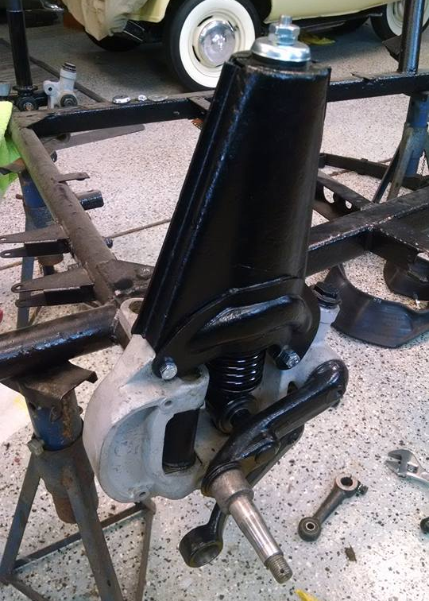
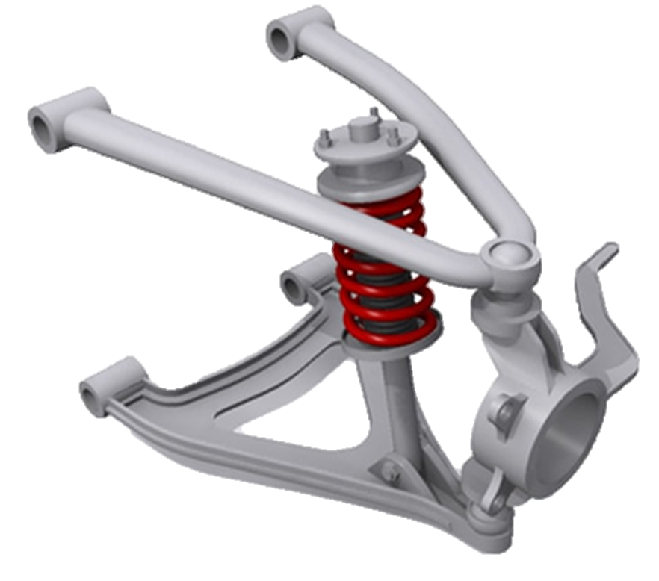
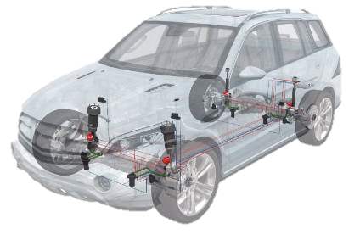
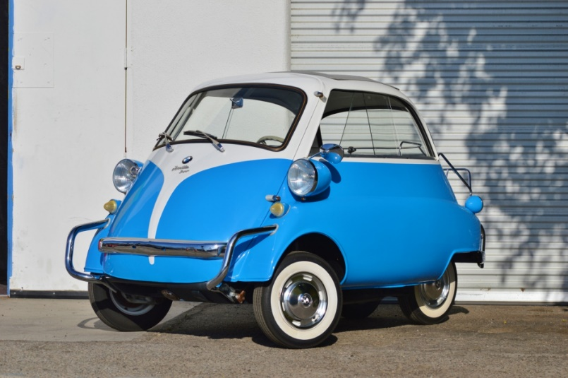
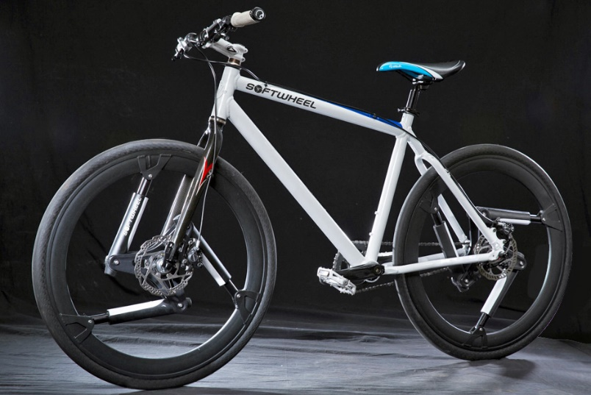
Suspension
Double Wishbone
BMW Isetta Outboard Swing Arm
Compressible Spoke

Slide 13
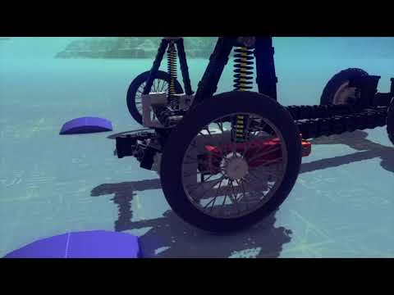
Isetta Suspension

Slide 14
Decision Matrix- Front Suspension
 | Minimal Space Occupied | Simplicity | Minimal Bump Steer | Total | Weighted Total
Weights | .3 | .5 | .2 | 1
Compressible Spoke | 5 | 4 | 5 | 14 | 4.5
Double Wishbone | 1 | 2 | 3 | 6 | 1.9
Isetta Swing Arm | 4 | 1 | 5 | 11 | 2.7
Transverse Leaf | 3 | 3 | 3 | 9 | 3

Slide 15
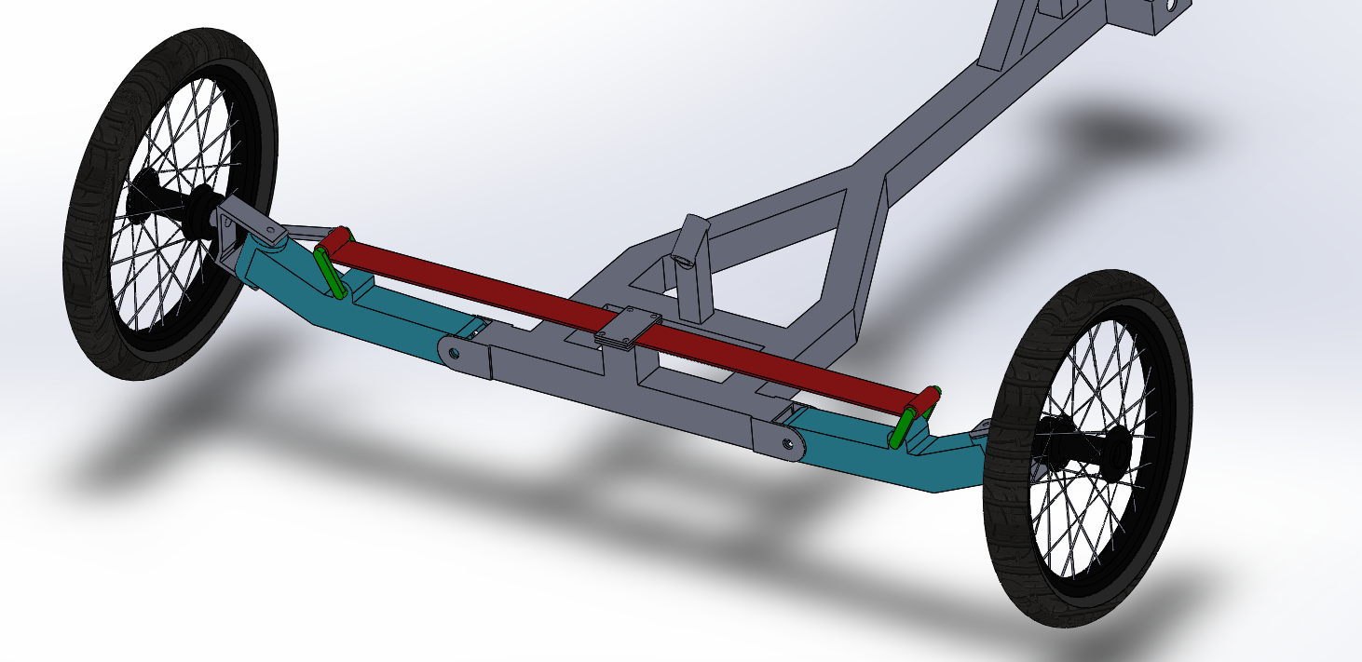
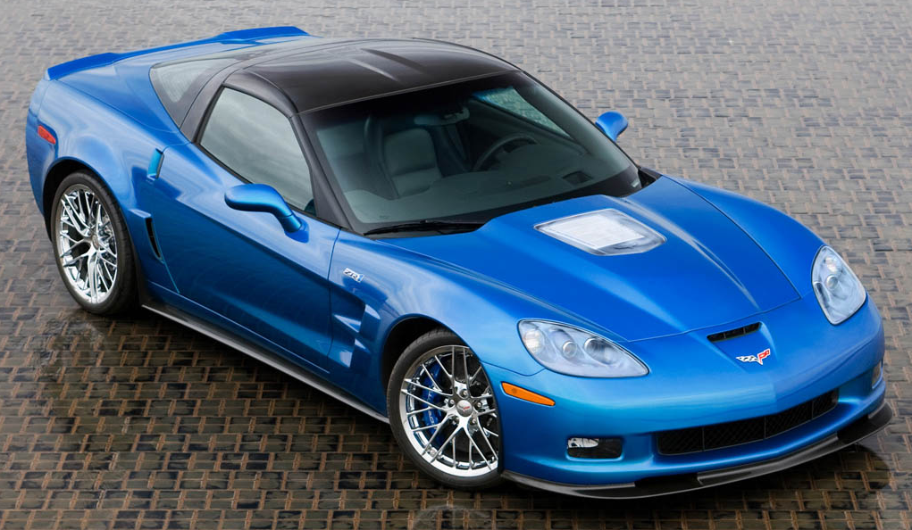
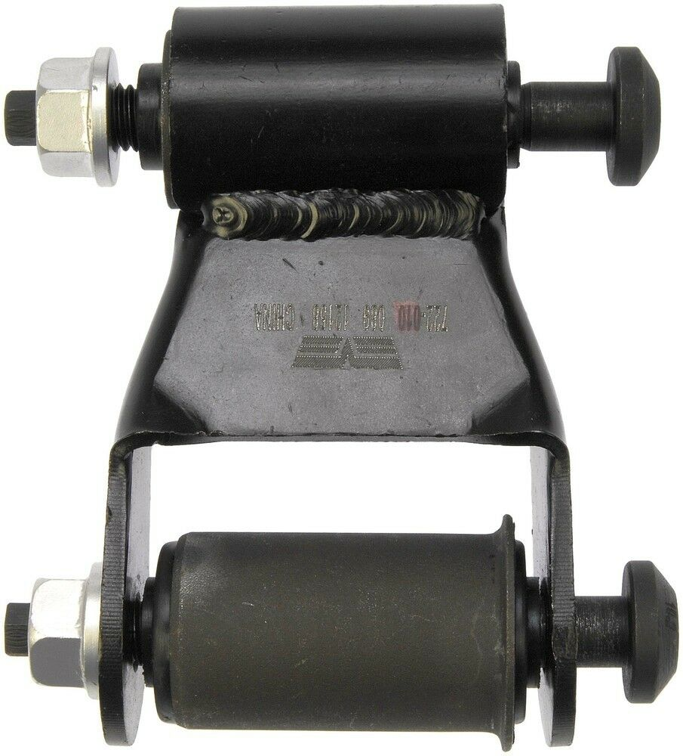
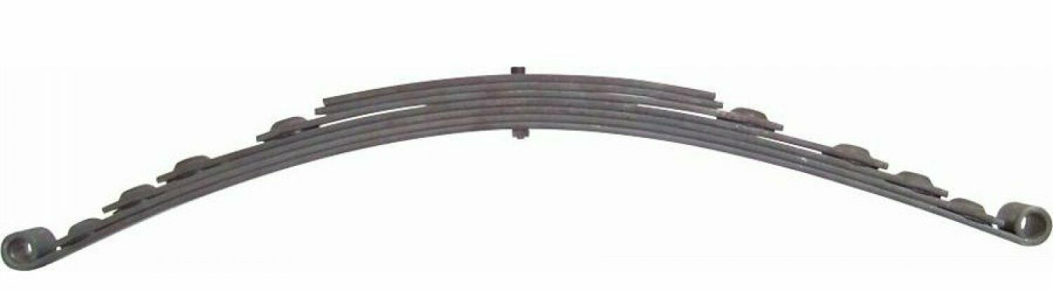
Leaf Suspension
The leaf suspension is sturdy and easy to fabricate
Minimal intrusion into driver area
Can be found on the Chevrolet Corvette
Leaf springs can be cheap and additional leaves may be added for greater loads

Slide 16
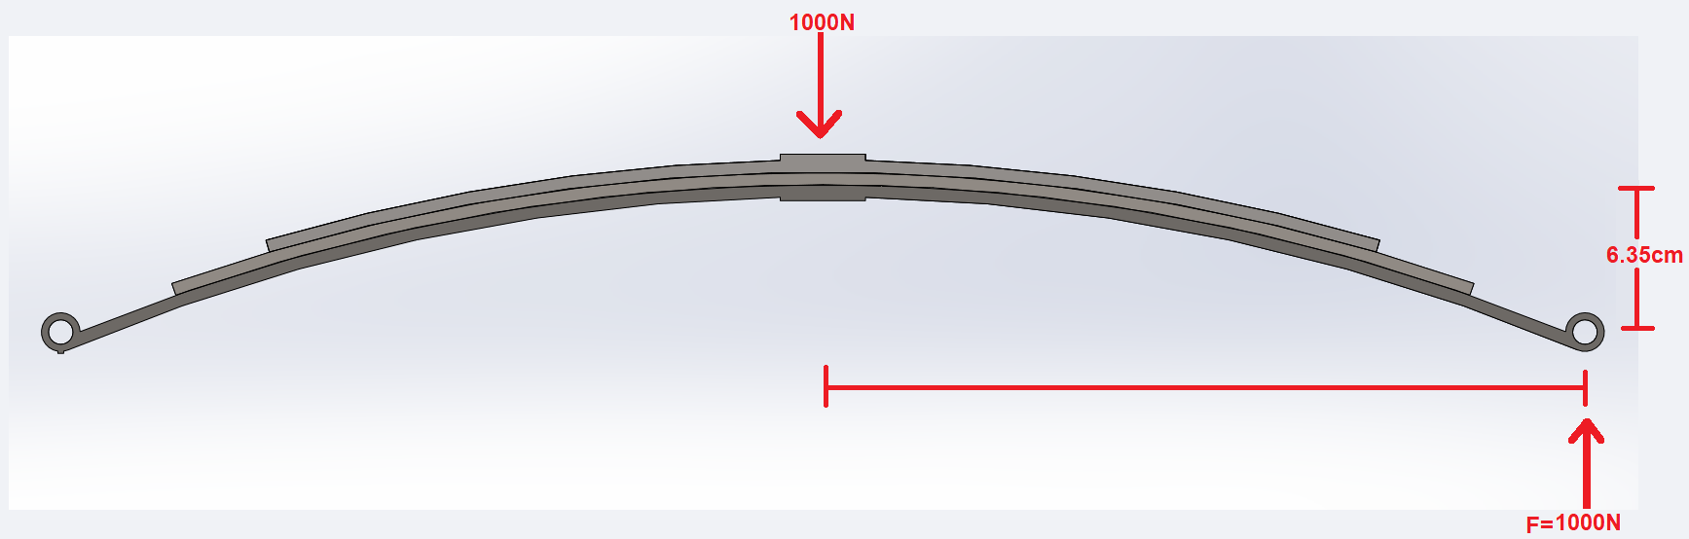

Suspension Deflection
Trike weighs 2880N, or 293 kg with 96kg rider
COG lies 95cm along 150cm wheelbase
Half of the front weight is borne by each wheel, so 1000N at a front corner
Leaf curves, so shackle holes are below center point
Displacing 6.35 cm will flatten leaf, creating negative camber
$$F=\frac{(Ebt^{3})δ_{max}(3n_{m}+2n_{g})}{12L^{3}}$$
F - Force
E - Young’s Modulus
b – Leaf Width
t – Leaf Thickness
𝛿 – Deflection
n_{m} – Number of Master Leaves
n_{g} – Number of Graduated Leaves
L – Leaf length

Slide 17
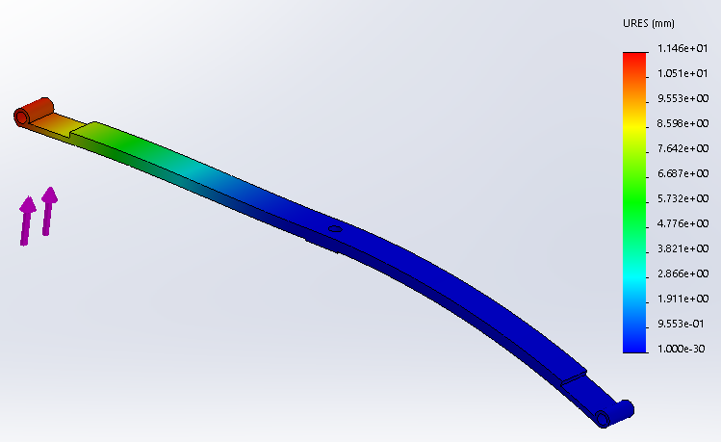


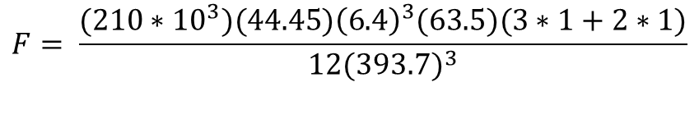
Suspension
$$F=\frac{(Ebt^{3})δ_{max}(3n_{m}+2n_{g})}{12L^{3}}$$
$$F= \frac{(210∗{10}^{3})(44.45){\left(6.4\right)}^{3}(63.5)(3∗1+2∗1)}{12{(393.7)}^{3}}$$
$$F=1030 N$$
Very near the desired force for flattening
Leaf Displacement at Max Capacity

Slide 18
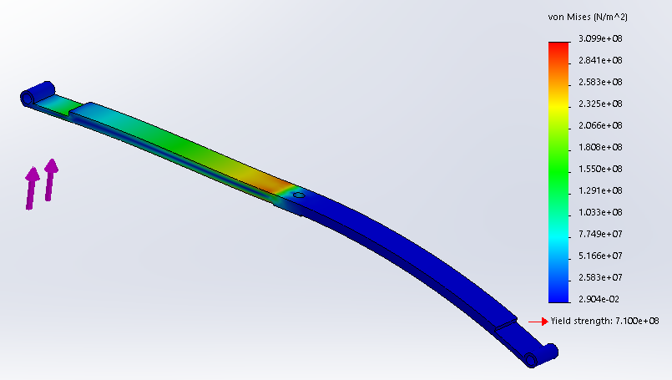
Suspension
The leaf remains well within its elastic region under load
Additional leaves may still be added for additional force
Center plate screws may be moved to adjust ride height
Leaf Strain Under Load

Slide 19
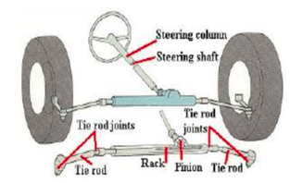
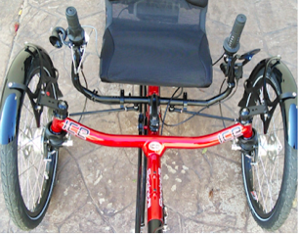
Role of the Steering System
The steering system, along with the suspension system allows the driver to easily and safely control the vehicle’s direction while driving.
Compared to the first generation steering system that had no suspension, we planned to implement a suspension system to our trike.
The steering system consists of a collection of components and linkages, which allows any vehicle (car, bicycle, motorcycle) to follow a desired path.
Most vehicle steering systems are composed of steering linkages, a steering column, a steering gear and a steering wheel.

Slide 20
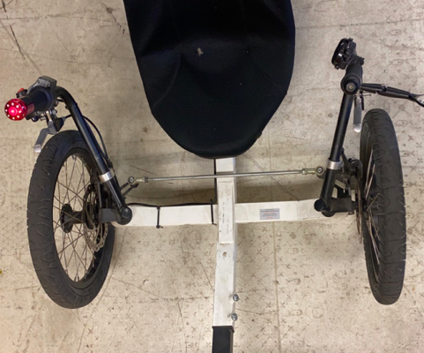
First Generation Steering System
The Turbo Trike Initially was designed with handlebars from side to side from driver.
Steering angles were limited and would range from 15-25 degrees depending on driver's body width.

Slide 21
Objective: what Do we want to improve and why?
Reduce Tire scrub
(Apply Ackerman Steering principle)
Easier to steer
(incorporating a steering wheel)
comfort
(sitting and handling position)
Safety
(turning radius/roll over)

Slide 22
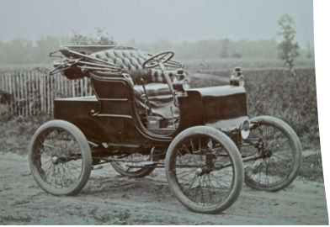
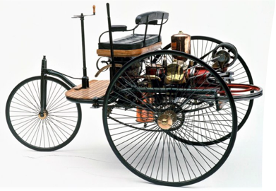
History
The first automobile was invented more than 100 years ago.
The first automobiles were steered with a tiller.
In 1898, steering wheels were introduced as a standard feature in cars.
At the start, steering wheels had a simple design: consisted of wooden circles directly connected to the wheel axis.
They were extremely hard to turn, especially at low speeds.
In 1920, the first power steering system was invented to make the turn of the steering wheel easier.

Slide 23
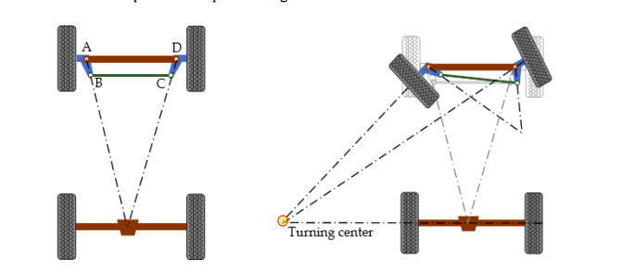
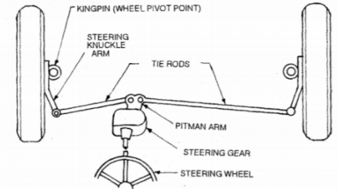
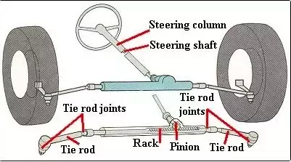
Different steering systems and geometries
Ackermann Geometry
Pitman Arm steering
Rack and Pinion Steering

Slide 24
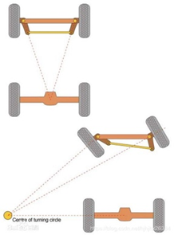
Ackermann Principle
Ackermann principle, is a common steering geometry that is used to reduce tire scrub when corning by making the inside wheel turn on a tighter radius than the outer wheel.
To achieve a smooth path the front wheel axis should intersect at an instantaneous center to the rear wheel axis, so that the front wheels create a concentric path.

Slide 25
Decision Matrix- Steering
 | Simplicity | Weight | Cost | Weighted Total
Weights | 5 | 3 | 2
Pitman arm | 20 | 10 | 9 | 39
Rack and pinion | 15 | 6 | 6 | 31

Slide 26
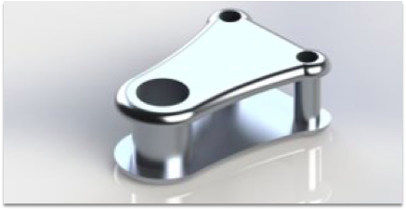
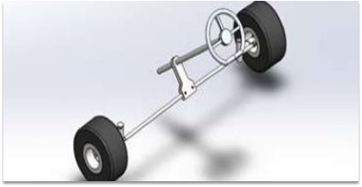
Pitman Arm Steering
The Pitman arm moves the steering rack according to how you steer.
The steering rack is connected to the tie rods, which are connected to the steering arm.
The tie rods are the connection from the steering system to the wheels.

Slide 27
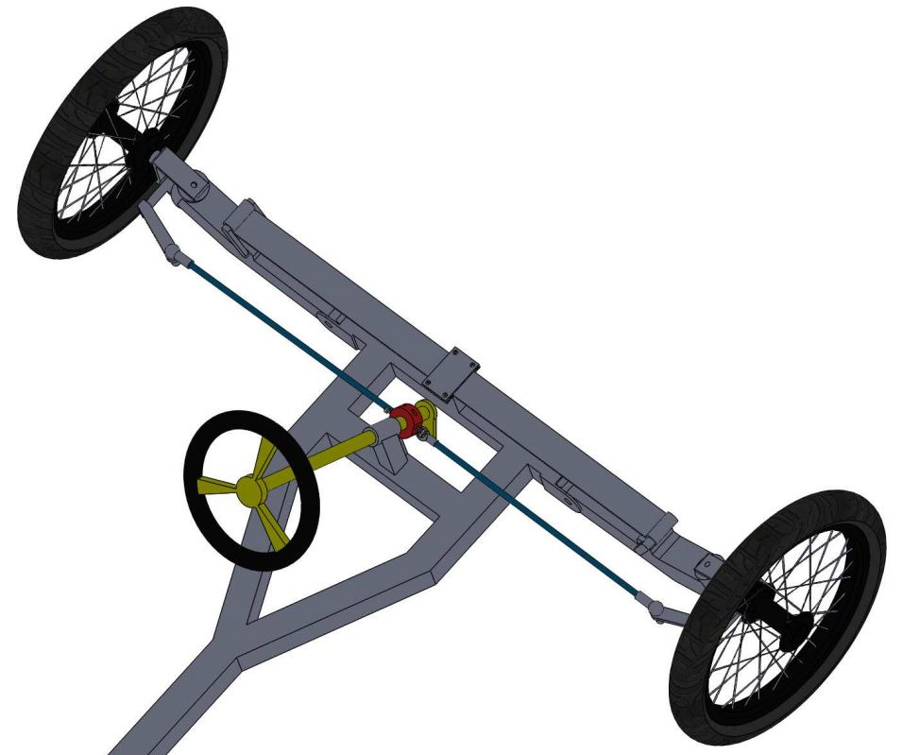
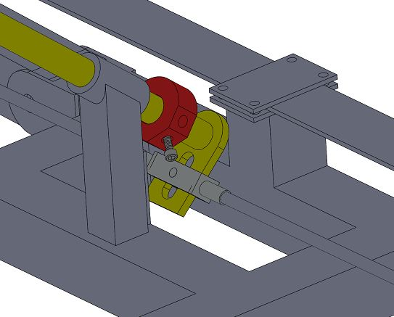
Steering - Pitman Arm
Clamp shaft with screw stoppers and tie rod slot
Pitman arm with leaf spring suspension

Slide 28
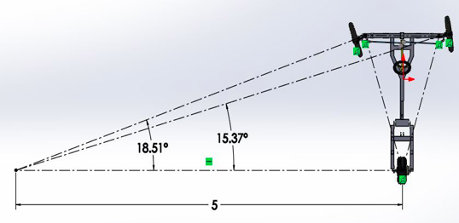
Turning Radius Calculations
Parameters ​
Wheelbase(L)​​ | 1.48 m​
Track width(d)​​ | 1.22 ​m​
Inner Angle​(A) | 18.51°
Outer Wheel​(B) | 15.37°
Pitman Arm Steering with stopper
1.22 m
1.48 m
Assume
Turning Radius of 5 meters.
Actual Turning Radius
R= d/2+[L(cosec (A/2+B/2))] [Eq.1]
R= 5.69 meters

Slide 29
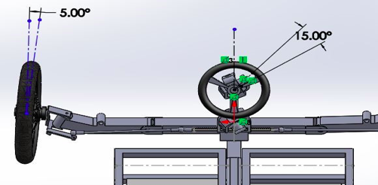
Steering Ratio
Low Steering ratio = more effort to steer
High Steering ratio= less effort to steer
Steering ratio Equation
Steering ratio = (Steering wheel rotation angle)/(Steer angle at the tire wheel)
Table- Steering ratio of different types of vehicles
Type of Vehicle | Steering Ratio
Normal Regular Cars | 12:1 to 20:1
Race cars | 10:1
Go-Kart | 1:1
Turbo Trike (Rack and Pinion steering) | 3:1
Turbo Trike (Pitman arm steering) | 1:1

Slide 30
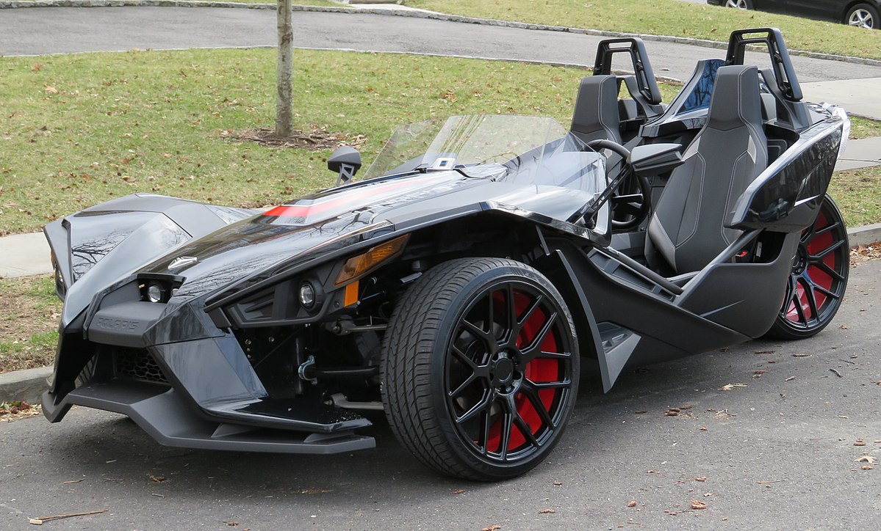
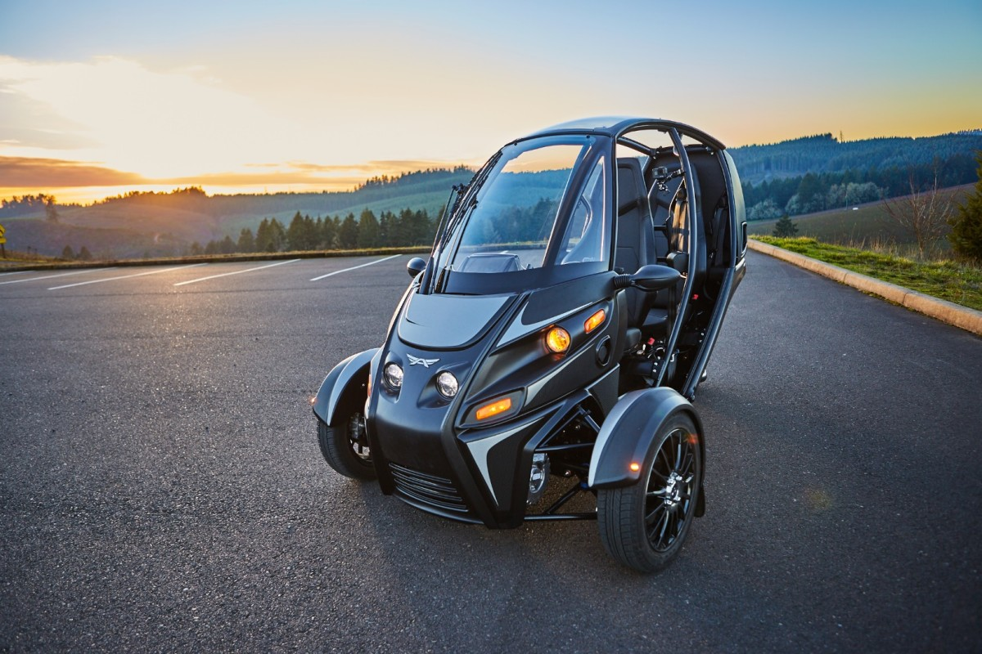
Roll CAGE
Roll cage is designed to protect the passengers in the vehicle from:
  Roll Over
  Collision

Slide 31
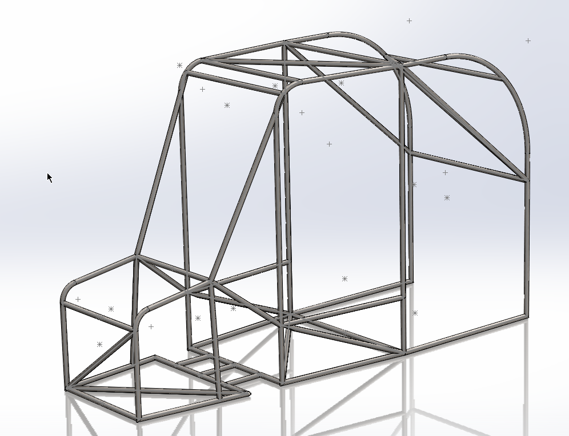
Roll Cage – Model A
Low Cost
Ease of Manufacturing and Assembly
Minimized joints while taking advantage of:
  Triangulation
  Diagonalization
Maximizing safety, while minimizing complex structures

Slide 32
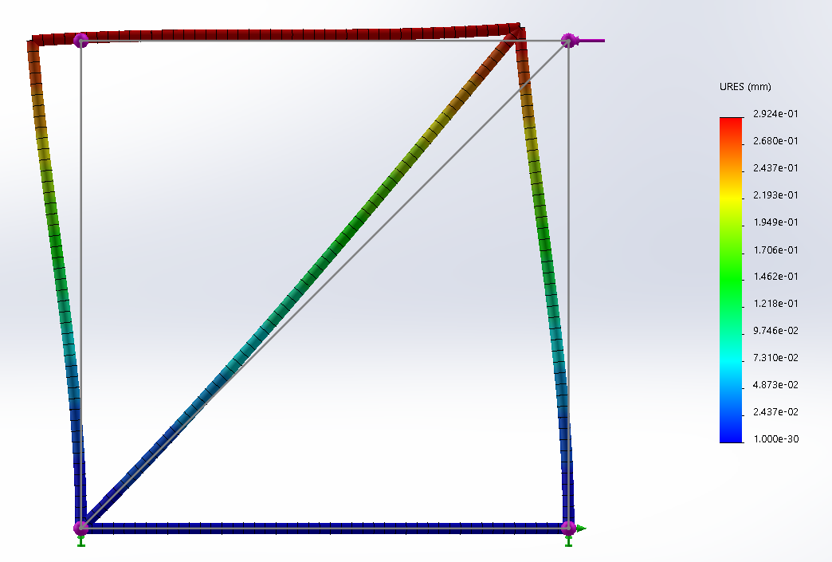
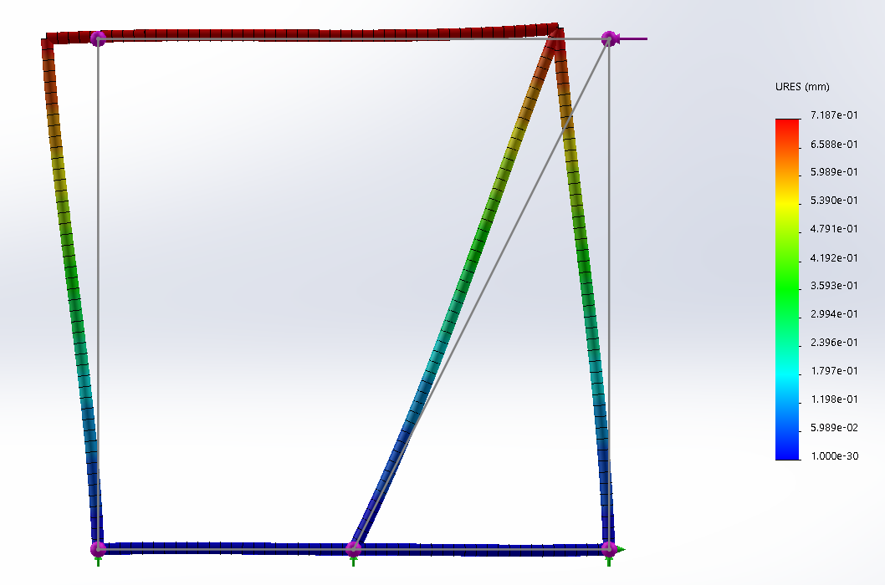
Triangulation
Basic tool for rigidity through shape
A diagonal member through connected corners protects a four-bar member from bending loads
  Placing structural members in pure tension/compression
Lightweight
  Use of less rigid materials won’t significantly affect the overall strength of the structure

Slide 33
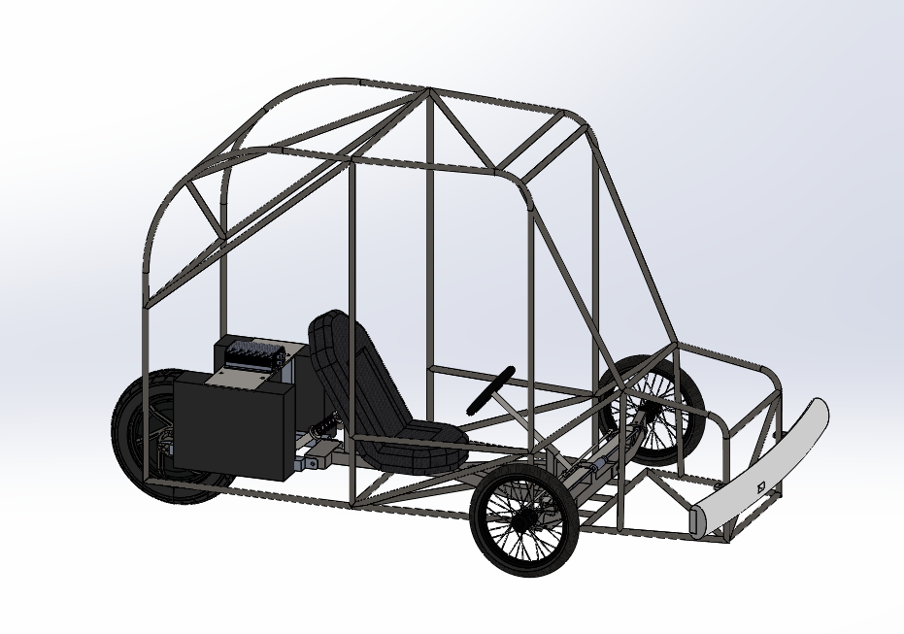
Benefits of Model A
Low seating position means low center of gravity
Minimal modifications require less time and money to perform
Lower weight increases range and efficiency
Simplicity of design allows for lower overall cost

Slide 34

Material Property Analysis
Material | Ultimate Tensile Strength (MPa) | Elastic Modulus (GPa) | Yield Strength (MPa) | Fatigue Strength (Uncorrected) (MPa) | Shear Modulus (GPa)
AISI 1015 Steel (CDS) | 385 | 205 | 325 | 193 | 80
AISI 4130 Steel Annealed at 865 C | 560 | 190 | 460 | 280 | 80
6061-T6 | 241 | 74 | 145 | 121 | 26
2219-T87 | 379 | 73 | 393 | 190 | 27
7075-T6 | 572 | 72 | 434 | 286 | 27

Slide 35
Cost analysis
Roll Cage Model A - Cost Analysis
Material | Weight (kg) | Cost/kg | Cost of Raw Material | Rate ($/hr) | Man Hours | Total Cost
AISI 1015 Steel (CDS) | 38.17433638 | $ 0.44 | $ 16.66 | $ 20 | 100 | $ 2,016.66
AISI 4130 Steel Annealed at 865 C | 38.07908198 | $ 0.51 | $ 19.61 | $ 20 | 100 | $ 2,019.61
6061-T6 | 13.09521259 | $ 2.20 | $ 28.82 | $ 30 | 100 | $ 3,028.82
2219-T87 | 13.77560119 | $ 2.17 | $ 29.89 | $ 30 | 100 | $ 3,029.89
7075-T6 | 13.63045162 | $ 2.30 | $ 31.40 | $ 30 | 100 | $ 3,031.40

Slide 36
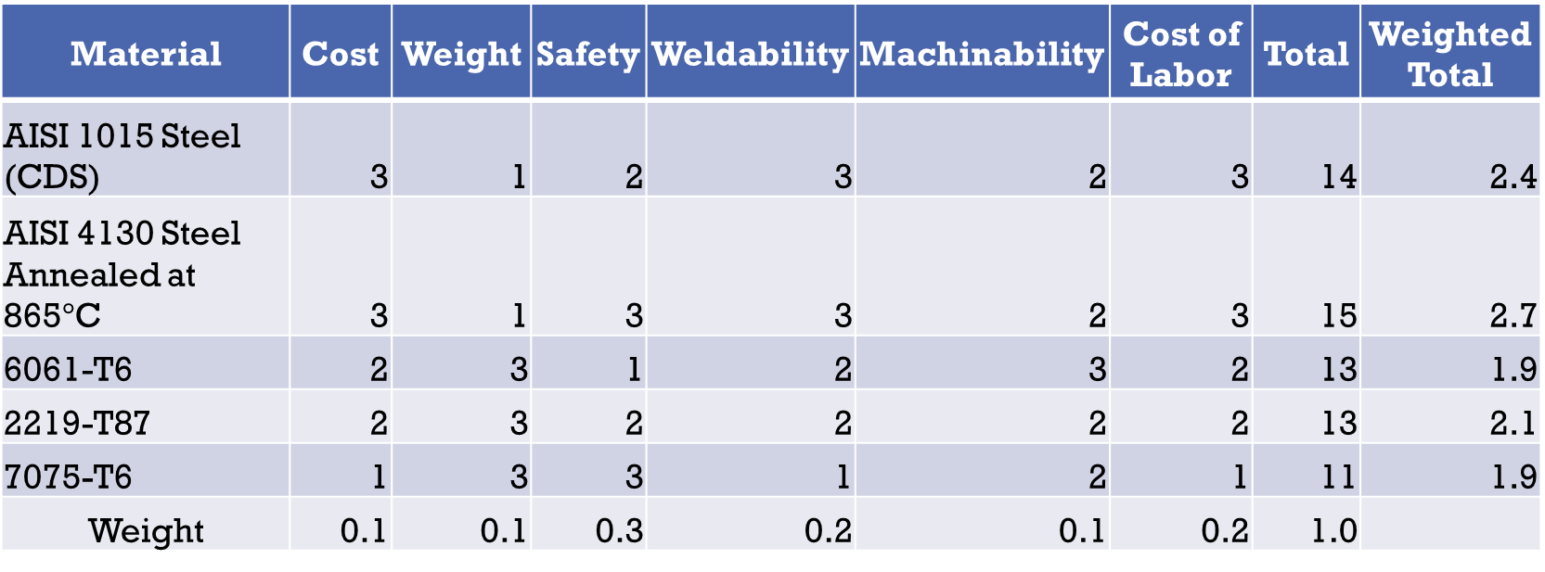
Decision Matrix
Material | Cost | Weight | Safety | Weldability | Machinability | Cost of Labor | Total | Weighted Total
AISI 1015 Steel (CDS) | 3 | 1 | 2 | 3 | 2 | 3 | 14 | 2.4
AISI 4130 Steel Annealed at 865$°$C | 3 | 1 | 3 | 3 | 2 | 3 | 15 | 2.7
6061-T6 | 2 | 3 | 1 | 2 | 3 | 2 | 13 | 1.9
2219-T87 | 2 | 3 | 2 | 2 | 2 | 2 | 13 | 2.1
7075-T6 | 1 | 3 | 3 | 1 | 2 | 1 | 11 | 1.9
Weight | 0.1 | 0.1 | 0.3 | 0.2 | 0.1 | 0.2 | 1.0

Slide 37
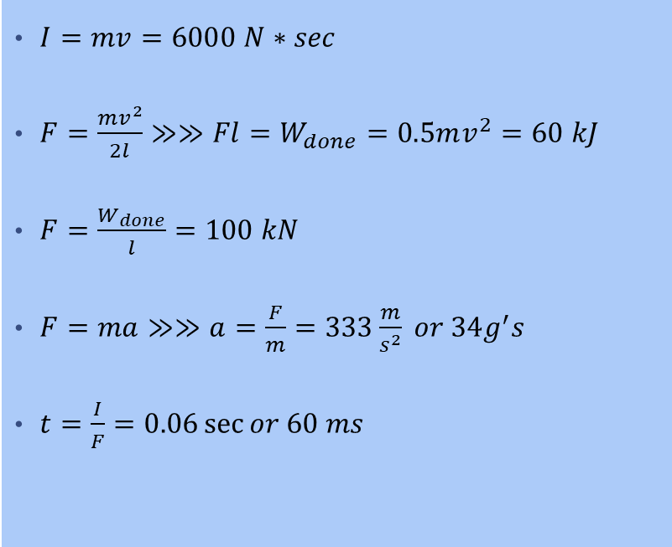
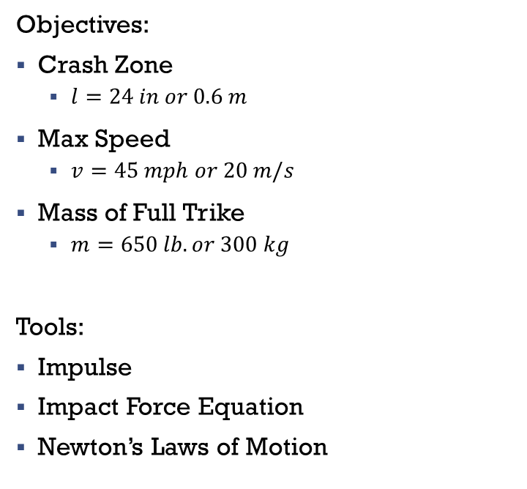
Energy Absorption – Front Collision
Objectives:
Crash Zone
  $l=24 in or 0.6 m$
Max Speed
  $v=45 mph or 20 m/s$
Mass of Full Trike
  $m=650 lb. or 300 kg$
Tools:
Impulse
Impact Force Equation
Newton’s Laws of Motion
$I=mv=6000 N∗sec$
$F=\frac{mv^{2}}{2l}≫≫Fl=W_{done}=0.5mv^{2}=60 kJ$
$F=\frac{W_{done}}{l}=100 kN$
$F=ma≫≫a=\frac{F}{m}=333\frac{m}{s^{2}} or 34g^{′}s$
$t=\frac{I}{F}=0.06\sec{or 60 ms}$

Slide 38
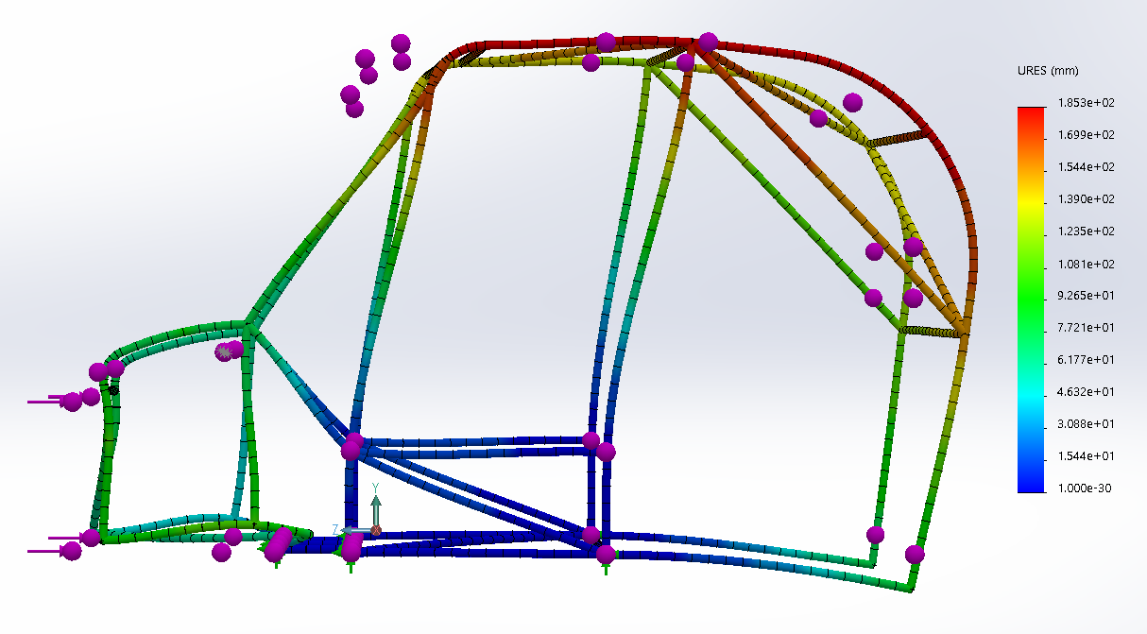
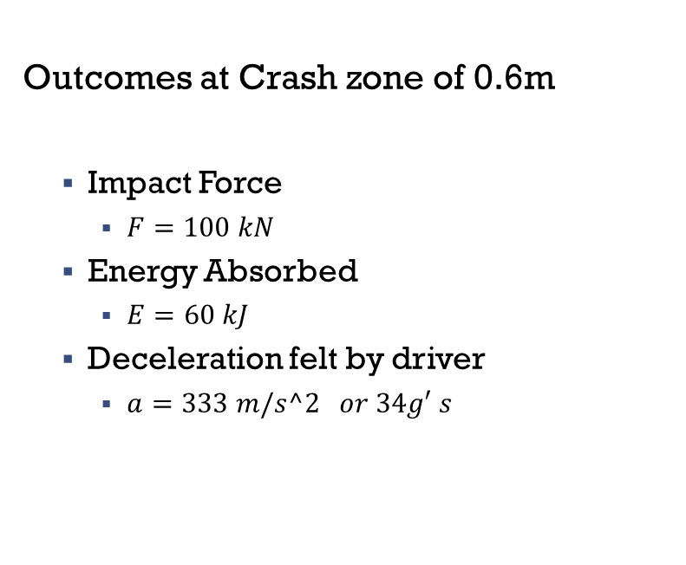
Stress Analysis – front collision
Outcomes at Crash zone of 0.6m
  Impact Force
    $F=100 kN$
  Energy Absorbed
    $E=60 kJ$
  Deceleration felt by driver
    $a=333 m/s^2 or 34g′ s$

Slide 39


Stress Analysis – Complete Rollover
$m=133.8kg$
$a=9.81 m/s^{2}$
$$F=ma=3 kN$$
Weight is in the back of the trike
Driver is protected from rollover
Structure is further improved with:
  Larger diameter tubing
  Thinner wall

Slide 40

Model B

Slide 41
Design Approach
Maximize Comfort
914mm driver cabin space
Damped front and rear suspension
Maximize ground clearance
Improved Driver Controls
Steering position and 3:1 turn ratio
Foot pedals
Driver Protection
Visually appealing
603 mm energy absorption zone in case of frontal impact
Safe for travel at 45 mph, or 20 m/s

Slide 42

Maximizing comfort-Cabin Space
In previous design the driver has approximately 27” of leg room before the front bar of the frame.
Rear swing arm linkage was approximately 21”
Driver’s legs would hang over the front bar of frame
Swing arm was this long because it carried the batteries
685 mm
533 mm
914 mm

Slide 43

Cabin Space- Solution
Relocate the batteries to the sides of the original frame, using cages that will serve to strengthen the original frame, and can be used as a floorboard.
Decrease rear swing arm length since it no longer carries the batteries
Add in structure to both support the seat and can serve as a fender frame for the rear tire.
914 mm
381 mm

Slide 44


Damped Front Suspension
Supported by offset members attached to battery cages
$51mm$ of travel
Spring/Damper setups are easy to source
Damper distance from wheel gives a firm ride
Firm ride is usually less comfortable but provides better suspension control.
552 mm
355 mm

Slide 45




Suspension Travel with Damper Geometry
C
Distance from pivot to wheel center, $AD=387mm$
Extended Shock Length $L_{s}=216mm$
Vertical height$AC=176 mm$
D
Static
$$L_{s}$$
B
A
D
Distance from pivot to wheel center, $AD=387 mm$
Vertical height$AC=176 mm$
Suspension Travel $L_{T}=51mm$
Compressed Shock Length $L_{C}=215mm$
Current
C
Deflection
B
$$L_{T}=51mm$$
A

Slide 46


Damped Rear Suspension
Currently the trike has one single damper mounted at the center.
This design uses two dampers to avoid torsion at the shock mounts.
Assumed suspension travel of $51mm$
Dual dampers also provides more ride control and helps avoid sag when loaded.

Slide 47

Rack And Pinion
The rotation of the pinion causes linear motion of the rack which turns the wheels left or right.
Can be found on cars, mini vans, and small suvs.

Slide 48


Improved Driver Controls-Steering
Previous model had quick turn go-kart style steering.
At 45 mph, quick steering can pose a danger if the wheel is turned too quickly.
Rack and pinion steering allows more precise control of the vehicle’s steering.
Steering Ration 3:1

Slide 49

Turning Radius Calculations
Parameters ​​
Wheelbase(L)​​​ | 1.34 m​​
Track width(d)​​​ | 1.31 ​m​​
Inner Angle​(A)​ | 21.09°​
Outer Wheel​(B)​ | 16.55°​
1.31 m
1.34 m
Assume:
Turning Radius of 4 meters.
Actual Turning Radius
R= d/2+[L(cosec (A/2+B/2))]
R= 4.8 meters

Slide 50
Comparison- Steering
​​ | Pitman arm Steering​​ | Rack and Pinion Steering​​
Complexity ​​ | ​less complex, easily machined​ | ​More complex due to a system of gears​
Durability ​​ | ​Contact with surfaces are less which leads to high durability​ | ​More wear takes place due to gear.​
Vibration ​​ | ​Vibration is less​ | ​More vibration in steering wheel​
Weight | ~5 lbs | ~7 lbs
Cost ​​ | ​30-70 $​ | ​50-150 $​
Common material used​​ | ​Alloy steel, Carbon steels, Iron​ | ​steel, aluminum ​

Slide 51

Improved Driver controls-Foot pedals
In the previous design the control pedals would have to hang over the front bar of the frame.
With model B, the pedals can be mounted within the cabin.
Driver will be raised from the floor, allow feet to be in a more comfortable position.

Slide 52

Roll cage For Model B
Objectives:
Safety
Easily accessible
Comfort
Aesthetics

Slide 53

Roll Cage
Model B had 15cm removed from rear swing arm.
Use those extra 15cm to add crumple zone in front of trike.
Battery cages are attached to frame at the same level, then lateral supports between both cages add strength to the design in the event of a lateral impact.
Roll cage B adds support for rollover conditions uses the front 15cm provided by the shortening of the rear swing arm.

Slide 54


Energy Absorption – Front Collision
Roll cage material ASI 1015
Dimensions of bars: 21.3 mm x 2.3 mm
Energy Absorption Area is 303mm x 441mm
Roll cage weights 48kg
Total Weight of Turbo trike 344kg
Force of impact during crash, with energy absorption zone
$F=\frac{mv^{2}}{2D}$ $=$ $\frac{344kg x {(20\frac{m}{s})}^{2}}{2x 0.303m}=227 194$N
$a=\frac{F}{m}=$ $\frac{227 194 N}{344.2kg }=$ 660 $\frac{m}{s^{2}}$ or $\frac{660\frac{m}{s^{2}}}{9.81\frac{m}{s^{2}}}$ = 67.28g’s
$I=mv=344kg∗20m/s$=6884 N*sec
$$t=\frac{I}{F}=\frac{6884 N∗sec}{227 194N}= 0.03\sec{or 30 ms}$$
D

Slide 55


Front Collision with Bumper
Total Weight of Turbo trike m=344.2kg
D= 0.60m
Force of impact during crash, with energy absorption zone
$F=\frac{mv^{2}}{2D}$ $=$ $\frac{344kg x {(20\frac{m}{s})}^{2}}{2x 0.60m}=114733$N
$a=\frac{F}{m}=$ $\frac{114 733N}{344.2kg }=$ $333\frac{m}{s^{2}}$ or $\frac{333\frac{m}{s^{2}}}{9.81\frac{m}{s^{2}}}$ = 33.94g’s
$$I=mv=344kg∗\frac{20m}{s}=6884 N∗sec$$
$$t=\frac{I}{F}=\frac{6884 N∗sec}{114 733N}= 0.06\sec{or 60 ms}$$
D

Slide 56

Roll cage Benefits
Large surface area on top of the roll cage for solar panels
Easy to weld
Higher seat position which allows driver a better visibility
Comfort

Slide 57




Components For Both Models

Slide 58


Turbo Trike
1st Gen
2nd Gen
Do not have any sensors incorpotated to the trike
Does not have any lights or turn signals
No solar panels
No regenerative braking
Lidar sensor for auto braking with and adruino board
Front and back lights with turning signals
Solar panels
And regenerative braking

Slide 59

Comparing Different Sensors

Slide 60
TF03 Long-Distance LiDAR Module
Lidar sensor range from .1m to 180m
10khz frequency measure
100klux Anti strong light with IP67
Can easily communicate with the Arduino through UART
Anti-shock and anti-vibration can operate between –25-60 degrees Celsius
Cost $229

Slide 61

Calculating Stopping Force
The program also calculate the speed and the amount of force needed to decelerate when an object is detected at a given distance
Depending on the distance and the acceleration of the trike the program will calculate how much force the regenerative braking needs to apply in order to prevent a collision

Slide 62

Auto Braking

Slide 63

Schematic

Slide 64

Demostration

Slide 65

Where do sensors Go?
Production vehicles use a wide range of sensors all throughout the car.
Of course, all the sensors responsible for auto braking are near the front with most being integrated into the front bumper

Slide 66


Sensors on the Turbo Trike
First design involved the TF03 sensor under the top part of the roll cage.
Final design will have both lidar sensor at the front of the bumper
Will be capable of protecting the sensors from damage in minor collisions.

Slide 67


Bumper Impact test (10mph)
Acceleration = $\frac{0−4.47 m/s}{0.1 s}=−44.7\frac{m}{s^{2}}$
Force = $348 kg ·44.7\frac{m}{s^{2}}=15,555 N$

Slide 68

Regenerative Braking
Tradition vehicles use friction to slow down and dissipates all the kinetic energy as heat
Regenerative braking allows the motor to turn mechanical energy to electric energy.

Slide 69


Brushless DC Motors
The Turbo Trike is outfitted with a Kelly Controls brushless DC hub motor.
In each pair of stator teeth, the coils are activated independently to induce an electromagnetic field.
Permanent magnets on the rotor follow the electromagnetic field produce the torque the moves the vehicle.
When regenerative braking is activated the only on pair teeth will be active attempting to hold the permanent magnet in place slowing the vehicle.

Slide 70

Regenerative braking
Efficiency
$$ε=\frac{\sum{E_{bat}}}{\sum{E_{kin}}}$$
$E_{bat}=\int_{t_{0}}^{t_{f}}{\left[E_{k}−I\left(t\right)R\left(t\right)\right]I\left(t\right)dt}$ $E_{kin}=\frac{1}{2}m({V_{1}}^{2}−{V_{2}}^{2})$
Effectiveness
  Depends on terrain, driving conditions, and vehicle size.
  Largest factor being vehicle size. Small personal ev’s see much smaller benefits, around 4-8%

Slide 71
Parallel vs. Serial Regenerative Braking
Parallel
Serial
Regenerative braking force and friction braking force increases together.
Does not require the use of an additional brake controller.
Effectiveness 9-18%
Adjustable braking system that uses a controller to vary amount of braking torque by friction Brakes and regenerative brakes.
Allow regenerative brakes to apply maximum braking force before friction brakes are applied
Requires brake by wire system.
Effectiveness 15-30%

Slide 72

Parallel Vs. Serial Regenerative Braking
Parallel Serial

Slide 73
Parallel Vs. Serial Regenerative Braking
 | Complexity (0.5) | Effectiveness (0.3) | Pedal Feel (0.2) | Total
Parallel Braking System | 4 | 3 | May compromise pedal feel, but can be adjusted 3 | 3.5
Serial Braking System | 2 | 4 | Smooth and linear 4 | 3

Slide 74


Implementation of Brakes
Throttle is on handlebar and individual hand brakes for the left and right wheel.
The pedals will be operated by the left and right foot similar to a go-kart.
Potentiometers will be attached to the axial at the pivot of the pedals and will be protected by small metal boxes.

Slide 75


Implementation of Brakes
Tensile hook springs will be used underneath the plate to return the pedals to neutral position.
Original cable driven brakes will be kept to work in tandem with the regenerative brakes.
Tension and length of cable can be adjusted to reach appropriate pedal feel.

Slide 76


Solar Panels History
Photovoltaic cells have been around since the late 1800s
Modern solar cell were created in 1954
More Americans are installing Solar Panels on their homes
As of 2020 the U.S has 97 gigawatts of Solar capacity
About 18 million homes can be powered solely from Solar Power
Becoming more efficient and more affordable

Slide 77




Solar Panels on Vehicles
- Toyota
Created 0.03 mm thick Solar cells to put on the Prius.
- Tesla
Adding a solar option on the Cybertruck that can add 15 miles of range.
- Hyundai
Added a panel that can charge 30% to 60% of battery
Aptera
  Panels can charge up 40 miles of range a day
- Lightyear One
Has 5$m^{2}$ of the roof and hood full of solar cells
that adds 40 miles of a range a day

Slide 78

What are We Solar Charging ?
Current Setup ​
Two 36 V LiFePO4 Batteries powering a 3kW-48V Brushless Motor​​
Battery Specs​
Brand - BYD
Actual Voltage - 32.8V​
Number of Cells 10 in series​
Connected to the Battery in Parallel
Estimated Combined Battery Capacity ​
3600 watt-hours or 100 amp-hours​

Slide 79


What is the Goal?
The goal is to not have to rely on the grid for charging
People on average drive 30 miles a day.
Current Estimated Battery Range
90 miles a charge
Energy usage per mile
$$\frac{Battery Energy}{Miles until Empty}=\frac{3600wh}{90 mi}=40\frac{wh}{mi}$$
Energy needed to drive the average
1200 𝑤h for 30 miles
The system needs to make at least 1200wh

Slide 80


Decision Matrix for Solar Panels
Series
Parallel
Panel Arrangement | Voltage | Current | Wiring Simplicity | Total
Series | 5 | 4 | 5 | 13
Parallel | 0 | 5 | 1 | 6

Slide 81

Decision Matrix for Solar Panel Type
Solar Panel Type | Price | Efficiency | Longevity | Options | Size | Total
Monocrystalline | 4 | 5 | 5 | 5 | 5 | 24
Polycrystalline | 5 | 3 | 5 | 0 | 4 | 17

Slide 82
Decision Matrix for Panels
Solar Panel Type 100w | Average Price | Efficiency | Nominal Voltage | Bendability | Mass (kg) | Total
Renogy Rigid Panel (Mono) | 5 | 3 | 4 | 0 | 1 | 13
Renogy Flexible Panel (Mono) | 3 | 4 | 5 | 5 | 5 | 22
Number of Flexible Panels | Average Price | Nominal Voltage in Series (V) | Mass added trike (kg) | Area Needed | Total
2 | 5 | 1 | 5 | 5 | 11
3 | 4 | 5 | 4 | 4 | 13
4 | 2 | 4 | 2 | 2 | 8
5 | 1 | 3 | 1 | 1 | 5

Slide 83

Solar System Schematic
Solar panels in series will give the system the needed voltage to charge the batteries.
Charge Controller needs to be rated for 36v system.
Fuse and charge disconnects gives user more control over system
This system can achieve 1200 W with 4 hours of sunlight at peak performance
300 watts * 4 hrs =1800 wh

Slide 84



Possible Fitments on Trike
Model A
Model B

Slide 85


Cost Comparison
Price of Panels
$169.99 x 3 = $509.97
Amount of Energy Created per Day
1800 Wh
Peak Energy Created in a Year
$300w∗6 hr/day ∗284\frac{days}{year}$= 511 kWh
Savings from Using Panels
Energy Generated * Price of Energy = Money Saved
511 kWh * $0.22/kWh=$112.42
Amount of saved $CO2$per Year
$$7.09 ∗{10}^{−4} metric\frac{metric ton}{kWh} ∗511 kWh=$$
$0.362 metric tons of {CO}_{2}$
Using the Grid
Cost of Electricity
$0.22/kWh
Cost of Charging per Day
$$1.8kWh ∗\frac{\$0.22}{kWh}=\$0.38$$
Cost in a Year
$$\$0.38 ∗365\frac{days}{year}=\$138.70$$

Slide 86

Street Legal
In order to make turbo trike street legal:
Headlight
Taillights
Turn signals
Horn
Mirrors
Speedometer
Helmet

Slide 87

Head Light System

Slide 88

Turn Signal System

Slide 89

Tail light System

Slide 90

Final Steps
Converter – Battery 36V and designed system works at 12V
Seatbelt
Inspection
Title and Registration
Insurance
License plate

Slide 91


Max lateral acceleration
$$\sum{M_{C}:a_{y}W\left(HG\right)=WF_{0}(\frac{TR}{2})}$$
$$\sum{M_{R}:}WF_{0}\left(LG\right)=W\left(WB−LG\right)$$
$$a_{y}=\frac{TR(WB−LG)}{2(WB)(HG)}$$

Slide 92


How many g’s can We Pull
Model A
HG = 0.42
LG = 0.56
WB = 1.5 m
TR = 1.3 m
$$L_{g}=\frac{1.3(1.5−0.56)}{2(1.5)(0.42)}=0.97g$$
$$R_{crit}=\frac{V^{2}}{L_{g}}=\frac{{20}^{2}}{0.97(9.81)}=42 m$$
Model B
HG = 0.60 m
LG = 0.57 m
WB = 1.3 m
TR = 1.3 m
$$L_{g}=\frac{1.3(1.3−0.57)}{2(1.3)(0.60)}=0.60g$$
$$R_{crit}=\frac{V^{2}}{L_{g}}=\frac{{20}^{2}}{0.60(9.81)}=68 m$$

Slide 93

Outrigger Wheels
Our design will incorporate a set a wheels placed 0.523 m out from the rear wheel and only 0.036 m from the ground.
The design will allow for a max of 15° of lean before enough force is applied to push back.

Slide 94



Spring design
$$F_{c}=\frac{mV^{2}}{R}=\frac{350(20)²}{60}=2300 N$$
$$\sum{M_{R_{3}x}:} \frac{TR}{2}R_{1}+\left(OR\right)R_{2}=\left(HG\right)F_{c−1}+(HG)tan15°mg$$
$$\sum{M_{R_{3}}z:(WB)R_{1}=(WB−LG)mg}$$

Slide 95


Spring Design
$$\sum{M_{R_{3}}z:(0.60)R_{1}=(0.60−0.57)(348)(9.81)}$$
$$R_{1}=1922 N$$
$$\sum{M_{R_{3}x}:} 0.648(1922)+\left(0.52\right)R_{2}=\left(0.60\right)(2300)+\left(0.60\right)tan15°\left(350\right)\left(9.81\right)$$
$$R_{2}=68 N$$
Hooke’s Law
$$k=\frac{F}{d}=\frac{680}{0.038}=18, 000\frac{N}{m}$$

Slide 96


RC Models
Model A
Model B
RC Models 3D printed with PLA and PLA+
Uses off-the-shelf hobby components
Used to test suspension performance and vehicle dynamics

Slide 97


Modified Frame
Model A
Model B

Slide 98
Final Decision Matrix
 | Simplicity | Cost | Ergonomics | Length | Tip-Over
Weights | .2 | .1 | .1 | .05 | .15
Model A | 5 | 4 | 2 | 3 | 4
Model B | 2 | 2 | 5 | 4 | 2
 | Steering Ratio | Safety | Mass | Total | Weighted Total
Weights | .1 | .15 | .15
Model A | 1 | 3 | 4 | 26 | 3.38
Model B | 5 | 4 | 3 | 27 | 3.09
Due to the weightings of each criteria, Trike A is the most viable option

Slide 99


K-12 Requirement
Three wheeled vehicle
$$a_{y}=\frac{TR(WB−LG)}{2(WB)(HG)}$$
Four-wheel Vehicle
$$a_{y}=\frac{TR}{2HG}$$
Solar Panel and Battery Equations
Energy (Wh) = Voltage (V) * Capacity (Ah)
Energy Density (Wh/g) = Voltage (V) * Specific Capacity
Discharge Time = Capacity (Ah) / Current (I)

Slide 100

K-12 Requirement
$v \left(speed\right)=\frac{average distance traveled}{time of travel}=\frac{∆d}{∆t}$
$a \left(acceleration\right)=\frac{average velocity during travel}{time of travel}=\frac{∆v}{∆t}$
$F \left(Force\right)=mass∗acceleration=m∗a$
$I \left(Impulse\right)=Force of Impact ∗Time of Impact=F∗∆t$
$I \left(another method\right)=mass ∗average velocity during travel=mv$

Slide 101
Questions?

