Slide 1

Randy Arruda Jr, Balarama Carter, Richard Cruz-Silva, Abram Flores,
Carlos Larios-solis, Khang Le, Brandon Lee, Casandra Pahed, Evelyn Ramirez
Advisor: John Hurley
Liaisons: Dr. Cynthia Wang, Zachary Vernon
UX Designer: Dulce Villanueva
Notes:
Include Dulce as designer under Liaisons

Slide 2
agenda
introduction & background
project technologies
major project requirements
project challenges
demonstration

Slide 3
what is the arqive?
The arqive is a social media website and mobile app for the LGBTQ+ community
A platform that enables them to document their stories and experiences
Location-based pins that document stories on the world map
Stories can be categorized as Personal, Resource, or Historical
Notes:
The arqive is a social media website and mobile app for the LGBTQ+ community
Provides users with a platform that enables them to document their stories and experiences
Allows users to post location-based pins that document stories on the world map
Stories can be categorized as Personal, Resource, or Historical

Slide 4
background
Founded in 2014 by Cynthia Wang, PhD, Assistant Professor, Department of Communication Studies
Joined by Zachary Vernon, Assistant Professor of Art (Graphic Design/Visual Communication) in 2019
Website was a Senior Design project last year
Notes:
Founded in 2014 by Cynthia Wang, PhD, Assistant Professor, Department of Communication Studies
Later joined by Zachary Vernon, Assistant Professor of Art (Graphic Design/Visual Communication) in 2019
Website overhauled as a Senior Design project last year by the arqive team

Slide 5
background
An archive of past and present movements, personal experiences, and resources/organizations
Gives LGBTQ+ people the opportunity to map out their stories, giving them a place in the world and in history
“By sharing stories, we can give each other hope.”
-Dr. Cynthia Wang
Notes:
Acts as an archive of past and present movements, personal experiences, and resources/organizations
The main purpose of the arqive is to give LGBTQ+ people the opportunity to map out their stories and give them a place in the world and in history

Slide 6
background
Very fortunate to collaborate with students of other disciplines
They provide us the necessary visual guidelines and cues on which to base our decisions
They make sure everything follows a consistent language
Notes:
Our team is very fortunate to collaborate with students of other disciplines
They provide us the necessary visual guidelines and cues on which to base our decisions
They make sure everything follows a consistent language

Slide 7
project technologies
Django REST Framework: A powerful and customizable toolkit for building Web APIs in Python
React: A JavaScript framework for creating user interfaces
  React Native: Open source mobile application framework
  ReactJS: Open source front end framework for developing websites
Hosting: Digital Ocean
  Ubuntu 18.04 (Server OS)
PostgreSQL: A popular open source database
SciKit-learn: Machine learning framework

Slide 8
project requirements

Slide 9
project requirements - mobile app
Native
  Better optimized per OS
  Need to develop two applications
  Steeper learning curve
  Efficient Code
Framework
  Might have less functionality
  One Codebase
  Community
  Fast Development
Notes:
Carlos Larios-Solis - we decided to go with react native and the reasons were yada yada

Slide 10
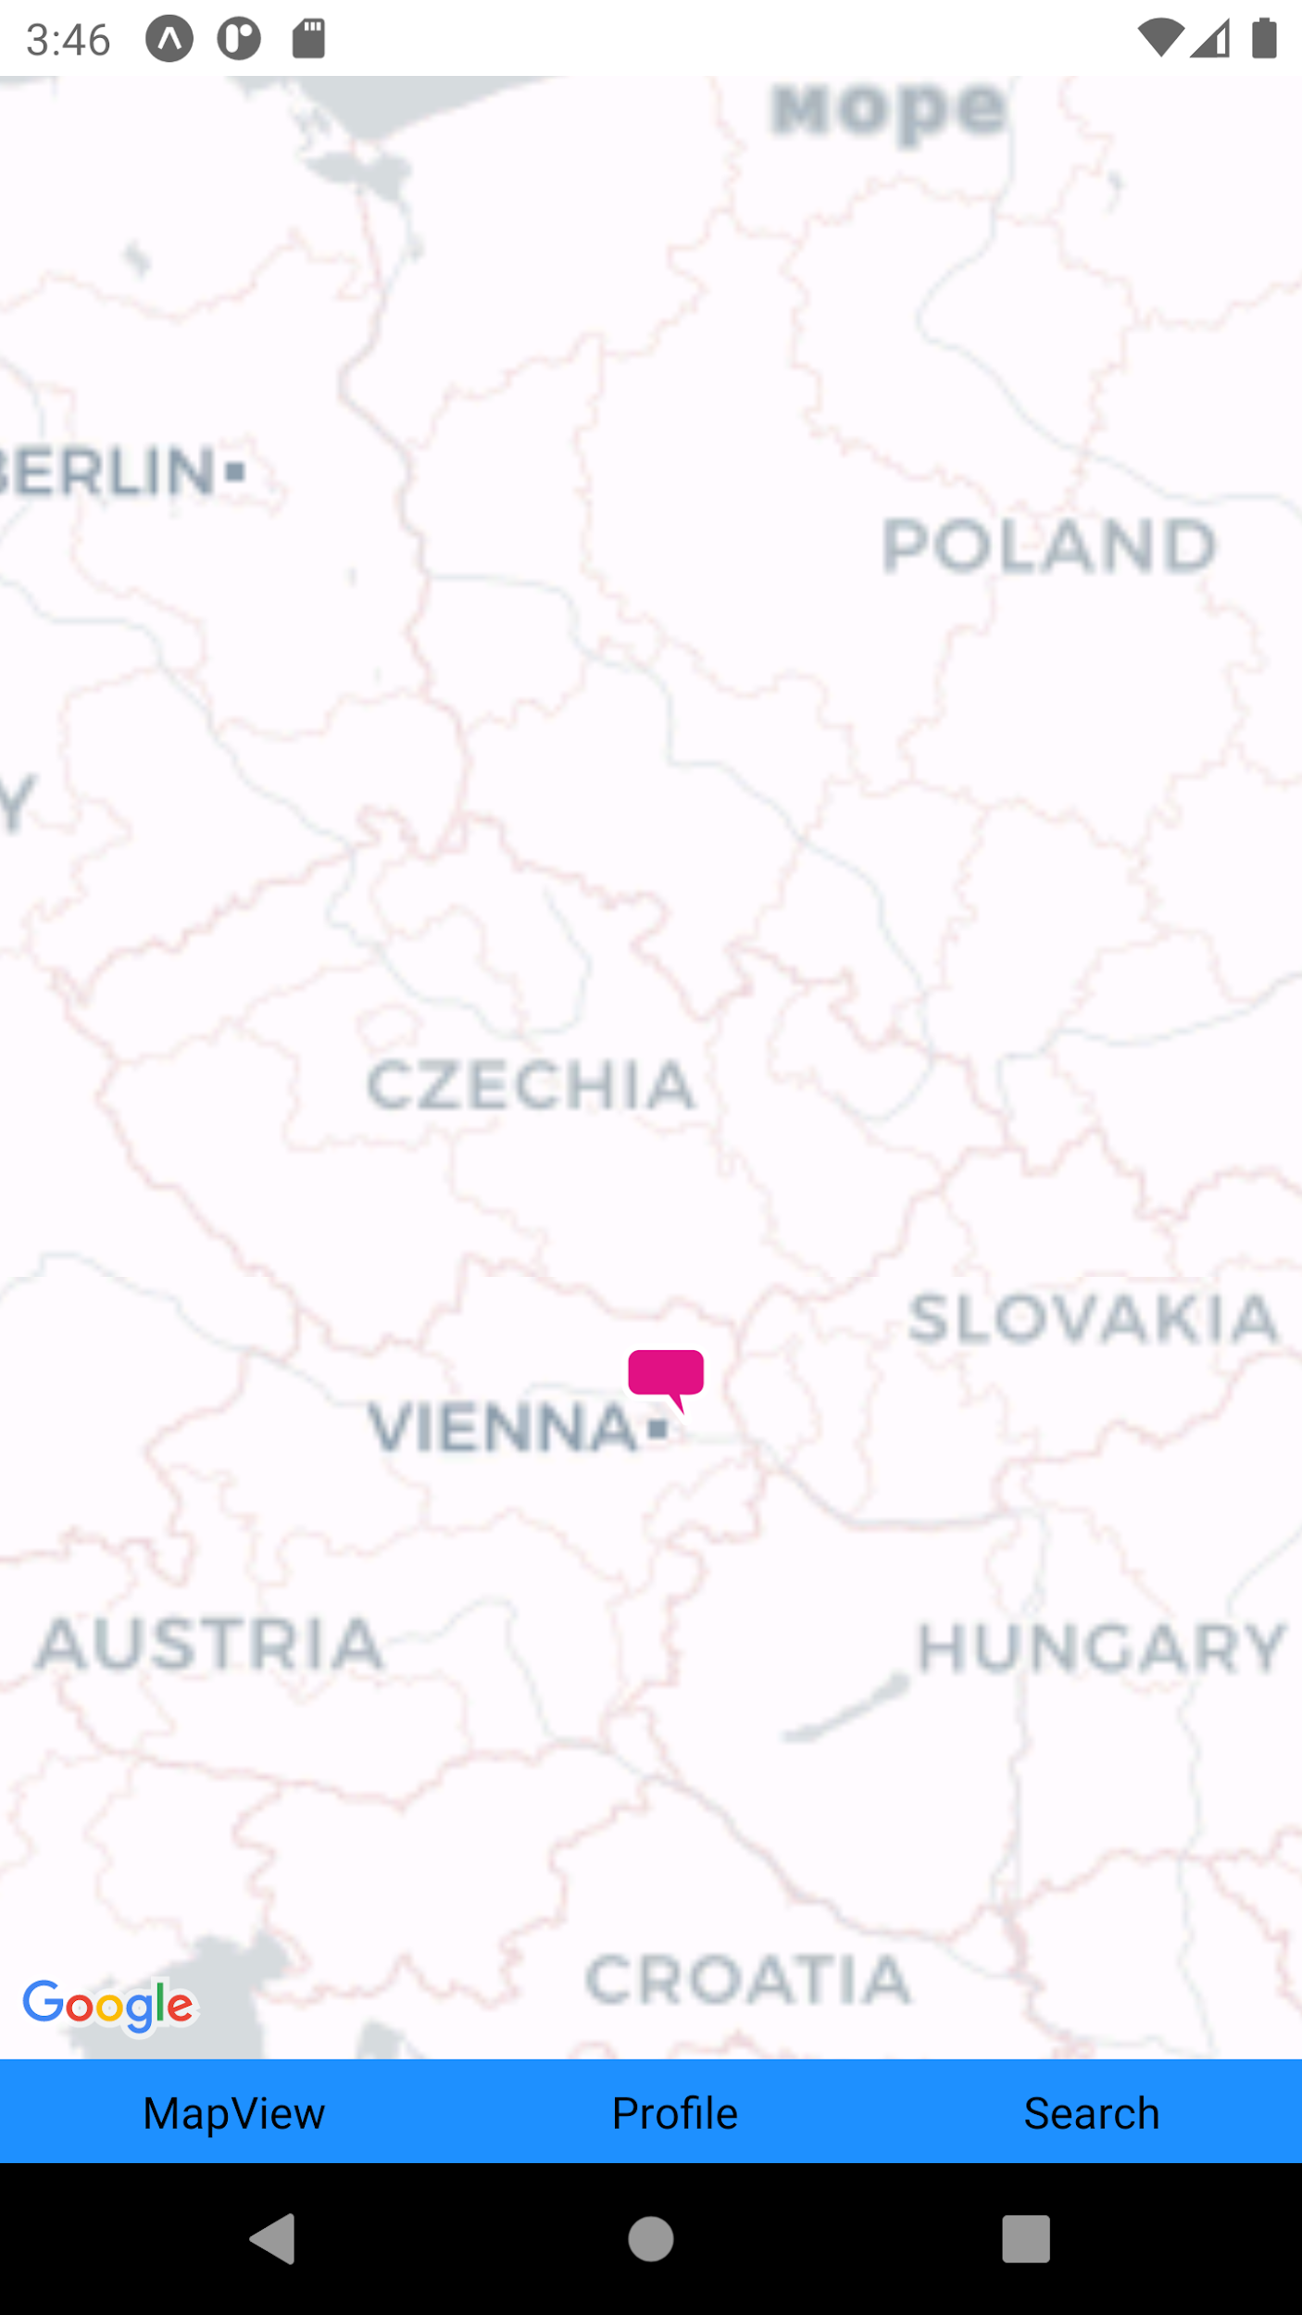
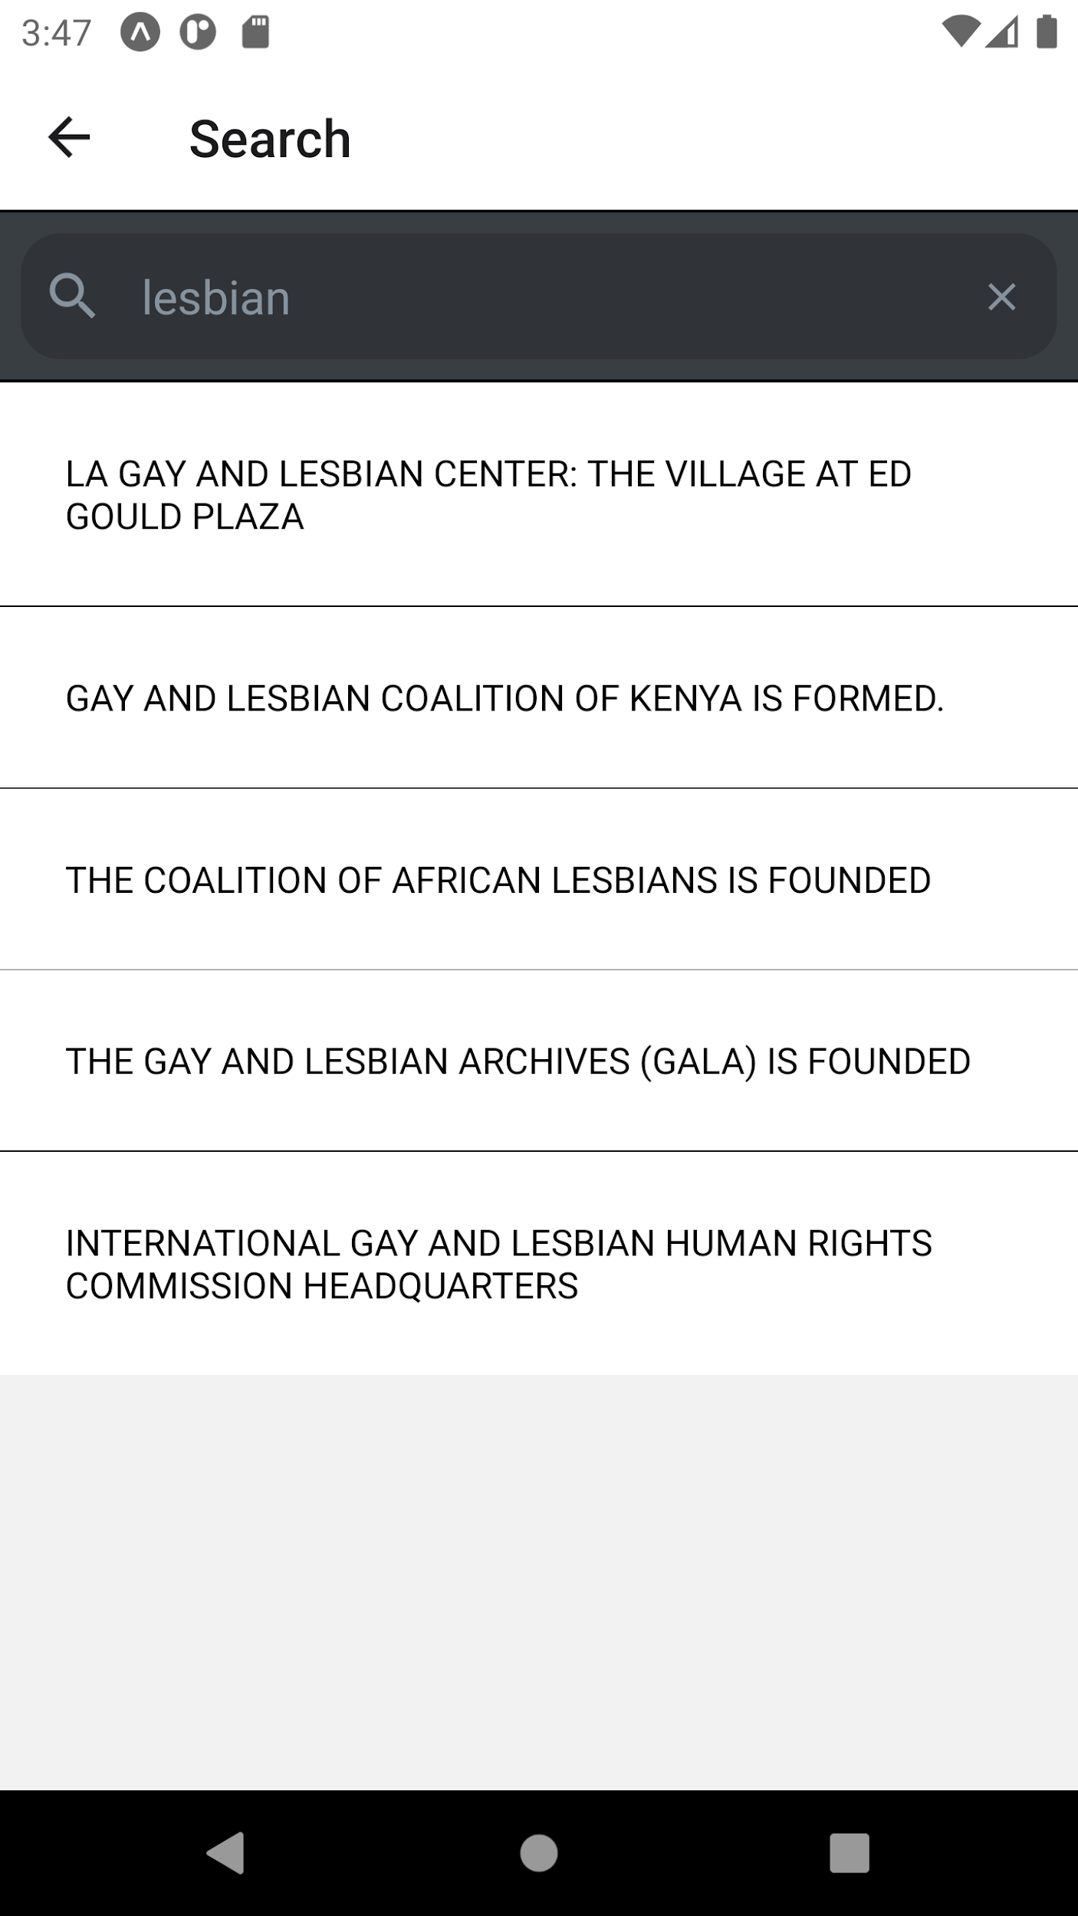
mobile app - search function
Originally accessed using a button navigating to a seperate screen
The SearchBar component is provided by react-native-elements and react-native-vector-icons
Search results displayed using a scrollable Flatlist
Screenshots on emulator from Android Studio
Notes:
Do a spell check when done with presentation, Might be a bit too much, spread over two if needed.

Slide 11
search function
Includes a basic search filter function:
  The search input text is compared with the data in the current stories list
  If a match is found a new data source is created and the list will re-render to show the filtered results
Flatlist props:
  keyExtractor: caching and tracking item re-ordering
  ItemSeperatorComponent: rendering between each item
  renderItem: renders item into the list from the data
Notes:
Continuation of last slide

Slide 12
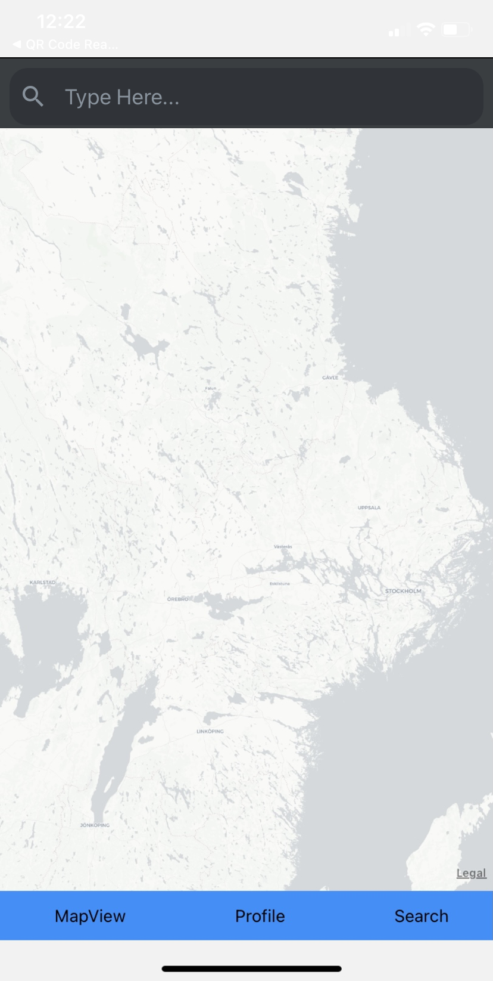
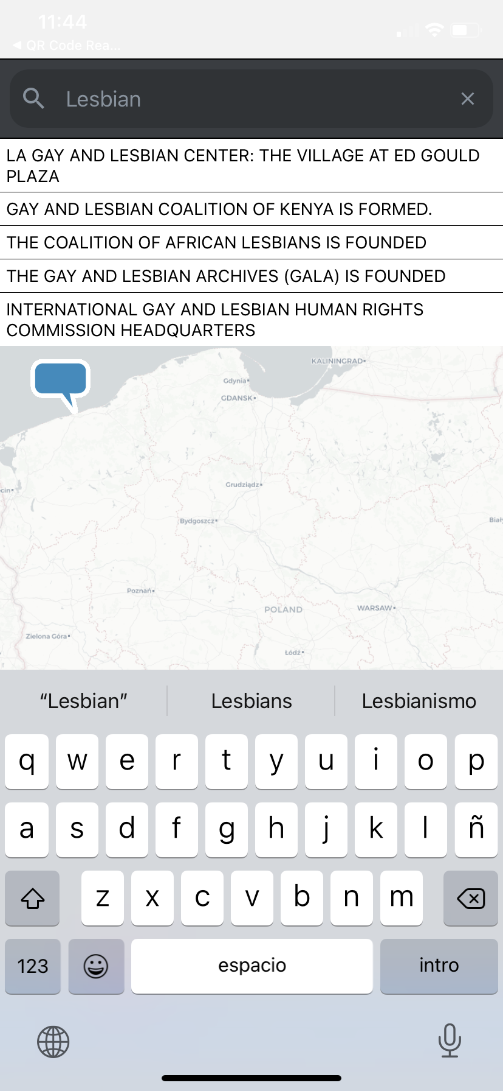
search function
Updates:
Completely removed the search screen and placed the search bar on the map screen at the top
Attempts to optimize Flatlist include:
  MaxToRenderPerBatch: Controls the amount of items rendered when rendering the next batch when scrolling
  windowSize: Controls viewport height, so a smaller windowSize results in fewer items mounted at once
Screenshots on iPhone XR using the Expo App
Notes:
If you do a live demo be ready that you have a fall back, either a video that you can switch to honestly but seamlessly or a video just in case. Might not need to do historically. You can say we tried this and replaced it with some other thing

Slide 13
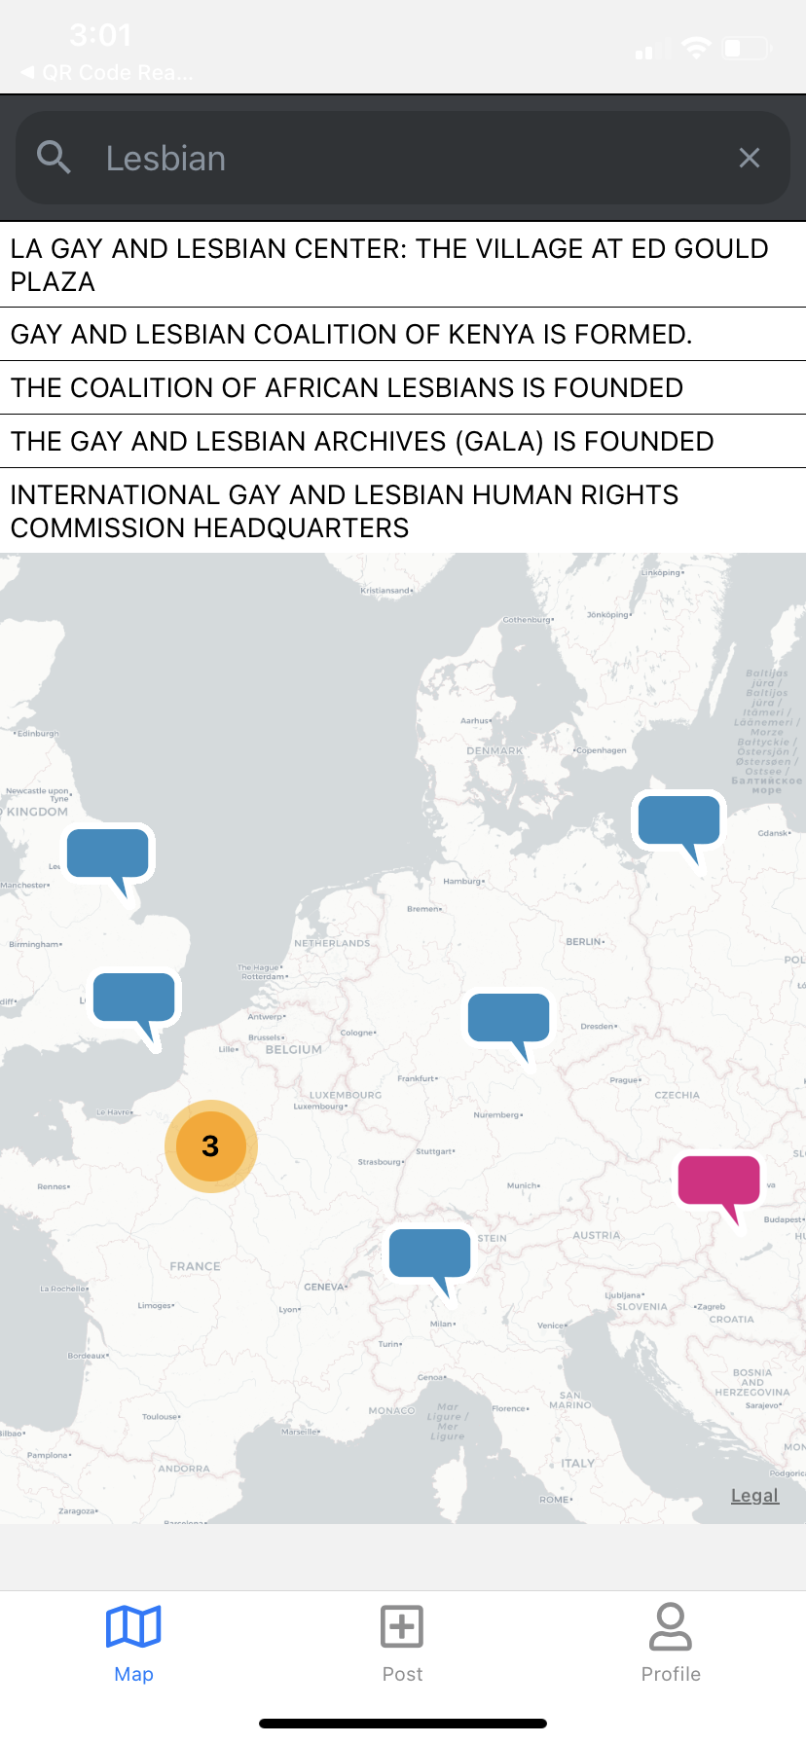
search function - current implementation
Updates:
Removal of Alert component to display the search result story
Implementation of Redux
Improved navigation bar
Screenshots on iPhone XR using the Expo App
Notes:
Include Redux in the tech list and talk about it

Slide 14
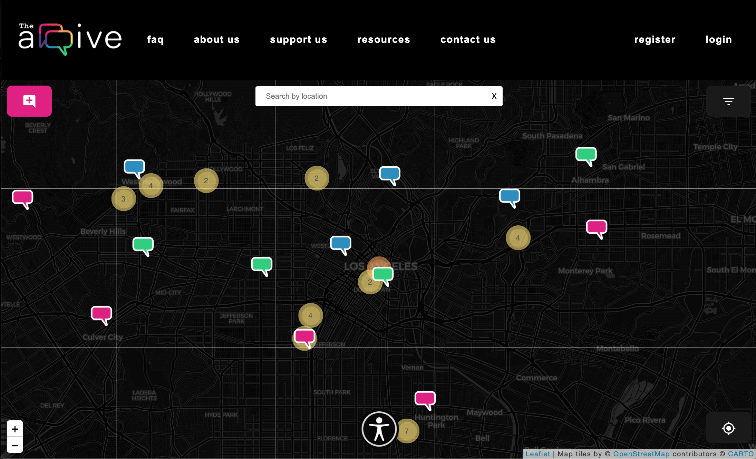
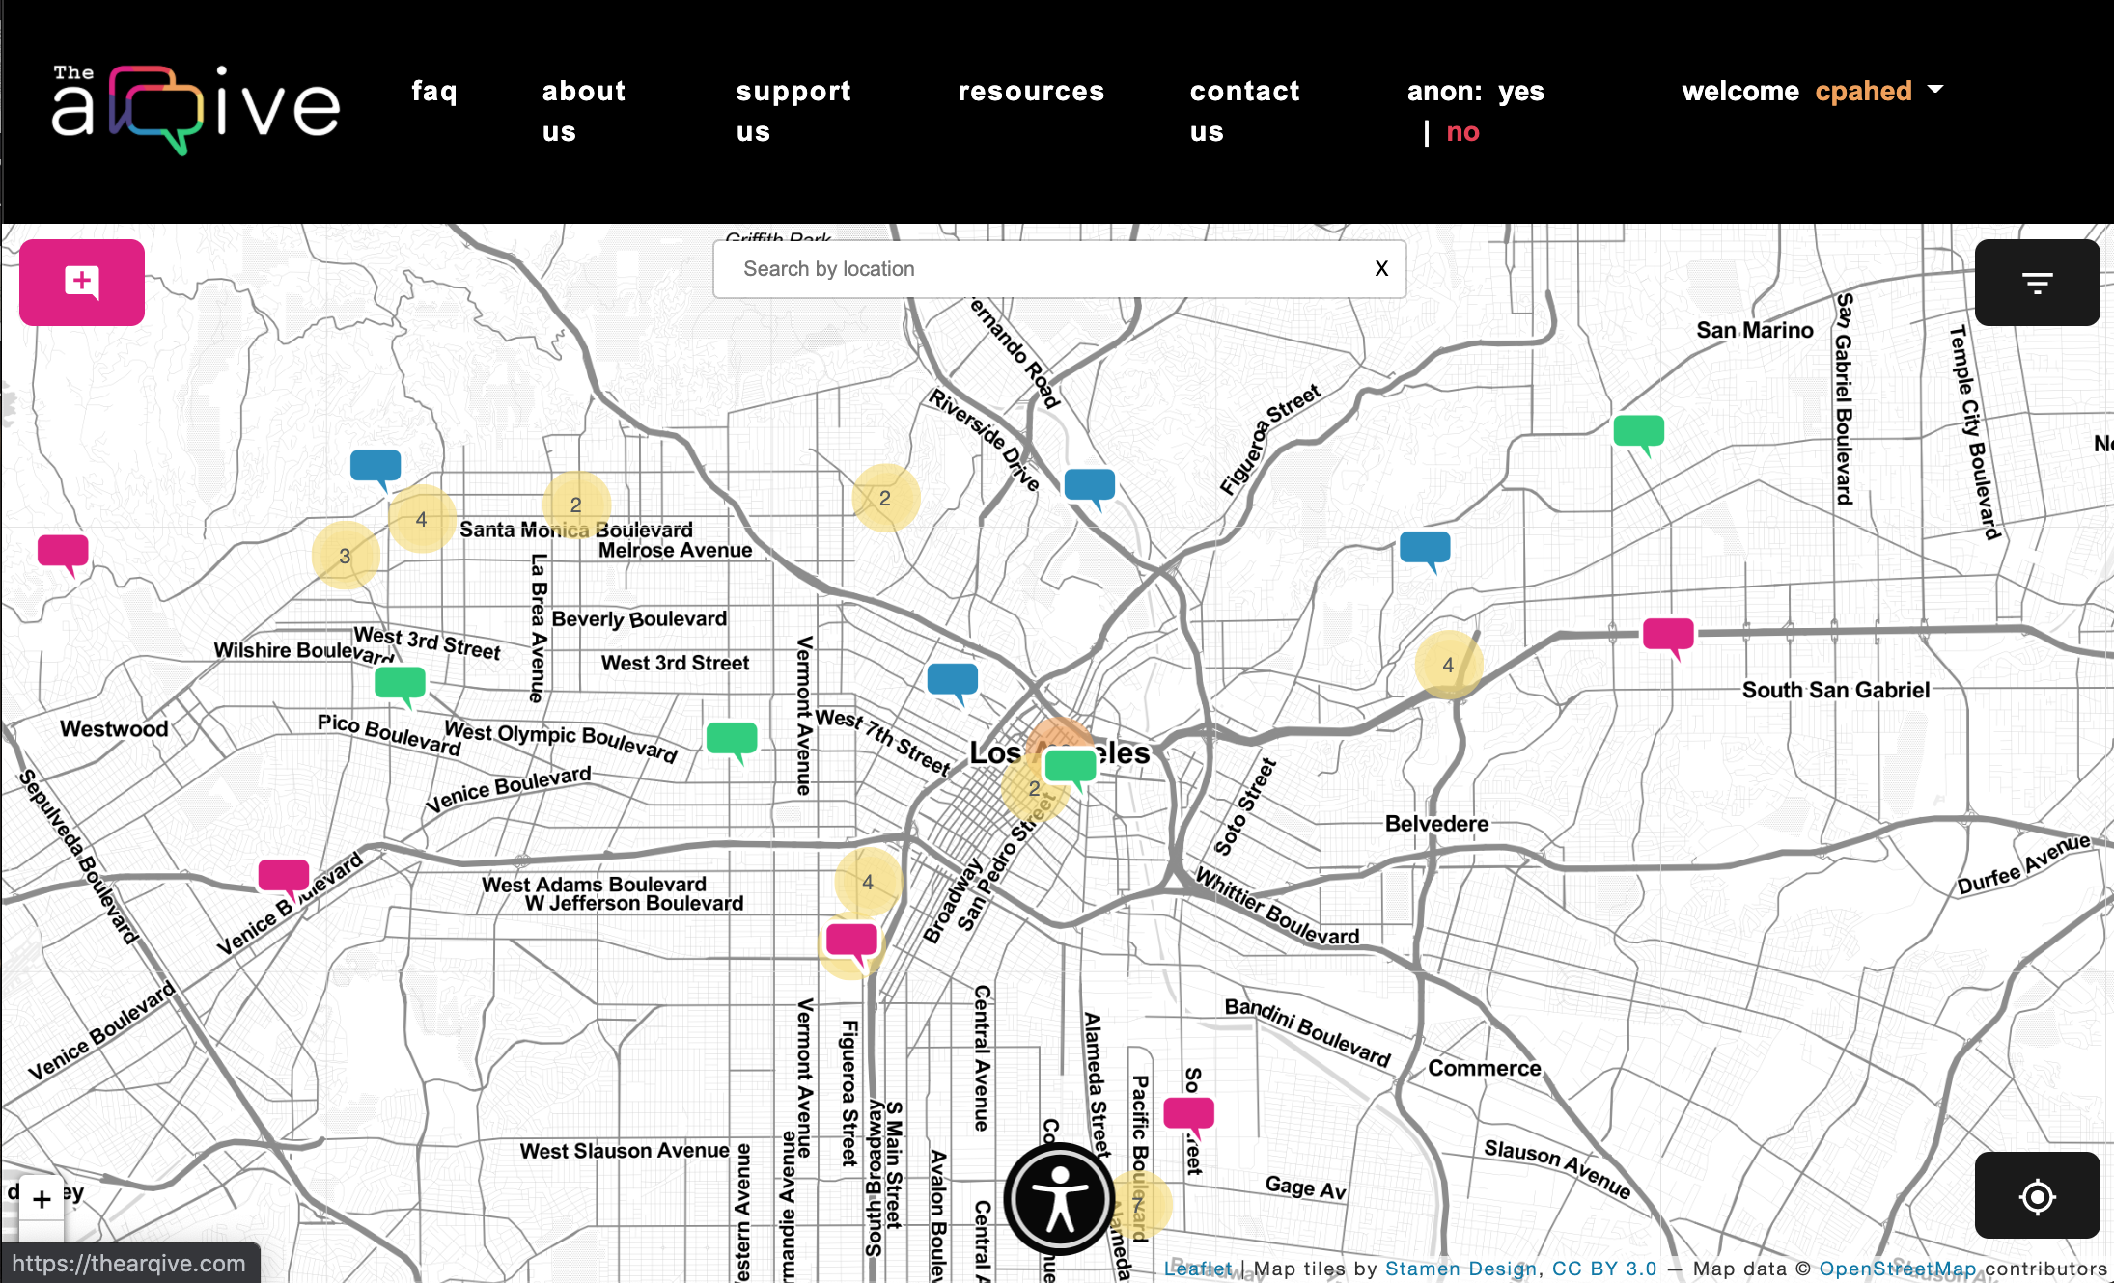
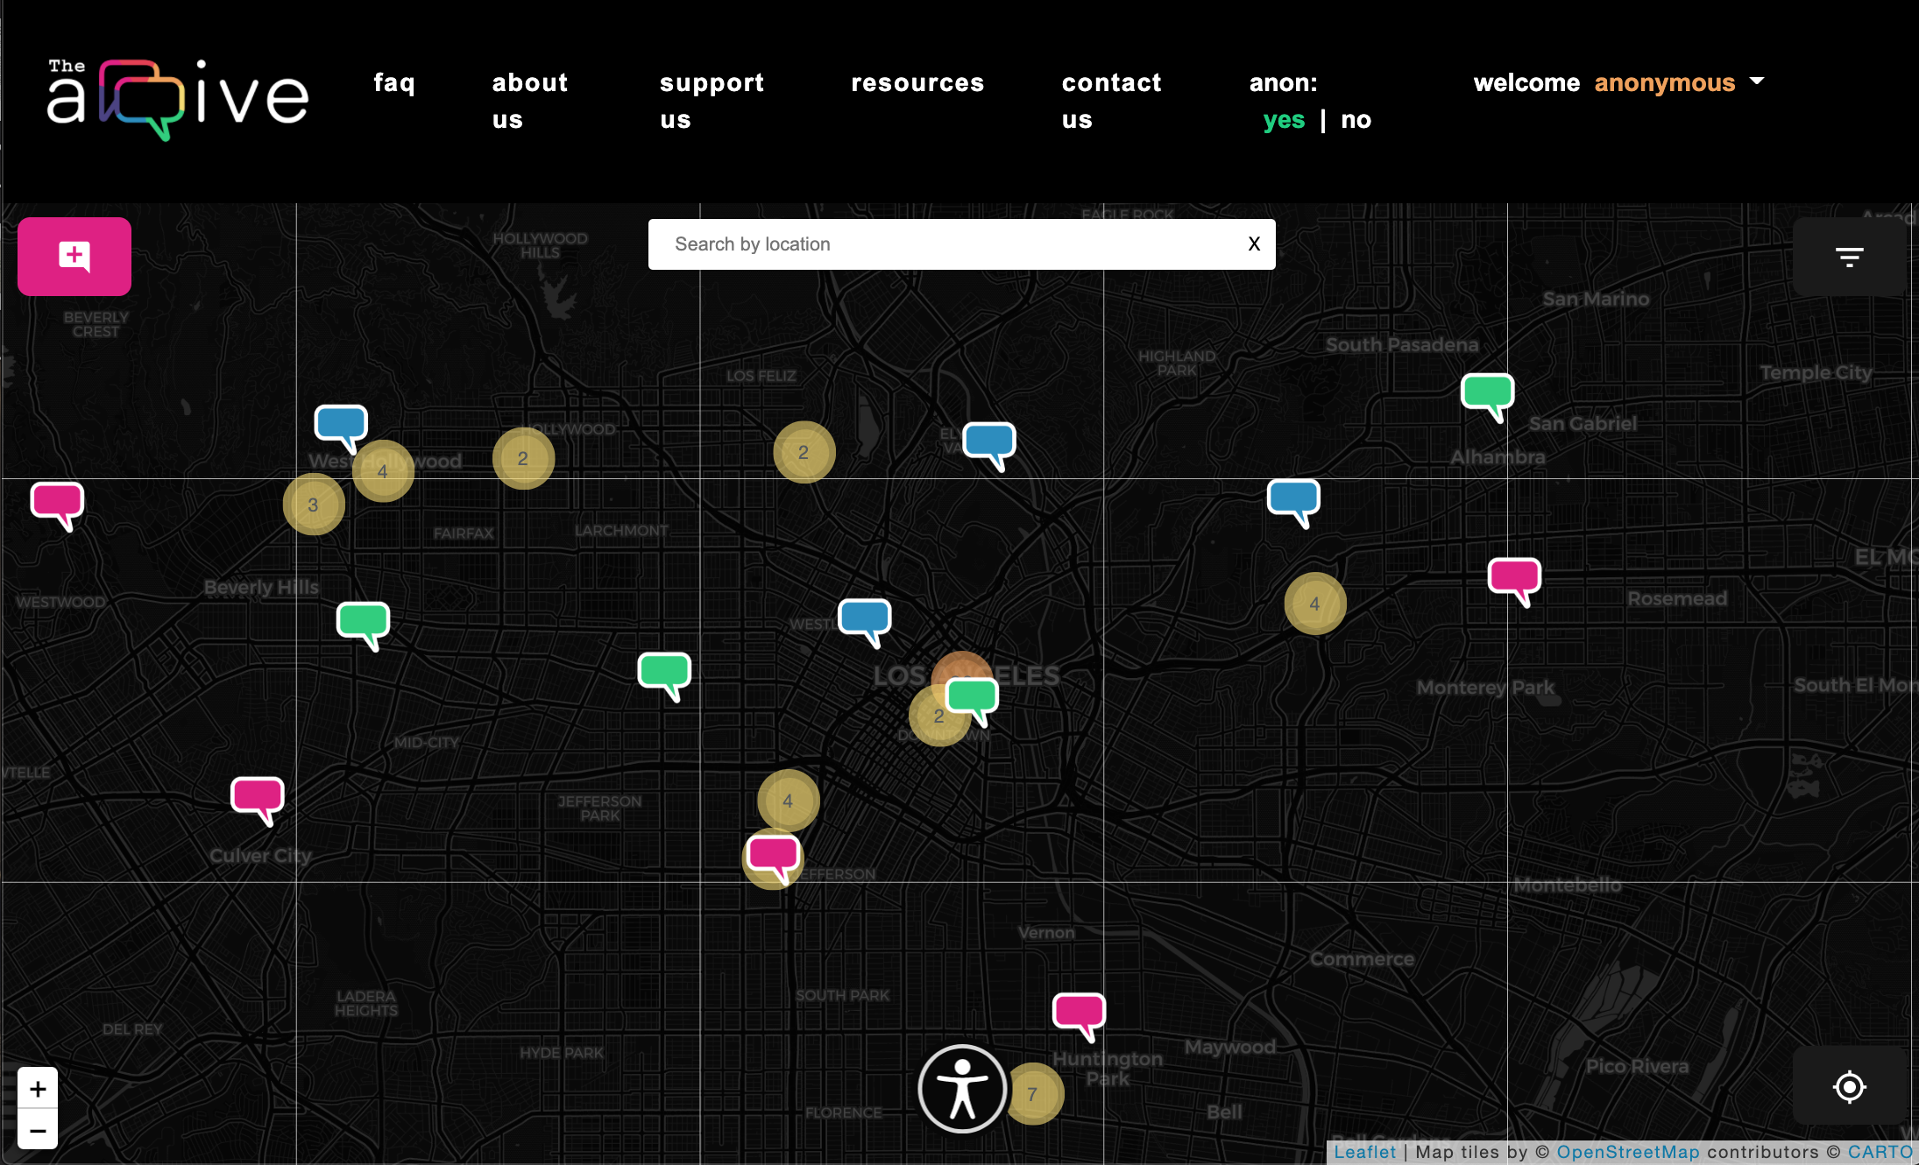
mobile app - login function
Unregistered users view the app as an anonymous user
Registered users can use their existing account to log into the app
When logged in, a user has access to more features
Unregistered user (left)
Logged in user who is not anonymous (middle)
Logged in user who is anonymous (right)
Notes:
Unregistered users:
View a darker map, view all posted stories from the arqive, and can only post a story as anonymous
Logged in users:
View a brighter map, view their own profile, can bookmark stories and other users, and interchange between showing their username and becoming anonymous

Slide 15
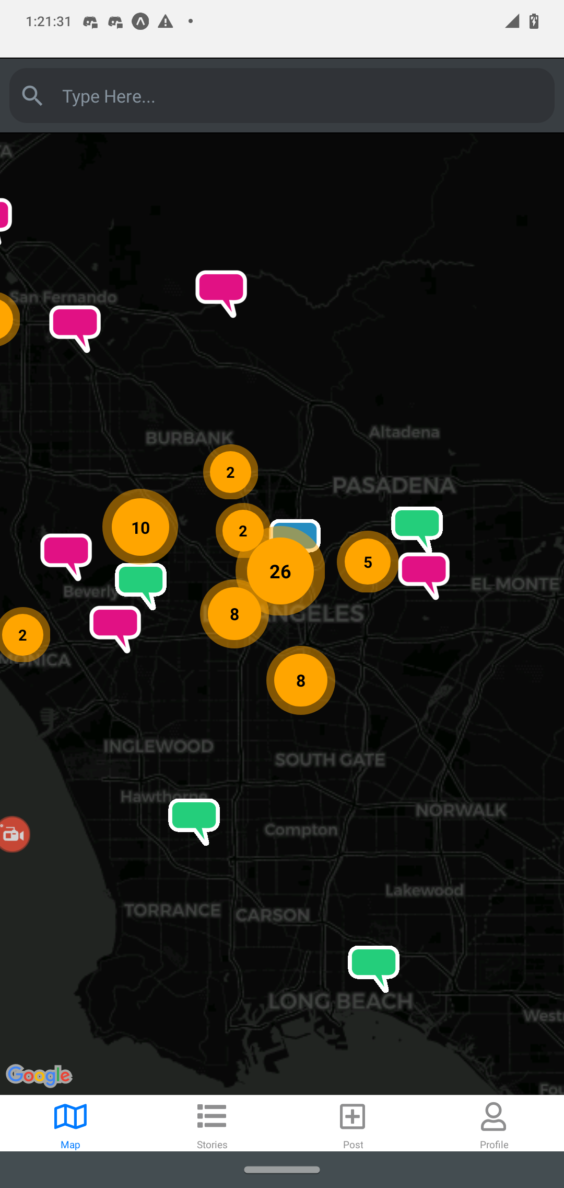
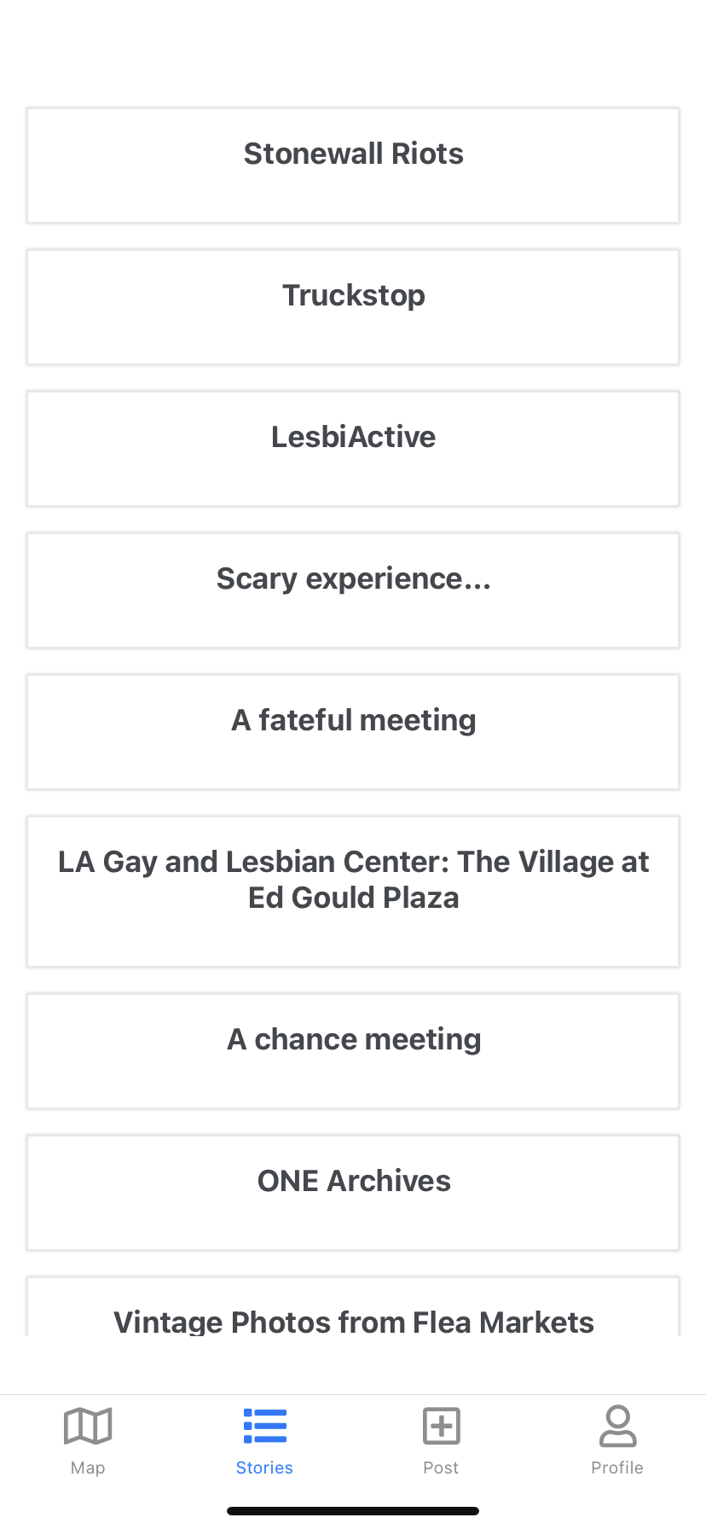
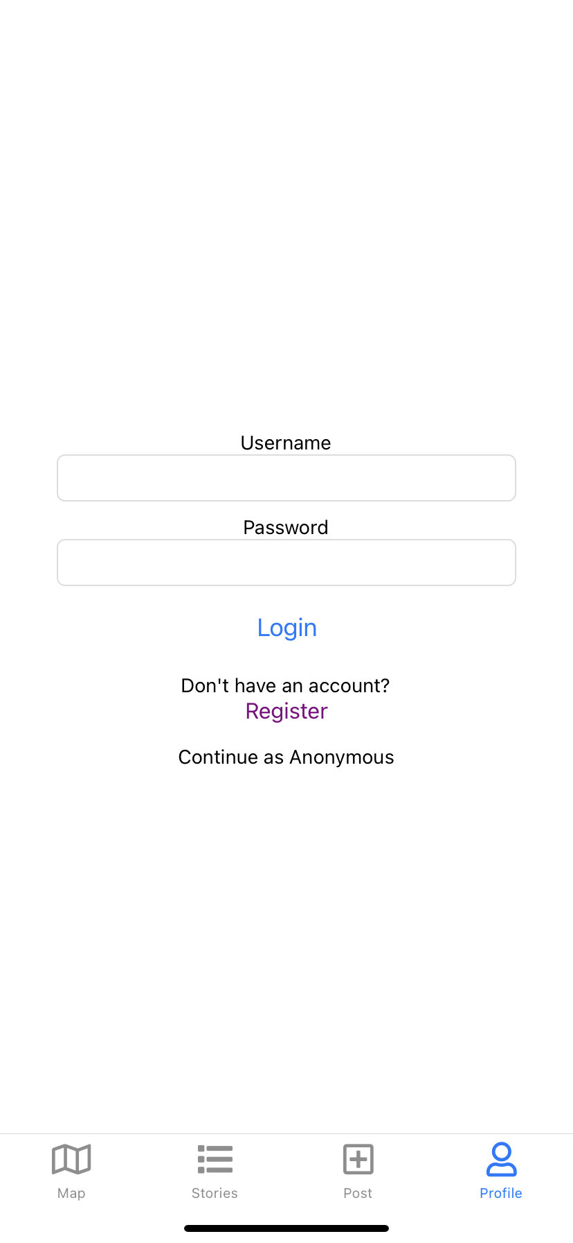
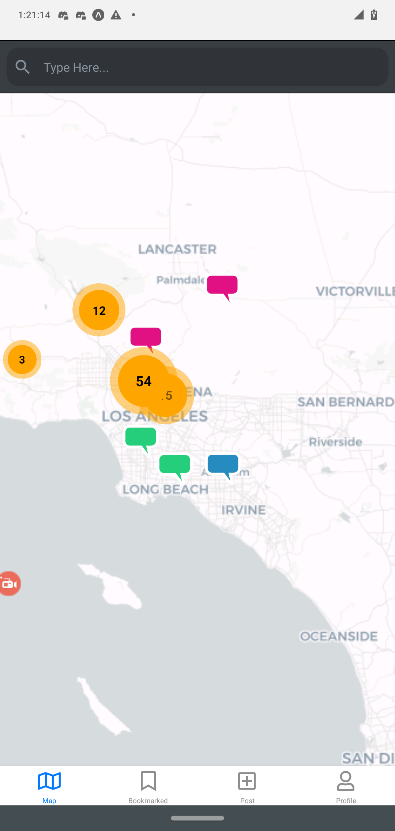
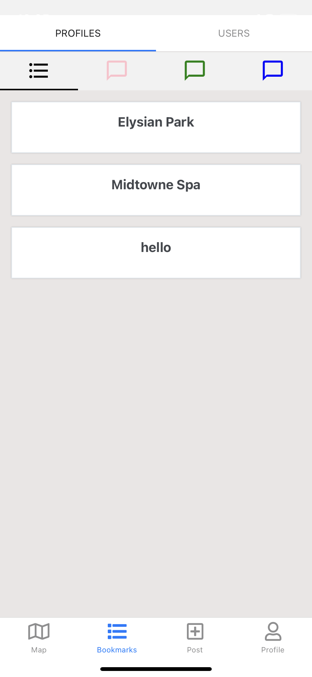
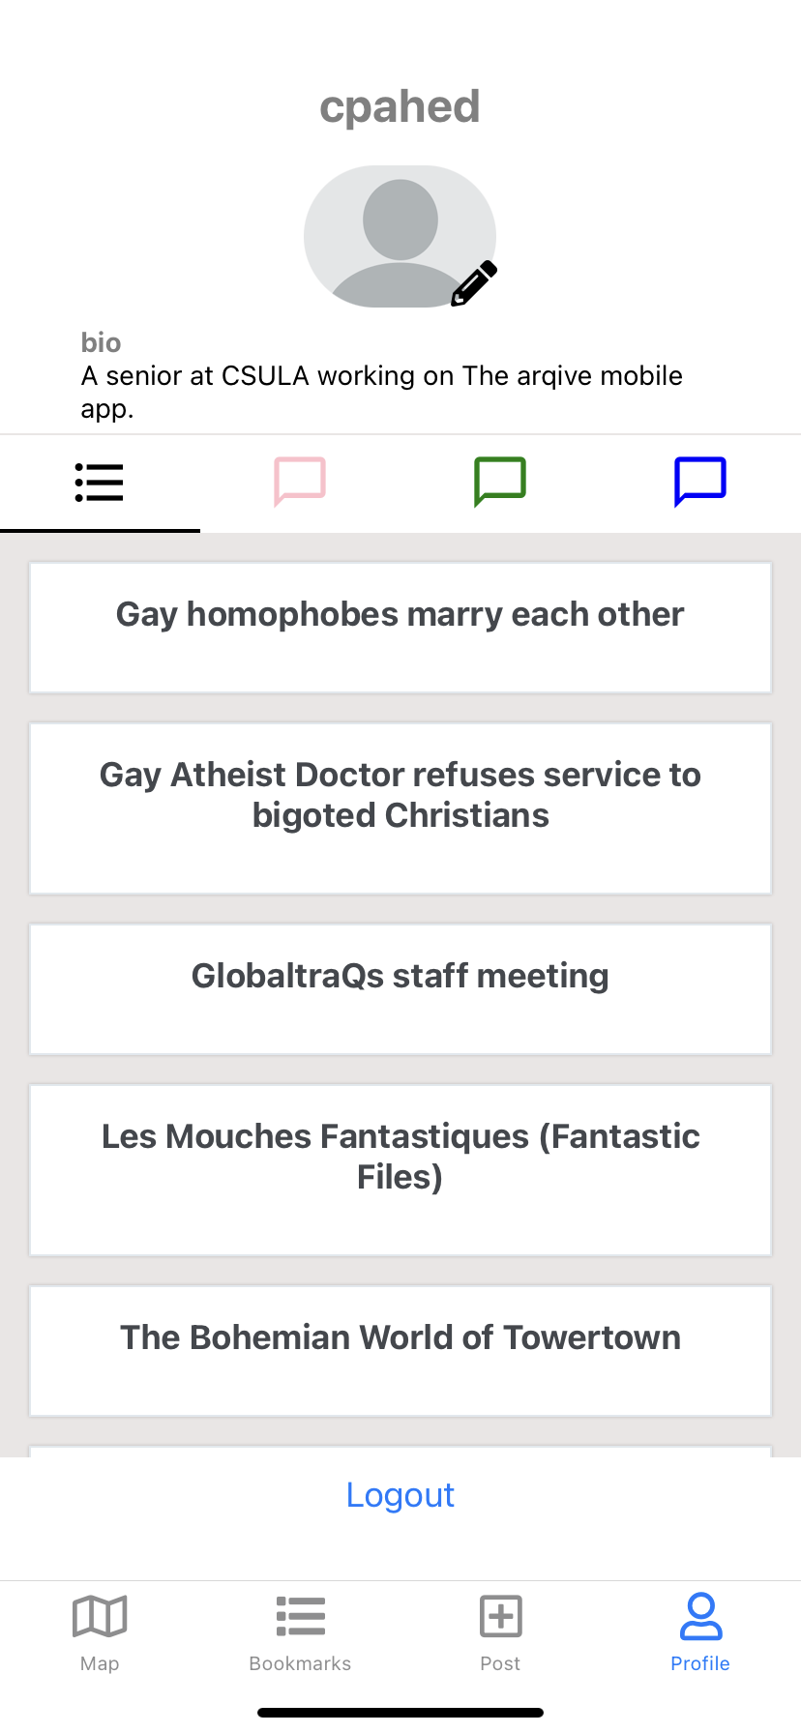
login function
Unregistered user is anonymous
Registered user is logged in
Notes:
Group of pictures on LEFT:
-Greet users with dark map
-Can only view stories
-Profile tab leads to login page
Group of pictures on RIGHT:
-Greet users with brighter map
-Can view all bookmarked stories and organize by category
-Logged in users can view their profile that displays all their posts which can be organized by category as well

Slide 16
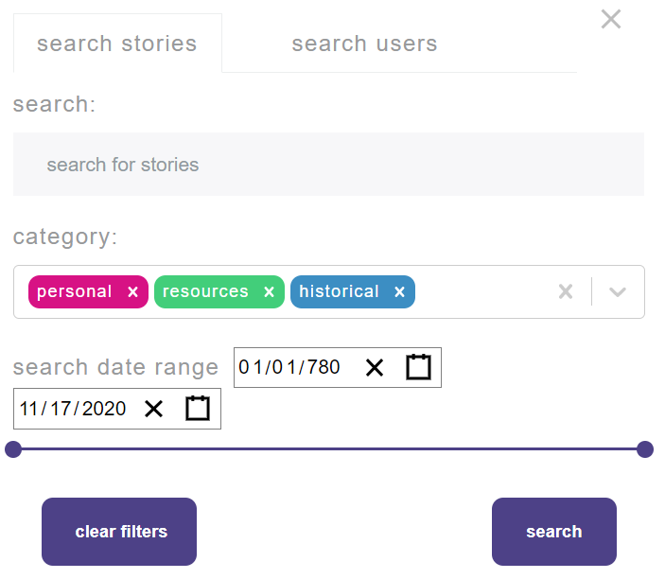


in progress
Search Function:
  Allow users to search stories by time frame and story type
  Story type categories include:
    Personal, Resources, Historical
Login Function:
  Allow unregistered users to create an account
  Logged in users being able to create posts anonymously
Current button sidebar filter component from the thearqive.com (top)
Option for logged in user to become anonymous (bottom)

Slide 17
content moderation
Anonymous forum where anyone can post. Spam, solicitation of drugs, unwanted sexual content, ect. must be filtered out.
Module will use Machine Learning to create an algorithm that can run automatically and can update itself over time.
Will flag suspicious posts to be reviewed manually by a site moderator

Slide 18
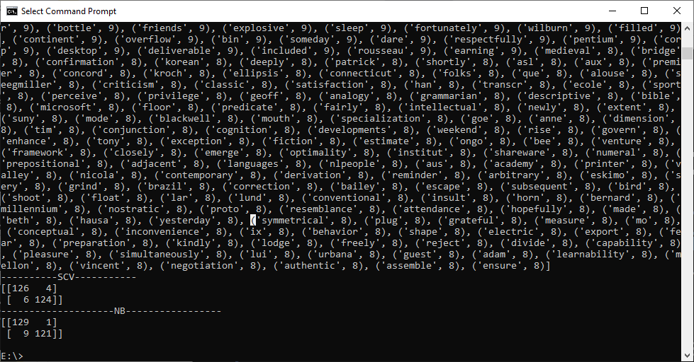
content moderation
Takes in test data from predetermined corpus to create a dictionary with word tally
Creates labels and feature vectors
Trains a Naive Bayesian Classifier to learn how to read input
Once it has a solid database to train itself, the algorithm can start working on real data.
Reward/Punishment system for correct and incorrect flags help keep the algorithm in check

Slide 19
project requirements - badges
Badge requirements
Receive badges for completing user milestones
Receive badges when the community reaches milestones
Display badges on user profile

Slide 20
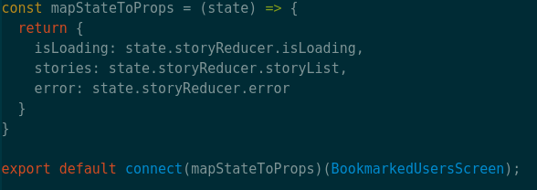

project requirements - redux
Redux requirements:
Makes it so that data is stored in a central store
Any screen or component that needs data can access it
Reduces code duplication
Notes:
Redux works by acting as a central store for any data that the application might need. For example in one screen of our application we might need our profile information, so we tell Redux to go fetch it, and when it is done to give it to that screen. Down the line we might need that information in another screen and since it's already stored we can choose to refresh it or use what we already have. One thing it helps reduce is code duplication, you don’t have to rewrite HTTP requests, the error handling, and then make sure that the code is up to date. You just modify it in one place and it works everywhere.

Slide 21
project requirements - security
Information might be maliciously used to target users
Political climates around the world could endanger our users’ safety if certain information leaked
Disabled password login to the server. Using SSH authentication keys with a passphrase.
a password only known to the user that is hashed and then column encrypted on the database server
Notes:
Randy - Security is important, especially for a website catering to a vulnerable group. We need to make sure information is secure, as it could potentially be used to harm our LGBTQ+ users, especially in countries where their identities are illegal and could potentially get them killed. For this reason we decided use SSH authentication keys for admins and devs, and encrypted passwords for all normal users on the ArQive website. And we will do our best to implement more security features in the future for the sake of our vulnerable users.

Slide 22
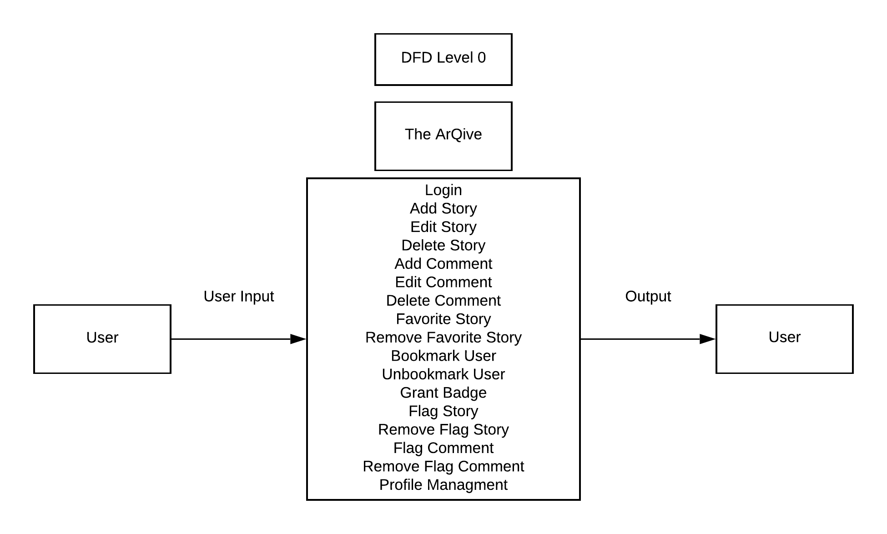
data-flow diagram
Notes:
Randy - This is a data flow diagram showcasing the data flowing to and from users in the ArQive app. It includes basic functions, like adding, editing, and deleting what you’ve written, as well as the ability to save and rate stories written into the app, and basic flagging options in case of inflammatory content. We hope to achieve the basic level of functionality and more to ensure a simple and welcoming experience for LGBT users.

Slide 23
project challenges

Slide 24
project challenges
Working WebAPI
Amazing website
Fully featured
Limited Documentation
  API Keys
  Information on how to set up environment
  API endpoint documentation
A few bugs
Little technical communication with the previous team
Coordinating with last year’s team to solve some issues with website deployment
Notes:
DO NOT CRITICIZE, that is not best practices. It was a hard technical knowledge on how to set up environment bc of differences in versions

Slide 25
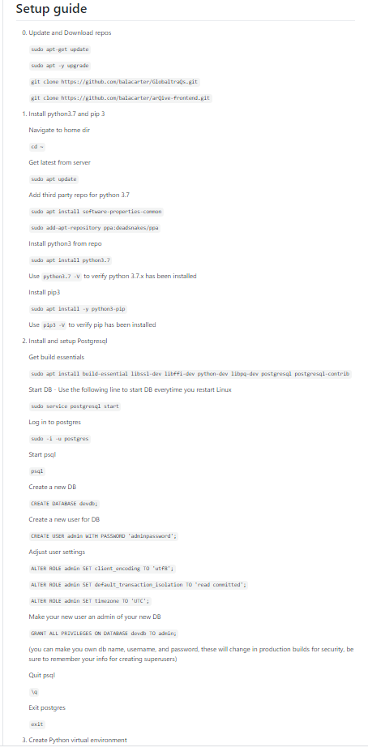
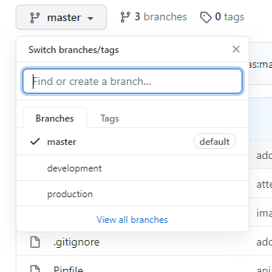
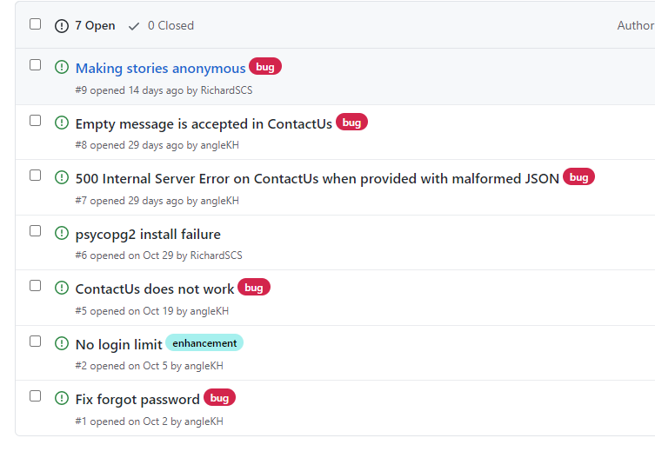
project challenges - development
Problems
  Complex development environment setup
  Outdated projects in provided repos
  Bug fixes needed
Solutions
  Created new step set up guide
  Implemented new deployment pipeline
    Revised version control procedure
    Redundancy checks
  Made use of GitHub issue tracking
    Students can report bugs
    Student can collaborate and fix

Slide 26
future goals
Winter Break:
Finish implementing current website features
Document code
Spring Semester:
Implement design teams style guidelines
Implement Badge feature
Roll out on app store
Create environment setup guides
Content filtering
Security
Notes:
Create slides about content filtering and security, one each, in about the req section. You’ll find that as you rehearse you get more confident and find more things to talk about. Polish and rehearse

Slide 27
demonstration

Slide 28
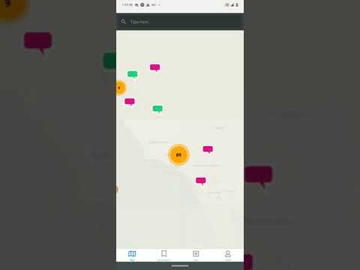
Notes:
https://www.youtube.com/watch?v=BePB0wnOteM

