Slide 1
Using VALUE Rubrics to Assess Almost Any Program Outcome
Let’s Get it Started!

Slide 2
Workshop Outcomes
As a result of this workshop you will be able to:
  Describe how VALUE rubrics can be used for program assessment
  Create a signature or key assignment that is aligned with program learning outcomes
  Collect student work from multiple course sections and/or instructors
  Use results to help students improve their skills and content knowledge

Slide 3
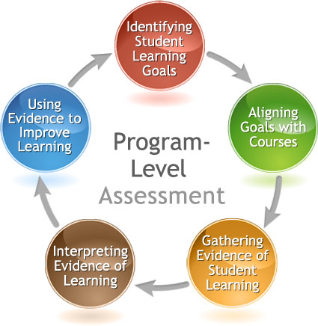
The Assessment Cycle
Today!

Slide 4
What Are value rubrics?
AAC&U (Association of American Colleges and Universities)’s VALUE (Valid Assessment of Learning in Undergraduate Education) project
A component of the LEAP (Liberal Education and America’s Promise) initiative
Goals:
  Develop shared understanding of student learning outcomes
  Promote authentic assessment of student work (vs. standardized tests)
Teams of faculty and academic affairs professionals synthesized rubrics into 15 areas of learning.

Slide 5
AAC&U’s 15 VALUE rubrics
  Intellectual and Practical Skills:
    Inquiry and analysis
    Critical thinking
    Creative thinking
    Written communication
    Oral communication
    Quantitative literacy
    Information literacy
    Teamwork
    Problem solving
  Personal and Social Responsibility:
    Civic knowledge and engagement—local and global
    Intercultural knowledge and competence
    Ethical reasoning and action
    Foundations and skills for lifelong learning
    Integrative and applied learning

Slide 6
Possible Uses of VALUE rubrics
Course evaluation
  Models for rubrics faculty can use to score of class assignments
  Student reflection
Program evaluation
  Help specify department learning outcomes
  Models for rubrics for program-level evaluation projects

Slide 7
Level of Performance Descriptors
Capstone- culminating level of achievement expected for baccalaureate degree
Milestones- progressively more sophisticated performance
Not intended for 1 = freshmen, 2 = sophomore, or 4 = A, 3 = B, etc.

Slide 8
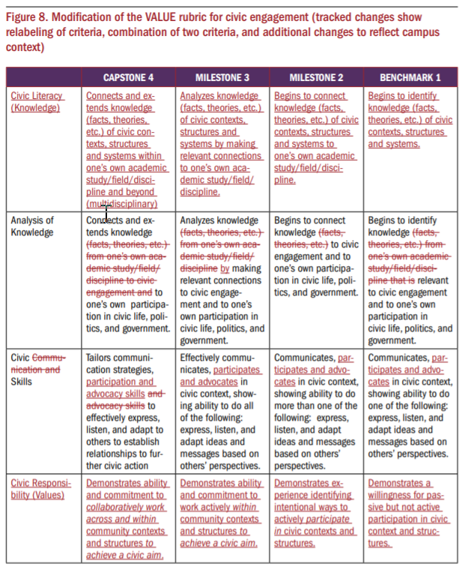
Modifying Value Rubrics
Meant to be modified!
Add more specific criteria based on your program or assignment
Add new dimensions to reflect issues important to your program

Slide 9
Salt Lake Community College
Require instructors to use of signature assignments to assess their general education outcomes, but allow faculty freedom in creating the assignments. A few general requirements for the assignments:
  address at least two learning outcomes
  include student reflection
  demonstrate a real world, not theoretical, application of disciplinary knowledge
A mathematics instructor created a signature assignment where students acted as potential car buyers and calculated how different interest rates affect the amount of money spent.
  Learning outcomes- quantitative literacy and written communication
  Students reflect on how this activity can be applied in other classes or real world scenarios.

Slide 10
Oral Communication Scores:
Psychology (n = 23)
Proficiency Score | Organization | Language | Delivery | Supporting Material | Central Message
3.75-4.0 | 0 (0%) | 3 (13%) | 1 (4%) | 2 (9%) | 1 (4%)
3.0-3.5 | 15 (65%) | 14 (61%) | 10 (44%) | 15 (65%) | 18 (78%)
2.0-2.75 | 8 (35%) | 6 (26%) | 9 (39%) | 6 (26%) | 4 (17%)
1.0-1.75 | 0 (0%) | 0 (0%) | 3 (13%) | 0 (0%) | 0 (0%)
Note. Scoring was as follows: 1 = Benchmark (Does not Meet Competency), 2 = Milestone (Minimal Competency), 3 = Milestone (Meets Competency), 4 = Capstone (Exceeds Competency).
What trends do you notice?
What questions are left unanswered?
How could we collect more useful data?

Slide 11
Activity #1: Choosing an Outcome
How do these align with your Program Learning Outcomes? Which learning outcomes are emphasized by your program?
What are your strengths and weaknesses?
Which seems like a priority for assessment?

Slide 12
Where is the Outcome taught in your curriculum?
 | 1500 | 2000 | 3020 | 3040 | 3080 | 3100 | 3220 | 3230 | 4110 | 4120 | 4250 | 4650
PLO1 | I |  | D |  | D | D |  |  | D | D | M | M
PLO2 |  | I | D |  |  |  |  |  | D |  |  | M
PLO3 |  | I |  |  | D |  |  | D
PLO4 | I | D |  | D | D | D | D | D |  | D | M | M
PLO5 |  | I |  | D | D |  |  |  |  |  |  | M
PLO6 |  | I |  | D
PLO7 | I |  | D |  |  | D |  |  | M
I = Introduced; D = Developed/Reinforced; M = Mastered

Slide 13
What is a Signature assignment?
Embedded in a course
Used for course grade and program assessment
Aligned with Program Learning Outcomes
Collaboratively designed by faculty
Meaningful and integrative
Why?
  Allows a program to assess learning across course sections or instructors
  Creates consistency
  Useful for assessing course sections with different modalities/pedagogies

Slide 14
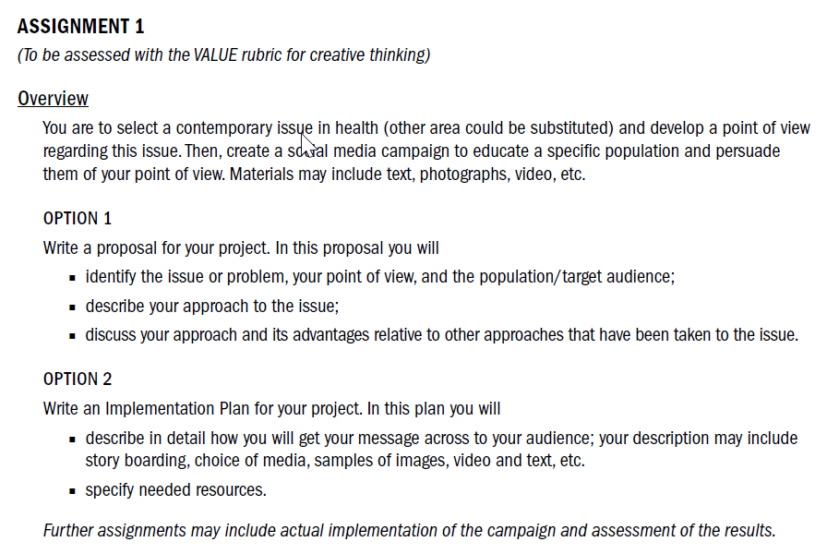

Slide 15
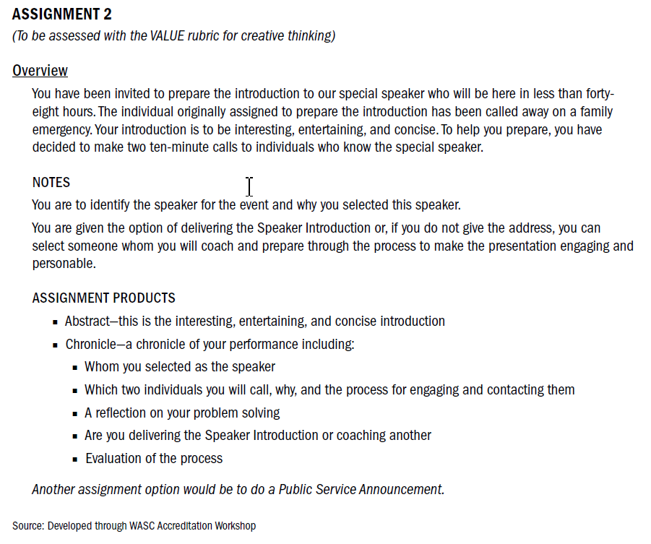

Slide 16
Assignment 3 (to be assessed with the VALUE rubrics Written Communication and Intercultural Understanding)
Instructions:
  Please take approximately 1– 2 hours to complete this assignment. The essay topic is designed to give you an opportunity to demonstrate your ability to write clearly and effectively. It will also allow you to display your knowledge of psychological diversity. Perfection is not expected, but you should try to produce the best essay possible in the time allotted. Your essay should be about 2 pages in length (4-5 paragraphs). Type this assignment and then upload the digital file to the course Moodle site.
  You do not have to cite sources in this essay, but please include specific terms and concepts from your psychology classes.
Prompt:
  Think about a group of people who are very different from you. These could be individuals from a different culture or perhaps members of a social group that hold views you disagree with.
  Briefly describe the group’s characteristics and how individuals in this group are different from you. Then, describe 1-3 concepts that you’ve learned from this class (or other psychology classes you’ve taken) that could be used to change or improve the way you interact with members of this group

Slide 17
Activity #2: Signature Assignment
What courses would use this assignment?
Describe instructions to students, providing explicit guidelines on:
  Learning outcomes and goals
  How to complete the assignment
  Length and time required
  Sources needed
  Evaluation criteria

Slide 18
Gather and Evaluate
Student Assignments
Student Assignments
Student Assignments
Student Assignments
Student Assignments
Student Assignments
Student Assignments
Student Assignments
Student Assignments
Student Assignments
Student Assignments
Student Assignments
Student Assignments
Student Assignments
Student Assignments
Grade to students
Grade to students
Grade to students
Course #1 Instructor
Course #2 Instructor
Course #3 Instructor
Team of Faculty Score Assignments
Course Instructor(s)
Score Assignments
or
Assessment Coordinator or Committee Compile Results
Program Faculty Reflect on Results

Slide 19
Scoring assignments: Rubric Calibration
Hold a calibration session with all instructors or faculty scorers.
Begin with a close reading of the rubric and identify areas of discussion.
Faculty should come to an agreement on interpretation of language in rubric.
Faculty are given an example of student work to score.
Discuss scores row by row. Faculty provide rationale for their scores and try to reach consensus.
Goal is to identify two scores around with the majority cluster.
Repeat with more examples of student work (high, low, medium)

Slide 20
Activity #3: Assessment Plan
  What assignment or activity will you use?
  How will you score student achievement?
  What classes would you target for sampling and when?
  Which faculty will be responsible for coordinating data collection? Data analysis?
  How will you analyze the results? Will you disaggregate results in some way?
  How will results be shared, discussed, and used to make changes?
  When will the PLO be assessed again?

Slide 21
Dos and Don’ts of Data Collection and Analysis
DO
DON’T
Form a department assessment committee charged with regularly collecting and disseminating data
Ask for faculty volunteers
Give faculty early notice regarding assessment plans
Disaggregate results across time, populations, and outcomes
Protect the confidentiality and anonymity of students and faculty by examining results at the group level
Use results to inform changes
Wait until the last minute
Pressure faculty to comply with assessment activities
Use assessment results to call attention to, judge, or punish individual faculty or students
Expect perfection
Collect more data than you can use

Slide 22
Using Results to Create A Culture of Evidence
Use results:
  To examine skill development across the curriculum
  To examine curriculum content coverage and areas for program modification
  To improve instruction and introduce new pedagogies
    Contact CETL for resources and support
  To improve and refine your assessment process/methods

Slide 23
Next Steps
What have you learned today that you want to share with others in your department?
Write down 1-3 you can do this semester to keep your assessment momentum going?

Slide 24
Resources and credits
“Using the VALUE Rubrics for Improvement of Learning and Authentic Assessment” by Rhodes & Finley (2013) Association of American Colleges and Universities
“Using Signature Assignments for Program-Level Assessment” Presentation Slides by University of Hawaii, Manoa
University of Texas signature assignments webpage:
  https://ugs.utexas.edu/sig/plan/samples/writing-model4

