Slide 1


Slide 2

Zero Waste Program

Slide 3

…Zero What?
Zero Waste aims to minimize the amount of materials sent to our landfills
by capturing valuable resources that can be recycled or composted.
According to the Zero Waste International Alliance:
“Zero Waste is a goal that is ethical, economical, efficient and visionary, to guide people in changing their lifestyles and practices to emulate sustainable natural cycles, where all discarded materials are designed to become resources for others to use. Zero Waste means designing and managing products and processes to systematically avoid and eliminate the volume and toxicity of waste and materials, conserve and recover all resources, and not burn or bury them. Implementing Zero Waste will eliminate all discharges to land, water or air that are a threat to planetary, human, animal or plant health.”

Slide 4
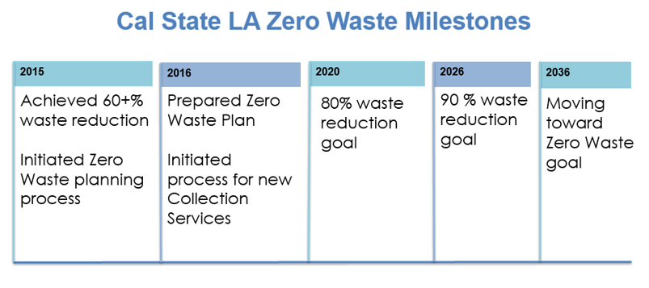

Slide 5
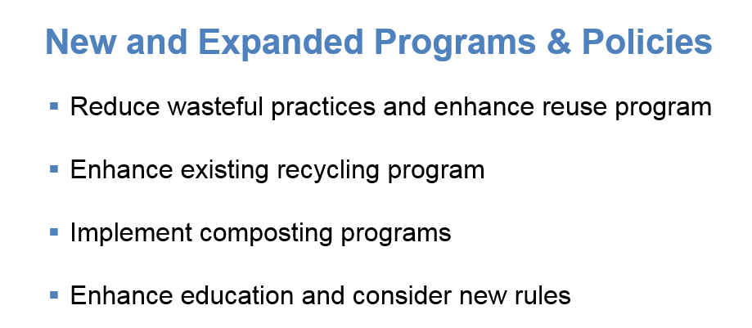

Slide 6
…but Why?
CSU Sustainability Policy:
Mandates 80% diversion by 2020 and “move toward Zero Waste”
State Law:
AB341, AB 1826 and SB 1383 require recycling and organic waste disposal
Second Nature Climate Commitment:
Reducing landfill emissions moves us closer to 2045 climate neutrality goal
Educational Mission:
Opportunity to engage our campus community in sustainability

Slide 7
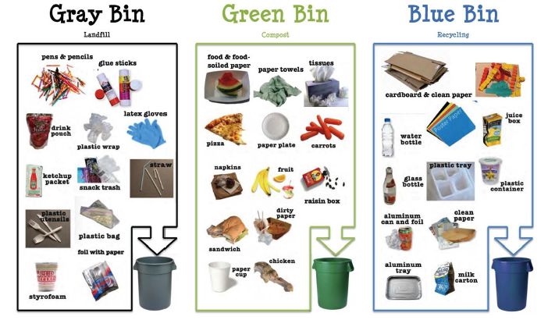

Slide 8

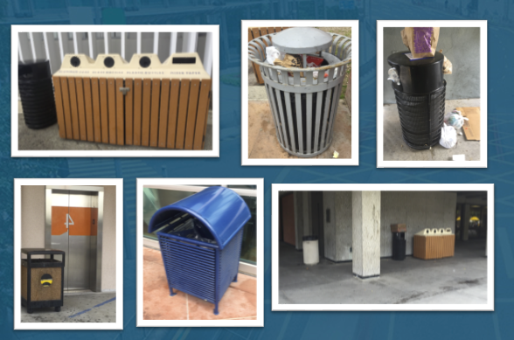

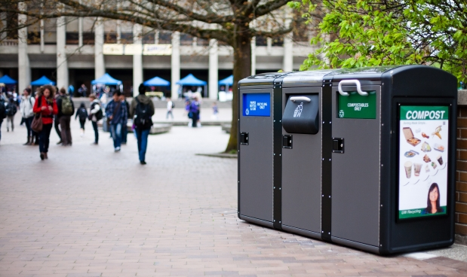
Repurpose Current Bins: Remove old stations and pair black and grey bins together
Pilot Bigbelly Stations: Install 8 Double Stations around Golden Eagle and Student Union
Expand Bigbelly Roll-out:
Increase # of Double Stations
Add Triple Stations for compost

Slide 9
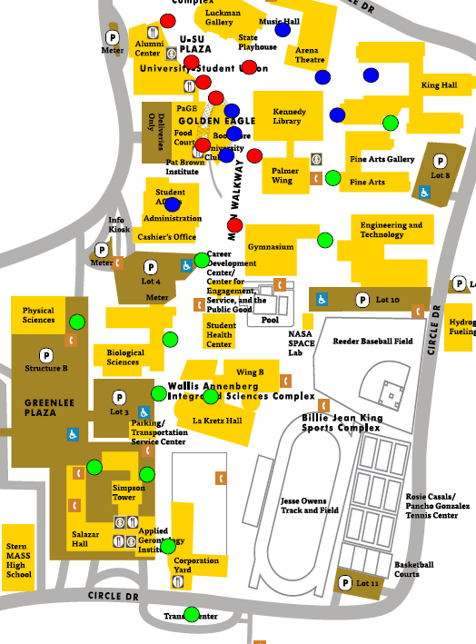
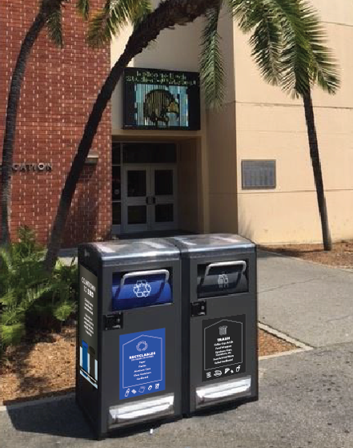


Slide 10
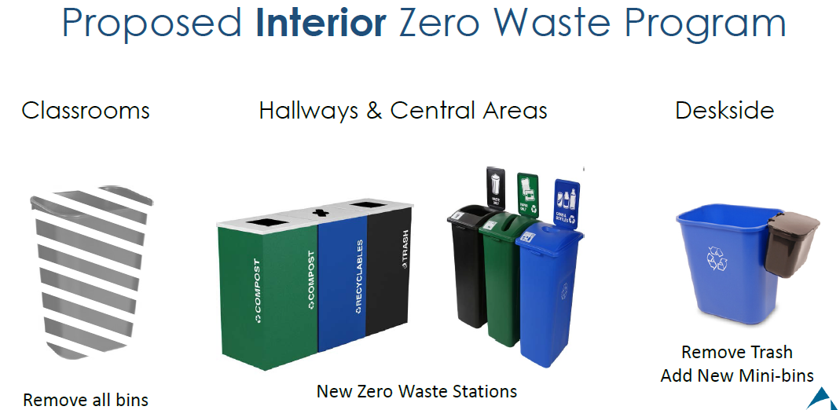

Slide 11
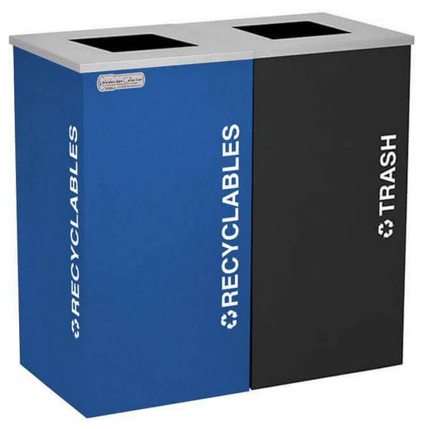
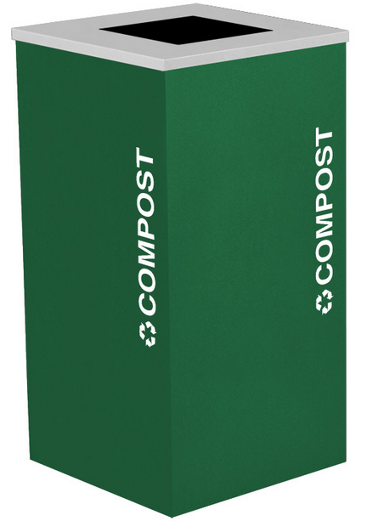
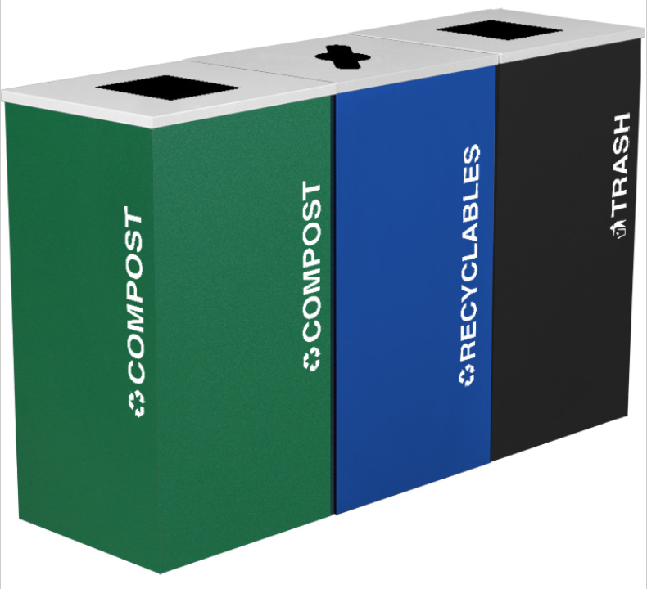
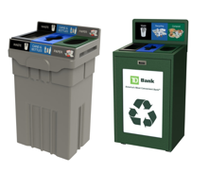
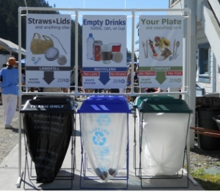
Some Next Steps…
Add compost bins
in interior spaces
Zero Waste Stations
in Common Areas/Breakrooms
Zero Waste Stations
for Special Events

Slide 12
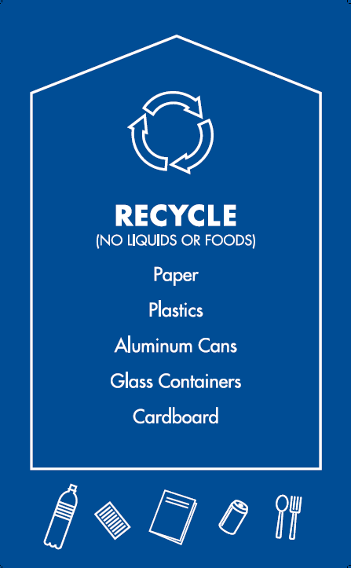
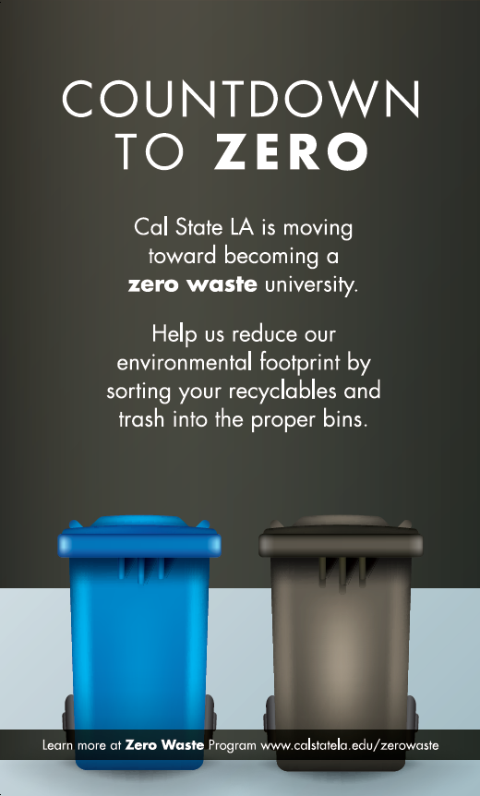
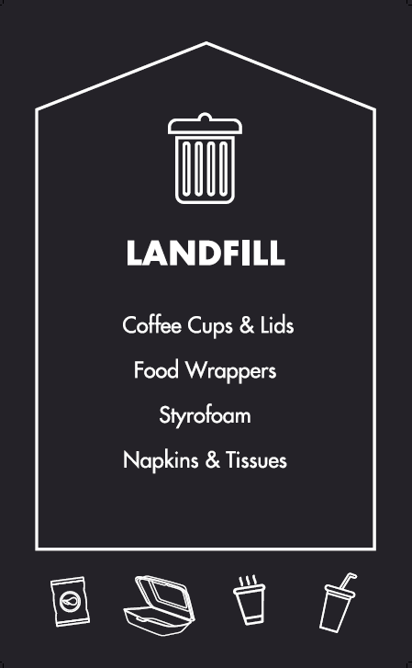

Slide 13
Brad Haydel
Energy & Sustainability Manager
Facilities, Planning, Design and Construction
California State University, Los Angeles
5151 State University Drive, Los Angeles, CA 90032
Phone
323.343.5782
Email
bhaydel@calstatela.edu
Web
calstatela.edu

