Slide 1


Cajalco Road
Concrete Gravity Dam
2021 Senior Design Presentation
Group 2
May 6th, 2021
Notes:
Speaker:

Slide 2
Outline
Project Introduction/Statement
Dam Design
Spillway
Outlet Works
Pipeline
Pumps
Water Tank
Roadway
Environmental, Sustainability, and Constructability
Cost Estimate
Summary
Notes:
Speaker: Jonathan

Slide 3
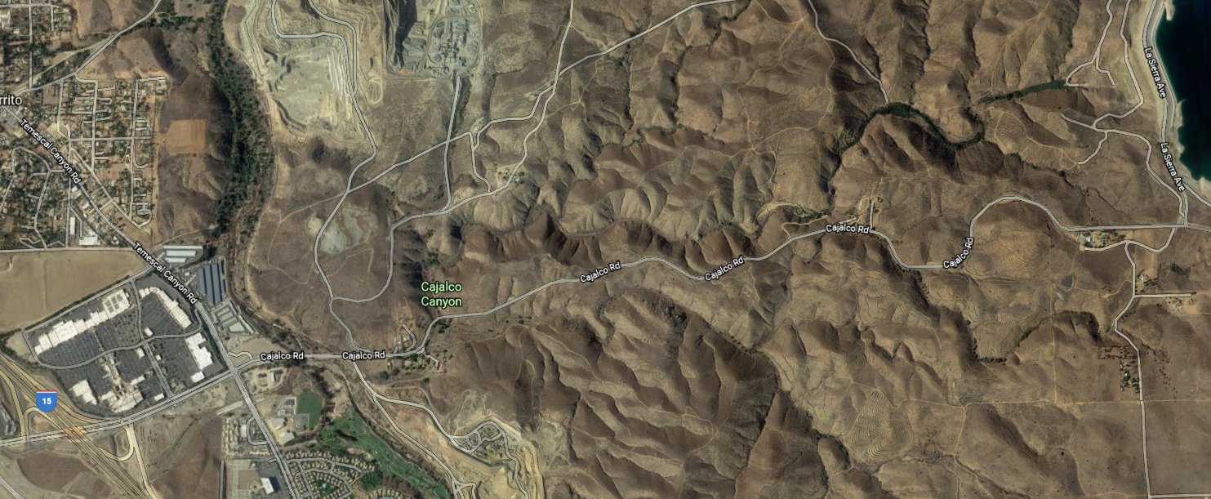
Introduction
Cajalco Creek, CA
Water
  Demand:
    1.8 million gallons/day
    54.75 million gallons/month
  Purchase from Metropolitan:
    0.984 million gallons/day
    29.92 million gallons/month
  Dam Capacity:
    157.67 million gallons
Type of Dam
  Concrete Gravity

Slide 4
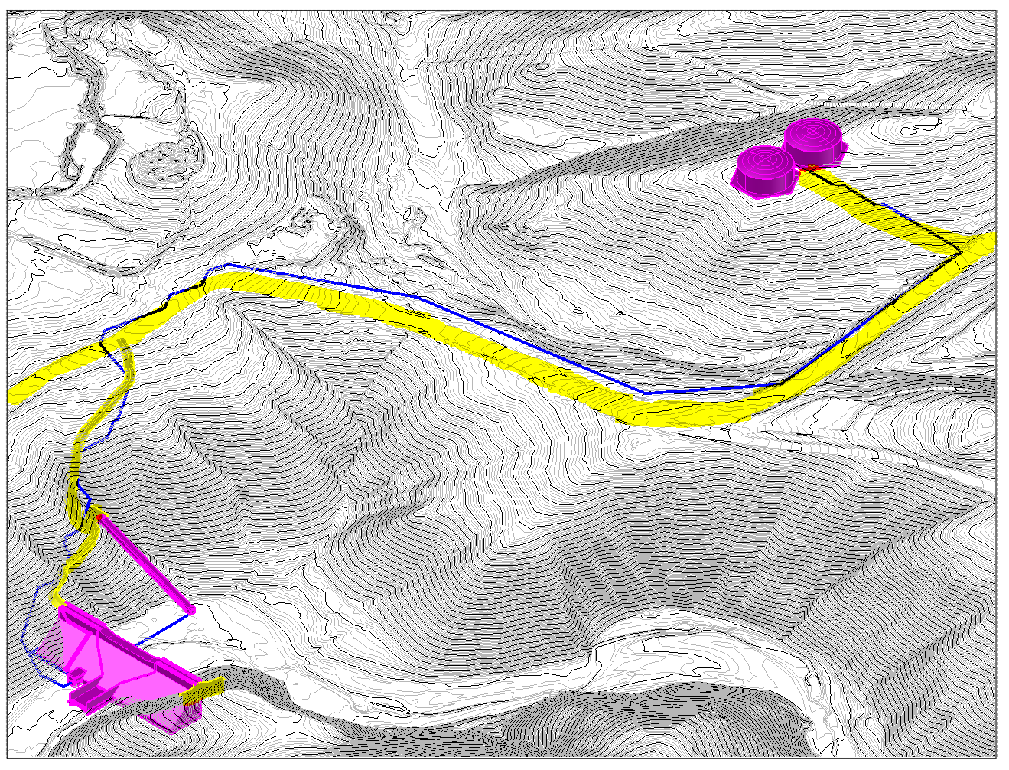
Project Statement
Water Tanks
N
Pipeline
Road 2
Eagle Canyon Road
Road 1
Inclined Intake Tower
Concrete Dam
Hammer Head Turn out

Slide 5
Outline
Project Introduction/Statement
Dam Design
Spillway
Outlet Works
Pipeline
Pumps
Water Tank
Roadway
Environmental, Sustainability, and Constructability
Cost Estimate
Summary
Notes:
Speaker: Jonathan

Slide 6
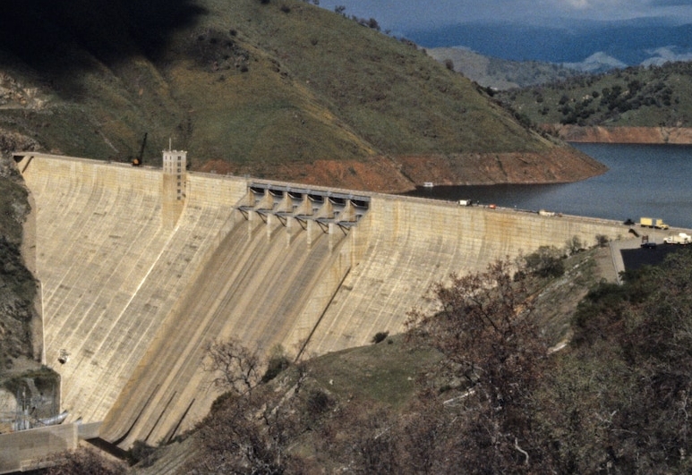
Dam Design: Concrete Gravity Dam
Characteristics:
Solid mass concrete
Self Weight used to resist forces
Integrated Spillway
Rock Foundation Recommended
Notes:
Pine Flat Dam (Fresno, CA) in image

Slide 7
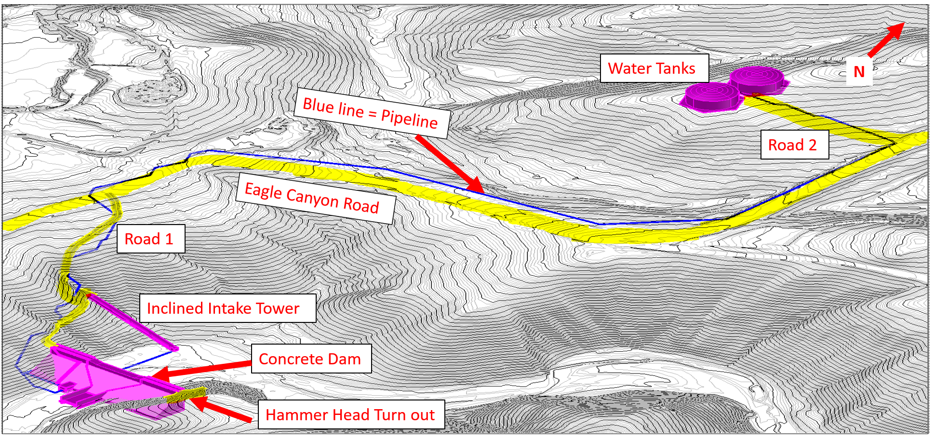
Dam Design: Location
N
Lake Mathews
Eagle Canyon Rd.
Site Location
15 Frwy
Cajalco Rd.
  Geotechnical Reports in project location:
    States top layer (10’) composed of Clay soil
    Bottom Layer composed of 90% Granite

Slide 8
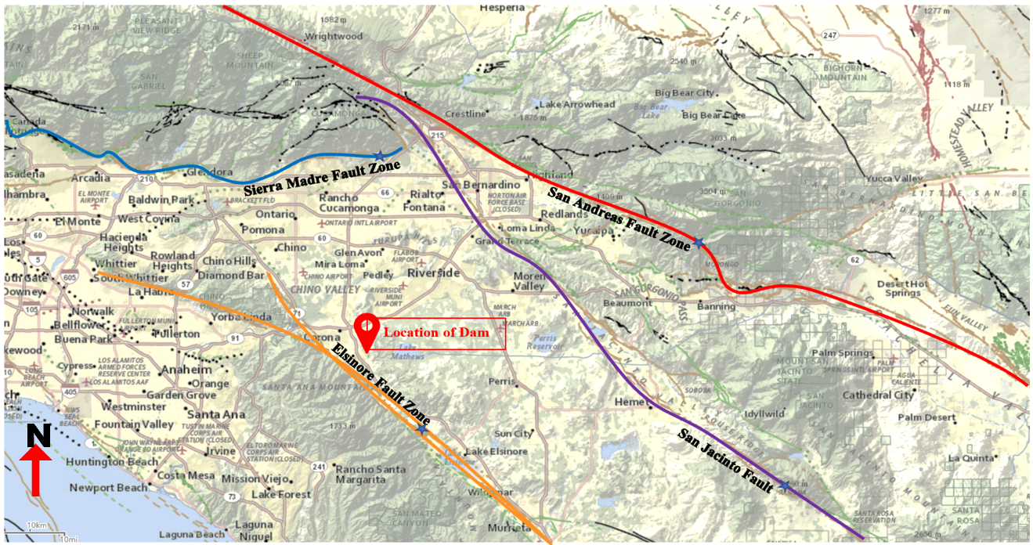
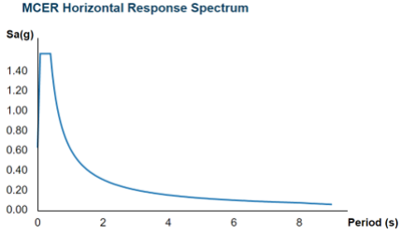
Dam Design: Seismicity
Seismic Analysis:
  Faults in Proximity:
    Elsinore
    San Andreas
    San Jacinto
    Sierra Madre
Peak Ground Acceleration:
  PGA (Horizontal) = 0.834 g
  PGA (Vertical) = 0.556 g

Slide 9
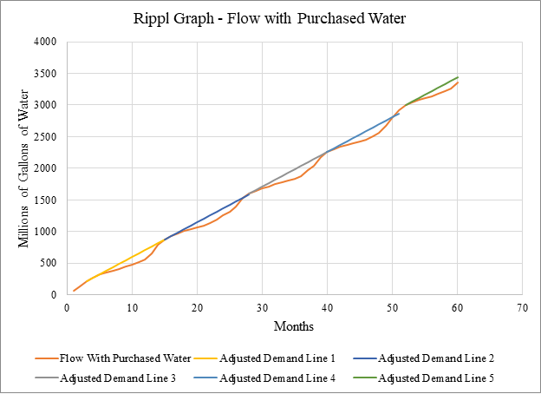
Dam Design: Water Capacity
Determination of Water Capacity
  (Ripple Method)
  483.84 acre-ft
  Water Level at 56 ft
157.7 Million
Gal. Difference

Slide 10
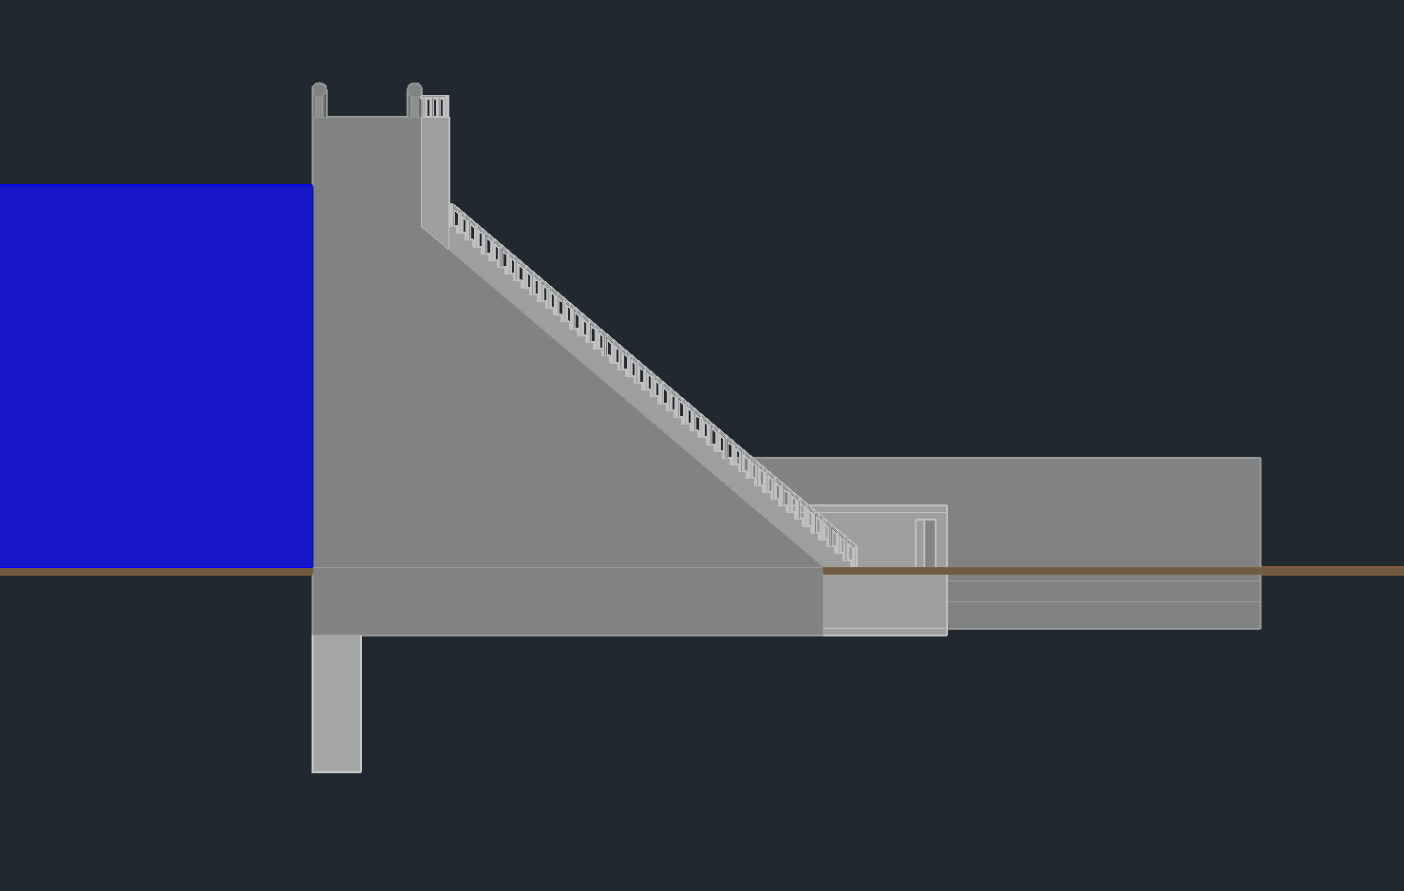
Dam Design: Dimensions
Concrete Gravity Dam:
Upstream
16’
Downstream
Water
Reservoir
Slope = 1:1
56’
10’
Shear Key

Slide 11
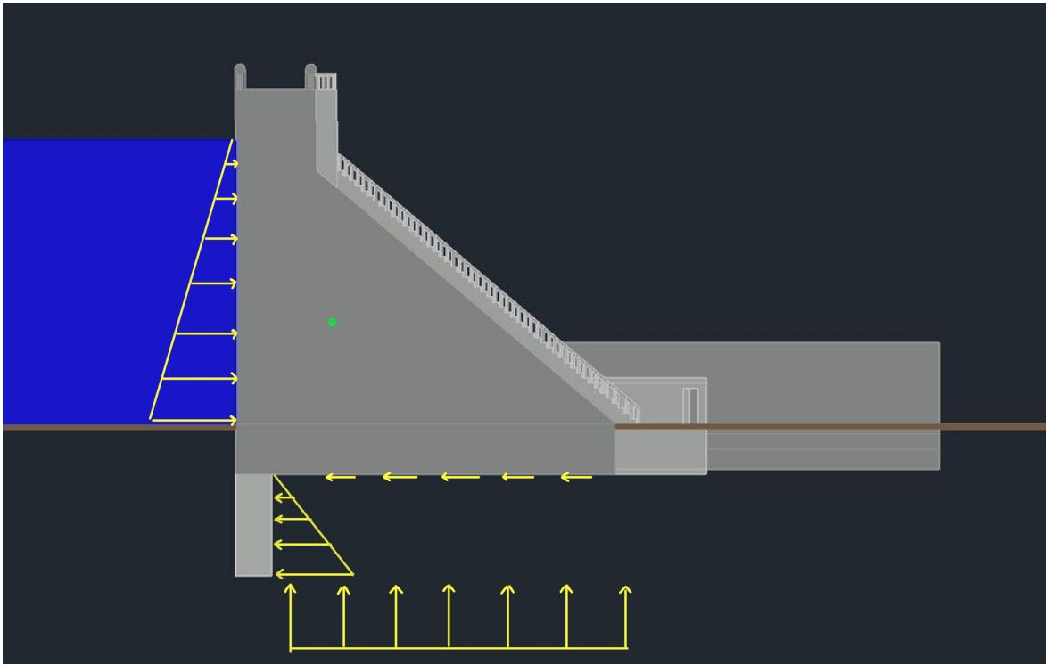
Dam Design: Structural Analysis
F_{weight}
Hydrostatic Pressure:
F_{hor., seismic}
F_{R,water}
F_{ver., seismic}
+
F_{friction}
Passive Pressure:
F_{R,pp}
F_{R,UL}
Uplift Pressure:
Notes:
Put labels inside picture, get rid of numbering

Slide 12
Dam Design: Structural Analysis
Sliding Check
Sliding Check w/ Seismic
F_{siesmic,hor.} = 316 kip/ft
F_{R,water}= 97kip/ft
F_{weight}
F_{weight}
+
F_{R,water}= 97kip/ft
+
F_{friction} = 172 kip/ft
F_{friction} = 172 kip/ft
F_{R,pp}=340 kip/ft
F_{R,pp}=340 kip/ft
Factor of Safety: 5.24 > Allowable FOS = 1.5
Factor of Safety : 1.51 > Allowable FOS = 1.1

Slide 13
Dam Design: Structural Analysis
Overturning Check
Overturning Check w/ Seismic
M_{hor., seismic} =
-8,605 k-ft
M_{weight} =
23,534 k-ft
M_{water} = -2,739 k-ft
+
M_{water} =
-2,739 k-ft
+
M_{weight} = 23,534 k-ft
M_{ver., seismic} =
-10,094 k-ft
M_{PP} = 6,810 k-ft
M_{PP} = 6,810 k-ft
M_{UL} = -7,722 k-ft
M_{UL} = -7,722 k-ft
Factor of Safety: 2.90 > Allowable FOS = 1.5
Factor of Safety: 1.11 > Allowable FOS = 1.1
Notes:
Add force values to images, split factor of safety, different cases

Slide 14
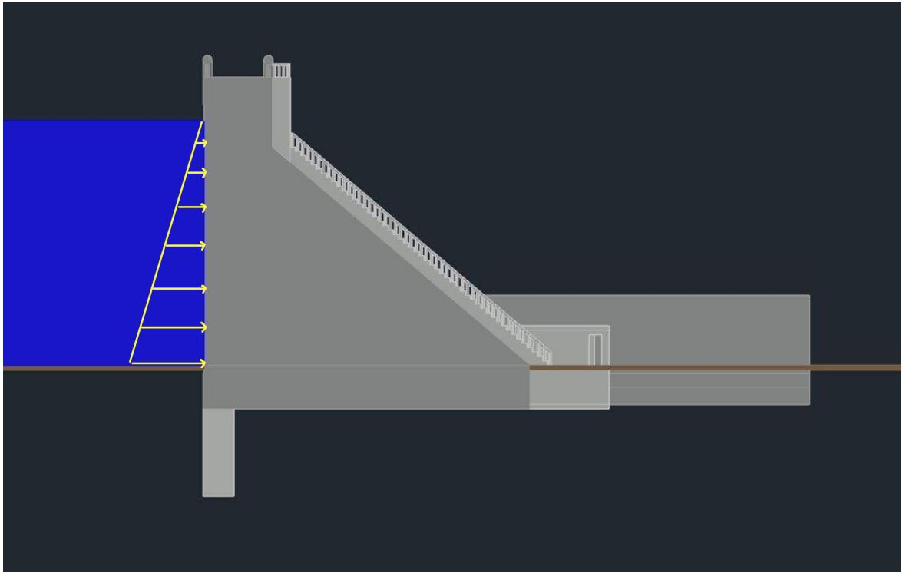
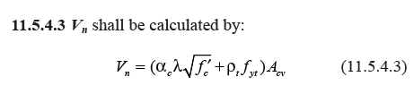
Dam Design: Structural Analysis
Shear Check:
ACI 318-14
Hydrostatic Pressure:
øVn (kip)
20,671
>
Vu (kip)
581
Notes:
Don’t go into the numbers just say concrete strength is adequate to resist shear loading

Slide 15

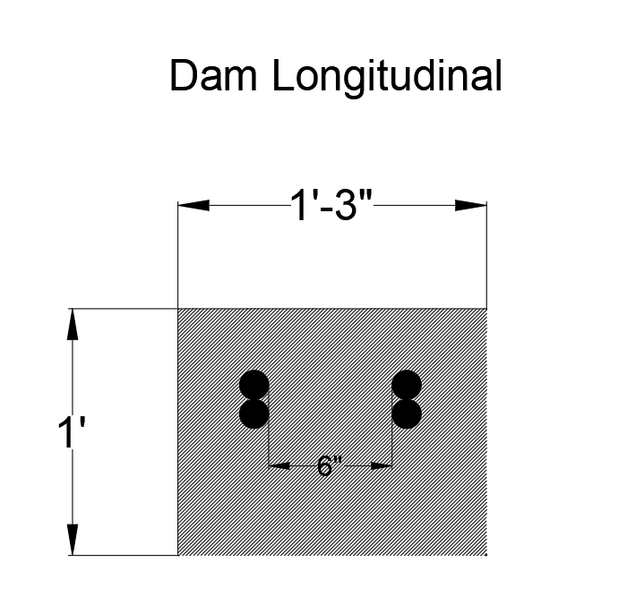
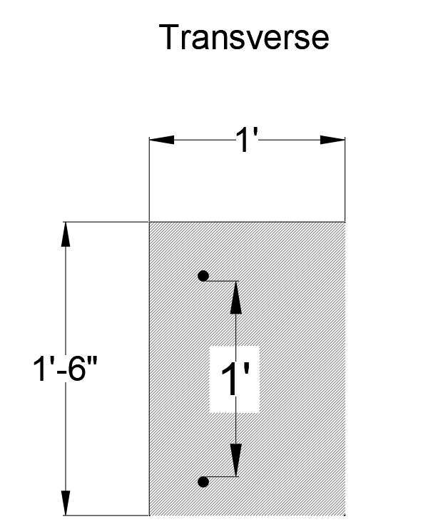
Shear Key Design
Longitudinal
Ultimate Moment: (Assume 1’ deep Cross Section)
Mu = 1.6(P*Y) = 3225.6 kip-ft
Shear Key Reinforcements:
Concrete Cover of 3” (ACI Table 20.6.1.3.1)
As = 5.82 in^2 (per foot)
(Bundle two bars per section)
Spacing = 6” OC
Transverse
F_{act. pressure}
Use:
2#11 bars @ 6” OC
Min Steel #5 bars @ 12” OC (Transverse Direction)

Slide 16
Outline
Project Introduction/Statement
Dam Design
Spillway
Outlet Works
Pipeline
Pumps
Water Tank
Roadway
Environmental, Sustainability, and Constructability
Cost Estimate
Summary
Omar Abdelhadi
Notes:
Speaker: Jonathan

Slide 17
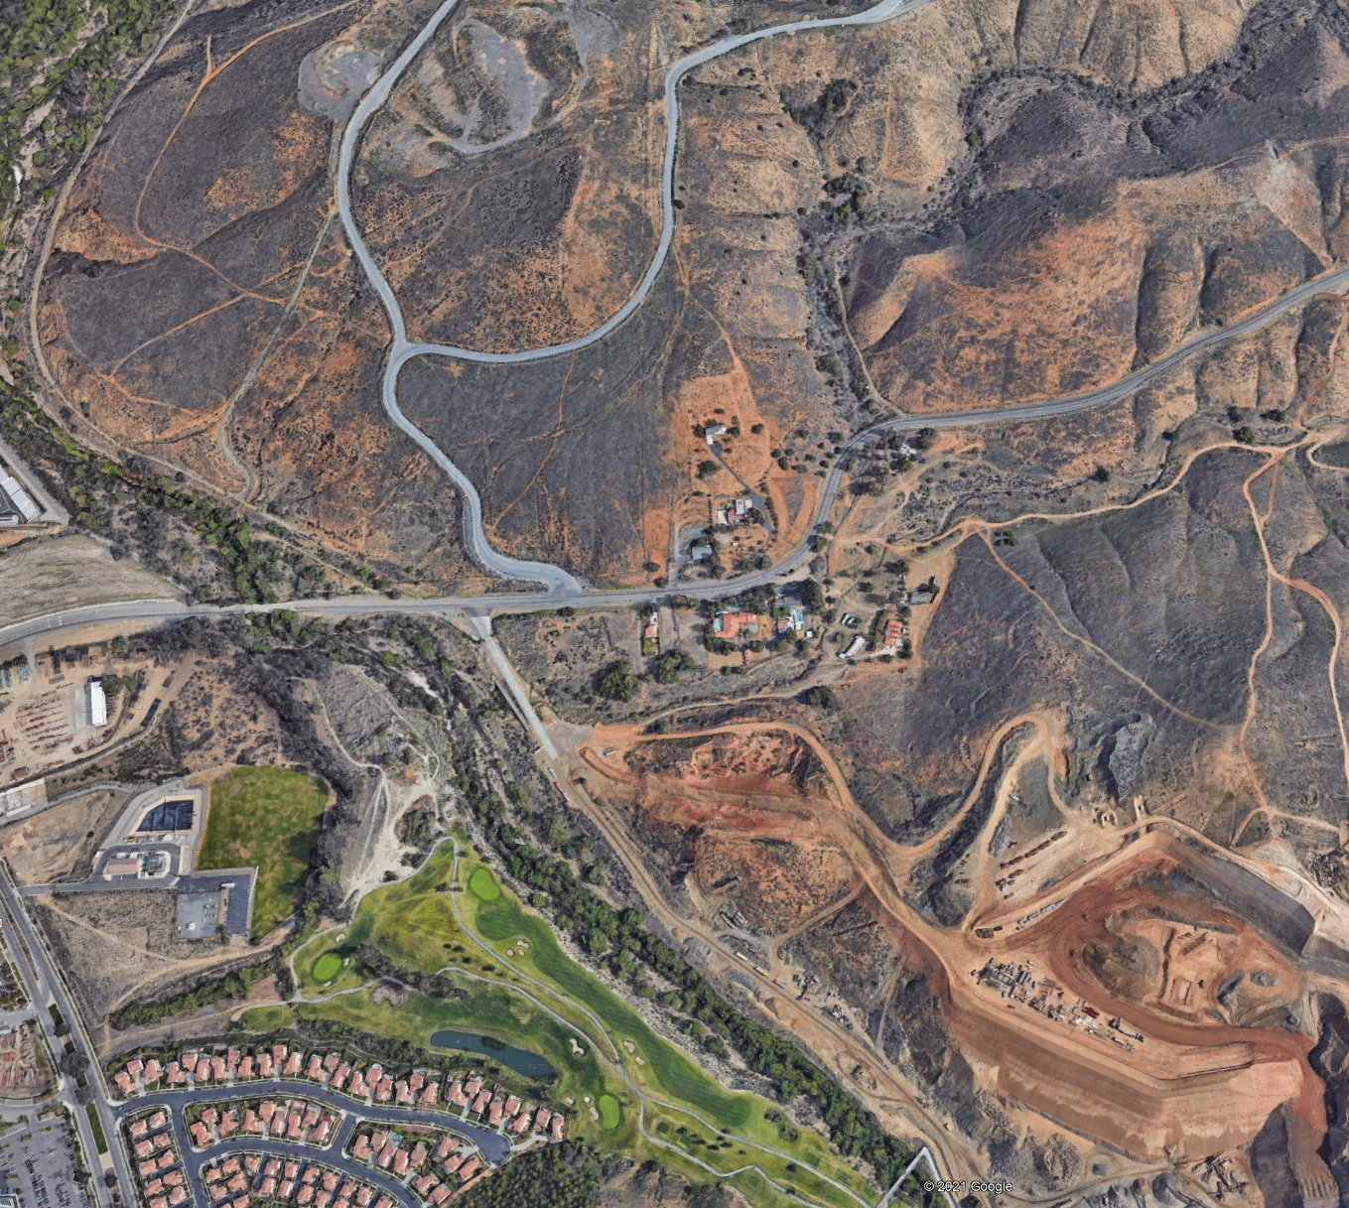
Spillway
Project
Site
Spillway allows controlled discharge of excess water from reservoir
Cajalco Creek is a tributary of Temescal Wash
Peak discharge in Cajalco Creek determined to be 3,070 cfs
Cajalco
Creek
Temescal
Wash
Omar Abdelhadi

Slide 18
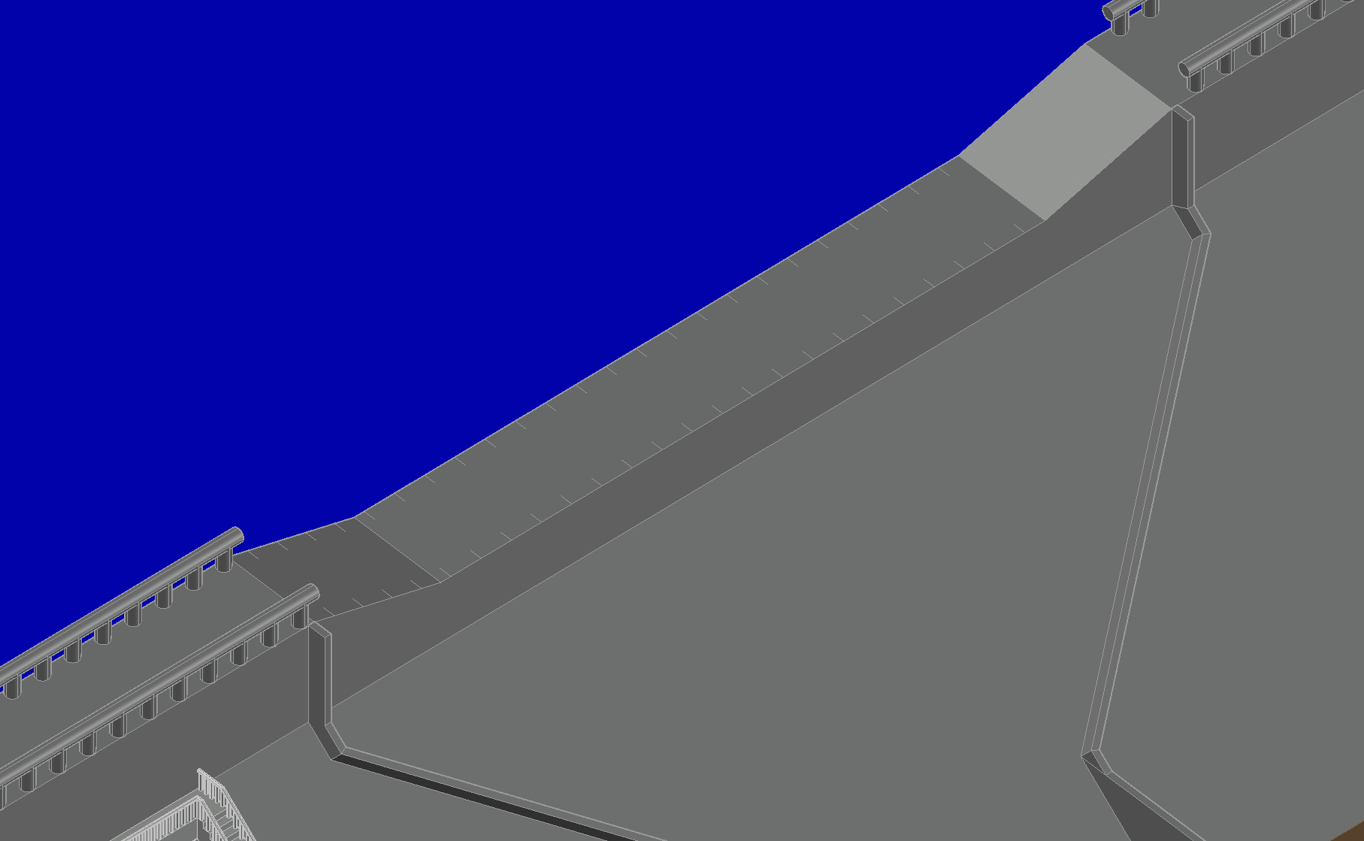

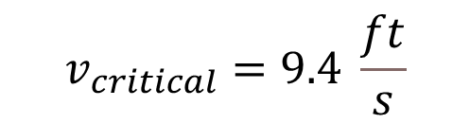
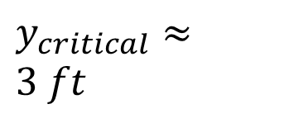
Spillway - Crest
$$v_{critical}=9.4 \frac{ft}{s}$$
$y_{critical}≈$ $3 ft$
Reservoir
$$Q=3,070 cfs$$
16°
Slope
Trapezoidal crest allows vehicles to traverse entire structure
Wider crest requires less hydraulic head to reach target flowrate
100 ft
Omar Abdelhadi

Slide 19
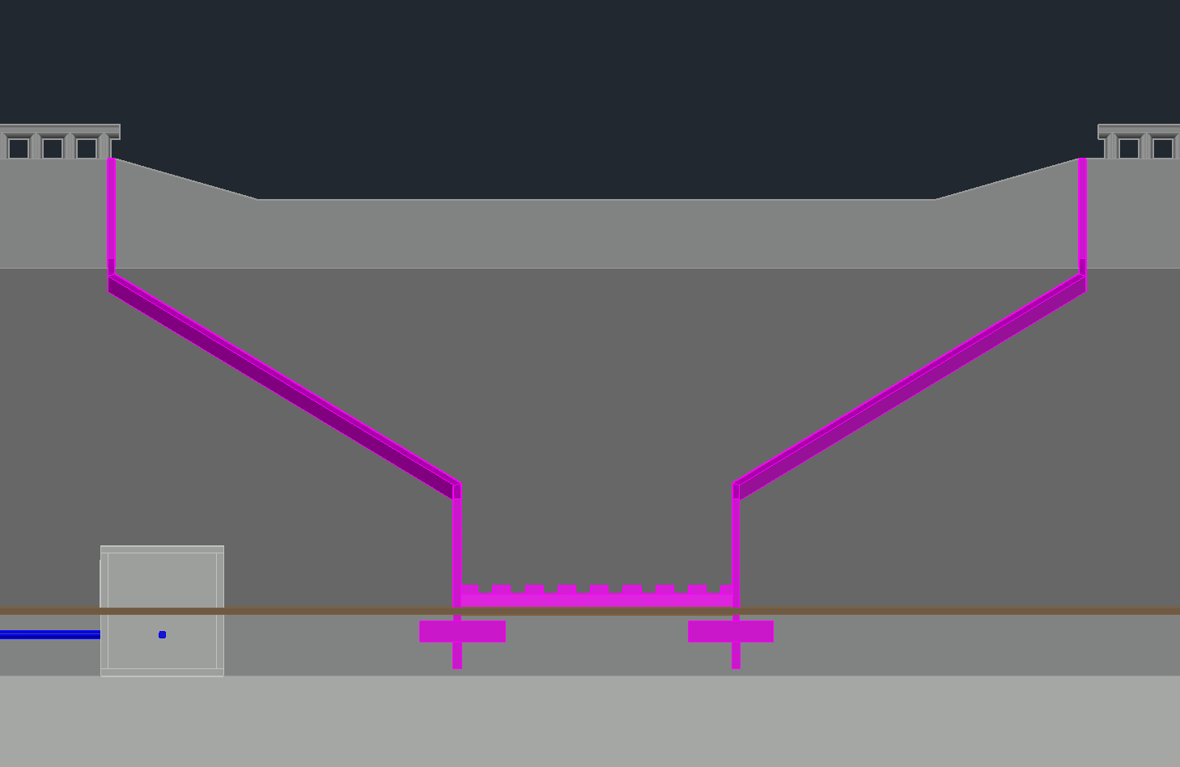


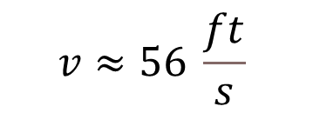
Spillway - Channel
At Narrowest Portion:
Upstream
$$v≈56 \frac{ft}{s}$$
$$h_{water}≈1.4 ft$$
$$Fr≈8.42$$
142 ft
Narrowing the channel reduces width of stilling basin and subsequently construction costs
height of the channel walls with freeboard of 3 feet.
40 ft
Downstream
Omar Abdelhadi

Slide 20
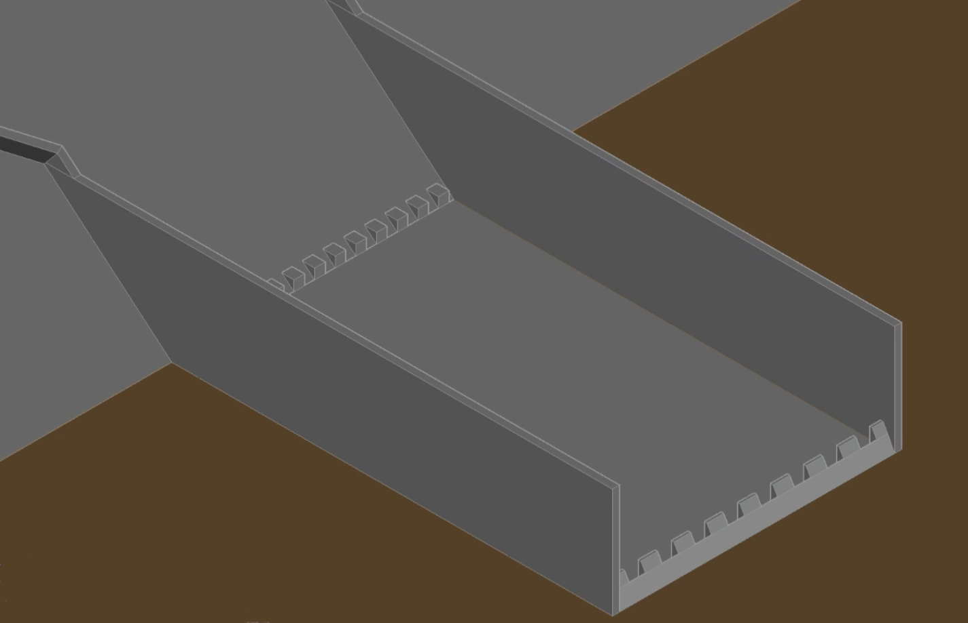


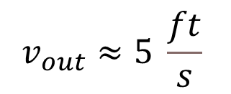
Spillway – Stilling Basin
$$v_{out}≈5 \frac{ft}{s}$$
$$h_{water}≈15 ft$$
$$Fr≈0.22$$
Hydraulic jump dissipates 68% of incoming water’s energy
Based on USBR Type II Stilling Basin
Streambed
Omar Abdelhadi

Slide 21
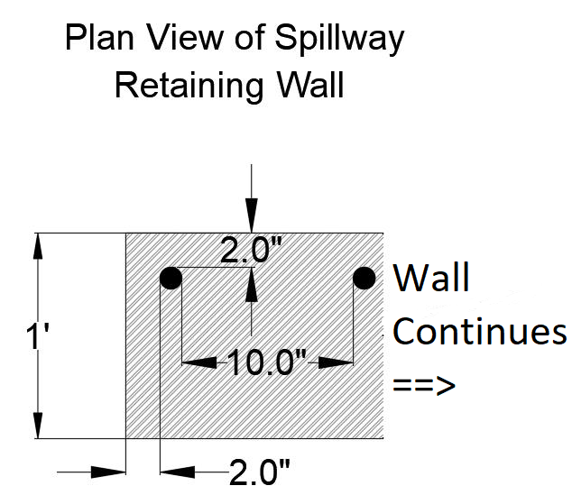
Spillway – Structural Design
High water height causes large moment in spillway walls
Flexural reinforcement needed to achieve moment capacity
#10 bar
Mu = 63.1 Kip-ft
Vu = 10.5 Kip
#10 bars @ 10” on Center
Omar Abdelhadi

Slide 22
Outline
Project Introduction/Statement
Dam Design
Spillway
Outlet Works
Pipeline
Pumps
Water Tank
Roadway
Environmental, Sustainability, and Constructability
Cost Estimate
Summary
Notes:
Speaker: Jonathan

Slide 23
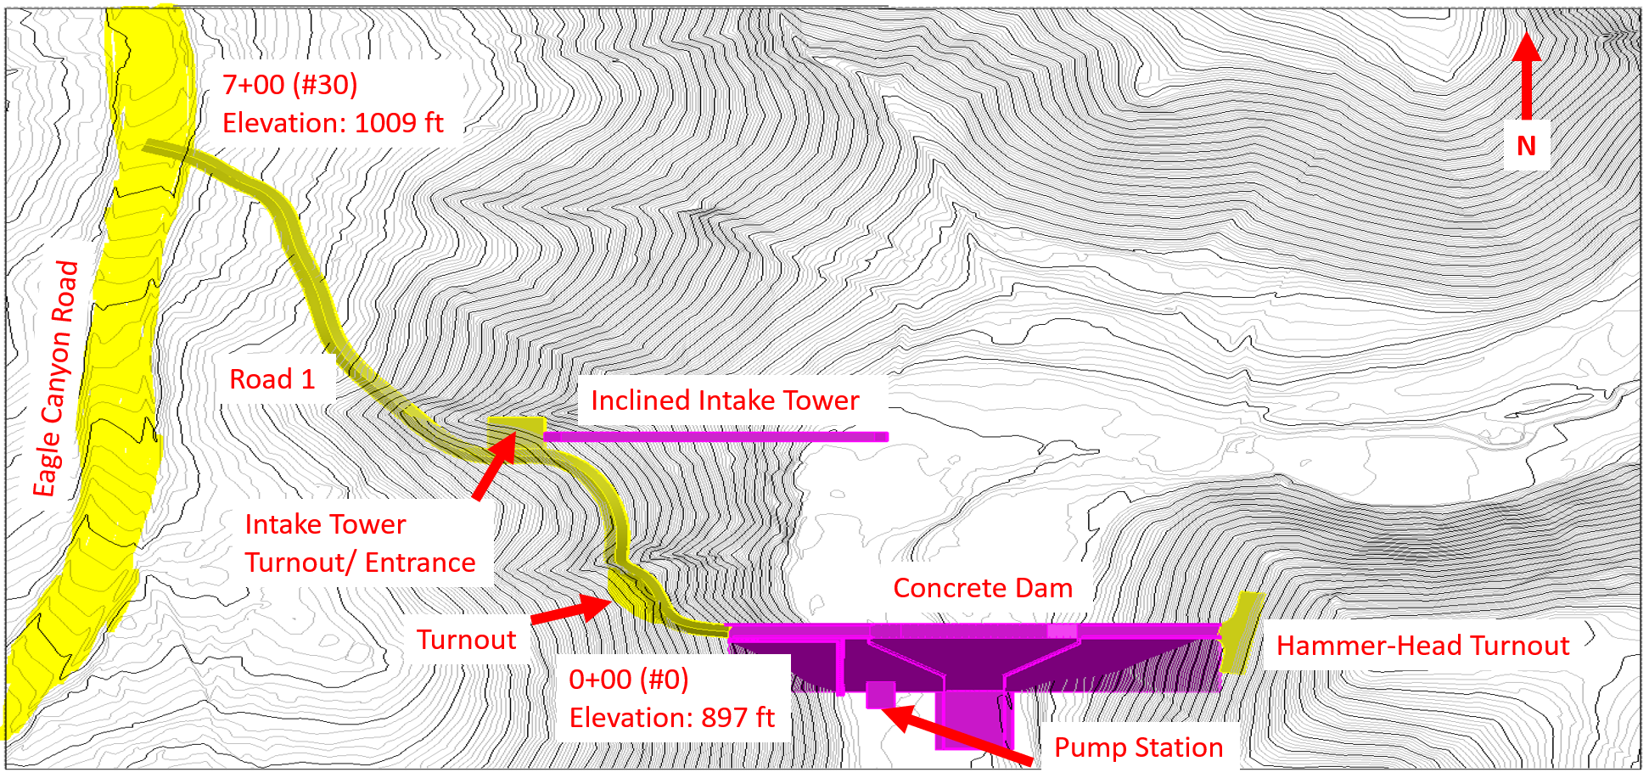
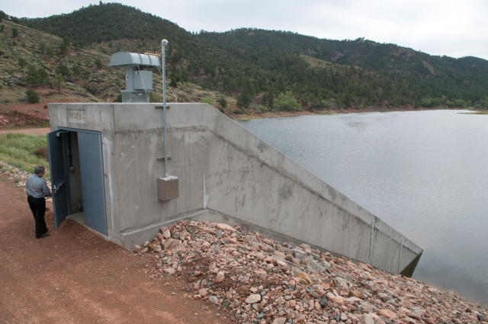

Water Supply Solution: Incline Intake Tower
What does it do?
How does one look?
Where is it located?
281ft north of dam upstream

Slide 24

Outlet Works: Hydraulics
Main Hydrological Features:
Drainage of the reservoir for emergency purposes
  Required by the Division of Safety of Dams
  50% drawdown (7-10 days) & 100% drawdown (20-30 days)
Drainage of the reservoir for operational purposes
  Delivering water to pump station with pipeline

Slide 25

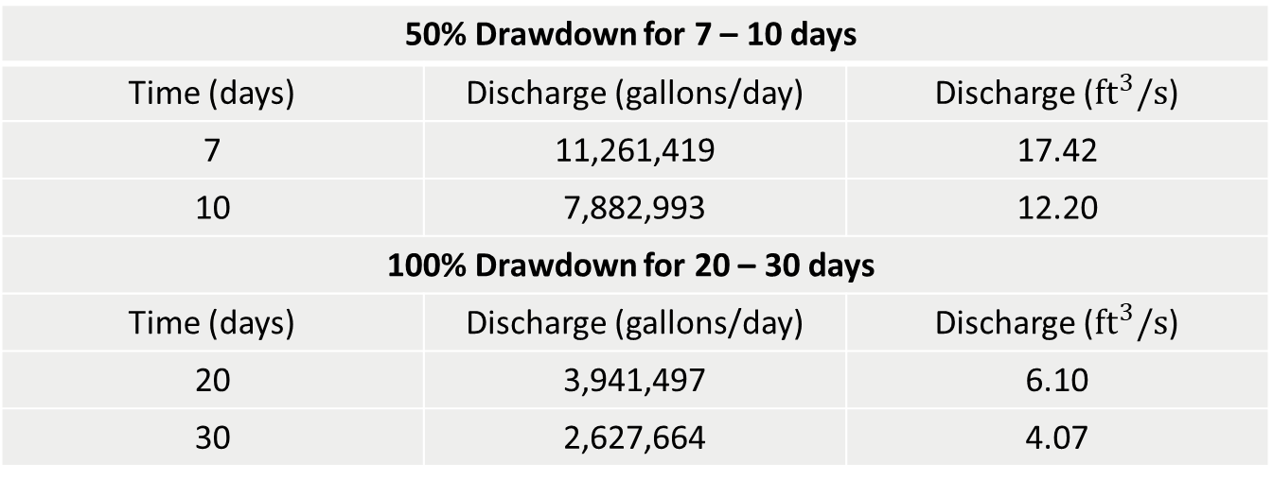
Outlet Works: Hydraulics
Emergency Release Criteria
Volumetric capacity of reservoir: 157.7 million gallons
50% Drawdown for 7 – 10 days
Time (days) | Discharge (gallons/day) | Discharge (${ft}^{3}/s$)
7 | 11,261,419 | 17.42
10 | 7,882,993 | 12.20
100% Drawdown for 20 – 30 days
Time (days) | Discharge (gallons/day) | Discharge (${ft}^{3}/s$)
20 | 3,941,497 | 6.10
30 | 2,627,664 | 4.07
Orifice Discharge Formula: $Q=C_{d}A\sqrt{2gh}$

Slide 26
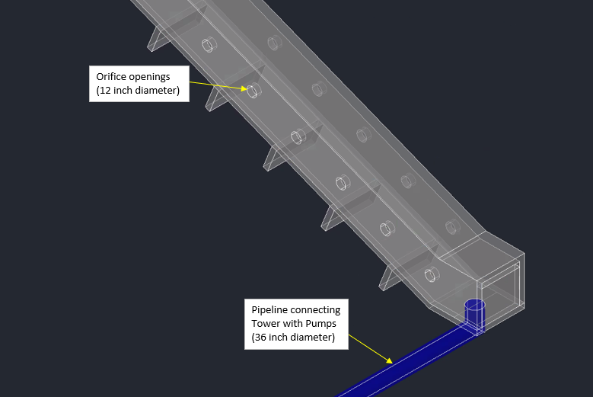
Outlet Works: Hydraulics

Slide 27
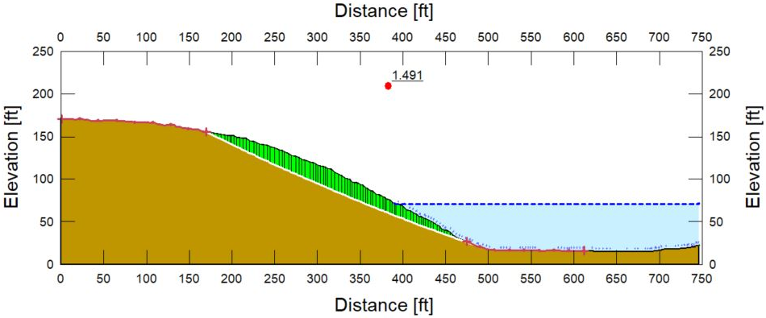
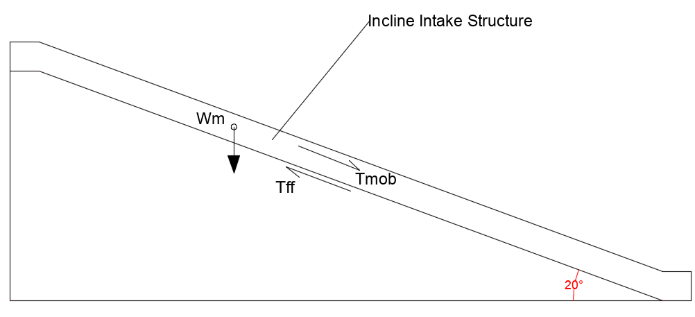

Outlet Works: Geotechnical
Minimum required static F.O.S: 1.5
Minimum required seismic F.O.S: 1.1
Assumptions: cohesionless soil, 120 pcf unit weight, 32º friction angle
Angle of inclination: 20 degrees
Actual factor of safety: 1.72
$$FS= \frac{T_{FF}}{T_{MOB}}$$

Slide 28
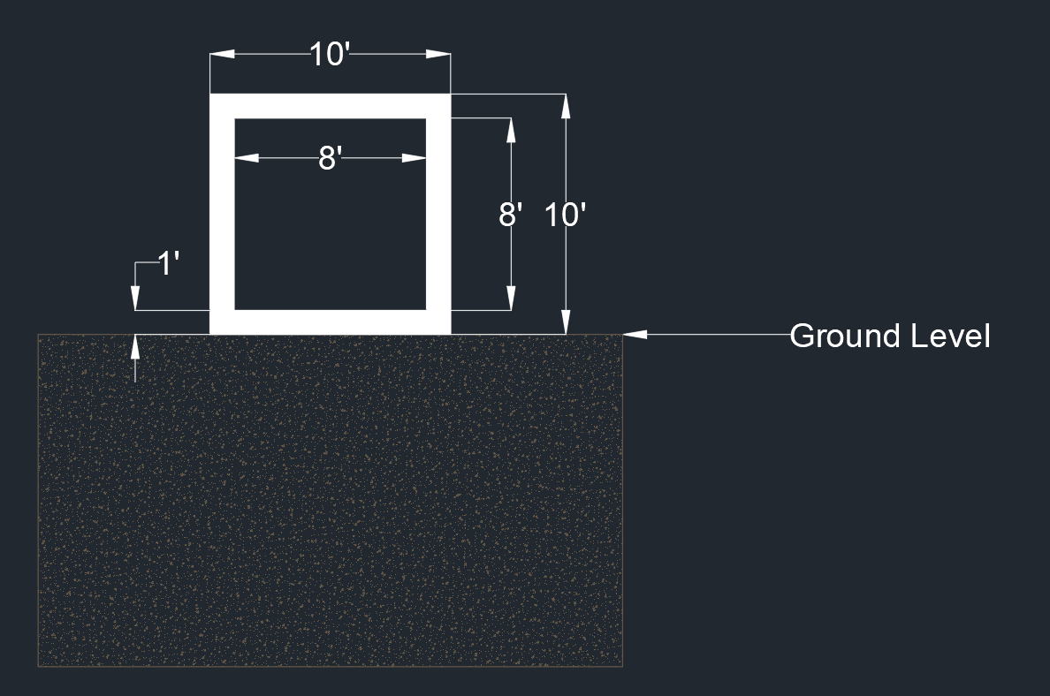
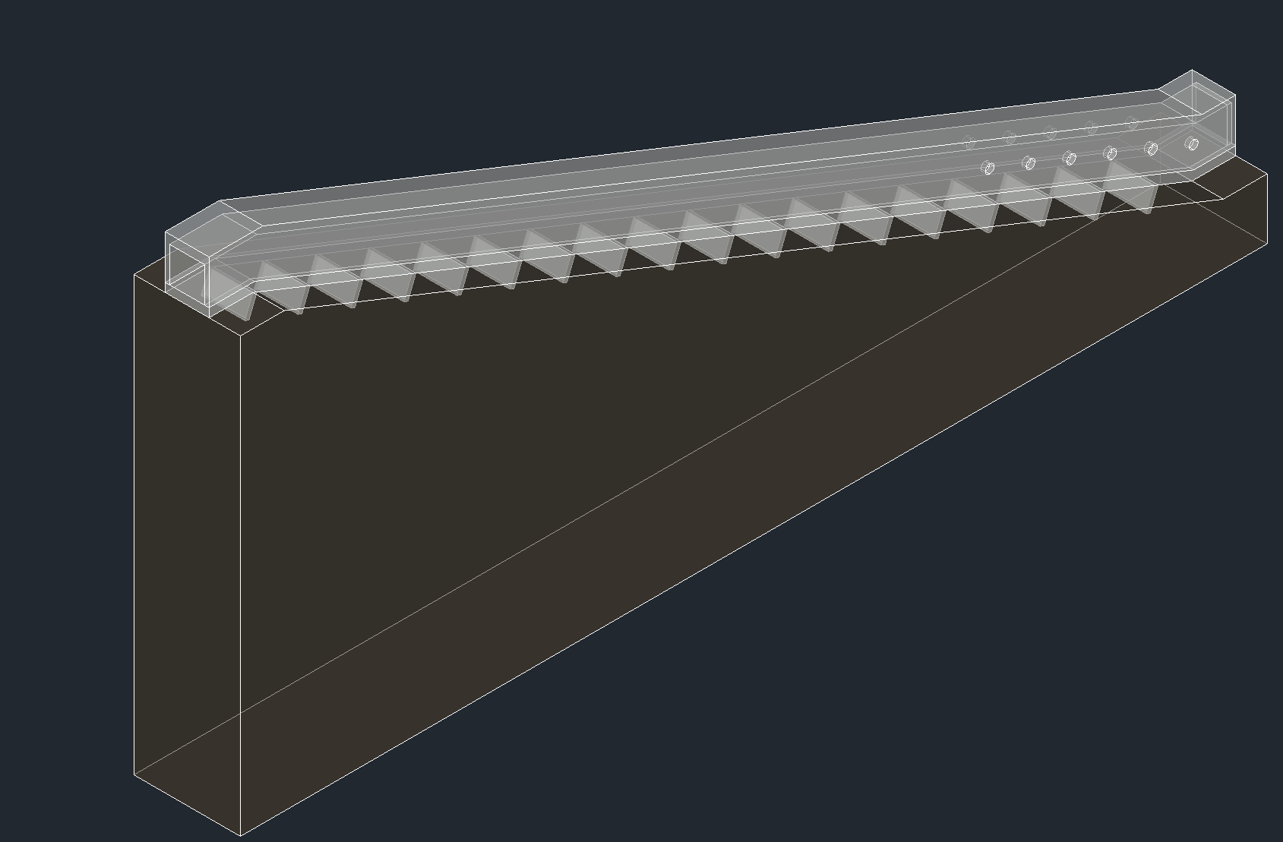
Outlet Works: Structural
Structure:
Reinforced Concrete
Loads Considered: Dead Load, Seismic, & Hydrostatic.
Dimensions per ACI requirements
Total Length down slope: 268’
Dimensions of Shear Keys:
Depth: 5’
Thickness: 1’
Width: 10’
Spacing 13’: 17 shear keys
Shear Keys

Slide 29
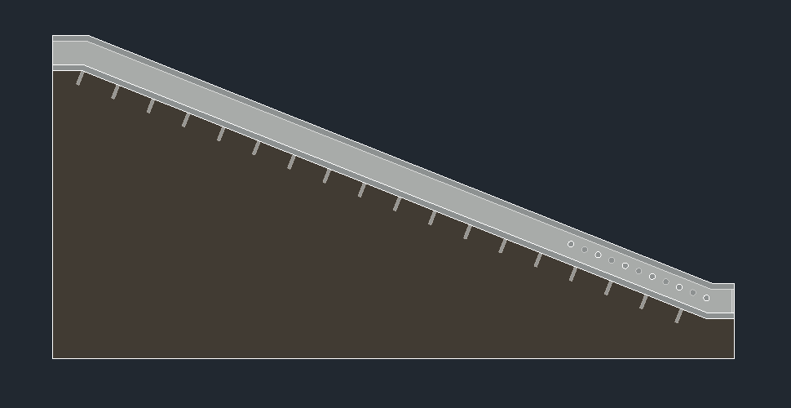
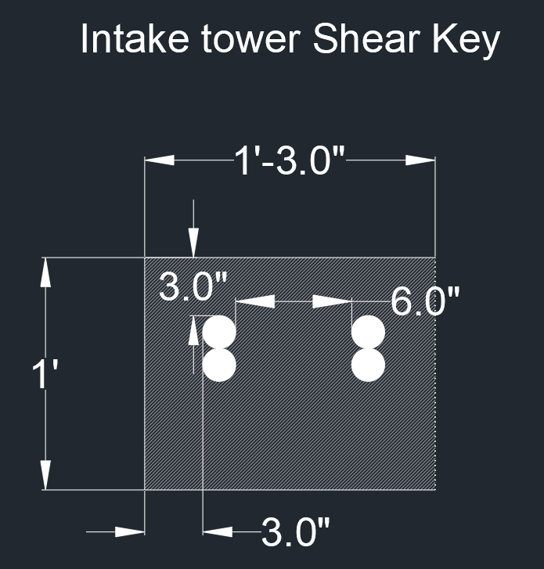
Outlet Works: Structural
Shear Key Reinforcement:
(ASCE 7-10 Load Combo: 1.2(D+F) + 1.0E+1.6H)
As = 3.27 in^2 (2-piece bundle)
Concrete Cover of 3” (ACI Table 20.6.1.3.1)
Spacing = 6” OC
Use: 2#14 Bars @ 6in OC
F(Hydro.)
W.L.
F(Seismic)

Slide 30
Outline
Project Introduction/Statement
Dam Design
Spillway
Outlet Works
Pipeline
Pumps
Water Tank
Roadway
Environmental, Sustainability, and Constructability
Cost Estimate
Summary
Notes:
Speaker: Jonathan

Slide 31
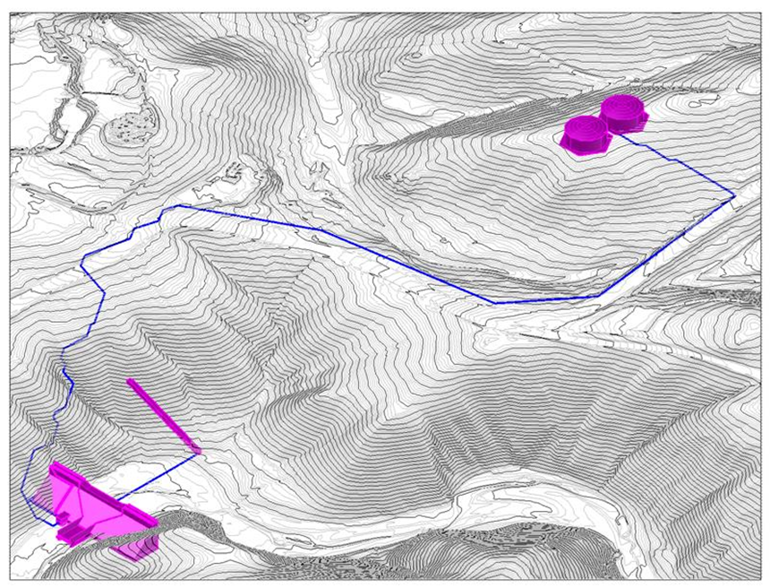


Pipeline Design Introduction
Consists of 3,522 feet of ductile iron pipeline running from the inclined intake tower to the pump station and lastly, to the tanks
The pipeline will lay 3 feet below our roadway
Designed our pipeline to fit the demand of 1.8 million gallons throughout a 9-hour period
Water Tanks
Inclined Intake Tower
Pump Station

Slide 32
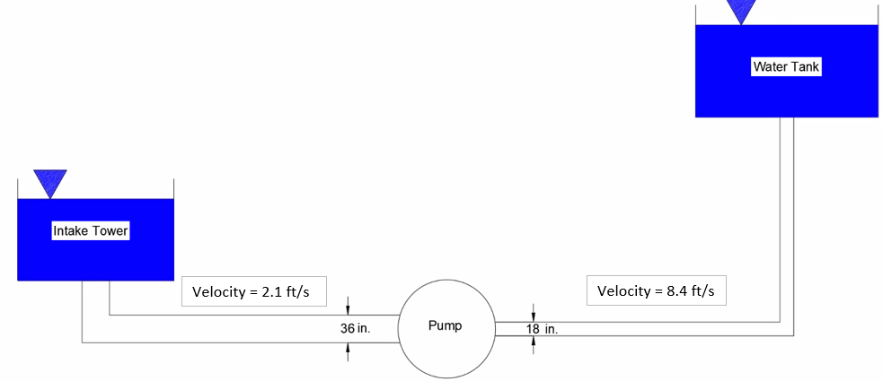

Pipeline Diameter
Demand Flow Rate: 14.85 cfs

Slide 33
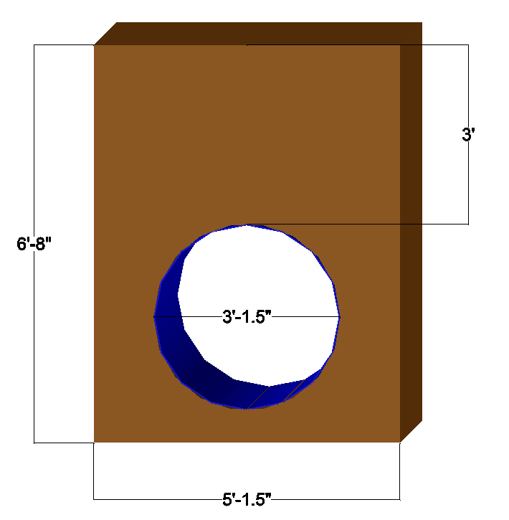
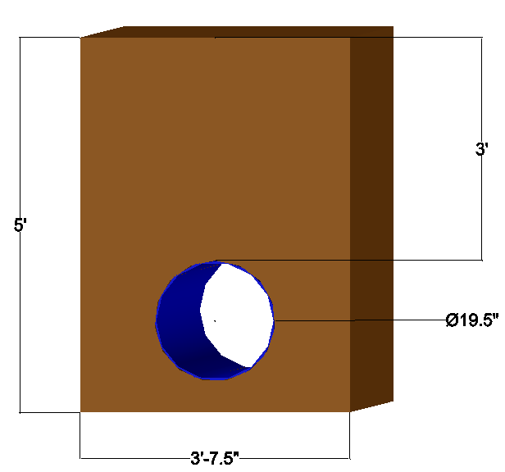
Pipe Trench
Trench will be dug along path of the pipe.
Embedment of 1 ft on each side for structural support.
Cover of 3 ft soil for deflection purposes.
Pipe 1: 36” interior diam
Pipe 2: 18” interior diameter.
Length = 3255 ft.
Length = 267 ft.

Slide 34
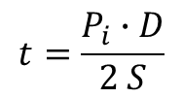

Pipe: Thickness and Deflection
Thickness
Depends on:
  Interior existing pressures: 288 psi
  Strength of materials: ductile iron / cement mortar lining
  Required thickness: 0.15 in.
  Actual thickness: 0.30 in.
  Total pipe 1 diameter: 37.5 in.
  Total pipe 2 diameter: 19.5 in.
Deflection
Depends on:
  Dead and live loads
  Strength of materials
  Embedment dimensions
  Allowable Deflection: 0.75 in.
  Pipe 1 deflection: 0.35
  Pipe 2 deflection: 0.09 in.
$$∆=\frac{D_{i}KWr^{3}}{EI+0.061 E^{′}r^{3}}$$
$$t=\frac{P_{i}∙D}{2 S}$$

Slide 35
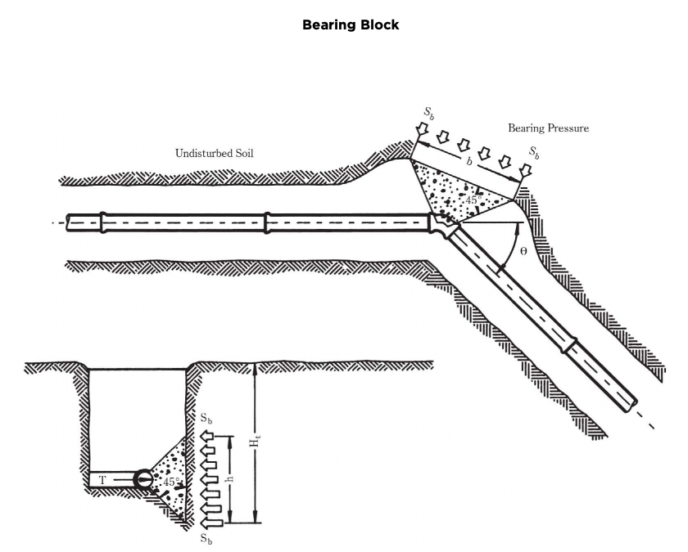
Pipe Thrust
  Thrust force
    45-degree bends: 66 kips.
    90-degree bends: 122 kips.
  Welds where pipe diameters and wall thicknesses are equal.
  Flanges where pipe diameters are different.
  Required restrained length
      75 ft for 45-degree angles
      180 ft. for 90-degree angles
  Areas of thrust blocks
      33 ft^2
      60 ft^2

Slide 36
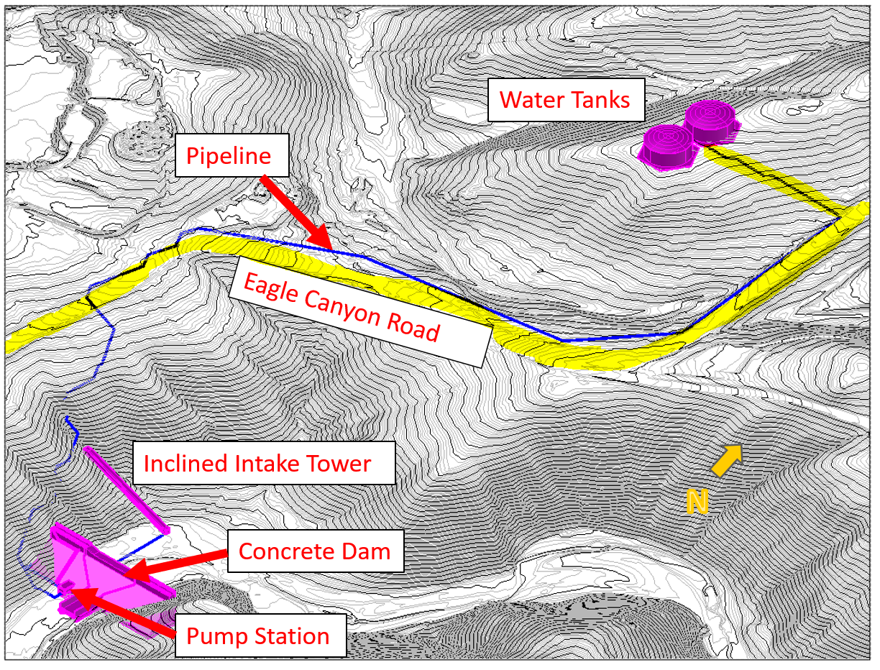
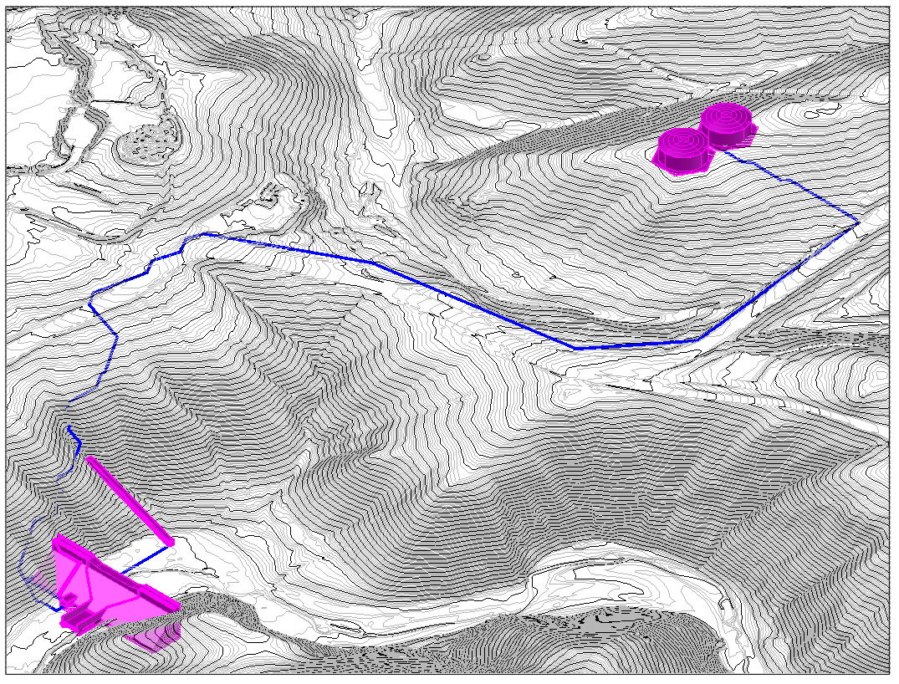
Pipeline Final Recommendations
Water Tanks
Length of Pipeline: 3522 ft
Nominal diameter of the pipe: 19.5 inches
Interior Diameter of the pipe: 18 inches
Pipeline Material: Ductile Iron
  Cement Mortar Lining
  Wall Thickness of pipe: 0.3 inches
Pipeline
Eagle Canyon Road
Inclined Intake Tower
N
Concrete Dam
Pump Station

Slide 37
Outline
Project Introduction/Statement
Dam Design
Spillway
Outlet Works
Pipeline
Pumps
Water Tank
Roadway
Environmental, Sustainability, and Constructability
Cost Estimate
Summary
Notes:
Speaker: Jonathan

Slide 38
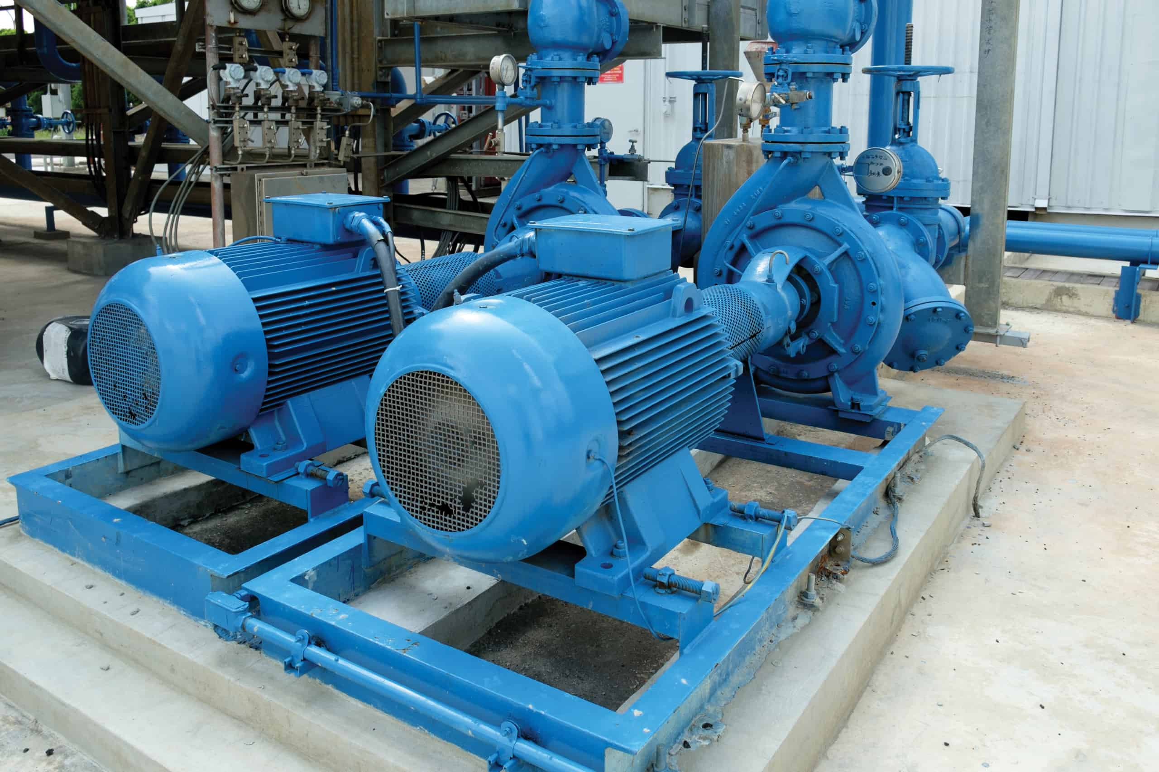
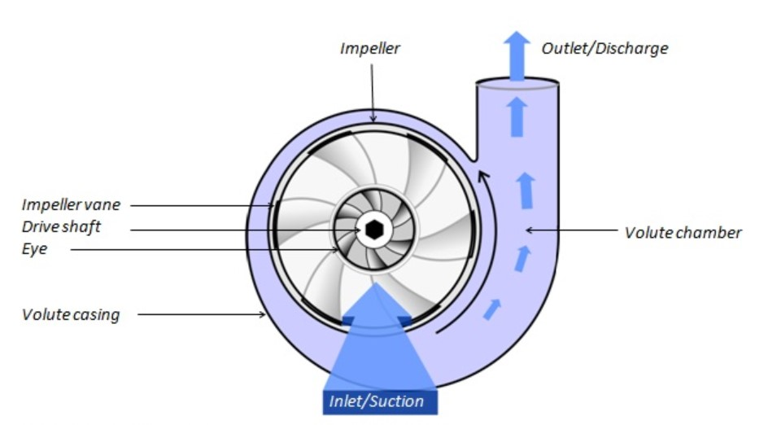
Pumps

Slide 39
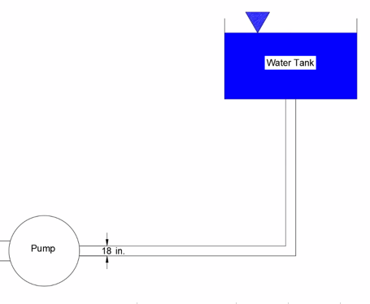

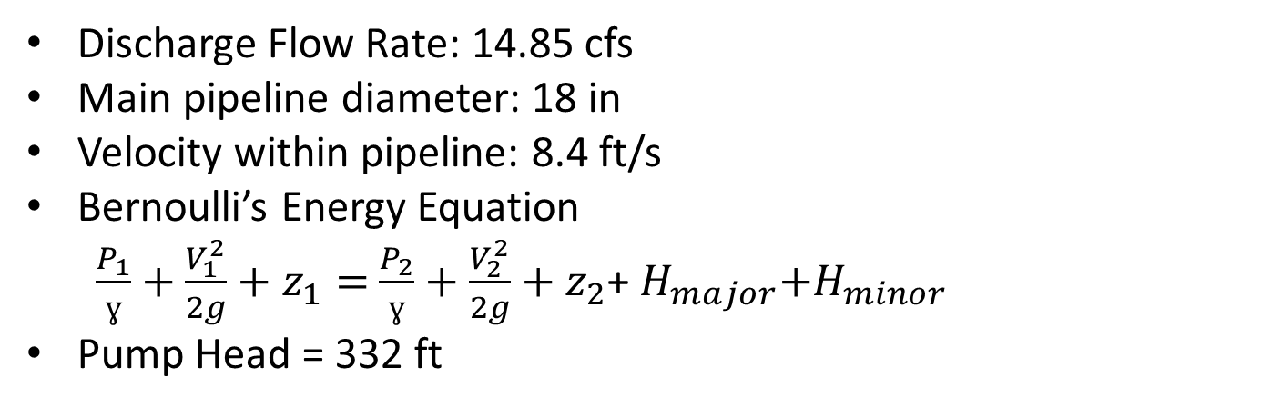
Determining Pump Head
Discharge Flow Rate: 14.85 cfs
Main pipeline diameter: 18 in
Velocity within pipeline: 8.4 ft/s
Bernoulli’s Energy Equation
$\frac{P_{1}}{ɣ}+\frac{V_{1}^{2}}{2g}+z_{1}=$ $\frac{P_{2}}{ɣ}+\frac{V_{2}^{2}}{2g}+z_{2}$+${ H}_{major}+H_{minor}$
Pump Head = 332 ft

Slide 40
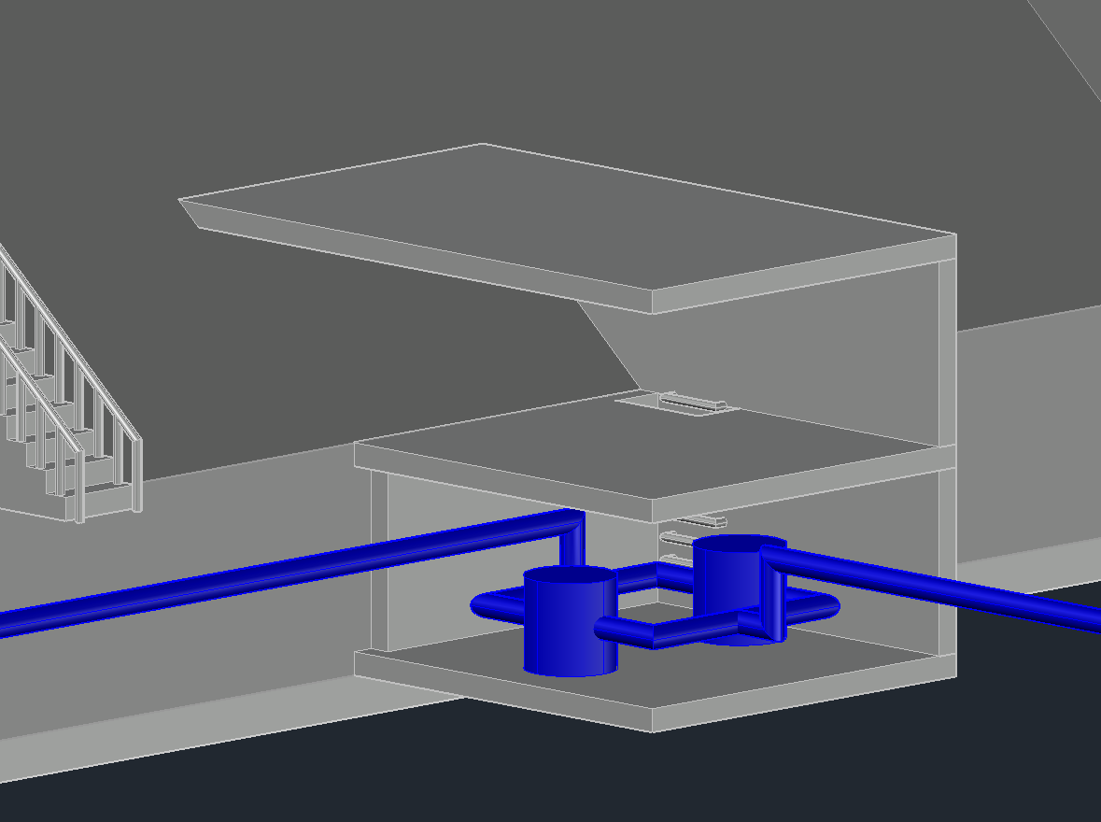
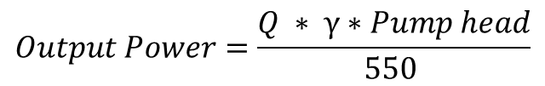
Pump Recommendations
Recommended Design Criteria
  Centrifugal Pump
  Overcome head of 332 feet
  Minimum Efficiency of 80 %
  Output Power of 280 HP
  9 - hour period
$$Output Power=\frac{Q ∗ γ∗Pump head}{550 }$$

Slide 41
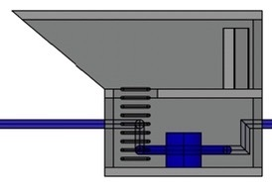
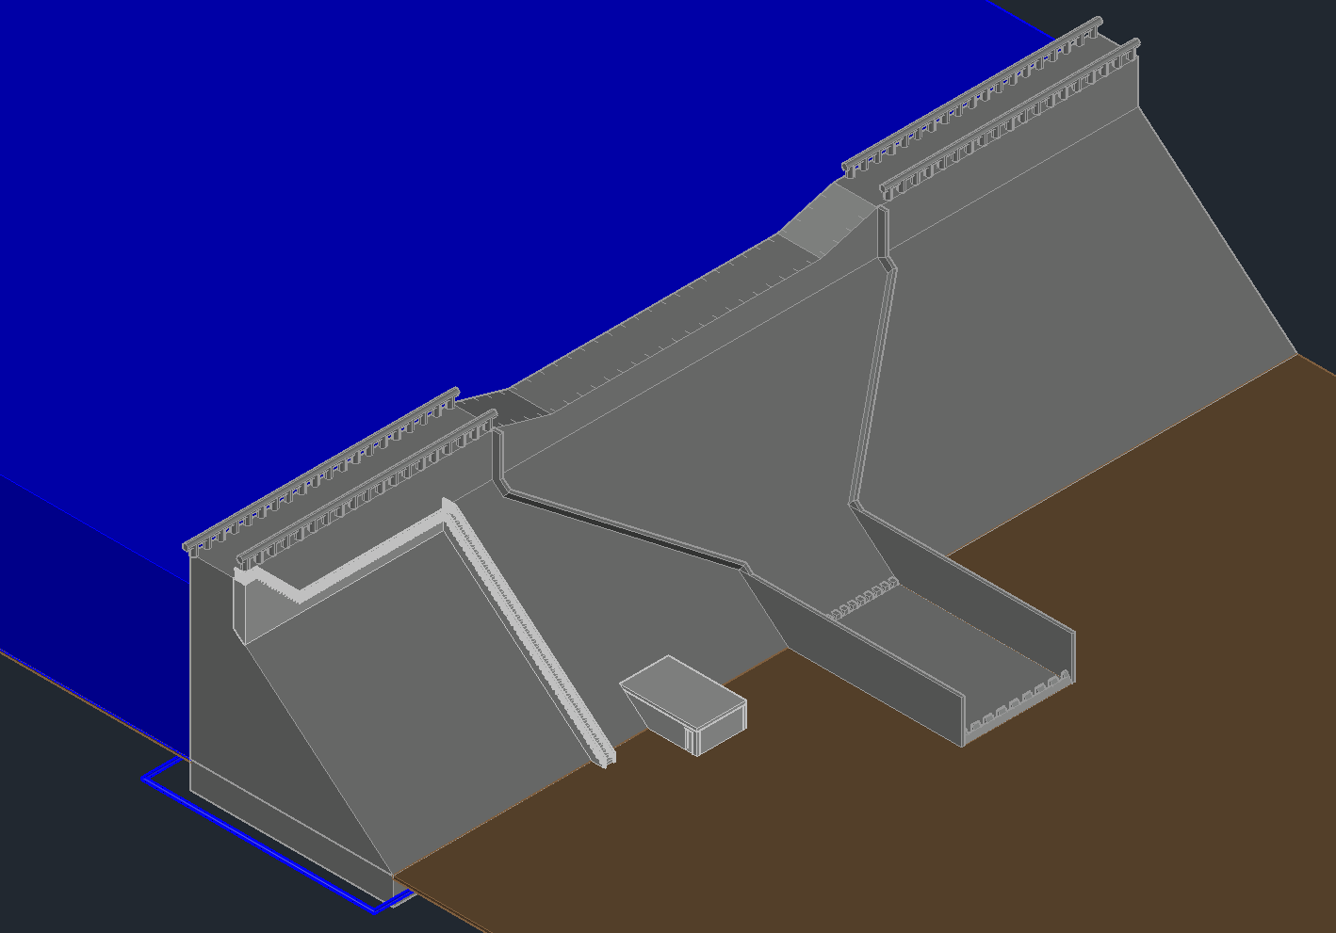

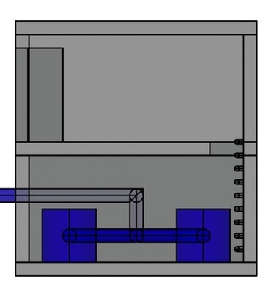
Pump Station
28.62 ft
Location:
  Connected to the Dam
  33 feet to the Right of the Spillway
Material:
  Concrete
Dimensions:
18 ft
Side View
18 ft
Top View
8 ft
Pump House
8 ft
Front View

Slide 42
Outline
Project Introduction/Statement
Dam Design
Spillway
Outlet Works
Pipeline
Pumps
Water Tank
Roadway
Environmental, Sustainability, and Constructability
Cost Estimate
Summary
Notes:
Speaker: Jonathan

Slide 43
Introduction of the Water Tanks Location ​
Water Tanks
Water tank is located North of the concrete gravity dam
The elevation of the concrete gravity dam is at 830 ft
The elevation of the water tank is 1,062 ft.
Elevation difference of 232 ft.
Pipeline
Road 2
Eagle Canyon Road
Road 1
N
Concrete Dam

Slide 44

Purpose of Water Tanks
Mining conglomerates
  1.8 million gallons of water
  Minimum water tank capacity of 450,000 gallons
Fire department
  3.15 million gallons
Total water tank size capacity
  3.6 million gallons

Slide 45
Water Tank Sizing
450,000
 | Table 2 Additional Water Requirement
Design Size [Gal] | Riverside Fire department Requirement [Gal] | Total [Gal}
450,000 | 3150000 | 3,600,000
Free Board Height
Radius = 50 ft
4ft
Fire Department Volume = 1,575,000
Fire Department Volume = 1,575,000
30ft
Daily Volume = 225,000 gal
Daily Volume = 225,000 gal

Slide 46


Water Tank Structural Design
 | Maximum Stress | Allowable Stress [D-100] Table 5 & 3
Shear | 19,700 psi | 21,000 psi
0.375’’
= 30 ft
= 100 ft

Slide 47

Water Tank Structural Design
Anchorage System
Concrete Strength | 3,500 psi
3/4 F1554 Gr.36 | # of bolts per tank [304]
SET 3G | Adhesive
Foundation Volume = 649 ft^3
5’0’
100’0’
66’5’
66’5’
Slab Volume = 16,552 ft^3

Slide 48



Excavation of Water Tanks Location
B
A'
A
B'
Figure B
Figure C
Highest initial elevation is around 1068 ft
Ground will be flattened to an elevation of 1058 ft
Total Excavation Volume: 7532 cubic yds
Figure A
Notes:
Finally I will be talking about the excavation of the water tanks location. Due to the uneven slope of the location an excavation of 7532 cubic yds will be required to flatten the area to an elevation of 1,068ft.

Slide 49
Outline
Project Introduction/Statement
Dam Design
Spillway
Outlet Works
Pipeline
Pumps
Water Tank
Roadway
Environmental, Sustainability, and Constructability
Cost Estimate
Summary
Notes:
Speaker: Jonathan

Slide 50


Roadway Introduction
N
Road 1
Inclined Intake Tower
Water Tanks
Concrete Dam
Road 2

Slide 51
Roadway Overview
Water Tanks
N
Pipeline
Road 2
Eagle Canyon Road
Road 1
Inclined Intake Tower
Concrete Dam
Hammer Head Turn out

Slide 52

Hammer-Head Turnaround
Location: East end of dam
  Allows for 3pt turn
  ~37% smaller by area than a cul-de-sac (r=28’)
  Designed for utility trucks
    Accommodates vehicles up to 24’ in length
96’
16’

Slide 53

Road 1 – Dam Road
Total Length: 750 ft
Average Grade: 15%
7+50 (#30)
7+50 (#30)
Elevation: 1009 ft
Elevation: 1009 ft
N
Road 1
Turnout
+ Intake Tower Entrance
Inclined Intake Tower
Eagle Canyon Road
Turnout
Hammer-Head Turnout
Concrete Dam
0+00 (#0)
Elevation: 897 ft
Notes:
>> show where hammer head turnout is from Paul's slide
>> Road 1 introduction
>Road from our concrete dam to Eagle canyon road.
>Total length of 750 ft
> Average grade of 15 %
>starts at elevation:897 ft
>ends at elevation: 1009 ft
>> Intake tower
>as previously mentioned in the Intake tower access road section of this presentation
both the intake tower and the dam share this access road and is connected by a turnout
as shown in the topographical map.
>>Turnout
> there is another turnout more south closer to the dam
> with this many turouts, drivers should have no problem finding a place to turn their vehicle around
or park on this road.

Slide 54
Road 1 – Dam Road
Total Length: 750 ft
Average Grade: 15%
7+50 (#30)
7+50 (#30)
Elevation: 1009 ft
Elevation: 1009 ft
N
Road 1
Turnout
+ Intake Tower Entrance
Inclined Intake Tower
Eagle Canyon Road
Turnout
Hammer-Head Turnout
Concrete Dam
0+00 (#0)
Elevation: 897 ft
Notes:
>> show where hammer head turnout is from Paul's slide
>> Road 1 introduction
>Road from our concrete dam to Eagle canyon road.
>Total length of 750 ft
> Average grade of 15 %
>starts at elevation:897 ft
>ends at elevation: 1009 ft
>> Intake tower
>as previously mentioned in the Intake tower access road section of this presentation
both the intake tower and the dam share this access road and is connected by a turnout
as shown in the topographical map.
>>Turnout
> there is another turnout more south closer to the dam
> with this many turouts, drivers should have no problem finding a place to turn their vehicle around
or park on this road.

Slide 55


Intake Tower Turnout/ Entrance
7+50 (#30)
Elevation: 1009 ft
Eagle Canyon Road
Eagle Canyon Road
N
Pipeline
Road 1
Intake Tower
Turnout/ Entrance
0+00 (#0)
Elevation: 897 ft
Inclined Intake Tower
Concrete Dam
Pump Station
Hammer Head Turnout
Notes:
>> Intake tower
>our access road to the intake tower is the same
road we are using for our access road to the dam.
>we decided to use a turnout to connect the intake tower to our
access road since it was relatively close to our access dam road
which we designed first
>More details on the access road will be provided later in the Roadway section
of this presentation.

Slide 56
Road 1 – Dam Road
Total Length: 750 ft
Average Grade: 15%
7+50 (#30)
7+50 (#30)
Elevation: 1009 ft
Elevation: 1009 ft
N
Road 1
Turnout
+ Intake Tower Entrance
Inclined Intake Tower
Eagle Canyon Road
Turnout
Hammer-Head Turnout
Concrete Dam
0+00 (#0)
Elevation: 897 ft
Notes:
>> show where hammer head turnout is from Paul's slide
>> Road 1 introduction
>Road from our concrete dam to Eagle canyon road.
>Total length of 750 ft
> Average grade of 15 %
>starts at elevation:897 ft
>ends at elevation: 1009 ft
>> Intake tower
>as previously mentioned in the Intake tower access road section of this presentation
both the intake tower and the dam share this access road and is connected by a turnout
as shown in the topographical map.
>>Turnout
> there is another turnout more south closer to the dam
> with this many turouts, drivers should have no problem finding a place to turn their vehicle around
or park on this road.

Slide 57

Retaining Wall
Total Length: 700 ft
Average Grade: 15%
7+00 (#28)
Elevation: 1000 ft
N
Retaining Wall
Eagle Canyon Road
Road 1
Inclined Intake Tower
Intake Tower
Turnout/ Entrance
Concrete Dam
Turnout
Hammer-Head Turnout
0+00 (#0)
Elevation: 897 ft
Pump Station
Notes:
>> show where hammer head turnout is from Paul's slide
>> Road 1 introduction
>Road from our concrete dam to Eagle canyon road.
>Total length of 750 ft
> Average grade of 15 %
>starts at elevation:897 ft
>ends at elevation: 1009 ft
>> Intake tower
>as previously mentioned in the Intake tower access road section of this presentation
both the intake tower and the dam share this access road and is connected by a turnout
as shown in the topographical map.
>>Turnout
> there is another turnout more south closer to the dam
> with this many turouts, drivers should have no problem finding a place to turn their vehicle around
or park on this road.

Slide 58

Road & Retaining Wall Cross-Section

Slide 59
Road & Retaining Wall Cross-Section

Slide 60
Road & Retaining Wall Cross-Section

Slide 61
Road & Retaining Wall Cross-Section

Slide 62

Road 1
Cut/Fill Volume
Cut | 2,215 cubic yards
Fill | 3,837 cubic yards
Ratio: | 0.57
Average Grade: 15%
Station # | 0 | 1 | 2 | 3 | 4 | 5 | 6 | 7 | 8 | 9 | 10 | 11 | 12 | 13 | 14 | 15 | 16 | 17 | 18 | 19 | 20 | 21 | 22 | 23 | 24 | 25 | 26 | 27 | 28 | 29 | 30
Stationing | 0+00 | 0+25 | 0+50 | 0+75 | 1+00 | 1+25 | 1+50 | 1+75 | 2+00 | 2+25 | 2+50 | 2+75 | 3+00 | 3+25 | 3+50 | 3+75 | 4+00 | 4+25 | 4+50 | 4+75 | 5+00 | 5+25 | 5+50 | 5+75 | 6+00 | 6+25 | 6+50 | 6+75 | 7+00 | 7+25 | 7+50

Slide 63

Road 2 – Tank Road
0+00 (#0)
Elev. 1026 ft
N
Water Tanks
Total Length: 450 ft
Turnout: 2,400 sq. ft.
Turnout
Average Grade: 8%
Eagle Canyon Road
4+50 (#18)
Elev. 1063 ft

Slide 64

Road 2
Cut/Fill Volume
Cut | 921 cubic yards
Fill | 4,210 cubic yards
Ratio: | 0.22
Average Grade: 8%
Station # | 0 | 1 | 2 | 3 | 4 | 5 | 6 | 7 | 8 | 9 | 10 | 11 | 12 | 13 | 14 | 15 | 16 | 17 | 18
Stationing | 0+00 | 0+25 | 0+50 | 0+75 | 1+00 | 1+25 | 1+50 | 1+75 | 2+00 | 2+25 | 2+50 | 2+75 | 3+00 | 3+25 | 3+50 | 3+75 | 4+00 | 4+25 | 4+50

Slide 65
Roadway Summary
Each roadway is created with design constraints and specifications in mind:
  Maximum grade of 16%
  Average End Method
  Single-lane roads, 2 ft shoulder, minimum of 1 turnout
Drainage is expected to occur naturally along the slope of the roads.
 | Road 1 | Road 2 | Retaining Wall | Hammer-Head | Total
Total Length | 750 ft | 400 ft | 700 ft | 96 ft | 1946 ft
Average Grade | 15% | 10% | 15% | - | -
Cut | 2,215 cubic yards | 921 cubic yards | 1,633 cubic yards | 38 cubic yards | 6,429 cubic yards
Fill | 3,837 cubic yards | 4,210 cubic yards | 726 cubic yards | 75 cubic yards | 7,226 cubic yards
Number of Turnouts | 2 | 1 | - | 1 | 4

Slide 66
Roadway Summary
Each roadway is created with design constraints and specifications in mind:
  Maximum grade of 16%
  Average End Method
  Single-lane roads, 2 ft shoulder, minimum of 1 turnout
Drainage is expected to occur naturally along the slope of the roads.
 | Road 1 | Road 2 | Retaining Wall | Hammer-Head | Total
Total Length | 750 ft | 400 ft | 700 ft | 96 ft | 1946 ft
Average Grade | 15% | 10% | 15% | - | -
Cut | 2,215 cubic yards | 921 cubic yards | 1,633 cubic yards | 38 cubic yards | 6,429 cubic yards
Fill | 3,837 cubic yards | 4,210 cubic yards | 726 cubic yards | 75 cubic yards | 7,226 cubic yards
Number of Turnouts | 2 | 1 | - | 1 | 4

Slide 67
Outline
Project Introduction/Statement
Dam Design
Spillway
Outlet Works
Pipeline
Pumps
Water Tank
Roadway
Environmental, Sustainability, and Constructability
Cost Estimate
Summary
Notes:
Speaker: Jonathan

Slide 68

Environmental – CEQA Checklist
Environmental Factors Potentially Affected:

Slide 69

Environmental – Construction Mitigation, Emergency Planning, and Federal Regulations.
Sample: www.tinyurl.com/group2EAPsample

Slide 70
Sustainability- Life Cycle Assessment
Material Production
Transportation of Construction Materials
  Cement
  Sand
  Aggregate
  Fly Ash
  Rock
    Diesel
    Gasoline
Hauling Materials
    Distance
    Load of the vehicle + Material
    Gasoline

Slide 71
Sustainability- Life Cycle Assessment
Construction
            Use
  Excavation
  Mixing
  Pouring
  Curing
    Diesel
    Electricity
    Gasoline
Operation & Maintenance
  Road Repair
  Spillway Maintenance
  Dam Maintenance
    Diesel
    Gasoline
    Electricity
    Materials

Slide 72



Sustainability- Climate Change/Adaptation
Sustainable Practices:
  Air Quality – reduce carbon emissions
  Recycle Material – reuse composite material
Adaptation Planning:
  Taking actions to reduce the negative impacts of climate change
  Climate Protection

Slide 73

Sustainability- Other Future Risks

Slide 74


Constructability
Constructability is the reflection of the design documents to ensure that the major issues are addressed early in the process.
1. Concrete batch plant
2. The materials need for the concrete plant
3. Transportation
4. The contractor lay out

Slide 75


Constructability
N
5. Temporary Roadways
  All construction material will be delivered through a temporary roadways.
  A permit will be required when making these temporary roadways by the Riverside Building Department.
6. Constraints
  Avoid anything that will impact the local community and the wildlife in a negative way.
  Contractors are allowed to bring essential equipment to the site.
* All transportation will follow local and federal state requirements to avoid citations throughout the transportation as well as on the site.
Pathway to the work site from I-15
N

Slide 76
Outline
Project Introduction/Statement
Dam Design
Spillway
Outlet Works
Pipeline
Pumps
Water Tank
Roadway
Environmental, Sustainability, and Constructability
Cost Estimate
Summary
Notes:
Speaker: Jonathan

Slide 77
Cost Estimate
Class 5: Order of Magnitude
Expected Accuracy Range: +30% to -50%
(AACE 18R-97)
Material/Work | Price ($)
Concrete | 32,325,094.91
Pipeline | 201,458.40
Water Tank | 3,000,000.00
Roadway | 465,909.24
Earthwork | 7,584,525.75
Pump Station | 3,000,000.00
Retaining Wall | 196000
Environmental (15%) | 7,015,948.24
Design (15%) | 7,015,948.24
Contingency (30%) | 14,031,896.49
Total Cost ($) | $ 74,836,781.27

Slide 78
Outline
Project Introduction/Statement
Dam Design
Spillway
Outlet Works
Pipeline
Pumps
Water Tank
Roadway
Environmental, Sustainability, and Constructability
Cost Estimate
Summary
Notes:
Speaker: Jonathan

Slide 79

Summary
Project Objective
Design
  Dam
  Incline Intake Tower
  Pipeline
  Water Tanks
  Access Roads
  CEQA/Cost Estimate
Summary
Water Tanks
Pipeline
Road 2
Road 1
Intake Tower
Concrete Dam
N
Water Reservoir
Pump Station

Slide 80
Questions?

