Slide 1
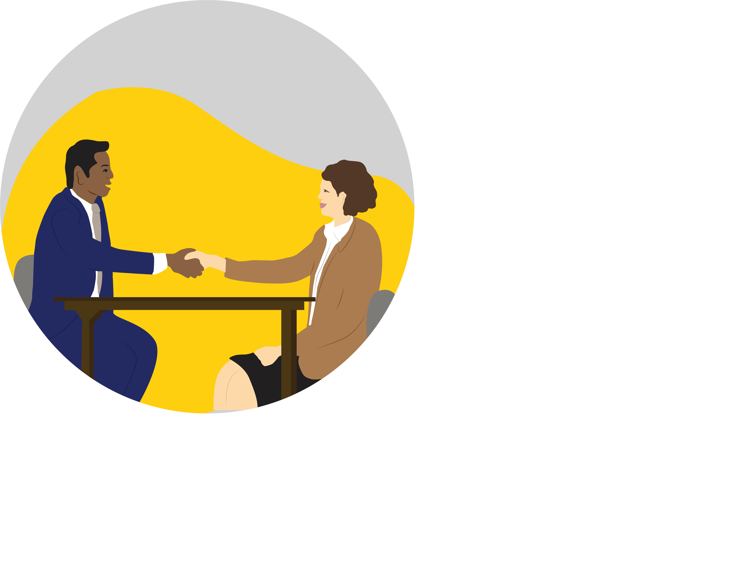

Student Assistant Orientation

Slide 2
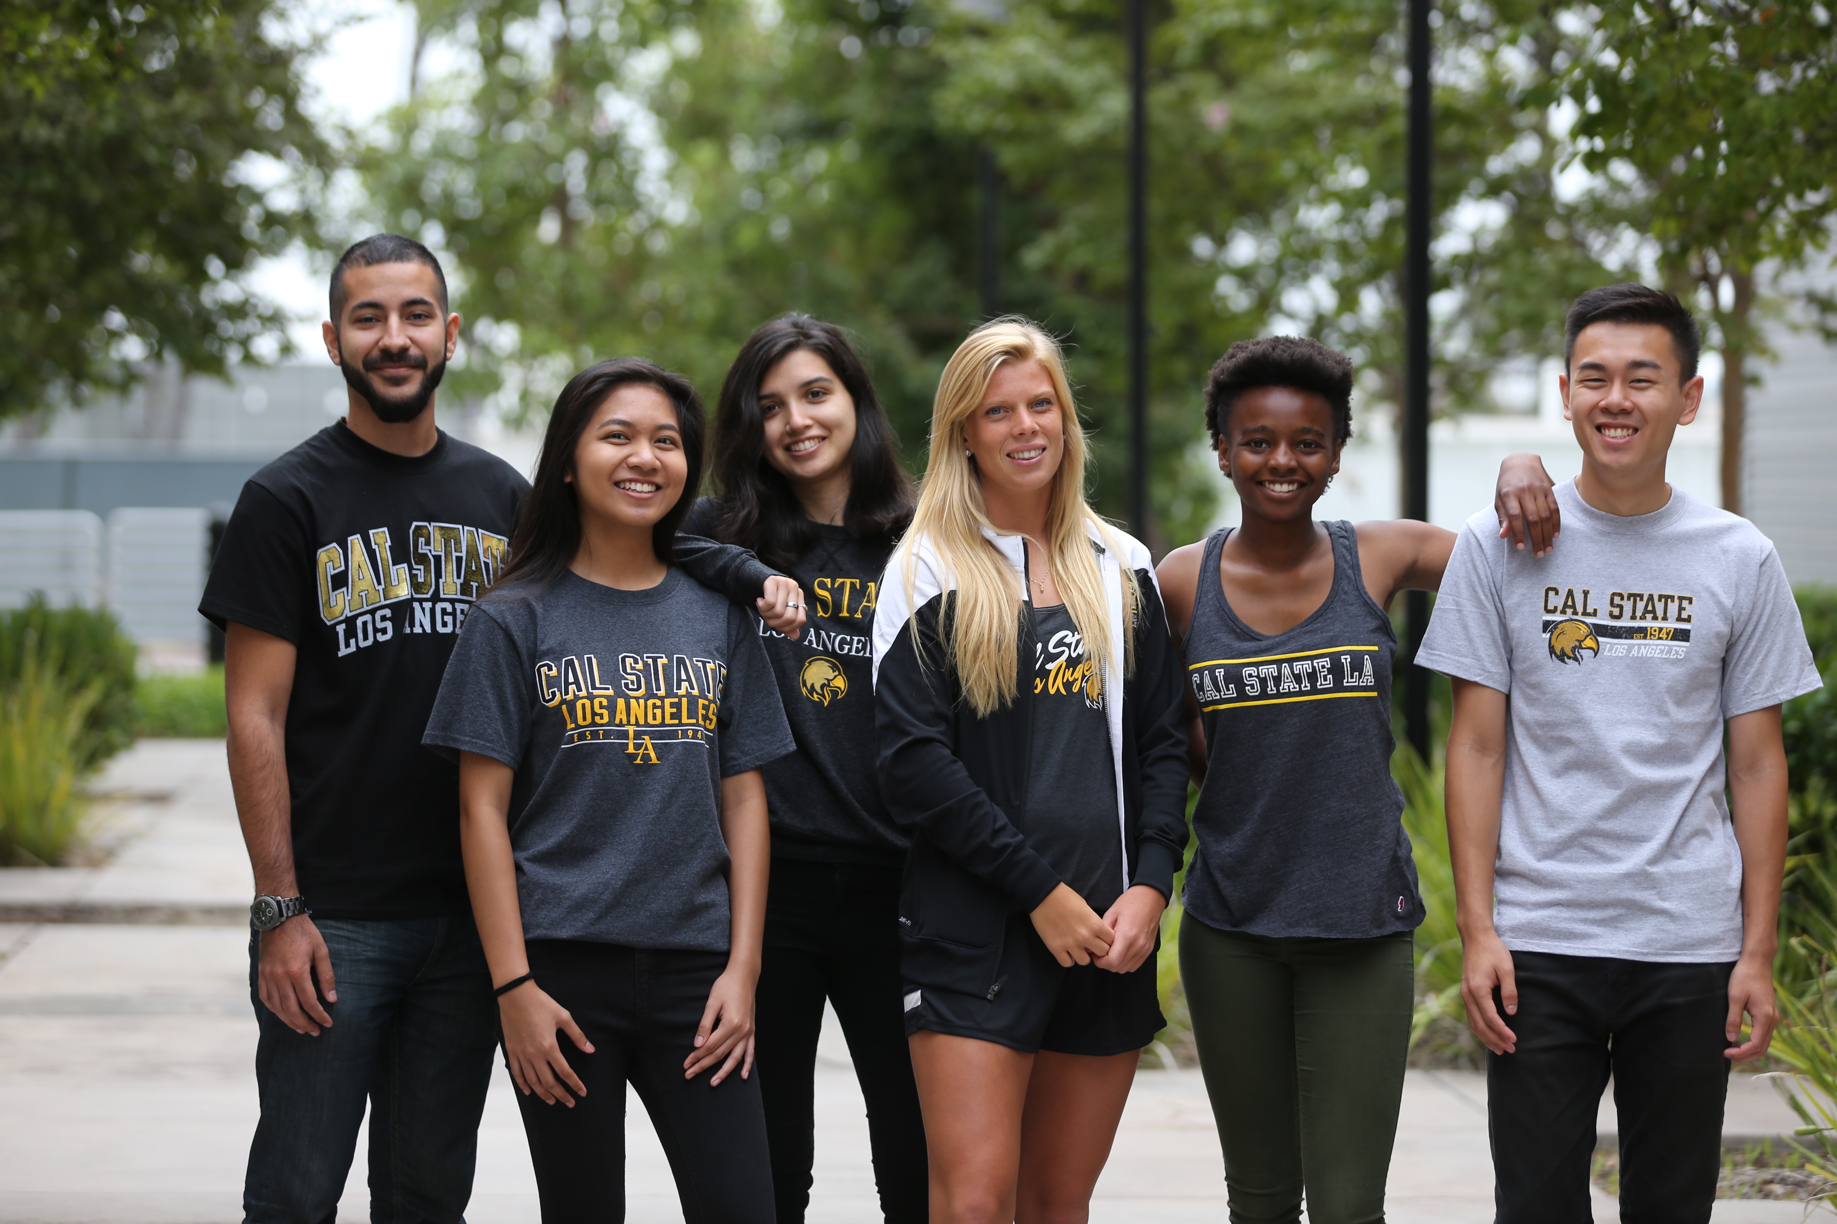
Welcome to the Team!
Congratulations! You are now a Student Assistant at Cal State LA, and officially a state employee. Now let’s talk about what to expect and how to navigate your new professional environment. Your accomplishments on the job today are going to help you long after you’ve graduated.
While this orientation will help you thrive as a Student Assistant, we also want you to be thinking about how to use the skills and experiences you will gain, for your future career.
We’re glad you’ve joined the team, and are bringing your own great skill sets to the job. Now it’s time to sharpen those skills and make some helpful additions. Let’s do this thing!

Slide 3
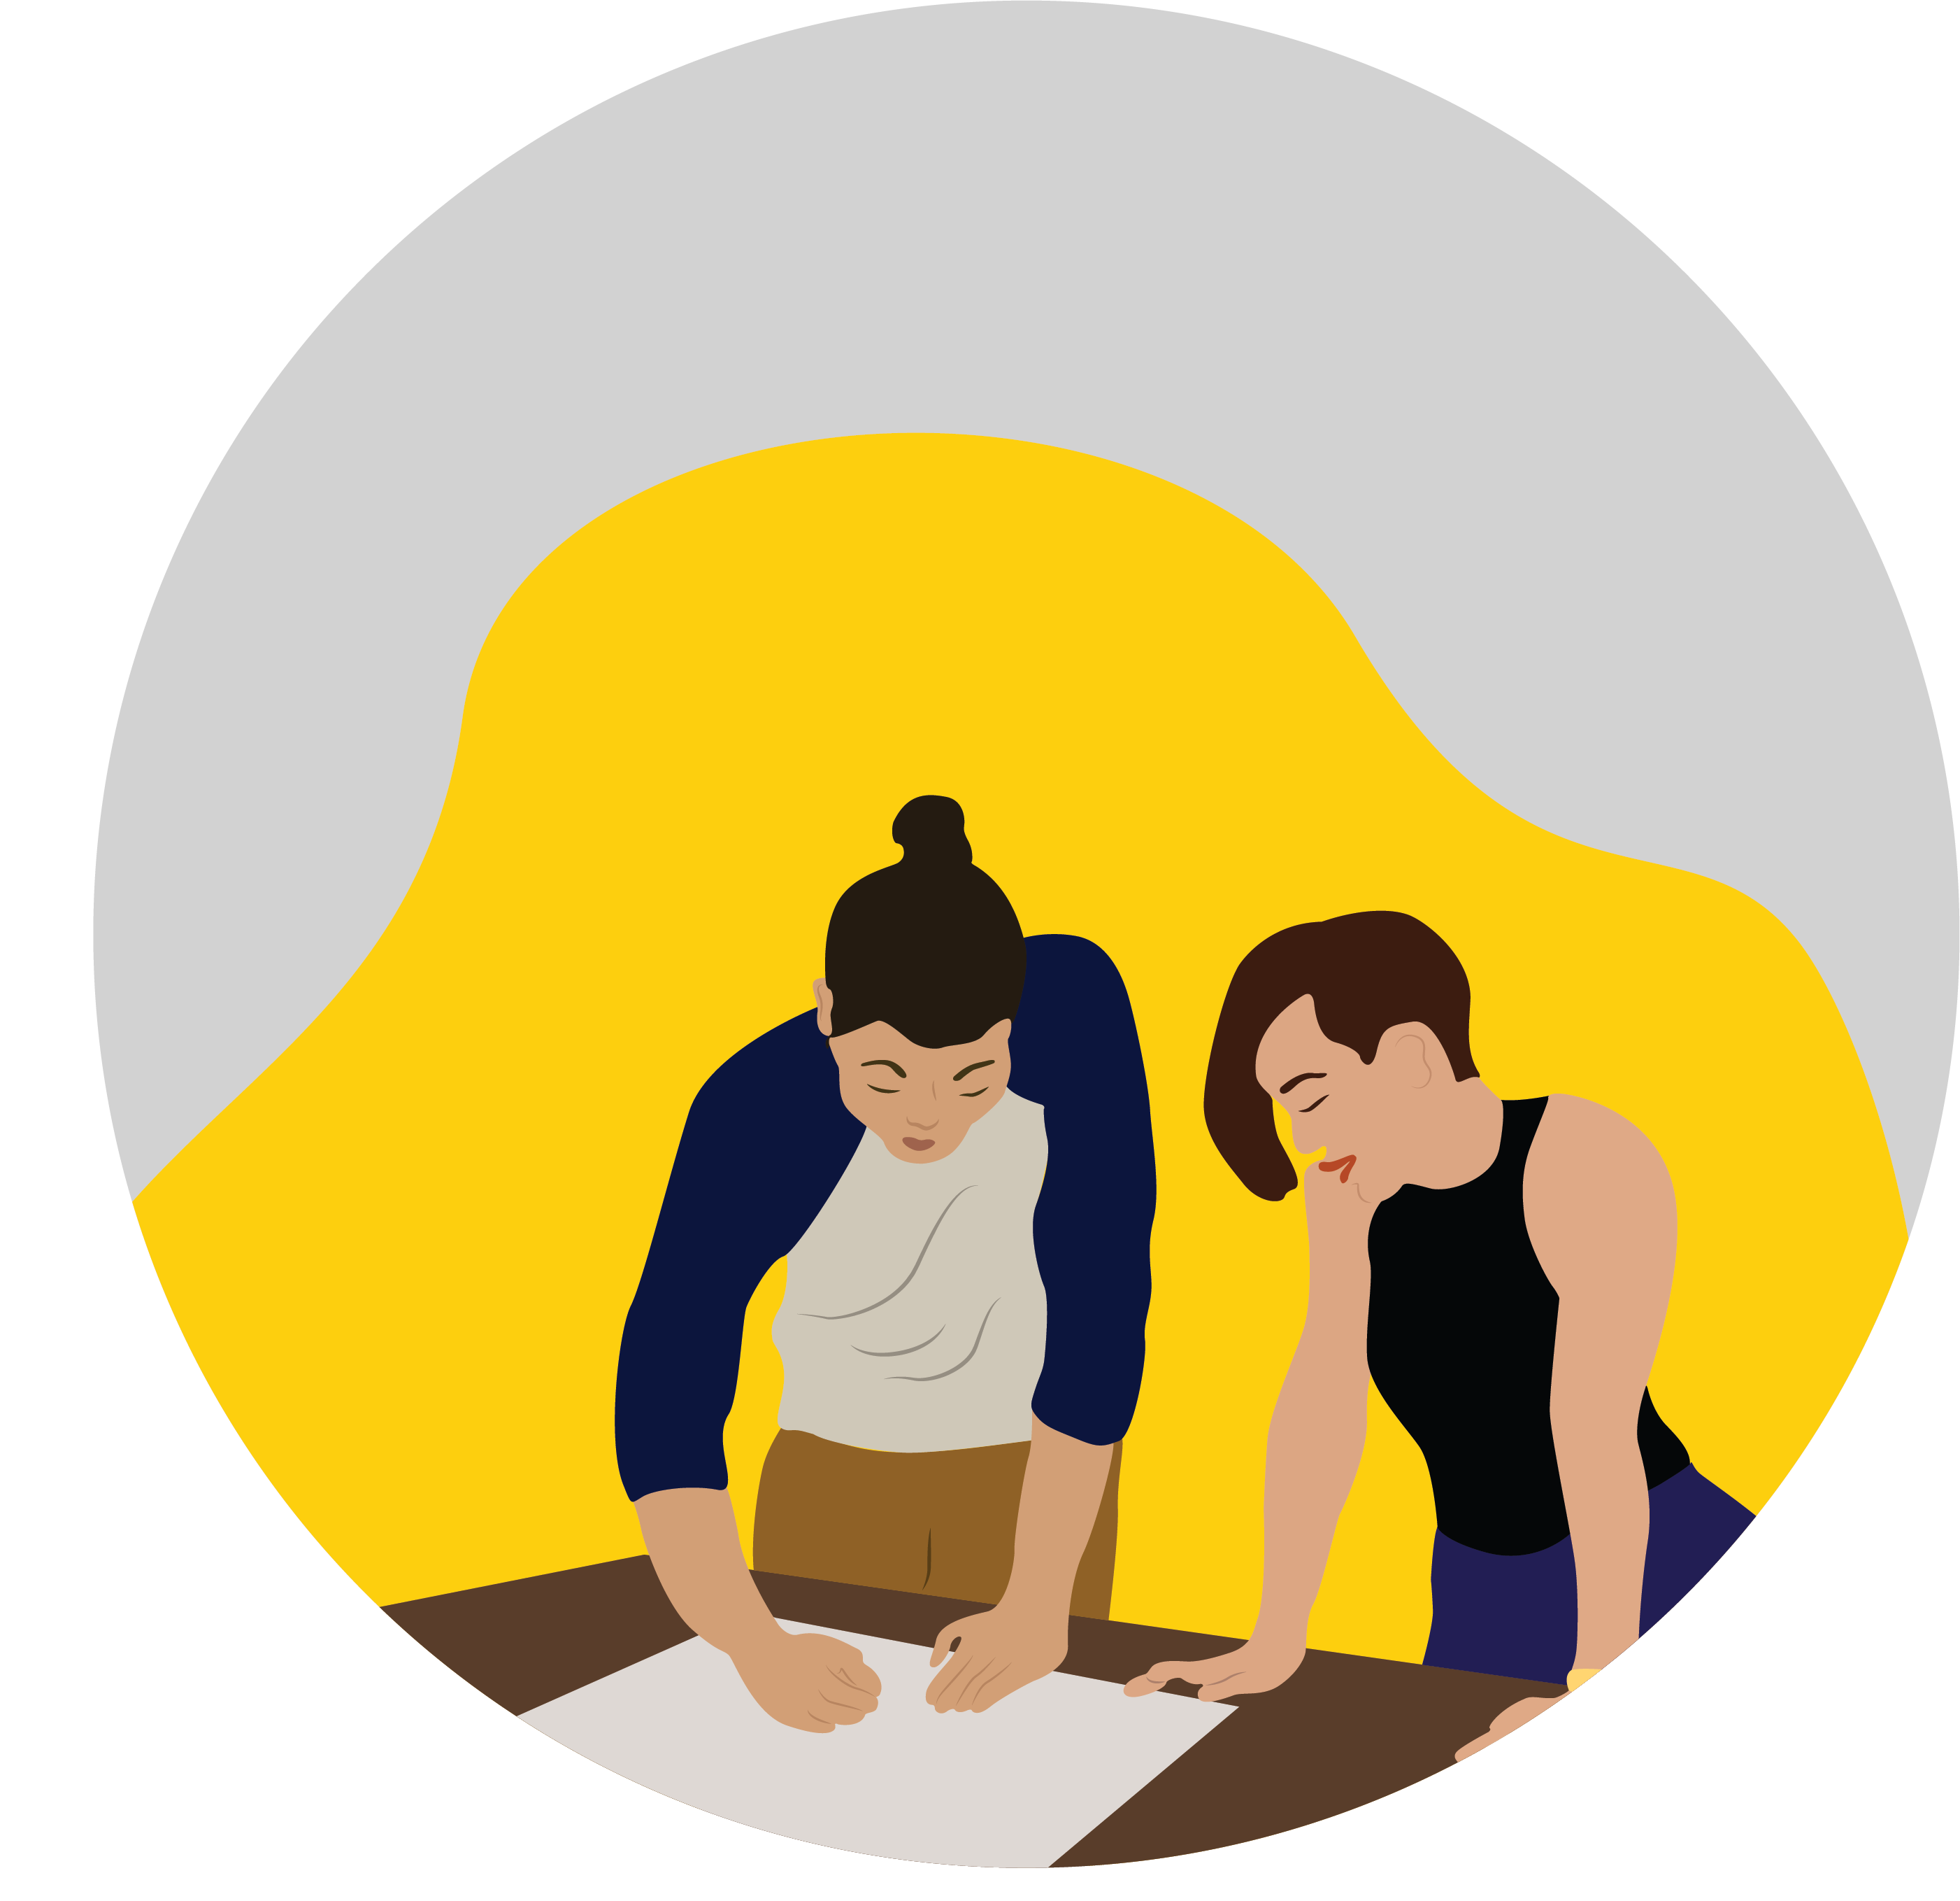
Welcome:
Getting Orientated to Your New Job
  Introductions
  Give them a firm handshake, make eye contact and be genuine. You will be spending lots of time with your new co-workers—building these relationships from the beginning is an excellent way to be successful moving forward.
  Making an Impression
  Punctuality is also important! We all know LA traffic can be a bit unpredictable. Allow yourself time for unexpected delays—we recommend arriving 15 minutes early.
  Your first few months will likely be filled with logistics, information and a lot of new faces. Listen carefully, take notes and be sure to smile!

Slide 4
Welcome:
Getting Orientated to Your New Job (continued)
  Training and Accounts
  In addition to meeting lots of new faces on your first day, you will be going over the Student Assistant Orientation and Safety Checklists with your supervisor.
  You should also be familiar with the student employment website and the Student Employee Handbook.
  Furthermore, you will need to read and sign a copy of the Appropriate Use Agreement for Student Assistants provided by Information Technology Services (ITS).
  Lastly, some students will be required to complete the Family Educational Rights and Privacy Act (FERPA) online training.
  You will also complete the Campus Security Authority online training.
  Lastly, you will need to activate your Faculty/Staff myCalStateLA ID to get your employee email address.
  If you haven’t completed these agreements, trainings and checklists within a few days of beginning your new position, we suggest taking initiative and letting your supervisor know.

Slide 5

Managing your Schedule:
Time to Take Initiative
  Breaks, Leaves, and Time Management
  Student Assistants can work a maximum of 20 hours per week during the semester and a maximum of 40 hours per week during winter and summer breaks. You CANNOT work over 8 hours per day. If you work more than 6 consecutive hours you must take an unpaid 30-minute break. If you work 4 consecutive hours, you are eligible for a paid 10-minute break. If you work less than 4 hours you are not eligible for breaks.
  Planning ahead and knowing how to handle your absences helps alleviate stress for everyone. If you know you’re going to be absent we recommend giving 48 hours notice. Remember it’s up to you to communicate with your supervisor and colleagues to mutually agree on your work schedule. Do you know when it’s ok to take a break? If you’re sick, who should you contact? If you feel overwhelmed during finals, how can you change your schedule? Keep a planner, input your schedule into Microsoft Outlook or find your own way to stay on top of your schedule. It’s a part of time management and it’s going to be a key to your success!
  Finished a task? Take some initiative and talk to your supervisor about finding a project to work on. Got an idea for how to improve something or make things run smoother? Don’t keep it a secret—Student Assistants have a lot of things to contribute. We’re counting on you!

Slide 6

You’ve got a Role to Play:
The Details are in the Job Description
  When you’re first starting a job, it’s not always easy to know what’s expected of you. Did you know there’s this thing called the job description that’s the key to many of your questions?! Chances are you looked at it when you applied, but now it’s time to pull it back out. If you don’t have access to it, ask your supervisor for a copy. Your job description has been written up just for you and it’s going to help guide you through your Student Assistantship—know what it says!
  To maintain eligibility for employment, you must maintain a minimum GPA and enrollment status. For undergraduates, 2.0 GPA and 6 units, unless summer break. For graduate students, 2.0 GPA/3.0 GPA and 4 units.
  The responsibilities written on your job description will soon become accomplishments and skills listed on your résumé. Not only that, but future employers will expect you to be able to talk about your Student Assistant experience during interviews. The Career Development Center can help you practice articulating this on another day, but it’s a good idea to start thinking about these things now.
  Can you concisely and passionately talk about your previous experiences? Don’t wait until graduation day before you start thinking about it. You’ve got a role to play—being able to talk about it is part of why you’re here.

Slide 7

Your Workplace Demeanor:
Keeping it Professional
  Professionalism isn’t some robotic way of acting while at work. It’s about understanding your environment, staying positive and being flexible. We want you to be comfortable in your own skin, but with new professional skills and habits. Here are three aspects to keep in mind:
  1. Understand your environment: Take your cues from experienced student assistants, staff, faculty and administrators. This might mean different things in different departments. Dressing appropriately is important while on the job. It’s not necessarily about wearing a suit and tie, rather it’s about staying in-tune with the environment you’re in. Maybe it’s a freshly ironed shirt. Or maybe it’s a t-shirt and shorts. Wherever you’re working, looking the part is vital.
  What’s the attire like where you work?

Slide 8
Your Workplace Demeanor:
Keeping it Professional (continued)
  2. Stay positive: There are plenty of challenges to overcome in any job. Don’t underestimate the power of positivity and mindfulness. If there’s an issue that’s affecting your well-being at work, try to resolve it with your co-workers. Talk to your supervisor. Do you have any ideas for how to solve the problem? Bring them to the table. Being diplomatic is really helpful whenever you’re working in a team. Keeping it positive is a great place to start.
  3. Be flexible: Ever have something unexpected happen at work? Sometimes it’s about expecting the unexpected and being flexible. If you can learn to be adaptable to sudden issues while you’re on the job at Cal State LA, then you’ll be well equipped to handle them once you’ve accepted that full-time gig after graduation. Flexibility is one of the most desired attributes employers seek in recent graduates.

Slide 9
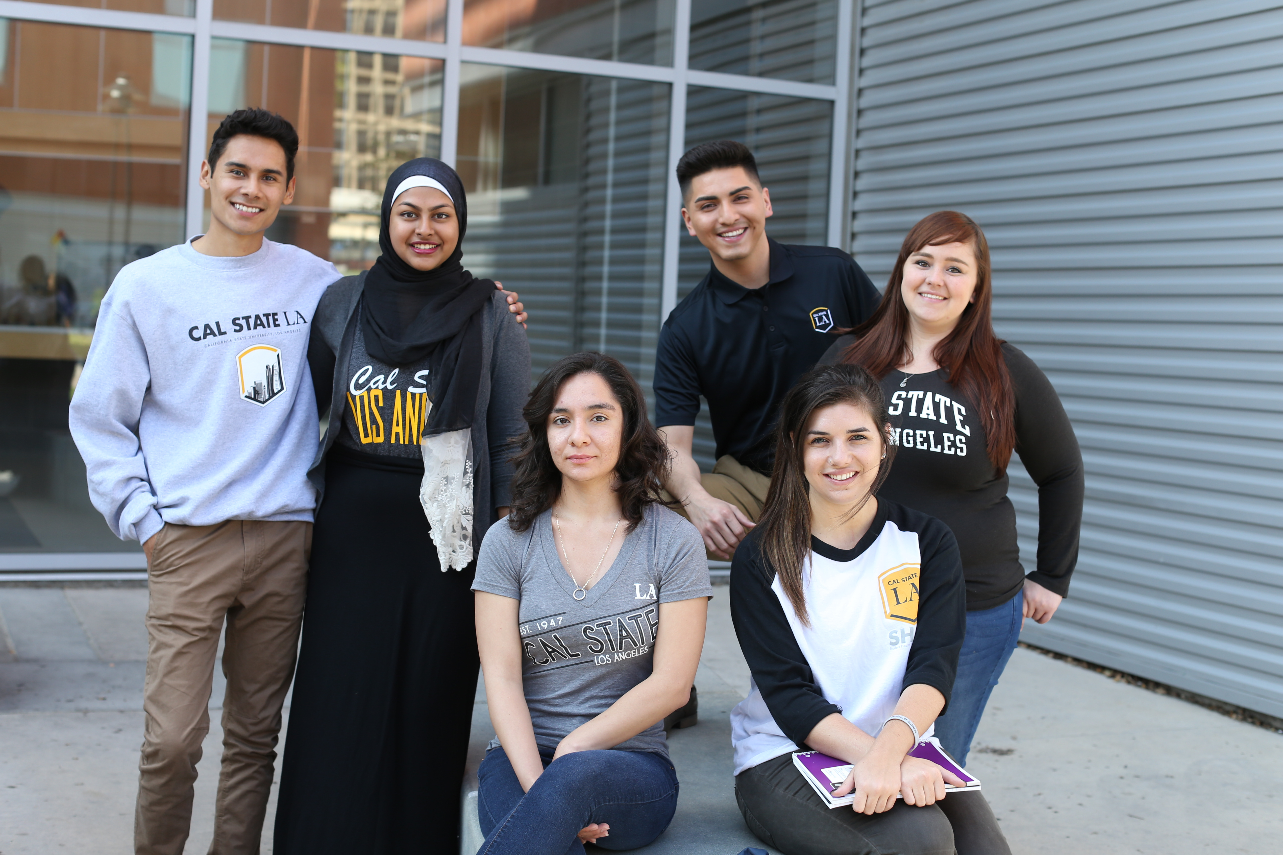
Whatever your campus job is, you will be serving “customers”.
They may be students seeking advice or information from your department. They may be faculty, staff or administrators whose departments need to interact with yours. The University functions best when they all have a positive customer service experience.
To help your workplace serve its customers, it’s important that you remember that they come from many cultures and social backgrounds, and some may speak and act in different ways than what you’re used to. Always be open-minded, respectful, and patient. Here are some ways to make that happen!
II.
Customer Service

Slide 10

Helping Customers with a Want or Need:
“The Customer Service Exchange”
Customer service rests on an exchange of courtesy and information.
Listen actively – give your full attention, making eye contact as they exchange information about their needs or problems. Even while writing things down, give your attention with gestures such as nodding your head, or with words like “Yes, I understand” or “OK, I got that”. If they are explaining a problem, you can express empathy by saying things like, “I’m sorry you’re having this problem”.
Seek solutions – refer them to documents or websites that may provide the information they need. Don’t just guess, base your advice on any training or materials you received. If you must consult with someone to find a solution to a customer’s issue, say so. Ask them if they wouldn’t mind waiting so you can look into how to provide the help they need. Think, create a solution, make the suggestion, get agreement, and plan a follow-up
Agree on a solution or plan – give the customer the information needed to answer their question(s). If the solution you give is not satisfactory, try to think of an alternate solution or seek the help of your immediate supervisor. When you are finished, say good-bye and thank them for coming to your department.

Slide 11

Greeting People in-person and by phone:
The “4 Star Greeting”
Always say your name when you greet someone – that’s worth One Star.
“This is Lucy Tran”
Also, ask how you can help them – so far, Two Stars.
“This is Lucy Tran, how can I help you?”
Identify your department or service area -- Three Stars.
“This is the History Department at Cal State LA, I’m Lucy Tran. How can I help you?”
(Even if they walk into your area, say its name, because they may be in the wrong place)
Add a friendly touch such as a smile and a “Good morning” – Four Stars.
(smiling) ”Good morning, this is the History Department at Cal State LA, I’m Lucy Tran.
How can I help you?”

Slide 12
Taking and Delivering Messages:
The 4 Steps
Step 1: “May I ask what the call is regarding?” (e.g. What the customer needs/wants). Write this down.
Step 2: “May I ask who is calling? … And this message is for Jane?” Again, write it down.
Step 3: “What’s the best way for them to contact you?” Note other information such as: when they need the help, or where something should be done or sent.
Step 4: Deliver the customer’s message. You may be expected to deliver messages in the following ways:
in-person delivery, department mailboxes, through email, or by phone.
*Remember: if you have trouble understanding someone, it’s OK to ask them to
repeat it, but be courteous and accepting towards differences in languages and/or cultures.

Slide 13
Emails on the Job:
Addressing, Greeting, and Replying
  Address the email – In the box after “To”, type in the email address for the primary recipient. The campus email Campus Directory can help you get the correct person and email address. If someone else should also get a copy, type their email address into the “Cc” box. Ask your supervisor(s) about when you should and shouldn’t use the box after “Bcc”.
  Greeting – Ask your supervisor what greetings and which titles you should use. For example, “Hello Dr. Smith”, or “Hi Dean Gomez”, or “Dear Mary”.
  Replying to emails – Above every email you can click on “Reply” to communicate back to the primary person who sent an email. If you also want to send it to people listed as “Cc”, click on “Reply All”. To send the original email to others, click on “Forward”.

Slide 14
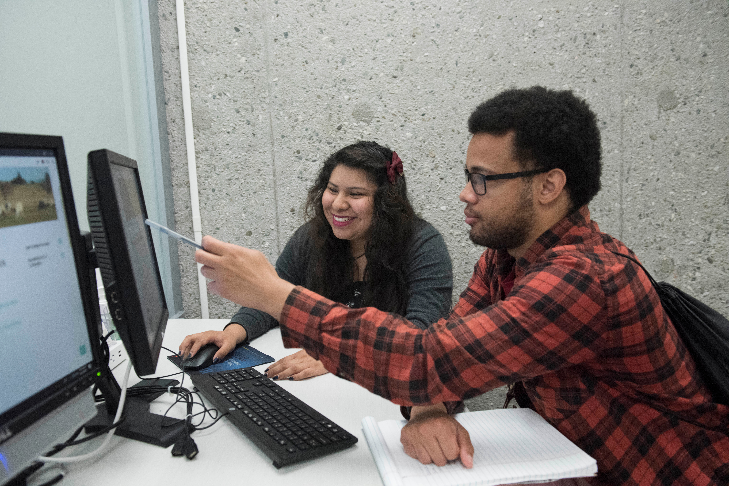
All Student Assistantship positions are different, but there’s a good chance you’ll be expected to use some digital tools while on the job. While you may be an absolute wizard with your smartphone, it's possible you haven’t yet had the opportunity to master your Microsoft Office skills, build a LinkedIn profile, or manage a professional social media account (hint: these are some tools employers are going to expect from you). ​
​
But here’s the good news. Now, you have that chance! The following are some ways to build up your expertise and prove to your current and future employers you have the proficiency they’re looking for.
III. Digital Tools

Slide 15
Mastering Microsoft Office Suite:
Training Resources & Workshops
Microsoft Office Suite which includes programs like: Word, PowerPoint, Excel and Outlook is widely used on campus. While you may be familiar with them, do you know how to enter formulas in Excel? Share calendars in Outlook? Customize your toolbars in Word? Sometimes we hear from employer's that students may not actually be proficient in the computer programs they list on their résumé…
​
This is why Cal State LA provides students with a variety of ways to learn about all types of software programs using online videos, tutorials, in-person workshops and LinkedIn Learning courses. They are all free, so take advantage of them!​
**Now take a few minutes on the next slide to browse the tutorials listed on the Information Technology Services (ITS) website. In addition, there are lots of great videos on LinkedIn Learning and YouTube to help you learn more.
​

Slide 16
We Want You to be Inclusive:
Making things more Accessible
California State University has an ongoing commitment to provide access to information resources and technologies to individuals with disabilities. Our vision is to create a culture of access for an inclusive learning and working environment.
As a Student Assistant you may be editing university webpages, developing presentations or creating documents. There are many things to consider in order to make these materials more accessible. You may be asked to create ALT TEXT for images or graphics, incorporate transcripts or captions, or simply format pages in a way so it’s easily interpreted by screen readers.
Over 1,500 students on campus have a visible (or invisible) disability yet have the same responsibilities and academic work as all other students. Treat them as you would any other student, but on occasion, it can be helpful to write things down for them, guide them, or send a follow up email, as needed. If any questions come up that you can’t answer, please connect them with the Office for Students with Disabilities, which helps students with classroom and testing accommodations

Slide 17
When You’re using Social Media:
Be Professional, Not Personal
Many of you may be in charge of your department’s social media accounts. This is a chance for you to promote events, be creative, and connect with your peers. Social media savviness is a great skill to market on your résumé. However, keep in mind that personal and professional accounts vary in their approach. Always remember you’re representing Cal State LA when you post. Here’s some do’s and don'ts to keep you soaring on that thing we like to call the internet.
Be Creative
Be Engaging
Be Mindful of your Audience
Preview Posts with a Test Account
Know the Best Times to Post
Check Grammar & Punctuation
Don’t Mix Personal & Professional
Don’t Plagiarize
Don’t lose focus of your Department’s Mission
Don’t Forget to Respond to Commenters
Don’t Forget you’re a GOLDEN EAGLE!
Don’t Cross the Line or be Inappropriate

Slide 18
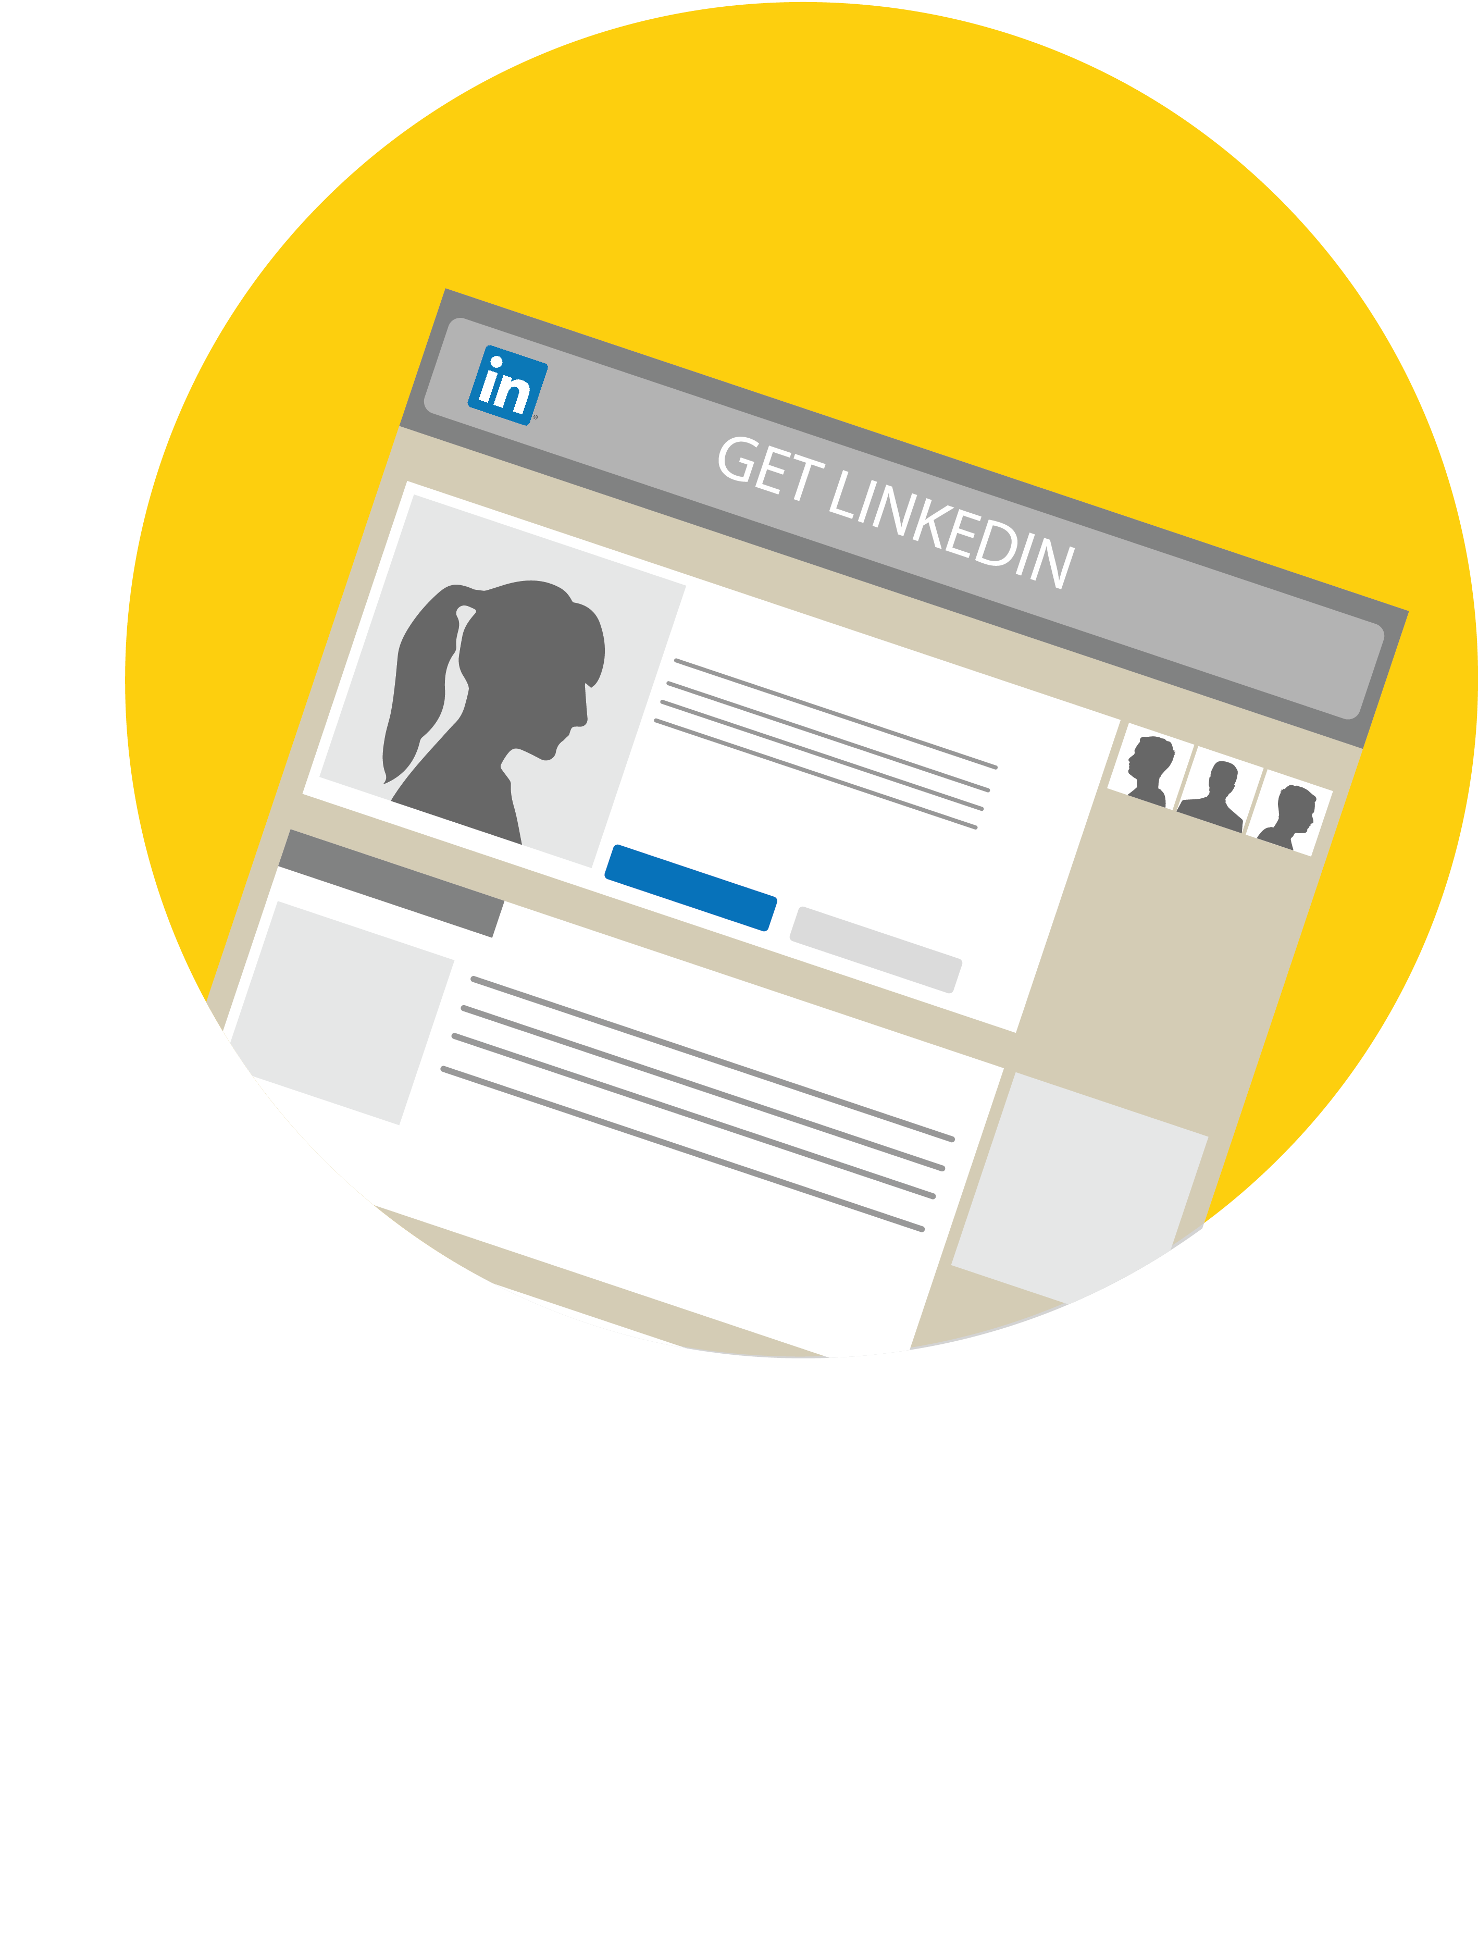
Building your Profile:
Networking with LinkedIn
LinkedIn is a professional networking site that allows people to connect with colleagues, classmates, and mentors. You can also research companies and search for jobs and internships. Creating a profile and keeping it up-to-date is a great way to promote yourself. ​
​
Recruiters and hiring managers often check to see if job seekers have a LinkedIn profile and note how up-to-date it is. It’s estimated 87% of recruiters find LinkedIn most effective for selecting candidates during the hiring process (Jobvite 2016 Recruiter Nation Report).
Looking to network and learn more from professionals in your field? LinkedIn is a great way to connect with alumni. There are around 77,000 Cal State LA Alumni currently registered on LinkedIn. We encourage you to find someone who had the same major or is in a career you’re interested in and connect with them. Start building your professional network today!
Have you created your account yet?

Slide 19

Contact us
Career Development Center
CALIFORNIA STATE UNIVERSITY, LOS ANGELES
5151 State University Drive, Los Angeles, CA 90032
Phone
323.343.3237
Email
careers@calstatela.edu
Web
www.calstatela.edu/careercenter

